Slide 1
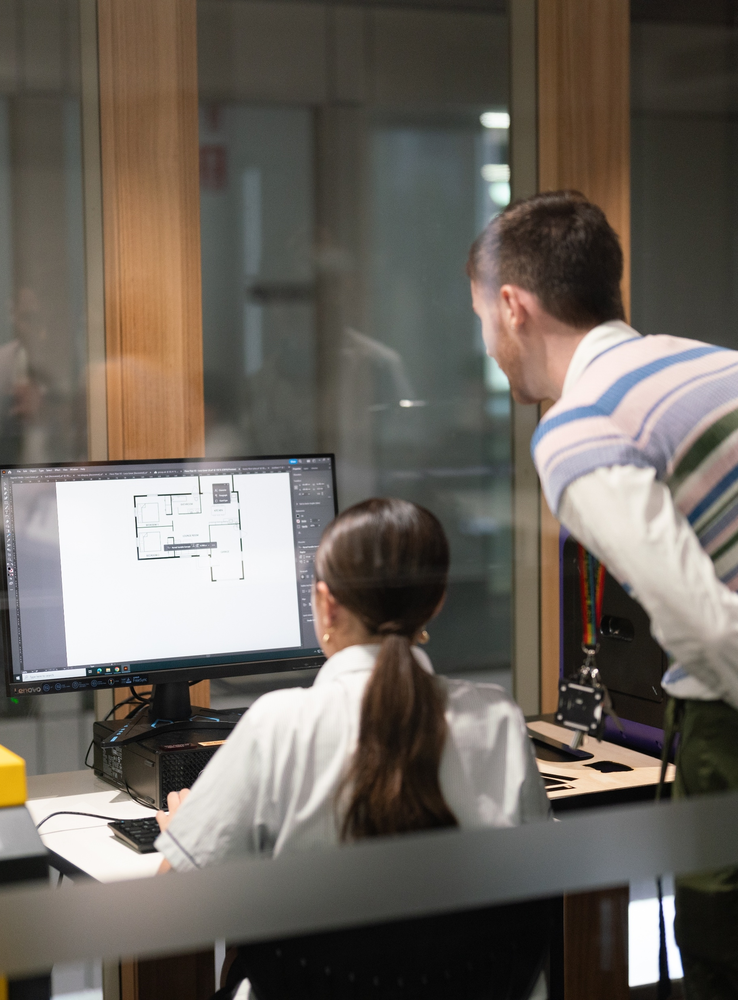
Volume
Mathematics Standard – Stage 6 (Year 11)
Making things

Slide 2
Learning intention and success criteria
Learning intention
To be able to calculate the volume and capacity of prisms, cylinders and composite solids.
Success criteria
I can calculate the volume and capacity of prisms and cylinders.
I can convert between units of volume and capacity.
I can calculate the volume and capacity of composite solids composed of prisms and cylinders.
Notes:
Notes for teachers:
Learning intentions and success criteria are best co-constructed with students. Adapt the learning intention as required and add matching success criteria.
For more information See ⁠AITSL or the NSW Department of Education explicit teaching strategies, ⁠Sharing learning intentions and ⁠Sharing success criteria
LISC is not necessarily presented at the beginning of the lesson. Teacher needs to consider most effectual time to introduce
LISC should be revisited during the lesson to support students' evaluation of their learning

Slide 3
Connecting learning

Slide 4
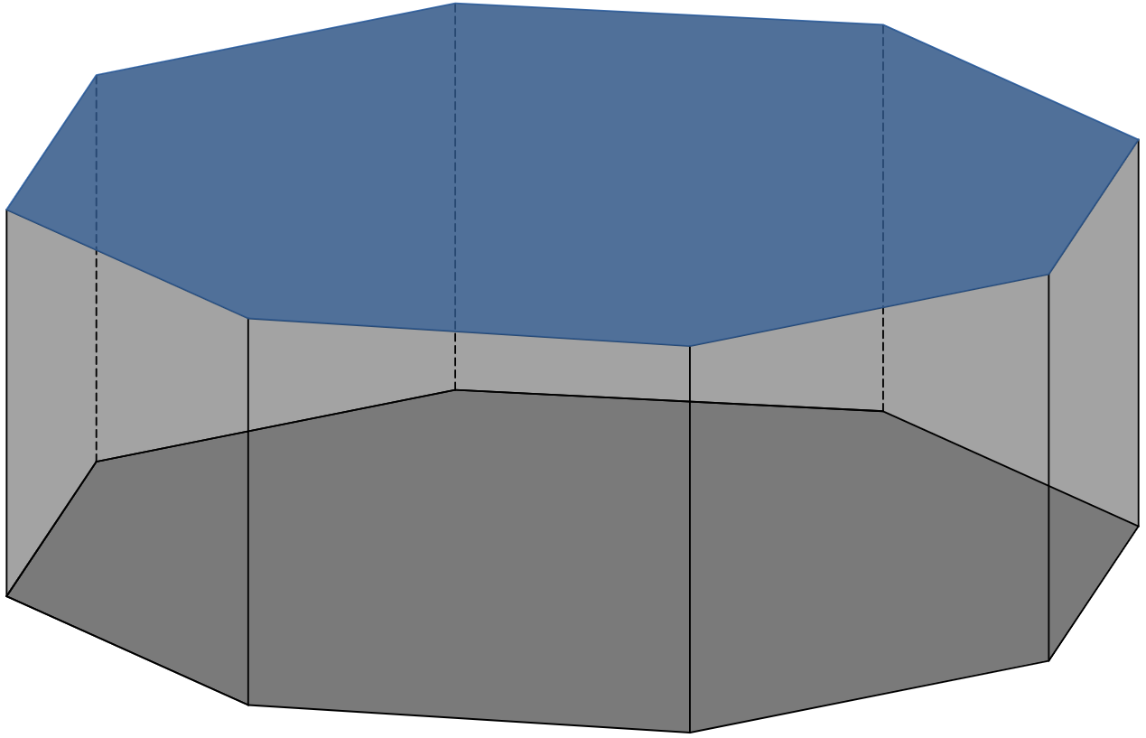
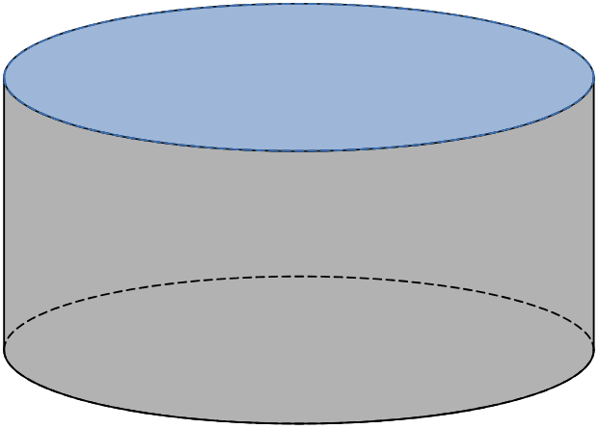
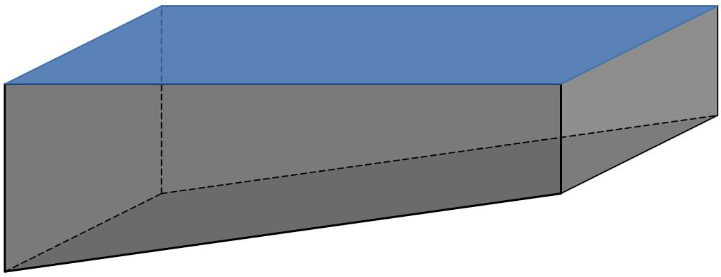
Pool designs
Naming a pool
Octagonal pool
Circular pool
? pool

Slide 5

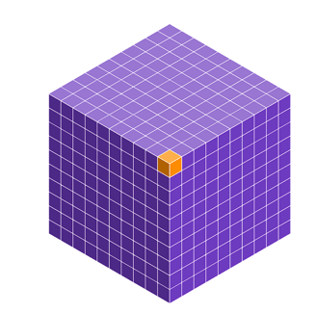
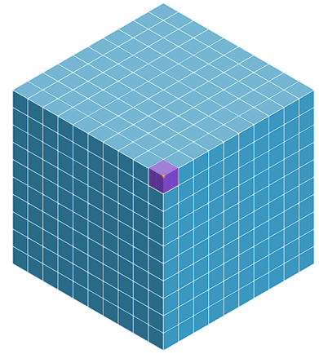
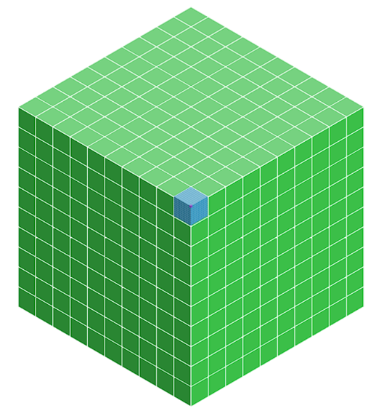



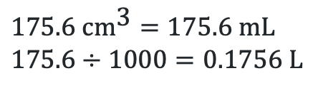




Conversions
Millilitres (mL), litres (L), kilolitres (kL) and Megalitres (ML)
$$1 {\text{cm}}^{\text{3}}=1 \text{mL}$$
$$1000 {\text{cm}}^{\text{3}}=1 \text{L}$$
What is $175.6{ \text{cm}}^{\text{3}}$ in litres?
$$1 {\text{m}}^{\text{3}}=1000 \text{L}=1 \text{kL}$$
$$175.6 {\text{cm}}^{\text{3}}=175.6 \text{mL} \\ 175.6÷1000=0.1756 \text{L}$$
$$1000{ \text{m}}^{\text{3}}=1000 \text{k}\text{L}=1 \text{ML}$$
What is $3750 L$ in ${\text{m}}^{\text{3}}$?
$$3750÷1000=3.75 {\text{m}}^{\text{3}}$$

Slide 6
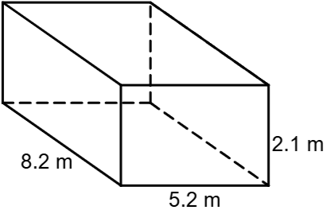
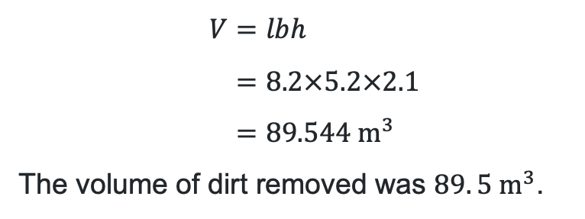
New pool (1)
Calculating volume
Angus was excited when the excavator dug the hole for his new concrete pool.
He measured the hole and determined how much dirt had been excavated.
$$V=lbh \\ =8.2×5.2×2.1 \\ =89.544 {\text{m}}^{3}$$
The volume of dirt removed was $89. 5 {\text{m}}^{3}$.

Slide 7
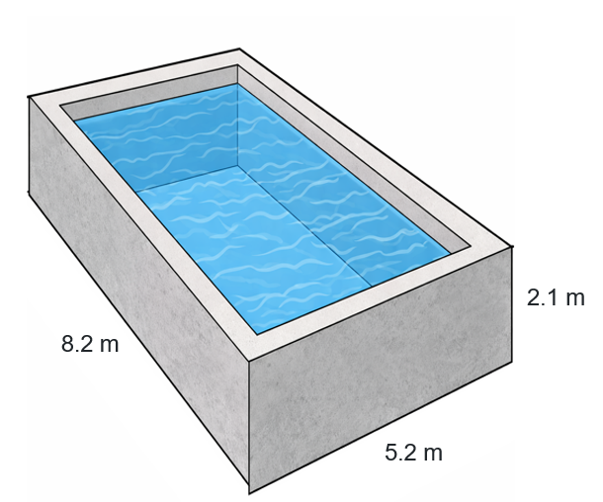
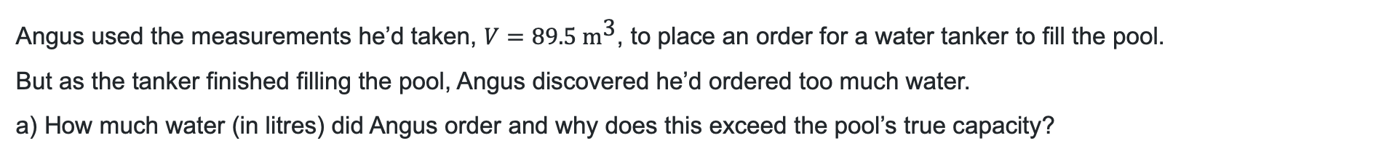
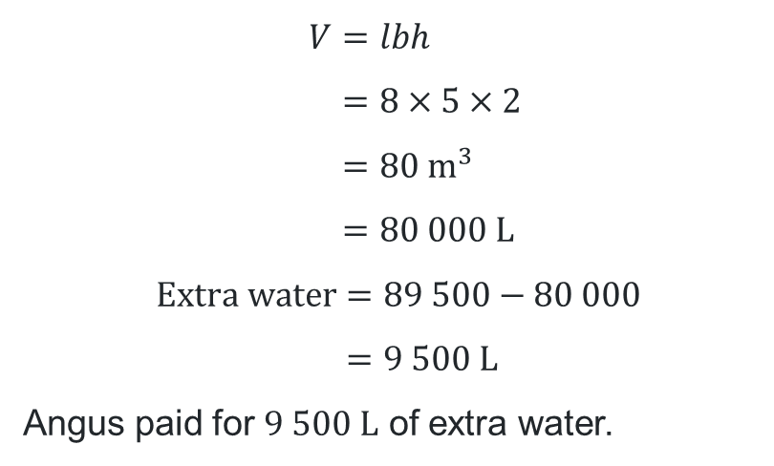
New pool (2)
Calculating volume
Angus used the measurements he’d taken, $V=89.5 {\text{m}}^{\text{3}}$, to place an order for a water tanker to fill the pool.
But as the tanker finished filling the pool, Angus discovered he’d ordered too much water.
a) How much water (in litres) did Angus order and why does this exceed the pool’s true capacity?
b) Calculate the pool’s capacity using the new measurements to find out how many extra litres Angus ordered.
$$V=lbh \\ =8×5×2 \\ =80 {\text{m}}^{3} \\ =80 000 \text{L}$$
$$Extra water=89 500−80 000 \\ =9 500 \text{L}$$
Angus paid for $9 500 \text{L}$ of extra water.
2 m
8 m
5 m
This work was generated using ChatGPT. Any copyright subsisting in this work is owned by © State of New South Wales (Department of Education), 2025.

Slide 8
Releasing responsibility

Slide 9
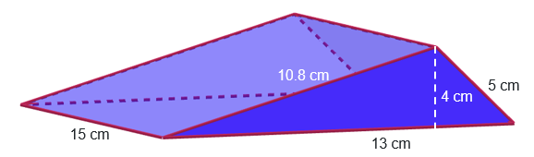
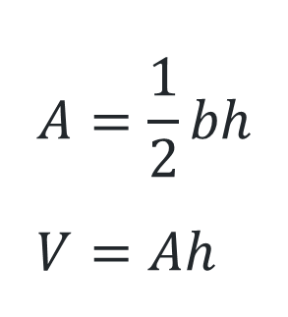
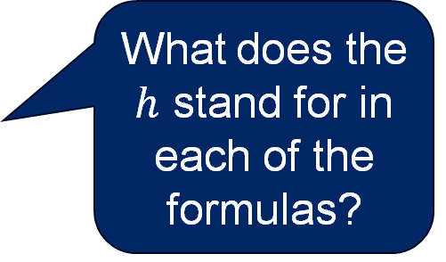
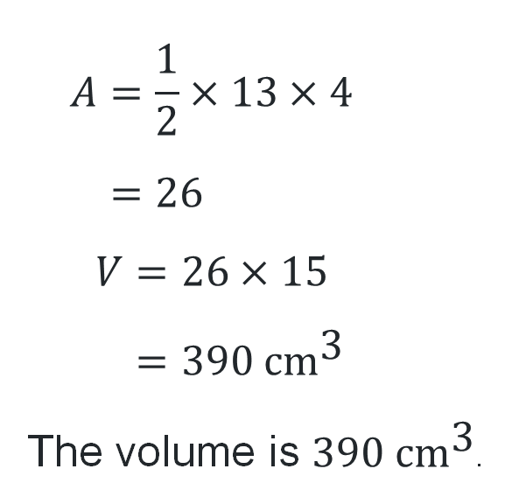
Triangular prism
Calculate the volume of the triangular prism.
$$A=\frac{1}{2}×13×4 \\ =26$$
$$V=26×15 \\ =390 \text{c}{\text{m}}^{\text{3}}$$
The volume is $390 \text{c}{\text{m}}^{\text{3}}$.
$$A=\frac{1}{2}bh \\ V=Ah$$
What does the $h$ stand for in each of the formulas?

Slide 10
Independent practice

Slide 11

11

Slide 12
References
This presentation contains NSW Curriculum and syllabus content. The NSW Curriculum is developed by the NSW Education Standards Authority. This content is prepared by NESA for and on behalf of the Crown in the right of the State of New South Wales. The material is protected by Crown copyright.
Please refer to the NESA Copyright Disclaimer for more information https://educationstandards.nsw.edu.au/wps/portal/nesa/mini-footer/copyright.
NESA holds the only official and up-to-date versions of the NSW Curriculum and syllabus documents. Please visit the NSW Education Standards Authority (NESA) website https://educationstandards.nsw.edu.au/wps/portal/nesa/home and the NSW Curriculum website https://curriculum.nsw.edu.au.
Mathematics Standard 11-12 Syllabus © NSW Education Standards Authority (NESA) for and on behalf of the Crown in right of the State of New South Wales, 2024.

Slide 13
Copyright
© State of New South Wales (Department of Education), 2026
The copyright material published in this resource is subject to the Copyright Act 1968 (Cth) and is owned by the NSW Department of Education or, where indicated, by a party other than the NSW Department of Education (third-party material).
Copyright material available in this resource and owned by the NSW Department of Education is licensed under a Creative Commons Attribution 4.0 International (CC BY 4.0) license.
This license allows you to share and adapt the material for any purpose, even commercially.
Attribution should be given to © State of New South Wales (Department of Education), 2026.
Material in this resource not available under a Creative Commons license:
the NSW Department of Education logo, other logos and trademark-protected material
Material owned by a third party that has been reproduced with permission. You will need to obtain permission from the third party to reuse its material.
Links to third-party material and websites
Please note that the provided (reading/viewing material/list/links/texts) are a suggestion only and implies no endorsement, by the New South Wales Department of Education, of any author, publisher, or book title. School principals and teachers are best placed to assess the suitability of resources that would complement the curriculum and reflect the needs and interests of their students.
If you use the links provided in this document to access a third-party’s website, you acknowledge that the terms of use, including licence terms set out on the third-party’s website apply to the use which may be made of the materials on that third-party website or where permitted by the Copyright Act 1968 (Cth). The department accepts no responsibility for content on third-party websites.

