Slide 1

Irregularly shaped blocks of land and Trapezoidal rule
Mathematics Standard – Stage 6 (Year 11)
Making things

Slide 2
Learning intentions and success criteria
Learning intentions
To understand how to calculate the perimeter and area of composite shapes.
To understand how to calculate the approximate area of an irregular shape using the trapezoidal rule.
Success criteria
I can calculate the perimeter of an irregular shape.
I can calculate the area of an irregular shape.
I can use the trapezoidal rule to find the area of a piece of land.
I can explain how increasing the number of trapeziums improves the accuracy of an area.
Notes:
Notes for teachers:
Learning intentions and success criteria are best co-constructed with students. Adapt the learning intention as required and add matching success criteria.
For more information See ⁠AITSL or the NSW Department of Education explicit teaching strategies, ⁠Sharing learning intentions and ⁠Sharing success criteria
LISC is not necessarily presented at the beginning of the lesson. Teacher needs to consider most effectual time to introduce
LISC should be revisited during the lesson to support students' evaluation of their learning

Slide 3
Retrieval practice

Slide 4
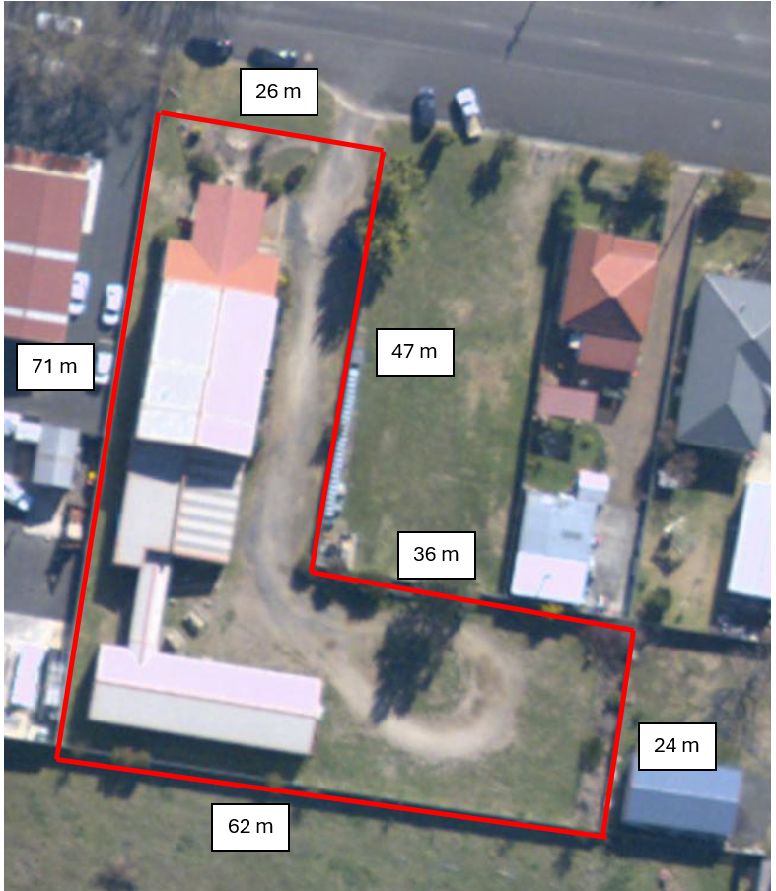
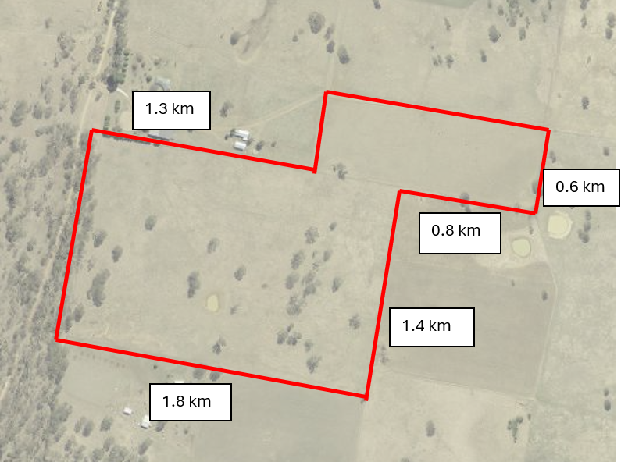
Scenario (1)

Slide 5

Area of a composite shape (1)
Find the area of this block in $m^{2}.$
All angles are right-angles.
How much should Walter list this property for sale if he sells it at $375 per $m^{2}$ ?

Slide 6
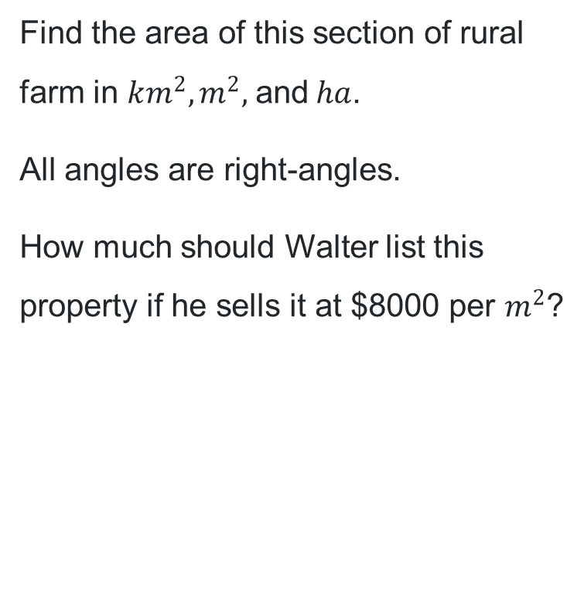
Area of a composite shape (2)
Find the area of this section of rural farm in $km^{2},m^{2},$and$ha$.
All angles are right-angles.
How much should Walter list this property if he sells it at $8000 per $m^{2}$?

Slide 7
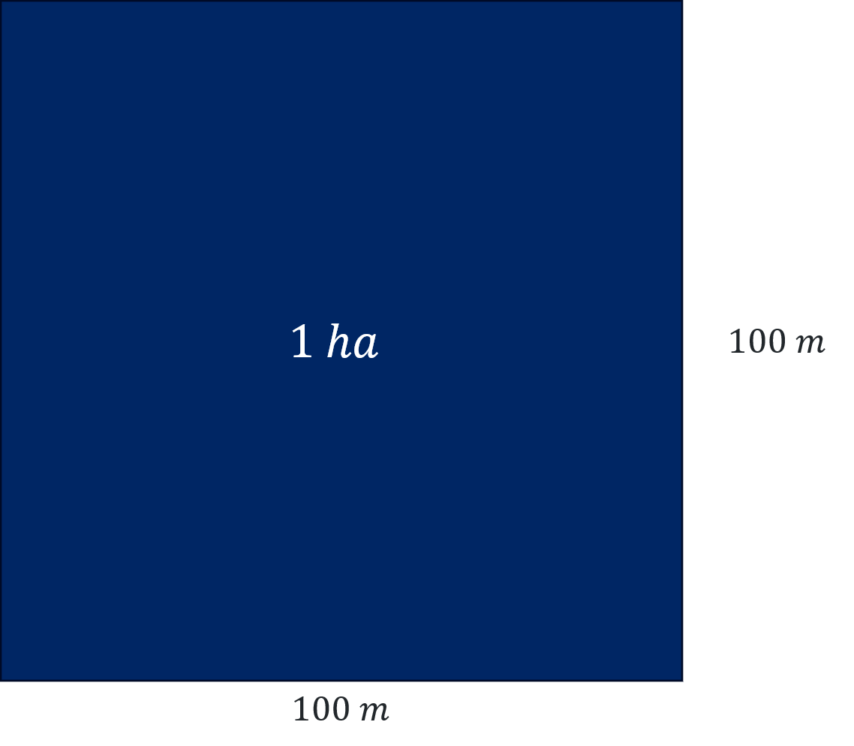
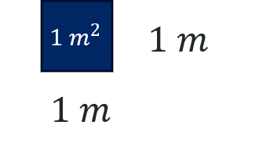

Area conversion
Square metres and hectares
$$1 ha=100 m×100 m \\ =10 000 m^{2}$$

Slide 8
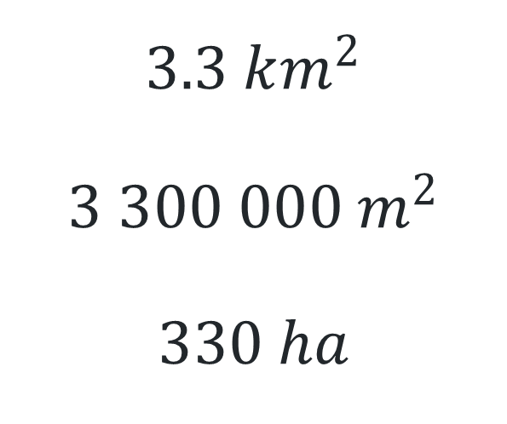
Unit comparison
$$3.3 km^{2}$$
$$3 300 000 m^{2}$$
$$330 ha$$

Slide 9
Activating prior knowledge

Slide 10
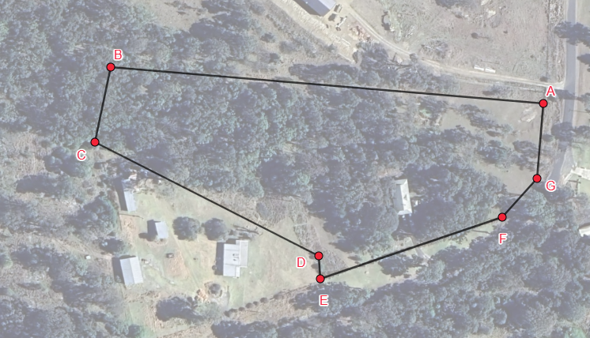
Scenario (2)
Each goat requires at least 0.1 hectares of natural bushland.
Calculate how many goats the land can support and how much fencing wire is required.

Slide 11
Block of land

Slide 12
Connecting learning

Slide 13
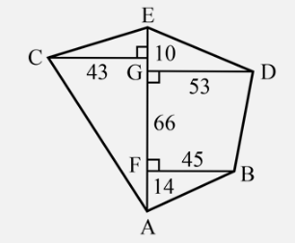
Traverse offset survey
A traverse offset survey is a technique where a straight line (the traverse) is constructed between 2 vertices across a piece of land, where perpendicular lines (the offsets) are measured to each vertex. This method forms triangles and trapeziums, enabling accurate measurement of irregular land shapes.
Screenshot from Mathematics Standard 11-12 Syllabus © NSW Education
Standards Authority (NESA)

Slide 14
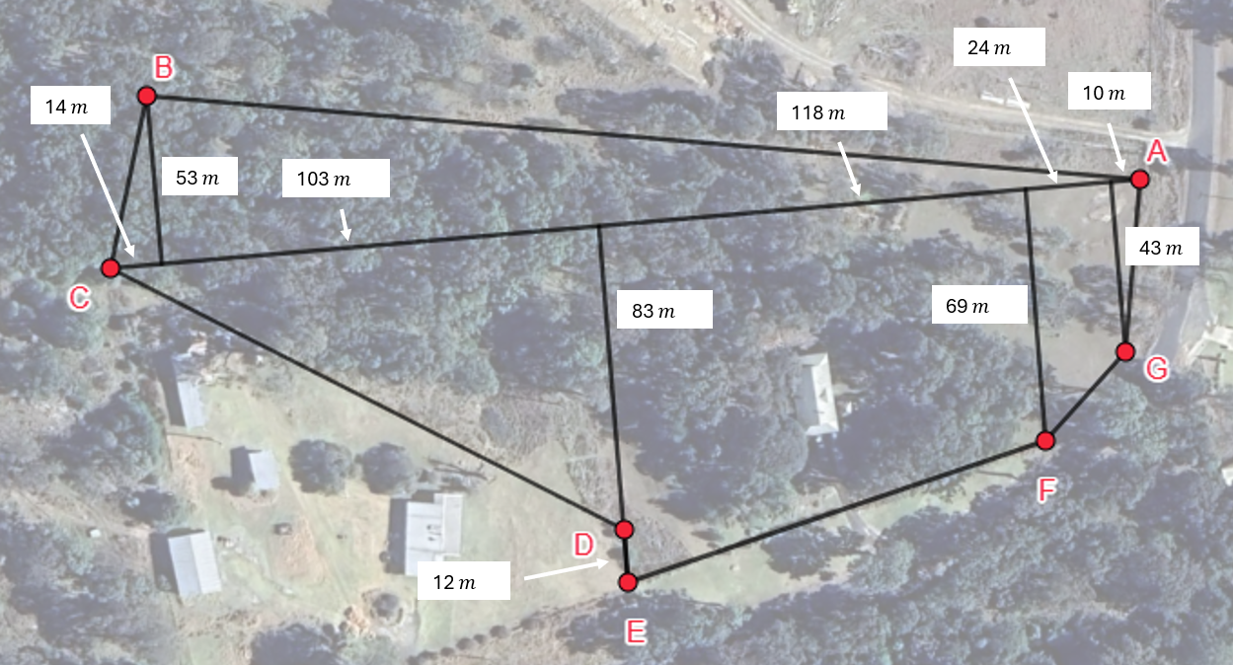
Block of land with more divisions

Slide 15
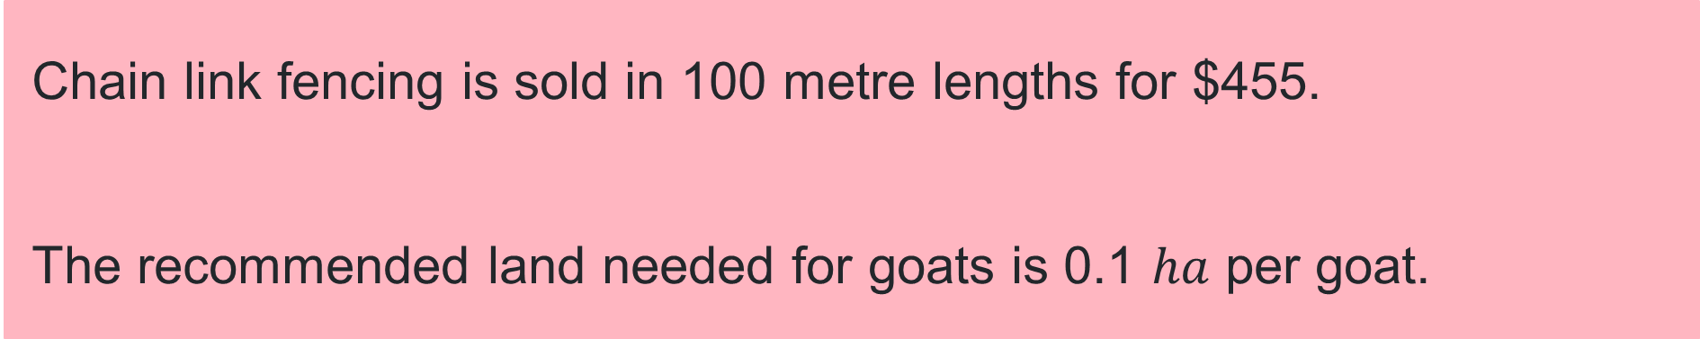
Fencing costs
Chain link fencing is sold in 100 metre lengths for $455.
The recommended land needed for goats is 0.1 $ha$ per goat.

Slide 16
Releasing responsibility

Slide 17
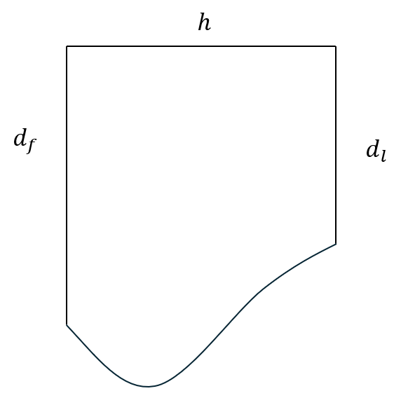


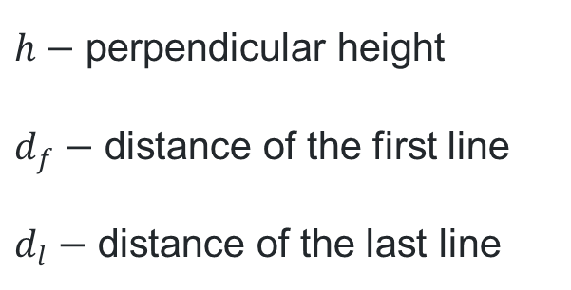
Trapezoidal rule (1)
Formula
The formula for area of a trapezium
$$A=\frac{h}{2}(a+b)$$
A method of approximating the area of an irregular shape, is by slicing the area up into trapeziums (trapezia) of equal height.
$$A≈\frac{h}{2}(d_{f}+d_{l})$$
$h−$ perpendicular height
$d_{f}−$ distance of the first line
$d_{l}−$ distance of the last line

Slide 18
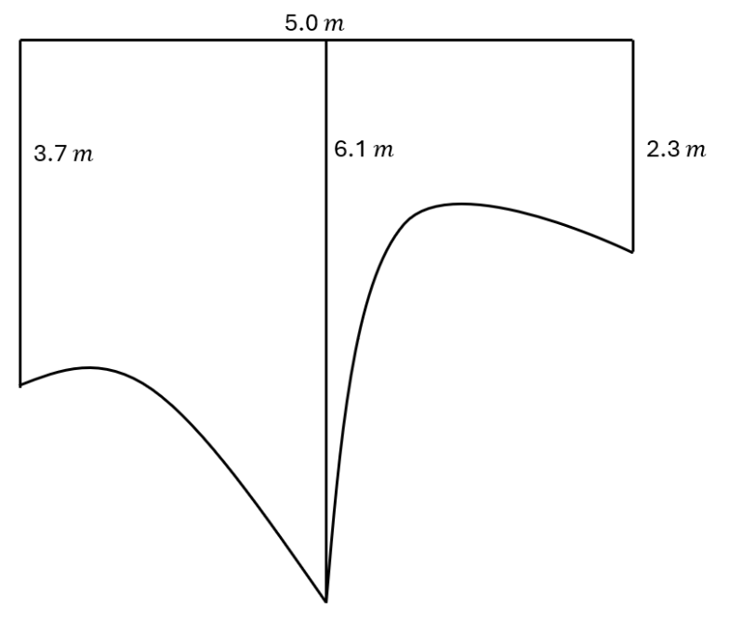

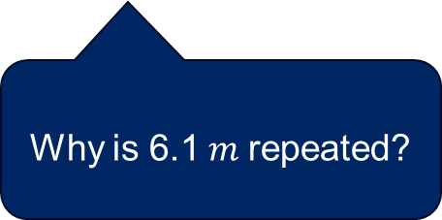
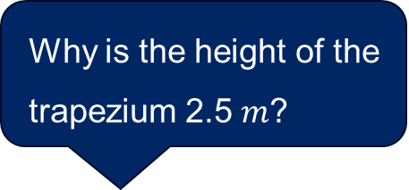
Trapezoidal rule (2)
Worked example 1
This diagram represents a grassed area.
What is the area of the grass, using 2 applications of the Trapezoidal rule?
Why is the height of the trapezium 2.5 $m$?
$$A≈\frac{h}{2}(d_{f}+d_{l}) \\ =\frac{2.5}{2}\left(3.7+6.1\right)+\frac{2.5}{2}\left(6.1+2.3\right) \\ =22.75 m^{2}$$
Why is 6.1$m$ repeated?

Slide 19
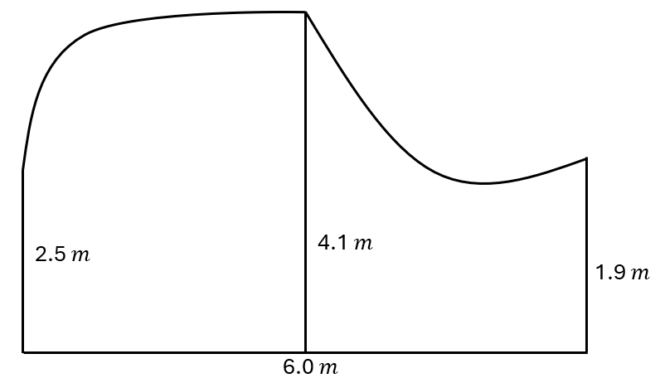

Trapezoidal rule (3)
Your turn 1
The diagram represents a garden bed.
What is the area of the garden bed, using 2 applications of the Trapezoidal rule?
$$A≈\frac{h}{2}(d_{f}+d_{l}) \\ =\frac{3}{2}\left(2.5+4.1\right)+\frac{3}{2}\left(4.1+1.9\right) \\ =18.9 m^{2}$$

Slide 20
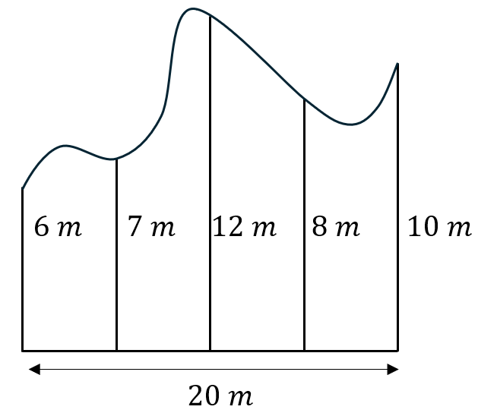

Trapezoidal rule (4)
Worked example 2
The diagram represents a field.
What is the area of the field, using 4 applications of the Trapezoidal rule?
Why do I need multiple calculations?
$$A≈\frac{h}{2}(d_{f}+d_{l}) \\ =\frac{5}{2}\left(6+7\right)+\frac{5}{2}\left(7+12\right)+\frac{5}{2}\left(12+8\right)+\frac{5}{2}\left(8+10\right) \\ =175 m^{2}$$
What is the height of each trapezium?

Slide 21
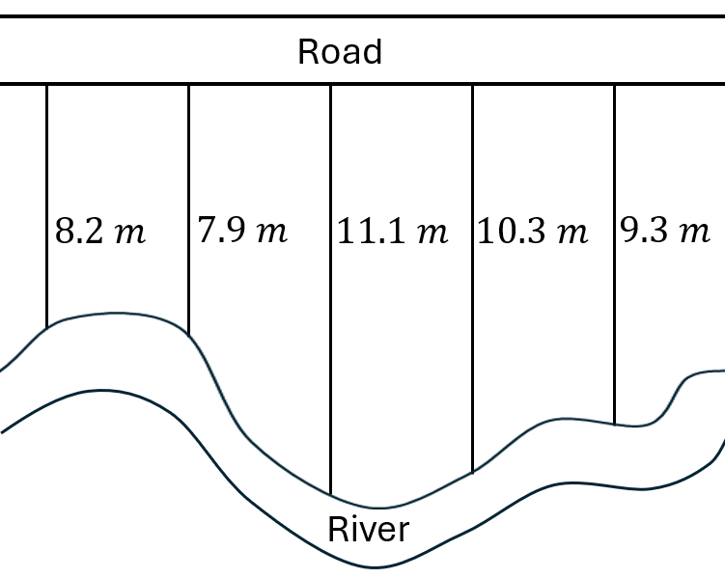
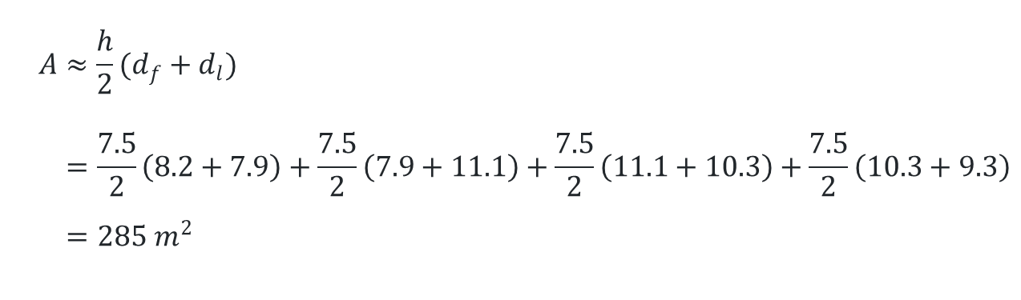
Trapezoidal rule (5)
Your turn 2
A field is bordered on one side by a straight road and on the other by a river, as shown. Measurements are taken perpendicular to the road every 7.5 m along the road.
Use the Trapezoidal rule to find an approximate area of the field. Answer to the nearest square metre.
$$A≈\frac{h}{2}(d_{f}+d_{l}) \\ =\frac{7.5}{2}\left(8.2+7.9\right)+\frac{7.5}{2}\left(7.9+11.1\right)+\frac{7.5}{2}\left(11.1+10.3\right)+\frac{7.5}{2}\left(10.3+9.3\right) \\ =285 m^{2}$$

Slide 22
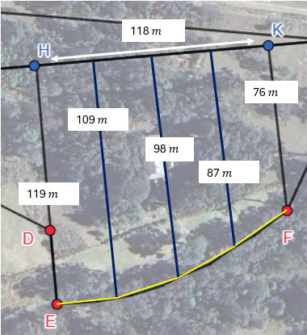
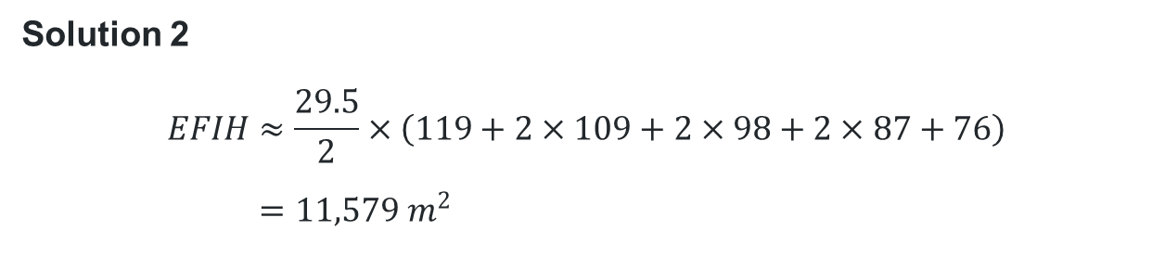
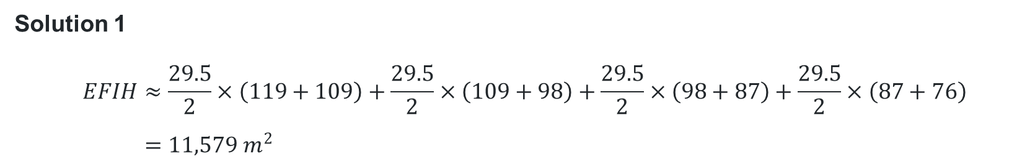
Comparative worked example
Appendix C
Use 4 applications of the Trapezoidal rule to find an approximate area of this section of the block.
Answer to the nearest square metre.
Solution 1
$$EFIH≈\frac{29.5}{2}×\left(119+109\right)+\frac{29.5}{2}×\left(109+98\right)+\frac{29.5}{2}×\left(98+87\right)+\frac{29.5}{2}×\left(87+76\right) \\ =11,579 m^{2}$$
Why can we combine the separate calculations?
Solution 2
$$EFIH≈\frac{29.5}{2}×\left(119+2×109+2×98+2×87+76\right) \\ =11,579 m^{2}$$
Which calculation is most efficient?

Slide 23
References
This presentation contains NSW Curriculum and syllabus content. The NSW Curriculum is developed by the NSW Education Standards Authority. This content is prepared by NESA for and on behalf of the Crown in the right of the State of New South Wales. The material is protected by Crown copyright.
Please refer to the NESA Copyright Disclaimer for more information https://educationstandards.nsw.edu.au/wps/portal/nesa/mini-footer/copyright.
NESA holds the only official and up-to-date versions of the NSW Curriculum and syllabus documents. Please visit the NSW Education Standards Authority (NESA) website https://educationstandards.nsw.edu.au/wps/portal/nesa/home and the NSW Curriculum website https://curriculum.nsw.edu.au.
Mathematics Standard Stage 6 Syllabus © NSW Education Standards Authority (NESA) for and on behalf of the Crown in right of the State of New South Wales, 2024.

Slide 24
Copyright
© State of New South Wales (Department of Education), 2025
The copyright material published in this resource is subject to the Copyright Act 1968 (Cth) and is owned by the NSW Department of Education or, where indicated, by a party other than the NSW Department of Education (third-party material).
Copyright material available in this resource and owned by the NSW Department of Education is licensed under a Creative Commons Attribution 4.0 International (CC BY 4.0) license.
This license allows you to share and adapt the material for any purpose, even commercially.
Attribution should be given to © State of New South Wales (Department of Education), 2025.
Material in this resource not available under a Creative Commons license:
the NSW Department of Education logo, other logos and trademark-protected material
Material owned by a third party that has been reproduced with permission. You will need to obtain permission from the third party to reuse its material.
Links to third-party material and websites
Please note that the provided (reading/viewing material/list/links/texts) are a suggestion only and implies no endorsement, by the New South Wales Department of Education, of any author, publisher, or book title. School principals and teachers are best placed to assess the suitability of resources that would complement the curriculum and reflect the needs and interests of their students.
If you use the links provided in this document to access a third-party’s website, you acknowledge that the terms of use, including licence terms set out on the third-party’s website apply to the use which may be made of the materials on that third-party website or where permitted by the Copyright Act 1968 (Cth). The department accepts no responsibility for content on third-party websites.

