Slide 1
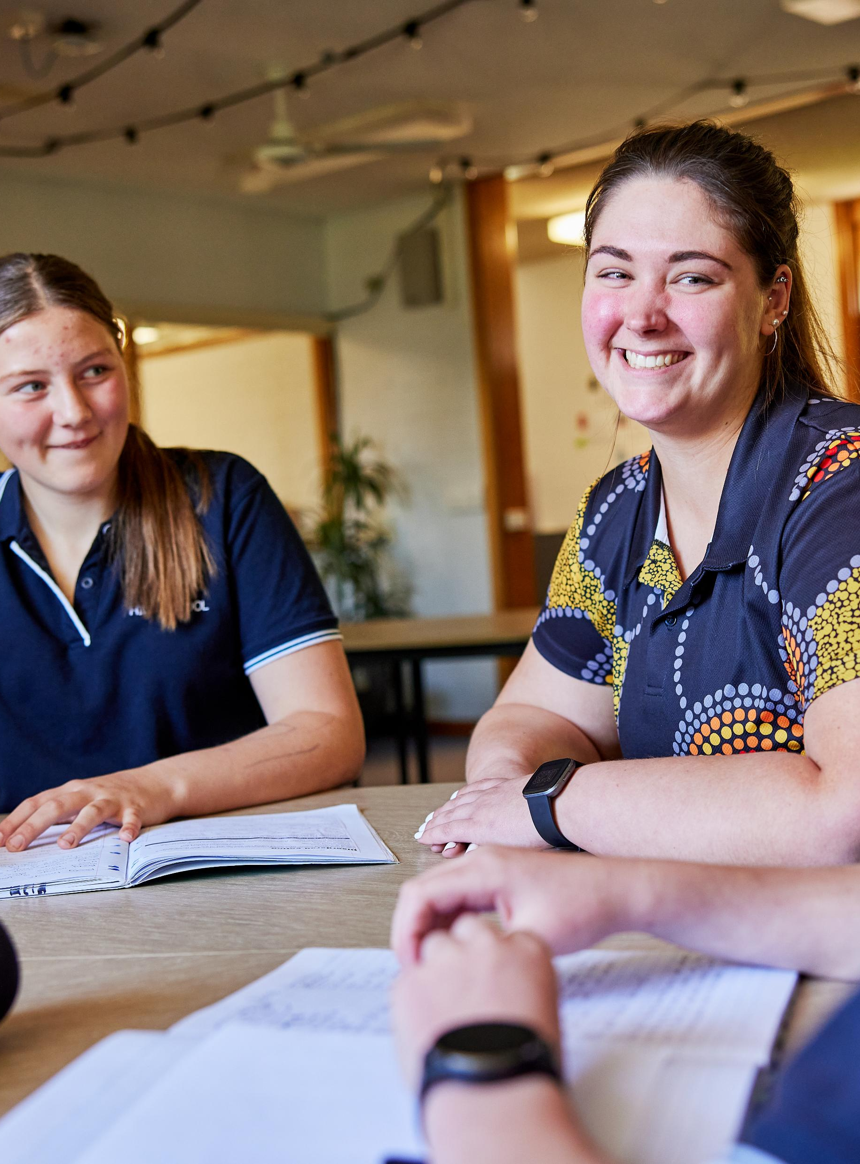
Arc length
Mathematics Standard – Stage 6 (Year 11)
Making things

Slide 2
Learning intentions and success criteria
Learning intentions
To know how to substitute numbers into a formula.
To be able to calculate the circumference and arc length of a circle.
Success criteria
I can name parts of a circle.
I can explain what each variable means in the arc length formula.
I can calculate arc length given an angle and the radius.
I can explain how to modify a formula to calculate different parts of a circle.
Notes:
Notes for teachers:
Learning intentions and success criteria are best co-constructed with students. Adapt the learning intention as required and add matching success criteria.
For more information See ⁠AITSL or the NSW Department of Education explicit teaching strategies, ⁠Sharing learning intentions and ⁠Sharing success criteria
LISC is not necessarily presented at the beginning of the lesson. Teacher needs to consider most effectual time to introduce
LISC should be revisited during the lesson to support students' evaluation of their learning

Slide 3
Retrieval practice

Slide 4
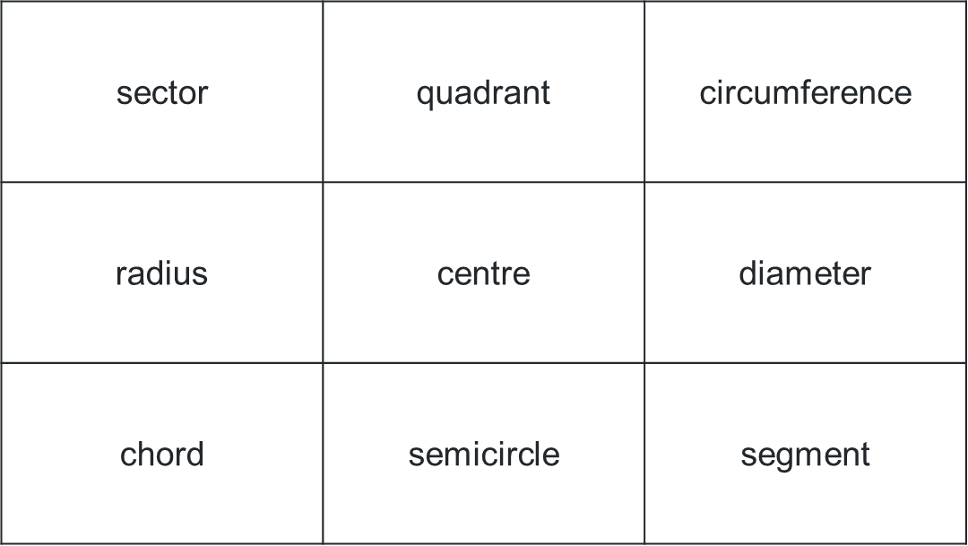
Bingo cards
Word bank
Create a 3x3 bingo card using the following words:
Radius
Diameter
Circumference
Arc
Centre
Chord
Sector
Segment
Quadrant
Semicircle
Example card

Slide 5
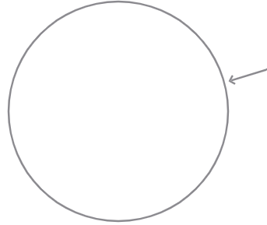
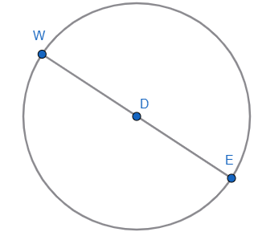
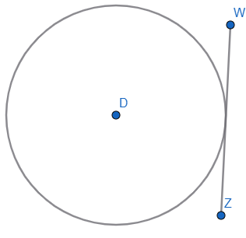
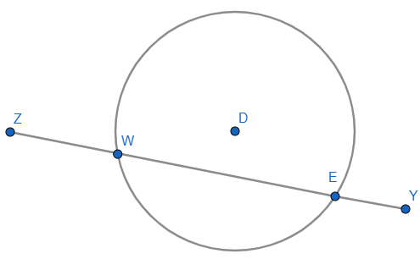
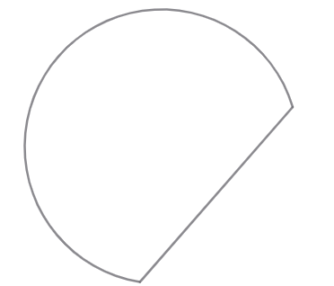
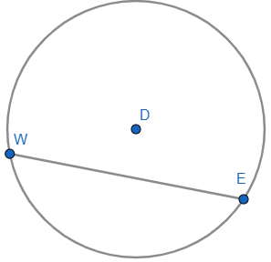
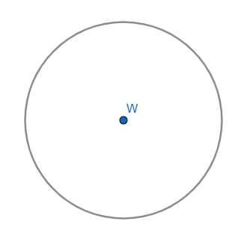
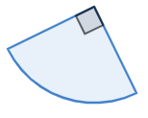
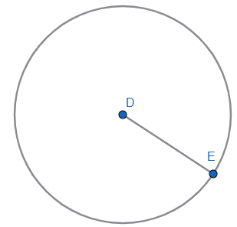
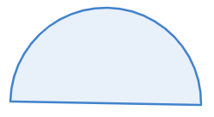
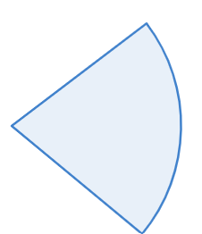

Bingo game
Click the boxes to reveal parts of a circle
1
2
3
4
5
6
7
8
9
10
11
12

Slide 6
Connecting learning

Slide 7
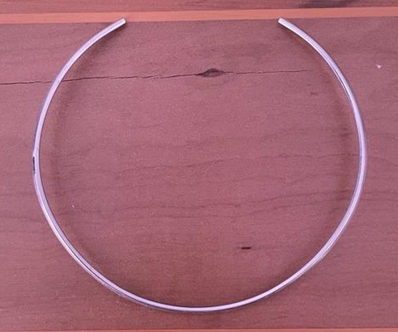


Circumference and arc length (1)
Necklace
$$7.5 cm$$
$$315°$$

Slide 8
Releasing responsibility

Slide 9

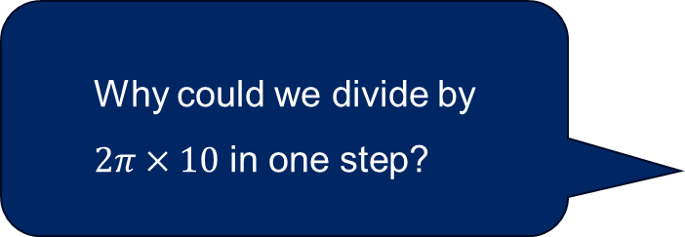
Worked example (your turn) (1)
Example 1
Calculate the size of the angle required, to the nearest degree, to create an arc that is 60 cm, given that the radius is 10 cm.
$$l=\frac{θ}{360}×2π×r \\ 60=\frac{θ}{360}×2π×10 \\ \frac{60}{2π×10}=\frac{θ}{360} \\ \frac{60}{2π×10}×360=θ \\ 343.77…=θ \\ 344°≈θ$$
How did we know this is where the values should be substituted?
Why could we divide by
$2π×10$ in one step?
How do we know what order to apply inverse operations to solve an equation?

Slide 10

Worked example (your turn) (2)
Your turn – Question 1
Calculate the size of the angle required, to the nearest degree, to create an arc that is 0.7 mm, given that the radius is 1 mm.
$$l=\frac{θ}{360}×2π×r \\ 0.7=\frac{θ}{360}×2π×1 \\ \frac{0.7}{2π×1}=\frac{θ}{360} \\ \frac{0.7}{2π×1}×360=θ \\ 40.107…=θ \\ 40°≈θ$$

Slide 11
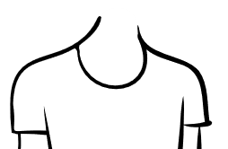
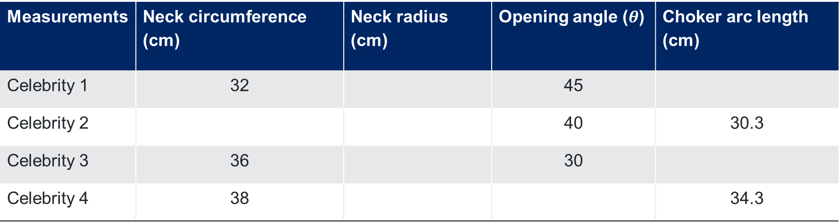


Circumference and arc length (2)
Celebrity measurements
$$θ$$
Measurements | Neck circumference (cm) | Neck radius (cm) | Opening angle ($θ$) | Choker arc length (cm)
Celebrity 1 | 32 |  | 45
Celebrity 2 |  |  | 40 | 30.3
Celebrity 3 | 36 |  | 30
Celebrity 4 | 38 |  |  | 34.3

Slide 12
Independent practice

Slide 13
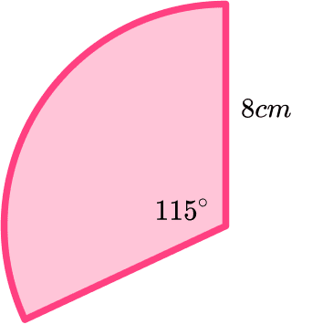
Circumference and arc length (3)
Consider the following sector. Find the arc length of this sector.
Use this arc length to find the angle of another sector with the same arc length but a different radius.
Find 2 different sectors, one with an acute angle and one with a reflex angle.

Slide 14
References
This presentation contains NSW Curriculum and syllabus content. The NSW Curriculum is developed by the NSW Education Standards Authority. This content is prepared by NESA for and on behalf of the Crown in the right of the State of New South Wales. The material is protected by Crown copyright.
Please refer to the NESA Copyright Disclaimer for more information https://educationstandards.nsw.edu.au/wps/portal/nesa/mini-footer/copyright.
NESA holds the only official and up-to-date versions of the NSW Curriculum and syllabus documents. Please visit the NSW Education Standards Authority (NESA) website https://educationstandards.nsw.edu.au/wps/portal/nesa/home and the NSW Curriculum website https://curriculum.nsw.edu.au.
Mathematics Standard Stage 6 Syllabus © NSW Education Standards Authority (NESA) for and on behalf of the Crown in right of the State of New South Wales, 2024.

Slide 15
Copyright
© State of New South Wales (Department of Education), 2025
The copyright material published in this resource is subject to the Copyright Act 1968 (Cth) and is owned by the NSW Department of Education or, where indicated, by a party other than the NSW Department of Education (third-party material).
Copyright material available in this resource and owned by the NSW Department of Education is licensed under a Creative Commons Attribution 4.0 International (CC BY 4.0) license.
This license allows you to share and adapt the material for any purpose, even commercially.
Attribution should be given to © State of New South Wales (Department of Education), 2025.
Material in this resource not available under a Creative Commons license:
the NSW Department of Education logo, other logos and trademark-protected material
Material owned by a third party that has been reproduced with permission. You will need to obtain permission from the third party to reuse its material.
Links to third-party material and websites
Please note that the provided (reading/viewing material/list/links/texts) are a suggestion only and implies no endorsement, by the New South Wales Department of Education, of any author, publisher, or book title. School principals and teachers are best placed to assess the suitability of resources that would complement the curriculum and reflect the needs and interests of their students.
If you use the links provided in this document to access a third-party’s website, you acknowledge that the terms of use, including licence terms set out on the third-party’s website apply to the use which may be made of the materials on that third-party website or where permitted by the Copyright Act 1968 (Cth). The department accepts no responsibility for content on third-party websites.

