Slide 1

Prefixes for units of measurement
Mathematics Standard – Stage 6 (Year 11)
Making things

Slide 2
Learning intentions and success criteria
Learning intentions
To be able to represent numbers with and without prefixes.
To be able to round numbers using significant figures.
Success criteria
I can identify standard prefixes on units of measurement.
I can represent numbers in scientific notation.
I can explain why we use prefixes to represent a unit of measurement.
I can explain what makes a number significant.
Notes:
Notes for teachers:
Learning intentions and success criteria are best co-constructed with students. Adapt the learning intention as required and add matching success criteria.
For more information See ⁠AITSL or the NSW Department of Education explicit teaching strategies, ⁠Sharing learning intentions and ⁠Sharing success criteria
LISC is not necessarily presented at the beginning of the lesson. Teacher needs to consider most effectual time to introduce
LISC should be revisited during the lesson to support students' evaluation of their learning

Slide 3
Retrieval practice

Slide 4
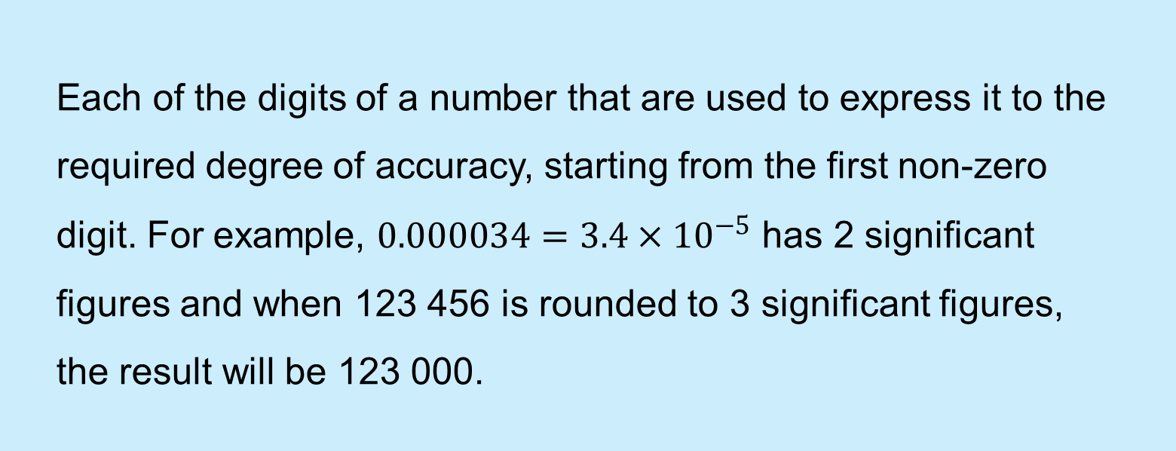
Significant figures (1)
Definition
Each of the digits of a number that are used to express it to the required degree of accuracy, starting from the first non-zero digit. For example, $0.000034=3.4×{10}^{−5}$ has 2 significant figures and when 123 456 is rounded to 3 significant figures, the result will be 123 000.

Slide 5
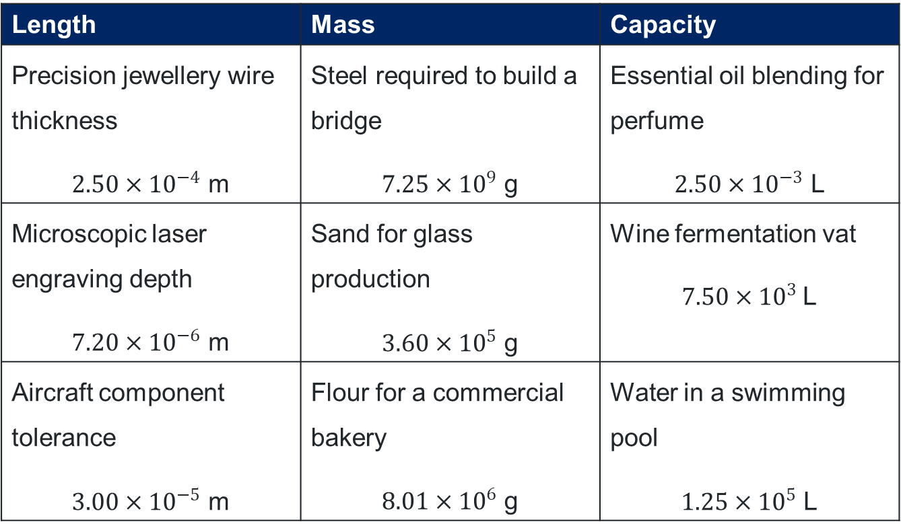
Significant figures (2)
Measurements
Length | Mass | Capacity
Precision jewellery wire thickness $2.50×{10}^{−4}$ m | Steel required to build a bridge $7.25×{10}^{9}$ g | Essential oil blending for perfume $2.50×{10}^{−3}$ L
Microscopic laser engraving depth $7.20×{10}^{−6}$ m | Sand for glass production $3.60×{10}^{5}$ g | Wine fermentation vat $7.50×{10}^{3}$L
Aircraft component tolerance $3.00×{10}^{−5}$ m | Flour for a commercial bakery $8.01×{10}^{6}$ g | Water in a swimming pool $1.25×{10}^{5}$ L

Slide 6
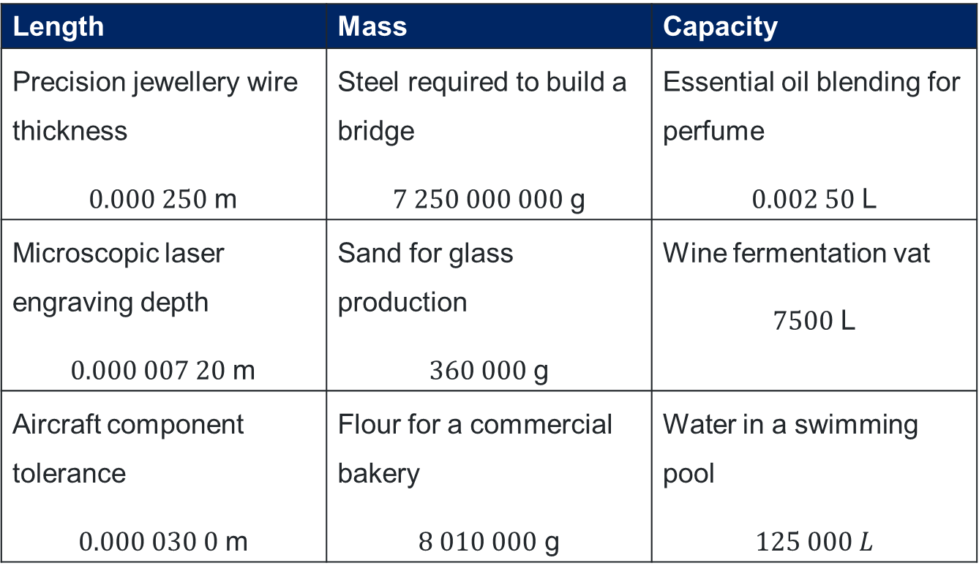
Significant figures (3)
Measurements
Length | Mass | Capacity
Precision jewellery wire thickness $0.000 250$ m | Steel required to build a bridge $7 250 000 000$ g | Essential oil blending for perfume $0.002 50$ L
Microscopic laser engraving depth $0.000 007 20$ m | Sand for glass production $360 000$ g | Wine fermentation vat $7500$ L
Aircraft component tolerance $0.000 030 0$ m | Flour for a commercial bakery $8 010 000$ g | Water in a swimming pool $125 000 L$

Slide 7
Connecting learning

Slide 8
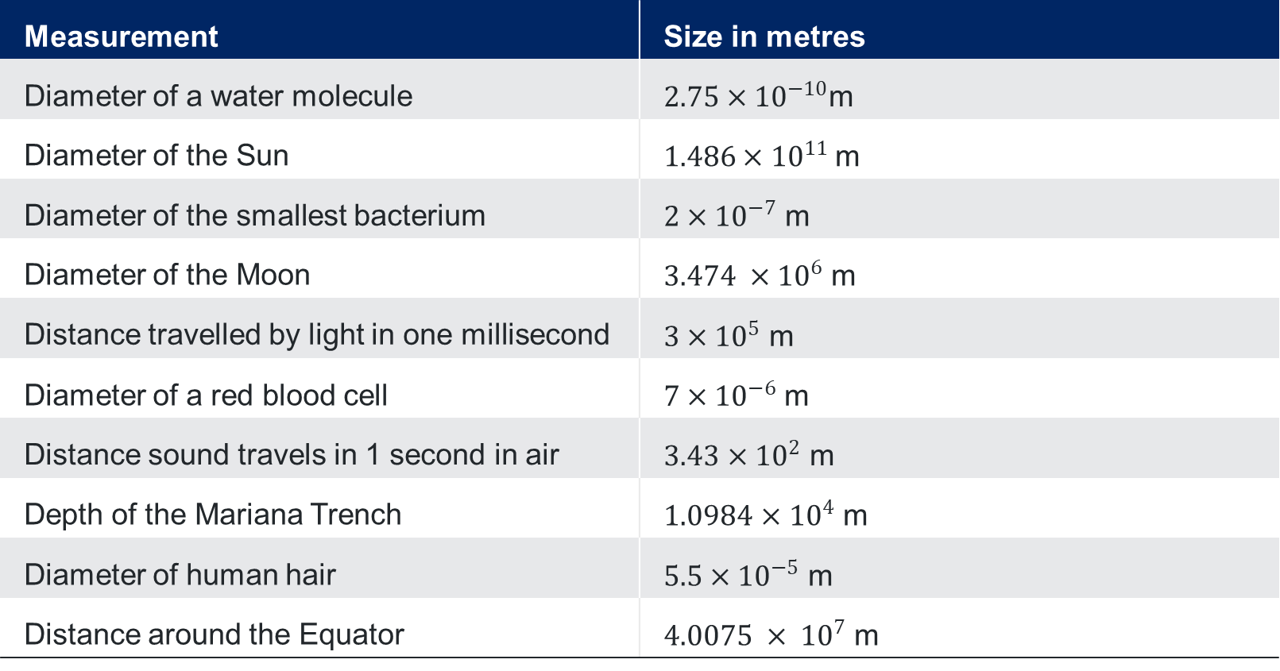
A question of scale – sizes
nRich activity
Measurement | Size in metres
Diameter of a water molecule | $2.75×{10}^{−10}$m
Diameter of the Sun | $1.486×{10}^{11}$m
Diameter of the smallest bacterium | $2×{10}^{−7}$ m
Diameter of the Moon | $3.474 ×{10}^{6}$ m
Distance travelled by light in one millisecond | $3×{10}^{5}$ m
Diameter of a red blood cell | $7×{10}^{−6}$m
Distance sound travels in 1 second in air | $3.43$ $×{10}^{2}$ m
Depth of the Mariana Trench | $1.0984$ $×{10}^{4}$ m
Diameter of human hair | $5.5×{10}^{−5}$ m
Distance around the Equator | $4.0075 × {10}^{7}$ m

Slide 9
Prefixes for units of measurement (1)
Prefixes
µ
micro)
G
(giga)
m
(milli)
T
(tera)
c
(centi)
n
(nano)
M
(mega)
k
(kilo)
Base unit

Slide 10
Prefixes for units of measurement (2)
Prefixes flow chart from base unit
Prefix | Relationship to other units
Tera (T)
Giga (G)
Mega (M)
Kilo (k)
BASE UNIT
Centi (c)
Milli (m)
Micro (µ)
Nano (n)

Slide 11
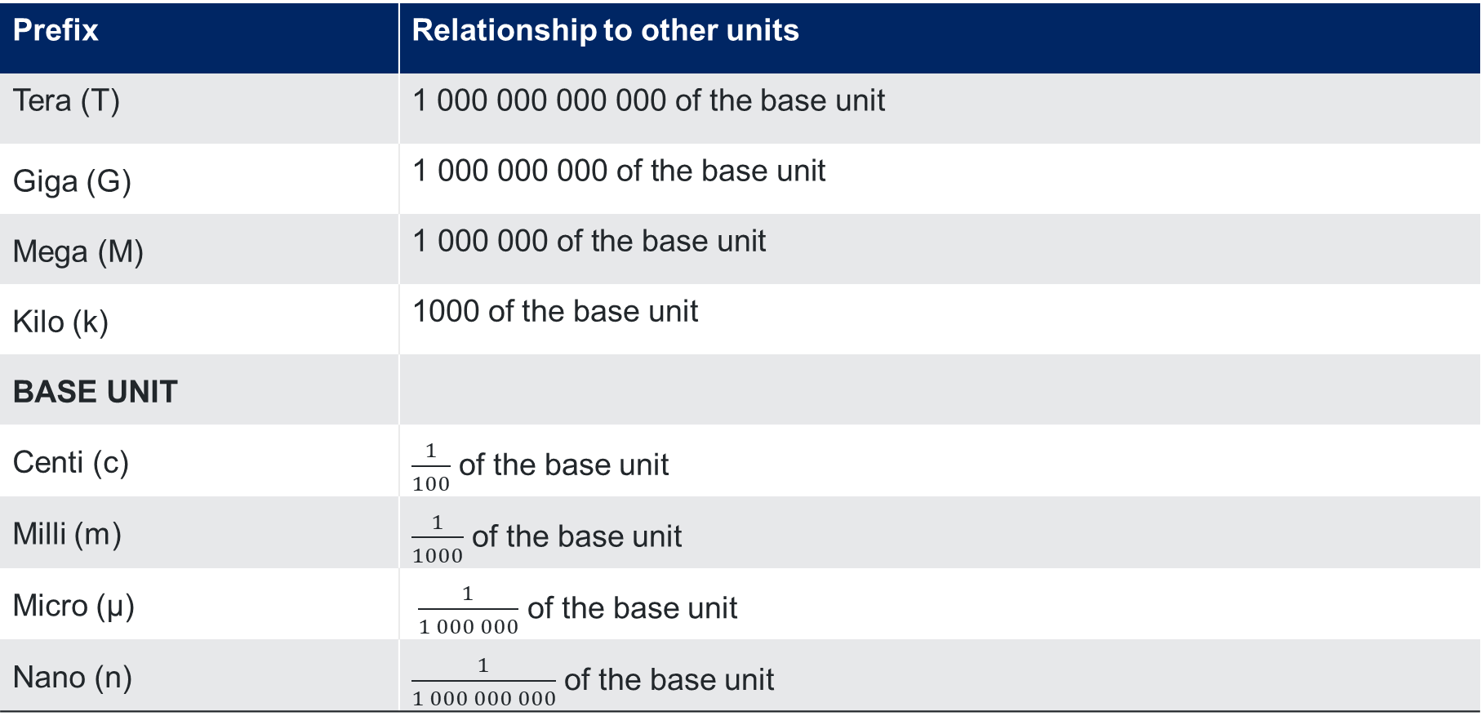
Prefixes for units of measurement (3)
Prefixes flow chart from base unit
Prefix | Relationship to other units
Tera (T) | 1 000 000 000 000 of the base unit
Giga (G) | $$\text{1 000 000 000 }\text{of} \text{the} \text{base} \text{unit}$$
Mega (M) | $$\text{1 000 000 }\text{of} \text{the} \text{base} \text{unit}$$
Kilo (k) | 1000 of the base unit
BASE UNIT
Centi (c) | $\frac{1}{100}$ of the base unit
Milli (m) | $\frac{1}{1000}$ of the base unit
Micro (µ) | $\frac{1}{1 000 000}$ of the base unit
Nano (n) | $\frac{1}{1 000 000 000}$ of the base unit

Slide 12
Releasing responsibility

Slide 13
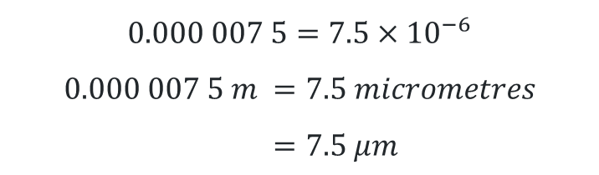
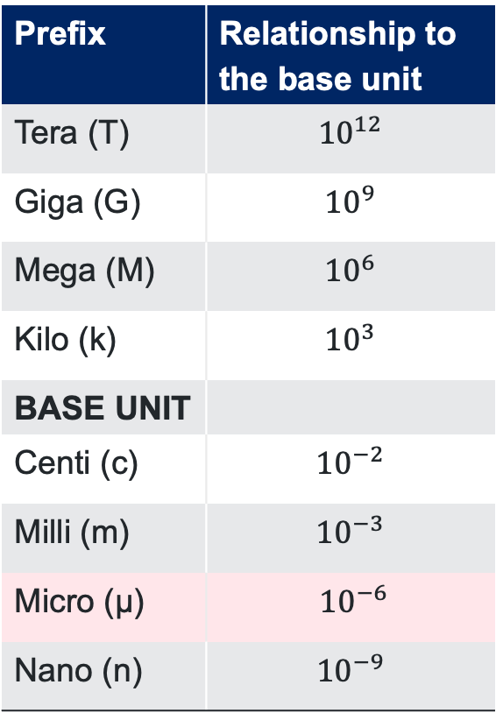
Prefixes for units of measurement (4)
Worked example
A microchip is 0.000 007 5 m wide. Represent this using the most appropriate unit.
Prefix | Relationship to the base unit
Tera (T) | $${10}^{12}$$
Giga (G) | $${10}^{9}$$
Mega (M) | $${10}^{6}$$
Kilo (k) | $${10}^{3}$$
BASE UNIT
Centi (c) | $${10}^{−2}$$
Milli (m) | $${10}^{−3}$$
Micro (µ) | $${10}^{−6}$$
Nano (n) | $${10}^{−9}$$
How did we convert the number to the appropriate power of 10?
$$0.000 007 5=7.5×{10}^{−6}$$
$$0.000 007 5 m =7.5 micrometres \\ =7.5 \text{µ}m$$
The microchip is 7.5 micrometres (µm).
How would this change if the measurement was to be given in millimetres?

Slide 14
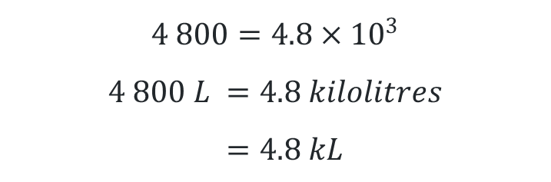
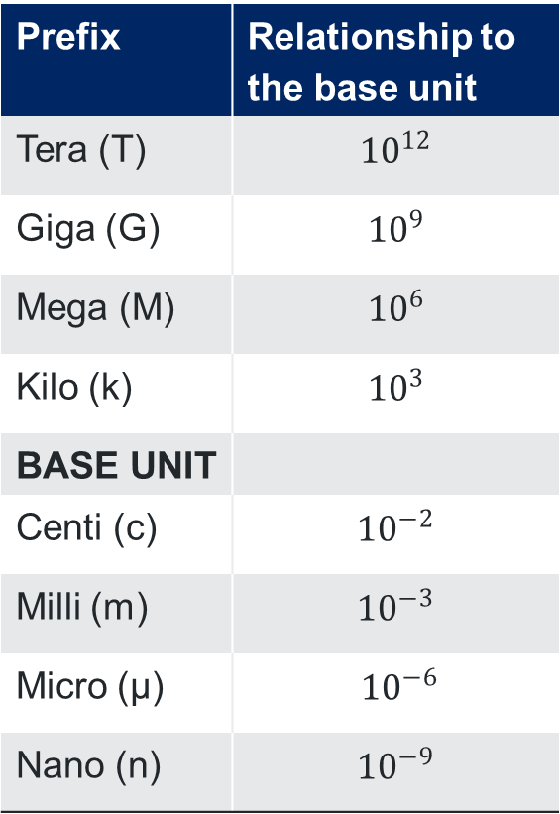
Prefixes for units of measurement (5)
Your turn
A backyard swimming pool requires 4 800 L of water to fill. Represent this with the most appropriate unit.
Prefix | Relationship to the base unit
Tera (T) | $${10}^{12}$$
Giga (G) | $${10}^{9}$$
Mega (M) | $${10}^{6}$$
Kilo (k) | $${10}^{3}$$
BASE UNIT
Centi (c) | $${10}^{−2}$$
Milli (m) | $${10}^{−3}$$
Micro (µ) | $${10}^{−6}$$
Nano (n) | $${10}^{−9}$$
$$4 800=4.8×{10}^{3}$$
$$4 800 L =4.8 kilolitres \\ =4.8 kL$$
The swimming pool requires 4.8 $kL$ to fill.

Slide 15
References
This presentation contains NSW Curriculum and syllabus content. The NSW Curriculum is developed by the NSW Education Standards Authority. This content is prepared by NESA for and on behalf of the Crown in the right of the State of New South Wales. The material is protected by Crown copyright.
Please refer to the NESA Copyright Disclaimer for more information https://educationstandards.nsw.edu.au/wps/portal/nesa/mini-footer/copyright.
NESA holds the only official and up-to-date versions of the NSW Curriculum and syllabus documents. Please visit the NSW Education Standards Authority (NESA) website https://educationstandards.nsw.edu.au/wps/portal/nesa/home and the NSW Curriculum website https://curriculum.nsw.edu.au.
Mathematics Standard Stage 6 Syllabus © NSW Education Standards Authority (NESA) for and on behalf of the Crown in right of the State of New South Wales, 2024.

Slide 16
Copyright
© State of New South Wales (Department of Education), 2025
The copyright material published in this resource is subject to the Copyright Act 1968 (Cth) and is owned by the NSW Department of Education or, where indicated, by a party other than the NSW Department of Education (third-party material).
Copyright material available in this resource and owned by the NSW Department of Education is licensed under a Creative Commons Attribution 4.0 International (CC BY 4.0) license.
This license allows you to share and adapt the material for any purpose, even commercially.
Attribution should be given to © State of New South Wales (Department of Education), 2025.
Material in this resource not available under a Creative Commons license:
the NSW Department of Education logo, other logos and trademark-protected material
Material owned by a third party that has been reproduced with permission. You will need to obtain permission from the third party to reuse its material.
Links to third-party material and websites
Please note that the provided (reading/viewing material/list/links/texts) are a suggestion only and implies no endorsement, by the New South Wales Department of Education, of any author, publisher, or book title. School principals and teachers are best placed to assess the suitability of resources that would complement the curriculum and reflect the needs and interests of their students.
If you use the links provided in this document to access a third-party’s website, you acknowledge that the terms of use, including licence terms set out on the third-party’s website apply to the use which may be made of the materials on that third-party website or where permitted by the Copyright Act 1968 (Cth). The department accepts no responsibility for content on third-party websites.

