Slide 1

Buy now, pay later
Mathematics Standard – Stage 6 (Year 11)
Show me the money

Slide 2
Learning intentions and success criteria
Learning intention
To understand the costs associated with buy now, pay later services.
Success criteria
I can identify and explain potential costs for buy now, pay later services.
I can calculate the total cost for a buy now, pay later service.
I can compare buy now, pay later services to justify which is the best suited to a given context.
Notes:
Notes for teachers:
Learning intentions and success criteria are best co-constructed with students. Adapt the learning intention as required and add matching success criteria.
For more information See ⁠AITSL or the NSW Department of Education explicit teaching strategies, ⁠Sharing learning intentions and ⁠Sharing success criteria
LISC is not necessarily presented at the beginning of the lesson. Teacher needs to consider most effectual time to introduce
LISC should be revisited during the lesson to support students' evaluation of their learning

Slide 3
Activating prior knowledge

Slide 4
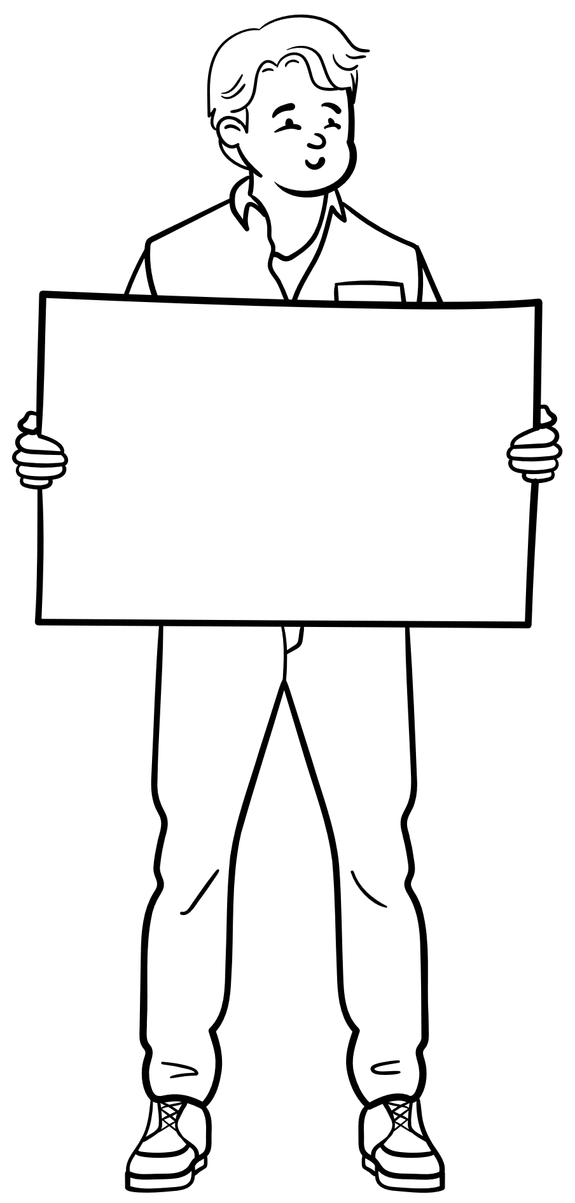

Buy now pay later (1)
Would you rather?
FuturePay
Repayment flexibility
Pay later, interest free
Approval in minutes
Earn instant cash back with reward partners
LaterPay
Quick set up
Free when you pay on time
Smart limits to stop overspending
Cap late fees

Slide 5
Independent practice

Slide 6
Buy now pay later (2)
Wylie’s financial situation
Wylie uses a buy now, pay later payment option to make a purchase of a $100 portable speaker.
His repayments are split across 4 equal payments over 6 weeks. No interest is charged.
Wylie misses his final payment and is charged a late fee outlined in the terms of his deal.
Calculate the total amount that Wylie pays for the portable speaker including the late fee.
Buying on terms promotional deal
Wylie had the option to pay for the $100 portable speaker by paying:
a 10% deposit
8 weekly payments of $13.

Slide 7
References
This presentation contains NSW Curriculum and syllabus content. The NSW Curriculum is developed by the NSW Education Standards Authority. This content is prepared by NESA for and on behalf of the Crown in the right of the State of New South Wales. The material is protected by Crown copyright.
Please refer to the NESA Copyright Disclaimer for more information https://educationstandards.nsw.edu.au/wps/portal/nesa/mini-footer/copyright.
NESA holds the only official and up-to-date versions of the NSW Curriculum and syllabus documents. Please visit the NSW Education Standards Authority (NESA) website https://educationstandards.nsw.edu.au/wps/portal/nesa/home and the NSW Curriculum website https://curriculum.nsw.edu.au.
Mathematics Standard Stage 6 Syllabus © NSW Education Standards Authority (NESA) for and on behalf of the Crown in right of the State of New South Wales, 2024.

Slide 8
Copyright
© State of New South Wales (Department of Education), 2024
The copyright material published in this resource is subject to the Copyright Act 1968 (Cth) and is owned by the NSW Department of Education or, where indicated, by a party other than the NSW Department of Education (third-party material).
Copyright material available in this resource and owned by the NSW Department of Education is licensed under a Creative Commons Attribution 4.0 International (CC BY 4.0) licence.
This licence allows you to share and adapt the material for any purpose, even commercially.
Attribution should be given to © State of New South Wales (Department of Education), 2024.
Material in this resource not available under a Creative Commons licence:
the NSW Department of Education logo, other logos and trademark-protected material
Material owned by a third party that has been reproduced with permission. You will need to obtain permission from the third party to reuse its material.
Links to third-party material and websites
Please note that the provided (reading/viewing material/list/links/texts) are a suggestion only and implies no endorsement, by the New South Wales Department of Education, of any author, publisher, or book title. School principals and teachers are best placed to assess the suitability of resources that would complement the curriculum and reflect the needs and interests of their students.
If you use the links provided in this document to access a third party’s website, you acknowledge that the terms of use, including licence terms set out on the third-party’s website apply to the use which may be made of the materials on that third-party website or where permitted by the Copyright Act 1968 (Cth). The department accepts no responsibility for content on third-party websites.

