Slide 1

Buying on terms
Mathematics Standard – Stage 6 (Year 11)
Show me the money

Slide 2
Learning intentions and success criteria
Learning intentions
To understand the costs associated with buying on terms that involve paying a deposit and making regular repayments.
Success criteria
I can calculate the overall cost when buying on terms.
I can explain how the interest is calculated when buying on terms.
I can calculate the cost of a repayment.
I can justify the most suitable purchasing method based on the context provided.
Notes:
Notes for teachers:
Learning intentions and success criteria are best co-constructed with students. Adapt the learning intention as required and add matching success criteria.
For more information See ⁠AITSL or the NSW Department of Education explicit teaching strategies, ⁠Sharing learning intentions and ⁠Sharing success criteria
LISC is not necessarily presented at the beginning of the lesson. Teacher needs to consider most effectual time to introduce
LISC should be revisited during the lesson to support students' evaluation of their learning

Slide 3
Activating prior knowledge

Slide 4
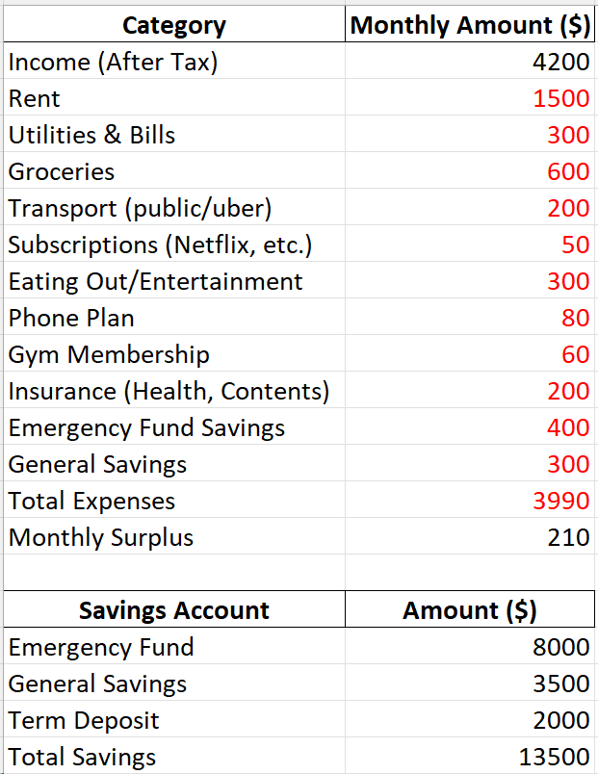
Sawyer’s budget
Can she afford a $45 000 car?

Slide 5
Connecting learning

Slide 6
Buying on terms (1)
Definitions
Deposit: A sum of money that is used for financial reasons. An amount of money that is placed in a bank or other financial institution either as a lump sum or as a regular payment, or an initial payment when purchasing something, with the rest to be payable later.
Repayment: A set amount, paid at regular intervals over the period of a loan, to pay off a loan.
Interest: Money paid or received in return for using or lending money.

Slide 7


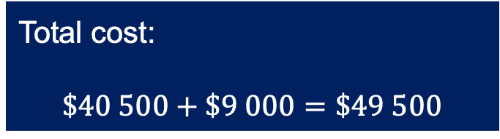
Buying on terms (2)
Car yard offer
Sale price: $45 000
Deposit: 20% of sale price
Repayments: $675 per month
Repayment term: 5 years
$$45 000×0.20=\$9000$$
$$675×(5×12)=\$40 500$$
Total cost:
$$\$40 500+\$9 000=\$49 500$$

Slide 8
Buying on terms (3)
Car deals
Sawyer is offered the following deals for purchasing a $45 000 car through buying on terms. Find the overall cost of each deal and justify which may be best deal for Sawyer.
Deal | 1 | 2 | 3 | 4
Deposit | 20% | 15% | 25% | 30%
Repayment amount | $660 per month | $870 per month | $780 per month | $490 per month
Repayment term | 5 years | 4 years | 4 years | 6 years

Slide 9
Releasing responsibility

Slide 10

Finding repayments (1)
Example 1
A car costs $37,000 to buy outright or $39,500 on terms. If Sally chooses to buy the car on terms with a 20% deposit and repays the balance over 4 years, what are her monthly repayments?
Why do we calculate the deposit amount first?
Deposit | $$37 000×20\% \\ =\$7 400$$
Remaining balance | $$39 500−7 400 \\ =\$32 100$$
Monthly repayments | $$32 100÷\left(4×12\right)$$ $$=\$668.75$$
How did we select these numbers?
How can you check you are correct?

Slide 11
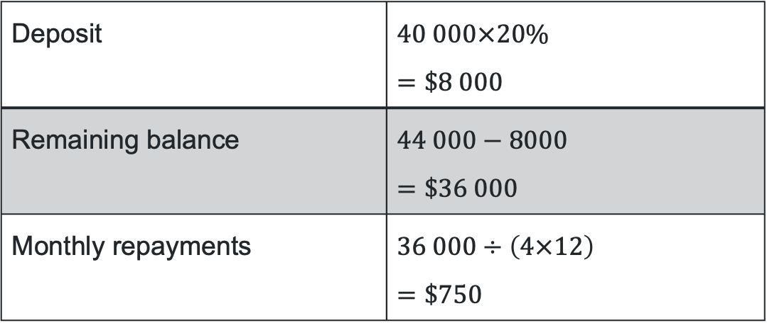
Finding repayments (2)
Your turn 1
A car costs $40,000 to buy outright or $44,000 on terms. If Steve chooses to buy the car on terms with a 20% deposit and repays the balance over 4 years, what are her monthly repayments?
Deposit | $$40 000×20\% \\ =\$8 000$$
Remaining balance | $$44 000−8000 \\ =\$36 000$$
Monthly repayments | $$36 000÷\left(4×12\right)$$ $$=\$750$$

Slide 12
References
This presentation contains NSW Curriculum and syllabus content. The NSW Curriculum is developed by the NSW Education Standards Authority. This content is prepared by NESA for and on behalf of the Crown in the right of the State of New South Wales. The material is protected by Crown copyright.
Please refer to the NESA Copyright Disclaimer for more information https://educationstandards.nsw.edu.au/wps/portal/nesa/mini-footer/copyright.
NESA holds the only official and up-to-date versions of the NSW Curriculum and syllabus documents. Please visit the NSW Education Standards Authority (NESA) website https://educationstandards.nsw.edu.au/wps/portal/nesa/home and the NSW Curriculum website https://curriculum.nsw.edu.au.
Mathematics Standard Stage 6 Syllabus © NSW Education Standards Authority (NESA) for and on behalf of the Crown in right of the State of New South Wales, 2024.

Slide 13
Copyright
© State of New South Wales (Department of Education), 2025
The copyright material published in this resource is subject to the Copyright Act 1968 (Cth) and is owned by the NSW Department of Education or, where indicated, by a party other than the NSW Department of Education (third-party material).
Copyright material available in this resource and owned by the NSW Department of Education is licensed under a Creative Commons Attribution 4.0 International (CC BY 4.0) license.
This license allows you to share and adapt the material for any purpose, even commercially.
Attribution should be given to © State of New South Wales (Department of Education), 2025.
Material in this resource not available under a Creative Commons license:
the NSW Department of Education logo, other logos and trademark-protected material
Material owned by a third party that has been reproduced with permission. You will need to obtain permission from the third party to reuse its material.
Links to third-party material and websites
Please note that the provided (reading/viewing material/list/links/texts) are a suggestion only and implies no endorsement, by the New South Wales Department of Education, of any author, publisher, or book title. School principals and teachers are best placed to assess the suitability of resources that would complement the curriculum and reflect the needs and interests of their students.
If you use the links provided in this document to access a third-party’s website, you acknowledge that the terms of use, including licence terms set out on the third-party’s website apply to the use which may be made of the materials on that third-party website or where permitted by the Copyright Act 1968 (Cth). The department accepts no responsibility for content on third-party websites.

