Slide 1

Medicare levy
Mathematics Standard – Stage 6 (Year 11)
Show me the money

Slide 2
Learning intentions and success criteria
Learning intentions
To understand what Medicare is and how it is funded through the Medicare levy.
Success criteria
I can calculate a taxable income.
I can describe ‘Medicare’ and ‘Medicare levy’ and explain their purpose.
I can calculate the Medicare levy owed from a taxable income.
I can explain misconceptions when calculating the Medicare levy and provide advice to avoid them.
Notes:
Notes for teachers:
Learning intentions and success criteria are best co-constructed with students. Adapt the learning intention as required and add matching success criteria.
For more information See ⁠AITSL or the NSW Department of Education explicit teaching strategies, ⁠Sharing learning intentions and ⁠Sharing success criteria
LISC is not necessarily presented at the beginning of the lesson. Teacher needs to consider most effectual time to introduce
LISC should be revisited during the lesson to support students' evaluation of their learning

Slide 3
Activating prior knowledge

Slide 4
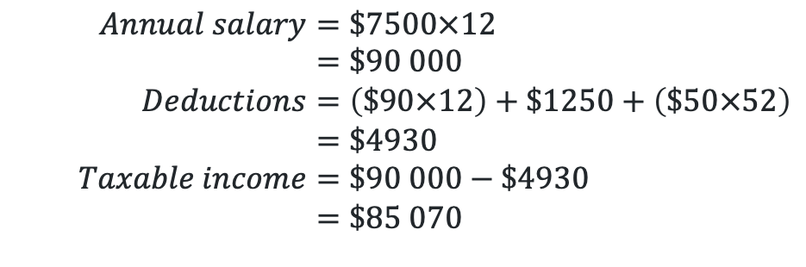
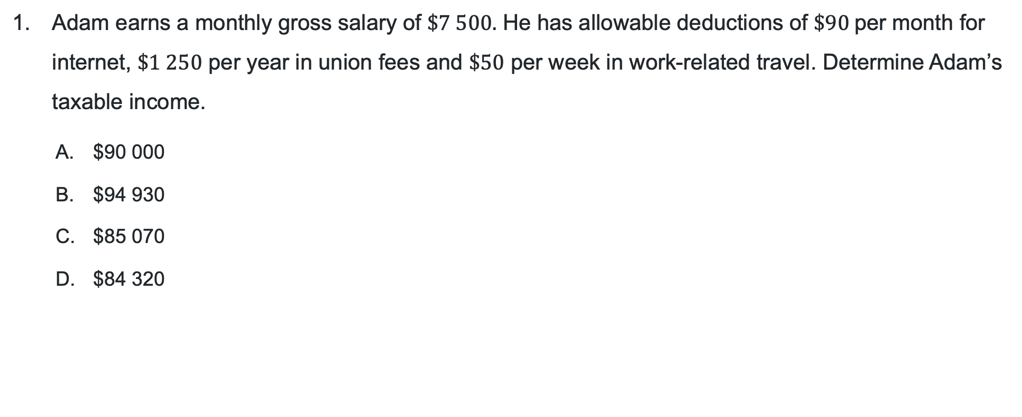
Allowable deductions and taxable income (1)
Hinge point question 1
Adam earns a monthly gross salary of $\$7 500.$ He has allowable deductions of $\$90$per month for internet, $\$1 250$ per year in union fees and $\$50$ per week in work-related travel. Determine Adam’s taxable income.
        $90 000
        $94 930
        $85 070
        $84 320
$$Annual salary=\$7500×12 \\ =\$90 000 \\ Deductions=\left(\$90×12\right)+\$1250+\left(\$50×52\right) \\ =\$4930 \\ Taxable income=\$90 000−\$4930 \\ =\$85 070$$

Slide 5


Allowable deductions and taxable income (2)
Hinge point question 2
2. If Adam’s taxable income is $\$85 070$, use the tax table below to determine his income tax.
Taxable income | Tax payable on this income
0 – $18 200 | Nil
$18 201 – $45 000 | 16 cents for each $1 over $ 18 200
$45 001 – $135 000 | $4 288 plus 30 cents for each $1 over 45 000
$135 001 – $190 000 | $31 288 plus 37 cents for each $1 over $135 000
$190 001 and more | $51 638 plus 45 cents for each $1 over $190 000
$$Income tax=\$4288+0.3×\left(\$85070 −\$45000\right) \\ =\$16 309$$
Therefore, Adam’s income tax is $16 309

Slide 6
Connecting learning

Slide 7
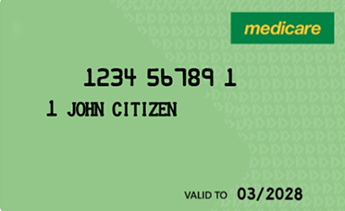
Medicare levy (1)
What is this?
Screenshot from Medicare online account help - Get a replacement or extra Medicare card

Slide 8
Releasing responsibility

Slide 9
Medicare levy (2)
Definition
A tax that finances the national health insurance program, Medicare, for all Australians, calculated as a percentage of taxable income.
Currently 2% of taxable income.
This could change.
Paid in addition to income tax

Slide 10
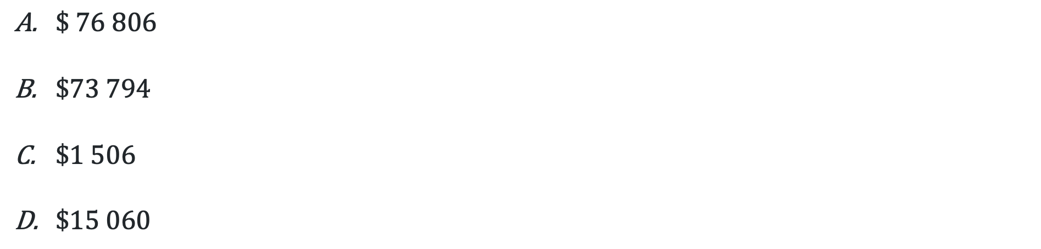

Medicare levy (3)
Basic question
Bella earns a taxable income of $75 300. Calculate the Medicare levy she is required to pay if this is taxed at 2% of her taxable income.
$\$ 76 806$
$\$73 794$
$\$1 506$
$\$15 060$
$$75 300×2\%$$

Slide 11
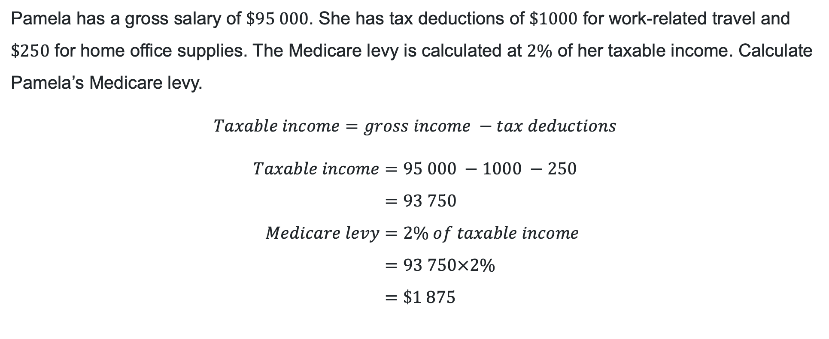
Medicare levy (4)
Worked example – self explanation prompts
Pamela has a gross salary of $\$95 000$. She has tax deductions of $\$1000$ for work-related travel and $\$250$ for home office supplies. The Medicare levy is calculated at $2\%$ of her taxable income. Calculate Pamela’s Medicare levy.
$$Taxable income=gross income −tax deductions$$
$$Taxable income=95 000 −1000 −250 \\ =93 750 \\ Medicare levy=2\% of taxable income \\ =93 750×2\% \\ =\$1 875$$
Why are we subtracting the tax deductions?
How do Pamela’s deductions impact the amount of Medicare levy she has to pay?
Why does multiplying by a percentage give us the correct value?

Slide 12


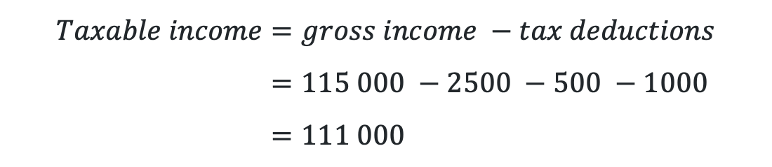
Medicare levy (5)
Your turn – solution
Greg has a gross salary of $\$115 000$. He has tax deductions of $\$2500$ for work tools, $\$500$ for work uniforms and $\$1000$for union fees. The Medicare levy is calculated at $2\%$ of his taxable income. Calculate Greg’s Medicare levy.
$$Taxable income=gross income −tax deductions \\ =115 000 −2500 −500 −1000 \\ =111 000$$
$$Medicare levy=2\% of taxable income \\ =111 000×2\% \\ =\$2 220$$

Slide 13

Approaching questions scaffold

Slide 14
Medicare levy and income tax (1)
HSC-style question
The table shows the income tax rates for the 2025–26 financial year
Xena has a gross annual salary of $84 000. She has allowable tax deductions of $1200 for home-office equipment and $500 in work-related travel expenses. Xena must also pay a Medicare levy of 2% of her taxable income. Calculate the total tax payable by Xena including the Medicare levy.
Taxable income | Tax payable on this income
0 – $18 200 | Nil
$18 201 – $45 000 | 16 cents for each $1 over $ 18 200
$45 001 – $135 000 | $4 288 plus 30 cents for each $1 over 45 000
$135 001 – $190 000 | $31 288 plus 37 cents for each $1 over $135 000
$190 001 and more | $51 638 plus 45 cents for each $1 over $190 000

Slide 15
Medicare levy and income tax (2)
Flow chart
Income
tax
Tax table
Gross income
Subtract taxable deductions
Taxable income
Calculate 2%
Medicare levy
Total tax payable

Slide 16
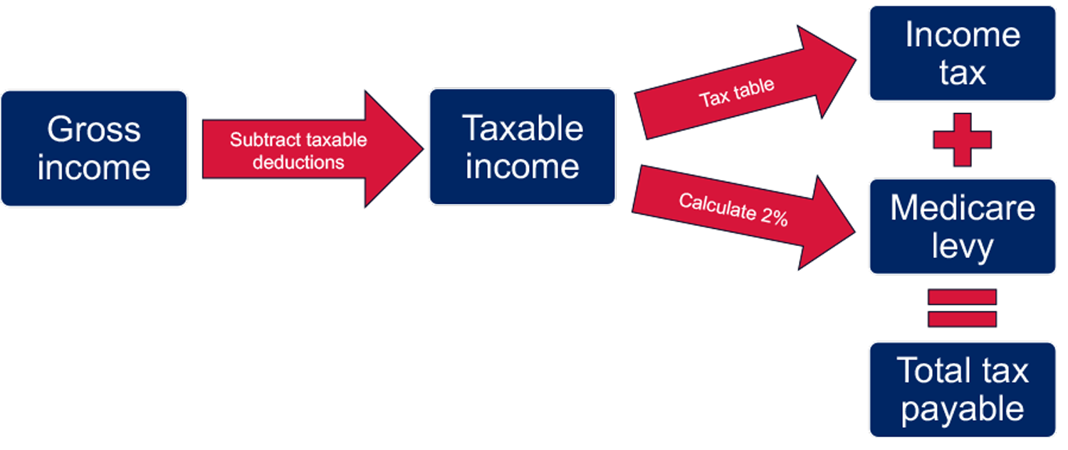
Medicare levy and income tax (3)
Calculate the answer
The table shows the income tax rates for the 2025–26 financial year
Taxable income | Tax payable on this income
0 – $18 200 | Nil
$18 201 – $45 000 | 16 cents for each $1 over $ 18 200
$45 001 – $135 000 | $4 288 plus 30 cents for each $1 over 45 000
$135 001 – $190 000 | $31 288 plus 37 cents for each $1 over $135 000
$190 001 and more | $51 638 plus 45 cents for each $1 over $190 000
Xena has a gross annual salary of $84 000. She has allowable tax deductions of $1200 for home-office equipment
and $500 in work-related travel expenses. Xena must also pay a Medicare levy of 2% of her taxable income.
Calculate the total tax payable by Xena including the Medicare levy.

Slide 17
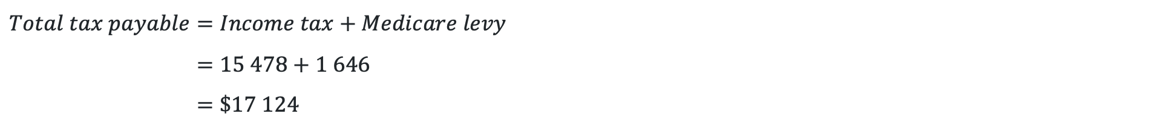

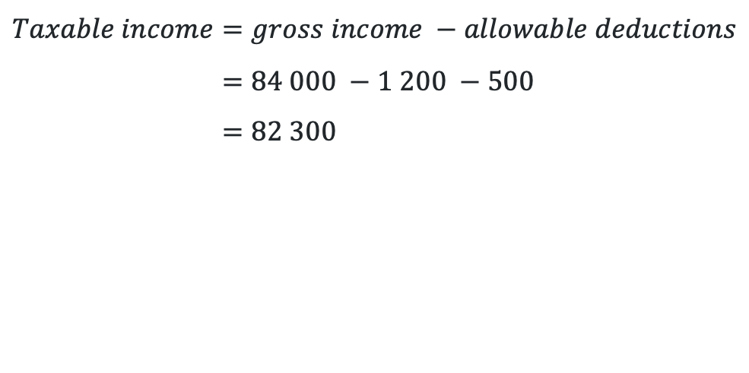
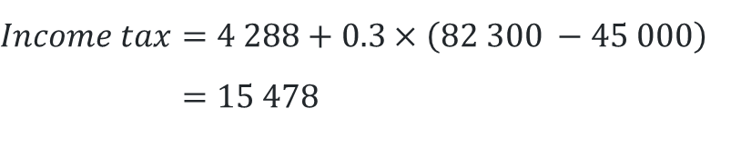
Medicare levy and income tax (4)
Solution
$$Taxable income=gross income −allowable deductions \\ =84 000 −1 200 −500 \\ =82 300$$
$$Income tax=4 288+0.3×\left(82 300 −45 000\right) \\ =15 478$$
Taxable income | Tax payable on this income
0 – $18 200 | Nil
$18 201 – $45 000 | 16 cents for each $1 over $ 18 200
$45 001 – $135 000 | $4 288 plus 30 cents for each $1 over 45 000
$135 001 – $190 000 | $31 288 plus 37 cents for each $1 over $135 000
$190 001 and more | $51 638 plus 45 cents for each $1 over $190 000
$$Medicare levy=2\% of taxable income \\ =82 300×2\% \\ =1646$$
$$Total tax payable=Income tax+Medicare levy \\ =15 478+1 646 \\ =\$17 124$$

Slide 18
References
This presentation contains NSW Curriculum and syllabus content. The NSW Curriculum is developed by the NSW Education Standards Authority. This content is prepared by NESA for and on behalf of the Crown in the right of the State of New South Wales. The material is protected by Crown copyright.
Please refer to the NESA Copyright Disclaimer for more information https://educationstandards.nsw.edu.au/wps/portal/nesa/mini-footer/copyright.
NESA holds the only official and up-to-date versions of the NSW Curriculum and syllabus documents. Please visit the NSW Education Standards Authority (NESA) website https://educationstandards.nsw.edu.au/wps/portal/nesa/home and the NSW Curriculum website https://curriculum.nsw.edu.au.
Mathematics Standard Stage 6 Syllabus © NSW Education Standards Authority (NESA) for and on behalf of the Crown in right of the State of New South Wales, 2024.

Slide 19
Copyright
© State of New South Wales (Department of Education), 2025
The copyright material published in this resource is subject to the Copyright Act 1968 (Cth) and is owned by the NSW Department of Education or, where indicated, by a party other than the NSW Department of Education (third-party material).
Copyright material available in this resource and owned by the NSW Department of Education is licensed under a Creative Commons Attribution 4.0 International (CC BY 4.0) license.
This license allows you to share and adapt the material for any purpose, even commercially.
Attribution should be given to © State of New South Wales (Department of Education), 2025.
Material in this resource not available under a Creative Commons license:
the NSW Department of Education logo, other logos and trademark-protected material
Material owned by a third party that has been reproduced with permission. You will need to obtain permission from the third party to reuse its material.
Links to third-party material and websites
Please note that the provided (reading/viewing material/list/links/texts) are a suggestion only and implies no endorsement, by the New South Wales Department of Education, of any author, publisher, or book title. School principals and teachers are best placed to assess the suitability of resources that would complement the curriculum and reflect the needs and interests of their students.
If you use the links provided in this document to access a third-party’s website, you acknowledge that the terms of use, including licence terms set out on the third-party’s website apply to the use which may be made of the materials on that third-party website or where permitted by the Copyright Act 1968 (Cth). The department accepts no responsibility for content on third-party websites.

