Slide 1

Calculating income tax
Mathematics Standard – Stage 6 (Year 11)
Show me the money

Slide 2
Learning intentions and success criteria
Learning intentions
To be able to determine the income tax payable using information in income tax tables.
Success criteria
I can explain why we pay taxes.
I can read and use income tax tables.
I can explain where the values $4288, $31 288 and $51 638 come from in the income tax table.
I can calculate the amount of income tax payable.
Notes:
Notes for teachers:
Learning intentions and success criteria are best co-constructed with students. Adapt the learning intention as required and add matching success criteria.
For more information See ⁠AITSL or the NSW Department of Education explicit teaching strategies, ⁠Sharing learning intentions and ⁠Sharing success criteria
LISC is not necessarily presented at the beginning of the lesson. Teacher needs to consider most effectual time to introduce
LISC should be revisited during the lesson to support students' evaluation of their learning

Slide 3
Connecting learning

Slide 4
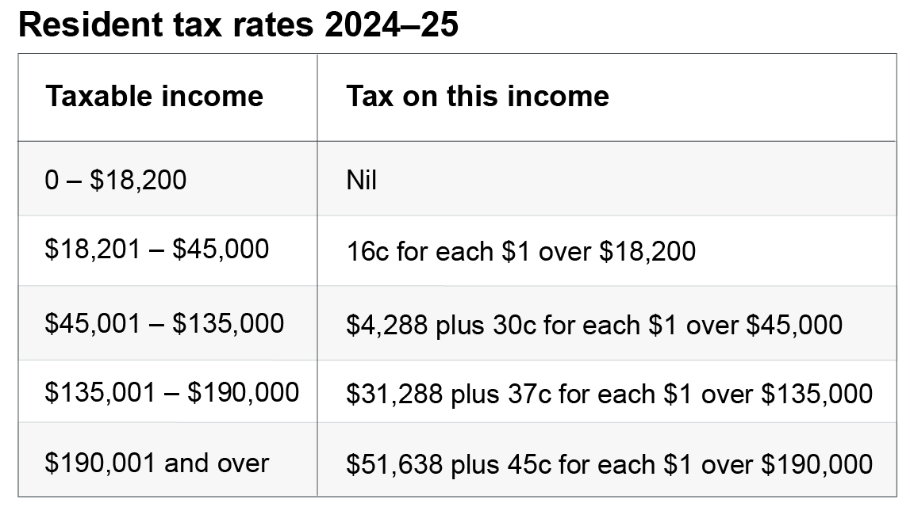
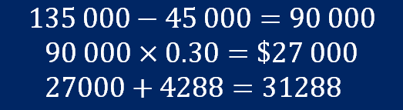
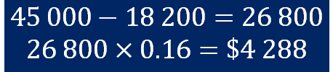
Calculating income tax (1)
2024–2025 Tax table
$$45 000−18 200=26 800$$
$$26 800×0.16=\$4 288$$
$$135 000−45 000=90 000$$
$$90 000×0.30=\$27 000 \\ 27000+4288=31288$$

Slide 5
Releasing responsibility

Slide 6
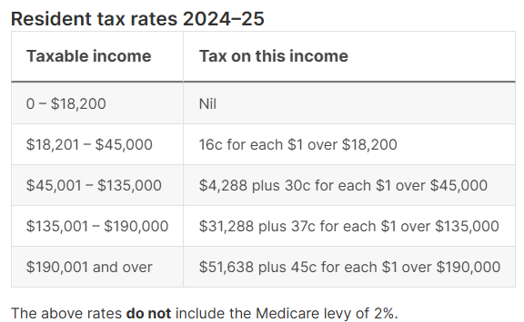

Calculating income tax (2)
Example 1
Paul has a taxable income of $\$175 000$.
Calculate his tax payable.
$$Tax payable=\$31 288+0.37×(\$175 000−\$135 000) \\ =\$46 088$$

Slide 7
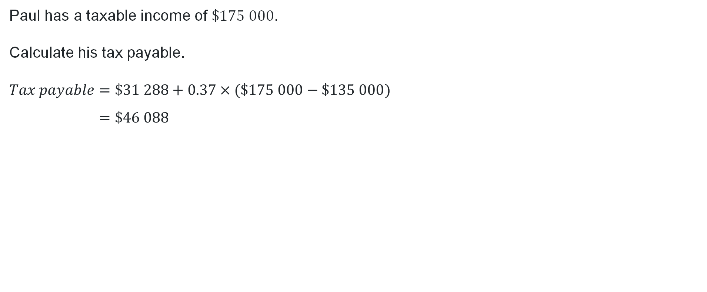
Calculating income tax (3)
Self-explanation prompts
Why do we subtract $135 000 from the taxable income?
Paul has a taxable income of $\$175 000$.
Calculate his tax payable.
$$Tax payable=\$31 288+0.37×(\$175 000−\$135 000) \\ =\$46 088$$
Why do we add on $31 288 to the calculation?
How might we know that this answer is reasonable?

Slide 8

Calculating income tax (4)
Your turn
Kimberley has a taxable income of $\$210 000$.
Calculate her tax payable.

Slide 9

Calculating income tax (5)
Solution
Kimberley has a taxable income of $\$210 000$.
Calculate her tax payable.
$$Tax payable=\$51 638+0.45×(\$210 000−\$190 000) \\ =\$60 638$$

Slide 10
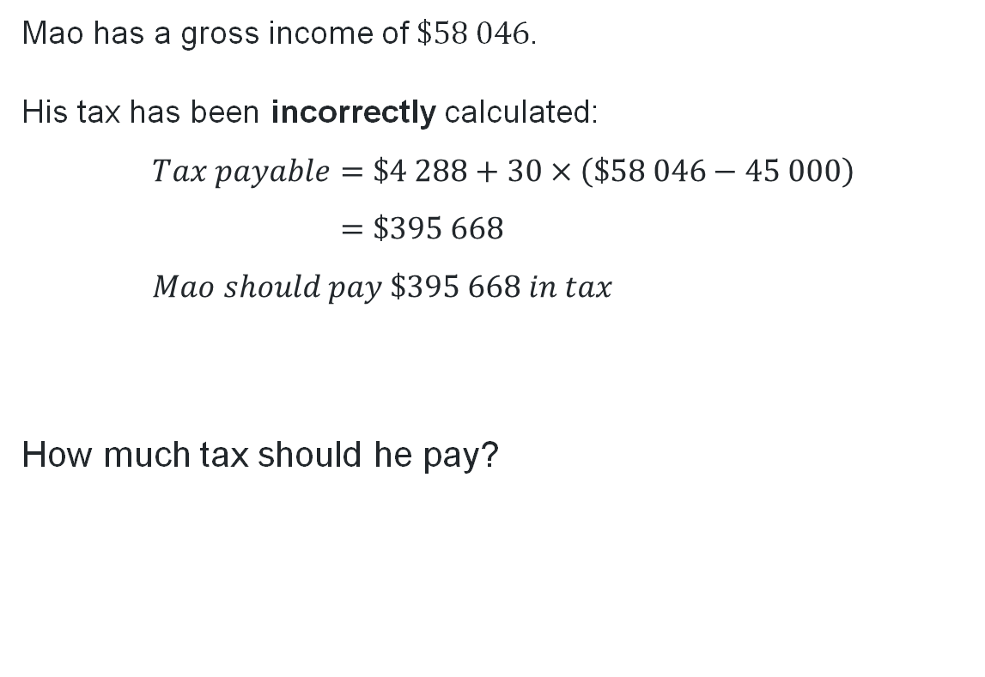
Non-example
Mao’s tax payable
Mao has a gross income of $\$58 046$.
His tax has been incorrectly calculated:
$$Tax payable=\$4 288+30×\left(\$58 046−45 000\right) \\ =\$395 668 \\ Mao should pay \$395 668 in tax$$
How much tax should he pay?

Slide 11
Independent practice

Slide 12
Calculating income tax (6)
Would you rather use the current tax table or pay a flat rate of 30% income tax?

Slide 13
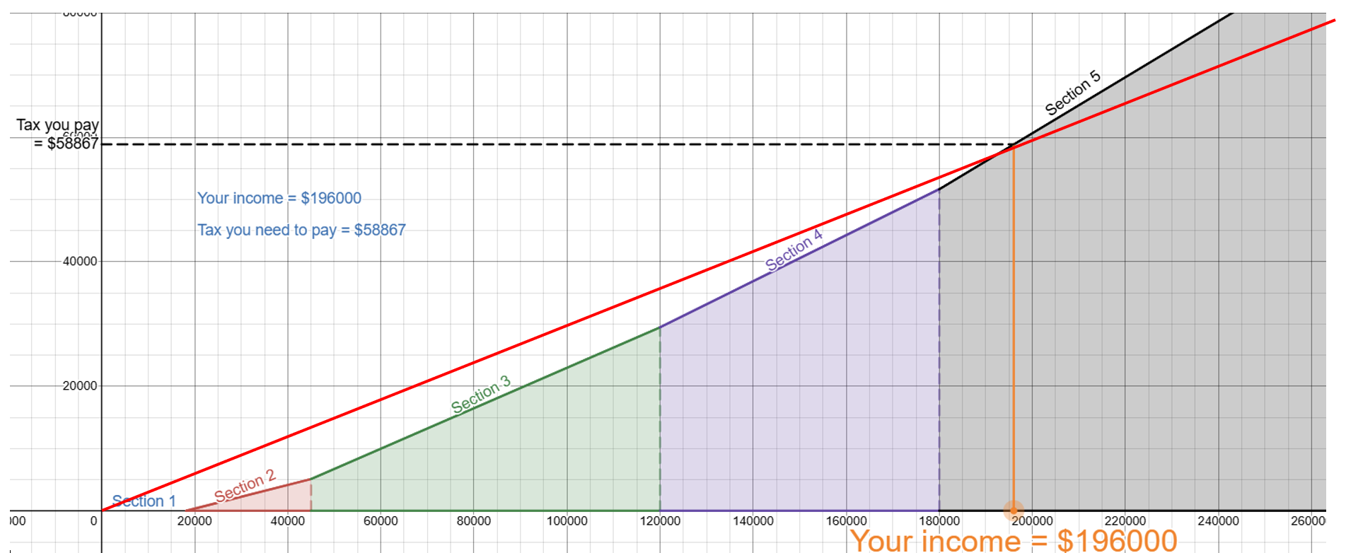
Calculating income tax (7)
Graph scenario

Slide 14
Calculating income tax (8)
Bracket creep scenario
Corinne earns $24/hr working a 35-hour week over 5 days.
She gets offered an extra hour at work each day.
However, she has to pay $20/ hour for someone to walk her dog at least 3 times a week if she picks up the extra hours.
Is it worthwhile for Corinne to take up the offer of the extra hours?

Slide 15
References
This presentation contains NSW Curriculum and syllabus content. The NSW Curriculum is developed by the NSW Education Standards Authority. This content is prepared by NESA for and on behalf of the Crown in the right of the State of New South Wales. The material is protected by Crown copyright.
Please refer to the NESA Copyright Disclaimer for more information https://educationstandards.nsw.edu.au/wps/portal/nesa/mini-footer/copyright.
NESA holds the only official and up-to-date versions of the NSW Curriculum and syllabus documents. Please visit the NSW Education Standards Authority (NESA) website https://educationstandards.nsw.edu.au/wps/portal/nesa/home and the NSW Curriculum website https://curriculum.nsw.edu.au.
Mathematics Standard Stage 6 Syllabus © NSW Education Standards Authority (NESA) for and on behalf of the Crown in right of the State of New South Wales, 2024.

Slide 16
Copyright
© State of New South Wales (Department of Education), 2025
The copyright material published in this resource is subject to the Copyright Act 1968 (Cth) and is owned by the NSW Department of Education or, where indicated, by a party other than the NSW Department of Education (third-party material).
Copyright material available in this resource and owned by the NSW Department of Education is licensed under a Creative Commons Attribution 4.0 International (CC BY 4.0) license.
This license allows you to share and adapt the material for any purpose, even commercially.
Attribution should be given to © State of New South Wales (Department of Education), 2025.
Material in this resource not available under a Creative Commons license:
the NSW Department of Education logo, other logos and trademark-protected material
Material owned by a third party that has been reproduced with permission. You will need to obtain permission from the third party to reuse its material.
Links to third-party material and websites
Please note that the provided (reading/viewing material/list/links/texts) are a suggestion only and implies no endorsement, by the New South Wales Department of Education, of any author, publisher, or book title. School principals and teachers are best placed to assess the suitability of resources that would complement the curriculum and reflect the needs and interests of their students.
If you use the links provided in this document to access a third-party’s website, you acknowledge that the terms of use, including licence terms set out on the third-party’s website apply to the use which may be made of the materials on that third-party website or where permitted by the Copyright Act 1968 (Cth). The department accepts no responsibility for content on third-party websites.

