Slide 1

Government payments
Mathematics Standard – Stage 6 (Year 11)
Show me the money

Slide 2
Learning intentions and success criteria
Learning intentions
To know about the different types of government payments
To be able to calculate income from government payments
Success criteria
I can find information on different government payments.
I can identify the criteria to be eligible for a government payment.
I can justify the total income a person may receive from the government.
Notes:
Notes for teachers:
Learning intentions and success criteria are best co-constructed with students. Adapt the learning intention as required and add matching success criteria.
For more information See ⁠AITSL or the NSW Department of Education explicit teaching strategies, ⁠Sharing learning intentions and ⁠Sharing success criteria
LISC is not necessarily presented at the beginning of the lesson. Teacher needs to consider most effectual time to introduce
LISC should be revisited during the lesson to support students' evaluation of their learning

Slide 3
Activating prior knowledge

Slide 4
Scenario
Jake is 16 years old and is enrolled in Year 11 at his local high school.
He lives with and cares for his mum, who has a disability and receives a disability support pension.
They are currently renting an apartment.
  Further information about Jake:
  Australian citizen
  single relationship
  no rent paid as he lives at home
  lives in a city
  hasn’t received income support payments before
  earns less than $1500 a fortnight
  has assets under $543,750

Slide 5
Releasing responsibility

Slide 6
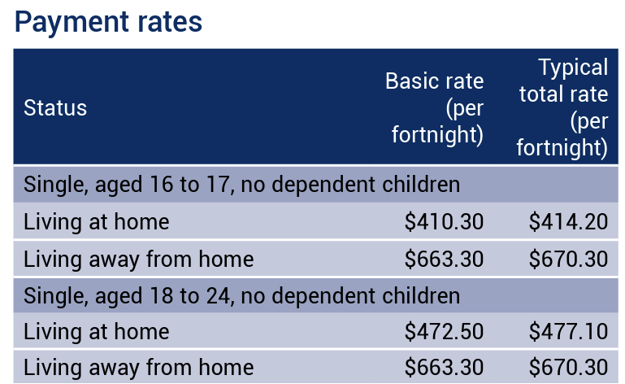
Government payments (1)
Worked example
Lisa is 18, single and has no dependent children. She is starting university in a few months.
Her family lives on a farm, so she will be living away from home in an apartment for students at the university.
How much will Lisa receive each fortnight in youth allowance payments?
Partial table information sourced from page 23, A guide to Australian Government payments, 20 March 2025 to 30 June 2025.

Slide 7
Government payments (2)
What information about Lisa was needed to interpret the payment rates table?
Example – self explanation prompts
Lisa is 18, single and has no dependent children.
She is starting university in a few months.
Her family lives on a farm, so she will be living away from home in an apartment for students at the university.
How much will Lisa receive each fortnight in youth allowance payments?
Youth allowance payment rates
Lisa will receive a minimum amount of $663.30 per fortnight.
Partial table information sourced from page 23, A guide to Australian Government payments, 20 March 2025 to 30 June 2025.
Why was this amount chosen from the table?

Slide 8
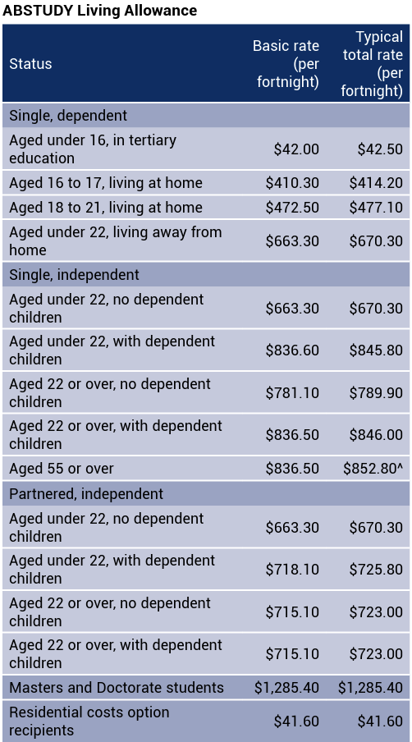
Government payments (3)
Your turn
Josh is a single, independent 21-year-old Aboriginal university student with no dependents. He is about to start his Masters. Josh currently receives the ABSTUDY Living Allowance.
Calculate how much income he will receive each fortnight and justify why he is still eligible to receive the payments?
Table information sourced from page 25, A guide to Australian Government payments, 20 March 2025 to 30 June 2025.

Slide 9
Government payments (4)
Your turn – solutions
Josh is a single, independent 21-year-old Aboriginal university student with no dependents. He is about to start his Masters in Economics. Josh currently receives the ABSTUDY Living Allowance.
Is Josh able to continue receiving ABSTUDY Living Allowance payments?
If yes, how much income will he receive each fortnight?
Yes
$1,285.40
Table information sourced from page 25, A guide to Australian Government payments, 20 March 2025 to 30 June 2025.

Slide 10
References
This presentation contains NSW Curriculum and syllabus content. The NSW Curriculum is developed by the NSW Education Standards Authority. This content is prepared by NESA for and on behalf of the Crown in the right of the State of New South Wales. The material is protected by Crown copyright.
Please refer to the NESA Copyright Disclaimer for more information https://educationstandards.nsw.edu.au/wps/portal/nesa/mini-footer/copyright.
NESA holds the only official and up-to-date versions of the NSW Curriculum and syllabus documents. Please visit the NSW Education Standards Authority (NESA) website https://educationstandards.nsw.edu.au/wps/portal/nesa/home and the NSW Curriculum website https://curriculum.nsw.edu.au.
Mathematics Standard Stage 6 Syllabus © NSW Education Standards Authority (NESA) for and on behalf of the Crown in right of the State of New South Wales, 2024.

Slide 11
Copyright
© State of New South Wales (Department of Education), 2025
The copyright material published in this resource is subject to the Copyright Act 1968 (Cth) and is owned by the NSW Department of Education or, where indicated, by a party other than the NSW Department of Education (third-party material).
Copyright material available in this resource and owned by the NSW Department of Education is licensed under a Creative Commons Attribution 4.0 International (CC BY 4.0) license.
This license allows you to share and adapt the material for any purpose, even commercially.
Attribution should be given to © State of New South Wales (Department of Education), 2025.
Material in this resource not available under a Creative Commons license:
the NSW Department of Education logo, other logos and trademark-protected material
Material owned by a third party that has been reproduced with permission. You will need to obtain permission from the third party to reuse its material.
Links to third-party material and websites
Please note that the provided (reading/viewing material/list/links/texts) are a suggestion only and implies no endorsement, by the New South Wales Department of Education, of any author, publisher, or book title. School principals and teachers are best placed to assess the suitability of resources that would complement the curriculum and reflect the needs and interests of their students.
If you use the links provided in this document to access a third-party’s website, you acknowledge that the terms of use, including licence terms set out on the third-party’s website apply to the use which may be made of the materials on that third-party website or where permitted by the Copyright Act 1968 (Cth). The department accepts no responsibility for content on third-party websites.

