Slide 1

Sole traders
Mathematics Standard – Stage 6 (Year 11)
Show me the money

Slide 2
Activating prior knowledge

Slide 3
Jim’s mowing business
Mini whiteboards
Jim wants to start up a business mowing lawns.
He owns a mower, whipper snipper and all the tools he needs. He knows he will have ongoing costs of purchasing fuel and servicing the mower which will amount to approximately $3.75 per lawn, and he plans to charge $50 per lawn.

Slide 4
Learning intentions and success criteria
Learning intentions
To know how a sole trader earns their money.
To be able to model linear relationships.
Success criteria
I can explain how a sole trader earns money.
I can write an equation to represent a worded problem.
I can create a spreadsheet model to represent the money earned as a sole trader.
I can calculate the earnings of a sole trader.
Notes:
Notes for teachers:
Learning intentions and success criteria are best co-constructed with students. Adapt the learning intention as required and add matching success criteria.
For more information See ⁠AITSL or the NSW Department of Education explicit teaching strategies, ⁠Sharing learning intentions and ⁠Sharing success criteria
LISC is not necessarily presented at the beginning of the lesson. Teacher needs to consider most effectual time to introduce
LISC should be revisited during the lesson to support students' evaluation of their learning

Slide 5
Connecting learning

Slide 6
KWL
K
What do I know?
W
What do I want to know?
L
What have I learned?

Slide 7
Releasing responsibility

Slide 8
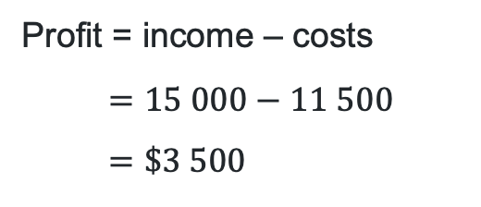
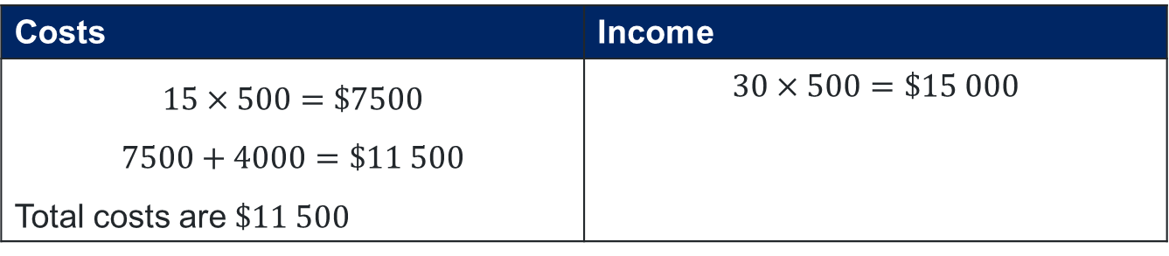
Sole traders (1)
Example 1
A sole trader sells 500 units of a product in a month. The price per unit sold is $30, and the cost to make a unit is $15. In addition to the cost to make the units, the sole trader has ongoing costs (rent, utilities, etc.) amounting to $4,000 for the month. How much would the sole trader earn for that month?
Costs | Income
$$15×500=\$7500$$ $$7500+4000=\$11 500$$ Total costs are $\$11 500$ | $$30×500=\$15 000$$
Why did we multiply these numbers?
How can we tell what is a cost and what is an income?
Profit = income – costs
$$=15 000−11 500 \\ =\$3 500$$
Explain how this finds the earnings for the sole trader.
How else could you calculate the earnings of the sole trader?
Total earnings for the month is $$3 500$

Slide 9
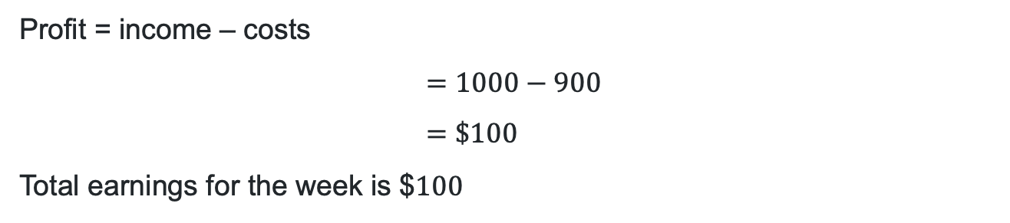
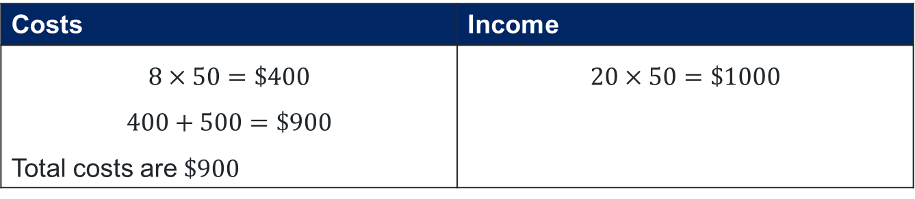
Sole traders (2)
Your turn – Question 1
A sole trader sells 50 units of a product each week. Each unit is sold for $20, and the production cost per unit is $8. The sole trader also has weekly expenses (such as rent, utilities, etc.) totalling $500. What is the sole trader’s earnings for one week?
Costs | Income
$$8×50=\$400$$ $$400+500=\$900$$ Total costs are $\$900$ | $$20×50=\$1000$$
Profit = income – costs
$$=1000−900 \\ =\$100$$
Total earnings for the week is $$100$

Slide 10
References
This presentation contains NSW Curriculum and syllabus content. The NSW Curriculum is developed by the NSW Education Standards Authority. This content is prepared by NESA for and on behalf of the Crown in the right of the State of New South Wales. The material is protected by Crown copyright.
Please refer to the NESA Copyright Disclaimer for more information https://educationstandards.nsw.edu.au/wps/portal/nesa/mini-footer/copyright.
NESA holds the only official and up-to-date versions of the NSW Curriculum and syllabus documents. Please visit the NSW Education Standards Authority (NESA) website https://educationstandards.nsw.edu.au/wps/portal/nesa/home and the NSW Curriculum website https://curriculum.nsw.edu.au.
Mathematics Standard Stage 6 Syllabus © NSW Education Standards Authority (NESA) for and on behalf of the Crown in right of the State of New South Wales, 2024.

Slide 11
Copyright
© State of New South Wales (Department of Education), 2025
The copyright material published in this resource is subject to the Copyright Act 1968 (Cth) and is owned by the NSW Department of Education or, where indicated, by a party other than the NSW Department of Education (third-party material).
Copyright material available in this resource and owned by the NSW Department of Education is licensed under a Creative Commons Attribution 4.0 International (CC BY 4.0) license.
This license allows you to share and adapt the material for any purpose, even commercially.
Attribution should be given to © State of New South Wales (Department of Education), 2025.
Material in this resource not available under a Creative Commons license:
the NSW Department of Education logo, other logos and trademark-protected material
Material owned by a third party that has been reproduced with permission. You will need to obtain permission from the third party to reuse its material.
Links to third-party material and websites
Please note that the provided (reading/viewing material/list/links/texts) are a suggestion only and implies no endorsement, by the New South Wales Department of Education, of any author, publisher, or book title. School principals and teachers are best placed to assess the suitability of resources that would complement the curriculum and reflect the needs and interests of their students.
If you use the links provided in this document to access a third-party’s website, you acknowledge that the terms of use, including licence terms set out on the third-party’s website apply to the use which may be made of the materials on that third-party website or where permitted by the Copyright Act 1968 (Cth). The department accepts no responsibility for content on third-party websites.

