Slide 1

Commission
Mathematics Standard – Stage 6 (Year 11)
Show me the money

Slide 2
Learning intentions and success criteria
Learning intentions
To know how you earn money using commission, including sliding scale commission.
To understand how to use a spreadsheet to model commission.
Success criteria
I can calculate the percentage of a quantity.
I can define commission, including sliding scale commission.
I can use a spreadsheet to calculate commission, including sliding scale commission.
I can solve problems involving sliding scale commission.
Notes:
Notes for teachers:
Learning intentions and success criteria are best co-constructed with students. Adapt the learning intention as required and add matching success criteria.
For more information See ⁠AITSL or the NSW Department of Education explicit teaching strategies, ⁠Sharing learning intentions and ⁠Sharing success criteria
LISC is not necessarily presented at the beginning of the lesson. Teacher needs to consider most effectual time to introduce
LISC should be revisited during the lesson to support students' evaluation of their learning

Slide 3
Activating prior knowledge

Slide 4

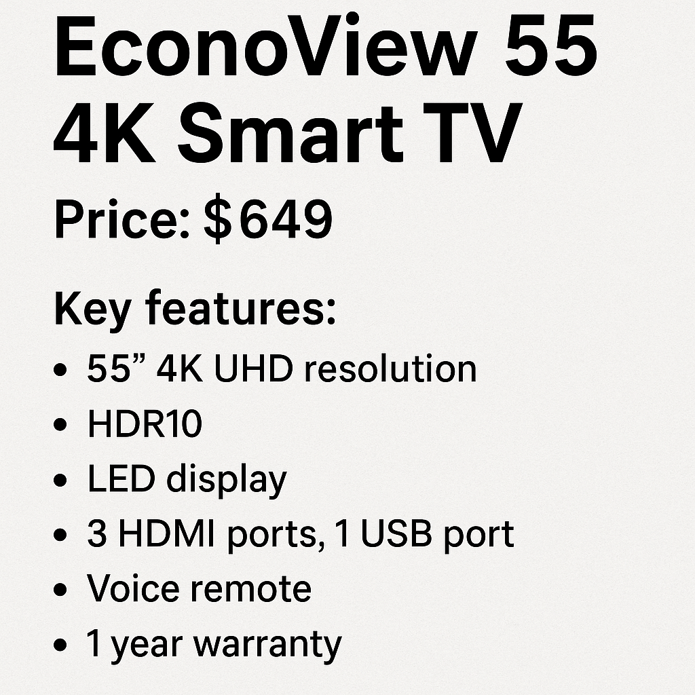
Commission (1)
Which one will you promote?

Slide 5
Commission (2)
How much did you earn?
Given you usually earn $100 as a base wage per day and 3% commission on sales, if you sold the VistaEdge TV for $849 what would be the total amount you earned that day?

Slide 6
Connecting learning

Slide 7
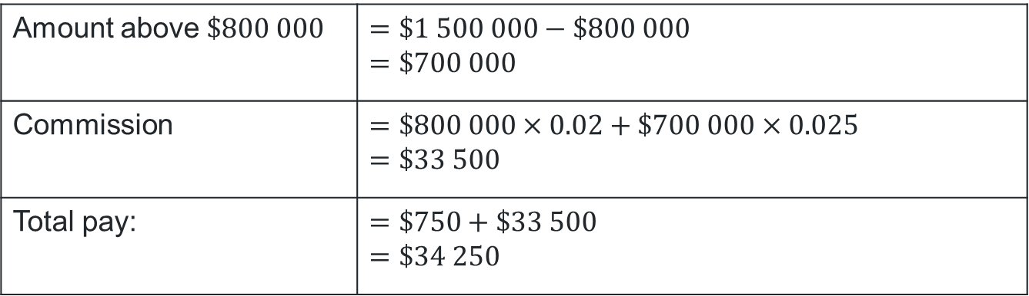
Commission (3)
Scenario
A real estate agent earns a base wage of $750 per week. They also receive 2% commission on the first $800 000 of a property’s sale price and 2.5% on any amount over $800 000. Last week, they sold a house for $1 500 000. Calculate their total earnings for the week.
Amount above $\$800 000$ | $$=\$1 500 000−\$800 000 \\ =\$700 000$$
Commission | $$=\$800 000×0.02+\$700 000×0.025$$ $$=\$33 500$$
Total pay: | $$=\$750+\$33 500$$ $$=\$34 250$$

Slide 8
Sliding scale commission
Description
A sliding scale commission is a payment structure where the commission rate changes based on the total sales value or the level of performance achieved. It can either be a decreasing or increasing sliding scale.
Decreasing:
$800 000 | any amount above $800 000
2% of $800 000
1.5% of amounts above $800 000
Increasing:
$10 000 | $10 000 | any amount above $20 000
3% of $10 000
4% of $10 000
6% of amounts above $20 000

Slide 9
Releasing responsibility

Slide 10
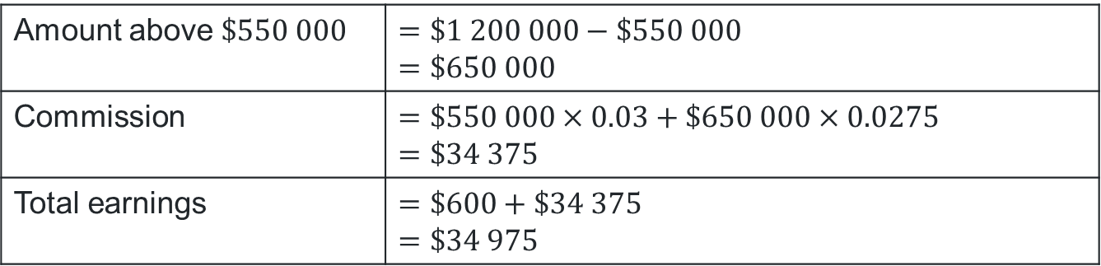
Commission (4)
Worked example
A real estate agent earns a base wage of $600 per week. They receive 3% commission on the first $550 000 of a property sale and 2.75% commission on any amount above $550 000.
Last week the agent sold a house for $1 200 000. Calculate the agent’s total earnings for the week.
Why do we subtract $550,000 from the sale price?
Amount above $\$550 000$ | $$=\$1 200 000−\$550 000$$ $$=\$650 000$$
Commission | $$=\$550 000×0.03+\$650 000×0.0275$$ $$=\$34 375$$
Total earnings | $$=\$600+\$34 375$$ $$=\$34 975$$
Why add $600 to the commission?
What do the decimals represent? Could they have been represented differently?

Slide 11
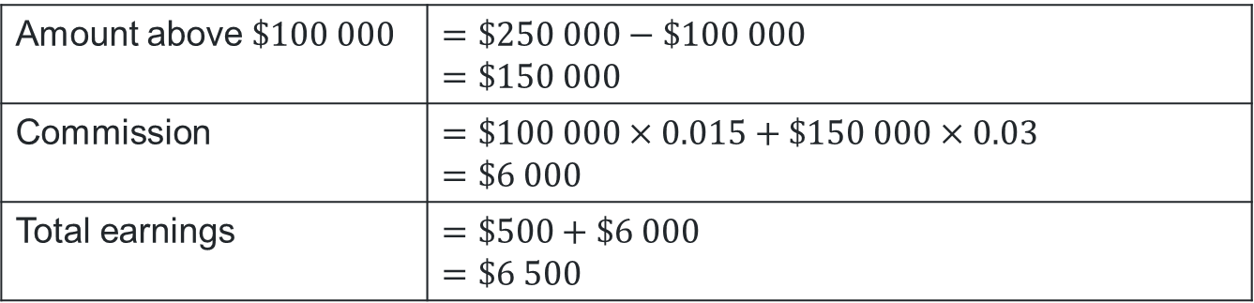
Commission (5)
Your turn
A luxury car salesperson earns a base wage of $500 per week. In addition, they receive 1.5% commission on the first $100 000 of each car sold, and 3% commission on any amount above $100 000. Last week, they sold a car for $250 000. Calculate their total earnings for the week.
Amount above $\$100 000$ | $$=\$250 000−\$100 000$$ $$=\$150 000$$
Commission | $$=\$100 000×0.015+\$150 000×0.03$$ $$=\$6 000$$
Total earnings | $$=\$500+\$6 000$$ $$=\$6 500$$

Slide 12
Independent practice

Slide 13

Approaching questions scaffold

Slide 14
Commission (6)
HSC-style question 1
A cosmetics company is considering partnering with Tahlia, a social medial influencer who promotes cosmetics using affiliate links. Two payment plans are being evaluated:
Option 1: Tahlia would be paid:
10% commission on the first $15 000 of affiliate sales each month,
8% commission on any affiliate sales above $15 000.
Option 2: Tahlia would receive a weekly sponsorship fee of $420, plus 4% commission on all monthly affiliate sales.
Based on Tahlia’s audience analytics, it is estimated that around 95 customers per month will make a purchase through her affiliate links, with an average purchase value of $190.
Which option should the company offer Tahlia?

Slide 15


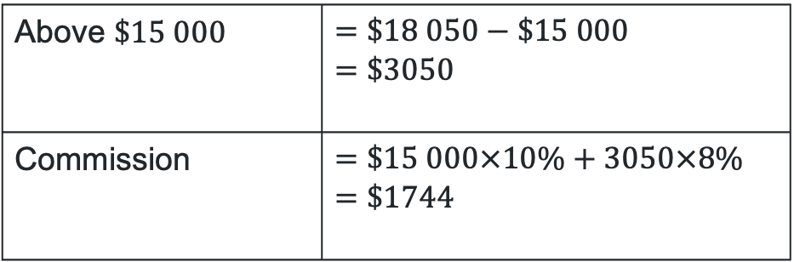
Commission (7)
HSC-style question 1 solution
Sales: $\$190×95=\$18 050 \text{per} \text{month}$
Option 1:
Option 2:
Above $\$15 000$ | $$=\$18 050−\$15 000 \\ =\$3050$$
Commission | $$=\$15 000×10\%+3050×8\% \\ =\$1744$$
Monthly sponsorship | $$=\frac{\$420×52}{12} \\ =\$1820$$
Commission | $$=\$18 050×4\% \\ =\$722$$
Total earnings | $$=\$1820+\$722 \\ =\$2542$$
The company should offer Tahlia option 1.

Slide 16
Commission (8)
HSC-style question 2
At Pinnacle Properties, real estate agents are paid a base wage and commission on their monthly property sales.
The commission is calculated using the following sliding scale:
1.8% on sales up to and including $500 000
2.5% on any sales above $500 000
Jackson’s total earnings for the month were $19 500, which included his base wage of $500 and the commission he earned from his monthly sales.
Calculate the value of Jackson’s monthly sales.

Slide 17

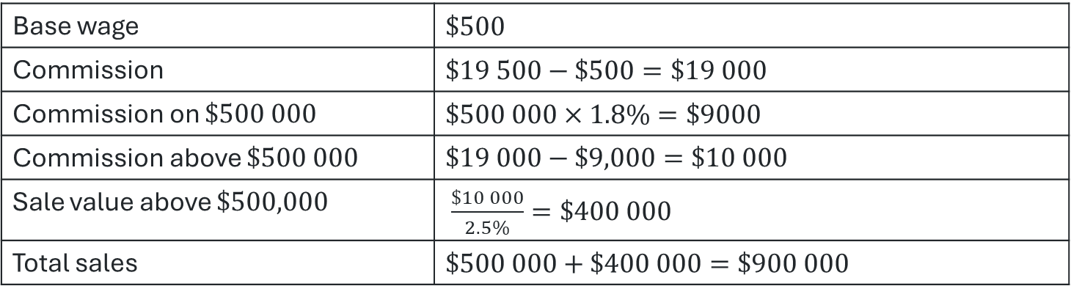
Commission (9)
HSC-style question 2 solution
Commission structure:
$1.8\%$ on sales up to and including $\$500 000$
$2.5\%$ on any sales above $\$500 000$
Total earning: $\$19 500$
Base wage | $$\$500$$
Commission | $$\$19 500−\$500=\$19 000$$
Commission on $\$500 000$ | $$\$500 000×1.8\%=\$9000$$
Commission above $\$500 000$ | $$\$19 000−\$9,000=\$10 000$$
Sale value above $\$500,000$ | $\frac{\$10 000}{2.5\%}=\$400 000$
Total sales | $$\$500 000+\$400 000=\$900 000$$

Slide 18
References
This presentation contains NSW Curriculum and syllabus content. The NSW Curriculum is developed by the NSW Education Standards Authority. This content is prepared by NESA for and on behalf of the Crown in the right of the State of New South Wales. The material is protected by Crown copyright.
Please refer to the NESA Copyright Disclaimer for more information https://educationstandards.nsw.edu.au/wps/portal/nesa/mini-footer/copyright.
NESA holds the only official and up-to-date versions of the NSW Curriculum and syllabus documents. Please visit the NSW Education Standards Authority (NESA) website https://educationstandards.nsw.edu.au/wps/portal/nesa/home and the NSW Curriculum website https://curriculum.nsw.edu.au.
Mathematics Standard Stage 6 Syllabus © NSW Education Standards Authority (NESA) for and on behalf of the Crown in right of the State of New South Wales, 2024.

Slide 19
Copyright
© State of New South Wales (Department of Education), 2025
The copyright material published in this resource is subject to the Copyright Act 1968 (Cth) and is owned by the NSW Department of Education or, where indicated, by a party other than the NSW Department of Education (third-party material).
Copyright material available in this resource and owned by the NSW Department of Education is licensed under a Creative Commons Attribution 4.0 International (CC BY 4.0) license.
This license allows you to share and adapt the material for any purpose, even commercially.
Attribution should be given to © State of New South Wales (Department of Education), 2025.
Material in this resource not available under a Creative Commons license:
the NSW Department of Education logo, other logos and trademark-protected material
Material owned by a third party that has been reproduced with permission. You will need to obtain permission from the third party to reuse its material.
Links to third-party material and websites
Please note that the provided (reading/viewing material/list/links/texts) are a suggestion only and implies no endorsement, by the New South Wales Department of Education, of any author, publisher, or book title. School principals and teachers are best placed to assess the suitability of resources that would complement the curriculum and reflect the needs and interests of their students.
If you use the links provided in this document to access a third-party’s website, you acknowledge that the terms of use, including licence terms set out on the third-party’s website apply to the use which may be made of the materials on that third-party website or where permitted by the Copyright Act 1968 (Cth). The department accepts no responsibility for content on third-party websites.

