Slide 1

Leave loading
Mathematics Standard – Stage 6 (Year 11)
Show me the money

Slide 2
Learning intentions and success criteria
Learning intentions
To be able to solve problems that involve leave loading.
Success criteria
I can explain what leave loading is and why certain workers are entitled to it.
I can calculate the leave loading and total pay for a period of leave.
I can explain how to modify the calculation to find leave loading when given different time periods.
Notes:
Notes for teachers:
Learning intentions and success criteria are best co-constructed with students. Adapt the learning intention as required and add matching success criteria.
For more information See ⁠AITSL or the NSW Department of Education explicit teaching strategies, ⁠Sharing learning intentions and ⁠Sharing success criteria
LISC is not necessarily presented at the beginning of the lesson. Teacher needs to consider most effectual time to introduce
LISC should be revisited during the lesson to support students' evaluation of their learning

Slide 3
Retrieval practice

Slide 4
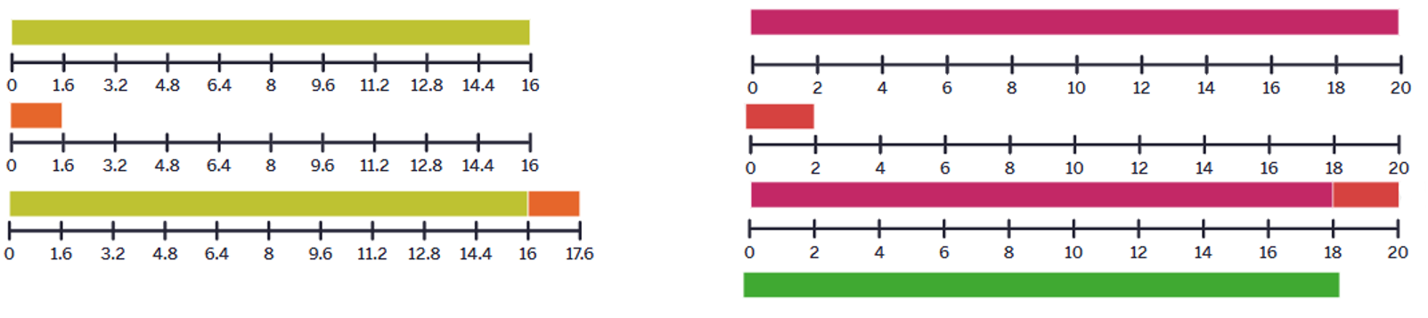
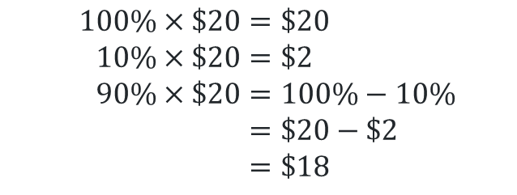
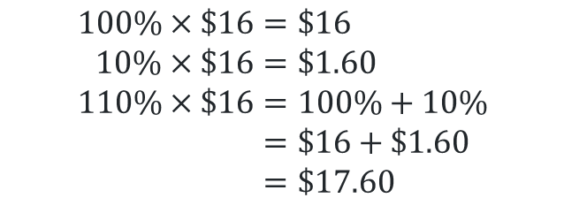
Scenario
Would you rather
110% of $16 or 90% of $20.
$$100\%×\$16=\$16 \\ 10\%×\$16=\$1.60 \\ 110\%×\$16=100\%+10\% \\ =\$16+\$1.60 \\ =\$17.60$$
$$100\%×\$20=\$20 \\ 10\%×\$20=\$2 \\ 90\%×\$20=100\%−10\% \\ =\$20−\$2 \\ =\$18$$

Slide 5
Activating prior knowledge

Slide 6
Leave loading (1)
Definition
Leave loading is an extra payment given in addition to annual leave pay.
It is also known as holiday loading or annual leave loading.
Depending on your award or agreement, leave loading is usually 17.5% extra pay on top of your annual leave pay.

Slide 7
Connecting learning

Slide 8
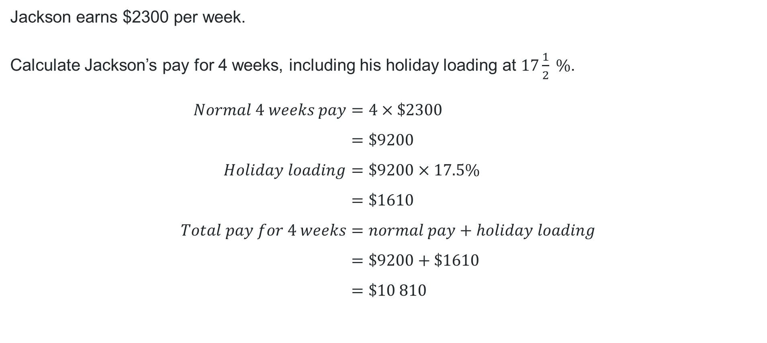
Leave loading (2)
Example 1 – self-explanation prompts
Jackson earns $2300 per week.
Calculate Jackson’s pay for 4 weeks, including his holiday loading at $17\frac{1}{2} \%$.
$$Normal 4 weeks pay=4×\$2300 \\ =\$9200 \\ Holiday loading=\$9200×17.5\% \\ =\$1610 \\ Total pay for 4 weeks=normal pay+holiday loading \\ =\$9200+\$1610 \\ =\$10 810$$
Why are we multiplying this amount by 4?
How could this be calculated differently?
Why are we adding these 2 amounts together?

Slide 9
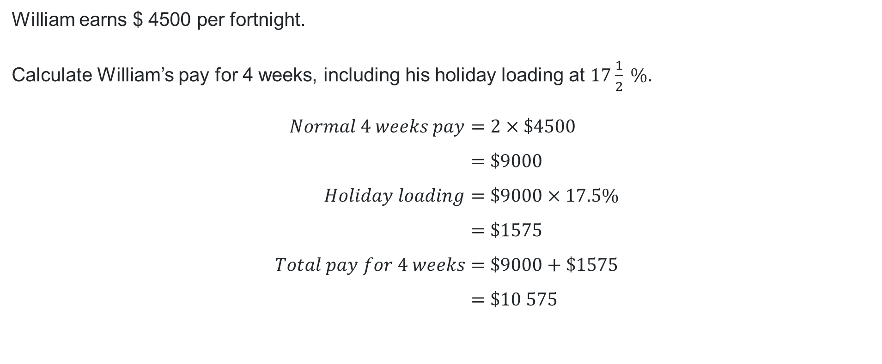
Leave loading (3)
Your turn-solution
William earns $ 4500 per fortnight.
Calculate William’s pay for 4 weeks, including his holiday loading at $17\frac{1}{2} \%$.
$$Normal 4 weeks pay=2×\$4500 \\ =\$9000 \\ Holiday loading=\$9000×17.5\% \\ =\$1575 \\ Total pay for 4 weeks=\$9000+\$1575 \\ =\$10 575$$

Slide 10

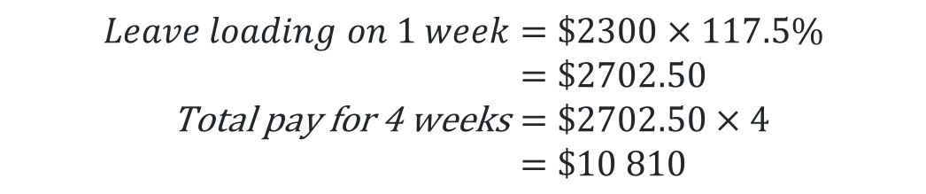
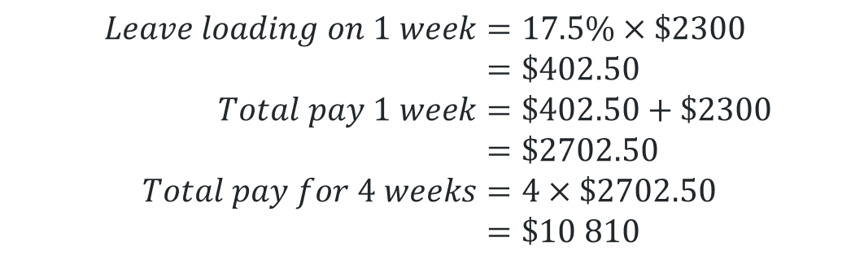
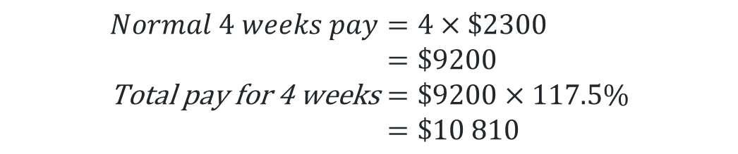
Leave loading (4)
Example – alternate solutions
Jackson earns $2300 per week.
Calculate Jackson’s pay for 4 weeks, including his holiday loading at $17\frac{1}{2} \%$.
$$Normal 4 weeks pay=4×\$2300 \\ =\$9200 \\ \text{Total} \text{pay} \text{for}\text{ 4 }\text{weeks}=\$9200×117.5\% \\ =\$10 810$$
$$Leave loading on 1 week=17.5\%×\$2300 \\ =\$402.50 \\ Total pay 1 week=\$402.50+\$2300 \\ =\$2702.50 \\ Total pay for 4 weeks=4×\$2702.50 \\ =\$10 810$$
$$Leave loading on 1 week=\$2300×117.5\% \\ =\$2702.50 \\ \text{Total} \text{pay} \text{for}\text{ 4 }\text{weeks}=\$2702.50×4 \\ =\$10 810$$

Slide 11
Independent practice

Slide 12

Approaching questions

Slide 13
References
This presentation contains NSW Curriculum and syllabus content. The NSW Curriculum is developed by the NSW Education Standards Authority. This content is prepared by NESA for and on behalf of the Crown in the right of the State of New South Wales. The material is protected by Crown copyright.
Please refer to the NESA Copyright Disclaimer for more information https://educationstandards.nsw.edu.au/wps/portal/nesa/mini-footer/copyright.
NESA holds the only official and up-to-date versions of the NSW Curriculum and syllabus documents. Please visit the NSW Education Standards Authority (NESA) website https://educationstandards.nsw.edu.au/wps/portal/nesa/home and the NSW Curriculum website https://curriculum.nsw.edu.au.
Mathematics Standard Stage 6 Syllabus © NSW Education Standards Authority (NESA) for and on behalf of the Crown in right of the State of New South Wales, 2024.

Slide 14
Copyright
© State of New South Wales (Department of Education), 2025
The copyright material published in this resource is subject to the Copyright Act 1968 (Cth) and is owned by the NSW Department of Education or, where indicated, by a party other than the NSW Department of Education (third-party material).
Copyright material available in this resource and owned by the NSW Department of Education is licensed under a Creative Commons Attribution 4.0 International (CC BY 4.0) license.
This license allows you to share and adapt the material for any purpose, even commercially.
Attribution should be given to © State of New South Wales (Department of Education), 2025.
Material in this resource not available under a Creative Commons license:
the NSW Department of Education logo, other logos and trademark-protected material
Material owned by a third party that has been reproduced with permission. You will need to obtain permission from the third party to reuse its material.
Links to third-party material and websites
Please note that the provided (reading/viewing material/list/links/texts) are a suggestion only and implies no endorsement, by the New South Wales Department of Education, of any author, publisher, or book title. School principals and teachers are best placed to assess the suitability of resources that would complement the curriculum and reflect the needs and interests of their students.
If you use the links provided in this document to access a third-party’s website, you acknowledge that the terms of use, including licence terms set out on the third-party’s website apply to the use which may be made of the materials on that third-party website or where permitted by the Copyright Act 1968 (Cth). The department accepts no responsibility for content on third-party websites.

