Slide 1

Finding and using the constant of variation
Mathematics Standard – Stage 6 (Year 11)
Show me the money

Slide 2
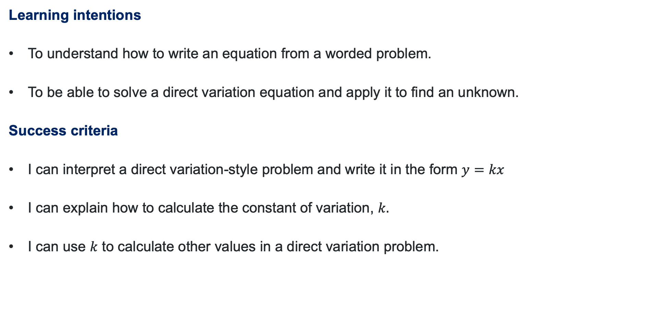
Learning intentions and success criteria
Learning intentions
To understand how to write an equation from a worded problem.
To be able to solve a direct variation equation and apply it to find an unknown.
Success criteria
I can interpret a direct variation-style problem and write it in the form $y=kx$
I can explain how to calculate the constant of variation, $k.$
I can use $k$ to calculate other values in a direct variation problem.
Notes:
Notes for teachers:
Learning intentions and success criteria are best co-constructed with students. Adapt the learning intention as required and add matching success criteria.
For more information See ⁠AITSL or the NSW Department of Education explicit teaching strategies, ⁠Sharing learning intentions and ⁠Sharing success criteria
LISC is not necessarily presented at the beginning of the lesson. Teacher needs to consider most effectual time to introduce
LISC should be revisited during the lesson to support students' evaluation of their learning

Slide 3
Activating prior knowledge

Slide 4
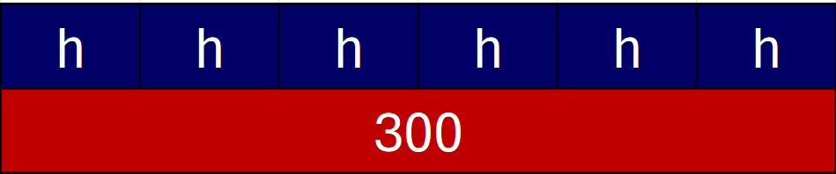
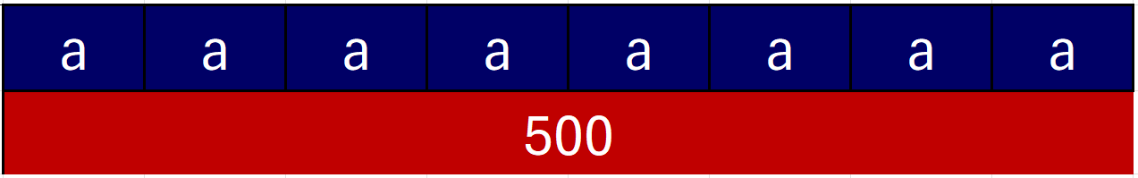
Activating prior knowledge (1)
Earning money questions
Daniel earns $300 for a 6-hour shift. Calculate his hourly wage.
Brock has earned $500 for producing 8 pieces of artwork. Calculate how much he earned for each artwork.
Courtney has earned $25 000 for 100 000 streams of her song. How much does she earn for each stream?

Slide 5
Activating prior knowledge (2)
General questions
1. A group of 4 removalists remove 200 boxes from a warehouse. On average, how many boxes did each removalist move?
2. Hayley used 36 eggs to make 12 cakes. How many eggs did each cake require?
3. Emma burned 250 kilojoules after completing some high intensity exercise for 10 minutes. How many kilojoules did Emma burn in 1 minute?

Slide 6
Connecting learning

Slide 7
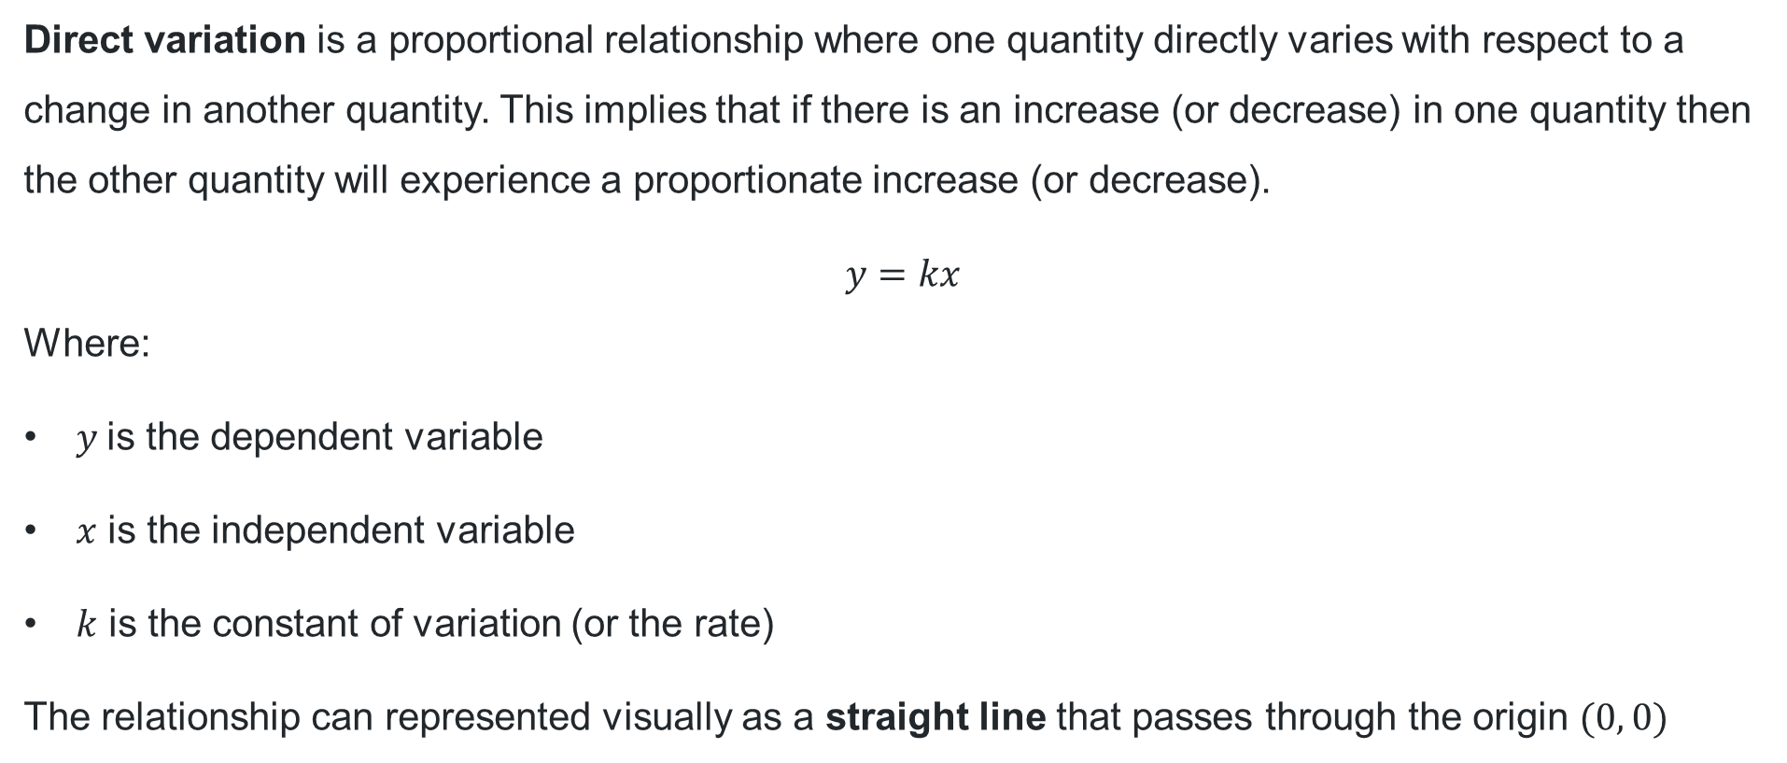
Direct variation (1)
Notes
Direct variation is a proportional relationship where one quantity directly varies with respect to a change in another quantity. This implies that if there is an increase (or decrease) in one quantity then the other quantity will experience a proportionate increase (or decrease).
$$y=kx$$
Where:
$y$is the dependent variable
$x$ is the independent variable
$k$ is the constant of variation (or the rate)
The relationship can represented visually as a straight line that passes through the origin $(0, 0)$

Slide 8


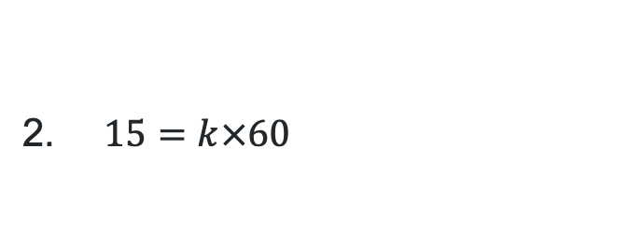
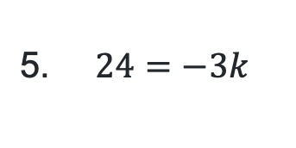


Direct variation (2)
Direct variation equations
Identify if the following equations are in the form $y=kx$:
$80= 20k$
$25=4k^{2}$
$15=k×60$
$24=−3k$
$27=9+k$

Slide 9
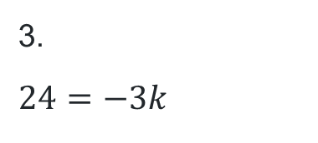
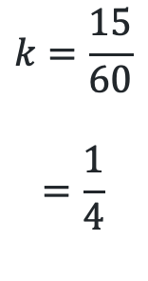
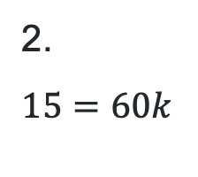
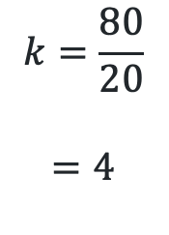
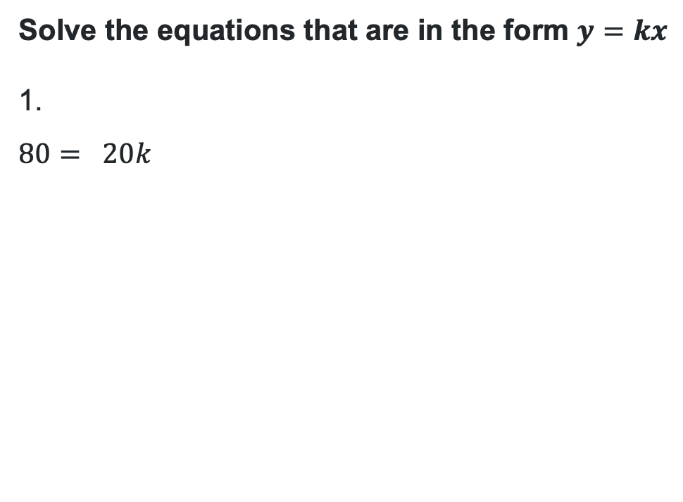
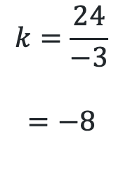
Direct variation (3)
Finding $k$
Solve the equations that are in the form $y=kx$
$$80= 20k$$
$$15=60k$$
$$24=−3k$$
$$k=\frac{80}{20}$$
$$=4$$
$$k=\frac{15}{60}$$
$$=\frac{1}{4}$$
$$k=\frac{24}{−3}$$
$$=−8$$

Slide 10
Releasing responsibility

Slide 11

Approaching questions scaffold

Slide 12



Finding $k$ in a HSC question (1)
Example 1
The distance travelled by a car at a constant speed varies directly with the time driven. A car travels 180 km in 3 hours.
Find the constant of variation ($k$) and write an equation to represent this relationship.
What are the 4 key phrases or information in this question?
What are the independent and dependent variables? Where do they go in the equation $y=kx$?
How do you find the value for $k$ to write the equation?

Slide 13
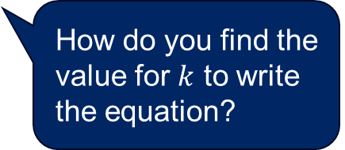
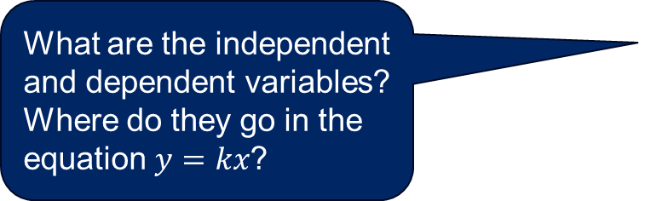

Finding $k$ in a HSC question (2)
Example 1 – solution
The distance travelled by a car at a constant speed varies directly with the time driven. A car travels 180 km in 3 hours.
Find the constant of variation (k) and write an equation to represent this relationship.
What are the independent and dependent variables? Where do they go in the equation $y=kx$?
$$d=kt \\ 180=k×3 \\ \frac{180}{3}=k \\ k=60$$
Therefore, the constant of variation ($k$) is 60. Hence the car is travelling at a constant speed of 60 km/h.
The equation to represent this relationship would be $d=60t$.
How do you find the value for $k$ to write the equation?

Slide 14
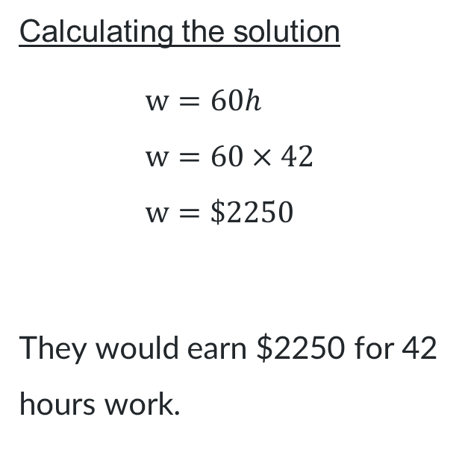
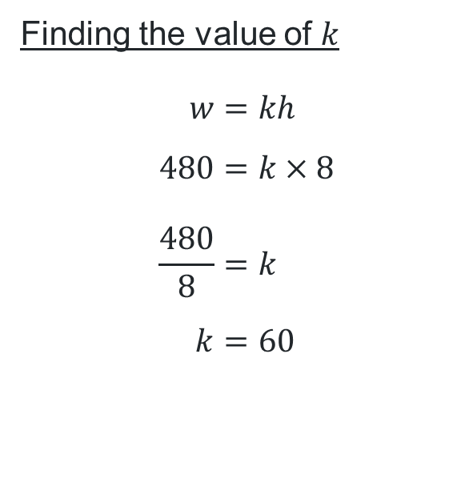
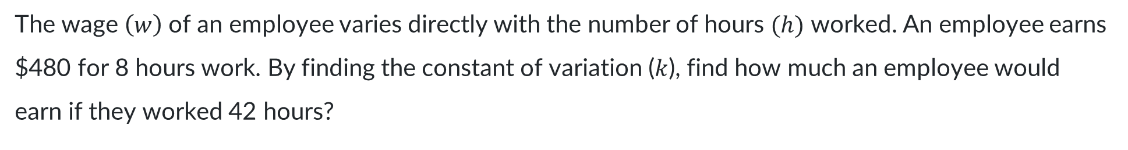
Using $k$ (1)
Worked example
The wage $\left(w\right)$of an employee varies directly with the number of hours $(h)$ worked. An employee earns $480 for 8 hours work. By finding the constant of variation ($k$), find how much an employee would earn if they worked 42 hours?
Finding the value of $k$
$$w=kh \\ 480=k×8 \\ \frac{480}{8}=k \\ k=60$$
Calculating the solution
$$w=60h \\ w=60×42 \\ w=\$2250$$
They would earn $2250 for 42 hours work.
How do we know this is the correct equation to represent the relationship?
What words in the question tell me to set up this equation?
Why has the 42 been substituted here?

Slide 15

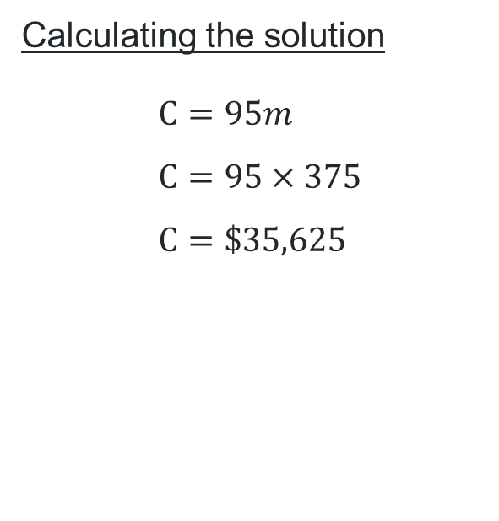
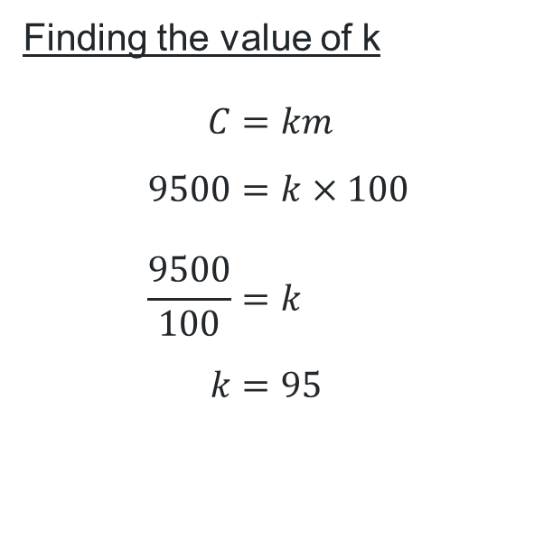
Using $k$ (2)
Your turn
The cost of gold (C) varies directly with its mass (m). A $100g$bar of gold cost $\$9500$. How much would a $375g$ bar of gold cost?
Finding the value of k
$$C=km \\ 9500=k×100 \\ \frac{9500}{100}=k \\ k=95$$
Calculating the solution
$$C=95m \\ C=95×375 \\ C=\$35,625$$

Slide 16
References
This presentation contains NSW Curriculum and syllabus content. The NSW Curriculum is developed by the NSW Education Standards Authority. This content is prepared by NESA for and on behalf of the Crown in the right of the State of New South Wales. The material is protected by Crown copyright.
Please refer to the NESA Copyright Disclaimer for more information https://educationstandards.nsw.edu.au/wps/portal/nesa/mini-footer/copyright.
NESA holds the only official and up-to-date versions of the NSW Curriculum and syllabus documents. Please visit the NSW Education Standards Authority (NESA) website https://educationstandards.nsw.edu.au/wps/portal/nesa/home and the NSW Curriculum website https://curriculum.nsw.edu.au.
Mathematics Standard Stage 6 Syllabus © NSW Education Standards Authority (NESA) for and on behalf of the Crown in right of the State of New South Wales, 2024.

Slide 17
Copyright
© State of New South Wales (Department of Education), 2025
The copyright material published in this resource is subject to the Copyright Act 1968 (Cth) and is owned by the NSW Department of Education or, where indicated, by a party other than the NSW Department of Education (third-party material).
Copyright material available in this resource and owned by the NSW Department of Education is licensed under a Creative Commons Attribution 4.0 International (CC BY 4.0) license.
This license allows you to share and adapt the material for any purpose, even commercially.
Attribution should be given to © State of New South Wales (Department of Education), 2025.
Material in this resource not available under a Creative Commons license:
the NSW Department of Education logo, other logos and trademark-protected material
Material owned by a third party that has been reproduced with permission. You will need to obtain permission from the third party to reuse its material.
Links to third-party material and websites
Please note that the provided (reading/viewing material/list/links/texts) are a suggestion only and implies no endorsement, by the New South Wales Department of Education, of any author, publisher, or book title. School principals and teachers are best placed to assess the suitability of resources that would complement the curriculum and reflect the needs and interests of their students.
If you use the links provided in this document to access a third-party’s website, you acknowledge that the terms of use, including licence terms set out on the third-party’s website apply to the use which may be made of the materials on that third-party website or where permitted by the Copyright Act 1968 (Cth). The department accepts no responsibility for content on third-party websites.

