Slide 1

Penalty rates
Mathematics Standard – Stage 6 (Year 11)
Show me the money

Slide 2
Learning intentions and success criteria
Learning intentions
To understand the concept of a penalty rate.
To be able to calculate the amount earned considering penalty rates.
Success criteria
I can define a penalty rate.
I can calculate the rate of pay given penalty rates.
I can explain the influence a penalty rate has on the total amount earned.
I can solve problems that include normal pay rates and penalty rates.
Notes:
Notes for teachers:
Learning intentions and success criteria are best co-constructed with students. Adapt the learning intention as required and add matching success criteria.
For more information See ⁠AITSL or the NSW Department of Education explicit teaching strategies, ⁠Sharing learning intentions and ⁠Sharing success criteria
LISC is not necessarily presented at the beginning of the lesson. Teacher needs to consider most effectual time to introduce
LISC should be revisited during the lesson to support students' evaluation of their learning

Slide 3
Retrieval practice

Slide 4
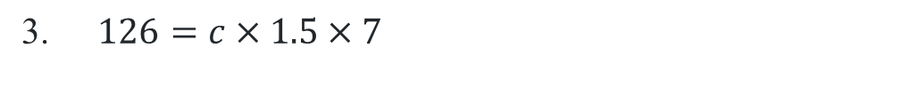
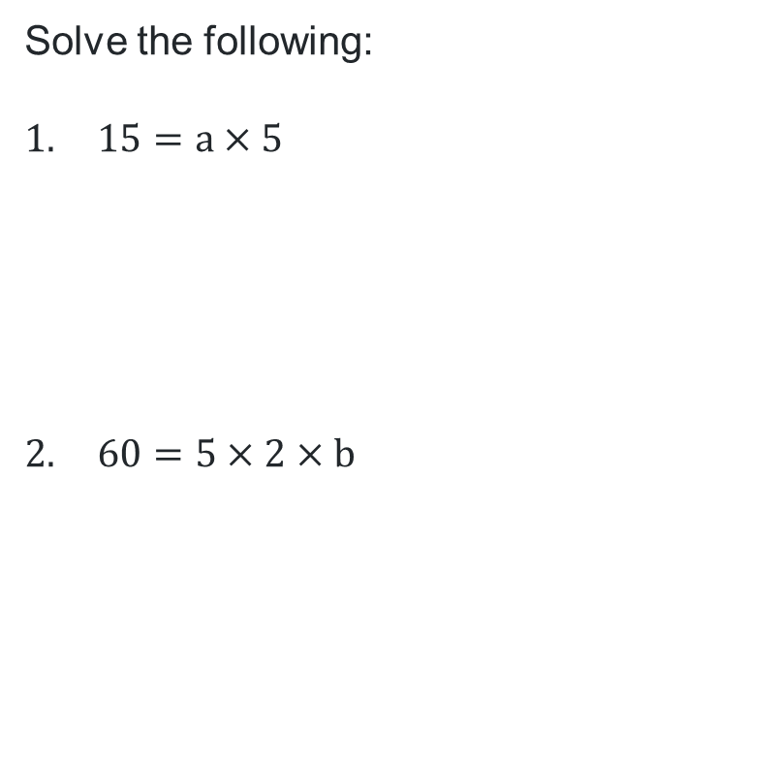
Penalty rates (1)
Equations review
Solve the following:
$15=a×5$
$60=5×2×b$
$126=c×1.5×7$

Slide 5

Penalty rates (2)
Question 1
$$15=a×5$$
$$\frac{15}{5}=a \\ 3=a$$
a
a
a
a
a
15
a
a
a
a
a
3
3
3
3
3

Slide 6

Penalty rates (3)
Question 2
$$60=5×2×b$$
60 = 10 x b
$$\frac{60}{10}=b$$
b=6
b
b
b
b
b
b
b
b
b
b
60
b
b
b
b
b
b
b
b
b
b
6
6
6
6
6
6
6
6
6
6

Slide 7

Penalty rates (4)
Question 3
$$126=c×1.5×7$$
126 = c $×$ 10.5
$$\frac{126}{10.5}=c \\ 12=c$$

Slide 8
Activating prior knowledge

Slide 9
Penalty rates (5)
Card matching activity solution
Overtime
Extra hours you work after your normal work hours. Usually, you get paid more for overtime.
Double time
A pay rate where you earn
2 times your normal hourly rate.
Penalty rates
Higher pay you get when working at special times, like weekends, public holidays, or late at night.
Allowances
Extra money added to your pay to cover special costs, like using your own car for work, buying uniforms, or working in dangerous places.
Time-and-a-half
A pay rate where you earn
1.5 times your normal hourly rate.
Hourly rate
The amount of money you earn for each hour you work.

Slide 10
Releasing responsibility

Slide 11
Penalty rates (6)
Worked example
Elle’s employer has said that they will pay her at time-and-a-half for working 4 hours on Sunday. After completing her shift, Elle is paid $180. Calculate Elle’s normal hourly rate.

Slide 12

Penalty rates (7)
Worked example – solution and prompts
Elle’s employer has said that they will pay her at time-and-a-half for working 4 hours on Sunday. After completing her shift, Elle is paid $180. Calculate Elle’s normal hourly rate.
Why do we have 1.5?
Why have we substituted these values?
Elle′s pay $=$hourly rate$×1.5×$hours worked
$$180=r×1.5×4$$
$$180=r×6$$
What would change if Elle was to earn a penalty rate of double time?
How did we get this value?
$$r=\frac{180}{6} \\ r=30$$
Elle earns $30 per hour

Slide 13
Penalty rates (8)
HSC-style question
Mark works a 40-hour week and is paid an hourly rate of $37.50. Any overtime hours are paid at
time-and-a-half. In a particular week, Mark worked the regular 40 hours and some overtime hours. In that week, Mark earned $1950.
How many hours of overtime did Mark work in that week?
Hint: work out how much Mark earned for 40 hours of work.

Slide 14
Penalty rates (9)
HSC-style question solution
Mark works a 40-hour week and is paid an hourly rate of $37.50. Any overtime hours are paid at time-and-a-half. In a particular week, Mark worked the regular 40 hours and some overtime hours. In that week, Mark earned $1950.
How many hours of overtime did Mark work in that week?
Total Normal Pay: $40×37.50=\$1500$
Overtime pay: $1950 −1500=\$450$
Overtime rate: $37.5×1.5=\$56.25$
Overtime hours worked: $450÷56.25=8$
Mark worked 8 hours of overtime in the week

Slide 15
References
This presentation contains NSW Curriculum and syllabus content. The NSW Curriculum is developed by the NSW Education Standards Authority. This content is prepared by NESA for and on behalf of the Crown in the right of the State of New South Wales. The material is protected by Crown copyright.
Please refer to the NESA Copyright Disclaimer for more information https://educationstandards.nsw.edu.au/wps/portal/nesa/mini-footer/copyright.
NESA holds the only official and up-to-date versions of the NSW Curriculum and syllabus documents. Please visit the NSW Education Standards Authority (NESA) website https://educationstandards.nsw.edu.au/wps/portal/nesa/home and the NSW Curriculum website https://curriculum.nsw.edu.au.
Mathematics Standard Stage 6 Syllabus © NSW Education Standards Authority (NESA) for and on behalf of the Crown in right of the State of New South Wales, 2024.

Slide 16
Copyright
© State of New South Wales (Department of Education), 2025
The copyright material published in this resource is subject to the Copyright Act 1968 (Cth) and is owned by the NSW Department of Education or, where indicated, by a party other than the NSW Department of Education (third-party material).
Copyright material available in this resource and owned by the NSW Department of Education is licensed under a Creative Commons Attribution 4.0 International (CC BY 4.0) license.
This license allows you to share and adapt the material for any purpose, even commercially.
Attribution should be given to © State of New South Wales (Department of Education), 2025.
Material in this resource not available under a Creative Commons license:
the NSW Department of Education logo, other logos and trademark-protected material
Material owned by a third party that has been reproduced with permission. You will need to obtain permission from the third party to reuse its material.
Links to third-party material and websites
Please note that the provided (reading/viewing material/list/links/texts) are a suggestion only and implies no endorsement, by the New South Wales Department of Education, of any author, publisher, or book title. School principals and teachers are best placed to assess the suitability of resources that would complement the curriculum and reflect the needs and interests of their students.
If you use the links provided in this document to access a third-party’s website, you acknowledge that the terms of use, including licence terms set out on the third-party’s website apply to the use which may be made of the materials on that third-party website or where permitted by the Copyright Act 1968 (Cth). The department accepts no responsibility for content on third-party websites.

