Slide 1

Direct variation
Mathematics Standard – Stage 6 (Year 11)
Show me the money

Slide 2
Learning intentions and success criteria
Learning intentions
To know what direct variation is.
To be able to represent direct variation in a variety of ways.
Success criteria
I can explain what direct variation is.
I can give an example of direct variation.
I can represent direct variation as an equation and a graph.
I can write an equation from a worded problem and solve.
Notes:
Notes for teachers:
Learning intentions and success criteria are best co-constructed with students. Adapt the learning intention as required and add matching success criteria.
For more information See ⁠AITSL or the NSW Department of Education explicit teaching strategies, ⁠Sharing learning intentions and ⁠Sharing success criteria
LISC is not necessarily presented at the beginning of the lesson. Teacher needs to consider most effectual time to introduce
LISC should be revisited during the lesson to support students' evaluation of their learning

Slide 3
Activating prior knowledge

Slide 4
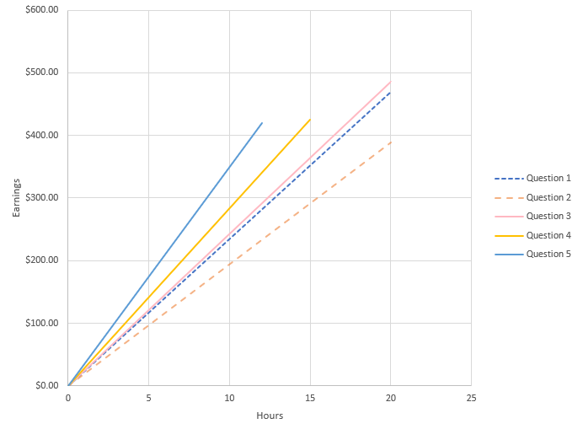
Direct variation (1)
Spreadsheet
Question 1: A retail worker earns $23.50 per hour. They work 4 shifts in a week with each shift being 5 hours long. Use the table of values to show their earnings for the week.
Hourly pay
Hours
0
5
10
15
20
Pay
$0.00
$117.50
$235.00
$352.50
$470.00
Question 2: An 18 year old barista earns $19.45 per hour. Use the table of values to show their earnings over a week where they work 4 hours each day for 5 days per week.
Hourly pay
Hours
0
4
8
12
16
20
Pay
$0.00
$77.80
$155.60
$233.40
$311.20
$389.00
Question 3: The same barista turns 19 and is now paid $24.31 per hour. Use the table of values to show their new earnings over a week if they work the same hours as before.
Hourly pay
$24.31
Hours
0
4
8
12
16
20
Pay
$0.00
$97.24
$194.48
$291.72
$388.96
$486.20
Question 4: A babysitter earns $28.33 per hour and works 3 hours per day, Monday to Friday. Use the table of values to show their earnings over a week.
Hourly pay
$28.33
Hours
0
3
6
9
12
15
Pay
$0.00
$84.99
$169.98
$254.97
$339.96
$424.95
Question 5: A tutor earns $35 per hour and tutors for 2 hours every day for 6 days per week. Use the table of values to show their earnings over the week.
Hourly pay
$35.00
Hours
0
2
4
6
8
10
12
Pay
$0.00
$70.00
$140.00
$210.00
$280.00
$350.00
$420.00

Slide 5
Connecting learning

Slide 6
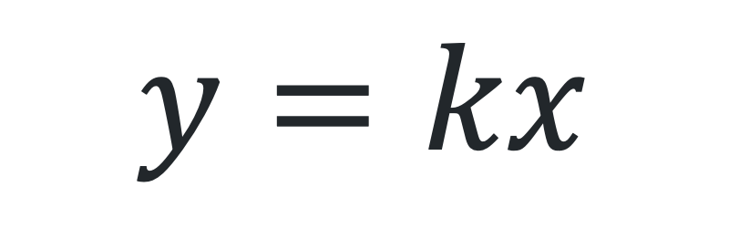
Direct variation (2)
Direct variation equation
Constant of variation
$$y=kx$$
Dependent variable
Independent variable

Slide 7
Direct variation (3)
Definition
Direct variation is a proportional relationship where one quantity directly varies with respect to a change in another quantity. This implies that if there is an increase (or decrease) in one quantity then the other quantity will experience a proportionate increase (or decrease).

Slide 8
Releasing responsibility

Slide 9
Direct variation (4)
Language of direct variation
The amount Josie earns directly varies with the number of hours she works.

Slide 10
Independent practice

Slide 11


Direct variation (5)
HSC style question
Tio knows that one Australian dollar is worth 0.62 euros. John wants to convert his Australian dollars to euros.
Write an equation to represent this scenario.
$$E=0.62d$$
Given Tio has $400 spending money for his holiday, calculate the amount he would have in euros.
$$E=0.62d \\ =0.62×400 \\ =248$$

Slide 12




Approaching questions
Understand
Plan
What is the question asking?
Identify key terms
Determine the focus area
How many marks is it worth?
How can I answer the question?
Draw a visual representation
Use a formula
Identify the steps
Solve
Check
Answer the question
Complete the steps
Perform any necessary calculations
Show all working
How can I check my answer?
Substitute and check
Check for reasonableness
Have I answered the question?

Slide 13
References
This presentation contains NSW Curriculum and syllabus content. The NSW Curriculum is developed by the NSW Education Standards Authority. This content is prepared by NESA for and on behalf of the Crown in the right of the State of New South Wales. The material is protected by Crown copyright.
Please refer to the NESA Copyright Disclaimer for more information https://educationstandards.nsw.edu.au/wps/portal/nesa/mini-footer/copyright.
NESA holds the only official and up-to-date versions of the NSW Curriculum and syllabus documents. Please visit the NSW Education Standards Authority (NESA) website https://educationstandards.nsw.edu.au/wps/portal/nesa/home and the NSW Curriculum website https://curriculum.nsw.edu.au.
Mathematics Standard Stage 6 Syllabus © NSW Education Standards Authority (NESA) for and on behalf of the Crown in right of the State of New South Wales, 2024.

Slide 14
Copyright
© State of New South Wales (Department of Education), 2025
The copyright material published in this resource is subject to the Copyright Act 1968 (Cth) and is owned by the NSW Department of Education or, where indicated, by a party other than the NSW Department of Education (third-party material).
Copyright material available in this resource and owned by the NSW Department of Education is licensed under a Creative Commons Attribution 4.0 International (CC BY 4.0) license.
This license allows you to share and adapt the material for any purpose, even commercially.
Attribution should be given to © State of New South Wales (Department of Education), 2025.
Material in this resource not available under a Creative Commons license:
the NSW Department of Education logo, other logos and trademark-protected material
Material owned by a third party that has been reproduced with permission. You will need to obtain permission from the third party to reuse its material.
Links to third-party material and websites
Please note that the provided (reading/viewing material/list/links/texts) are a suggestion only and implies no endorsement, by the New South Wales Department of Education, of any author, publisher, or book title. School principals and teachers are best placed to assess the suitability of resources that would complement the curriculum and reflect the needs and interests of their students.
If you use the links provided in this document to access a third-party’s website, you acknowledge that the terms of use, including licence terms set out on the third-party’s website apply to the use which may be made of the materials on that third-party website or where permitted by the Copyright Act 1968 (Cth). The department accepts no responsibility for content on third-party websites.

