Slide 1
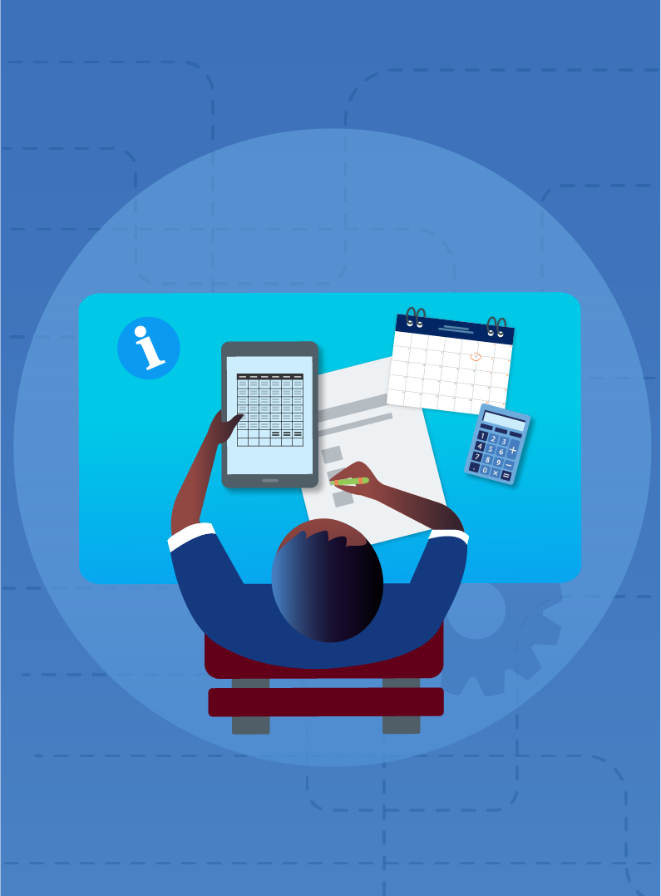
Spreadsheets through wages
Mathematics Standard – Stage 6 (Year 11)
Show me the money

Slide 2
Learning intentions and success criteria
Learning intentions
To understand how to calculate the amount earned through wages.
To be able to use a spreadsheet to model a relationship.
Success criteria
I can calculate the amount earned for a specific time period.
I can input data into a spreadsheet.
I can explain how to populate a table of values using cell references.
I can interpret a graph that represents earnings over time.
Notes:
Notes for teachers:
Learning intentions and success criteria are best co-constructed with students. Adapt the learning intention as required and add matching success criteria.
For more information See ⁠AITSL or the NSW Department of Education explicit teaching strategies, ⁠Sharing learning intentions and ⁠Sharing success criteria
LISC is not necessarily presented at the beginning of the lesson. Teacher needs to consider most effectual time to introduce
LISC should be revisited during the lesson to support students' evaluation of their learning

Slide 3
Releasing responsibility

Slide 4
Checking for understanding
Question 1
In a spreadsheet, the hourly rate is entered in cell B2 and the number of hours worked is in cell C2. Which formula in cell D2 correctly calculates the gross wage?
=B2+C2
=B2*C2
=B2/C2
=C2-B2

Slide 5
Checking for understanding (2)
Question 2
In a spreadsheet, a student wants to calculate the pay for different hours worked using a fixed hourly rate stored in cell A1. What is the correct formula to ensure the hourly rate remains constant when dragging the formula across?
=A1*B2
=$A1*B2
=A$1*B2
=$A$1*B2

Slide 6
Checking for understanding (3)
Question 3
A student creates a spreadsheet that graphs weekly earnings against hours worked at a constant hourly rate. The graph produced is:
A vertical line
A straight line through the y axis
A straight line through the origin
A horizontal line

Slide 7

Checking for understanding (4)
Question 4
A student creates a spreadsheet that graphs weekly earnings against hours worked at a constant hourly rate. Which variable is the independent variable and appears on the $x−$axis?
Hours worked

Slide 8
Checking for understanding (5)
Question 5
A spreadsheet is used to calculate weekly wages. The hourly rate is in cell B1, and the hours worked each day are in cells A2 to A6.
a) Write a formula that calculates the total hours worked in a week in cell A7.
b) Write a formula in cell B2 that calculates the daily pay for Monday.
=SUM(A2:A6)
=B1*A2

Slide 9
Checking for understanding (6)
Question 6
A spreadsheet is used to calculate weekly earnings for several employees. The hourly rate is stored in cell B1.
In cell C3, the formula =B1*A3 is used to calculate pay.
When this formula is dragged down the column, it gives incorrect results.
Rewrite the formula using absolute cell referencing so that it works correctly when copied down the column.
=$B$1*A3

Slide 10
References
This presentation contains NSW Curriculum and syllabus content. The NSW Curriculum is developed by the NSW Education Standards Authority. This content is prepared by NESA for and on behalf of the Crown in the right of the State of New South Wales. The material is protected by Crown copyright.
Please refer to the NESA Copyright Disclaimer for more information https://educationstandards.nsw.edu.au/wps/portal/nesa/mini-footer/copyright.
NESA holds the only official and up-to-date versions of the NSW Curriculum and syllabus documents. Please visit the NSW Education Standards Authority (NESA) website https://educationstandards.nsw.edu.au/wps/portal/nesa/home and the NSW Curriculum website https://curriculum.nsw.edu.au.
Mathematics Standard Stage 6 Syllabus © NSW Education Standards Authority (NESA) for and on behalf of the Crown in right of the State of New South Wales, 2024.

Slide 11
Copyright
© State of New South Wales (Department of Education), 2025
The copyright material published in this resource is subject to the Copyright Act 1968 (Cth) and is owned by the NSW Department of Education or, where indicated, by a party other than the NSW Department of Education (third-party material).
Copyright material available in this resource and owned by the NSW Department of Education is licensed under a Creative Commons Attribution 4.0 International (CC BY 4.0) license.
This license allows you to share and adapt the material for any purpose, even commercially.
Attribution should be given to © State of New South Wales (Department of Education), 2025.
Material in this resource not available under a Creative Commons license:
the NSW Department of Education logo, other logos and trademark-protected material
Material owned by a third party that has been reproduced with permission. You will need to obtain permission from the third party to reuse its material.
Links to third-party material and websites
Please note that the provided (reading/viewing material/list/links/texts) are a suggestion only and implies no endorsement, by the New South Wales Department of Education, of any author, publisher, or book title. School principals and teachers are best placed to assess the suitability of resources that would complement the curriculum and reflect the needs and interests of their students.
If you use the links provided in this document to access a third-party’s website, you acknowledge that the terms of use, including licence terms set out on the third-party’s website apply to the use which may be made of the materials on that third-party website or where permitted by the Copyright Act 1968 (Cth). The department accepts no responsibility for content on third-party websites.

