Slide 1

Formulas and medication dosages
Mathematics Standard – Stage 6 (Year 11)
Unit 1 – getting healthy

Slide 2
Learning intentions and success criteria
Learning intention
To be able to substitute into, rearrange and evaluate formulas.
Success criteria
I can substitute values into formulas to evaluate the subject of a formula.
I can select and use an appropriate dosage formula (Fried’s, Young’s or Clark’s) based on the information provided.
I can apply formulas to solve problems in medical contexts.
I can explain why accuracy is important when calculating medication dosages.
Notes:
Notes for teachers:
Learning intentions and success criteria are best co-constructed with students. Adapt the learning intention as required and add matching success criteria.
For more information See ⁠AITSL or the NSW Department of Education explicit teaching strategies, ⁠Sharing learning intentions and ⁠Sharing success criteria
LISC is not necessarily presented at the beginning of the lesson. Teacher needs to consider most effectual time to introduce
LISC should be revisited during the lesson to support students' evaluation of their learning

Slide 3
Retrieval practice

Slide 4
Unit conversions
Practice
18 months = years
1.25 years = months
6 months = years
2 years 3 months = months
4 g = mg
2500 mg = g
0.75 g = mg
600 mg = g
1.5 years
15 months
0.5 years
27 months
4000 mg
2.5 g
750 mg
0.6 g

Slide 5


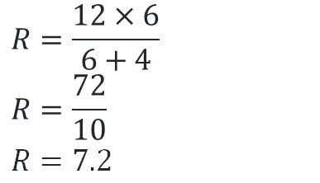

Substitution and evaluation
Practice
$$A=3×2+4 \\ A=6+4 \\ A=10$$
Given $A=3x+4$, find $A$ when $x=2$.
$$13=2a+5 \\ 13−5=2a \\ 2a=13−5 \\ 2a=8 \\ a=4$$
Using the formula $T=2a+5$, if $T=13$, solve for $a.$
$$R=\frac{12×6}{6+4} \\ R=\frac{72}{10}$$
$R=7.2$
Given $R=\frac{p×t}{t+4}$, find $R$ when $p=12$ and $t=6$

Slide 6
Activating prior knowledge

Slide 7
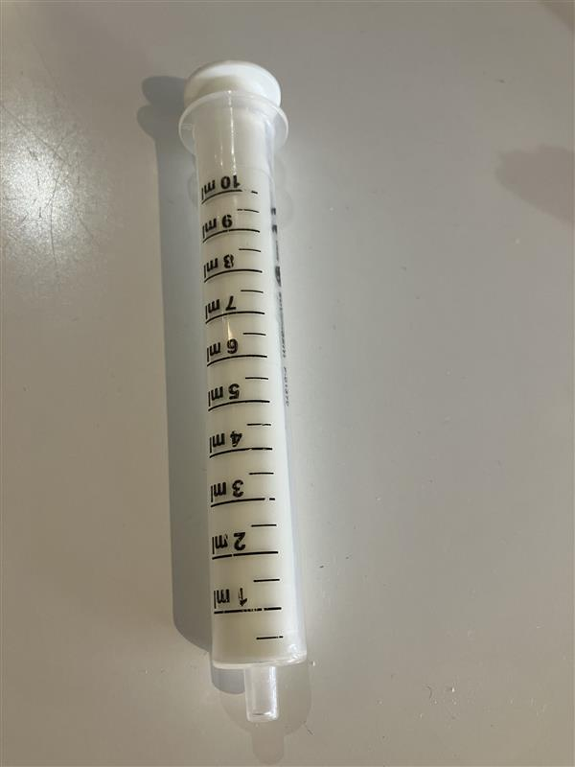
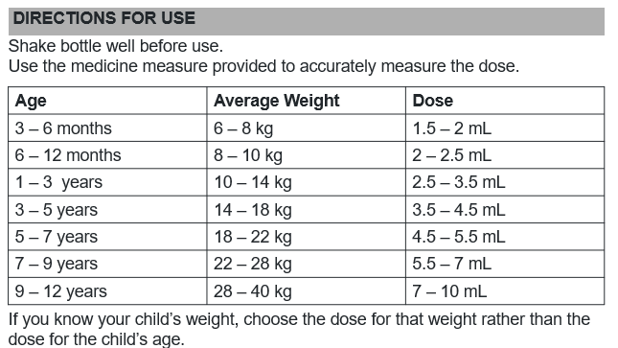
Medication dosages

Slide 8
Connecting learning

Slide 9
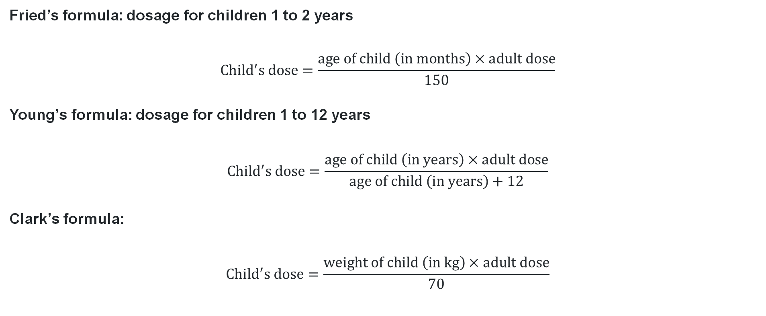
Dosage formulas (1)
Converting dosage for adults to dosage for children
Fried’s formula: dosage for children 1 to 2 years
$${Child}^{′}s dose=\frac{age of child \left(in months\right)×adult dose}{150}$$
Young’s formula: dosage for children 1 to 12 years
$${Child}^{′}s dose=\frac{age of child \left(in years\right)×adult dose}{age of child \left(in years\right)+12}$$
Clark’s formula:
$${Child}^{′}s dose=\frac{weight of child \left(in kg\right)×adult dose}{70}$$

Slide 10
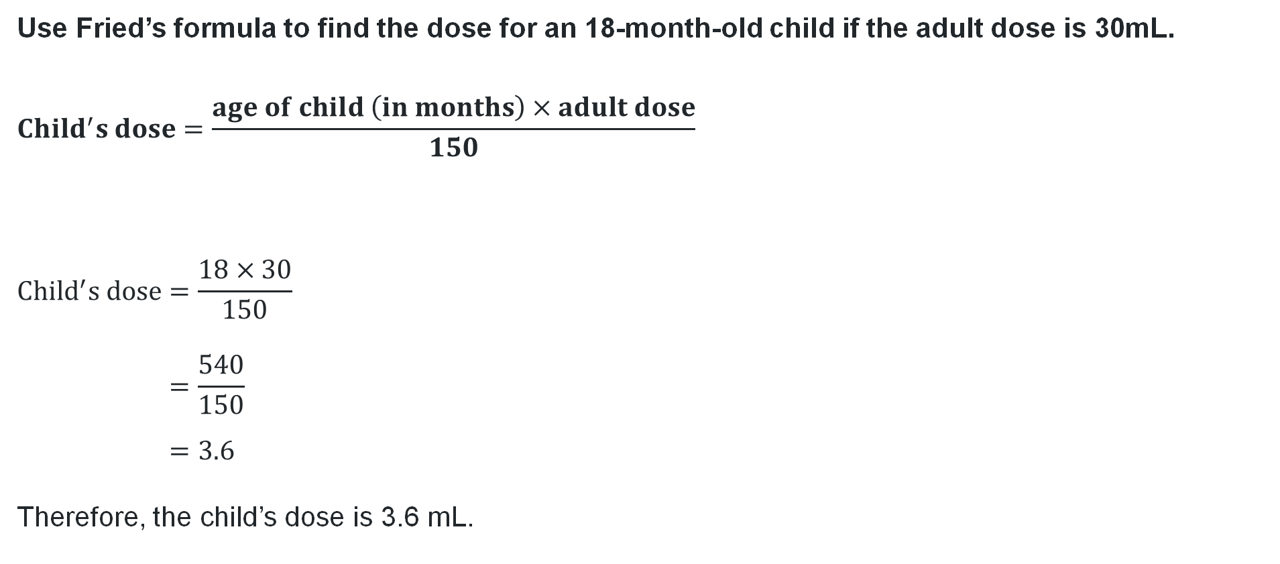
Dosage formulas (2)
Worked example 1
Use Fried’s formula to find the dose for an 18-month-old child if the adult dose is 30mL.
$${Child}^{′}s dose=\frac{age of child \left(in months\right)×adult dose}{150}$$
$$Child^{′}s dose=\frac{18×30}{150} \\ =\frac{540}{150} \\ =3.6$$
Therefore, the child’s dose is 3.6 mL.
Why is Fried’s formula used?
Why is the child’s dose in millilitres?

Slide 11
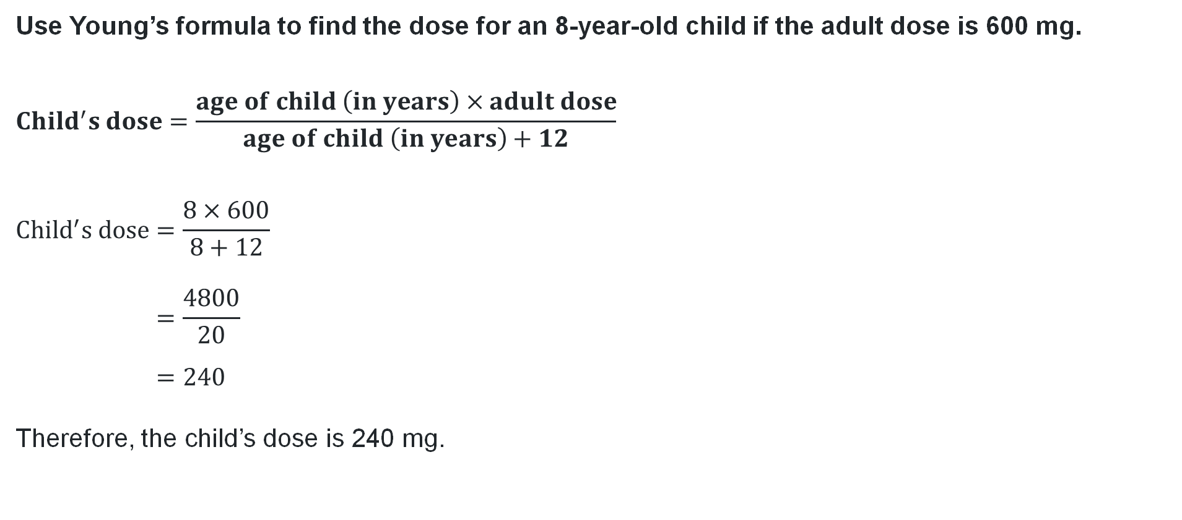
Dosage formulas (3)
Your turn question 1
Use Young’s formula to find the dose for an 8-year-old child if the adult dose is 600 mg.
$${Child}^{′}s dose=\frac{age of child \left(in years\right)×adult dose}{age of child \left(in years\right)+12}$$
$${Child}^{′}s dose=\frac{8×600}{8+12} \\ =\frac{4800}{20} \\ =240$$
Therefore, the child’s dose is 240 mg.

Slide 12
Releasing responsibility

Slide 13
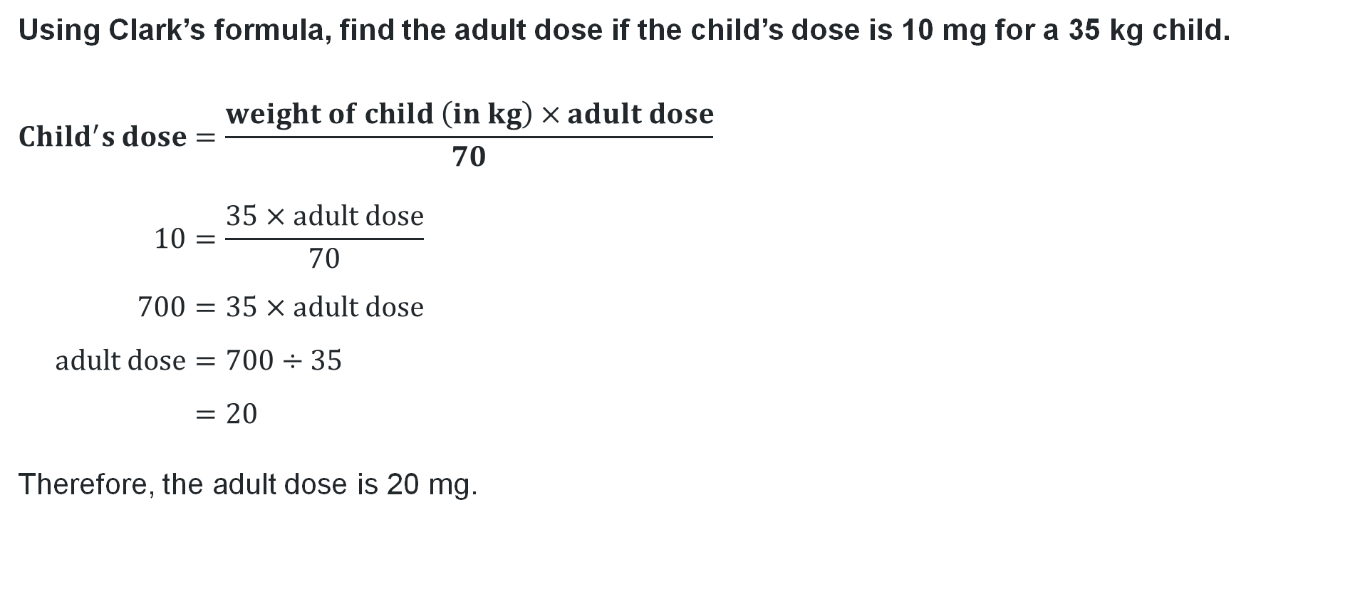
Dosage formulas (4)
Worked example 2
Using Clark’s formula, find the adult dose if the child’s dose is 10 mg for a 35 kg child.
$${Child}^{′}s dose=\frac{weight of child \left(in kg\right)×adult dose}{70} \\ 10=\frac{35×adult dose}{70} \\ 700=35×adult dose \\ adult dose=700÷35 \\ =20$$
Therefore, the adult dose is 20 mg.
Why is Clarke’s formula used?
Why have values been substituted on both sides of the formula?

Slide 14
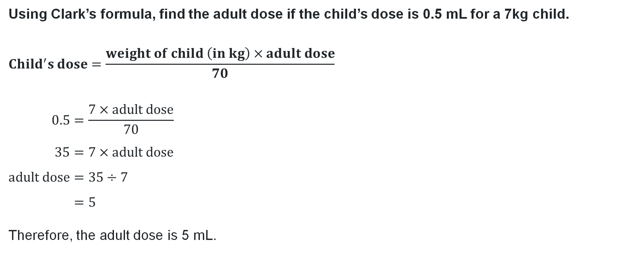
Dosage formulas (5)
Your turn question 2
Using Clark’s formula, find the adult dose if the child’s dose is 0.5 mL for a 7kg child.
$${Child}^{′}s dose=\frac{weight of child \left(in kg\right)×adult dose}{70}$$
$$0.5=\frac{7×adult dose}{70} \\ 35=7×adult dose \\ adult dose=35÷7 \\ =5$$
Therefore, the adult dose is 5 mL.

Slide 15


Calculation error
Incorrect example
Alex is a nurse. Alex has to administer medication to a 20-month-old child. The adult dose is 30 mL. Alex uses Young’s formula to calculate the child’s dose. Below is the calculation:
$${Child}^{′}s dose=\frac{20×30}{20+12} \\ =\frac{600}{32} \\ ≈18.75 mL$$
What error has Alex made?
Fried’s formula: dosage for children 1 to 2 years
$${Child}^{′}s dose=\frac{age of child \left(in months\right)×adult dose}{150}$$
Young’s formula: dosage for children 1 to 12 years
$${Child}^{′}s dose=\frac{age of child \left(in years\right)×adult dose}{age of child \left(in years\right)+12}$$
Clark’s formula:
$${Child}^{′}s dose=\frac{weight of child \left(in kg\right)×adult dose}{70}$$

Slide 16
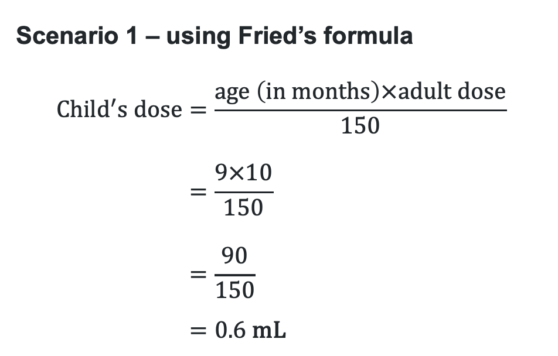
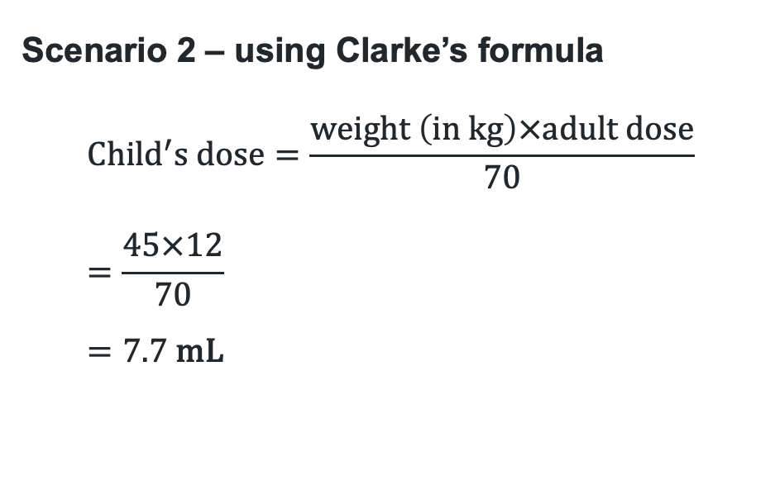
Scenarios (1)
For each scenario, first decide which formula is needed before completing the calculation.
Scenario 1
Jane is 9 months old and requires medication that has an adult dosage amount of 10 mL.
How much medication should be given to Jane?
Scenario 2
Tim weighs 45 kg and the adult dosage for his medication is 12 mL. What is Tim’s medication amount?
Scenario 1 – using Fried’s formula
$$Child^{′}s dose=\frac{age \left(in months\right)×adult dose}{150} \\ =\frac{9×10}{150} \\ =\frac{90}{150} \\ =0.6 \text{mL}$$
Scenario 2 – using Clarke’s formula
$$Child^{′}s dose=\frac{weight \left(in kg\right)×adult dose}{70} \\ =\frac{45×12}{70} \\ =7.7 \text{mL}$$

Slide 17
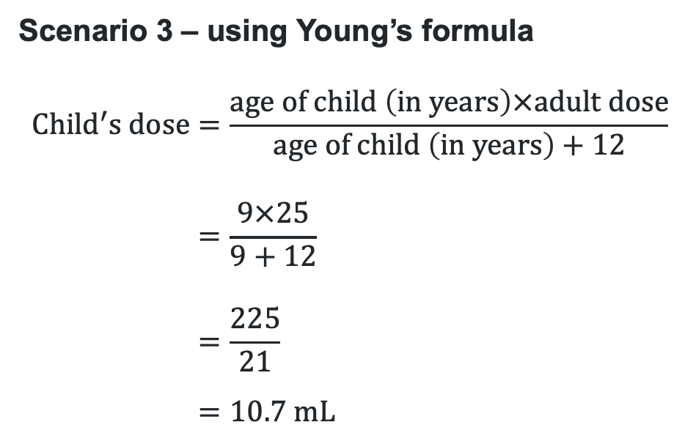
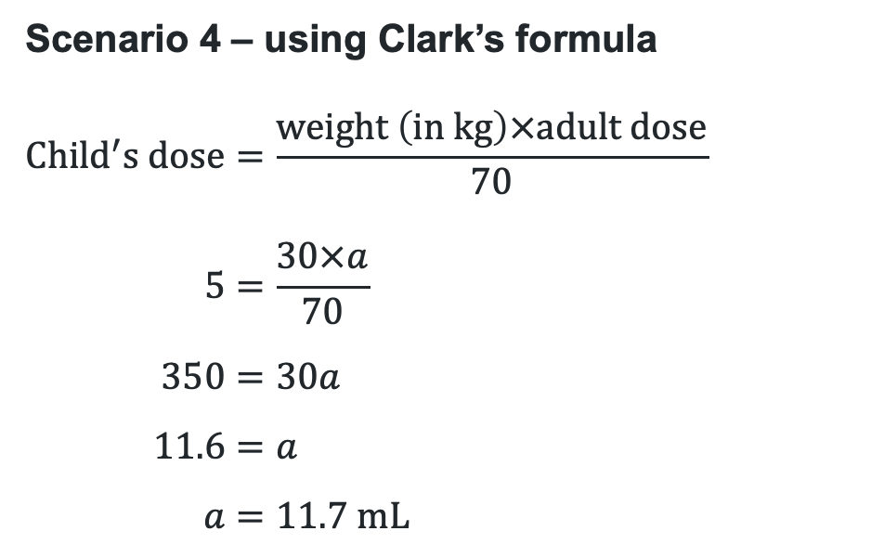
Scenarios (2)
For each scenario, first decide which formula is needed before completing the calculation.
Scenario 3
An adult medication dosage is given as 25 mL.
What would the dosage be for a 9-year-old child?
Scenario 4
A 12-year-old child who weighs 30 kg has medication with a dosage of 5 mL. How much is the adult dosage?
Scenario 3 – using Young’s formula
$$Child^{′}s dose=\frac{age of child \left(in years\right)×adult dose}{age of child \left(in years\right)+12} \\ =\frac{9×25}{9+12} \\ =\frac{225}{21} \\ =10.7 \text{mL}$$
Scenario 4 – using Clark’s formula
$$Child^{′}s dose=\frac{weight \left(in kg\right)×adult dose}{70} \\ 5=\frac{30×a}{70} \\ 350=30a \\ 11.6=a \\ a=11.7 \text{mL}$$

Slide 18
References
This presentation contains NSW Curriculum and syllabus content. The NSW Curriculum is developed by the NSW Education Standards Authority. This content is prepared by NESA for and on behalf of the Crown in the right of the State of New South Wales. The material is protected by Crown copyright.
Please refer to the NESA Copyright Disclaimer for more information https://educationstandards.nsw.edu.au/wps/portal/nesa/mini-footer/copyright.
NESA holds the only official and up-to-date versions of the NSW Curriculum and syllabus documents. Please visit the NSW Education Standards Authority (NESA) website https://educationstandards.nsw.edu.au/wps/portal/nesa/home and the NSW Curriculum website https://curriculum.nsw.edu.au.
Mathematics Standard 11–12 Syllabus © NSW Education Standards Authority (NESA) for and on behalf of the Crown in right of the State of New South Wales, 2024.

Slide 19
Copyright
© State of New South Wales (Department of Education), 2025
The copyright material published in this resource is subject to the Copyright Act 1968 (Cth) and is owned by the NSW Department of Education or, where indicated, by a party other than the NSW Department of Education (third-party material).
Copyright material available in this resource and owned by the NSW Department of Education is licensed under a Creative Commons Attribution 4.0 International (CC BY 4.0) license.
This license allows you to share and adapt the material for any purpose, even commercially.
Attribution should be given to © State of New South Wales (Department of Education), 2025.
Material in this resource not available under a Creative Commons license:
the NSW Department of Education logo, other logos and trademark-protected material
Material owned by a third party that has been reproduced with permission. You will need to obtain permission from the third party to reuse its material.
Links to third-party material and websites
Please note that the provided (reading/viewing material/list/links/texts) are a suggestion only and implies no endorsement, by the New South Wales Department of Education, of any author, publisher, or book title. School principals and teachers are best placed to assess the suitability of resources that would complement the curriculum and reflect the needs and interests of their students.
If you use the links provided in this document to access a third-party’s website, you acknowledge that the terms of use, including licence terms set out on the third-party’s website apply to the use which may be made of the materials on that third-party website or where permitted by the Copyright Act 1968 (Cth). The department accepts no responsibility for content on third-party websites.

