Slide 1

Outliers
Mathematics Standard – Stage 6 (Year 11)
Unit 1 – getting healthy

Slide 2
Learning intentions and success criteria
Learning intentions
To be able to apply formal methods to identify outliers.
To understand how outliers affect statistical analysis.
Success criteria
I can explain the meaning of an outlier.
I can identify an outlier using both visual and formal methods (formula).
I can explain how an outlier affects measures like the mean, median and range.
I can decide when it is appropriate to include or exclude an outlier and justify my reasoning.
Notes:
Notes for teachers:
Learning intentions and success criteria are best co-constructed with students. Adapt the learning intention as required and add matching success criteria.
For more information See ⁠AITSL or the NSW Department of Education explicit teaching strategies, ⁠Sharing learning intentions and ⁠Sharing success criteria
LISC is not necessarily presented at the beginning of the lesson. Teacher needs to consider most effectual time to introduce
LISC should be revisited during the lesson to support students' evaluation of their learning

Slide 3
Activating prior knowledge

Slide 4
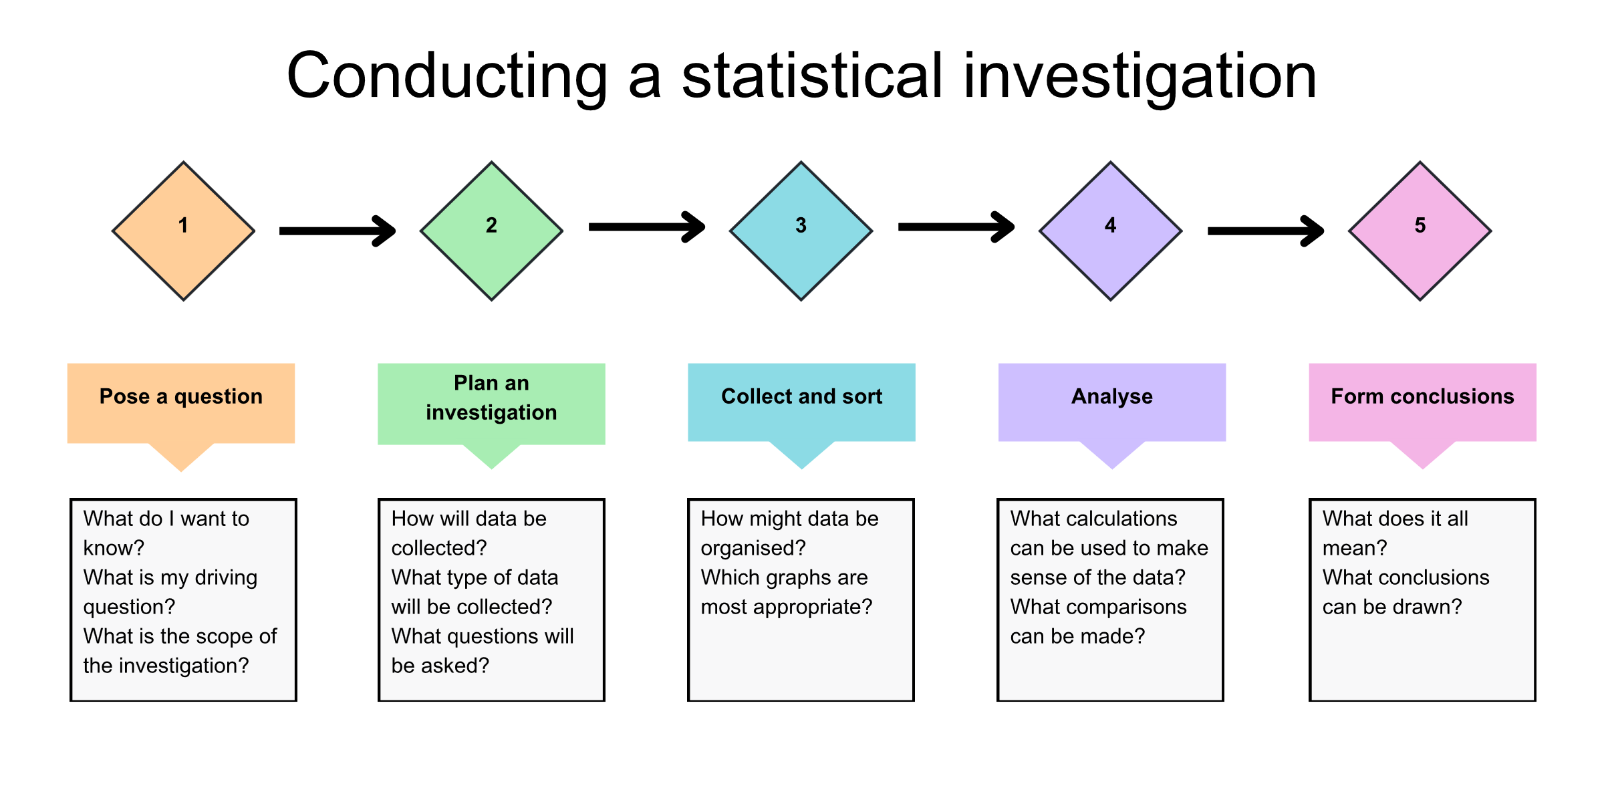
Statistical investigation process

Slide 5
Fitness centre
New fitness and diet program
The table represents the change in weight of 10 participants over a 12-week period.
Participant | Loss | Participant | Loss
Participant 1 | -1.5 kg | Participant 6 | -2.5 kg
Participant 2 | -2.2 kg | Participant 7 | -2.0 kg
Participant 3 | -2.8 kg | Participant 8 | -2.3 kg
Participant 4 | -1.2 kg | Participant 9 | -12.0 kg
Participant 5 | -3.0 kg | Participant 10 | -2.1 kg

Slide 6
Connecting learning

Slide 7
Outliers (1)
Glossary
An outlier is a data value that appears to stand out from the other members of the dataset by being unusually high or low.

Slide 8
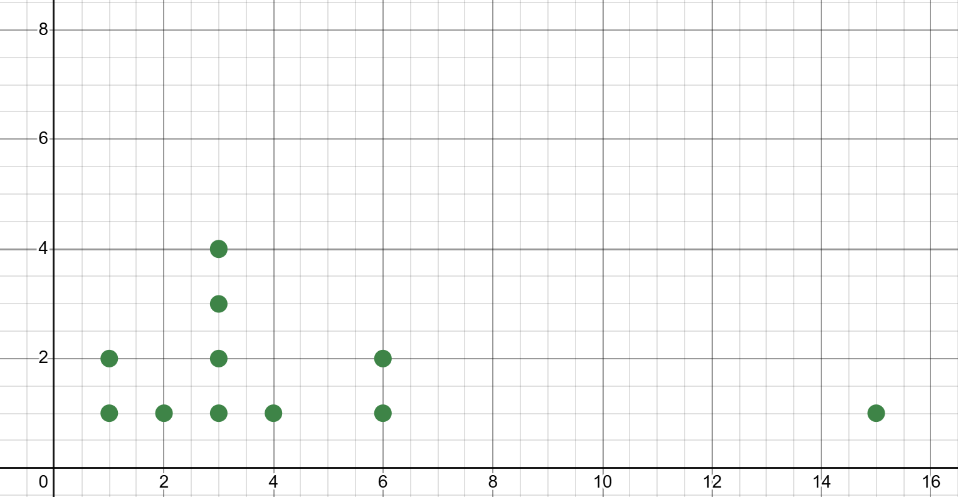
Outliers (2)
Spot the outlier

Slide 9
Releasing Responsibility

Slide 10

Outliers (3)
Calculating the boundaries for outliers
An outlier is a score
less than $Q_{1}−1.5×IQR$
or
more than $Q_{3}+1.5×IQR$

Slide 11
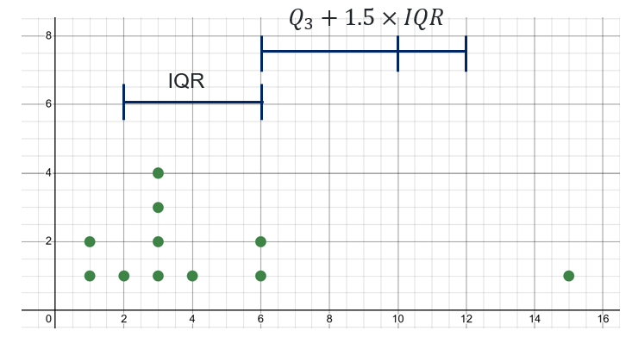
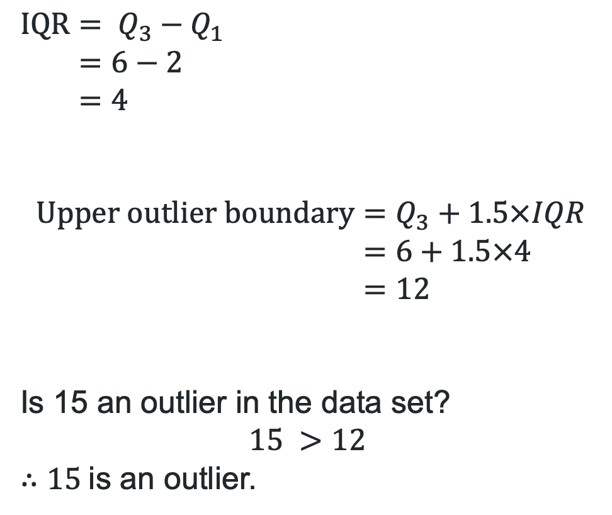
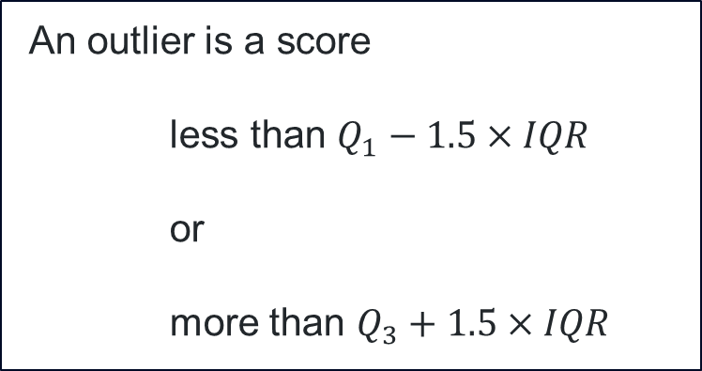
Outliers (4)
Is 15 an outlier in the dataset?
$$IQR= Q_{3}−Q_{1} \\ =6−2 \\ =4$$
$$Upper outlier boundary=Q_{3}+1.5×IQR \\ =6+1.5×4 \\ =12$$
Is 15 an outlier in the data set?
$$15 >12$$
$∴15$is an outlier.
An outlier is a score
less than $Q_{1}−1.5×IQR$
or
more than $Q_{3}+1.5×IQR$

Slide 12
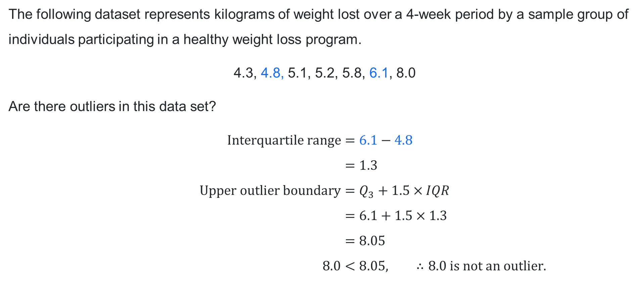

Outliers (5)
Worked example 1
The following dataset represents kilograms of weight lost over a 4-week period by a sample group of individuals participating in a healthy weight loss program.
4.3, 4.8, 5.1, 5.2, 5.8, 6.1, 8.0
Are there outliers in this data set?
$$\text{Interquartile} \text{range}=6.1−4.8 \\ =1.3 \\ \text{Upper} \text{outlier} \text{boundary}=Q_{3}+1.5×IQR \\ =6.1+1.5×1.3 \\ =8.05 \\ 8.0<8.05, ∴8.0 \text{is} \text{not} \text{an} \text{outlier}\text{.}$$
$$Q_{1}=4.8$$
$$Q_{3}=6.1$$

Slide 13


Outliers (6)
Worked example 1 – self-explanation prompts
4.3, 4.8, 5.1, 5.2, 5.8, 6.1, 8.0
Are there outliers in this data set?
$$Interquartile range=6.1−4.8 \\ =1.3 \\ Upper outlier boundary=Q_{3}+1.5×IQR \\ =6.1+1.5×1.3 \\ =8.05 \\ 8.0<8.05, ∴8.0 is not an outlier.$$
Why was only the upper boundary tested?
$$Q_{1}=4.8$$
$$Q_{3}=6.1$$
Why are we comparing where 8.0 is in relation to 8.05?

Slide 14
Outliers (7)
Your turn question 1
A person of average health and fitness level, had their resting heart rate recorded hourly during their recovery day. The dataset below represents the beats per minute (bpm):
72, 82, 87, 93, 95, 98, 100, 102, 107
Is 72 an outlier in this data set?

Slide 15
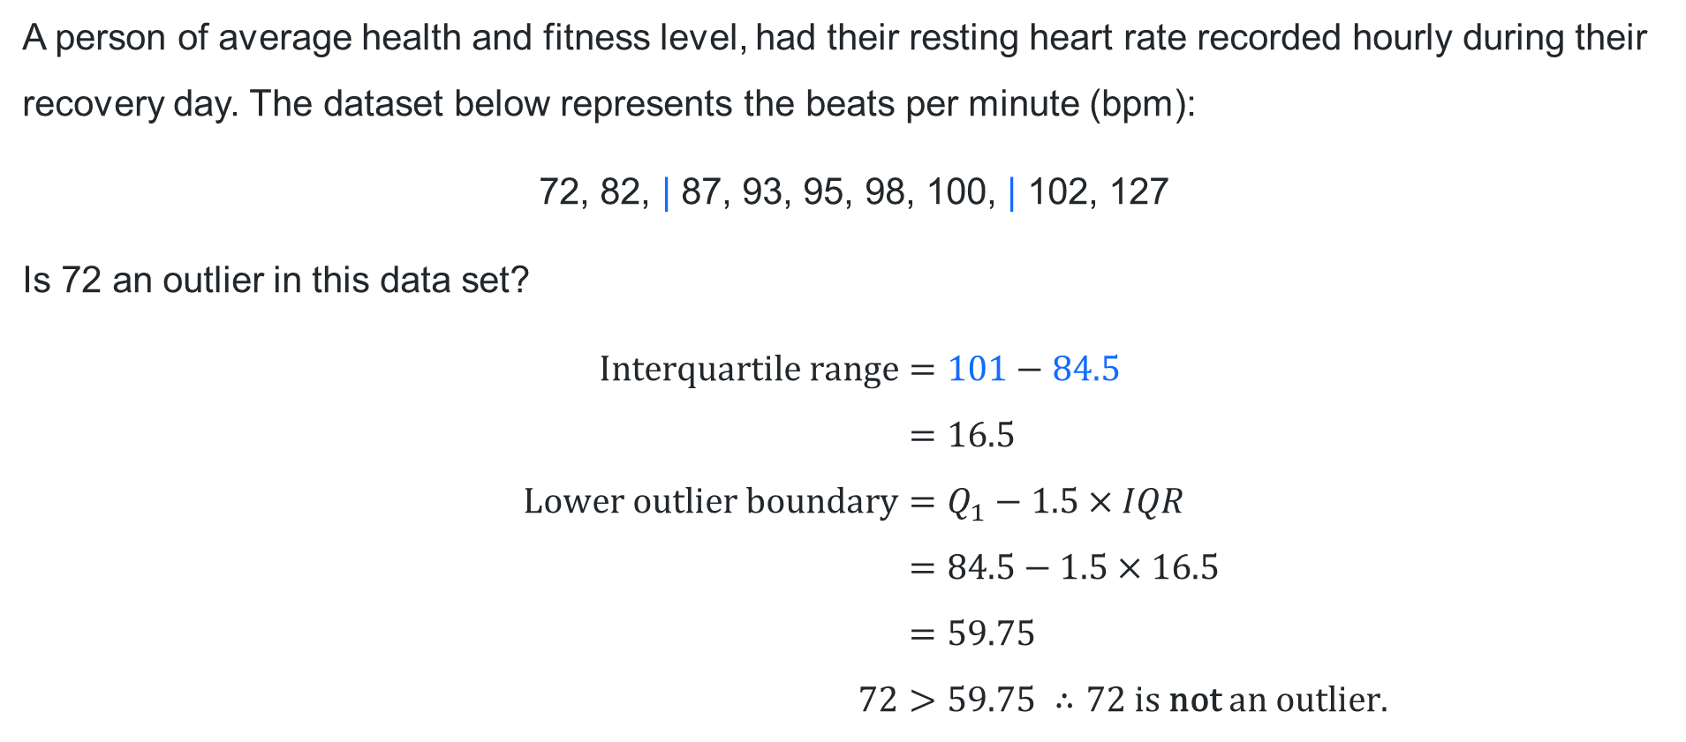

Outliers (8)
Your turn solution 1
A person of average health and fitness level, had their resting heart rate recorded hourly during their recovery day. The dataset below represents the beats per minute (bpm):
72, 82, | 87, 93, 95, 98, 100, | 102, 127
Is 72 an outlier in this data set?
$$\text{Interquartile} \text{range}=101−84.5 \\ =16.5 \\ \text{L}\text{ower} \text{outlier} \text{boundary}=Q_{1}−1.5×IQR \\ =84.5−1.5×16.5 \\ =59.75 \\ 72>59.75 ∴72 \text{is} \text{not} \text{an} \text{outlier}.$$
$$Q_{1}=84.5$$
$$Q_{3}=101$$

Slide 16
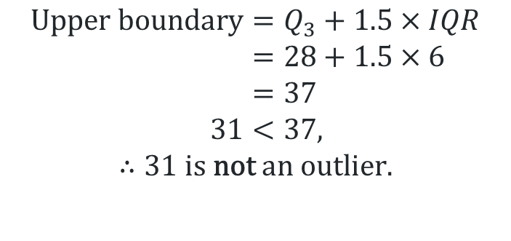
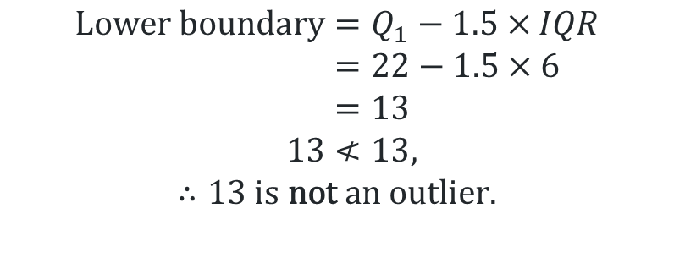
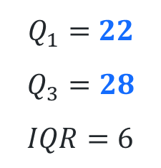
Outliers (9)
Worked example 2
The following dataset shows the number of soft drinks consumed in a month for a Year 11 class:
Are there any outliers in this data set?
Stem | Leaf
1 | 3
2 | 1 2 2 3 5 7 8 8 9
3 | 1
$$Q_{1}=22$$
$$Q_{3}=28 \\ IQR=6$$
$$\text{Lower} \text{boundary}=Q_{1}−1.5×IQR \\ =22−1.5×6 \\ =13 \\ 13≮13,$$
$$∴13 \text{is} \text{not} \text{an} \text{outlier}.$$
$$\text{Upper} \text{boundary}=Q_{3}+1.5×IQR \\ =28+1.5×6 \\ =37 \\ 31<37,∴13 is not an outlier.$$
$$∴31 \text{is} \text{not} \text{an} \text{outlier}.$$

Slide 17

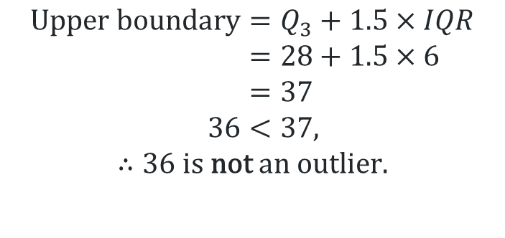
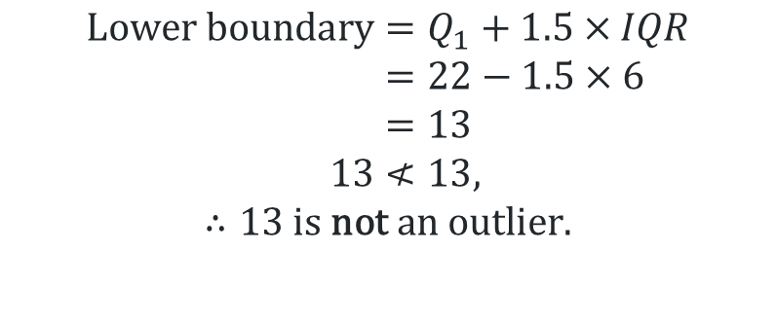
Outliers (10)
Worked example 2 – self-explanation prompts
The following dataset shows the number of soft drinks consumed in a month for a Year 11 class.
Are there any outliers in this data set?
Stem | Leaf
1 | 3
2 | 1 2 2 3 5 7 8 8 9
3 | 6
Why are both boundaries tested?
$$Q_{1}=22$$
$$Q_{3}=28 \\ IQR=6$$
$$\text{Lower} \text{boundary}=Q_{1}+1.5×IQR \\ =22−1.5×6 \\ =13 \\ 13≮13,$$
$$∴13 \text{is} \text{not} \text{an} \text{outlier}.$$
$$\text{Upper} \text{boundary}=Q_{3}+1.5×IQR \\ =28+1.5×6 \\ =37 \\ 36<37,∴13 is not an outlier.$$
$$∴36 \text{is} \text{not} \text{an} \text{outlier}.$$
Why is 13 not considered an outlier?

Slide 18
Outliers (11)
Your turn question 2
The following dataset shows the number of minutes of exercise completed this week for a Year 11 class:
Are there any outliers in this data set?
Stem | Leaf
15 | 2 5
16 | 2 2 4 8
17 | 0 2 4 6
18 | 0 4
19
20 | 2
Notes:
152, 155, 162, 162, 164, 168, 170, 172, 174, 176, 180, 184, 202

Slide 19
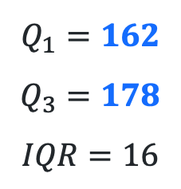
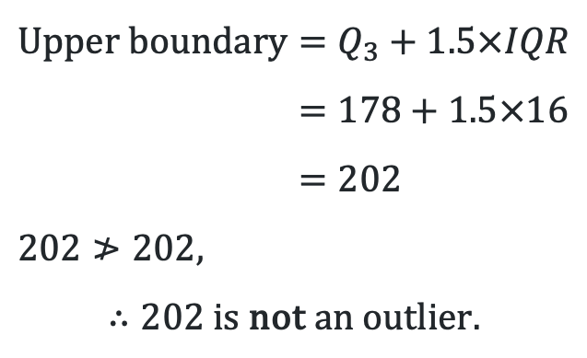
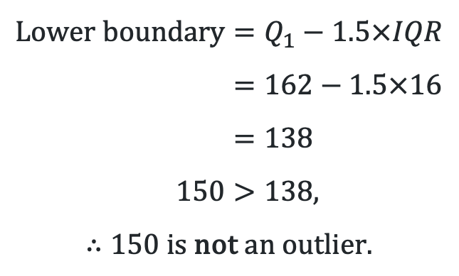
Outliers (12)
Your turn solution 2
$$\text{Lower} \text{boundary}=Q_{1}−1.5×IQR \\ =162−1.5×16 \\ =138 \\ 150>138,$$
$$∴150 \text{is} \text{not} \text{an} \text{outlier}.$$
Stem | Leaf
15 | 0
16 | 0 2 | 2 4 8
17 | 0 2 4 6 |
18 | 0 4
19
20 | 2
$$Q_{1}=162$$
$$Q_{3}=178$$
$$IQR=16$$
$$\text{Upper} \text{boundary}=Q_{3}+1.5×IQR \\ =178+1.5×16 \\ =202 \\ 202≯202,$$
$$∴202 \text{is} \text{not} \text{an} \text{outlier}.$$

Slide 20
Independent practice

Slide 21
Exit ticket
HSC style question
A patient’s blood pressure was measured and tracked every day for a week.
The recordings were 120, 123, 129, 132, 133, 135, 150.
Is the recording of 150 an outlier for this set of data?
Justify your answer with calculations.

Slide 22
References
This presentation contains NSW Curriculum and syllabus content. The NSW Curriculum is developed by the NSW Education Standards Authority. This content is prepared by NESA for and on behalf of the Crown in the right of the State of New South Wales. The material is protected by Crown copyright.
Please refer to the NESA Copyright Disclaimer for more information https://educationstandards.nsw.edu.au/wps/portal/nesa/mini-footer/copyright.
NESA holds the only official and up-to-date versions of the NSW Curriculum and syllabus documents. Please visit the NSW Education Standards Authority (NESA) website https://educationstandards.nsw.edu.au/wps/portal/nesa/home and the NSW Curriculum website https://curriculum.nsw.edu.au.
Mathematics Standard 11–12 Syllabus © NSW Education Standards Authority (NESA) for and on behalf of the Crown in right of the State of New South Wales, 2024.

Slide 23
Copyright
© State of New South Wales (Department of Education), 2025
The copyright material published in this resource is subject to the Copyright Act 1968 (Cth) and is owned by the NSW Department of Education or, where indicated, by a party other than the NSW Department of Education (third-party material).
Copyright material available in this resource and owned by the NSW Department of Education is licensed under a Creative Commons Attribution 4.0 International (CC BY 4.0) license.
This license allows you to share and adapt the material for any purpose, even commercially.
Attribution should be given to © State of New South Wales (Department of Education), 2025.
Material in this resource not available under a Creative Commons license:
the NSW Department of Education logo, other logos and trademark-protected material
Material owned by a third party that has been reproduced with permission. You will need to obtain permission from the third party to reuse its material.
Links to third-party material and websites
Please note that the provided (reading/viewing material/list/links/texts) are a suggestion only and implies no endorsement, by the New South Wales Department of Education, of any author, publisher, or book title. School principals and teachers are best placed to assess the suitability of resources that would complement the curriculum and reflect the needs and interests of their students.
If you use the links provided in this document to access a third-party’s website, you acknowledge that the terms of use, including licence terms set out on the third-party’s website apply to the use which may be made of the materials on that third-party website or where permitted by the Copyright Act 1968 (Cth). The department accepts no responsibility for content on third-party websites.

