Slide 1
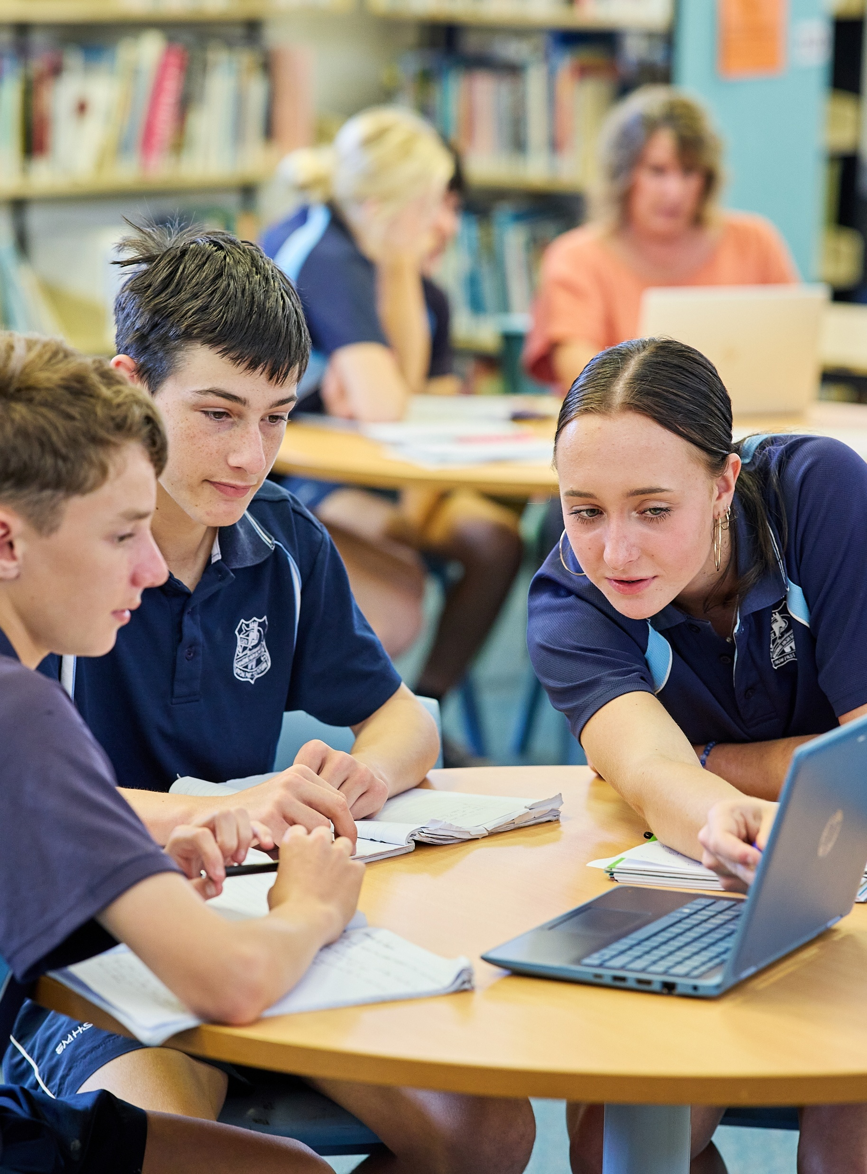
Least-squares regression line
Mathematics Standard 2 – Stage 6 (Year 12)
Correlation

Slide 2
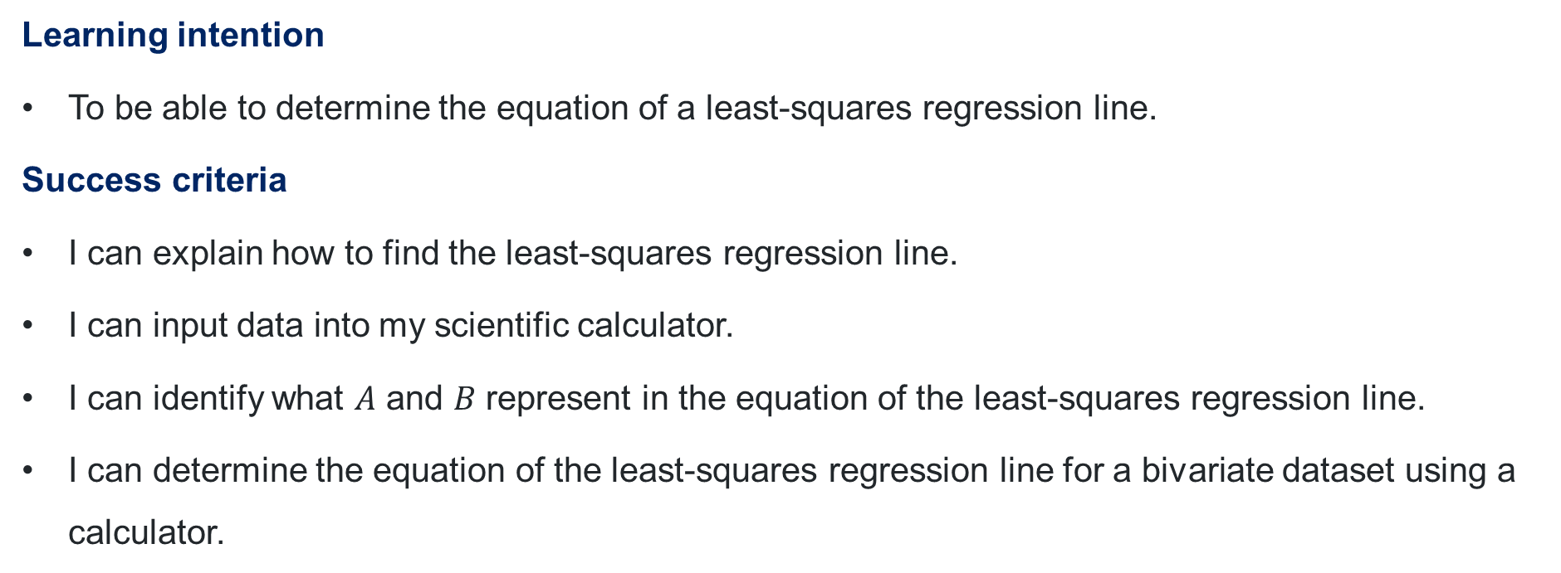
Learning intention and success criteria
Learning intention
To be able to determine the equation of a least-squares regression line.
Success criteria
I can explain how to find the least-squares regression line.
I can input data into my scientific calculator.
I can identify what $A$ and $B$ represent in the equation of the least-squares regression line.
I can determine the equation of the least-squares regression line for a bivariate dataset using a calculator.

Slide 3
Connecting learning

Slide 4
Least-squares regression line (1)
Influencer data
Following | 118 | 761 | 1786 | 17 | 88 | 108 | 0 | 2023 | 1344 | 50
Followers (000s) | 99 | 42 | 191 | 29 | 154 | 139 | 88 | 249 | 78.8 | 27.7
Following | 745 | 2075 | 493 | 388 | 761 | 304 | 1294 | 111 | 184 | 998
Followers (000s) | 11 | 222 | 65.7 | 31 | 14.8 | 59 | 189 | 80 | 91 | 105

Slide 5
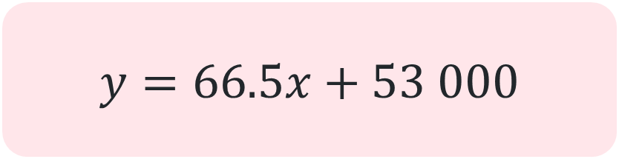
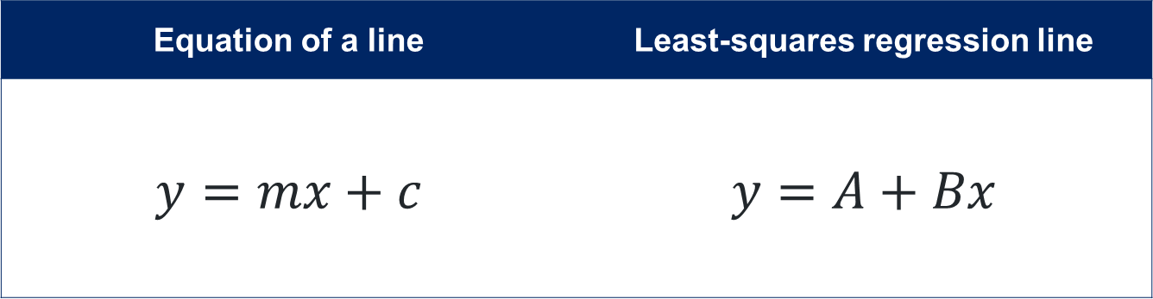
Least-squares regression line (2)
Notation
Equation of a line | Least-squares regression line
$$y=mx+c$$ | $$y=A+Bx$$
$$y=66.5x+53 000$$

Slide 6
Releasing responsibility

Slide 7
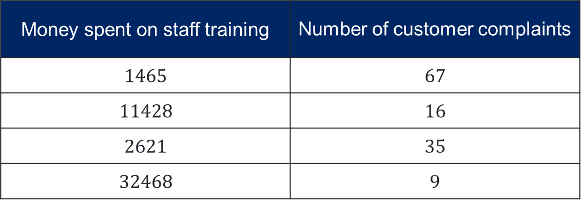
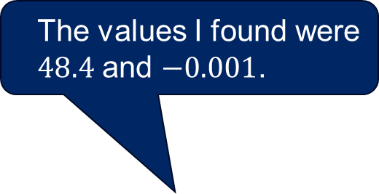
Least-squares regression line (3)
Mix up
Dylan has found the values for $A$ and $B$ given the data in the table but forgot which value represents the gradient and $y$-intercept. How can he work this out?
Money spent on staff training | Number of customer complaints
$$1465$$ | $$67$$
$$11428$$ | $$16$$
$$2621$$ | $$35$$
$$32468$$ | $$9$$
The values I found were $48.4$ and $−0.001$.

Slide 8
References
This presentation contains NSW Curriculum and syllabus content. The NSW Curriculum is developed by the NSW Education Standards Authority. This content is prepared by NESA for and on behalf of the Crown in the right of the State of New South Wales. The material is protected by Crown copyright.
Please refer to the NESA Copyright Disclaimer for more information https://educationstandards.nsw.edu.au/wps/portal/nesa/mini-footer/copyright.
NESA holds the only official and up-to-date versions of the NSW Curriculum and syllabus documents. Please visit the NSW Education Standards Authority (NESA) website https://educationstandards.nsw.edu.au/wps/portal/nesa/home and the NSW Curriculum website https://curriculum.nsw.edu.au.
Mathematics Standard Stage 6 Syllabus © NSW Education Standards Authority (NESA) for and on behalf of the Crown in right of the State of New South Wales, 2024.
.

Slide 9
Copyright
© State of New South Wales (Department of Education), 2026
The copyright material published in this resource is subject to the Copyright Act 1968 (Cth) and is owned by the NSW Department of Education or, where indicated, by a party other than the NSW Department of Education (third-party material).
Copyright material available in this resource and owned by the NSW Department of Education is licensed under a Creative Commons Attribution 4.0 International (CC BY 4.0) license.
This license allows you to share and adapt the material for any purpose, even commercially.
Attribution should be given to © State of New South Wales (Department of Education), 2026.
Material in this resource not available under a Creative Commons license:
the NSW Department of Education logo, other logos and trademark-protected material
Material owned by a third party that has been reproduced with permission. You will need to obtain permission from the third party to reuse its material.
Links to third-party material and websites
Please note that the provided (reading/viewing material/list/links/texts) are a suggestion only and implies no endorsement, by the New South Wales Department of Education, of any author, publisher, or book title. School principals and teachers are best placed to assess the suitability of resources that would complement the curriculum and reflect the needs and interests of their students.
If you use the links provided in this document to access a third-party’s website, you acknowledge that the terms of use, including licence terms set out on the third-party’s website apply to the use which may be made of the materials on that third-party website or where permitted by the Copyright Act 1968 (Cth). The department accepts no responsibility for content on third-party websites.

