Slide 1

Interpreting the equation of line of best fit
Mathematics Standard 2 – Stage 6 (Year 12)
Correlation

Slide 2
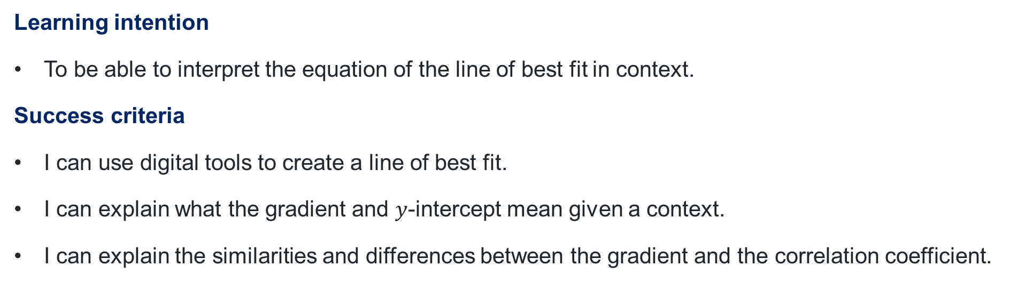
Learning intention and success criteria
Learning intention
To be able to interpret the equation of the line of best fit in context.
Success criteria
I can use digital tools to create a line of best fit.
I can explain what the gradient and $y$-intercept mean given a context.
I can explain the similarities and differences between the gradient and the correlation coefficient.

Slide 3
Activating prior knowledge

Slide 4
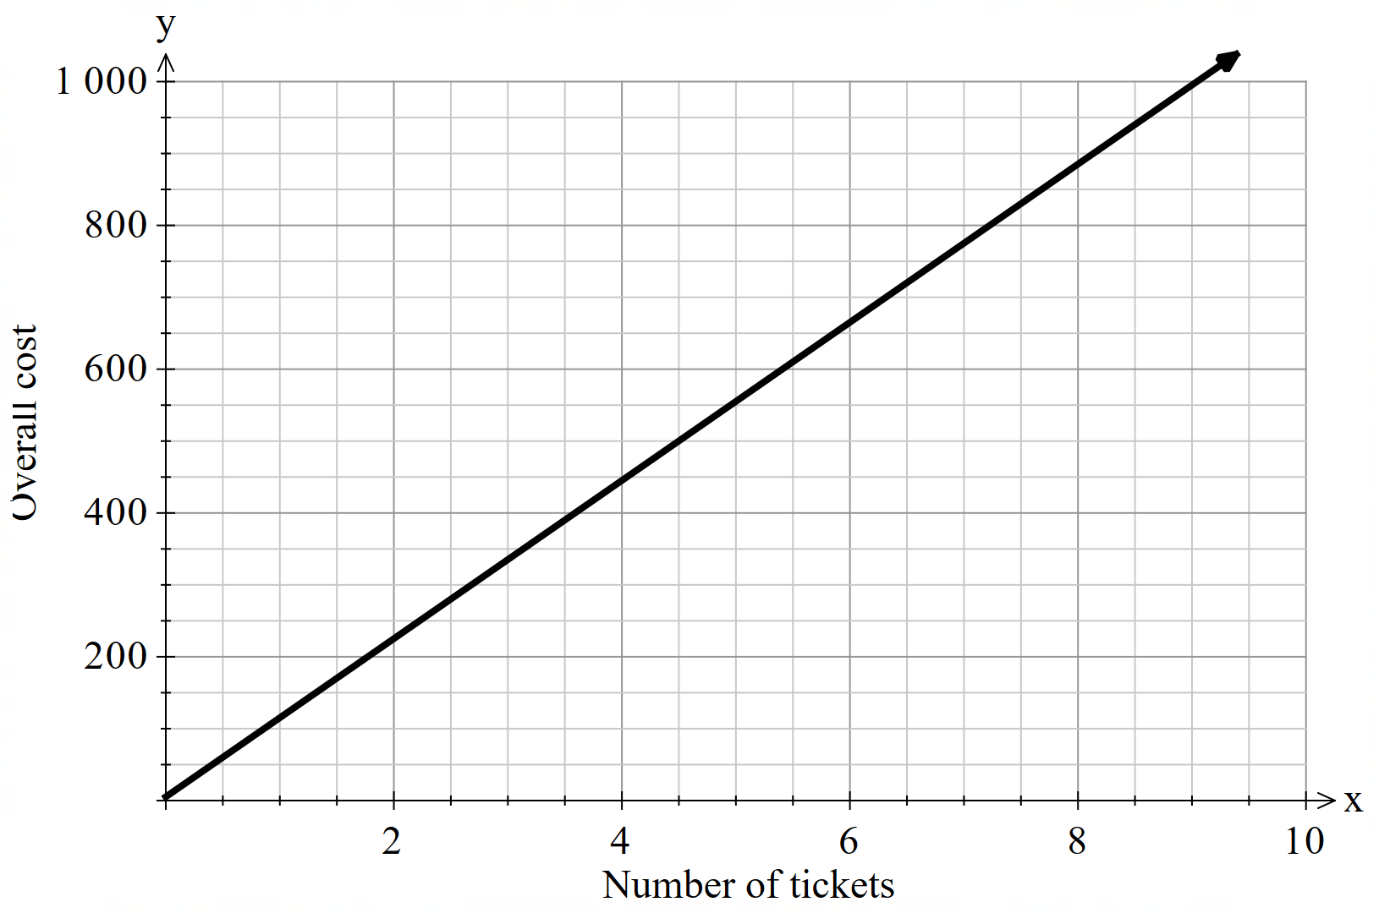
Concert tickets
Simone is going to buy some concert tickets. They cost $110 per ticket with a $5.20 booking fee for each transaction. The graph and equation below represent this.
Overall cost
$$y=110x+5.2$$

Slide 5
Releasing responsibility

Slide 6
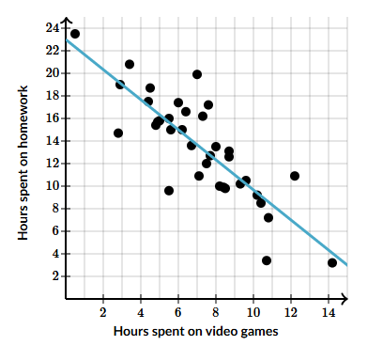

Interpreting the equation of the line of best fit (1)
Question 1
The graph shows the relationship between the hours spent on video games and hours spent on homework last week for students in Joyce’s class. The line of best fit has a $y$-intercept of 23.
What is the best interpretation of the $y$-intercept?
(A) Joyce spent approximately 23 hours on video games.
(B) The model indicates that students who spent 0 hours on
video games will average 23 hours on homework.
(C) The model indicates that students who spent 23 hours on
video games will average approximately 0 hours on homework
(D) Joyce spent approximately 23 hours on homework.

Slide 7
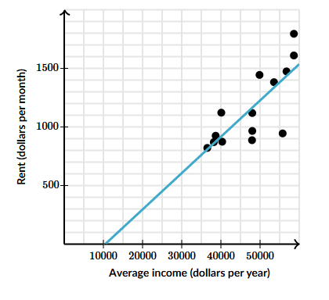
Interpreting the equation of the line of best fit (2)
Question 2
The scatter plot and line of best fit below show the average income, in dollars, in several major American cities plotted against the cost per month to rent a 2-bedroom apartment in those cities. The line of best fit has a gradient of 0.031. What is the best interpretation of the gradient?
(A) On average, each $1 increase in average income was associated with
a $0.031 increase in average rent.
(B) On average, each $0.031 increase in average income was associated
with a $1 increase in average rent.
(C) We would predict a city whose average income was $0 to pay an
average rent of $0.031
(D) We would predict a city whose average income was $0.031 to
have an average rent of $0

Slide 8
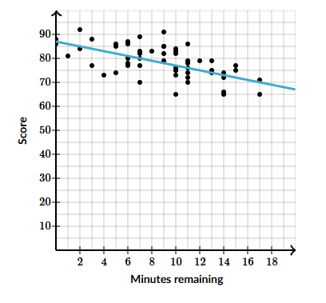
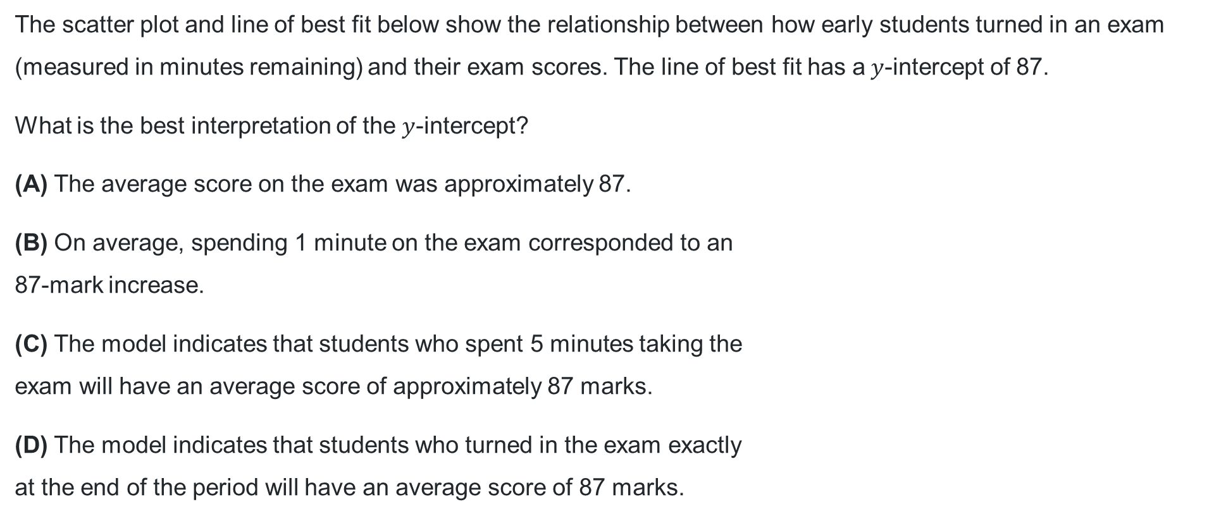
Interpreting the equation of the line of best fit (3)
Question 3
The scatter plot and line of best fit below show the relationship between how early students turned in an exam (measured in minutes remaining) and their exam scores. The line of best fit has a$y$-intercept of 87.
What is the best interpretation of the $y$-intercept?
(A) The average score on the exam was approximately 87.
(B) On average, spending 1 minute on the exam corresponded to an
87-mark increase.
(C) The model indicates that students who spent 5 minutes taking the
exam will have an average score of approximately 87 marks.
(D) The model indicates that students who turned in the exam exactly
at the end of the period will have an average score of 87 marks.

Slide 9
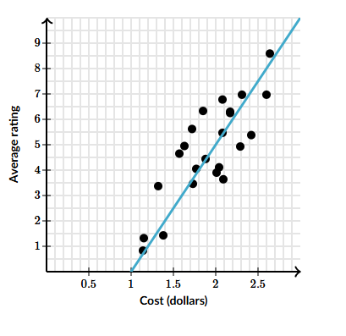
Interpreting the equation of the line of best fit (4)
Question 4
A panel of judges was asked to judge the quality of different kinds of potato chips. The scatter plot and line of best fit below show the relationship between their ratings and the price of the chips. The line of best fit has a gradient of 5.
What is the best interpretation of the gradient?
(A) We would predict a bag of chips that cost $0 to have a rating of 5.
(B) We would predict a bag of chips that cost $0 to have a rating of -5.
(C) On average, each $5 increase in cost was associated with a 1-point
increase in rating.
(D) On average, each $1 increase in cost was associated with a 5-point
rating increase.

Slide 10
References
This presentation contains NSW Curriculum and syllabus content. The NSW Curriculum is developed by the NSW Education Standards Authority. This content is prepared by NESA for and on behalf of the Crown in the right of the State of New South Wales. The material is protected by Crown copyright.
Please refer to the NESA Copyright Disclaimer for more information https://educationstandards.nsw.edu.au/wps/portal/nesa/mini-footer/copyright.
NESA holds the only official and up-to-date versions of the NSW Curriculum and syllabus documents. Please visit the NSW Education Standards Authority (NESA) website https://educationstandards.nsw.edu.au/wps/portal/nesa/home and the NSW Curriculum website https://curriculum.nsw.edu.au.
Mathematics Standard 11–12 Syllabus © NSW Education Standards Authority (NESA) for and on behalf of the Crown in right of the State of New South Wales, 2024.
.

Slide 11
Copyright
© State of New South Wales (Department of Education), 2026
The copyright material published in this resource is subject to the Copyright Act 1968 (Cth) and is owned by the NSW Department of Education or, where indicated, by a party other than the NSW Department of Education (third-party material).
Copyright material available in this resource and owned by the NSW Department of Education is licensed under a Creative Commons Attribution 4.0 International (CC BY 4.0) license.
This license allows you to share and adapt the material for any purpose, even commercially.
Attribution should be given to © State of New South Wales (Department of Education), 2026.
Material in this resource not available under a Creative Commons license:
the NSW Department of Education logo, other logos and trademark-protected material
Material owned by a third party that has been reproduced with permission. You will need to obtain permission from the third party to reuse its material.
Links to third-party material and websites
Please note that the provided (reading/viewing material/list/links/texts) are a suggestion only and implies no endorsement, by the New South Wales Department of Education, of any author, publisher, or book title. School principals and teachers are best placed to assess the suitability of resources that would complement the curriculum and reflect the needs and interests of their students.
If you use the links provided in this document to access a third-party’s website, you acknowledge that the terms of use, including licence terms set out on the third-party’s website apply to the use which may be made of the materials on that third-party website or where permitted by the Copyright Act 1968 (Cth). The department accepts no responsibility for content on third-party websites.

