Slide 1
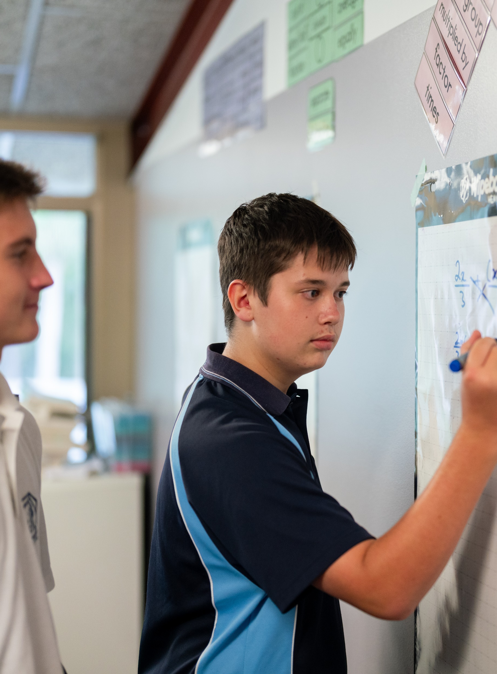
Interpreting box plots
Mathematics Standard – Stage 6 (Year 11)
Unit 1 – getting healthy

Slide 2
Learning intentions and success criteria
Learning intentions
To understand how to compare the use of range and interquartile range (IQR) as measures of spread.
To be able to interpret box plots to make conclusions and inferences about a dataset within a given context.
Success criteria
I can find the IQR of a given dataset.
I can explain when the range or the IQR is more appropriate to describe the spread of the data.
I can make inferences about data from parallel box plots.
I can compare 2 or more datasets using IQR, range, and box plots to justify conclusions about variability.
Notes:
Notes for teachers:
Learning intentions and success criteria are best co-constructed with students. Adapt the learning intention as required and add matching success criteria.
For more information See ⁠AITSL or the NSW Department of Education explicit teaching strategies, ⁠Sharing learning intentions and ⁠Sharing success criteria
LISC is not necessarily presented at the beginning of the lesson. Teacher needs to consider most effectual time to introduce
LISC should be revisited during the lesson to support students' evaluation of their learning

Slide 3
Activating prior knowledge

Slide 4
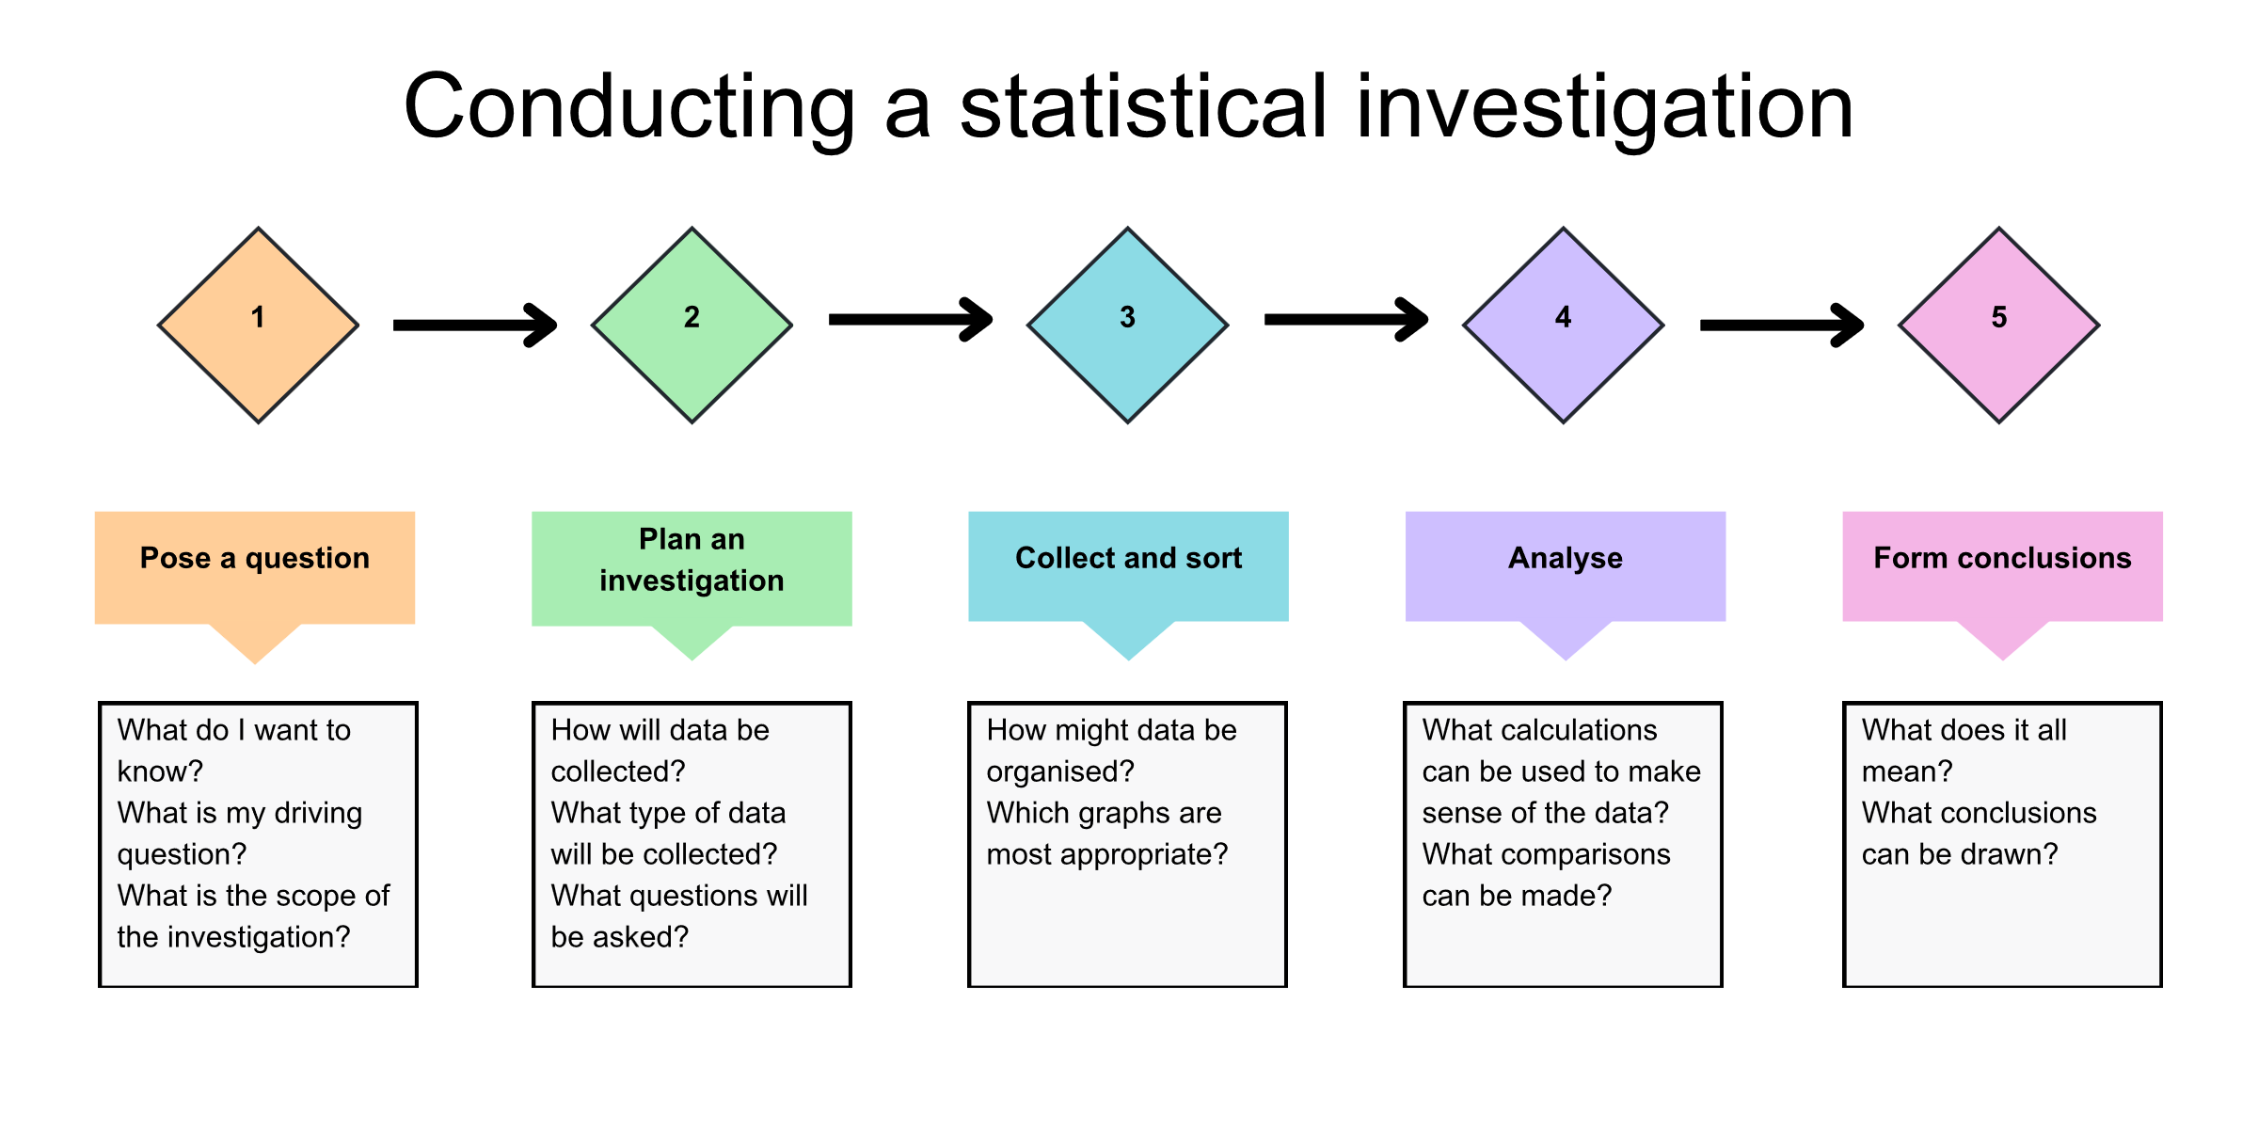
Statistical investigation process

Slide 5
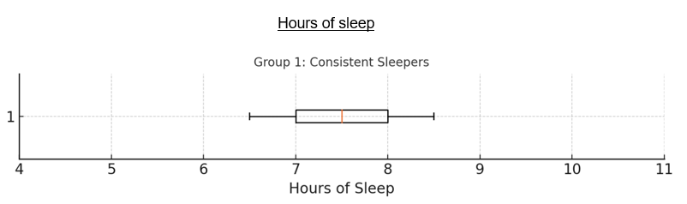
Creating datasets
Step 1: On your vertical non-permanent surface, write the five-number summary for the following box plot:
Step 2: Answer these questions:
  What is the range of your dataset?
  What is the IQR of your dataset?
  Which measure (range or IQR) better describes the spread? Why?
  Write one “75% of people…” and one “25% of people…” statement from your data.
Step 3: Create a set of 10–12 numbers that fits the box plot and matches your five-number summary.

Slide 6
Connecting learning

Slide 7
Comparing datasets
The 3 datasets below show the amount of sleep 3 different people get for 10 consecutive nights. Use the data to construct 3 parallel box plots :
Dataset A: 7, 7, 6, 7, 8, 7, 6, 7, 8, 14
Dataset B: 5, 8, 6, 7, 8, 5, 6, 7, 5, 12
Dataset C: 6, 6, 7, 7, 6, 6, 6, 8, 6, 13

Slide 8
Releasing responsibility

Slide 9
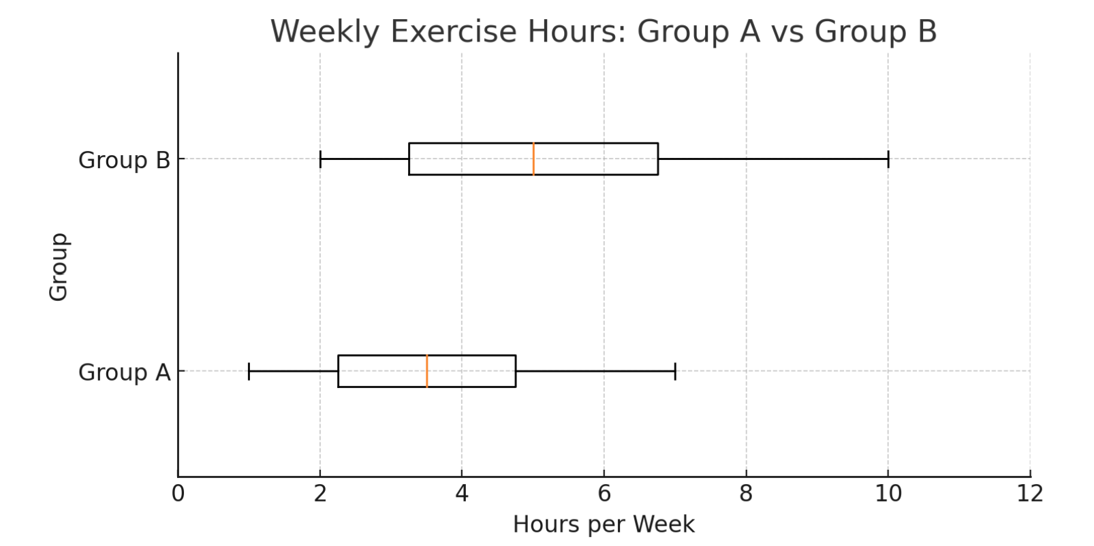
Two truths and a lie
50% of Group B is higher than that of 75% of Group A. | Group B has a wider range of values in the top 25% of the data. | If Group A had a maximum of 9, we could say they are equally as consistent because their ranges are the same.

Slide 10
Independent practice

Slide 11
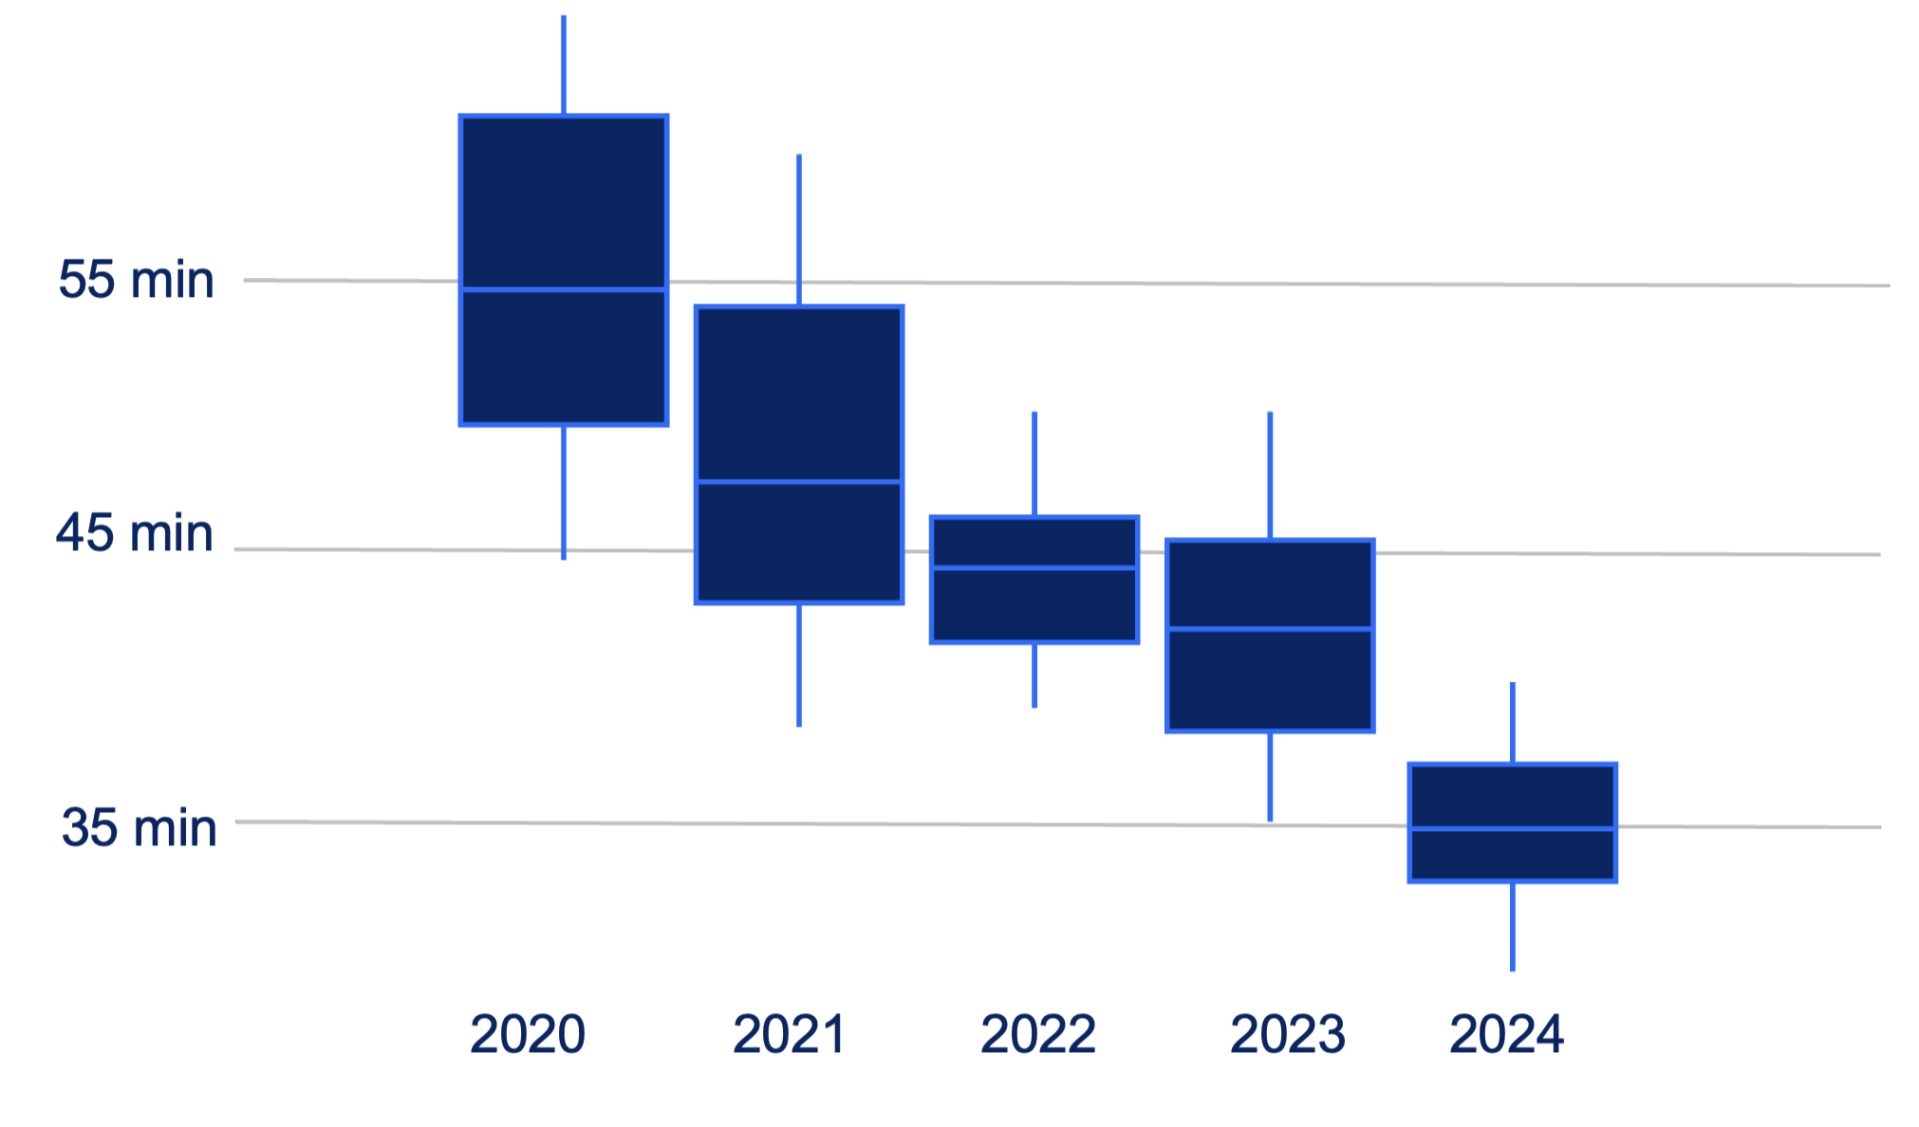
Scenario
5km running times

Slide 12
References
This presentation contains NSW Curriculum and syllabus content. The NSW Curriculum is developed by the NSW Education Standards Authority. This content is prepared by NESA for and on behalf of the Crown in the right of the State of New South Wales. The material is protected by Crown copyright.
Please refer to the NESA Copyright Disclaimer for more information https://educationstandards.nsw.edu.au/wps/portal/nesa/mini-footer/copyright.
NESA holds the only official and up-to-date versions of the NSW Curriculum and syllabus documents. Please visit the NSW Education Standards Authority (NESA) website https://educationstandards.nsw.edu.au/wps/portal/nesa/home and the NSW Curriculum website https://curriculum.nsw.edu.au.
Mathematics Standard 11–12 Syllabus © NSW Education Standards Authority (NESA) for and on behalf of the Crown in right of the State of New South Wales, 2024.

Slide 13
Copyright
© State of New South Wales (Department of Education), 2025
The copyright material published in this resource is subject to the Copyright Act 1968 (Cth) and is owned by the NSW Department of Education or, where indicated, by a party other than the NSW Department of Education (third-party material).
Copyright material available in this resource and owned by the NSW Department of Education is licensed under a Creative Commons Attribution 4.0 International (CC BY 4.0) license.
This license allows you to share and adapt the material for any purpose, even commercially.
Attribution should be given to © State of New South Wales (Department of Education), 2025.
Material in this resource not available under a Creative Commons license:
the NSW Department of Education logo, other logos and trademark-protected material
Material owned by a third party that has been reproduced with permission. You will need to obtain permission from the third party to reuse its material.
Links to third-party material and websites
Please note that the provided (reading/viewing material/list/links/texts) are a suggestion only and implies no endorsement, by the New South Wales Department of Education, of any author, publisher, or book title. School principals and teachers are best placed to assess the suitability of resources that would complement the curriculum and reflect the needs and interests of their students.
If you use the links provided in this document to access a third-party’s website, you acknowledge that the terms of use, including licence terms set out on the third-party’s website apply to the use which may be made of the materials on that third-party website or where permitted by the Copyright Act 1968 (Cth). The department accepts no responsibility for content on third-party websites.

