Slide 1
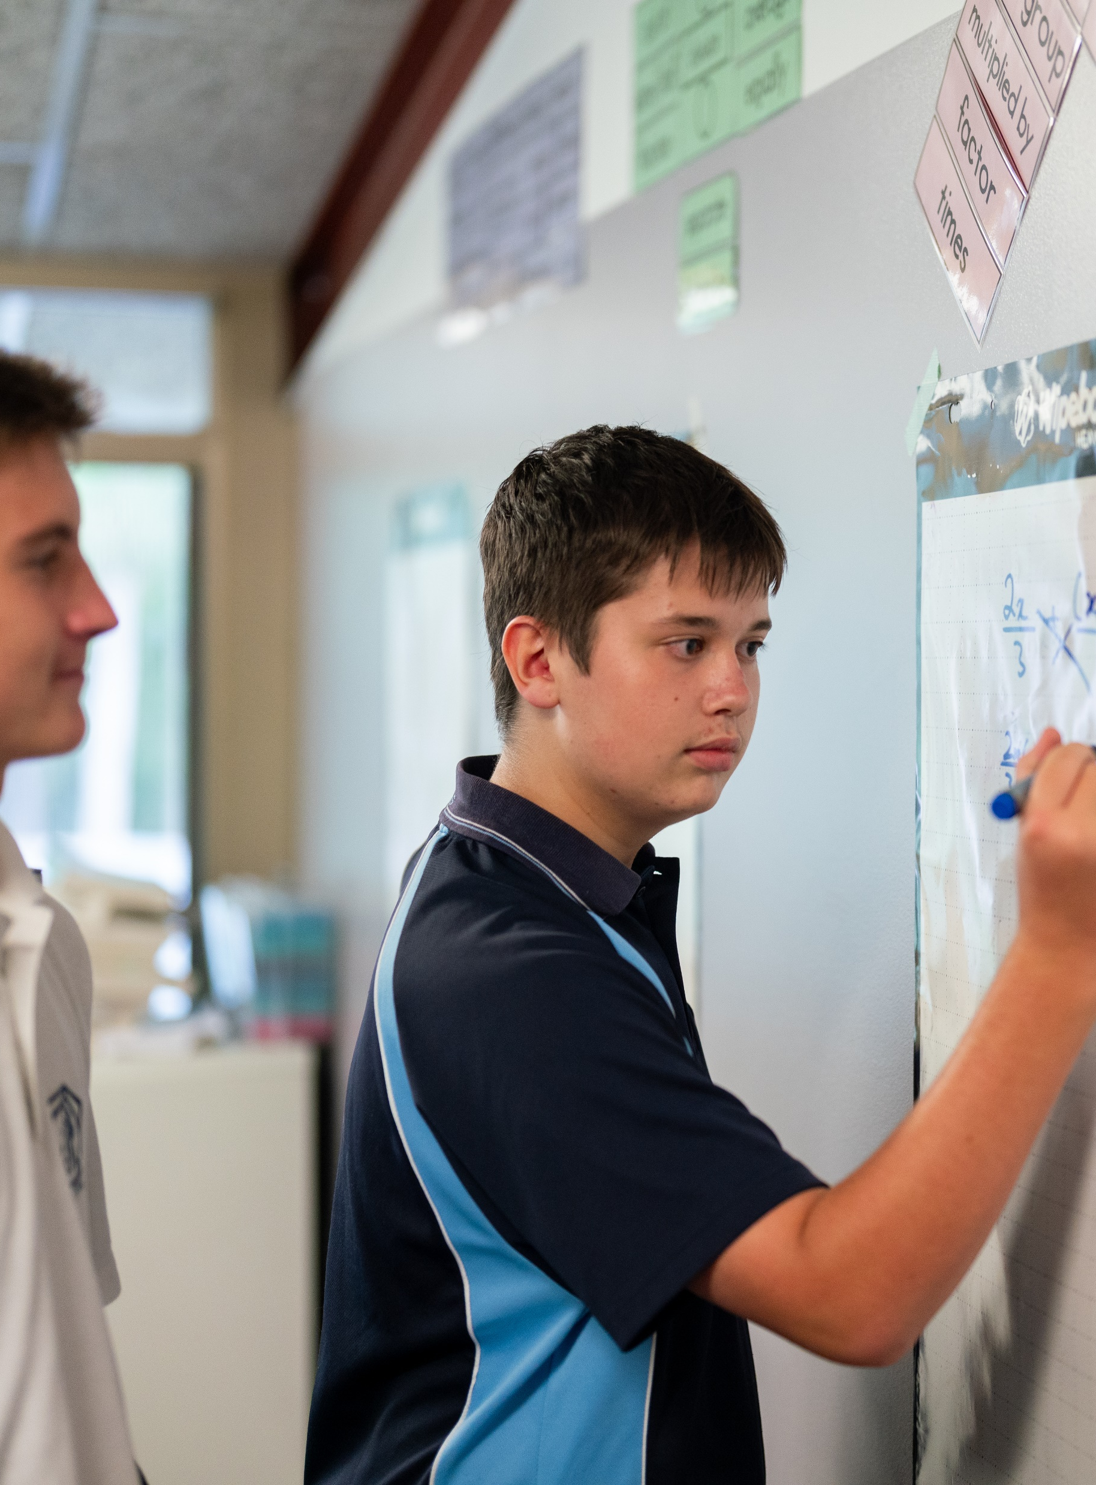
Five-number summary
Mathematics Standard – Stage 6 (Year 11)
Unit 1 – getting healthy

Slide 2
Learning intentions and success criteria
Learning intention
To be able to calculate and interpret the five-number summary from numerical data or graphical representations.
Success criteria
I can identify and calculate the minimum value, quartiles and maximum value of a dataset displayed in a variety of ways.
I can explain how cumulative frequency graph are used to find quartiles.
Notes:
Notes for teachers:
Learning intentions and success criteria are best co-constructed with students. Adapt the learning intention as required and add matching success criteria.
For more information See ⁠AITSL or the NSW Department of Education explicit teaching strategies, ⁠Sharing learning intentions and ⁠Sharing success criteria
LISC is not necessarily presented at the beginning of the lesson. Teacher needs to consider most effectual time to introduce
LISC should be revisited during the lesson to support students' evaluation of their learning

Slide 3
Activating prior knowledge

Slide 4
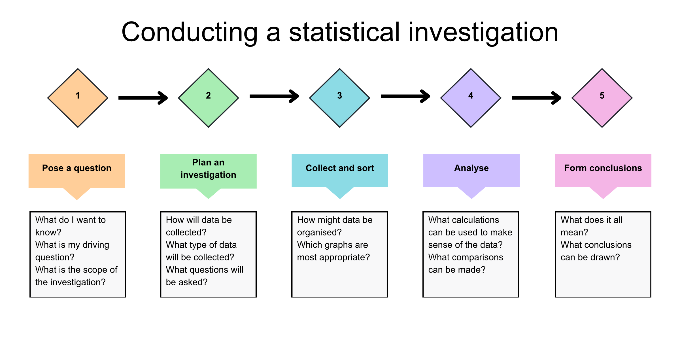
Statistical investigation process

Slide 5
Class data (1)
NSW Premier’s Sporting Challenge
Which class is doing better?
Class A
60, 280, 280, 280, 280, 300, 300, 300, 300, 300, 300, 300, 320, 320, 500
Class B
140, 160, 180, 200, 220, 240, 260, 280, 300, 320, 340, 360, 380, 400, 420

Slide 6
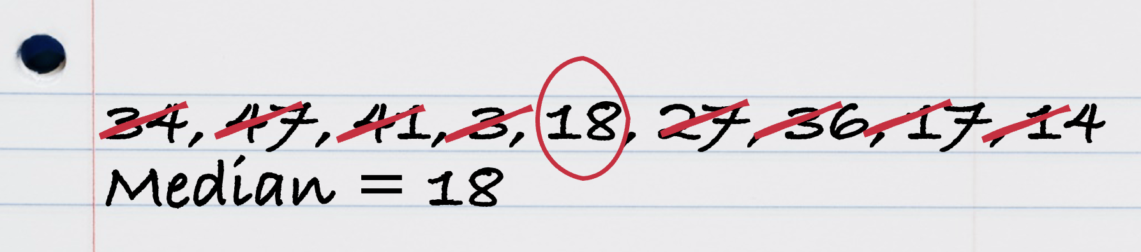
Five-number summary (1)
Incorrect example 1
Mark attempted to calculate the median of this dataset but made an error.
34, 47, 41, 3, 18, 27, 36, 17, 14
This is his working out.
What step has Mark forgotten to do?
What did Mark do well?

Slide 7
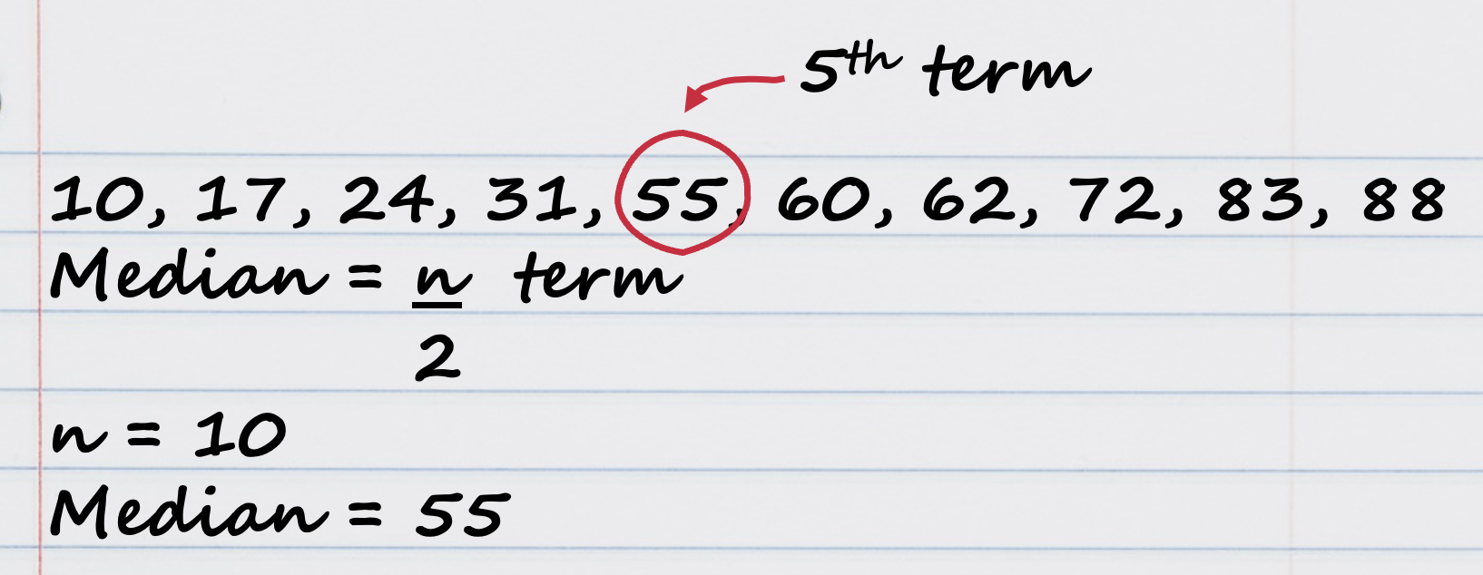
Five-number summary (2)
Incorrect example 2
Helena attempted to calculate the median of this dataset but made an error.
24, 17, 55, 83, 72, 62, 31, 60, 88, 10
This is her working out.
What should Helena do when she has an even number of scores?
What should this look like algebraically?

Slide 8
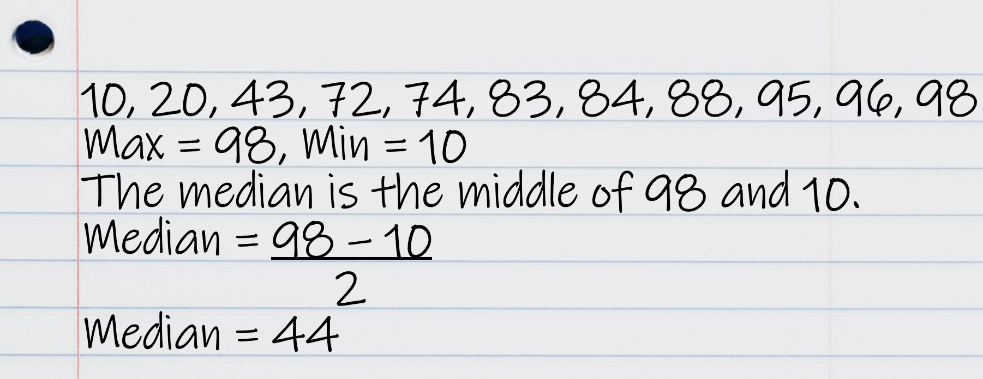
Five-number summary (3)
Incorrect example 3
Dylan attempted to calculate the median of this dataset but made an error.
43, 96, 98, 72, 88, 84, 95, 20, 83, 74, 10
This is his working out.
How has Dylan misunderstood the term median?
How could you explain the term median to Dylan to help with his misconception?

Slide 9
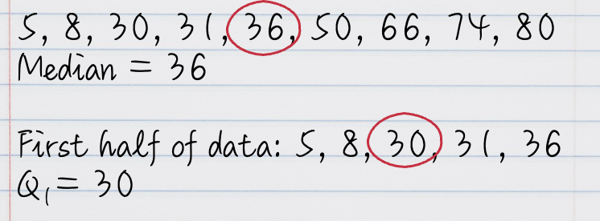
Five-number summary (4)
Incorrect example 4
Harmony attempted to calculate the lower quartile from the dataset but made an error.
5, 66, 50, 30, 31, 74, 36, 80, 8
This is her working out.
Has Harmony calculated the median correctly?
Have the correct numbers been included for the lower half of the data?

Slide 10
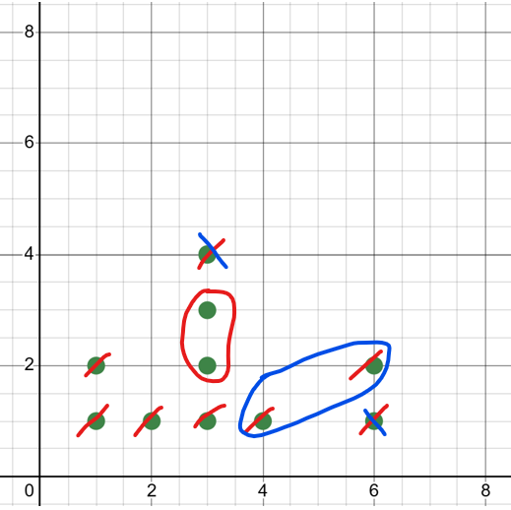
Five-number summary (5)
Incorrect example 5
Seth attempted to calculate the upper quartile from the dot plot but made an error.
Here is his working out.
Has Seth calculated the median correctly?
How else could Seth have organised this data?
median = 3
Quartile 3 = 5
Have the correct numbers been included for the upper half of the data?
Notes:
1, 1, 2, 3, 3, 3, 3, 4, 6, 6

Slide 11
Connecting learning

Slide 12
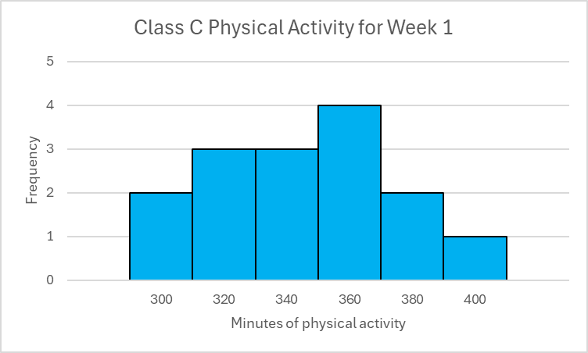
Class data (2)
NSW Premier’s Sporting Challenge
Class D Physical Activity for Week 1
Minutes | Frequency
200 | 1
220 | 0
240 | 1
260 | 1
280 | 5
300 | 3
320 | 1
340 | 0
360 | 2
380 | 1
Notes:
300 300 320 320 320 340 340 340 360 360 360 360 380 380 400
200 240 260 280 280 280 280 280 300 300 300 320 360 360 380

Slide 13
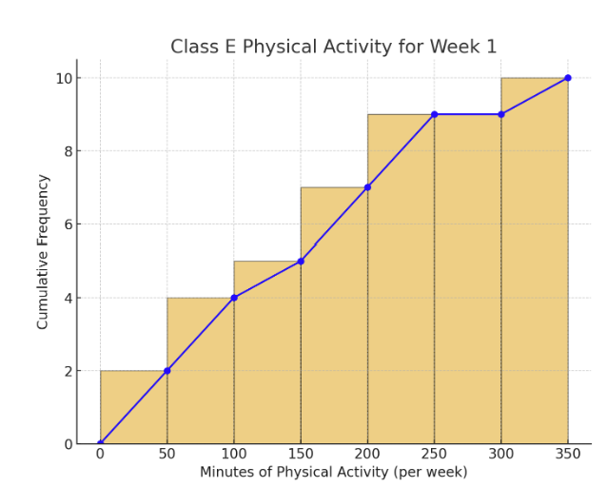
Class data (3)
NSW Premier’s Sporting Challenge

Slide 14
Releasing responsibility

Slide 15
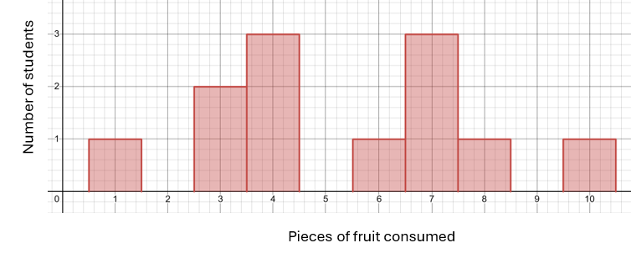

Five-number summary (6)
Worked example 1
The histogram shows the survey results of how many pieces of fruit a class of Year 11 students consume in a week. Determine the five-number summary and use this to calculate the interquartile range.
Fruit consumed in a week by students
1, 3, 3, | 4, 4, 4, | 6, 7, 7, | 7, 8, 10
$$Min=1 \\ Q_{1}=3.5 \\ Median=5 \\ Q_{3}=7 \\ Max=10$$
Why has the data been listed?
Is there another way to determine the median and quartiles?

Slide 16
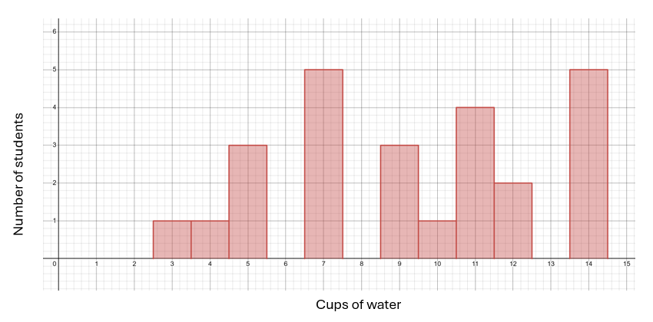
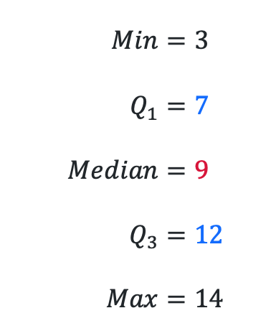
Five-number summary (7)
Your turn question 1
The histogram represents the cups of water consumed by Year 11 students in 3 days. Determine the five-number summary.
Water consumed by Year 11 students
$$Min=3 \\ Q_{1}=7 \\ Median=9 \\ Q_{3}=12 \\ Max=14$$
3, 4, 5, 5, 5, 7, | 7, 7, 7, 7, 9, 9, 9, 10, 11, 11, 11, 11, 12, | 12, 14, 14, 14, 14, 14

Slide 17
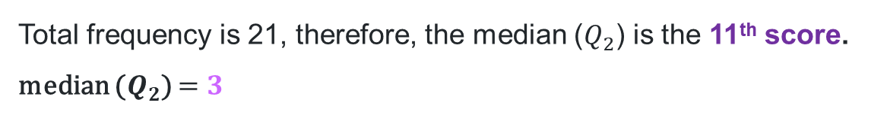
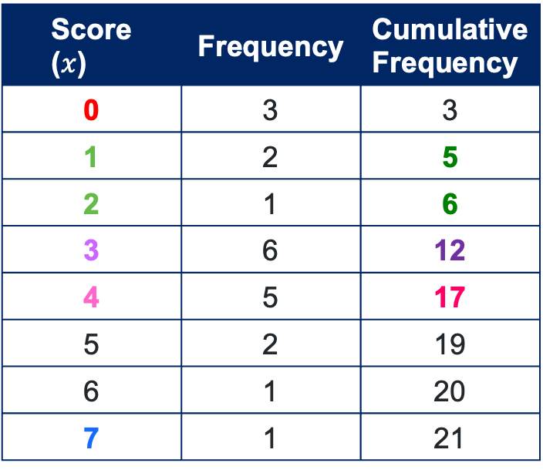
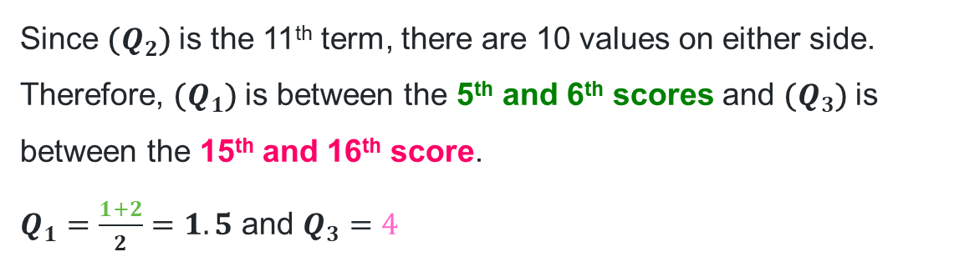


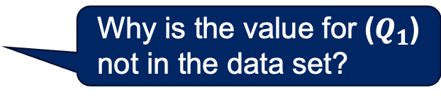
Five-number summary (8)
Worked example 2
The frequency table shows the survey results of how many days the members of a Year 11 class exercised last week. Determine the five-number summary for the data.
Where did these numbers come from?
Score ($x$) | Frequency | Cumulative Frequency
0 | 3 | 3
1 | 2 | 5
2 | 1 | 6
3 | 6 | 12
4 | 5 | 17
5 | 2 | 19
6 | 1 | 20
7 | 1 | 21
$$min=0$$
$$max=7$$
Total frequency is 21, therefore, the median ($Q_{2}$) is the 11th score.
median ($Q_{2}$) $=3$
Why is the median 3?
Since ($Q_{2}$) is the 11th term, there are 10 values on either side. Therefore, ($Q_{1}$) is between the 5th and 6th scores and ($Q_{3}$) is between the 15th and 16th score.
$Q_{1}=\frac{1+2}{2}=1.5$ and $Q_{3}=4$
Why is the value for ($Q_{1}$) not in the data set?

Slide 18
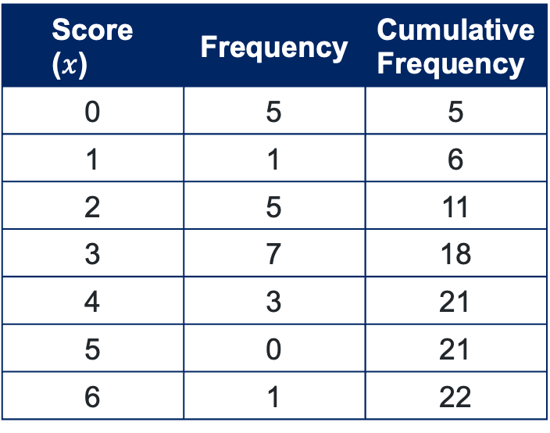
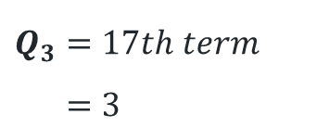
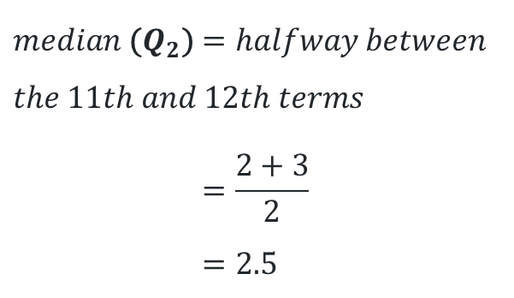
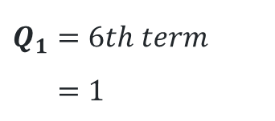
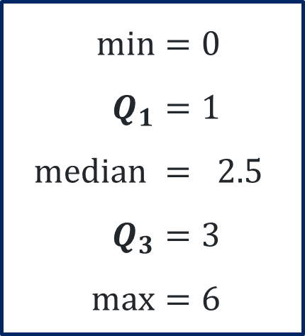
Five-number summary (9)
Your turn question 2
The frequency table shows the survey results of how many days members of a Year 12 class exercised last week. Determine the five-number summary.
Score ($x$) | Frequency | Cumulative Frequency
0 | 5 | 5
1 | 1 | 6
2 | 5 | 11
3 | 7 | 18
4 | 3 | 21
5 | 0 | 21
6 | 1 | 22
$$median \text{(}Q_{2}\text{)}=halfway between \\ the 11th and 12th terms \\ =\frac{2+3}{2} \\ =2.5$$
$$min=0 \\ Q_{1}=1 \\ median = 2.5 \\ Q_{3}=3 \\ max=6$$
$$Q_{1}=6th term \\ =1$$
$$Q_{3}=17th term \\ =3$$

Slide 19
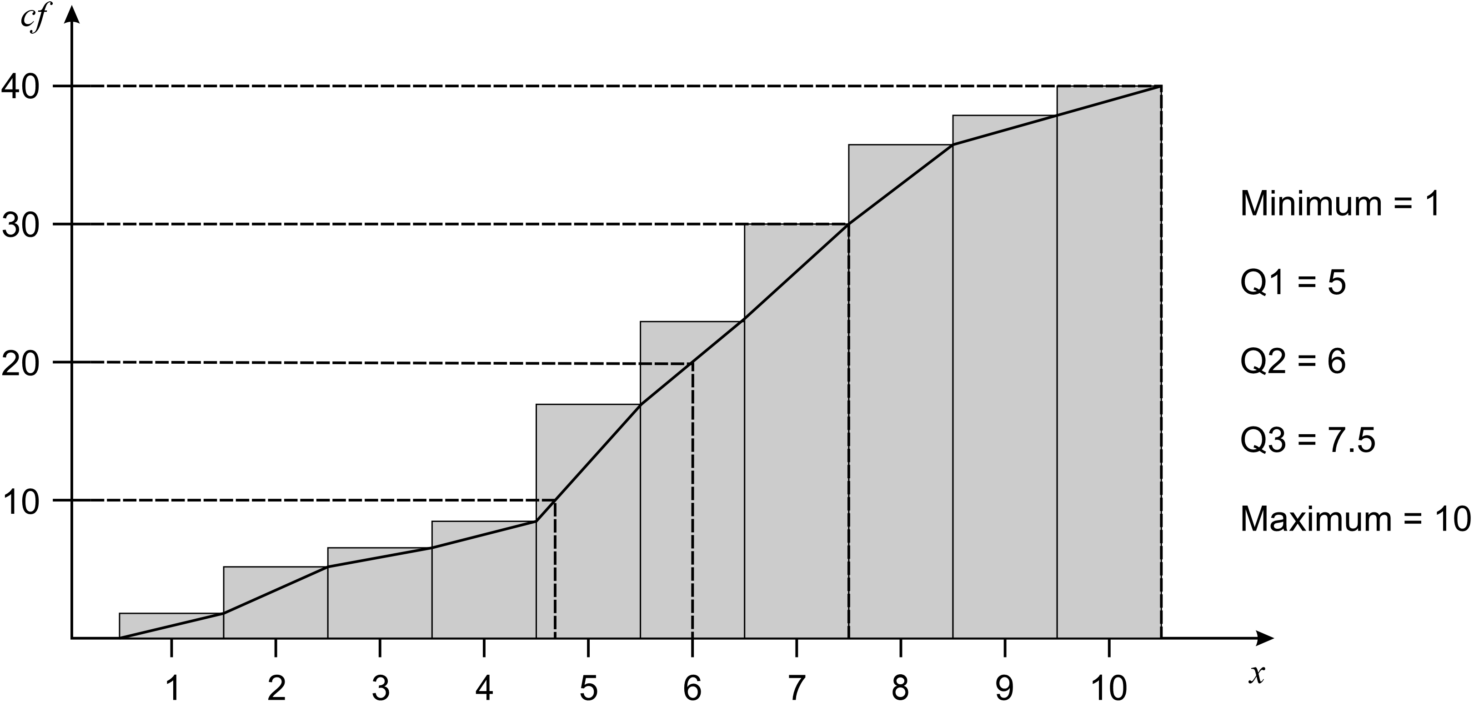
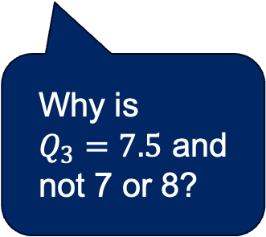
Cumulative frequency
Worked example 3
Why is
$Q_{3}=7.5$ and not 7 or 8?
Why are horizontal lines drawn at 10, 20, 30 and 40?

Slide 20
Independent practice

Slide 21

Approaching questions scaffold

Slide 22
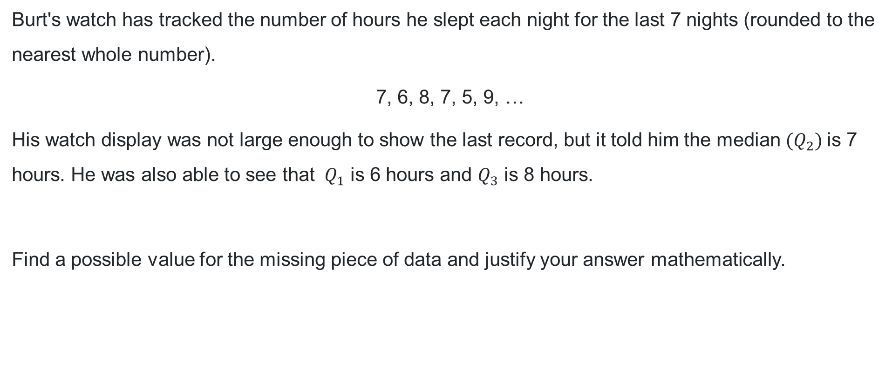
HSC Focus
HSC style question
Burt's watch has tracked the number of hours he slept each night for the last 7 nights (rounded to the nearest whole number).
7, 6, 8, 7, 5, 9, …
His watch display was not large enough to show the last record, but it told him the median ($Q_{2}$) is 7 hours. He was also able to see that $Q_{1}$ is 6 hours and $Q_{3}$ is 8 hours.
Find a possible value for the missing piece of data and justify your answer mathematically.

Slide 23
References
This presentation contains NSW Curriculum and syllabus content. The NSW Curriculum is developed by the NSW Education Standards Authority. This content is prepared by NESA for and on behalf of the Crown in the right of the State of New South Wales. The material is protected by Crown copyright.
Please refer to the NESA Copyright Disclaimer for more information https://educationstandards.nsw.edu.au/wps/portal/nesa/mini-footer/copyright.
NESA holds the only official and up-to-date versions of the NSW Curriculum and syllabus documents. Please visit the NSW Education Standards Authority (NESA) website https://educationstandards.nsw.edu.au/wps/portal/nesa/home and the NSW Curriculum website https://curriculum.nsw.edu.au.
Mathematics Standard 11–12 Syllabus © NSW Education Standards Authority (NESA) for and on behalf of the Crown in right of the State of New South Wales, 2024.

Slide 24
Copyright
© State of New South Wales (Department of Education), 2025
The copyright material published in this resource is subject to the Copyright Act 1968 (Cth) and is owned by the NSW Department of Education or, where indicated, by a party other than the NSW Department of Education (third-party material).
Copyright material available in this resource and owned by the NSW Department of Education is licensed under a Creative Commons Attribution 4.0 International (CC BY 4.0) license.
This license allows you to share and adapt the material for any purpose, even commercially.
Attribution should be given to © State of New South Wales (Department of Education), 2025.
Material in this resource not available under a Creative Commons license:
the NSW Department of Education logo, other logos and trademark-protected material
Material owned by a third party that has been reproduced with permission. You will need to obtain permission from the third party to reuse its material.
Links to third-party material and websites
Please note that the provided (reading/viewing material/list/links/texts) are a suggestion only and implies no endorsement, by the New South Wales Department of Education, of any author, publisher, or book title. School principals and teachers are best placed to assess the suitability of resources that would complement the curriculum and reflect the needs and interests of their students.
If you use the links provided in this document to access a third-party’s website, you acknowledge that the terms of use, including licence terms set out on the third-party’s website apply to the use which may be made of the materials on that third-party website or where permitted by the Copyright Act 1968 (Cth). The department accepts no responsibility for content on third-party websites.

