Slide 1

Finding and using the equation of the line of best fit
Mathematics Standard 2 – Stage 6 (Year 12)
Correlation

Slide 2
Learning intentions and success criteria
Learning intentions
To be able to determine the equation of a line of best fit.
Success criteria
I can identify the y-intercept from a graph.
I can determine the equation of the line of best fit using the gradient and y-intercept.
I can determine the equation of the line of best fit given a gradient and point on the line.

Slide 3
Activating prior knowledge

Slide 4
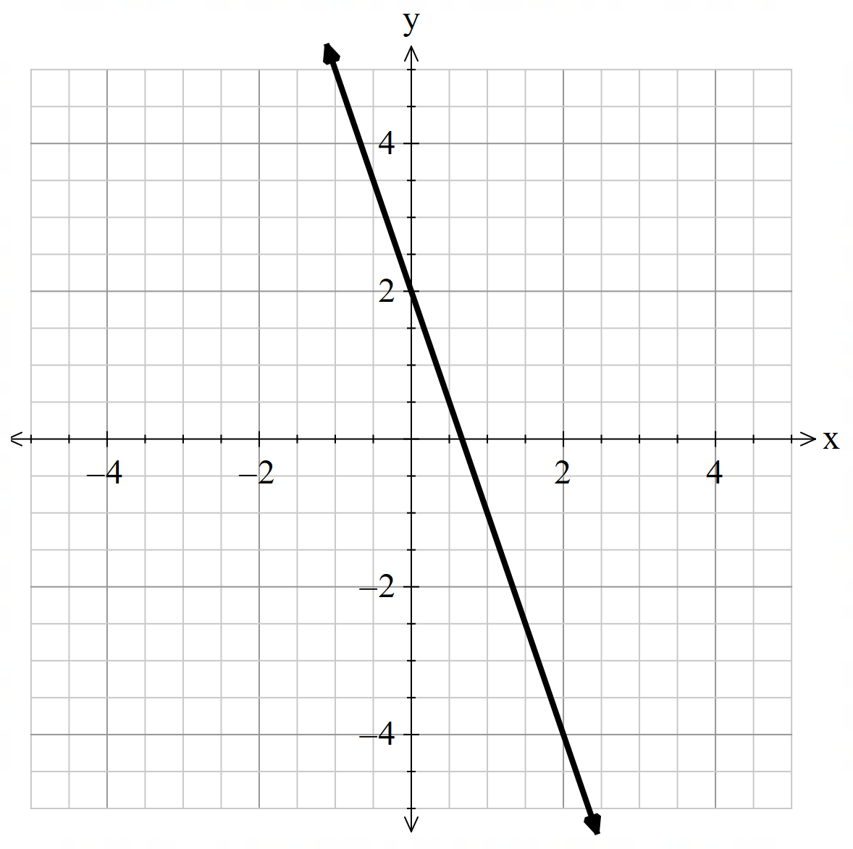

Equations of lines (1)
Convince me - question 1
Convince me that the equation of the line shown in the graph is $y=−3x+2,$and not $y=3x+2$.

Slide 5
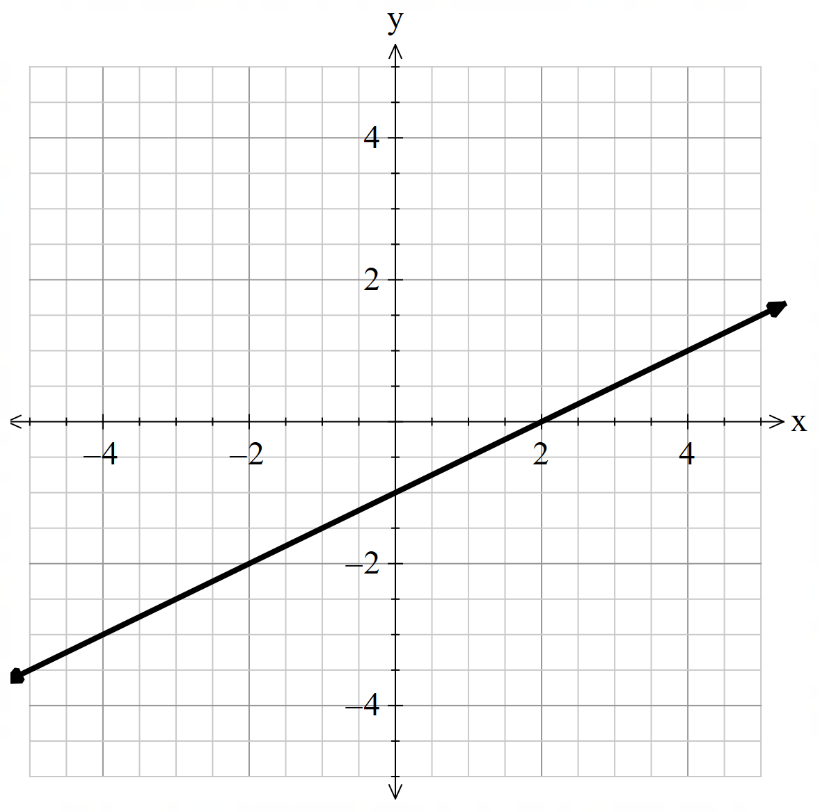

Equations of lines (2)
Convince me – question 2
Convince me that the equation of the line shown in the graph is $y=\frac{1}{2}x−1,$and not $y=\frac{1}{2}x+2$.

Slide 6
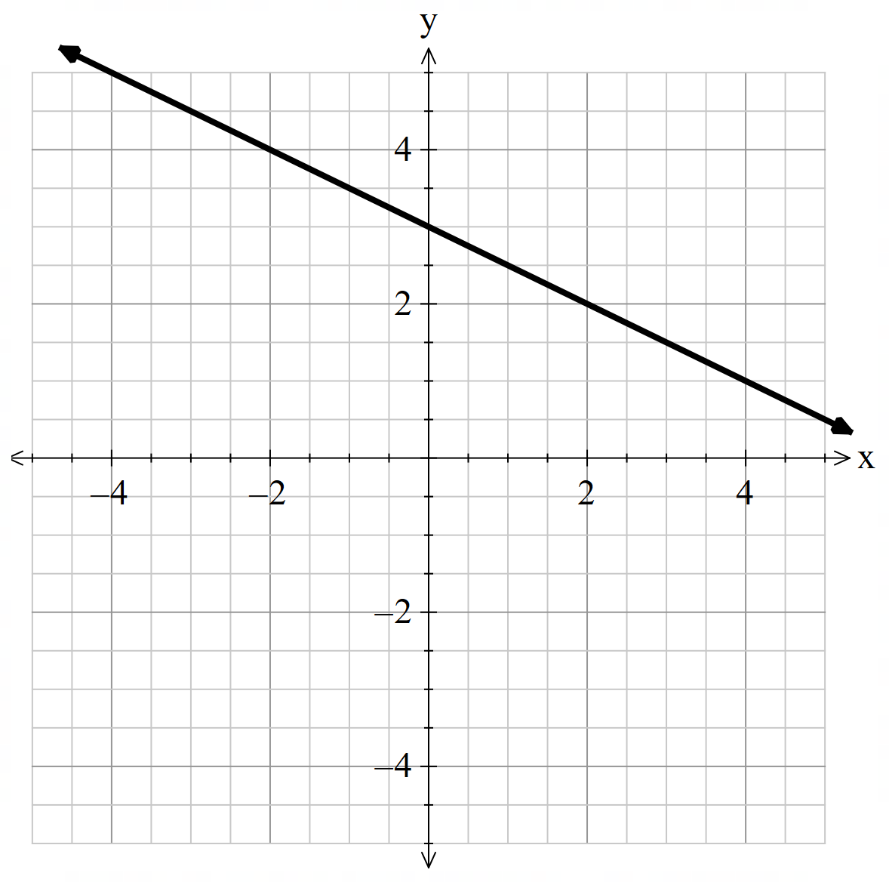

Equation of a line (3)
Convince me – question 3
Convince me that the equation of the line shown in the graph is $y=−\frac{1}{2}x+3,$and not $y=−2x+3$.

Slide 7
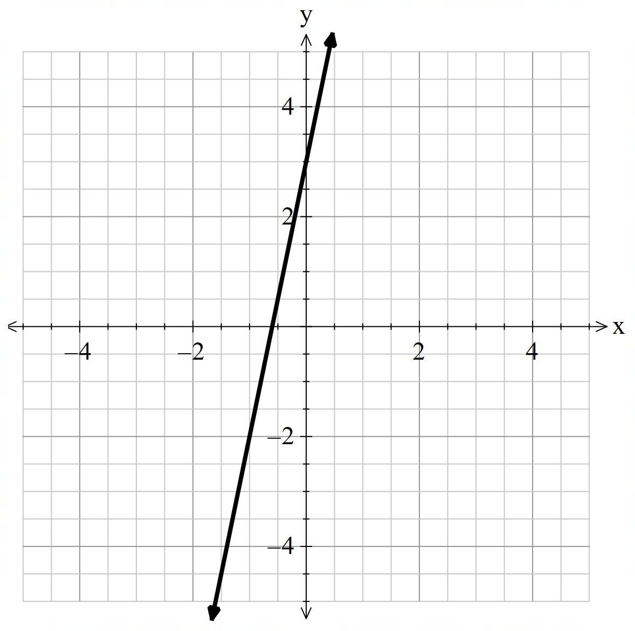

Equation of a line (4)
Convince me – question 4
Convince me that the equation of the line shown in the graph is $y=5x+3,$and not $y=3x+5$.

Slide 8
Connecting learning

Slide 9
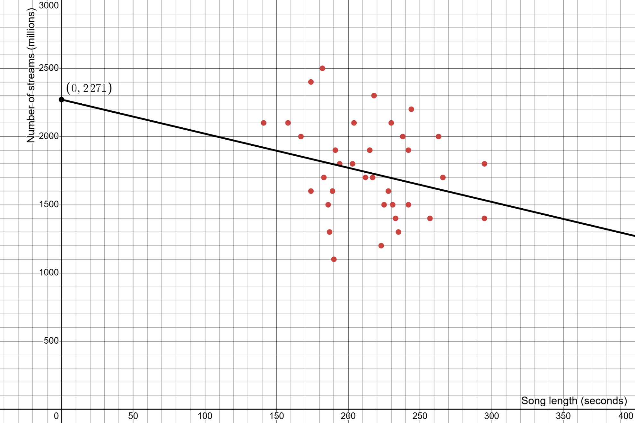
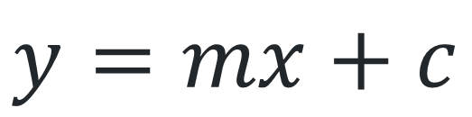
Finding the equation of the line of best fit (1)
Scatter plot
$$y=mx+c$$

Slide 10
Releasing responsibility

Slide 11
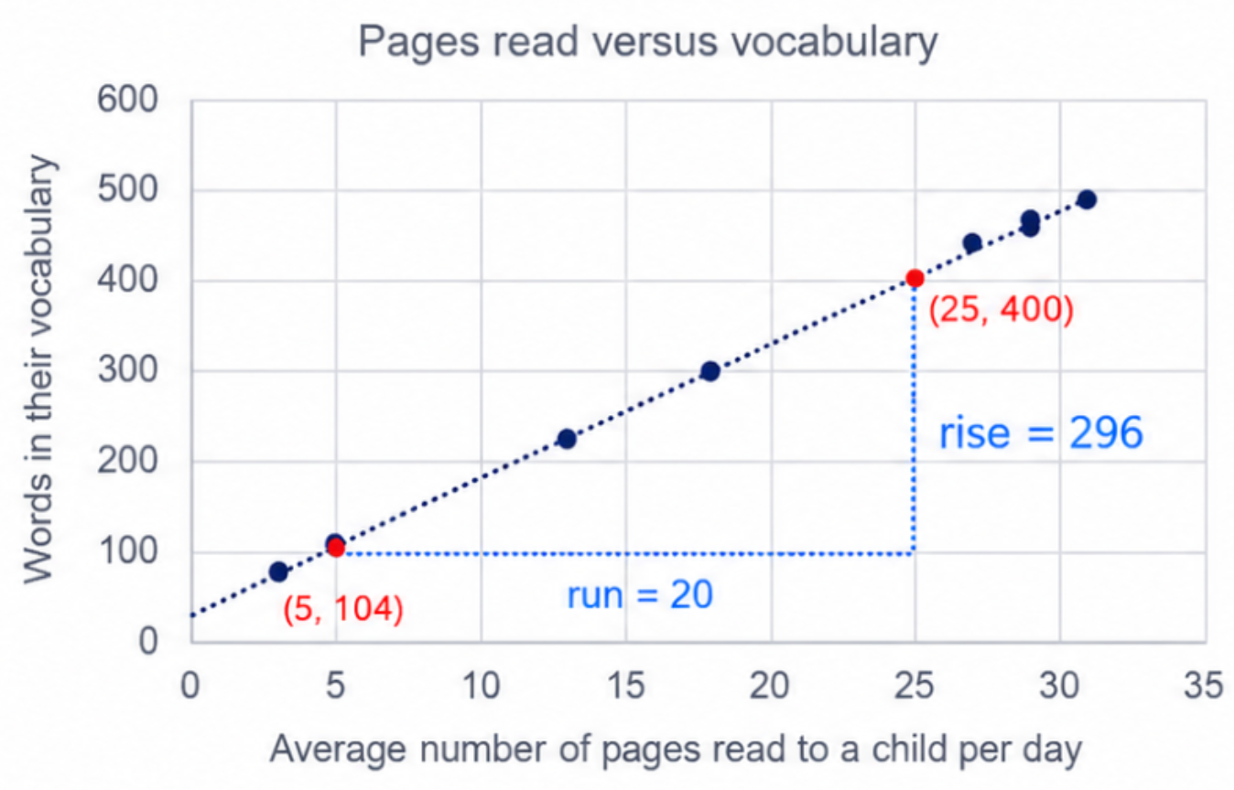
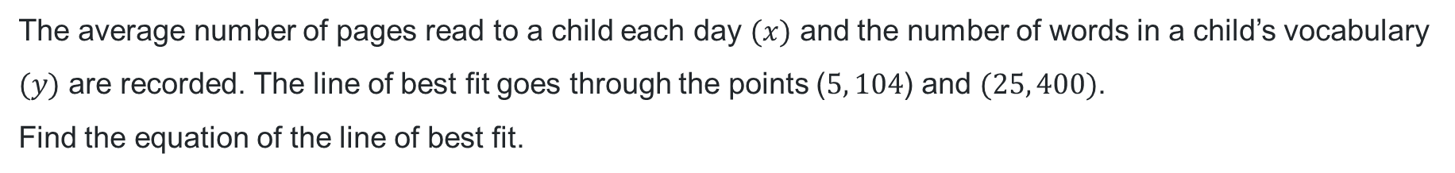
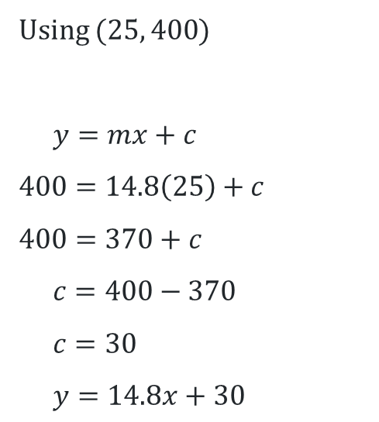
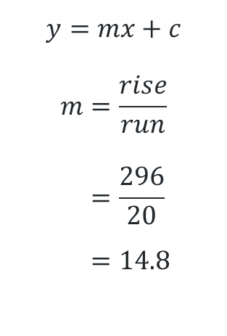
Finding and using the equation of the line of best fit (1)
Worked example 1
The average number of pages read to a child each day $(x)$ and the number of words in a child’s vocabulary $(y)$ are recorded. The line of best fit goes through the points ($5, 104$) and $(25, 400)$.
Find the equation of the line of best fit.
How did we find the rise and run?
Using ($25, 400$)
$$y=mx+c$$
$$400=14.8\left(25\right)+c$$
$$400=370+c$$
$$c=400−370$$
$$c=30$$
$$y=14.8x+30$$
$$y=mx+c$$
$$m=\frac{rise}{run} \\ =\frac{296}{20} \\ =14.8$$
How do we know which values to substitute into the equation?
What does the 30 tells us about the line of best fit?

Slide 12
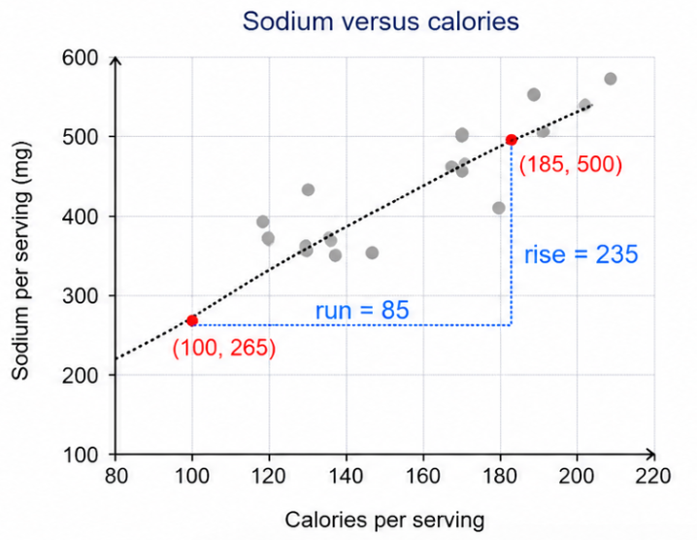
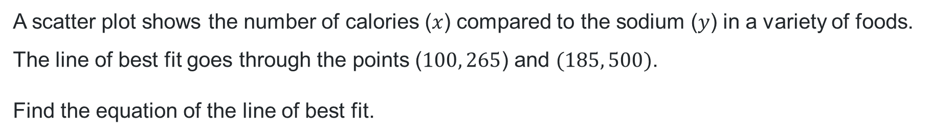
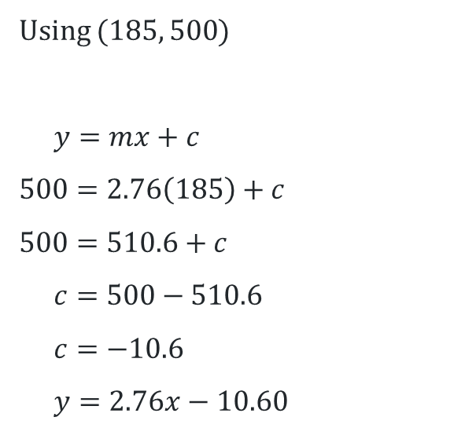
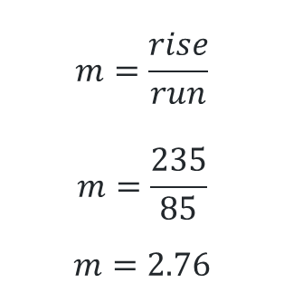
Finding and using the equation of the line of best fit (2)
Your turn – question 1
A scatter plot shows the number of calories ($x$) compared to the sodium ($y$) in a variety of foods. The line of best fit goes through the points ($100, 265$) and $(185, 500)$.
Find the equation of the line of best fit.
Using ($185, 500$)
$$y=mx+c$$
$$500=2.76\left(185\right)+c$$
$$500=510.6+c$$
$$c=500−510.6$$
$$c=−10.6$$
$$y=2.76x−10.60$$
$$m=\frac{rise}{run}$$
$$m=\frac{235}{85}$$
$$m=2.76$$

Slide 13
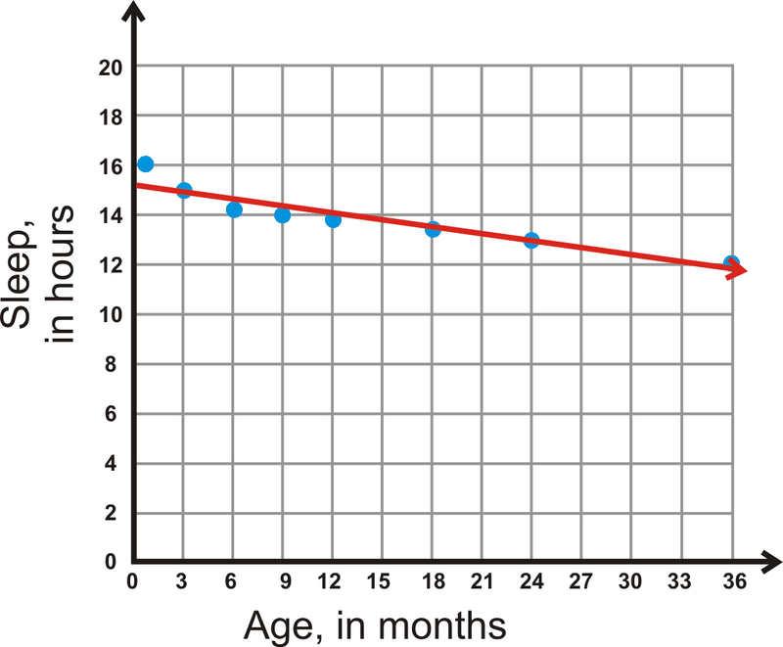
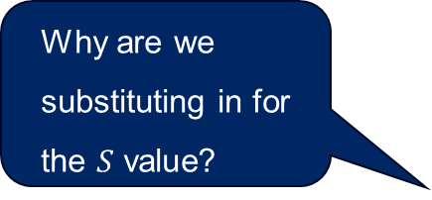
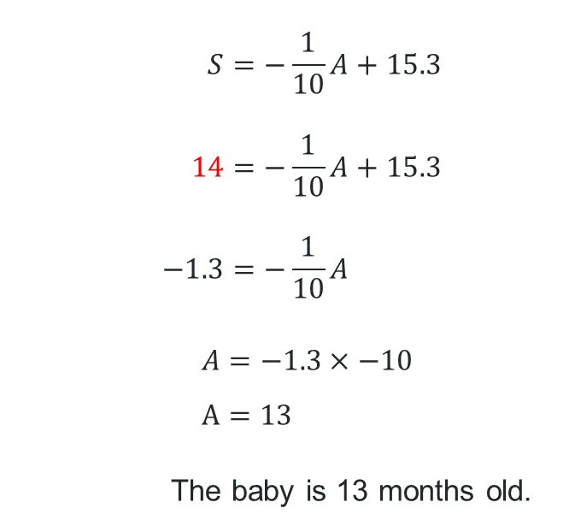
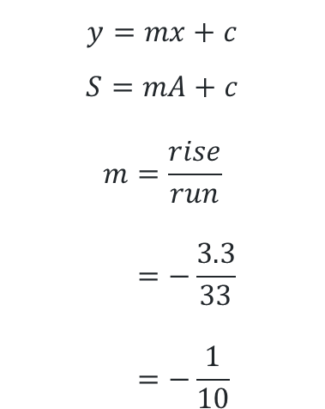
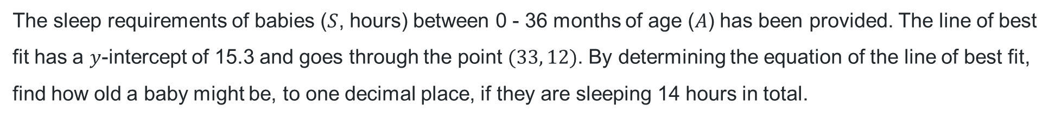
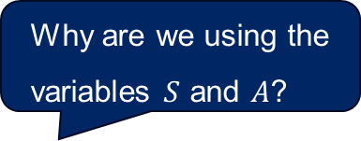
Using the line of best fit (1)
Worked example 2
The sleep requirements of babies ($S$, hours) between 0 - 36 months of age ($A$) has been provided. The line of best fit has a $y$-intercept of 15.3 and goes through the point $(33, 12)$. By determining the equation of the line of best fit, find how old a baby might be, to one decimal place, if they are sleeping 14 hours in total.
Why are we using the variables $S$ and $A$?
$$y=mx+c$$
$$S=mA+c$$
$$m=\frac{rise}{run} \\ =−\frac{3.3}{33} \\ =−\frac{1}{10}$$
Why are we substituting in for the $S$ value?
$$S=−\frac{1}{10}A+15.3 \\ 14=−\frac{1}{10}A+15.3 \\ −1.3=−\frac{1}{10}A$$
$$A=−1.3×−10 \\ A=13$$
The baby is 13 months old.
run
rise
How else could this be written?
Why is this gradient negative?

Slide 14
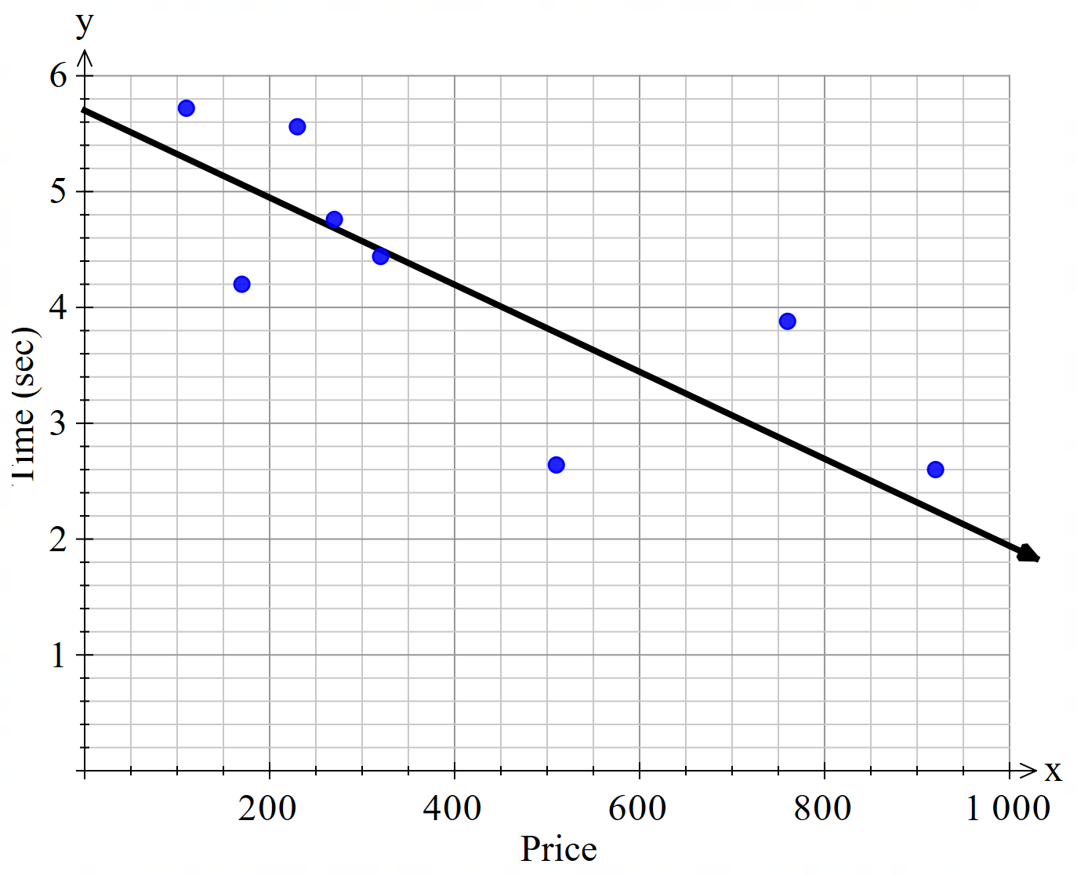
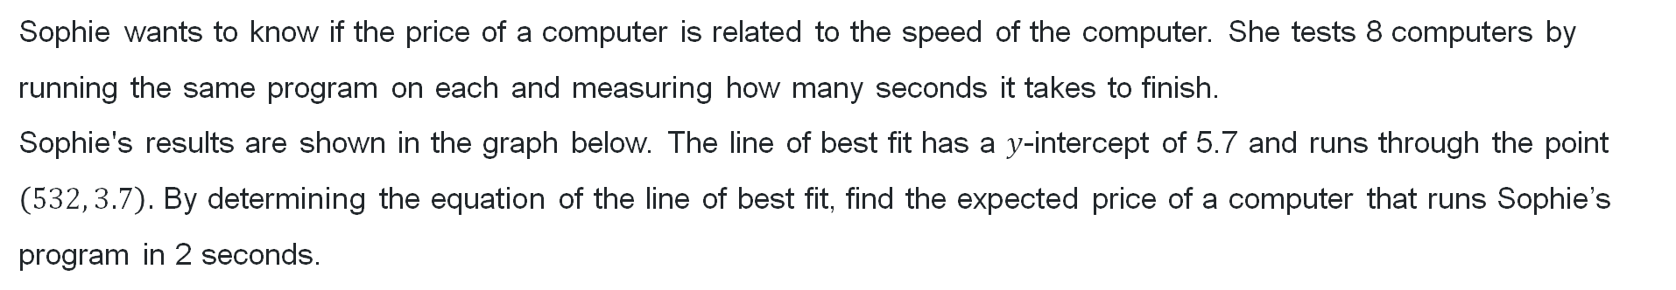
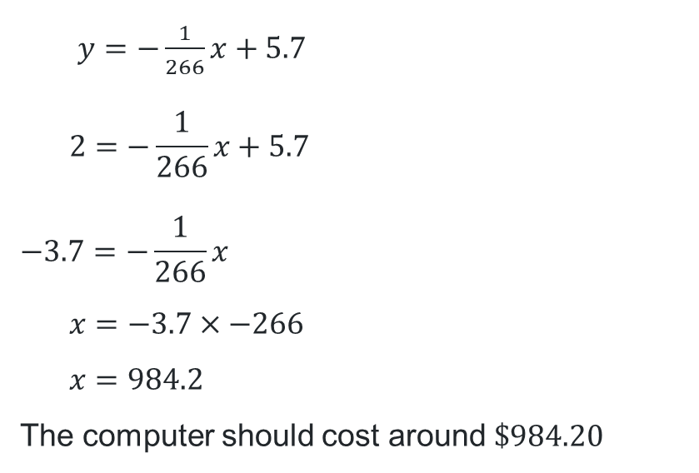

Using the line of best fit (2)
Your turn – question 2
Sophie wants to know if the price of a computer is related to the speed of the computer. She tests 8 computers by running the same program on each and measuring how many seconds it takes to finish.
Sophie's results are shown in the graph below. The line of best fit has a $y$-intercept of 5.7 and runs through the point $\left(532, 3.7\right).$ By determining the equation of the line of best fit, find the expected price of a computer that runs Sophie’s program in 2 seconds.
$y=−\frac{1}{266}x+5.7$
$$2=−\frac{1}{266}x+5.7$$
$$−3.7=−\frac{1}{266}x$$
$$x=−3.7×−266 \\ x=984.2$$
The computer should cost around $\$984.20$
run
$$m=\frac{rise}{run} \\ =−\frac{2}{532} \\ =−\frac{1}{266}$$
Time (s)
rise

Slide 15
Independent practice

Slide 16

Approaching questions scaffold

Slide 17
References
This presentation contains NSW Curriculum and syllabus content. The NSW Curriculum is developed by the NSW Education Standards Authority. This content is prepared by NESA for and on behalf of the Crown in the right of the State of New South Wales. The material is protected by Crown copyright.
Please refer to the NESA Copyright Disclaimer for more information https://educationstandards.nsw.edu.au/wps/portal/nesa/mini-footer/copyright.
NESA holds the only official and up-to-date versions of the NSW Curriculum and syllabus documents. Please visit the NSW Education Standards Authority (NESA) website https://educationstandards.nsw.edu.au/wps/portal/nesa/home and the NSW Curriculum website https://curriculum.nsw.edu.au.
Mathematics Standard 11–12 Syllabus © NSW Education Standards Authority (NESA) for and on behalf of the Crown in right of the State of New South Wales, 2024.
.

Slide 18
Copyright
© State of New South Wales (Department of Education), 2026
The copyright material published in this resource is subject to the Copyright Act 1968 (Cth) and is owned by the NSW Department of Education or, where indicated, by a party other than the NSW Department of Education (third-party material).
Copyright material available in this resource and owned by the NSW Department of Education is licensed under a Creative Commons Attribution 4.0 International (CC BY 4.0) license.
This license allows you to share and adapt the material for any purpose, even commercially.
Attribution should be given to © State of New South Wales (Department of Education), 2026.
Material in this resource not available under a Creative Commons license:
the NSW Department of Education logo, other logos and trademark-protected material
Material owned by a third party that has been reproduced with permission. You will need to obtain permission from the third party to reuse its material.
Links to third-party material and websites
Please note that the provided (reading/viewing material/list/links/texts) are a suggestion only and implies no endorsement, by the New South Wales Department of Education, of any author, publisher, or book title. School principals and teachers are best placed to assess the suitability of resources that would complement the curriculum and reflect the needs and interests of their students.
If you use the links provided in this document to access a third-party’s website, you acknowledge that the terms of use, including licence terms set out on the third-party’s website apply to the use which may be made of the materials on that third-party website or where permitted by the Copyright Act 1968 (Cth). The department accepts no responsibility for content on third-party websites.

