Slide 1
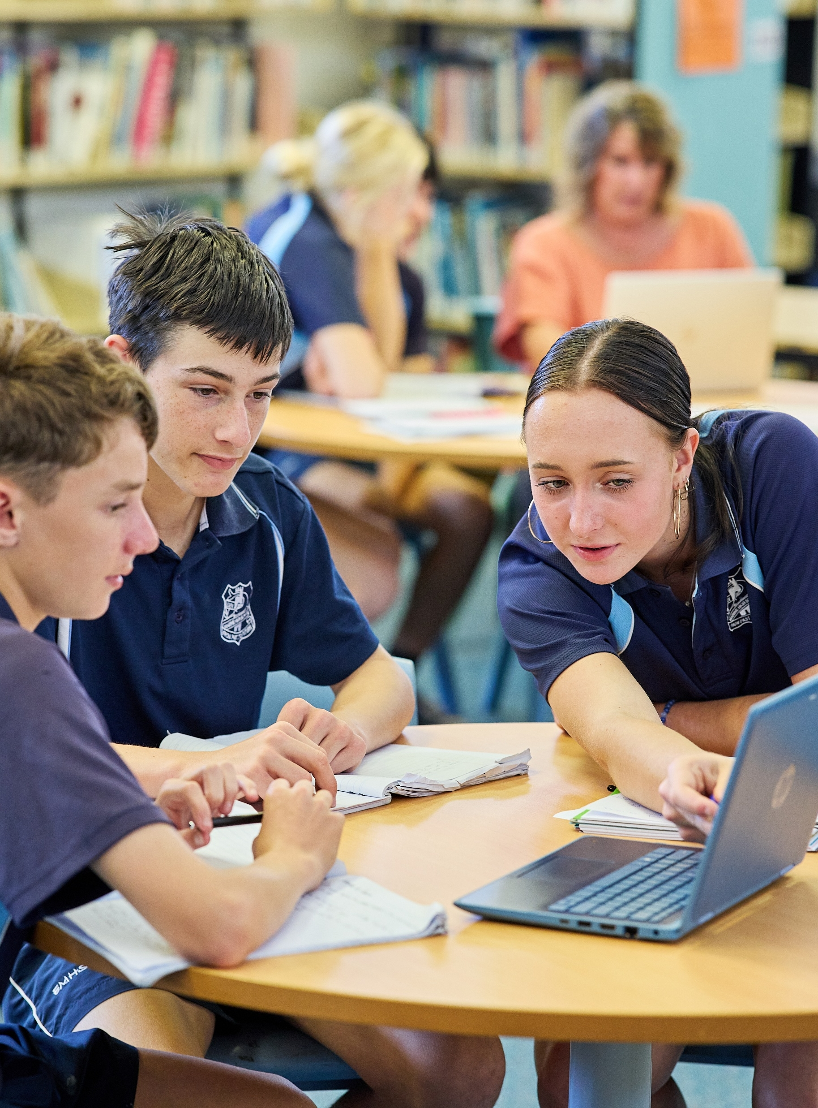
Creating and using the line of best fit by hand
Mathematics Standard – Stage 6 (Year 12)
Correlation

Slide 2
Learning intentions and success criteria
Learning intentions
To be able to create a line of best fit to represent a relationship between 2 variables.
To be able to use a line of best fit to make predictions.
Success criteria
I can draw a line of best fit by eye through a scatter plot.
I can explain the differences between interpolating and extrapolating.
I can interpolate and extrapolate using a line of best fit.
I can explain the limitations of a model given the context.

Slide 3
Connecting learning

Slide 4
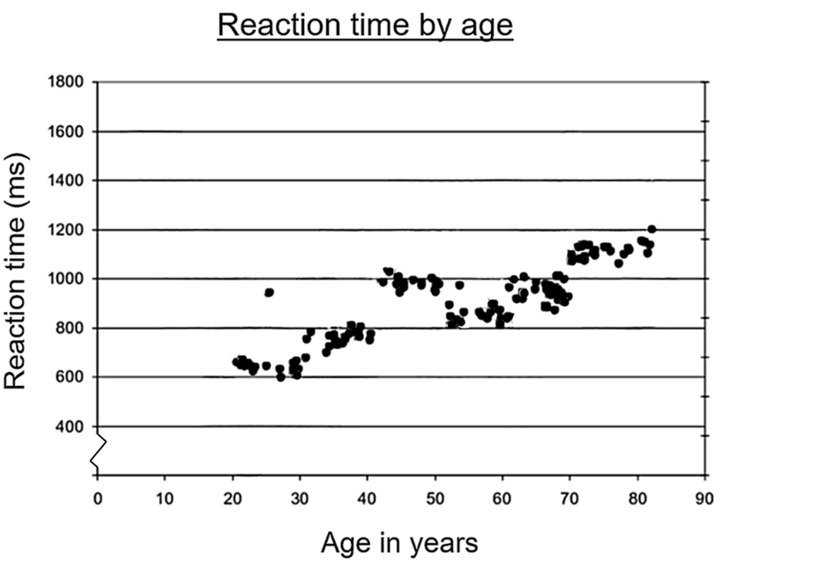
Line of best fit (1)
Age versus reaction time
Predict the reaction times for a:
50-year-old
70-year-old
90-year-old
10-year-old
Graph modified from the research article ‘Life-span changes in task switching’ by Melody Wiseheart (bit.ly/life-span-task-switching).

Slide 5
Releasing responsibility

Slide 6
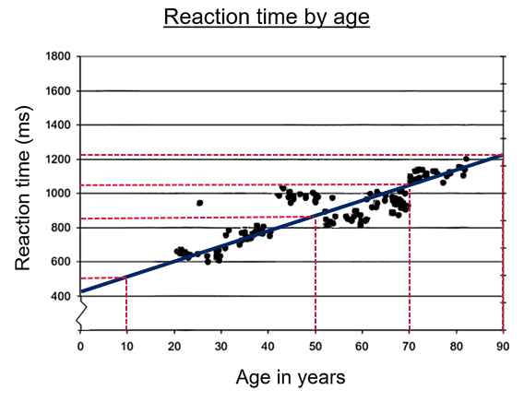
Line of best fit (2)
Age versus reaction time with line of best fit
Graph modified from the research article ‘Life-span changes in task switching’ by Melody Wiseheart (bit.ly/life-span-task-switching).

Slide 7
Independent practice

Slide 8

Approaching questions scaffold

Slide 9
References
This presentation contains NSW Curriculum and syllabus content. The NSW Curriculum is developed by the NSW Education Standards Authority. This content is prepared by NESA for and on behalf of the Crown in the right of the State of New South Wales. The material is protected by Crown copyright.
Please refer to the NESA Copyright Disclaimer for more information https://educationstandards.nsw.edu.au/wps/portal/nesa/mini-footer/copyright.
NESA holds the only official and up-to-date versions of the NSW Curriculum and syllabus documents. Please visit the NSW Education Standards Authority (NESA) website https://educationstandards.nsw.edu.au/wps/portal/nesa/home and the NSW Curriculum website https://curriculum.nsw.edu.au.
Mathematics Standard 11–12 Syllabus © NSW Education Standards Authority (NESA) for and on behalf of the Crown in right of the State of New South Wales, 2024.
.

Slide 10
Copyright
© State of New South Wales (Department of Education), 2026
The copyright material published in this resource is subject to the Copyright Act 1968 (Cth) and is owned by the NSW Department of Education or, where indicated, by a party other than the NSW Department of Education (third-party material).
Copyright material available in this resource and owned by the NSW Department of Education is licensed under a Creative Commons Attribution 4.0 International (CC BY 4.0) license.
This license allows you to share and adapt the material for any purpose, even commercially.
Attribution should be given to © State of New South Wales (Department of Education), 2026.
Material in this resource not available under a Creative Commons license:
the NSW Department of Education logo, other logos and trademark-protected material
Material owned by a third party that has been reproduced with permission. You will need to obtain permission from the third party to reuse its material.
Links to third-party material and websites
Please note that the provided (reading/viewing material/list/links/texts) are a suggestion only and implies no endorsement, by the New South Wales Department of Education, of any author, publisher, or book title. School principals and teachers are best placed to assess the suitability of resources that would complement the curriculum and reflect the needs and interests of their students.
If you use the links provided in this document to access a third-party’s website, you acknowledge that the terms of use, including licence terms set out on the third-party’s website apply to the use which may be made of the materials on that third-party website or where permitted by the Copyright Act 1968 (Cth). The department accepts no responsibility for content on third-party websites.

