Slide 1
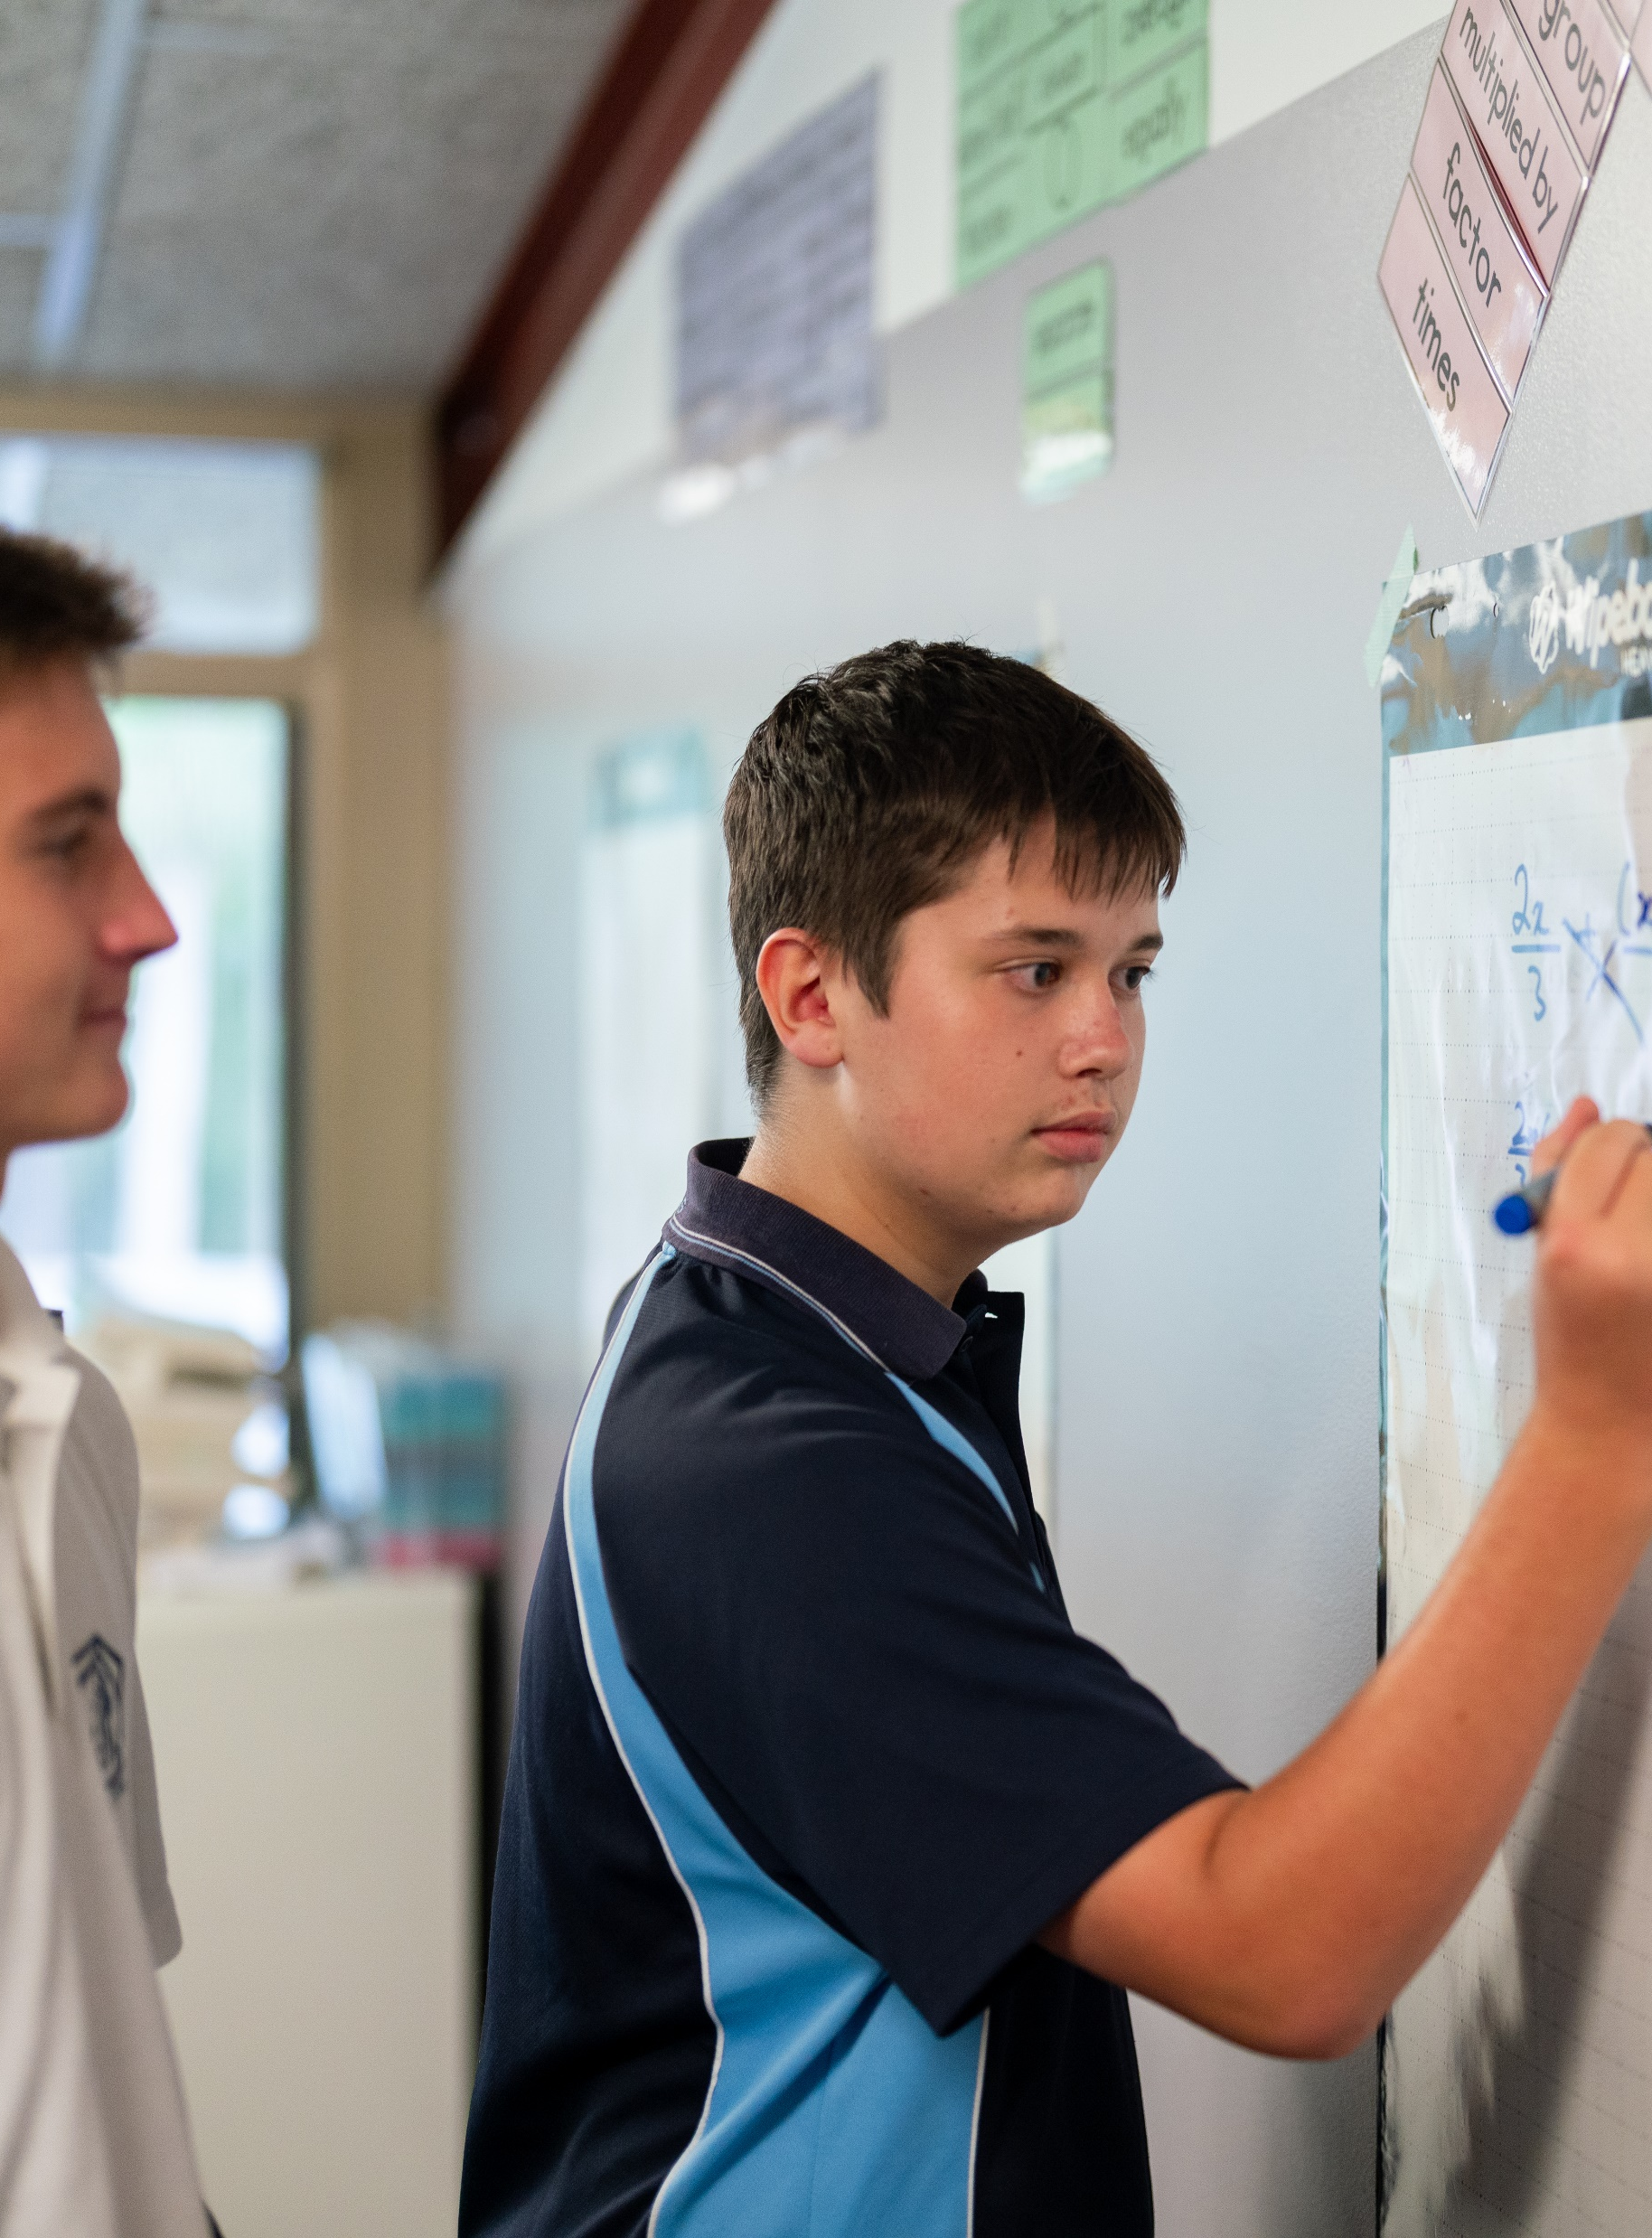
Frequency polygons
Mathematics Standard – Stage 6 (Year 11)
Unit 1 – getting healthy

Slide 2
Learning intentions and success criteria
Learning intentions
To understand the difference between a frequency polygon and a cumulative frequency polygon.
To be able to create a cumulative frequency histogram and polygon with technology.
Success criteria
I can display a histogram and its associated polygon using technology.
I can display a cumulative frequency histogram and its associated polygon using technology.
I can explain the benefits of a cumulative frequency polygon over a frequency polygon
Notes:
Notes for teachers:
Learning intentions and success criteria are best co-constructed with students. Adapt the learning intention as required and add matching success criteria.
For more information See ⁠AITSL or the NSW Department of Education explicit teaching strategies, ⁠Sharing learning intentions and ⁠Sharing success criteria
LISC is not necessarily presented at the beginning of the lesson. Teacher needs to consider most effectual time to introduce
LISC should be revisited during the lesson to support students' evaluation of their learning

Slide 3
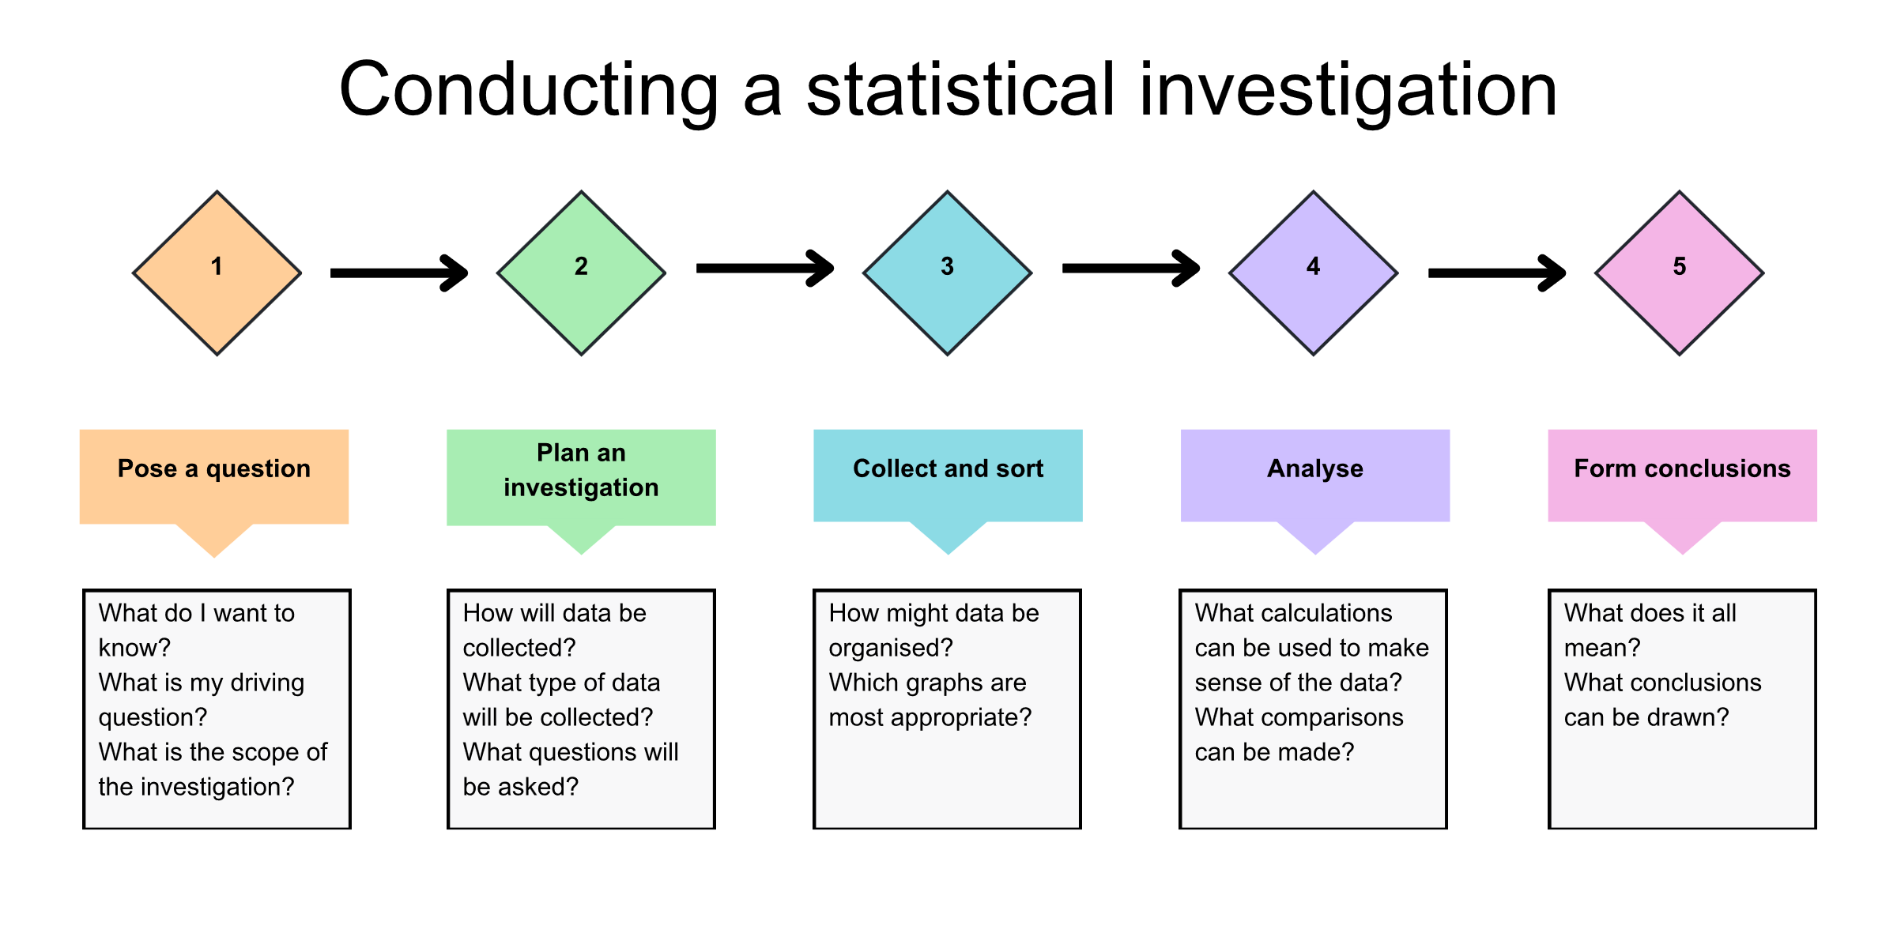
Statistical investigation process

Slide 4
Activating prior knowledge

Slide 5
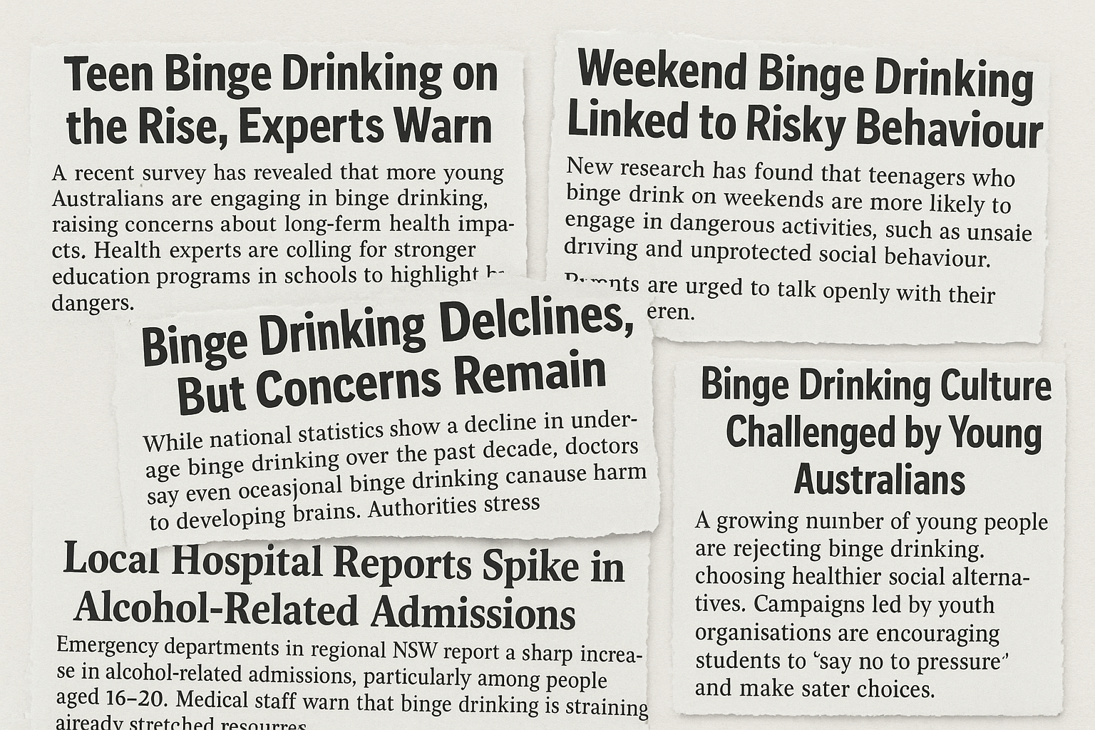
Binge drinking

Slide 6
Connecting learning

Slide 7
Binge drinking in Australia (2021 – 2023)

Slide 8
Binge drinking in Australia (2021 – 2023) by gender

Slide 9
Releasing responsibility

Slide 10
Features of a frequency polygon
Midpoints of each bar
Finishes at zero
Half bar gap at each end

Slide 11
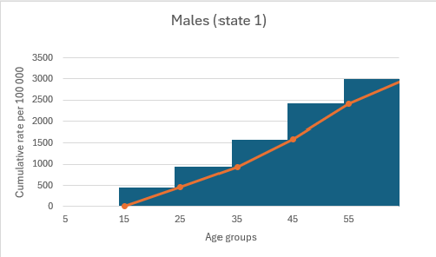
Features of a cumulative frequency polygon
Ends at the total sum of all scores
Top right of each bar
Starts at bottom left of first bar

Slide 12
Independent practice

Slide 13
HSC style question
A survey was conducted on the number of hours that 40 Year 11 students spend on social media each week. The results were grouped into the following frequency table:
Hours per week | Frequency
0-5 | 2
6-10 | 6
11-15 | 9
16-20 | 12
21-25 | 7
26-30 | 3
31-35 | 1
Complete the cumulative frequency table for the data and use it to construct a cumulative frequency polygon.
Use your cumulative frequency polygon to estimate the:
  median
  number of students who spend more than 20 hours per week on social media.
Explain one advantage of using a cumulative frequency polygon instead of a histogram for this dataset.

Slide 14
HSC style question – answer part a)
Complete the cumulative frequency table for the data and use it to construct a cumulative frequency polygon.
Hours per week | Frequency | Cumulative frequency
0-5 | 2 | 2
6-10 | 6 | 8
11-15 | 9 | 17
16-20 | 12 | 29
21-25 | 7 | 36
26-30 | 3 | 39
31-35 | 1 | 40

Slide 15
HSC style question – answer part b)
Use your cumulative frequency polygon to estimate the:
    median approximately 16 hours per week
    number of students who spend more than 20 hours per week on social media.
    40 – 29 = 11 students

Slide 16
HSC style question – answer part c)
Explain one advantage of using a cumulative frequency polygon instead of a histogram for this dataset.
You can estimate a single figure for the median, rather than a median group.

Slide 17
References
This presentation contains NSW Curriculum and syllabus content. The NSW Curriculum is developed by the NSW Education Standards Authority. This content is prepared by NESA for and on behalf of the Crown in the right of the State of New South Wales. The material is protected by Crown copyright.
Please refer to the NESA Copyright Disclaimer for more information https://educationstandards.nsw.edu.au/wps/portal/nesa/mini-footer/copyright.
NESA holds the only official and up-to-date versions of the NSW Curriculum and syllabus documents. Please visit the NSW Education Standards Authority (NESA) website https://educationstandards.nsw.edu.au/wps/portal/nesa/home and the NSW Curriculum website https://curriculum.nsw.edu.au.
Mathematics Standard 11–12 Syllabus © NSW Education Standards Authority (NESA) for and on behalf of the Crown in right of the State of New South Wales, 2024.

Slide 18
Copyright
© State of New South Wales (Department of Education), 2025
The copyright material published in this resource is subject to the Copyright Act 1968 (Cth) and is owned by the NSW Department of Education or, where indicated, by a party other than the NSW Department of Education (third-party material).
Copyright material available in this resource and owned by the NSW Department of Education is licensed under a Creative Commons Attribution 4.0 International (CC BY 4.0) license.
This license allows you to share and adapt the material for any purpose, even commercially.
Attribution should be given to © State of New South Wales (Department of Education), 2025.
Material in this resource not available under a Creative Commons license:
the NSW Department of Education logo, other logos and trademark-protected material
Material owned by a third party that has been reproduced with permission. You will need to obtain permission from the third party to reuse its material.
Links to third-party material and websites
Please note that the provided (reading/viewing material/list/links/texts) are a suggestion only and implies no endorsement, by the New South Wales Department of Education, of any author, publisher, or book title. School principals and teachers are best placed to assess the suitability of resources that would complement the curriculum and reflect the needs and interests of their students.
If you use the links provided in this document to access a third-party’s website, you acknowledge that the terms of use, including licence terms set out on the third-party’s website apply to the use which may be made of the materials on that third-party website or where permitted by the Copyright Act 1968 (Cth). The department accepts no responsibility for content on third-party websites.

