Slide 1

Pearson’s correlation coefficient
Mathematics Standard 2 – Stage 6 (Year 12)
Correlation

Slide 2
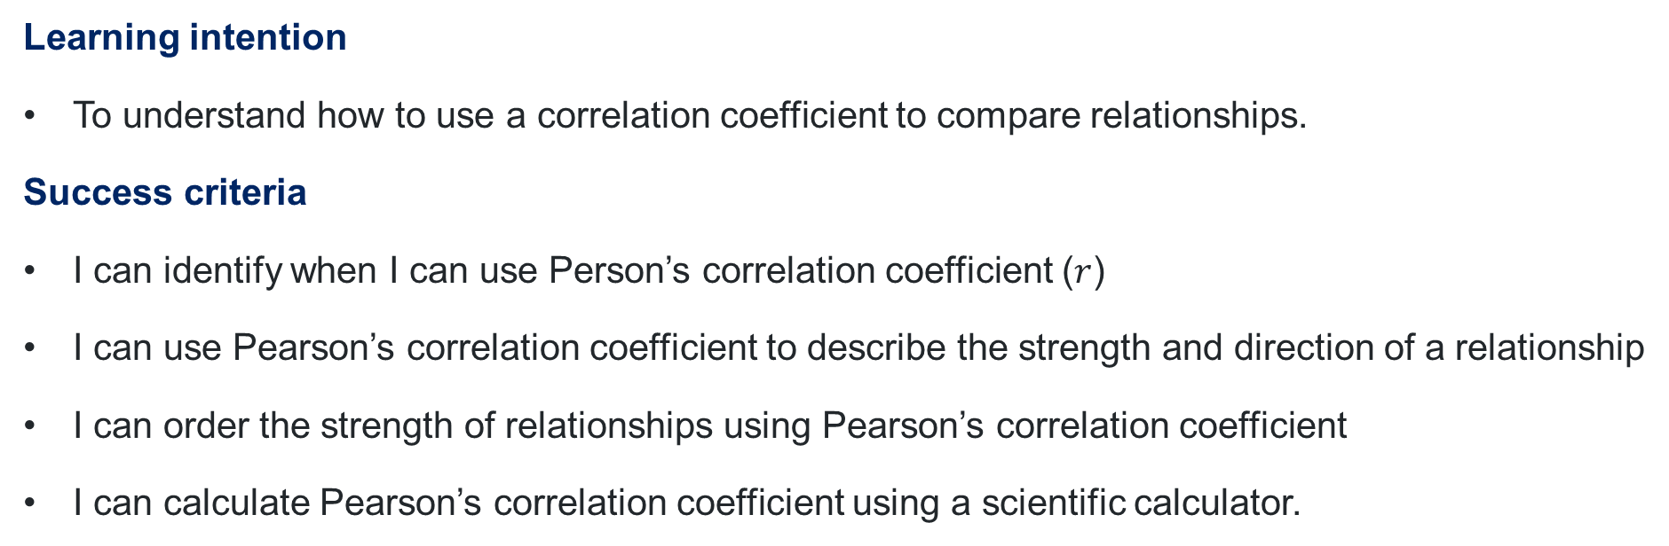
Learning intention and success criteria
Learning intention
To understand how to use a correlation coefficient to compare relationships.
Success criteria
I can identify when I can use Person’s correlation coefficient ($r$)
I can use Pearson’s correlation coefficient to describe the strength and direction of a relationship
I can order the strength of relationships using Pearson’s correlation coefficient
I can calculate Pearson’s correlation coefficient using a scientific calculator.

Slide 3
Activating prior knowledge

Slide 4
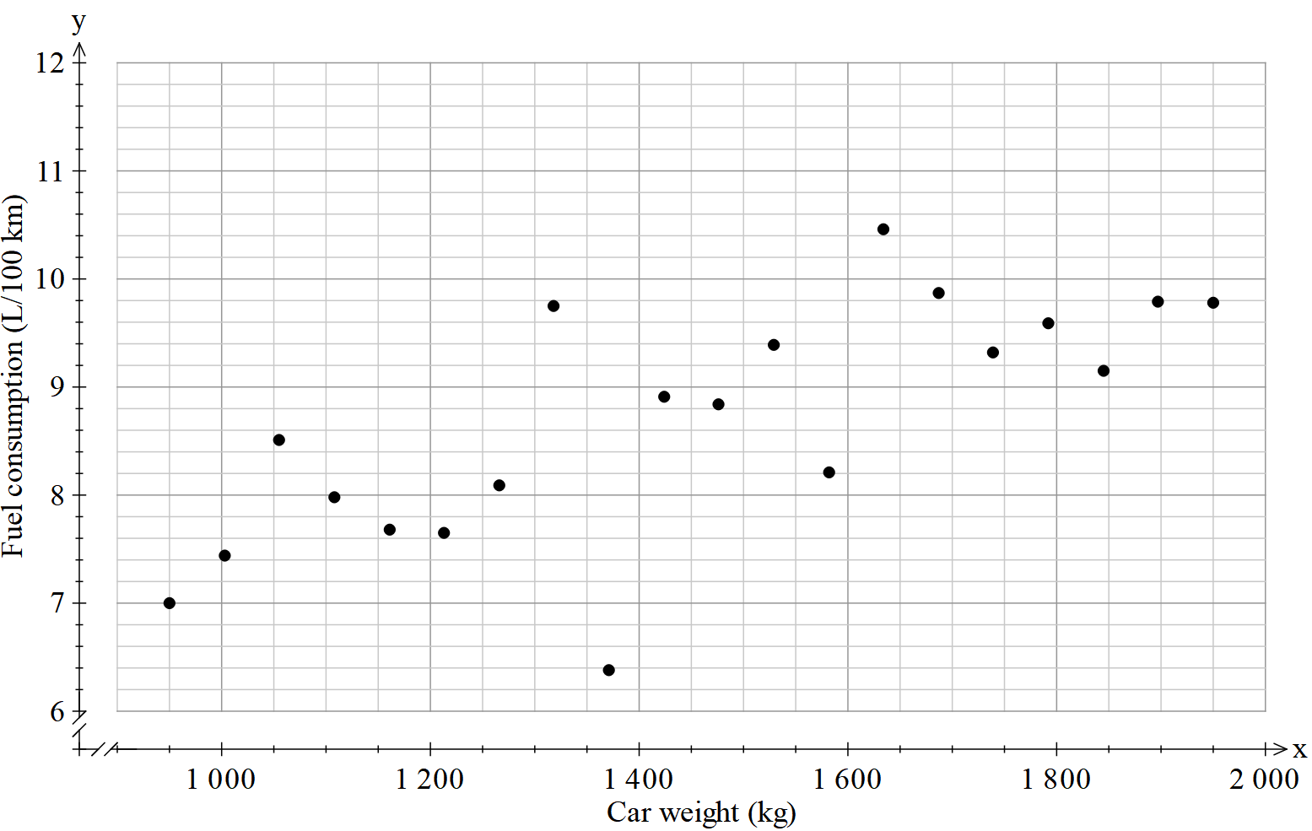
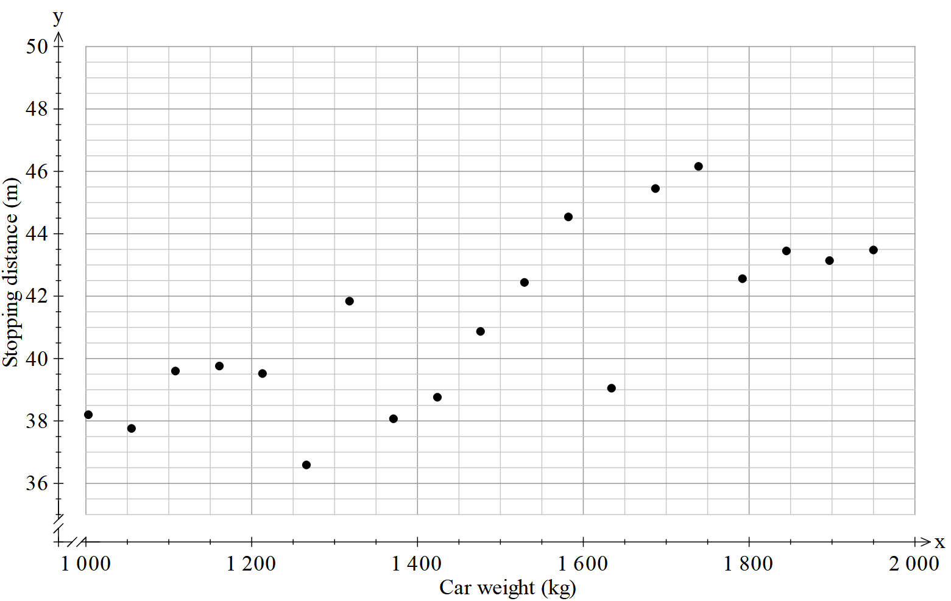
Scatter plot comparison (1)
Car weight vs. fuel consumption
Car weight vs. stopping distance

Slide 5
Connecting learning

Slide 6
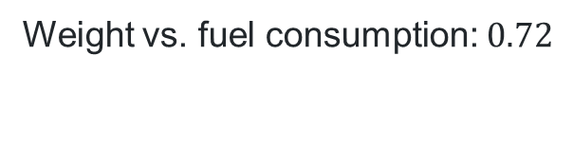
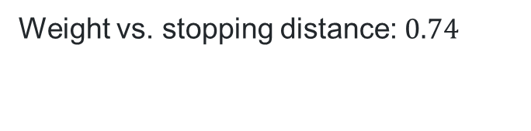
Scatter plot comparison (2)
Car weight vs. fuel consumption
Car weight vs. stopping distance
Weight vs. fuel consumption: $0.72$
Weight vs. stopping distance: $0.74$

Slide 7
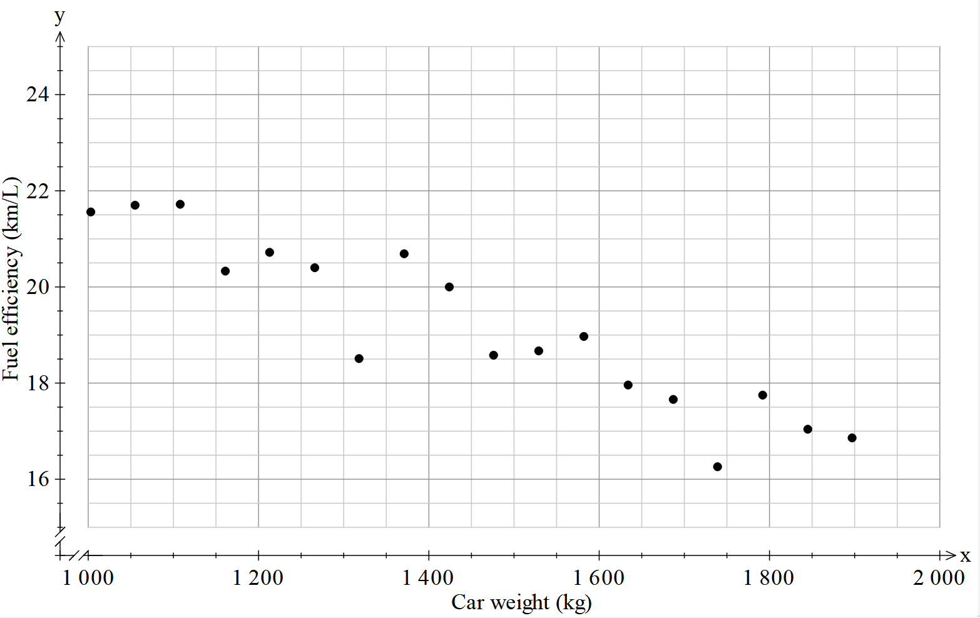
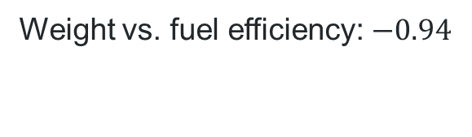
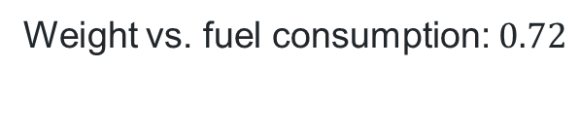
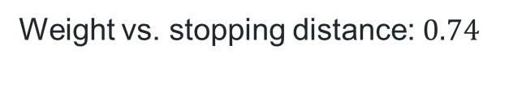
Scatter plot comparison (3)
Car weight vs. fuel consumption
Car weight vs. stopping distance
Car weight vs. fuel efficiency
Weight vs. fuel consumption: $0.72$
Weight vs. stopping distance: $0.74$
Weight vs. fuel efficiency: $−0.94$

Slide 8
Releasing responsibility

Slide 9
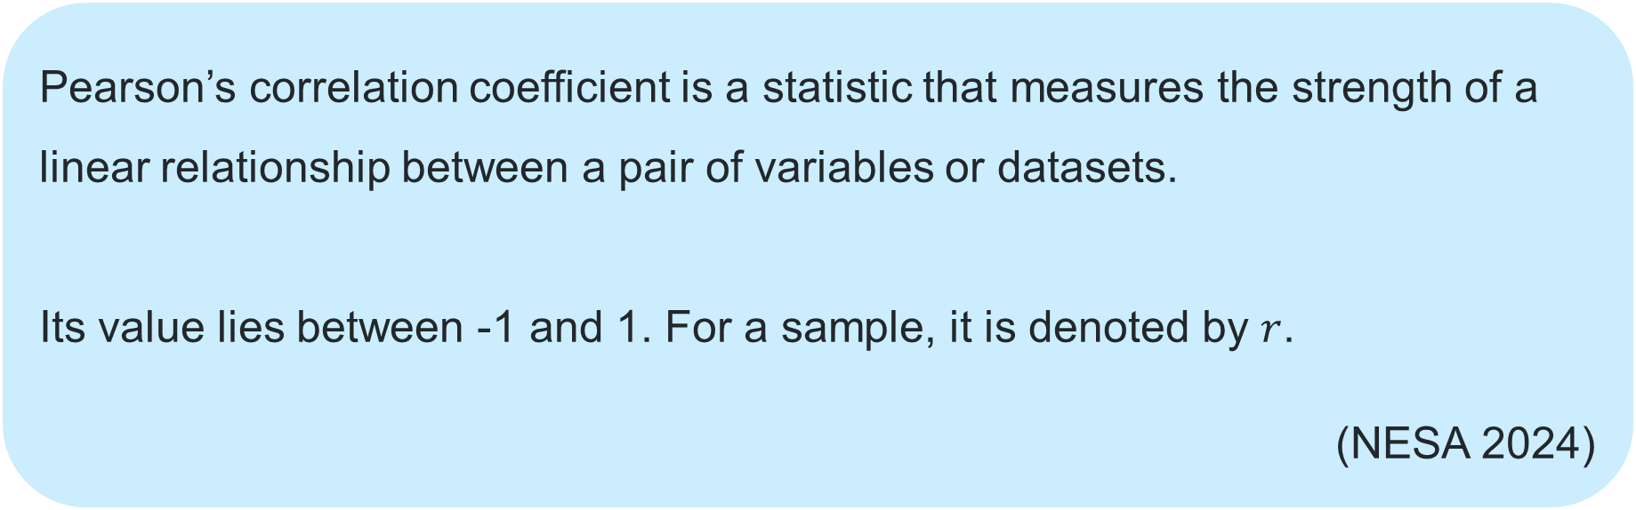
Pearson’s correlation coefficient (1)
NESA Glossary definition
Pearson’s correlation coefficient is a statistic that measures the strength of a linear relationship between a pair of variables or datasets.
Its value lies between -1 and 1. For a sample, it is denoted by $r$.
(NESA 2024)

Slide 10
Pearson’s correlation coefficient (2)
Number line
Strong negative relationship
Weak linear relationship
Strong positive relationship
-1
0
1

Slide 11
Pearson’s correlation coefficient (3)
Car speed versus braking distance dataset
Car speed (km/h) | Braking distance (m)
40 | 9
50 | 13
60 | 18
70 | 24
80 | 31
90 | 39
100 | 48
What does the correlation coefficient reveal about the relationship between car speed and braking distance?
Based on this context, does this relationship appear to be causal? Explain your reasoning.

Slide 12
Independent practice

Slide 13

Approaching questions scaffold

Slide 14
References
This presentation contains NSW Curriculum and syllabus content. The NSW Curriculum is developed by the NSW Education Standards Authority. This content is prepared by NESA for and on behalf of the Crown in the right of the State of New South Wales. The material is protected by Crown copyright.
Please refer to the NESA Copyright Disclaimer for more information https://educationstandards.nsw.edu.au/wps/portal/nesa/mini-footer/copyright.
NESA holds the only official and up-to-date versions of the NSW Curriculum and syllabus documents. Please visit the NSW Education Standards Authority (NESA) website https://educationstandards.nsw.edu.au/wps/portal/nesa/home and the NSW Curriculum website https://curriculum.nsw.edu.au.
Mathematics Standard 11–12 Syllabus © NSW Education Standards Authority (NESA) for and on behalf of the Crown in right of the State of New South Wales, 2024.
.

Slide 15
Copyright
© State of New South Wales (Department of Education), 2026
The copyright material published in this resource is subject to the Copyright Act 1968 (Cth) and is owned by the NSW Department of Education or, where indicated, by a party other than the NSW Department of Education (third-party material).
Copyright material available in this resource and owned by the NSW Department of Education is licensed under a Creative Commons Attribution 4.0 International (CC BY 4.0) license.
This license allows you to share and adapt the material for any purpose, even commercially.
Attribution should be given to © State of New South Wales (Department of Education), 2026.
Material in this resource not available under a Creative Commons license:
the NSW Department of Education logo, other logos and trademark-protected material
Material owned by a third party that has been reproduced with permission. You will need to obtain permission from the third party to reuse its material.
Links to third-party material and websites
Please note that the provided (reading/viewing material/list/links/texts) are a suggestion only and implies no endorsement, by the New South Wales Department of Education, of any author, publisher, or book title. School principals and teachers are best placed to assess the suitability of resources that would complement the curriculum and reflect the needs and interests of their students.
If you use the links provided in this document to access a third-party’s website, you acknowledge that the terms of use, including licence terms set out on the third-party’s website apply to the use which may be made of the materials on that third-party website or where permitted by the Copyright Act 1968 (Cth). The department accepts no responsibility for content on third-party websites.

