Slide 1
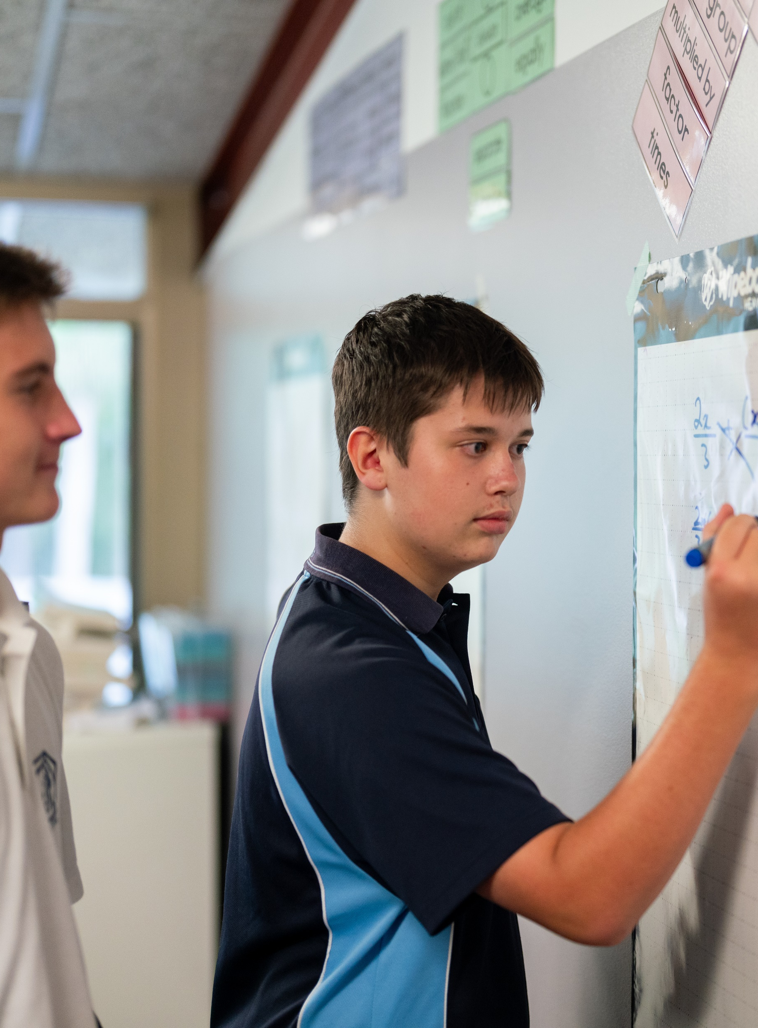
Cumulative frequency
Mathematics Standard – Stage 6 (Year 11)
Unit 1 – getting healthy

Slide 2
Learning intentions and success criteria
Learning intentions
To be able to represent data in cumulative frequency tables.
To be able to represent data in cumulative frequency histograms and polygons.
Success criteria
I can represent numerical data in a frequency table.
I can construct a cumulative frequency column in a frequency table.
I can use the cumulative frequency column to identify missing values from the frequency column.
I can make decisions based on data in a cumulative frequency table
Notes:
Notes for teachers:
Learning intentions and success criteria are best co-constructed with students. Adapt the learning intention as required and add matching success criteria.
For more information See ⁠AITSL or the NSW Department of Education explicit teaching strategies, ⁠Sharing learning intentions and ⁠Sharing success criteria
LISC is not necessarily presented at the beginning of the lesson. Teacher needs to consider most effectual time to introduce
LISC should be revisited during the lesson to support students' evaluation of their learning

Slide 3
Connecting learning

Slide 4
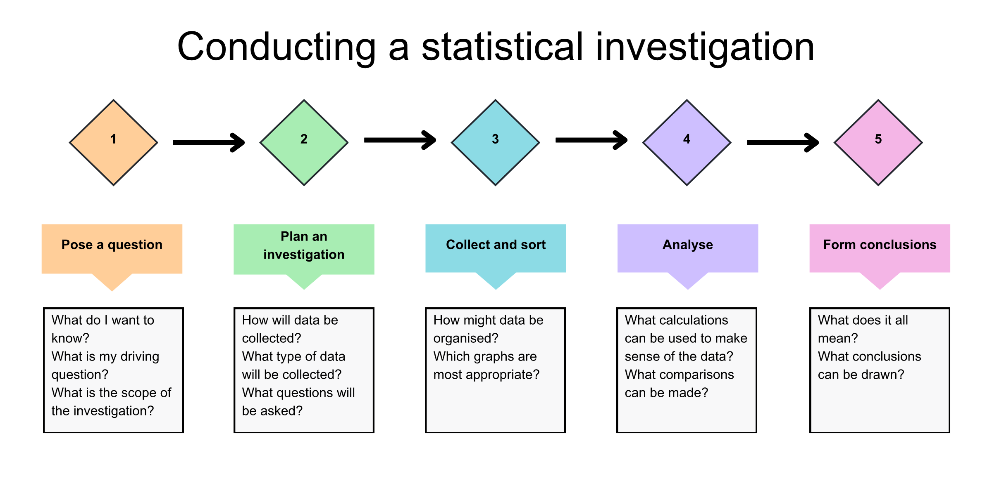
Statistical investigation process

Slide 5
Self-explanation prompts
A sample of school students who use e-cigarettes
Age of e-cigarette users
What benefits are there in displaying the data like this?
Age | Frequency
12 | 1
13 | 2
14 | 6
15 | 7
16 | 9
17 | 5
18 | 3
Does the data in the frequency column align with what you might expect?
How might you explain the decrease in frequency for these ages?

Slide 6
Questions to consider
A sample of school students who use e-cigarettes
How many students in Year 7, aged 12–13, use e-cigarettes?
How many students in Years 7 to 9, aged 12–15, use e-cigarettes?
How many students from Years 7 to 11, aged 12–17 use e-cigarettes?
What is the median age of e-cigarette users?
What is the total number of e-cigarette users in this sample?
Age of e-cigarette users
Age | Frequency
12 | 1
13 | 2
14 | 6
15 | 7
16 | 9
17 | 5
18 | 3

Slide 7
Frequency histogram
How many students in Year 7, aged 12–13, use e-cigarettes?
How many students in Years 7 to 9, aged 12–15, use e-cigarettes?
How many students from Years 7 to 11, aged 12–17 use e-cigarettes?
What is the median age of e-cigarette users?
What is the total number of e-cigarette users in this sample?

Slide 8
Cumulative frequency table
Including the cumulative frequency column
Age of e-cigarette users
Age | Frequency | Cumulative frequency
12 | 1 | 1
13 | 2 | 3
14 | 6 | 9
15 | 7 | 16
16 | 9 | 25
17 | 5 | 30
18 | 3 | 33

Slide 9
Cumulative frequency table (1)
Including the cumulative frequency column
How many students in Year 7, aged 12–13, use e-cigarettes?
How many students in Years 7 to 9, aged 12–15, use e-cigarettes?
How many students from Years 7 to 11, aged 12–17 use e-cigarettes?
What is the median age of e-cigarette users?
What is the total number of e-cigarette users in this sample?
Age of e-cigarette users
Age | Frequency | Cumulative frequency
12 | 1 | 1
13 | 2 | 3
14 | 6 | 9
15 | 7 | 16
16 | 9 | 25
17 | 5 | 30
18 | 3 | 33

Slide 10
Cumulative frequency histogram
How many students in Year 7, aged 12–13, use e-cigarettes?
How many students in Years 7 to 9, aged 12–15, use e-cigarettes?
How many students from Years 7 to 11, aged 12–17 use e-cigarettes?
What is the median age of e-cigarette users?
What is the total number of e-cigarette users in this sample?

Slide 11
Releasing responsibility

Slide 12
Cumulative frequency tables (1)
Example 1
Find the median of the data.
Score | Frequency | Cumulative frequency
0 | 1 | 1
1 | 3 | 4
2 | 6
3 | 7 | 17
4 |  | 19
5 or more | 1 | 20
10
10th score = 2
11th score = 3
Median = 2.5
2

Slide 13
Cumulative frequency tables (2)
Example 1
Find the median of the data.
Score | Frequency | Cumulative frequency
0 | 1 | 1
1 | 3 | 4
2 | 6
3 | 7 | 17
4 |  | 19
5 or more | 1 | 20
Why is the 11th value 3?
10th score = 2
11th score = 3
Median = 2.5
10
2
How do we know where to find the median?
Why is the median not the middle of 10 and 17?

Slide 14
Cumulative frequency tables (3)
Your turn
Find the missing values and then calculate the median.
Score | Frequency | Cumulative frequency
0 | 2 | 2
1 | 5
2 | 7 | 14
3 |  | 23
4 | 2 | 25
5 or more | 3 | 28

Slide 15
Cumulative frequency tables (4)
Your turn - solution
Find the missing values and then calculate the median.
Score | Frequency | Cumulative frequency
0 | 2 | 2
1 | 5 | 7
2 | 7 | 14
3 | 9 | 23
4 | 2 | 25
5 or more | 3 | 28
14th score = 2
15th score = 3
Median = 2.5

Slide 16
Cumulative frequency graphs
Example 2
Calculate the median of the data.
Total scores = 33
Median = 17th score = age 16

Slide 17
Cumulative frequency graphs (1)
Example 2
Calculate the median of the data.
What would change if there were 34 scores?
Total scores = 33
Median = 17th score = age 16
How did we know the median would be the 17th score?

Slide 18
Cumulative frequency graphs (2)
Your turn
Calculate the median of the data.

Slide 19
Cumulative frequency graphs (3)
Your turn - solution
Calculate the median of the data.
Total scores = 33
Median = 17th score = age 15

Slide 20
Frayer diagram
Definition
Facts/Characteristics
Cumulative frequency
Examples
Non-examples

Slide 21
References
This presentation contains NSW Curriculum and syllabus content. The NSW Curriculum is developed by the NSW Education Standards Authority. This content is prepared by NESA for and on behalf of the Crown in the right of the State of New South Wales. The material is protected by Crown copyright.
Please refer to the NESA Copyright Disclaimer for more information https://educationstandards.nsw.edu.au/wps/portal/nesa/mini-footer/copyright.
NESA holds the only official and up-to-date versions of the NSW Curriculum and syllabus documents. Please visit the NSW Education Standards Authority (NESA) website https://educationstandards.nsw.edu.au/wps/portal/nesa/home and the NSW Curriculum website https://curriculum.nsw.edu.au.
Mathematics Standard 11–12 Syllabus © NSW Education Standards Authority (NESA) for and on behalf of the Crown in right of the State of New South Wales, 2024.

Slide 22
Copyright
© State of New South Wales (Department of Education), 2025
The copyright material published in this resource is subject to the Copyright Act 1968 (Cth) and is owned by the NSW Department of Education or, where indicated, by a party other than the NSW Department of Education (third-party material).
Copyright material available in this resource and owned by the NSW Department of Education is licensed under a Creative Commons Attribution 4.0 International (CC BY 4.0) license.
This license allows you to share and adapt the material for any purpose, even commercially.
Attribution should be given to © State of New South Wales (Department of Education), 2025.
Material in this resource not available under a Creative Commons license:
the NSW Department of Education logo, other logos and trademark-protected material
Material owned by a third party that has been reproduced with permission. You will need to obtain permission from the third party to reuse its material.
Links to third-party material and websites
Please note that the provided (reading/viewing material/list/links/texts) are a suggestion only and implies no endorsement, by the New South Wales Department of Education, of any author, publisher, or book title. School principals and teachers are best placed to assess the suitability of resources that would complement the curriculum and reflect the needs and interests of their students.
If you use the links provided in this document to access a third-party’s website, you acknowledge that the terms of use, including licence terms set out on the third-party’s website apply to the use which may be made of the materials on that third-party website or where permitted by the Copyright Act 1968 (Cth). The department accepts no responsibility for content on third-party websites.

