Slide 1
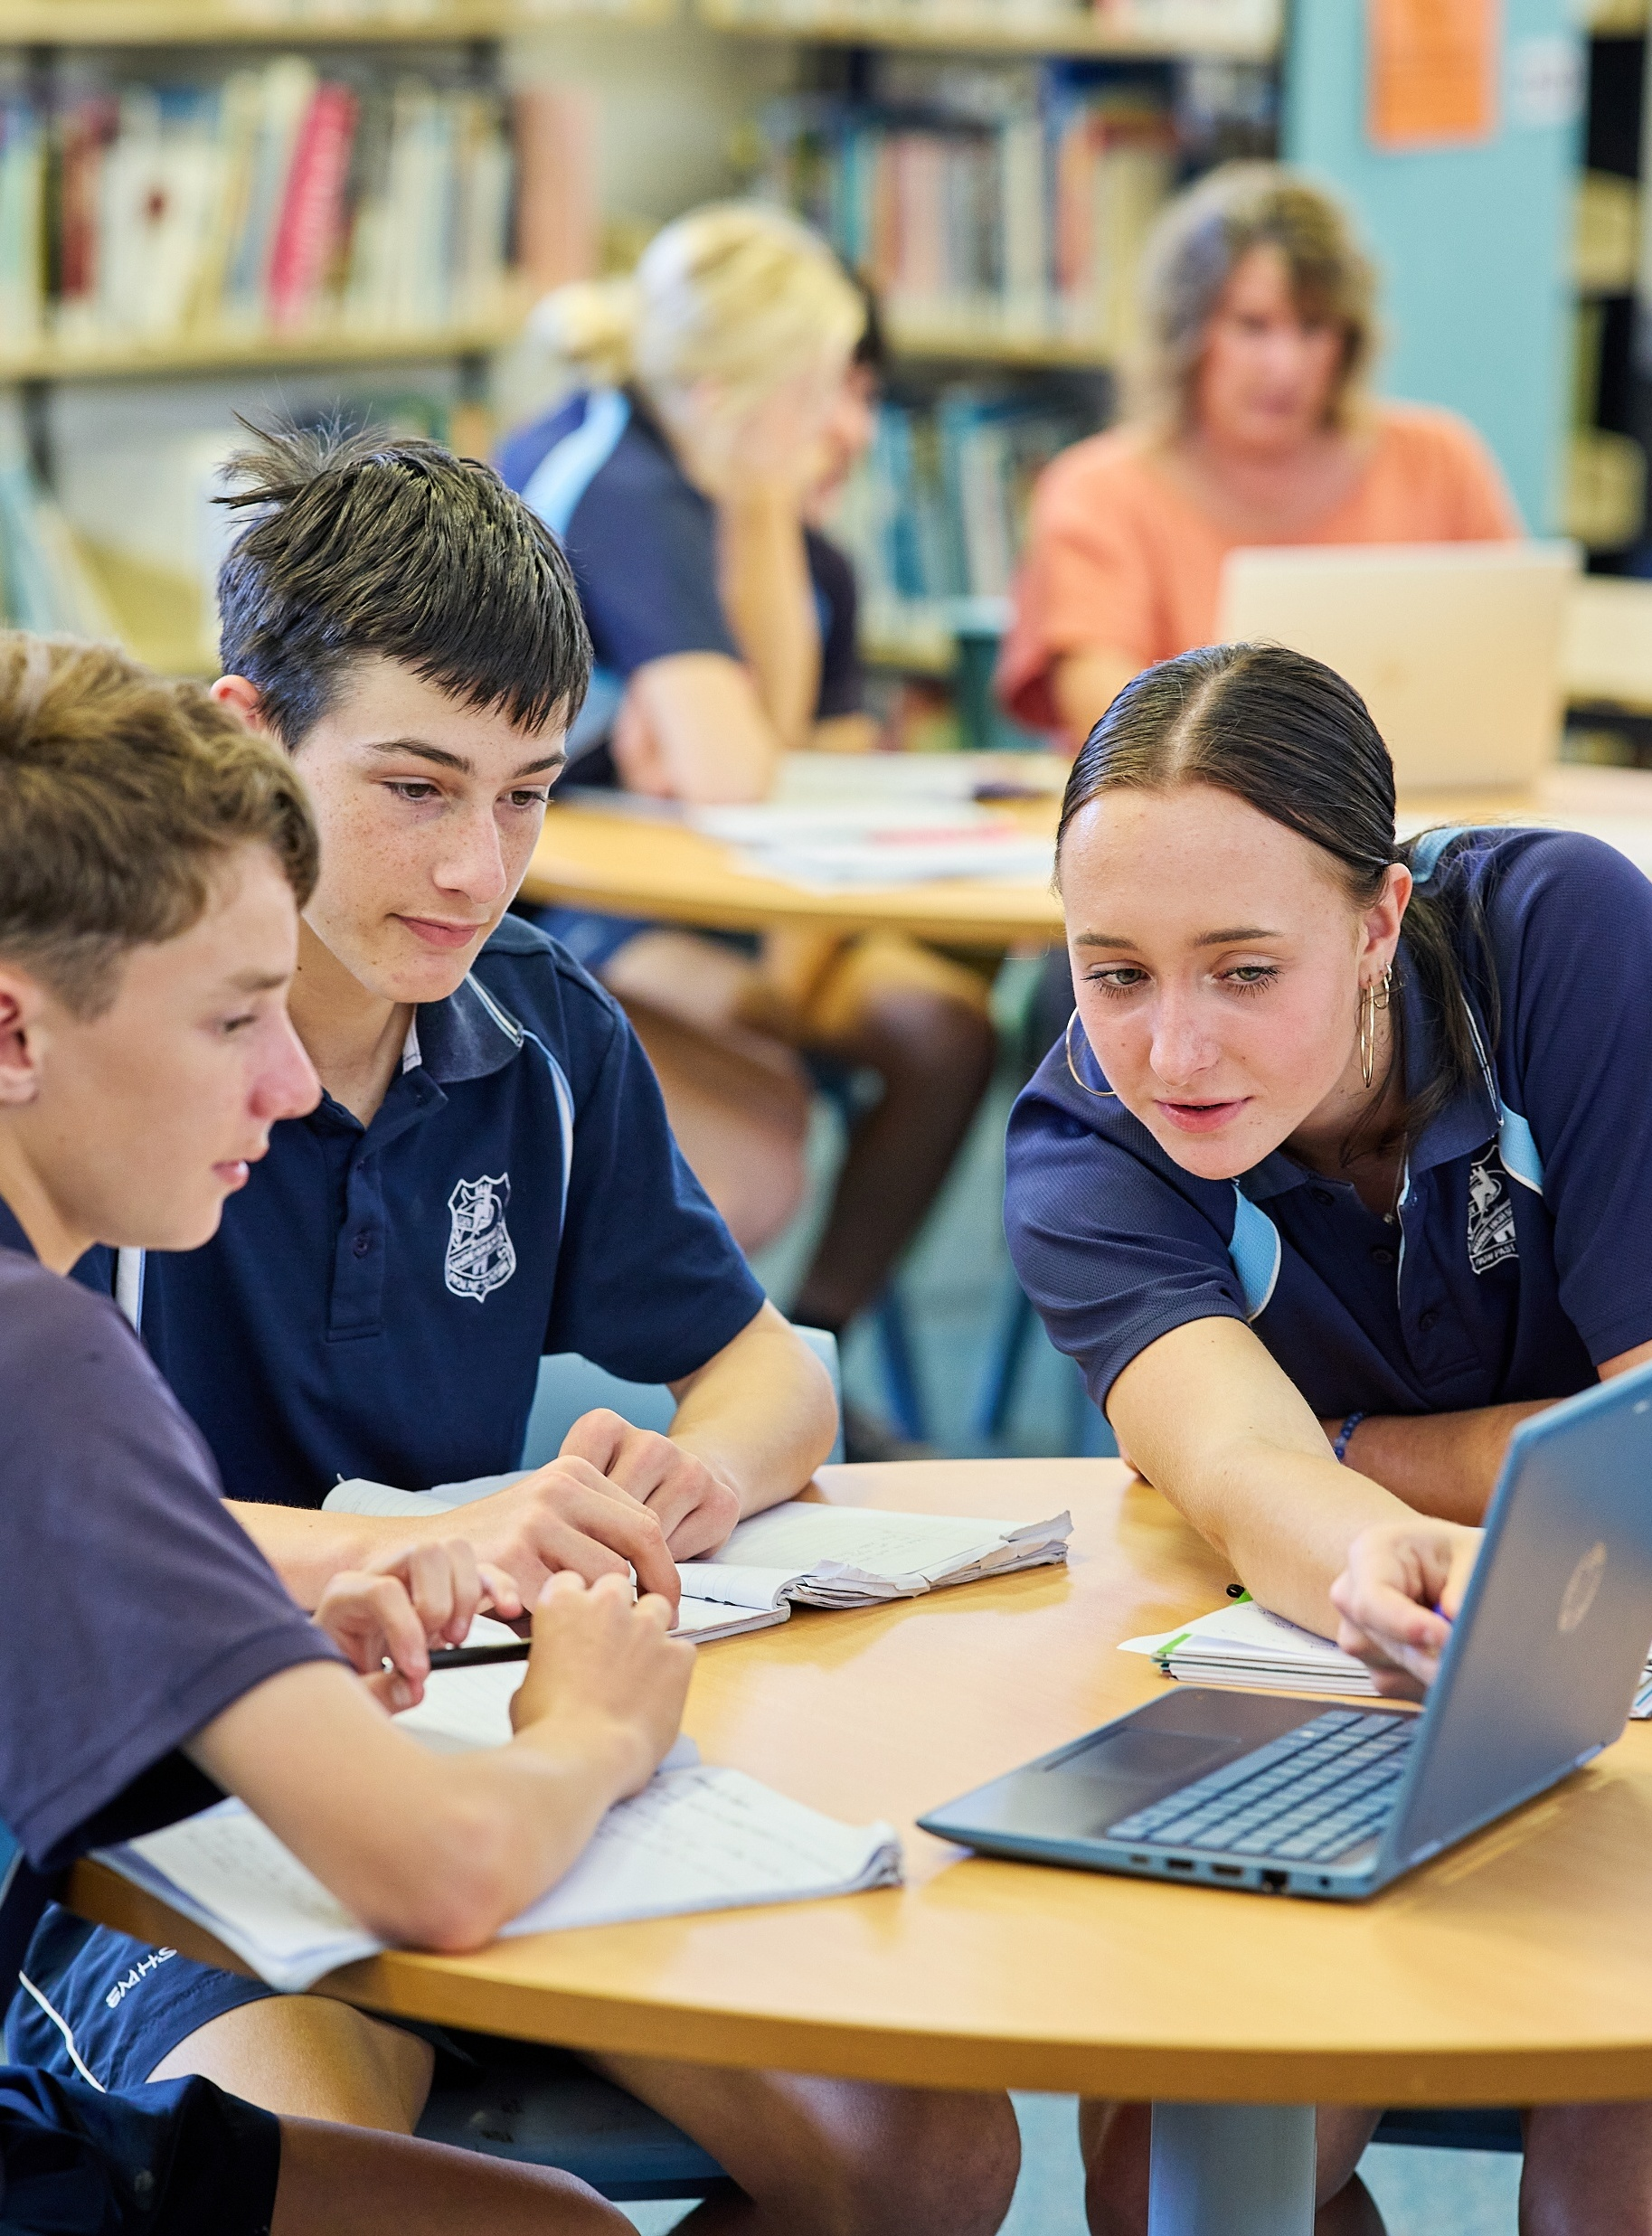
Formalising correlation
Mathematics Standard 2 – Stage 6 (Year 12)
Correlation

Slide 2
Learning intention and success criteria
Learning intention
To understand the concept of correlation.
Success criteria
I can identify the association between 2 variables as linear or non-linear given a scatter plot.
I can describe the strength of an association between 2 variables given a scatter plot.
I can describe a linear association as either positive or negative given a scatter plot.
I can explain the difference between correlation and causation.

Slide 3
Activating prior knowledge

Slide 4
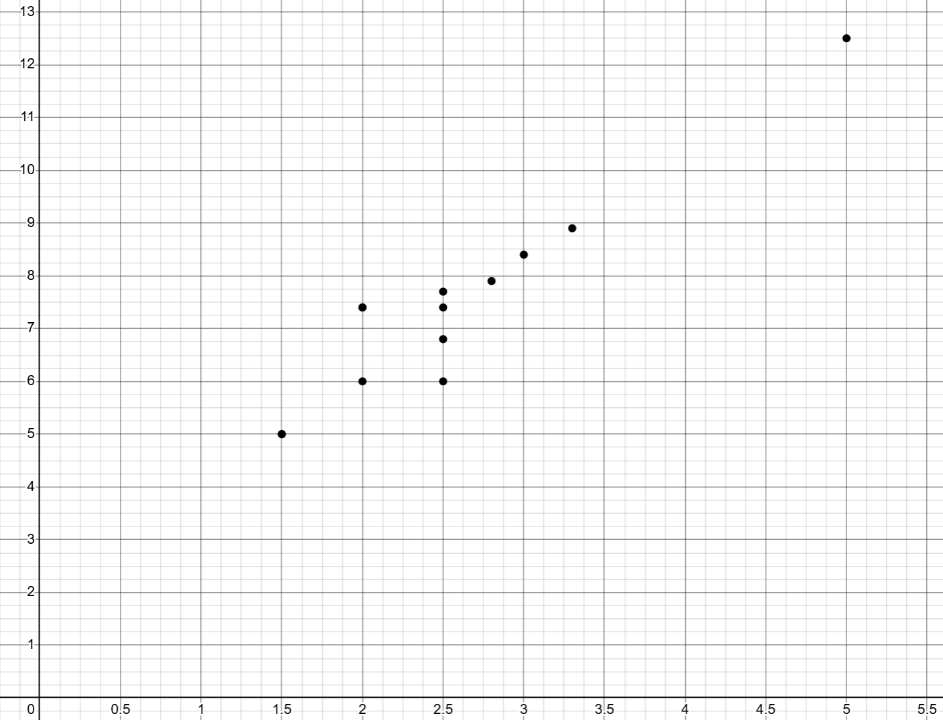
Slow reveal graph (1)
What do you notice?

Slide 5
Slow reveal graph (2)
What do you notice?
Engine size (L)

Slide 6
Slow reveal graph (3)
What do you notice?
Fuel consumption (L/100 km)
Engine size (L)

Slide 7
Slow reveal graph (4)
Engine size versus fuel consumption (selected Australian vehicles)
Fuel consumption (L/100 km)
Engine size (L)

Slide 8
Connecting learning

Slide 9
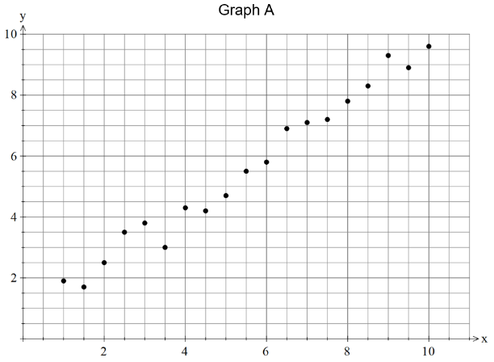
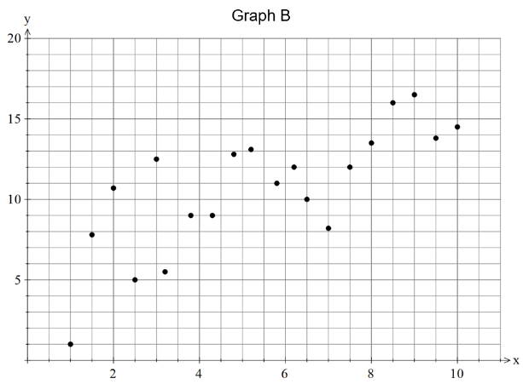
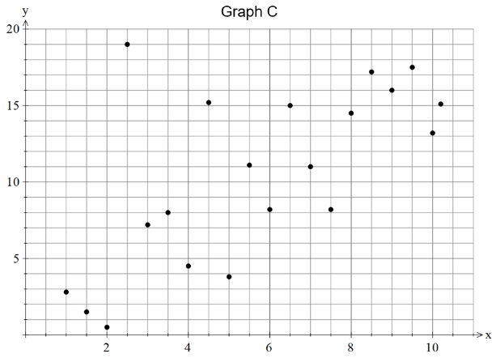
Comparing scatter plots
Which graph appears to show the strongest association?
What features of the scatter plot helped you make that decision?

Slide 10
Releasing responsibility

Slide 11
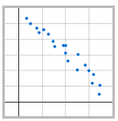
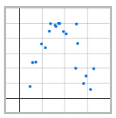
Definitions (1)
Linear and non-linear (form)
Form: the shape of the trend the data points follow. Generally stated as linear, non-linear or no relationship.
Linear: data that can be represented or modelled by a straight line.
Non-linear: data that cannot be represented by a straight line or linear function.
Linear
Non-linear

Slide 12
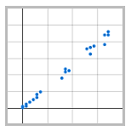
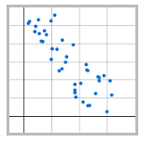
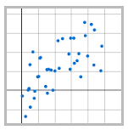
Definitions (2)
Strength and direction
Strength: how closely the data points follow a particular form (usually a straight line). Usually stated as strong, moderate, weak associations.
Strong
Moderate
Weak

Slide 13
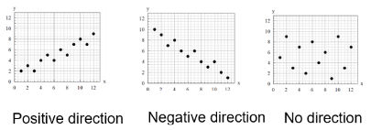
Definitions (3)
Strength and direction
Direction: the association between 2 numerical values as either positive, negative or no direction.

Slide 14
Correlation
Engine size versus fuel consumption (selected Australian vehicles)
Fuel consumption (L/100 km)
Engine size (L)
Correlation: a measure of the strength of the linear relationship between 2 variables (NESA 2024)

Slide 15
References
This presentation contains NSW Curriculum and syllabus content. The NSW Curriculum is developed by the NSW Education Standards Authority. This content is prepared by NESA for and on behalf of the Crown in the right of the State of New South Wales. The material is protected by Crown copyright.
Please refer to the NESA Copyright Disclaimer for more information https://educationstandards.nsw.edu.au/wps/portal/nesa/mini-footer/copyright.
NESA holds the only official and up-to-date versions of the NSW Curriculum and syllabus documents. Please visit the NSW Education Standards Authority (NESA) website https://educationstandards.nsw.edu.au/wps/portal/nesa/home and the NSW Curriculum website https://curriculum.nsw.edu.au.
Mathematics Standard 11–12 Syllabus © NSW Education Standards Authority (NESA) for and on behalf of the Crown in right of the State of New South Wales, 2024.
.

Slide 16
Copyright
© State of New South Wales (Department of Education), 2026
The copyright material published in this resource is subject to the Copyright Act 1968 (Cth) and is owned by the NSW Department of Education or, where indicated, by a party other than the NSW Department of Education (third-party material).
Copyright material available in this resource and owned by the NSW Department of Education is licensed under a Creative Commons Attribution 4.0 International (CC BY 4.0) license.
This license allows you to share and adapt the material for any purpose, even commercially.
Attribution should be given to © State of New South Wales (Department of Education), 2026.
Material in this resource not available under a Creative Commons license:
the NSW Department of Education logo, other logos and trademark-protected material
Material owned by a third party that has been reproduced with permission. You will need to obtain permission from the third party to reuse its material.
Links to third-party material and websites
Please note that the provided (reading/viewing material/list/links/texts) are a suggestion only and implies no endorsement, by the New South Wales Department of Education, of any author, publisher, or book title. School principals and teachers are best placed to assess the suitability of resources that would complement the curriculum and reflect the needs and interests of their students.
If you use the links provided in this document to access a third-party’s website, you acknowledge that the terms of use, including licence terms set out on the third-party’s website apply to the use which may be made of the materials on that third-party website or where permitted by the Copyright Act 1968 (Cth). The department accepts no responsibility for content on third-party websites.

