Slide 1

Flaws and fakes in data
Mathematics Standard – Year 11
Unit 1 – getting healthy

Slide 2
Learning intentions and success criteria
Learning intentions
To recognise and explain how statistical calculations can be used to mislead an audience.
To recognise and explain how graphs can be misleading, whether intentionally or unintentionally.
Success criteria
I can explain why a data display might be misleading and suggest specific improvements.
I can explain which measure of centre to use to support a persuasive argument.
I can create a data display that supports a persuasive argument

Slide 3
Activating prior knowledge

Slide 4
Recognising faults in survey design
Survey Question:
Don’t you agree that getting vaccinated is the safest and most responsible choice for protecting your community? ______________________________________________________________________________________________________
What limitations might there be in using hospital admission rates to assess the overall health of a community?
Data collection:
A health department uses hospital admission rates to assess the overall health of a community.
How might the wording of the question influence the responses given?

Slide 5
Recognising potential misunderstandings
Survey Question:
How often do you consume fast food regularly?
How might this question be interpreted differently by different people?
Are there any words that might be misunderstood in this question?

Slide 6
Recognising faults in observational studies
Question – What proportion of students use hand sanitiser when it is available at the entrance to the canteen?
Process –
Observe the canteen line from a distance during one or more lunch breaks.
Record a tally for the number of:
  Students who use the sanitiser.
  Students who notice the sanitiser but don’t use it.
  Students who walk past without noticing.
Calculate percentages and draw conclusions about the study.
What biases might affect the observations made during the study?
What factors outside of your control could impact whether students notice or use the sanitiser?

Slide 7
Faults in a data collection process
Design and practicalities
Survey questions can lead to bias when the wording...
Emotionally charged or coercive language shapes opinions by...
The credibility of a source influences conclusions because...
Small sample sizes or biased sampling methods affect conclusions by...

Slide 8
Connecting learning

Slide 9
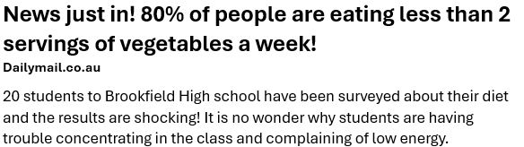
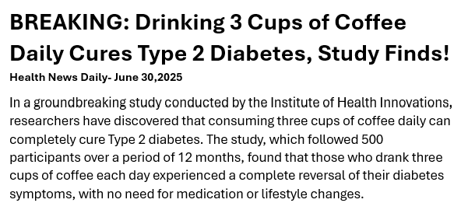
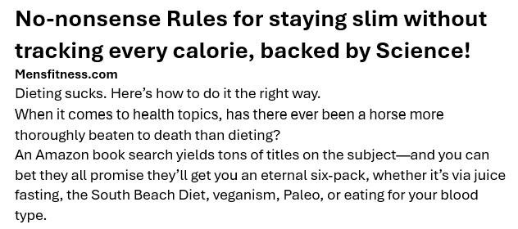
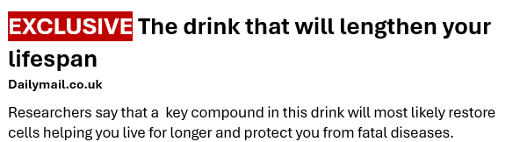
Health articles
Do you trust these headlines?

Slide 10
Recognising misrepresentations
Does this lead the public to believe in something more positive than what the data supports?
Age of people who attend the gym weekly.
31-50 years
(23%)
51+ years
(15%)
16-30 years
(72%)
NEWS! Majority of teens in top physical shape!
Survey responses showed that 58% of students said they exercise 3 or more times per week.
What is misleading about the sector graph representing the age of people who attend the gym on a weekly basis?
Did this survey measure any actual fitness?

Slide 11
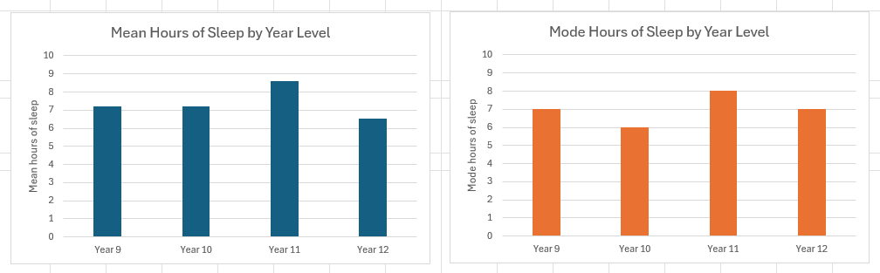
Mean versus mode
Misrepresentation
A school conducted a health survey to determine how many hours of sleep its students get to assess their overall wellbeing.

Slide 12
Releasing responsibility

Slide 13
Misleading features of a graph
Common ways a graph can be misleading
Displaced axis: Starting the vertical axis at a non-zero value can make values appear much larger than they actually are.
Visual manipulation: Using an uneven scale or adding 3D effects can distort the shape of the data and make it difficult to accurately compare values.
Graph type: Choosing the wrong type of graph for the data can lead to misinterpretations. For example, using a sector graph with too many categories can make it difficult to compare values and understand the data.
Omitted information: Leaving out important data points, using unclear labels or presenting data without context can create a false impression or hide trends.

Slide 14
Misleading summary statistics
Common ways statistics can be misleading
Mean – best when the data is symmetrical and has no extreme values
Median – best when data is skewed or has extreme values
Mode – best when data is categorical or when the most common item is important.

Slide 15
Independent practice

Slide 16
Scenario
Writing an argument
Write a short argument for the students in this scenario:
Students at your school are experiencing back pain from carrying heavy backpacks all day. A group of students approach the principal to request that lockers be installed. The principal, however, believes lockers are unnecessary.

Slide 17
Manipulating the argument
Tools for being more persuasive
Aspects | Examples of how to use it
Data displays | Exaggerate injury rates
Language and tone | Use emotive language (e.g. suffering)
Anecdotes | Use personal stories with lockers in other schools
Evidence | Reference research and/or school policy

Slide 18
References
This presentation contains NSW Curriculum and syllabus content. The NSW Curriculum is developed by the NSW Education Standards Authority. This content is prepared by NESA for and on behalf of the Crown in the right of the State of New South Wales. The material is protected by Crown copyright.
Please refer to the NESA Copyright Disclaimer for more information https://educationstandards.nsw.edu.au/wps/portal/nesa/mini-footer/copyright.
NESA holds the only official and up-to-date versions of the NSW Curriculum and syllabus documents. Please visit the NSW Education Standards Authority (NESA) website https://educationstandards.nsw.edu.au/wps/portal/nesa/home and the NSW Curriculum website https://curriculum.nsw.edu.au.
Mathematics Standard 11–12 Syllabus © NSW Education Standards Authority (NESA) for and on behalf of the Crown in right of the State of New South Wales, 2024.

Slide 19
Copyright
© State of New South Wales (Department of Education), 2025
The copyright material published in this resource is subject to the Copyright Act 1968 (Cth) and is owned by the NSW Department of Education or, where indicated, by a party other than the NSW Department of Education (third-party material).
Copyright material available in this resource and owned by the NSW Department of Education is licensed under a Creative Commons Attribution 4.0 International (CC BY 4.0) license.
This license allows you to share and adapt the material for any purpose, even commercially.
Attribution should be given to © State of New South Wales (Department of Education), 2025.
Material in this resource not available under a Creative Commons license:
the NSW Department of Education logo, other logos and trademark-protected material
Material owned by a third party that has been reproduced with permission. You will need to obtain permission from the third party to reuse its material.
Links to third-party material and websites
Please note that the provided (reading/viewing material/list/links/texts) are a suggestion only and implies no endorsement, by the New South Wales Department of Education, of any author, publisher, or book title. School principals and teachers are best placed to assess the suitability of resources that would complement the curriculum and reflect the needs and interests of their students.
If you use the links provided in this document to access a third-party’s website, you acknowledge that the terms of use, including licence terms set out on the third-party’s website apply to the use which may be made of the materials on that third-party website or where permitted by the Copyright Act 1968 (Cth). The department accepts no responsibility for content on third-party websites.

