Slide 1
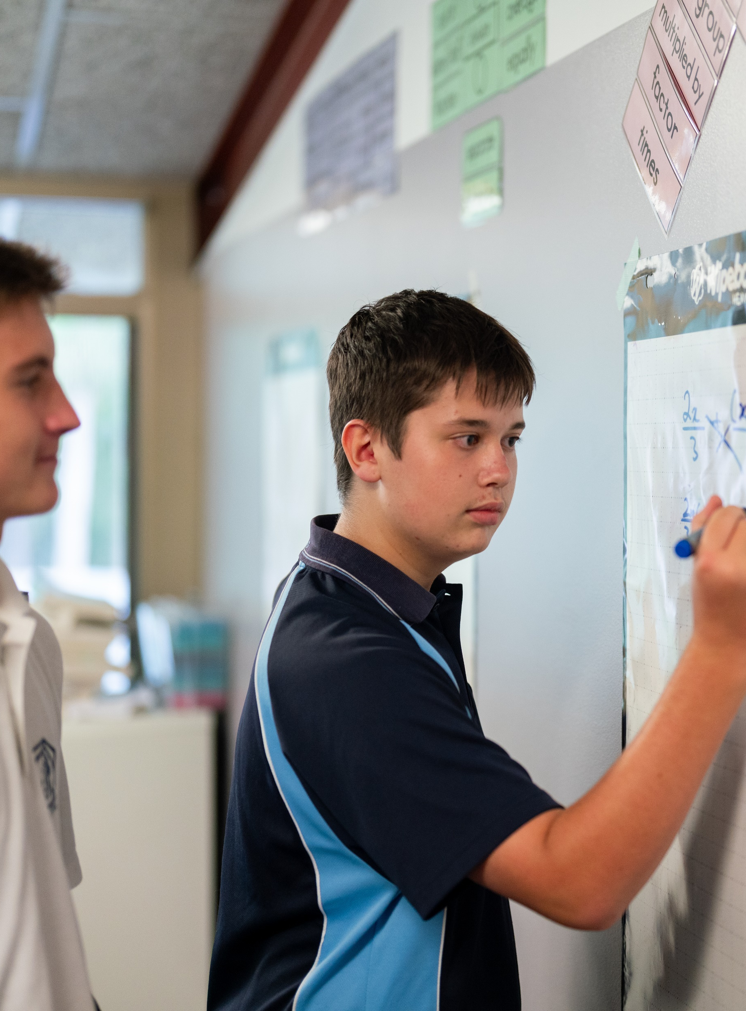
Designing questions and data classification
Mathematics Standard – Stage 6 (Year 11)
Unit 1 – getting healthy

Slide 2
Learning intentions and success criteria
Learning intentions
To understand how to apply questionnaire design principles to collect data.
To be able to classify and describe data by its different types.
Success criteria
I can write clear and unambiguous survey questions to collect data.
I can explain how issues of privacy, bias, ethics and responsiveness to diverse groups and cultures relate to data collection.
I can classify data using the terms categorical, numerical, nominal, ordinal, discrete and continuous.
I can identify data that can be considered both numerical and categorical.
Notes:
Notes for teachers:
Learning intentions and success criteria are best co-constructed with students. Adapt the learning intention as required and add matching success criteria.
For more information See ⁠AITSL or the NSW Department of Education explicit teaching strategies, ⁠Sharing learning intentions and ⁠Sharing success criteria
LISC is not necessarily presented at the beginning of the lesson. Teacher needs to consider most effectual time to introduce
LISC should be revisited during the lesson to support students' evaluation of their learning

Slide 3
Activating prior knowledge

Slide 4
Types of data (1)
Data
Categorical
Numerical
Ordinal
Nominal
Discrete
Continuous

Slide 5
Types of data (2)
Categorical
Categorical
Data associated with a categorical variable. Also known as qualitative data. A categorical variable describes a quality or characteristic of something. For example, your home state or blood type are categorical variables.
Nominal
A type of categorical variable whose values have no natural order in which they may be placed, for example, eye colour.
Ordinal
A type of categorical variable whose responses have a natural order. For example, level of happiness: very unhappy, unhappy, neutral, happy, very happy.

Slide 6
Types of data (3)
Numerical
Numerical
Variables whose values are numbers, and for which arithmetic processes such as adding and subtracting, or calculating an average, make sense. For example, the number of children in a family or the number of days in a month.
Discrete
Individual and countable items that can be listed. For example, the number of children in a family.
Continuous
A numerical variable that can take any value that lies within an interval. The values taken are subject to the accuracy of the measuring instrument used to obtain these values. For example, height, reaction time to a stimulus, and systolic blood pressure.

Slide 7
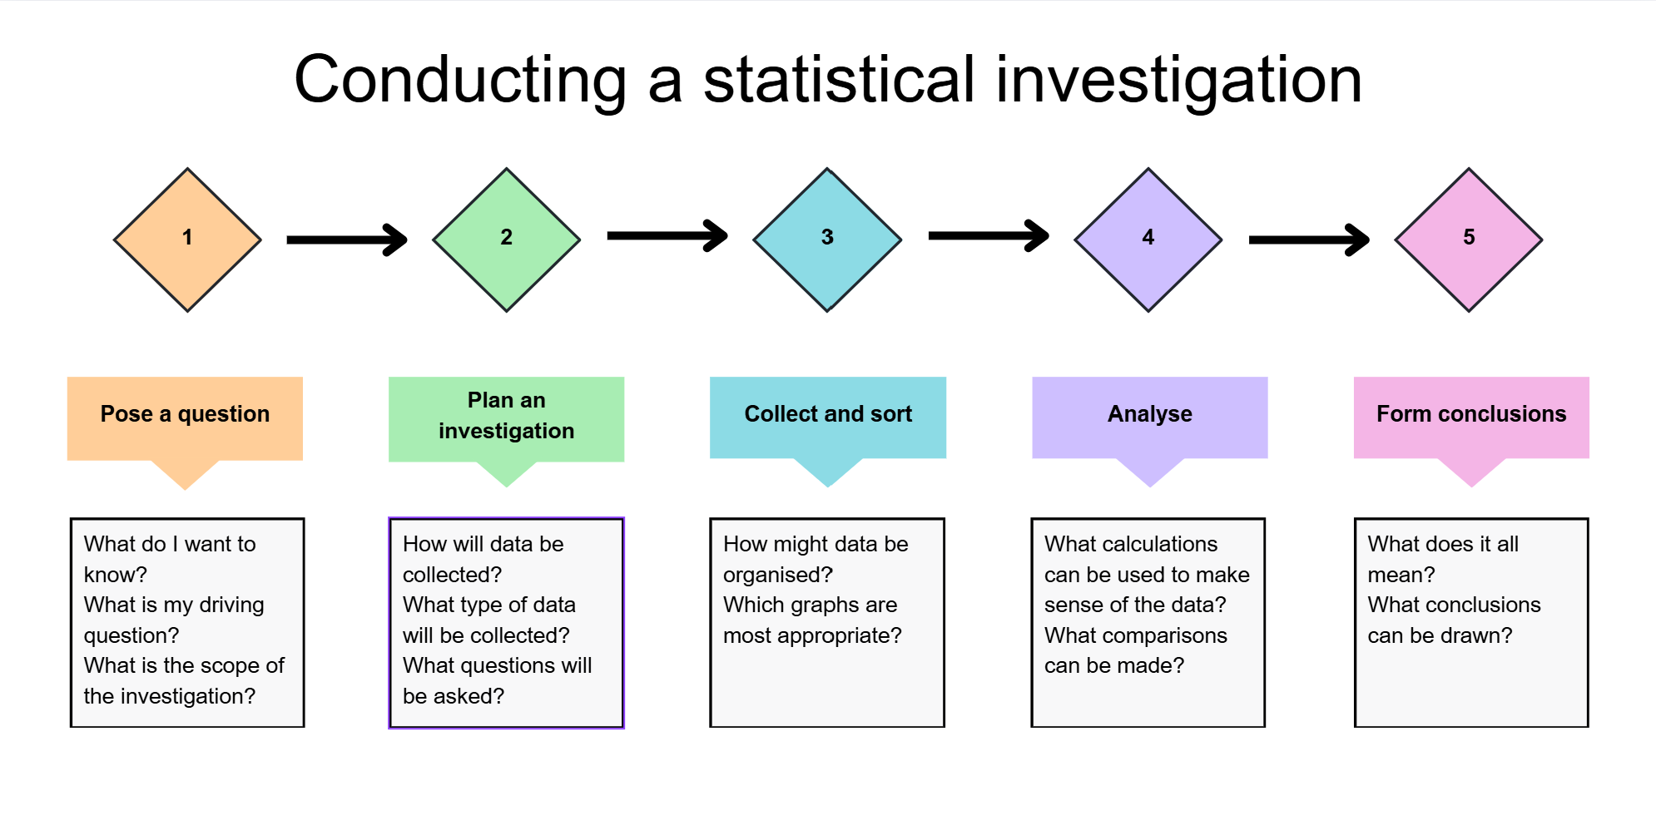
Statistical investigation process

Slide 8
Connecting learning

Slide 9
Dates of birth
05/02/2008
March 17, 2007
2007-12-01
14.08.2008
7 April 2007
08/09/07
2008/01/22
May 3rd, 2008
27-06-2007
2007.11.05
4/7/08
2008 March 30
18th May 2007
2008.04.11
July 9, 2007
02.01.2008
11/10/07
2008-06-15
16 Sept 2007
08-08-2008

Slide 10
How many steps do you walk in a day?
Survey question
0 – 3000
3000 – 5000
5000 – 8000
8000 – 10000
More than 15000

Slide 11
Releasing responsibility

Slide 12
Writing good survey questions
Use inclusive language and ensure terms are appropriate for the audience.
  AVOID: How often do you participate in anaerobic or aerobic exercise?
Use neutral and unbiased language
  AVOID: Don’t you think the product was excellent?
Use balanced answer choices
    AVOID: Excellent, Very Good, Great, Good, Neutral, Bad
Ask one thing at a time
  AVOID: How good was the location and the service?
Use closed questions where possible – multiple choice, rating scales
AVOID: Explain how you will use the service in your home

Slide 13
Independent practice

Slide 14
Exit ticket
A client’s Body Mass Index (BMI) category is listed using the following codes.
U = underweight
NW = normal weight
OW = overweight
O = obese
What type of data is this?
Justify your answer.

Slide 15
References
This presentation contains NSW Curriculum and syllabus content. The NSW Curriculum is developed by the NSW Education Standards Authority. This content is prepared by NESA for and on behalf of the Crown in the right of the State of New South Wales. The material is protected by Crown copyright.
Please refer to the NESA Copyright Disclaimer for more information https://educationstandards.nsw.edu.au/wps/portal/nesa/mini-footer/copyright.
NESA holds the only official and up-to-date versions of the NSW Curriculum and syllabus documents. Please visit the NSW Education Standards Authority (NESA) website https://educationstandards.nsw.edu.au/wps/portal/nesa/home and the NSW Curriculum website https://curriculum.nsw.edu.au.
Mathematics Standard 11–12 Syllabus © NSW Education Standards Authority (NESA) for and on behalf of the Crown in right of the State of New South Wales, 2024.

Slide 16
Copyright
© State of New South Wales (Department of Education), 2025
The copyright material published in this resource is subject to the Copyright Act 1968 (Cth) and is owned by the NSW Department of Education or, where indicated, by a party other than the NSW Department of Education (third-party material).
Copyright material available in this resource and owned by the NSW Department of Education is licensed under a Creative Commons Attribution 4.0 International (CC BY 4.0) license.
This license allows you to share and adapt the material for any purpose, even commercially.
Attribution should be given to © State of New South Wales (Department of Education), 2025.
Material in this resource not available under a Creative Commons license:
the NSW Department of Education logo, other logos and trademark-protected material
Material owned by a third party that has been reproduced with permission. You will need to obtain permission from the third party to reuse its material.
Links to third-party material and websites
Please note that the provided (reading/viewing material/list/links/texts) are a suggestion only and implies no endorsement, by the New South Wales Department of Education, of any author, publisher, or book title. School principals and teachers are best placed to assess the suitability of resources that would complement the curriculum and reflect the needs and interests of their students.
If you use the links provided in this document to access a third-party’s website, you acknowledge that the terms of use, including licence terms set out on the third-party’s website apply to the use which may be made of the materials on that third-party website or where permitted by the Copyright Act 1968 (Cth). The department accepts no responsibility for content on third-party websites.

