Slide 1
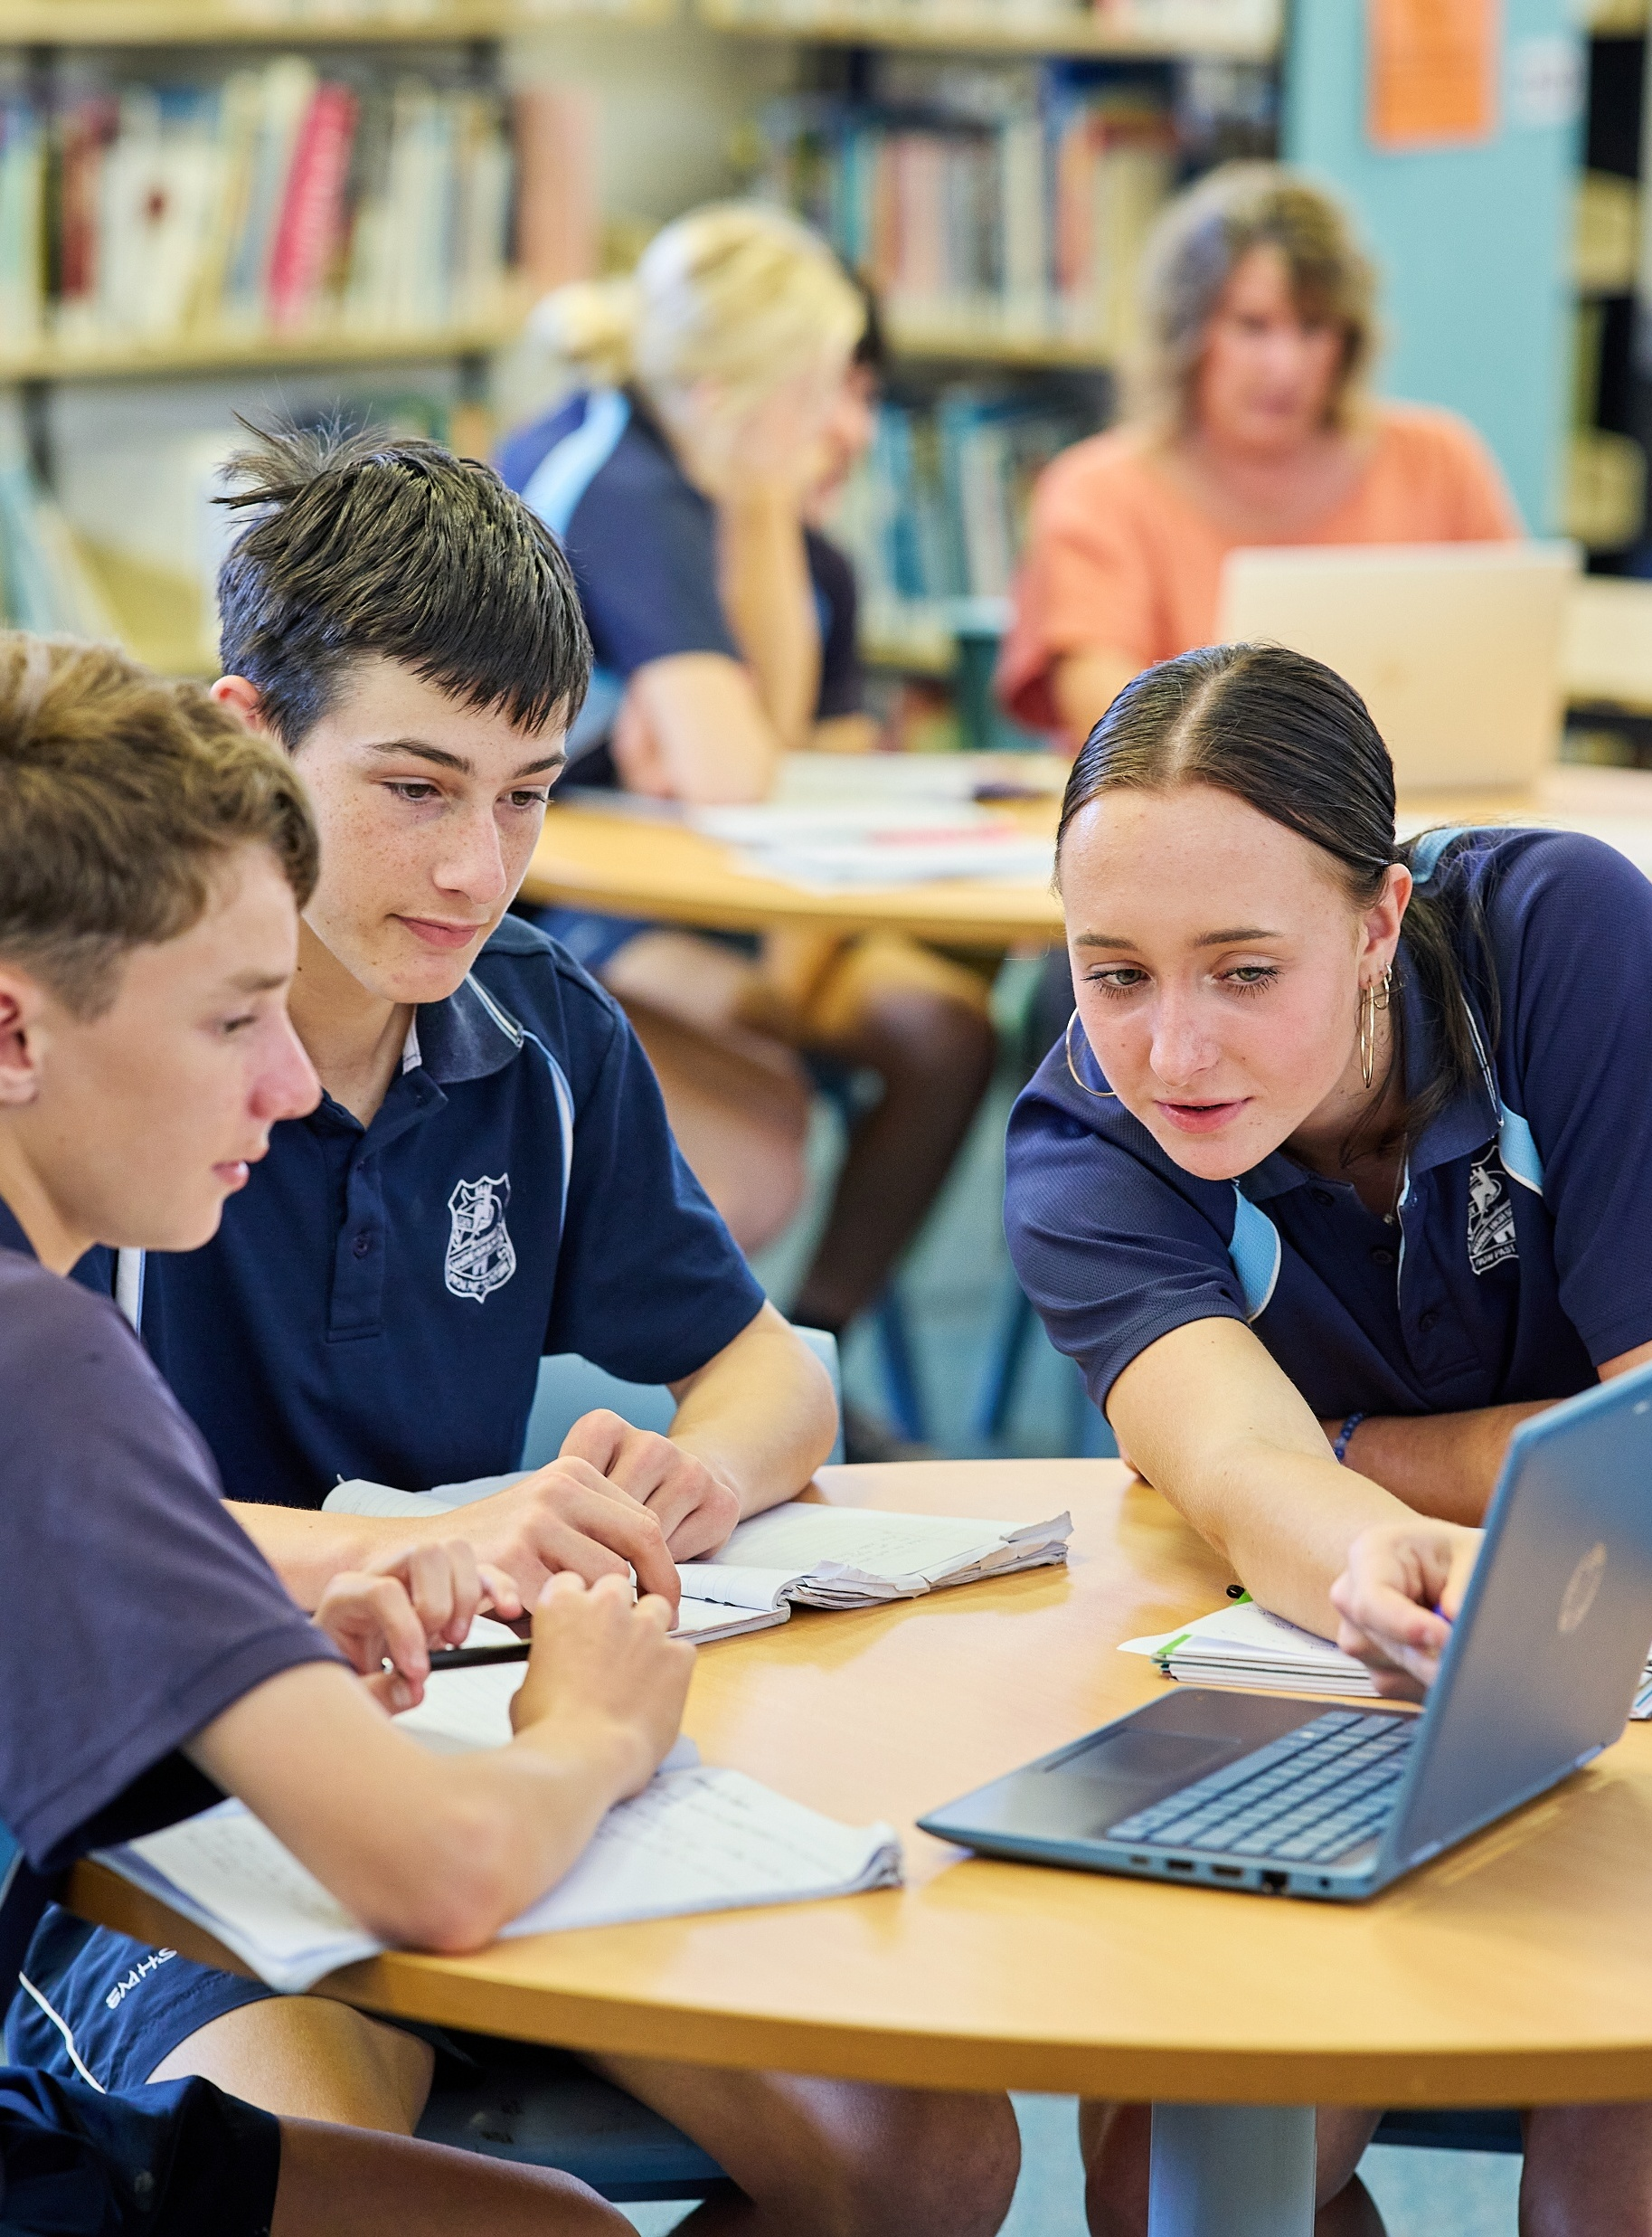
Creating scatter plots using spreadsheets
Mathematics Standard 2 – Stage 6 (Year 12)
Correlation

Slide 2
Learning intentions and success criteria
Learning intentions
To understand and represent the relationship between 2 variables.
To be able to distinguish between association and causation.
Success criteria
I can create a scatter plot from bivariate data using a spreadsheet.
I can describe the association between 2 variables from a scatter plot.
I can explain if an association between the independent and dependent variables may be causal.
I can make observations about a potential causal relationship given a scatter plot.

Slide 3
Activating prior knowledge

Slide 4
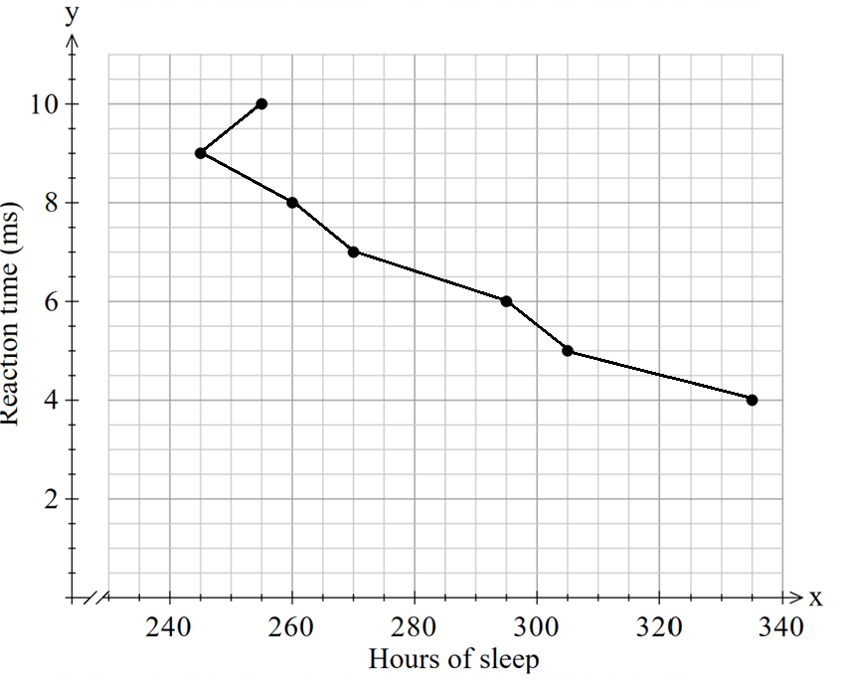
Incorrect scatter plot
Identify the errors
Hours of sleep | 4 | 5 | 6 | 7 | 8 | 9 | 10
Reaction time (milliseconds) | 335 | 305 | 295 | 270 | 260 | 245 | 255
Hours of sleep
Reaction time (ms)

Slide 5
Connecting learning

Slide 6
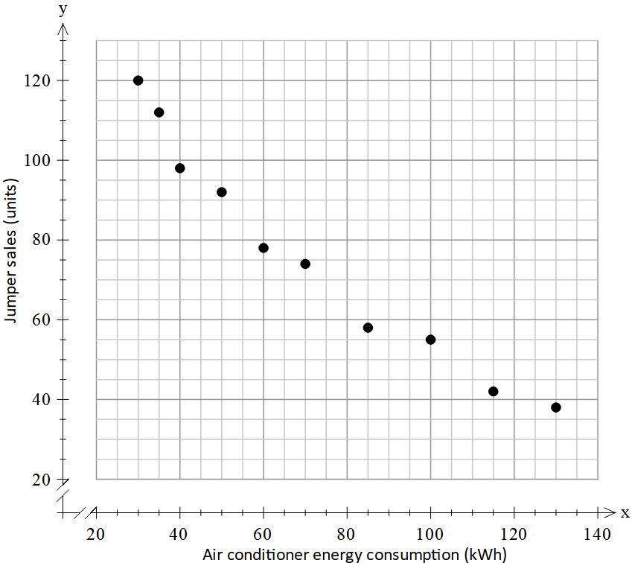
Association
Jumper sales and air conditioning energy consumption over October - April
Association: relationship between pairs of numerical variables.

Slide 7
Do you agree with this statement? Why or why not?
The more we use air conditioners; the fewer jumpers people buy. So, air conditioning must be the cause…. Right?
Jumper sales and air conditioning energy consumption over October - April
Causal: Two variables with a relationship which indicates that one event is the result of the occurrence of the other event.

Slide 8
Releasing responsibility

Slide 9
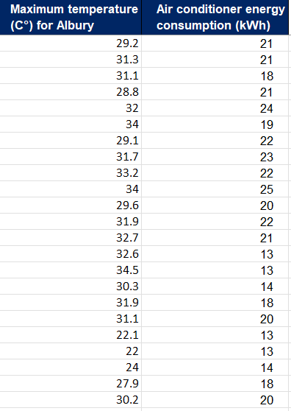
Spreadsheets (1)
If we want to create a graph from this data, how would we start?
Within the charts section, how could we identify the correct icon for scatter plot?

Slide 10
Independent practice

Slide 11
Humidity (%) versus rainfall (mm)
Create a scatter plot and answer the following questions:
1. Does the scatter plot support your initial expectation? Explain using evidence from the graph.
2. What observations can you make about how rainfall changes as humidity changes?
3. How would you describe the association between humidity and rainfall?
4. Based on your scatter plot, does this association appear to be causal? Explain your reasoning.
5. What other factors might influence rainfall, and how does this support your conclusion about causation?

Slide 12
References
This presentation contains NSW Curriculum and syllabus content. The NSW Curriculum is developed by the NSW Education Standards Authority. This content is prepared by NESA for and on behalf of the Crown in the right of the State of New South Wales. The material is protected by Crown copyright.
Please refer to the NESA Copyright Disclaimer for more information https://educationstandards.nsw.edu.au/wps/portal/nesa/mini-footer/copyright.
NESA holds the only official and up-to-date versions of the NSW Curriculum and syllabus documents. Please visit the NSW Education Standards Authority (NESA) website https://educationstandards.nsw.edu.au/wps/portal/nesa/home and the NSW Curriculum website https://curriculum.nsw.edu.au.
Mathematics Standard 11–12 Syllabus © NSW Education Standards Authority (NESA) for and on behalf of the Crown in right of the State of New South Wales, 2024.
.

Slide 13
Copyright
© State of New South Wales (Department of Education), 2026
The copyright material published in this resource is subject to the Copyright Act 1968 (Cth) and is owned by the NSW Department of Education or, where indicated, by a party other than the NSW Department of Education (third-party material).
Copyright material available in this resource and owned by the NSW Department of Education is licensed under a Creative Commons Attribution 4.0 International (CC BY 4.0) license.
This license allows you to share and adapt the material for any purpose, even commercially.
Attribution should be given to © State of New South Wales (Department of Education), 2026.
Material in this resource not available under a Creative Commons license:
the NSW Department of Education logo, other logos and trademark-protected material
Material owned by a third party that has been reproduced with permission. You will need to obtain permission from the third party to reuse its material.
Links to third-party material and websites
Please note that the provided (reading/viewing material/list/links/texts) are a suggestion only and implies no endorsement, by the New South Wales Department of Education, of any author, publisher, or book title. School principals and teachers are best placed to assess the suitability of resources that would complement the curriculum and reflect the needs and interests of their students.
If you use the links provided in this document to access a third-party’s website, you acknowledge that the terms of use, including licence terms set out on the third-party’s website apply to the use which may be made of the materials on that third-party website or where permitted by the Copyright Act 1968 (Cth). The department accepts no responsibility for content on third-party websites.

