Slide 1

Variables and scatter plots
Mathematics Standard 2 – Stage 6 (Year 12)
Correlation

Slide 2
Learning intentions and success criteria
Learning intentions
To understand that bivariate data describes relationships between 2 variables.
To know how to represent the relationship between 2 variables graphically.
Success criteria
I can identify situations where we use bivariate data over one-variable data.
I can explain the difference between independent and dependent variables.
I can represent bivariate data using a scatter plot.

Slide 3
Activating prior knowledge

Slide 4
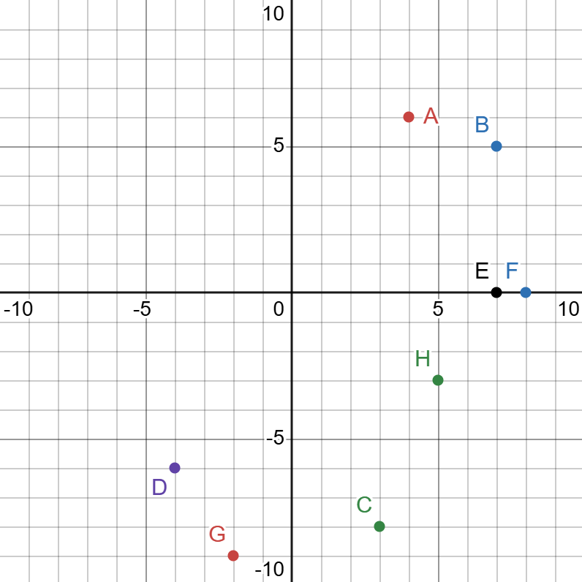
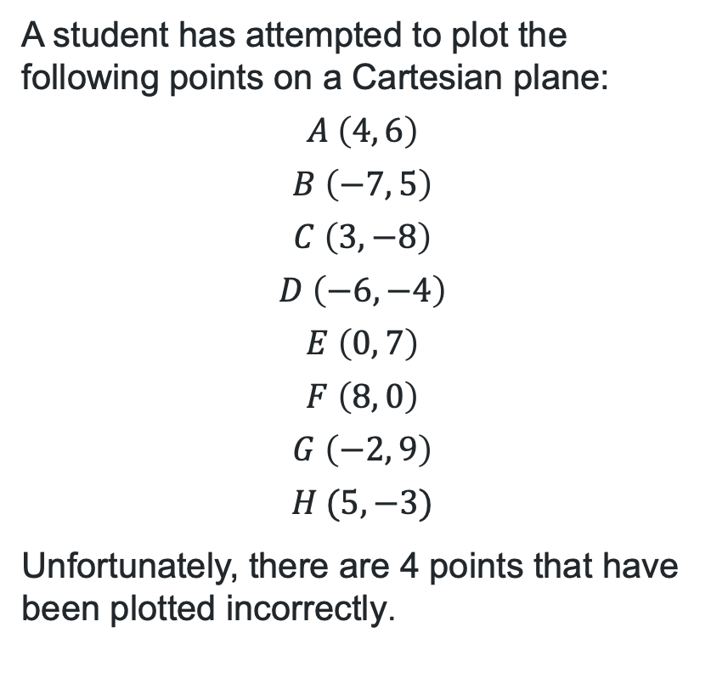
Plotting points on a Cartesian plane
Cartesian plane errors
A student has attempted to plot the following points on a Cartesian plane:
$$A \left(4, 6\right)$$
$$B \left(−7, 5\right)$$
$$C \left(3, −8\right)$$
$$D \left(−6, −4\right)$$
$$E \left(0, 7\right)$$
$$F \left(8, 0\right)$$
$$G \left(−2, 9\right)$$
$$H (5, −3)$$
Unfortunately, there are 4 points that have been plotted incorrectly.

Slide 5
Connecting learning

Slide 6
Scenarios
One set of data or 2 sets of data?
What is the typical size of bushfires (measured in hectares)?
Do bushfires that burn for longer require more water to extinguish?
How long does it usually take firefighters to arrive at a bushfire?
Do larger bushfires require more firefighters?
One-variable data is a dataset that involves only one variable.
Bivariate data is data relating to the measurement of 2 variables.

Slide 7
Scenario
Emergency services record the size of each bushfire in hectares and the number of firefighters deployed.
Bushfire size (hectares) | Firefighters deployed
0.5 | 3
1.2 | 4
2 | 6
3.5 | 8
5 | 10
7 | 12
10 | 15
14 | 18
18 | 21
22 | 25
30 | 32
40 | 40
Does the table of values help us see how the number of firefighters changes as the size of the fire increases?
If we wanted to represent this data graphically, how might we represent it?
Remember, these are 2 numerical measurements recorded and kept together as a pair.

Slide 8
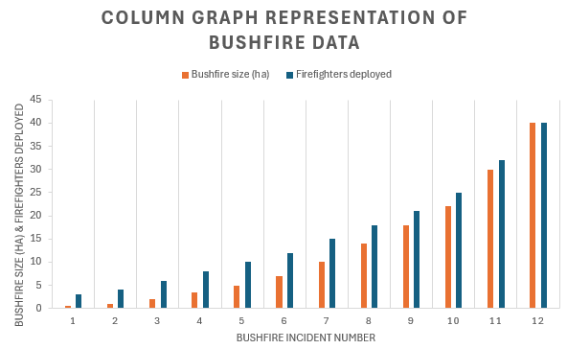
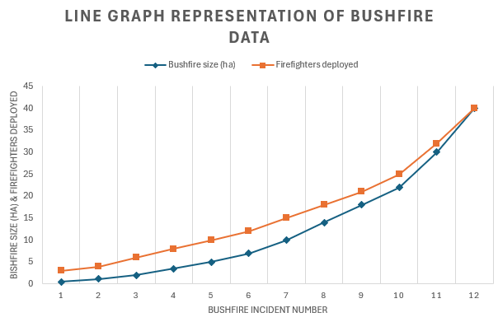
Investigating graphs
Column graphs and line graphs

Slide 9
Releasing responsibility

Slide 10
Independent and dependent variables
Scenario
Emergency services record the size of each bushfire in hectares and the number of firefighters deployed.
Independent variable – the variable used to explain or predict changes in another variable. It is generally represented on the horizontal axis of a graph and the first variable listed in a table.
Dependent variable – the variable whose value changes in response to the independent variable. It is generally represented on the vertical axis of a graph and is the second variable listed in a table.

Slide 11
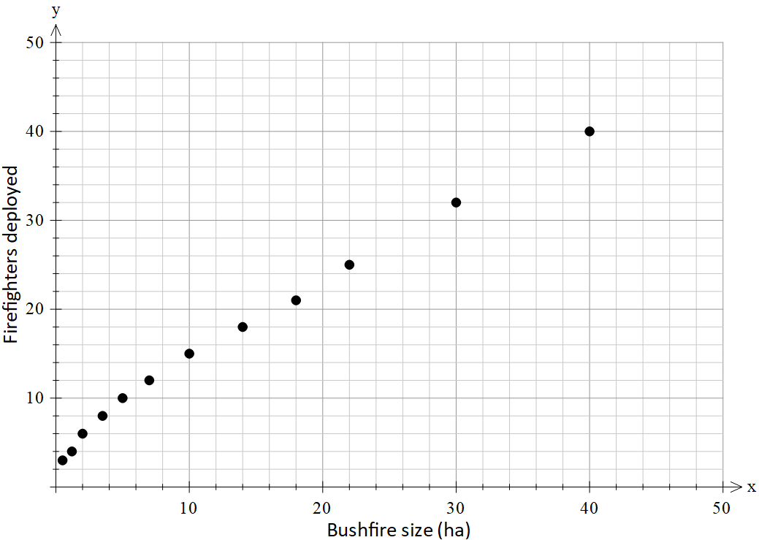
Scatter plot
Size of bushfires (hectares) and the number of firefighters deployed
Bushfire size (hectares) | Firefighters deployed
0.5 | 3
1.2 | 4
2 | 6
3.5 | 8
5 | 10
7 | 12
10 | 15
14 | 18
18 | 21
22 | 25
30 | 32
40 | 40

Slide 12
Scenario 1
A school records the number of students absent each day for a month.
“This is bivariate data because it changes each day.”
“This is one-variable data because only one variable is being measured.”
Sally
Bob

Slide 13
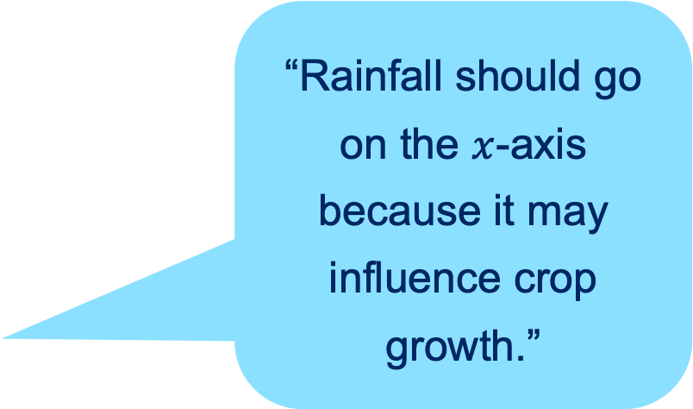
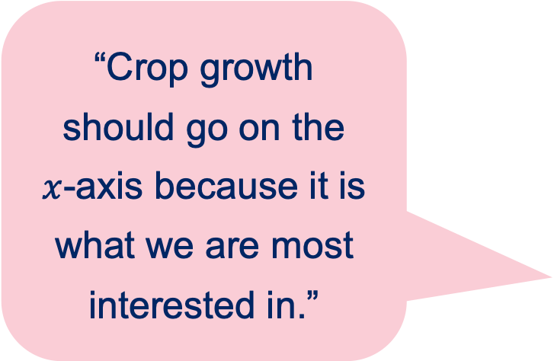
Scenario 2
A study investigates the relationship between the amount of rainfall and crop growth.
“Rainfall should go on the $x$-axis because it may influence crop growth.”
“Crop growth should go on the
$x$-axis because it is what we are most interested in.”
Sally
Bob

Slide 14
Scenario 3
A fitness app records the number of steps a person takes each day for 30 days.
“This is bivariate data because both ‘day’ and ‘number of steps’ are recorded.”
“This is one-variable data because the investigation is only measuring one characteristic.”
Sally
Bob

Slide 15
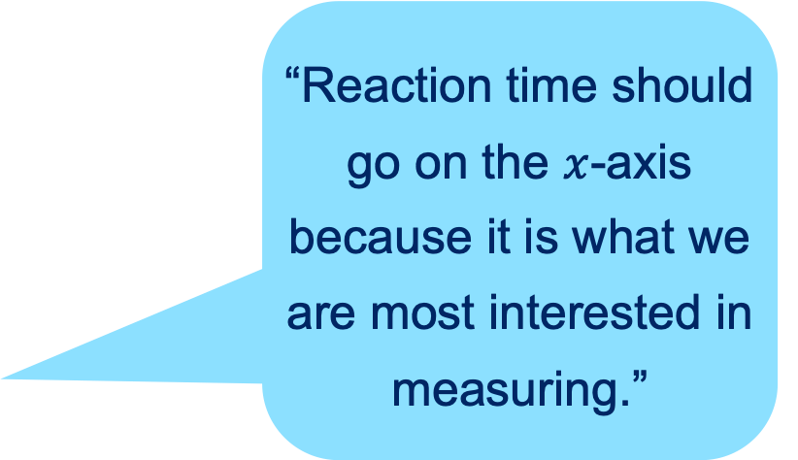
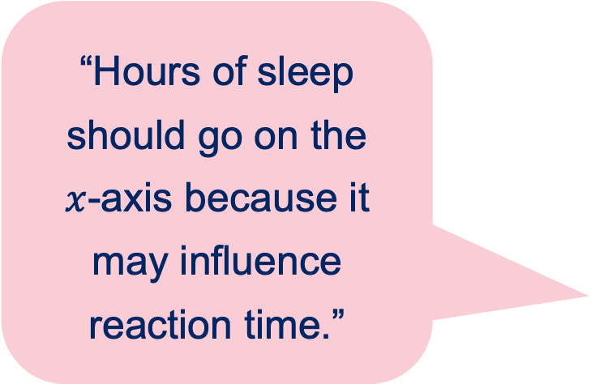
Scenario 4
A researcher investigates the relationship between the number of hours of sleep students get and their reaction time in a driving simulator test.
“Reaction time should go on the $x$-axis because it is what we are most interested in measuring.”
“Hours of sleep should go on the
$x$-axis because it may influence reaction time.”
Sally
Bob

Slide 16
Independent practice

Slide 17

Approaching questions scaffold

Slide 18
References
This presentation contains NSW Curriculum and syllabus content. The NSW Curriculum is developed by the NSW Education Standards Authority. This content is prepared by NESA for and on behalf of the Crown in the right of the State of New South Wales. The material is protected by Crown copyright.
Please refer to the NESA Copyright Disclaimer for more information https://educationstandards.nsw.edu.au/wps/portal/nesa/mini-footer/copyright.
NESA holds the only official and up-to-date versions of the NSW Curriculum and syllabus documents. Please visit the NSW Education Standards Authority (NESA) website https://educationstandards.nsw.edu.au/wps/portal/nesa/home and the NSW Curriculum website https://curriculum.nsw.edu.au.
Mathematics Standard 11–12 Syllabus © NSW Education Standards Authority (NESA) for and on behalf of the Crown in right of the State of New South Wales, 2024.

Slide 19
Copyright
© State of New South Wales (Department of Education), 2026
The copyright material published in this resource is subject to the Copyright Act 1968 (Cth) and is owned by the NSW Department of Education or, where indicated, by a party other than the NSW Department of Education (third-party material).
Copyright material available in this resource and owned by the NSW Department of Education is licensed under a Creative Commons Attribution 4.0 International (CC BY 4.0) license.
This license allows you to share and adapt the material for any purpose, even commercially.
Attribution should be given to © State of New South Wales (Department of Education), 2026.
Material in this resource not available under a Creative Commons license:
the NSW Department of Education logo, other logos and trademark-protected material
Material owned by a third party that has been reproduced with permission. You will need to obtain permission from the third party to reuse its material.
Links to third-party material and websites
Please note that the provided (reading/viewing material/list/links/texts) are a suggestion only and implies no endorsement, by the New South Wales Department of Education, of any author, publisher, or book title. School principals and teachers are best placed to assess the suitability of resources that would complement the curriculum and reflect the needs and interests of their students.
If you use the links provided in this document to access a third-party’s website, you acknowledge that the terms of use, including licence terms set out on the third-party’s website apply to the use which may be made of the materials on that third-party website or where permitted by the Copyright Act 1968 (Cth). The department accepts no responsibility for content on third-party websites.

