Slide 1

Sampling techniques
Mathematics Standard – Stage 6 (Year 11)
Unit 1 – getting healthy

Slide 2
Activating prior knowledge

Slide 3

Japanese symbol for 10,000

Slide 4
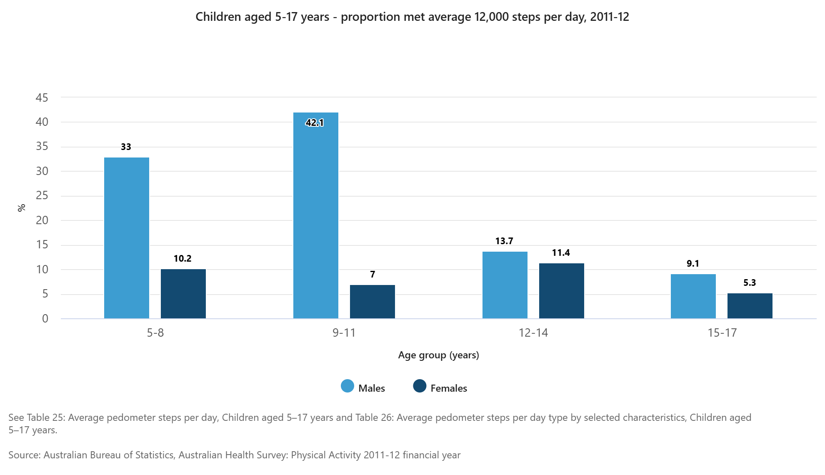
Children aged 5-17 years – proportion who met 12000 steps per day 2011–2012
Notes:
Graph downloaded from https://www.abs.gov.au/statistics/health/health-conditions-and-risks/australian-health-survey-physical-activity/latest-release

Slide 5
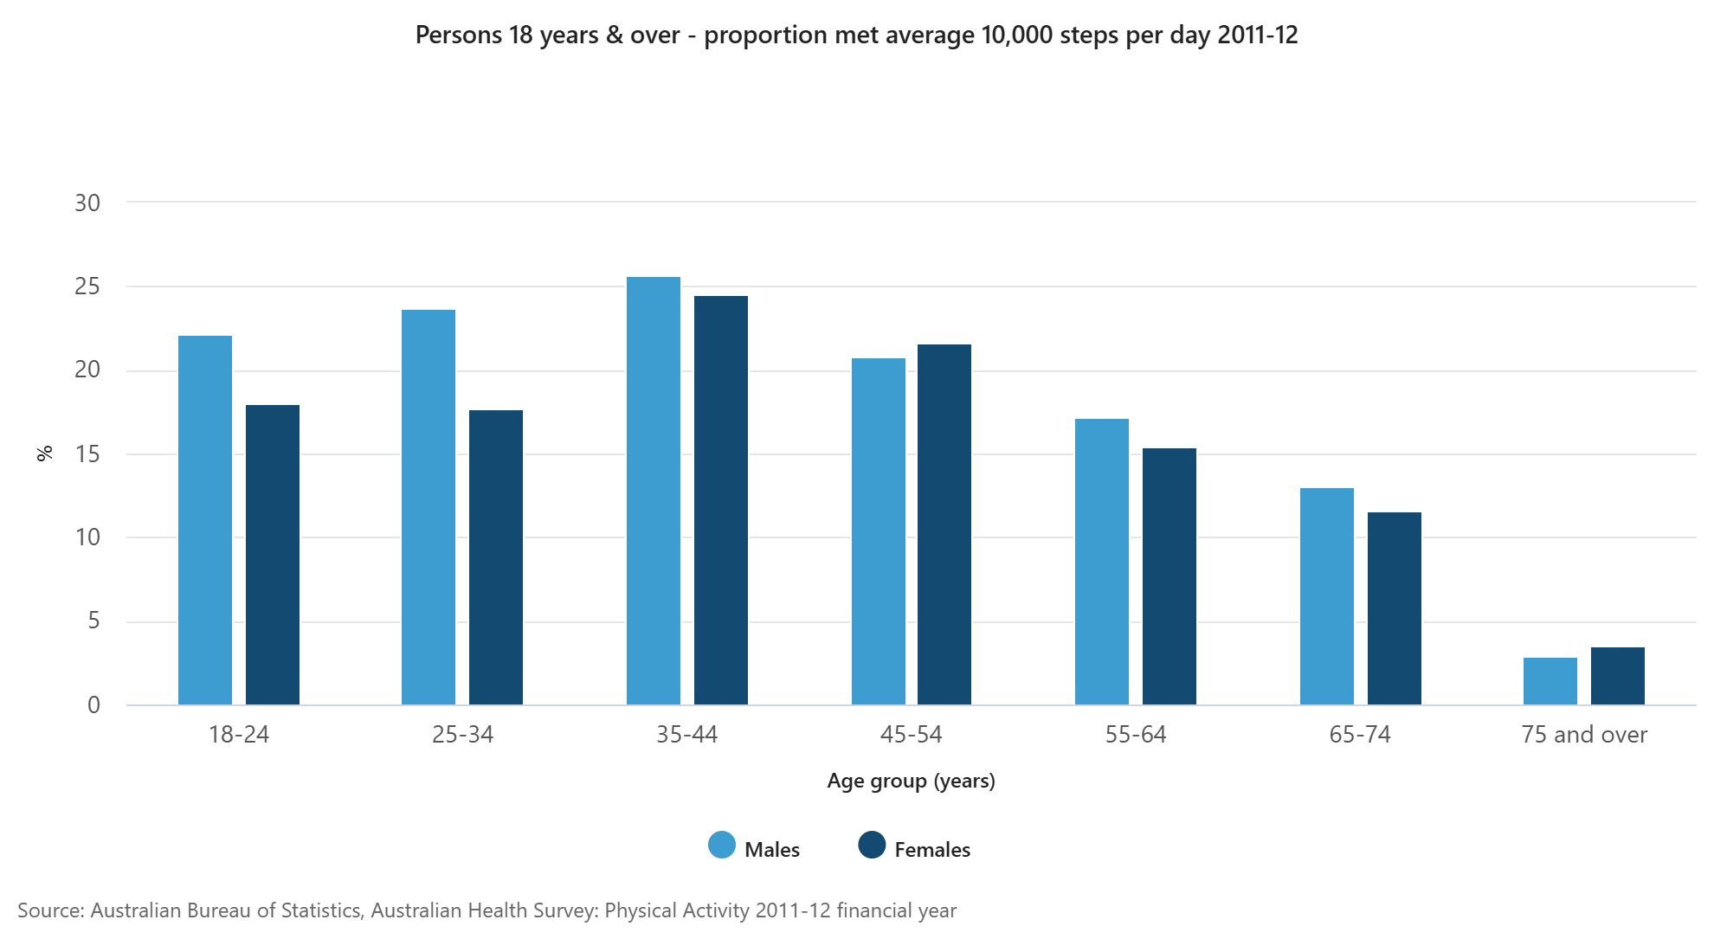
Persons 18 years and over – proportion met average 10000 steps per day 2011–2012

Slide 6
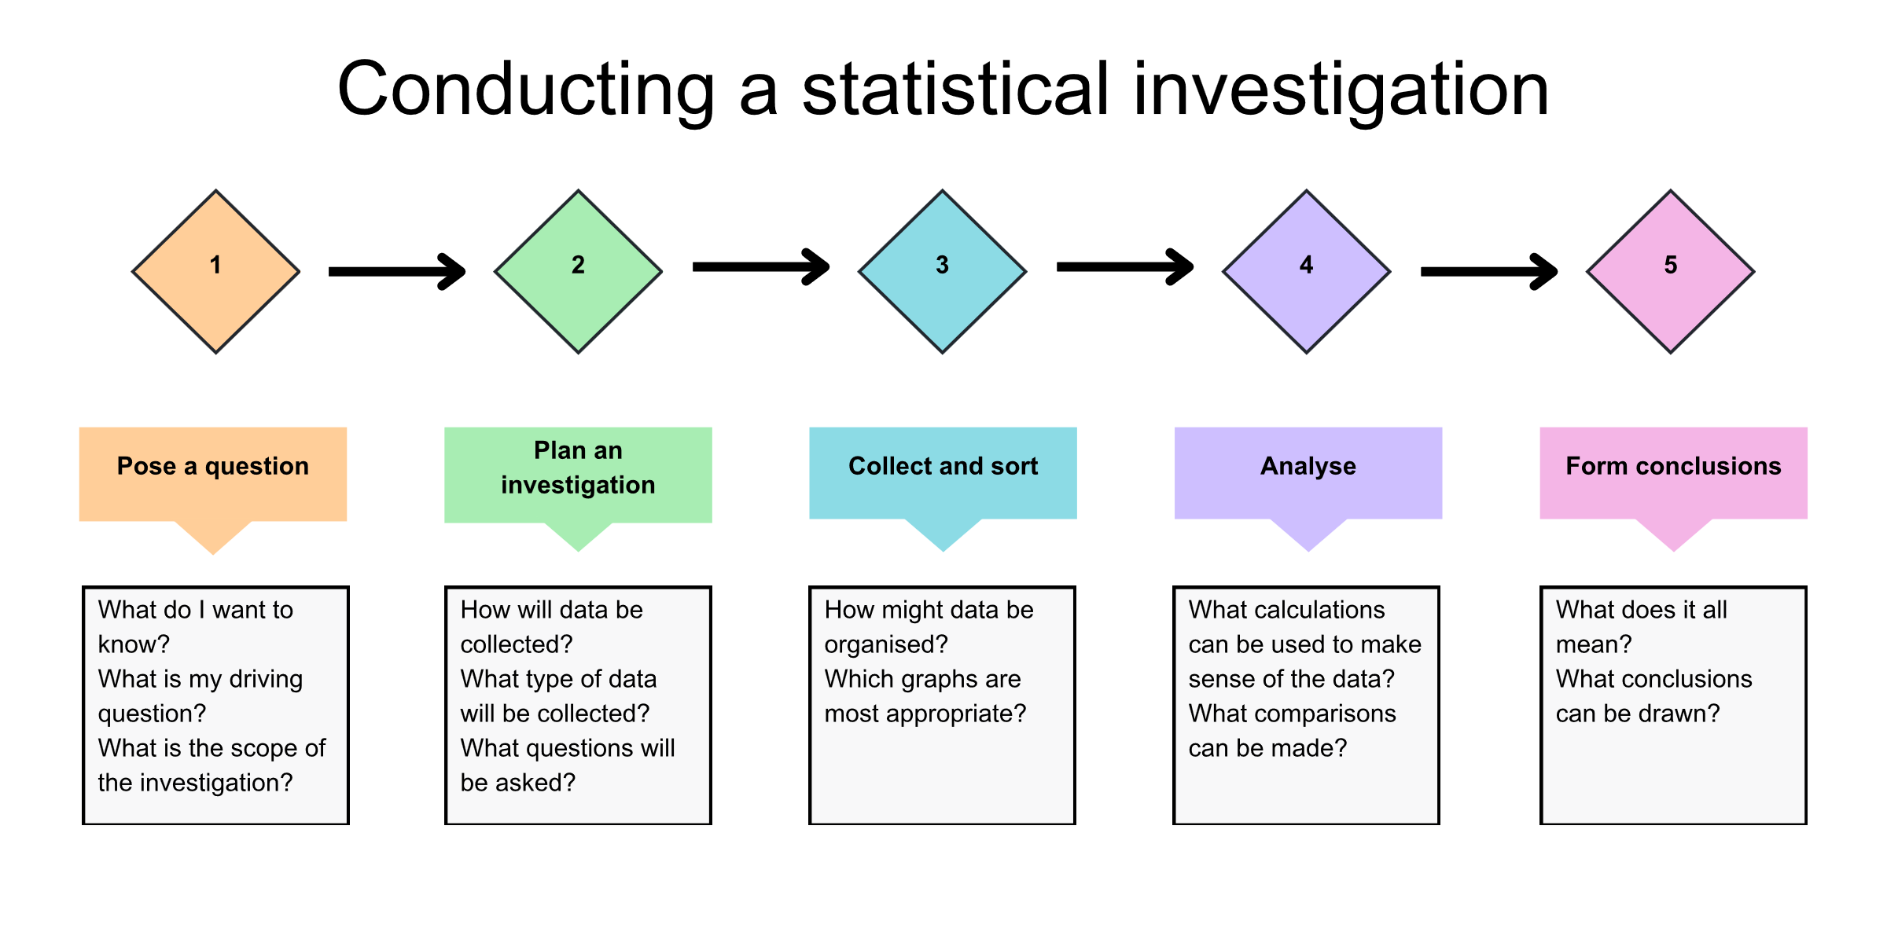
Statistical investigation process

Slide 7
Learning intention and success criteria
Learning intention
To understand the advantages and disadvantages of different sampling methods
Success criteria
I can explain the concept of a sample.
I can describe different sampling methods.
I can identify the benefits and limitations of using different sampling methods.
I can justify why a sample is representative of a population.
Notes:
Notes for teachers:
Learning intentions and success criteria are best co-constructed with students. Adapt the learning intention as required and add matching success criteria.
For more information See ⁠AITSL or the NSW Department of Education explicit teaching strategies, ⁠Sharing learning intentions and ⁠Sharing success criteria
LISC is not necessarily presented at the beginning of the lesson. Teacher needs to consider most effectual time to introduce
LISC should be revisited during the lesson to support students' evaluation of their learning

Slide 8
Releasing responsibility

Slide 9
Types of sampling techniques
Self-selected sample: Participants choose whether to be a part of the sample.
Random sample: A selection is made where every member of a population has an equal chance of being selected.
Systematic sample: The sample is selected from the total population at regular sub intervals.
Stratified sample: Divide a population into distinct subgroups that share characteristics and ensure samples proportionally represent each subgroup.

Slide 10
Independent practice

Slide 11
Exit ticket
Mathematics Standard 2 2024 HSC Q3
Shoppers are invited to complete an online questionnaire. What type of sampling is this?
Self-selecting
Simple random
Stratified
Systematic
Mathematics Standard 2 HSC © NSW Education Standards Authority (NESA) for and on behalf of the Crown in right of the State of New South Wales, 2024
Explain your choice.

Slide 12
References
This presentation contains NSW Curriculum and syllabus content. The NSW Curriculum is developed by the NSW Education Standards Authority. This content is prepared by NESA for and on behalf of the Crown in the right of the State of New South Wales. The material is protected by Crown copyright.
Please refer to the NESA Copyright Disclaimer for more information https://educationstandards.nsw.edu.au/wps/portal/nesa/mini-footer/copyright.
NESA holds the only official and up-to-date versions of the NSW Curriculum and syllabus documents. Please visit the NSW Education Standards Authority (NESA) website https://educationstandards.nsw.edu.au/wps/portal/nesa/home and the NSW Curriculum website https://curriculum.nsw.edu.au.
Mathematics Standard 11–12 Syllabus © NSW Education Standards Authority (NESA) for and on behalf of the Crown in right of the State of New South Wales, 2024.
Mathematics Standard 2 HSC © NSW Education Standards Authority (NESA) for and on behalf of the Crown in right of the State of New South Wales, 2024

Slide 13
Copyright
© State of New South Wales (Department of Education), 2025
The copyright material published in this resource is subject to the Copyright Act 1968 (Cth) and is owned by the NSW Department of Education or, where indicated, by a party other than the NSW Department of Education (third-party material).
Copyright material available in this resource and owned by the NSW Department of Education is licensed under a Creative Commons Attribution 4.0 International (CC BY 4.0) license.
This license allows you to share and adapt the material for any purpose, even commercially.
Attribution should be given to © State of New South Wales (Department of Education), 2025.
Material in this resource not available under a Creative Commons license:
the NSW Department of Education logo, other logos and trademark-protected material
Material owned by a third party that has been reproduced with permission. You will need to obtain permission from the third party to reuse its material.
Links to third-party material and websites
Please note that the provided (reading/viewing material/list/links/texts) are a suggestion only and implies no endorsement, by the New South Wales Department of Education, of any author, publisher, or book title. School principals and teachers are best placed to assess the suitability of resources that would complement the curriculum and reflect the needs and interests of their students.
If you use the links provided in this document to access a third-party’s website, you acknowledge that the terms of use, including licence terms set out on the third-party’s website apply to the use which may be made of the materials on that third-party website or where permitted by the Copyright Act 1968 (Cth). The department accepts no responsibility for content on third-party websites.

