Slide 1

Trigonometry in three dimensions further problems
Mathematics Extension 1 – Stage 6 (Year 11)
Further trigonometry

Slide 2
Learning intentions and success criteria
Learning intentions
To understand how to interpret information from both diagrams and written descriptions to identify key details and relationships.
To be able to solve 3-dimensional trigonometry problems involving bearings.
Success criteria
I can identify and classify 2-dimensional triangles within a 3-dimensional scenario.
I can interpret written descriptions and match them to diagrammatic representations.
I can select and apply the correct trigonometric method to find unknown sides or angles.
I can justify my reasoning and explain the steps I take to solve a problem.

Slide 3
Connecting learning

Slide 4
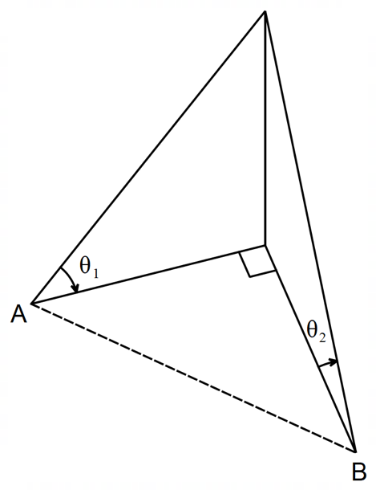
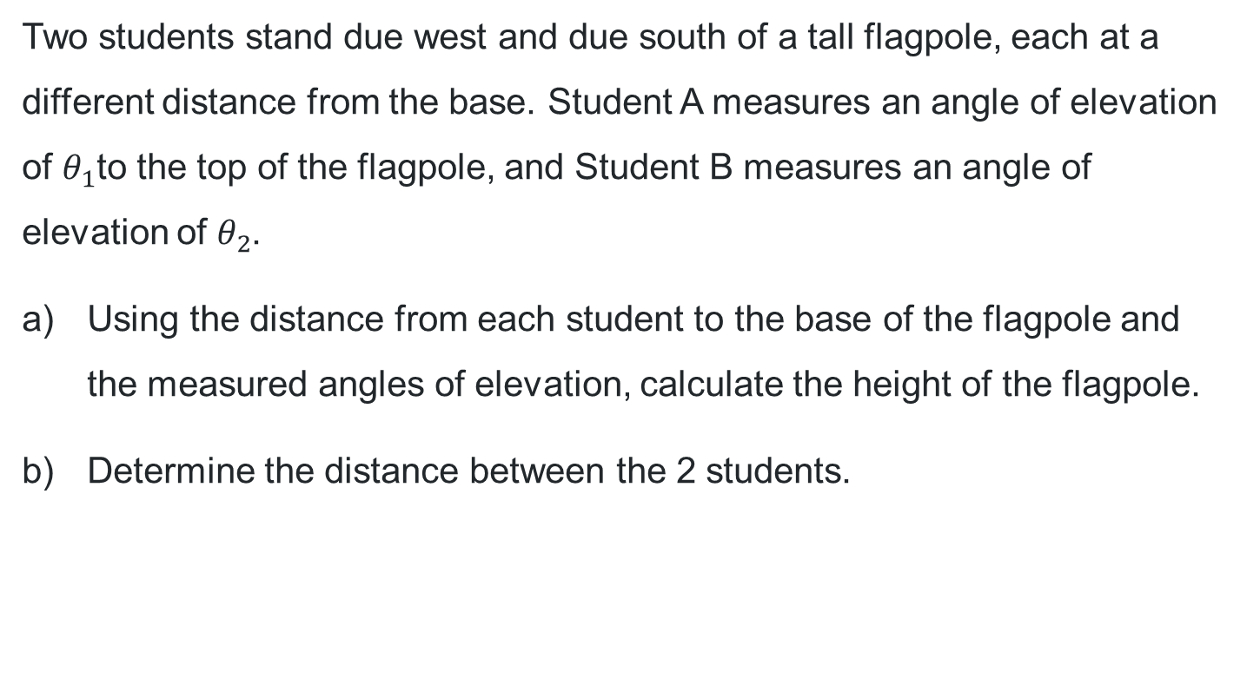
Written description (1)
Two students stand due west and due south of a tall flagpole, each at a different distance from the base. Student A measures an angle of elevation of $θ_{1}$to the top of the flagpole, and Student B measures an angle of elevation of $θ_{2}$.
Using the distance from each student to the base of the flagpole and the measured angles of elevation, calculate the height of the flagpole.
Determine the distance between the 2 students.

Slide 5
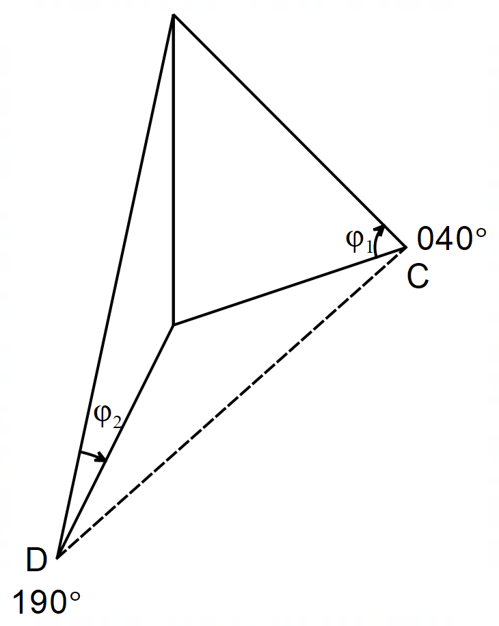
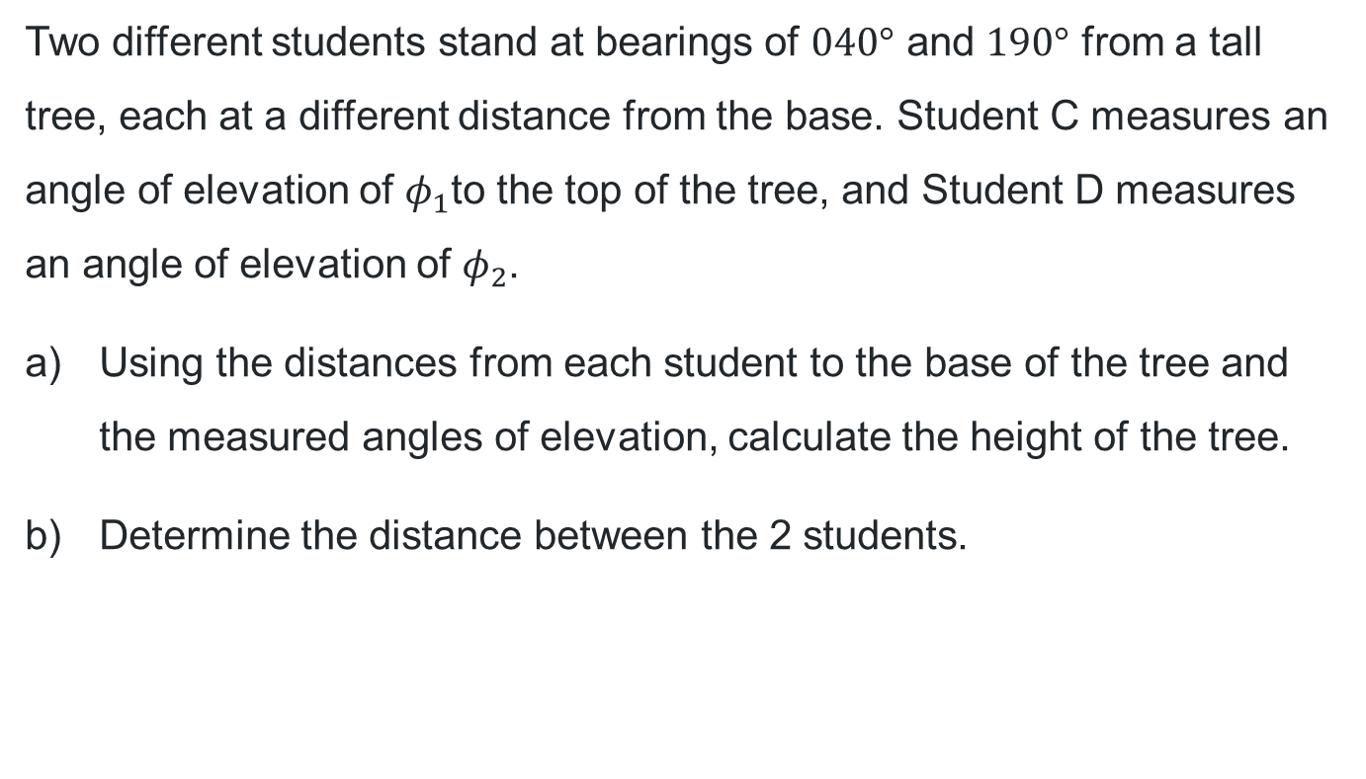
Written descriptions (2)
Two different students stand at bearings of $040°$ and $190°$ from a tall tree, each at a different distance from the base. Student C measures an angle of elevation of $φ_{1}$to the top of the tree, and Student D measures an angle of elevation of $φ_{2}$.
Using the distances from each student to the base of the tree and the measured angles of elevation, calculate the height of the tree.
Determine the distance between the 2 students.

Slide 6
Releasing responsibility

Slide 7

Approaching questions scaffold

Slide 8
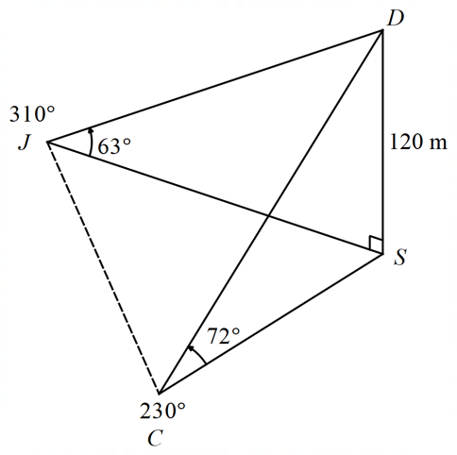















Bearings and 3D trigonometry (1)
Worked example – Step 1
At a music festival, a camera drone hovers above the centre of the main stage at a height of 120 m.
Colleen stands on a bearing of 230° from the stage and observes the angle of elevation to the drone as 72°.
John stands on a bearing of 310° from the stage and observes the angle of elevation to the drone as 63°.
Determine the distance between Colleen and John on the ground.
1. Construct the 2D labelled triangles and identify the required side
$$D$$
$$D$$
$$J$$
$$S$$
$$80°$$
$$120 \text{m}$$
$$120 \text{m}$$
$$x$$
$$J$$
$$63°$$
$$72°$$
$$S$$
$$S$$
$$C$$
$$C$$
Which triangles are right angled, and which are non-right angled?
How do you know?
$$310°−230°=80°$$
Why have some of the sides of the triangles been colour coded?

Slide 9
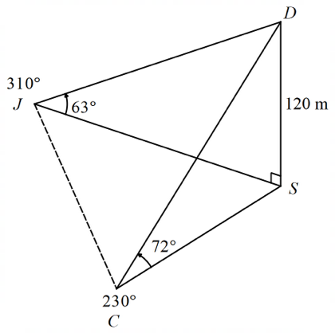




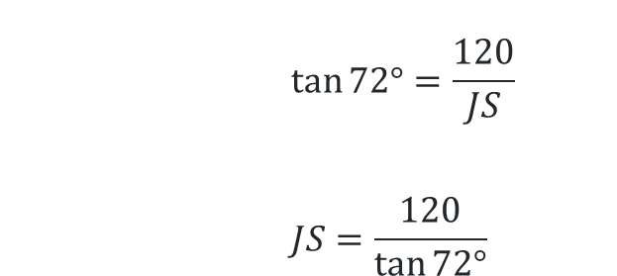




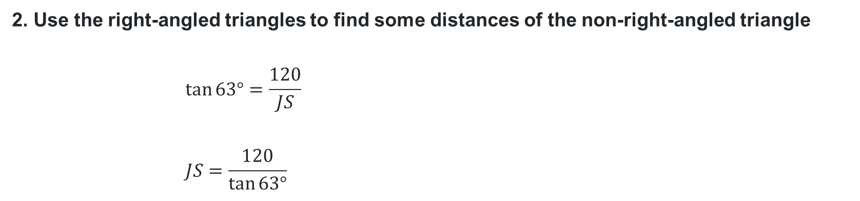
Bearings and 3D trigonometry (2)
Worked example – Step 2 and 3
2. Use the right-angled triangles to find some distances of the non-right-angled triangle
$$\tan{63°}=\frac{120}{JS}$$
$$JS=\frac{120}{\tan{63°}}$$
$$D$$
Why might the answers have been kept in exact form?
$$120 \text{m}$$
$$J$$
$$63°$$
$$S$$
$$D$$
$$\frac{120}{\tan{63°}}$$
$$\tan{72°}=\frac{120}{JS}$$
$$JS=\frac{120}{\tan{72°}}$$
$$J$$
$$120 \text{m}$$
$$S$$
$$80°$$
$$72°$$
$$S$$
$$x$$
$$C$$
$$\frac{120}{\tan{72°}}$$
3. Use this information to label the non-right-angled triangle
$$C$$

Slide 10





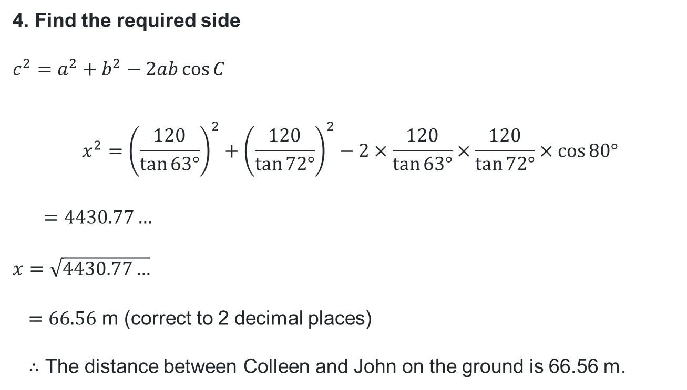
Bearings and 3D trigonometry (3)
Worked example – Step 4
4. Find the required side
$$c^{2}=a^{2}+b^{2}−2ab\cos{C}$$
$$x^{2}={\left(\frac{120}{\tan{63°}}\right)}^{2}+{\left(\frac{120}{\tan{72°}}\right)}^{2}−2×\frac{120}{\tan{63°}}×\frac{120}{\tan{72°}}×\cos{80°}$$
$$=4430.77…$$
$$x=\sqrt{4430.77…}$$
$=66.56$ m (correct to 2 decimal places)
$∴$ The distance between Colleen and John on the ground is 66.56 m.
Why was the cosine rule used?
What common errors could occur here when typing this expression into your calculator?
$$\frac{120}{\tan{63°}}$$
$$J$$
$$S$$
$$80°$$
$$x$$
$$\frac{120}{\tan{72°}}$$
$$C$$

Slide 11
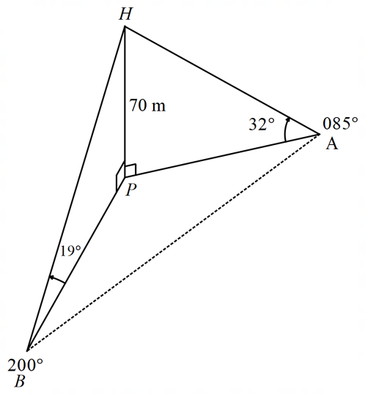






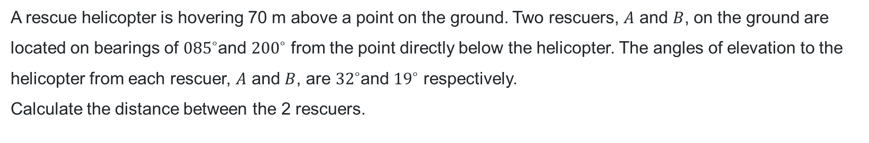







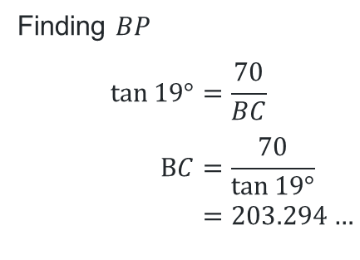
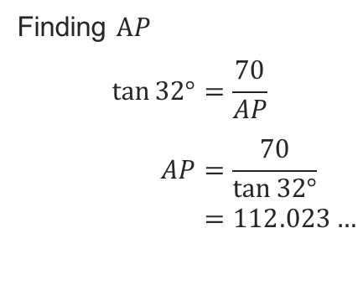
Bearings and 3D trigonometry (4)
Your turn
A rescue helicopter is hovering 70 m above a point on the ground. Two rescuers, $A$ and $B$, on the ground are located on bearings of ${085}^{∘}$and ${200}^{∘}$ from the point directly below the helicopter. The angles of elevation to the helicopter from each rescuer, $A$ and $B$, are ${32}^{∘}$and ${19}^{∘}$ respectively.
Calculate the distance between the 2 rescuers.
$$\frac{70}{\tan{19°}}=203.294…$$
$$H$$
$$H$$
$$J$$
$$S$$
$$70 \text{m}$$
$$80°$$
$$70 \text{m}$$
$$x$$
$$\frac{70}{\tan{32°}} =112.023…$$
$$B$$
$$19°$$
$$P$$
$$32°$$
$$P$$
$$A$$
Finding $BP$
$$\tan{19°=\frac{70}{BC}} \\ BC=\frac{70}{\tan{19°}} \\ =203.294…$$
Finding $AP$
$$\tan{32°=\frac{70}{AP}} \\ AP=\frac{70}{\tan{32°}} \\ =112.023…$$
$$C$$

Slide 12

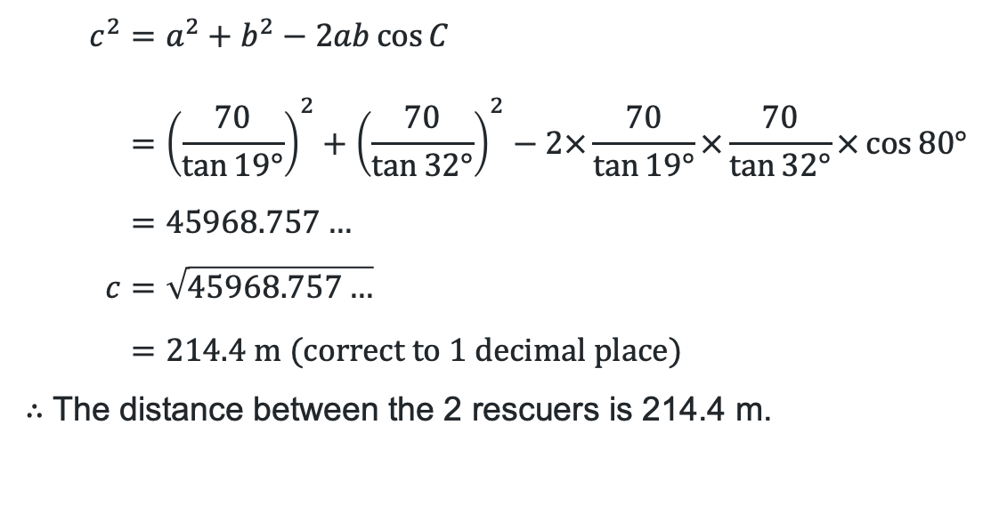
Bearings and 3D trigonometry (5)
Your turn continued
$$c^{2}=a^{2}+b^{2}−2ab\cos{C} \\ ={\left(\frac{70}{\tan{19°}}\right)}^{2}+{\left(\frac{70}{\tan{32°}}\right)}^{2}−2×\frac{70}{\tan{19°}}×\frac{70}{\tan{32°}}×\cos{80°} \\ =45968.757… \\ c=\sqrt{45968.757…} \\ =214.4 \text{m} \text{(}\text{correct} \text{to} \text{1 }\text{decimal} \text{place}\text{)}$$
$∴$ The distance between the 2 rescuers is 214.4 m.
$$\frac{70}{\tan{19°}}=203.294…$$
$$J$$
$$S$$
$$80°$$
$$x$$
$$\frac{70}{\tan{32°}} =112.023…$$
$$C$$

Slide 13
References
This presentation contains NSW Curriculum and syllabus content. The NSW Curriculum is developed by the NSW Education Standards Authority. This content is prepared by NESA for and on behalf of the Crown in the right of the State of New South Wales. The material is protected by Crown copyright.
Please refer to the NESA Copyright Disclaimer for more information https://educationstandards.nsw.edu.au/wps/portal/nesa/mini-footer/copyright.
NESA holds the only official and up-to-date versions of the NSW Curriculum and syllabus documents. Please visit the NSW Education Standards Authority (NESA) website https://educationstandards.nsw.edu.au/wps/portal/nesa/home and the NSW Curriculum website https://curriculum.nsw.edu.au.
Mathematics Extension 1 Stage 6 Syllabus © NSW Education Standards Authority (NESA) for and on behalf of the Crown in right of the State of New South Wales, 2024.

Slide 14
Copyright
© State of New South Wales (Department of Education), 2026
The copyright material published in this resource is subject to the Copyright Act 1968 (Cth) and is owned by the NSW Department of Education or, where indicated, by a party other than the NSW Department of Education (third-party material).
Copyright material available in this resource and owned by the NSW Department of Education is licensed under a Creative Commons Attribution 4.0 International (CC BY 4.0) license.
This license allows you to share and adapt the material for any purpose, even commercially.
Attribution should be given to © State of New South Wales (Department of Education), 2025.
Material in this resource not available under a Creative Commons license:
the NSW Department of Education logo, other logos and trademark-protected material
Material owned by a third party that has been reproduced with permission. You will need to obtain permission from the third party to reuse its material.
Links to third-party material and websites
Please note that the provided (reading/viewing material/list/links/texts) are a suggestion only and implies no endorsement, by the New South Wales Department of Education, of any author, publisher, or book title. School principals and teachers are best placed to assess the suitability of resources that would complement the curriculum and reflect the needs and interests of their students.
If you use the links provided in this document to access a third-party’s website, you acknowledge that the terms of use, including licence terms set out on the third-party’s website apply to the use which may be made of the materials on that third-party website or where permitted by the Copyright Act 1968 (Cth). The department accepts no responsibility for content on third-party websites.

