Slide 1

Trigonometry in three dimensions
Mathematics Extension 1 – Stage 6 (Year 11)
Further trigonometry

Slide 2
Learning intention and success criteria
Learning intention
To be able to interpret 3-dimensional contexts from diagrams and written descriptions.
To be able to identify relevant triangles in 3-dimensional problems and apply trigonometry to solve them.
Success criteria
I can extract 2D triangles from 3D diagrams and written descriptions.
I can apply trigonometry to solve problems in three dimensions.
I can justify my reasoning and explain the steps I take to solve a problem.

Slide 3
Activating prior knowledge

Slide 4
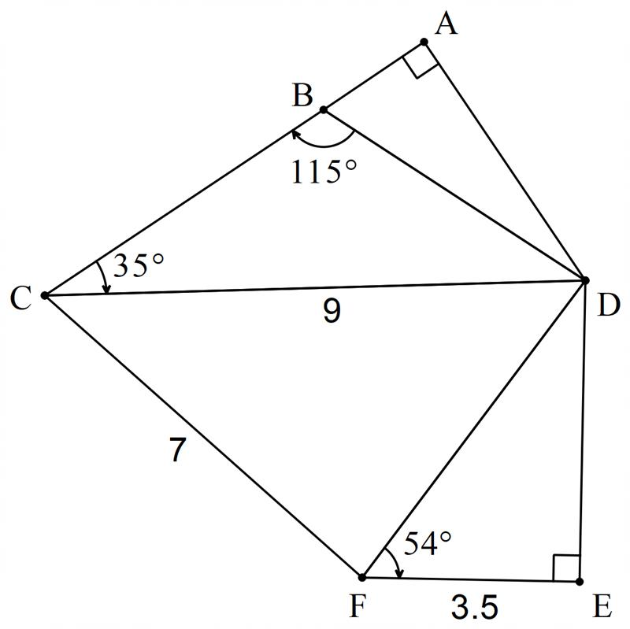
Goal-free problem

Slide 5
Releasing responsibility

Slide 6
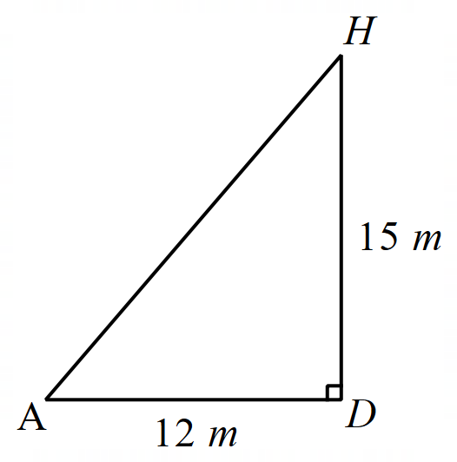
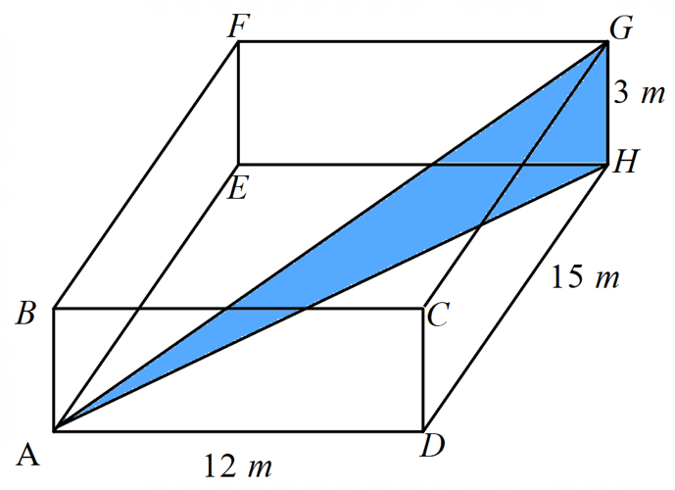
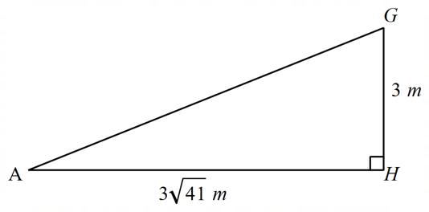

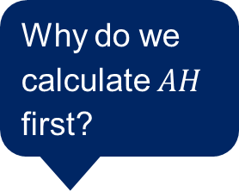
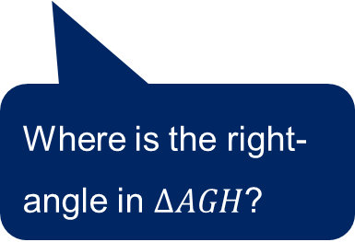
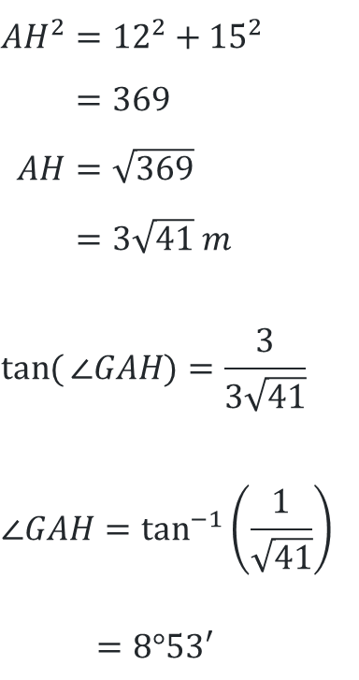
Finding diagonals (1)
Why do we calculate $AH$ first?
Worked example 1
Find the size of $∠GAH$, to the nearest minute, in this rectangular prism.
$${AH}^{2}={12}^{2}+{15}^{2} \\ =369 \\ AH=\sqrt{369} \\ =3\sqrt{41} m$$
$$\tan{(}∠GAH)=\frac{3}{3\sqrt{41}}$$
$$∠GAH=\tan^{−1}\left(\frac{1}{\sqrt{41}}\right)$$
$$=8°53′$$
What parts of the solution would change if you were asked to find $AG$?
Where is the right-angle in $∆AGH$?

Slide 7
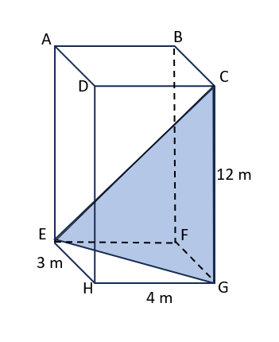
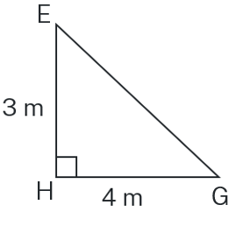
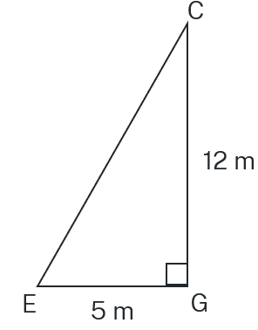
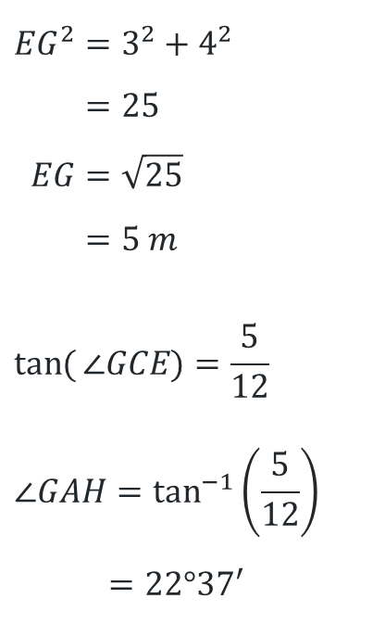
Finding diagonals (2)
Your turn – solution 1
Find the size of $∠GCE$, to the nearest minute, in this rectangular prism.
$${EG}^{2}=3^{2}+4^{2} \\ =25 \\ EG=\sqrt{25} \\ =5 m$$
$$\tan{(}∠GCE)=\frac{5}{12}$$
$$∠GAH=\tan^{−1}\left(\frac{5}{12}\right)$$
$$=22°37′$$

Slide 8
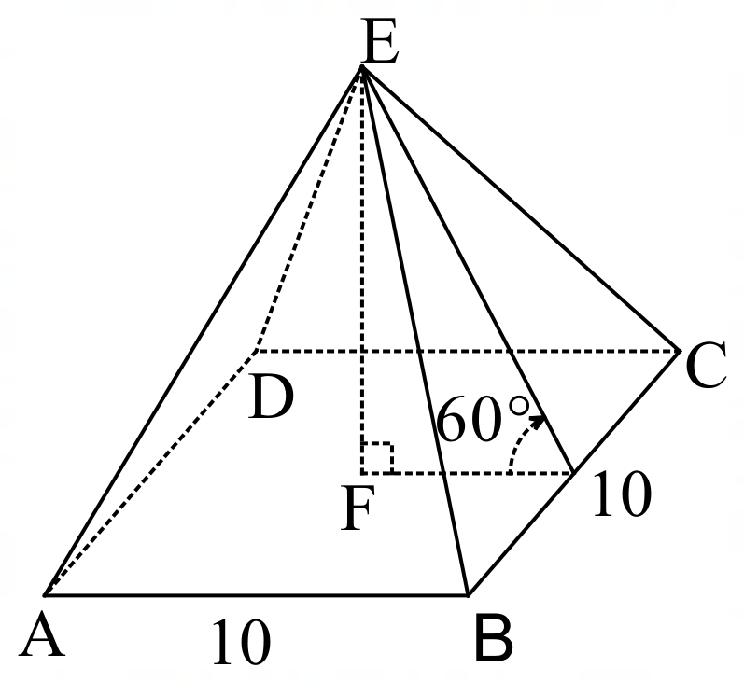
Pyramids (1)
Find the volume and surface area of the pyramid
$ABCDE$ is a square pyramid. The side $EBC$ makes an angle of $60°$ with the base $ABCD$.

Slide 9
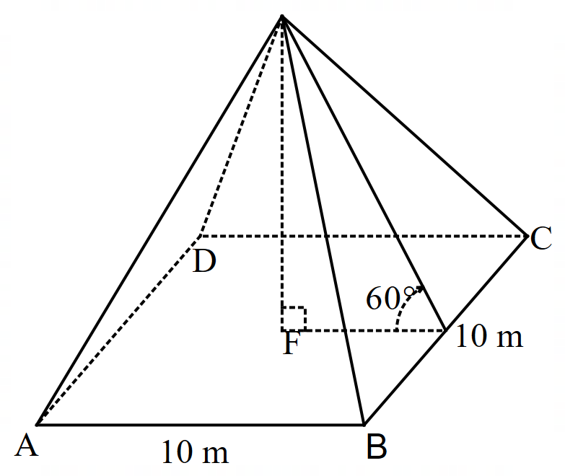
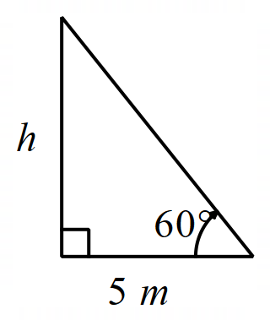
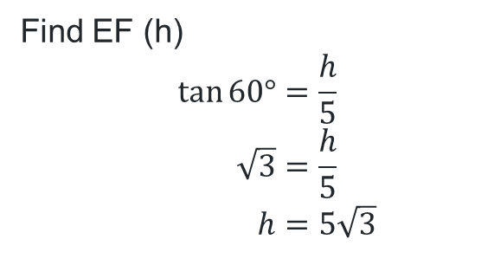
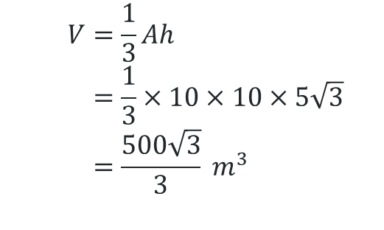
Pyramids (2)
Find the volume of the pyramid.
Find EF (h)
$$\tan{60°=\frac{h}{5}} \\ \sqrt{3}=\frac{h}{5} \\ h=5\sqrt{3}$$
$$V=\frac{1}{3}Ah \\ =\frac{1}{3}×10×10×5\sqrt{3} \\ =\frac{500\sqrt{3}}{3} m^{3}$$

Slide 10
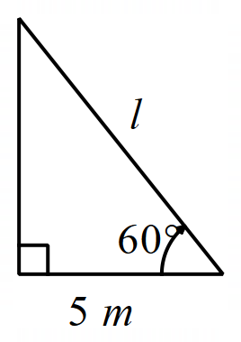
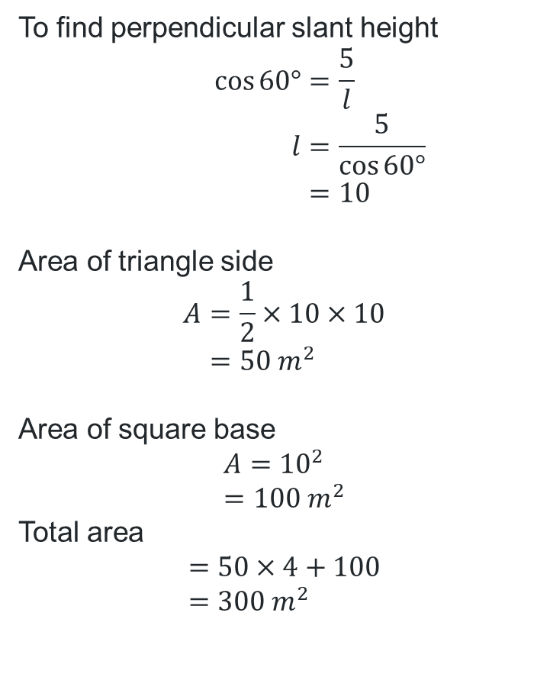
Pyramids (3)
Find the surface area of the pyramid.
To find perpendicular slant height
$$\cos{60°}=\frac{5}{l} \\ l=\frac{5}{\cos{60°}} \\ =10$$
Area of triangle side
$$A=\frac{1}{2}×10×10 \\ =50 m^{2}$$
Area of square base
$$A={10}^{2} \\ =100 m^{2}$$
Total area
$$=50×4+100 \\ =300 m^{2}$$

Slide 11
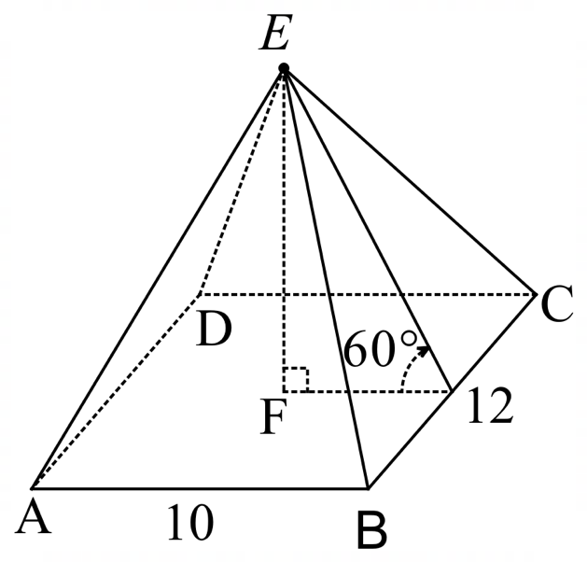
Pyramids (4)
Volume and surface area
ABCDE is a rectangular pyramid. The side EBC makes an angle of $60°$ with the base ABCD.

Slide 12
Independent practice

Slide 13

Approaching questions scaffold

Slide 14
References
This presentation contains NSW Curriculum and syllabus content. The NSW Curriculum is developed by the NSW Education Standards Authority. This content is prepared by NESA for and on behalf of the Crown in the right of the State of New South Wales. The material is protected by Crown copyright.
Please refer to the NESA Copyright Disclaimer for more information https://educationstandards.nsw.edu.au/wps/portal/nesa/mini-footer/copyright.
NESA holds the only official and up-to-date versions of the NSW Curriculum and syllabus documents. Please visit the NSW Education Standards Authority (NESA) website https://educationstandards.nsw.edu.au/wps/portal/nesa/home and the NSW Curriculum website https://curriculum.nsw.edu.au.
Mathematics Extension 1 11–12 Syllabus © NSW Education Standards Authority (NESA) for and on behalf of the Crown in right of the State of New South Wales, 2024.

Slide 15
Copyright
© State of New South Wales (Department of Education), 2026
The copyright material published in this resource is subject to the Copyright Act 1968 (Cth) and is owned by the NSW Department of Education or, where indicated, by a party other than the NSW Department of Education (third-party material).
Copyright material available in this resource and owned by the NSW Department of Education is licensed under a Creative Commons Attribution 4.0 International (CC BY 4.0) license.
This license allows you to share and adapt the material for any purpose, even commercially.
Attribution should be given to © State of New South Wales (Department of Education), 2026.
Material in this resource not available under a Creative Commons license:
the NSW Department of Education logo, other logos and trademark-protected material
Material owned by a third party that has been reproduced with permission. You will need to obtain permission from the third party to reuse its material.
Links to third-party material and websites
Please note that the provided (reading/viewing material/list/links/texts) are a suggestion only and implies no endorsement, by the New South Wales Department of Education, of any author, publisher, or book title. School principals and teachers are best placed to assess the suitability of resources that would complement the curriculum and reflect the needs and interests of their students.
If you use the links provided in this document to access a third-party’s website, you acknowledge that the terms of use, including licence terms set out on the third-party’s website apply to the use which may be made of the materials on that third-party website or where permitted by the Copyright Act 1968 (Cth). The department accepts no responsibility for content on third-party websites.

