Slide 1
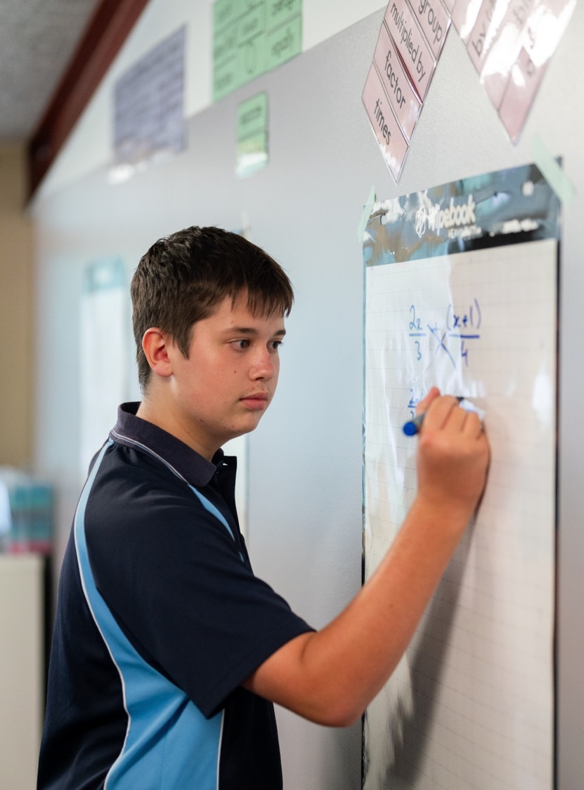
Modelling and solving problems using trigonometry
Mathematics Extension 1 – Stage 6 (Year 11)
Further trigonometry

Slide 2
Learning intentions and success criteria
Learning intentions
To understand how combined sine and cosine functions can model real-world phenomena.
To be able to solve trigonometric equations and interpret their solutions in context.
Success criteria
I can explain what the graph of a combined sine and cosine function shows in the context of the problem.
I can justify where the maximum or minimum values occur using both the algebraic equation and the graph.
I can manipulate and solve trigonometric equations to find specific values relevant to the context.

Slide 3
Activating prior knowledge

Slide 4
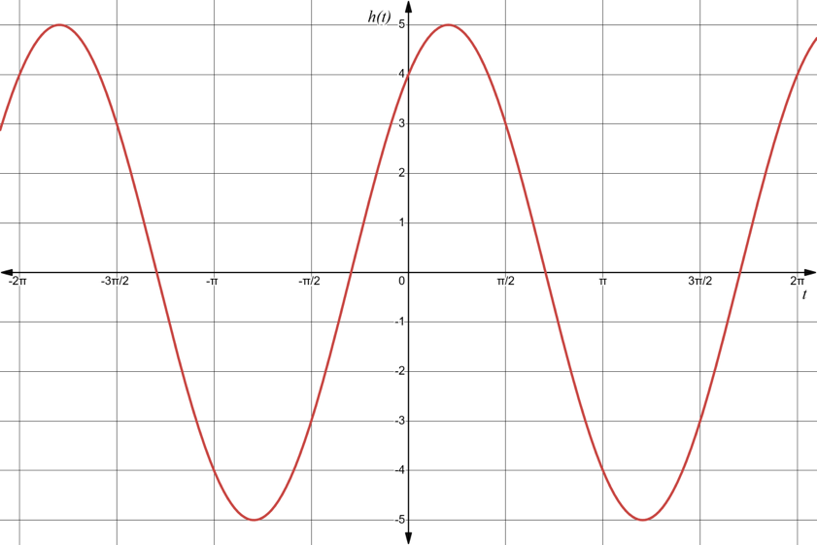
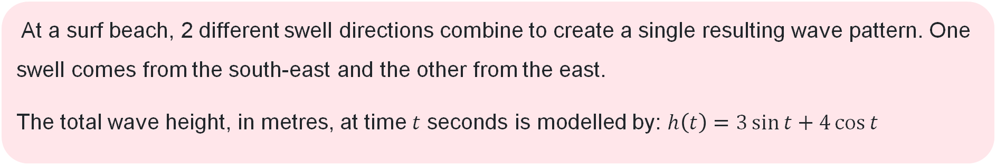
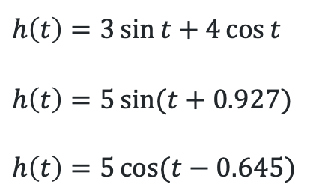
Scenario (1)
At a surf beach, 2 different swell directions combine to create a single resulting wave pattern. One swell comes from the south-east and the other from the east.
The total wave height, in metres, at time $t$ seconds is modelled by: $h\left(t\right)=3\sin{t}+4\cos{t}$
$$h\left(t\right)=3\sin{t}+4\cos{t}$$
$$h\left(t\right)=5\sin{(t+0.927)}$$
$$h\left(t\right)=5\cos{(t−0.645)}$$

Slide 5
Connecting learning

Slide 6
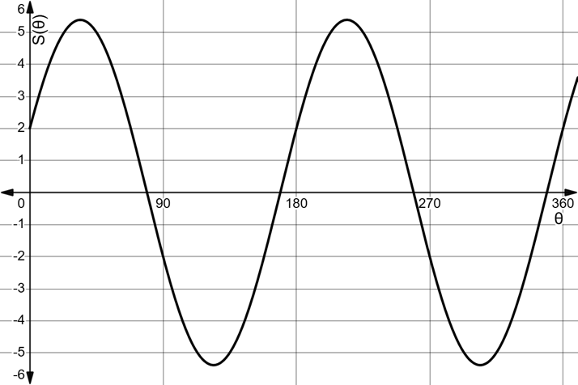
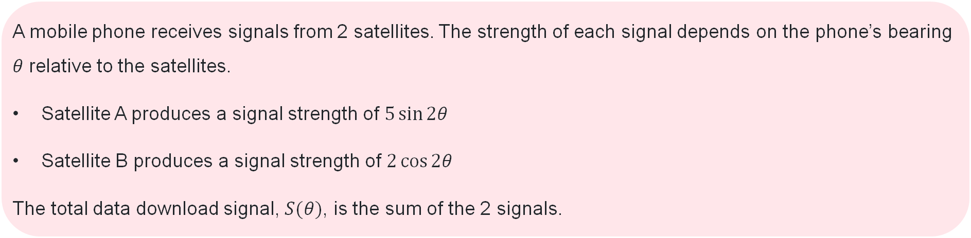
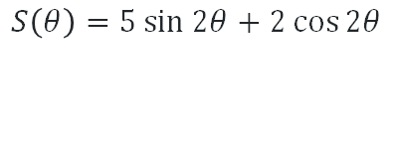
Scenario (2)
A mobile phone receives signals from 2 satellites. The strength of each signal depends on the phone’s bearing $θ$ relative to the satellites.
Satellite A produces a signal strength of $5\sin{2θ}$
Satellite B produces a signal strength of $2\cos{2θ}$
The total data download signal, $S(θ)$, is the sum of the 2 signals.
$$S\left(θ\right)=5\sin{2θ}+2\cos{2θ}$$

Slide 7




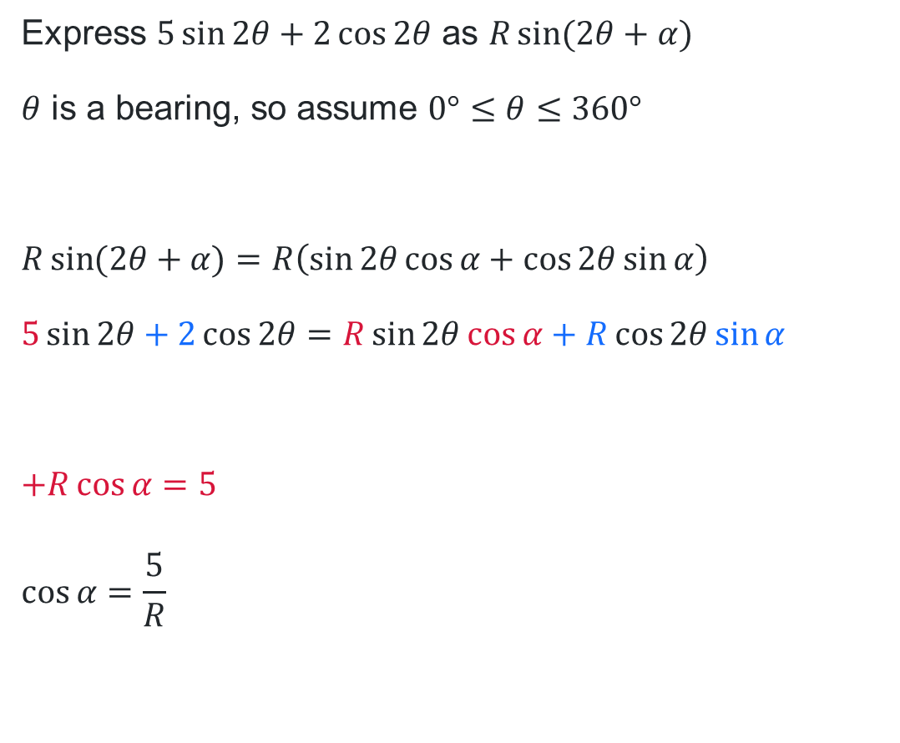


Solution using $R\sin{(2θ+α)}$ (1)
Expressing as $R\sin{(2θ+α)}$
Express $5\sin{2θ}+2\cos{2θ}$ as $R\sin{(2θ+α)}$
$θ$ is a bearing, so assume $0°≤θ≤360°$
$$R\sin{(2θ+α)}=R\left(\sin{2θ}\cos{α}+\cos{2θ}\sin{α}\right)$$
$$5\sin{2θ}+2\cos{2θ}=R\sin{2θ}\cos{α}+R\cos{2θ}\sin{α}$$
$$+R\cos{α}=5$$
$$\cos{α}=\frac{5}{R}$$
$$R=\sqrt{5^{2}+2^{2}}$$
$$=\sqrt{29}$$
$$α=\tan^{−1}\left(\frac{2}{5}\right)$$
$$=21°48′$$
$$∴5\sin{2θ}+2\cos{2θ}=\sqrt{29}\sin{(2θ}+21°48′)$$
$$R$$
$$2$$
$$α$$
$$5$$
$$R\sin{α}=+2$$
$$\sin{α}=\frac{2}{R}$$

Slide 8
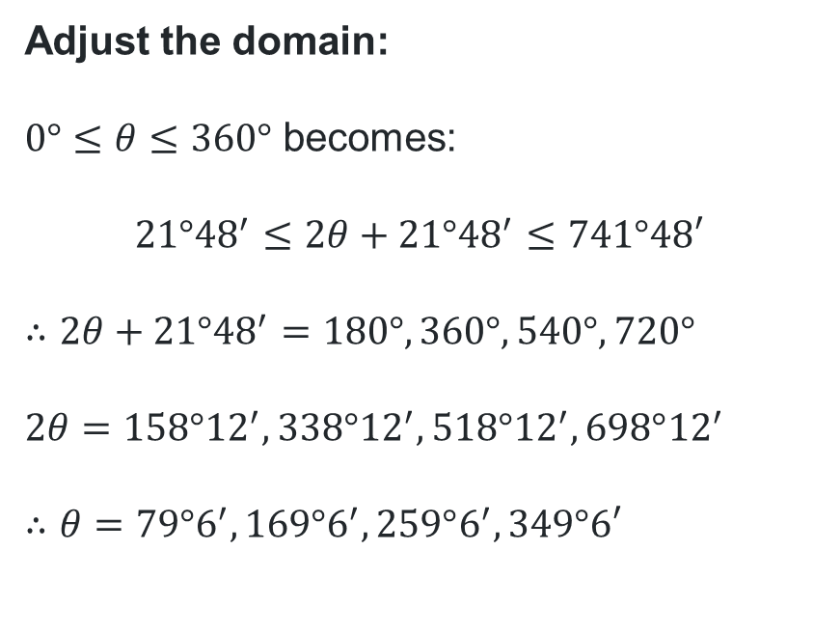
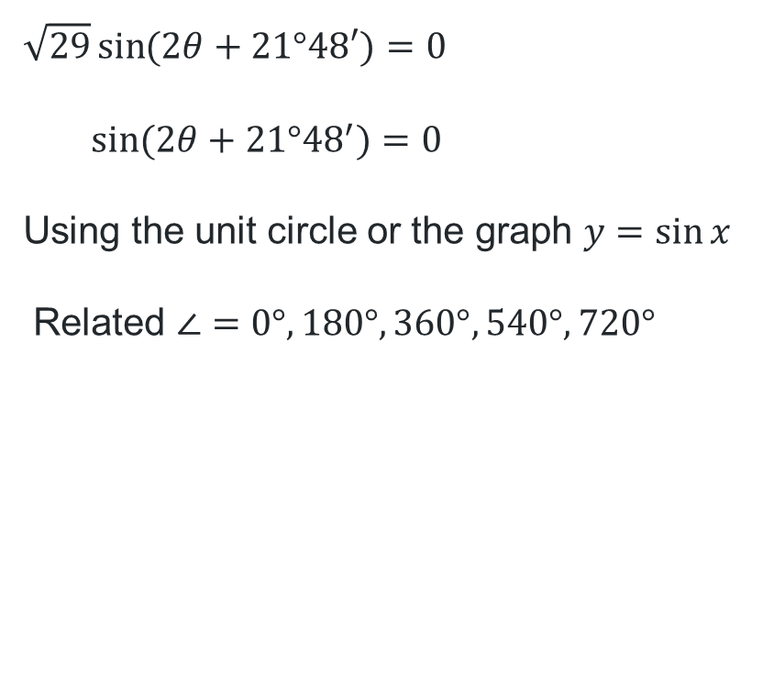
Solution using $R\sin\left(2θ+α\right)$ (2)
Solving the equation
$$\sqrt{29}\sin{(2θ}+21°48′)=0$$
$$\sin{(2θ+21°{48}^{′})}=0$$
Using the unit circle or the graph $y=\sin{x}$
Related $∠=0°, 180°, 360°,540°, 720°$
Adjust the domain:
$0°≤θ≤360°$ becomes:
$$21°{48}^{′}≤2θ+21°{48}^{′}≤741°48′$$
$$∴2θ+21°{48}^{′}=180°, 360°,540°, 720°$$
$$2θ=158°{12}^{′},338°{12}^{′}, 518°{12}^{′}, 698°{12}^{′}$$
$$∴θ=79°6^{′}, 169°6^{′}, 259°6^{′}, 349°6′$$

Slide 9


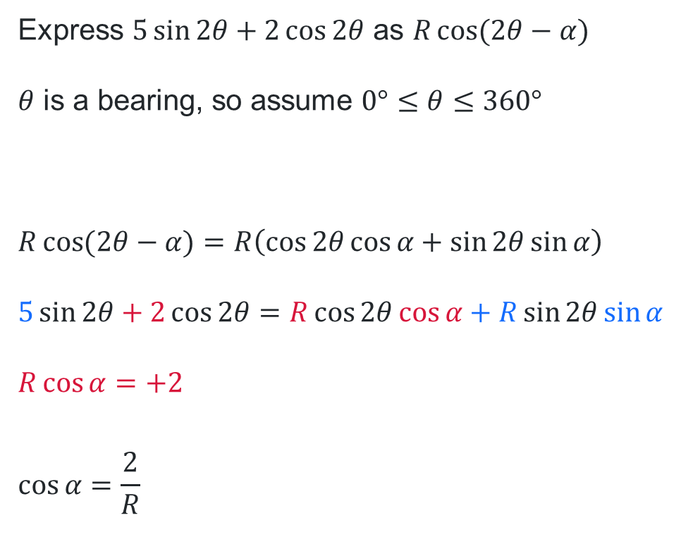

Solution using $R\cos{(2θ−α)}$ (1)
Expressing as $R\cos{(2θ−α)}$
Express $5\sin{2θ}+2\cos{2θ}$ as $R\cos{(2θ−α)}$
$θ$ is a bearing, so assume $0°≤θ≤360°$
$$R\cos{(2θ−α)}=R\left(\cos{2θ}\cos{α}+\sin{2θ}\sin{α}\right)$$
$$5\sin{2θ}+2\cos{2θ}=R\cos{2θ}\cos{α}+R\sin{2θ}\sin{α}$$
$$R\cos{α}=+2$$
$$\cos{α}=\frac{2}{R}$$
$$R=\sqrt{5^{2}+2^{2}}$$
$$=\sqrt{29}$$
$$α=\tan^{−1}\left(\frac{5}{2}\right)$$
$$=68°12′$$
$$∴5\sin{2θ}+2\cos{2θ}=\sqrt{29}\cos{(2θ}−68°12′)$$
$$R$$
$$5$$
$$α$$
$$2$$
$$+R\sin{α}=5$$
$$\sin{α}=\frac{5}{R}$$

Slide 10
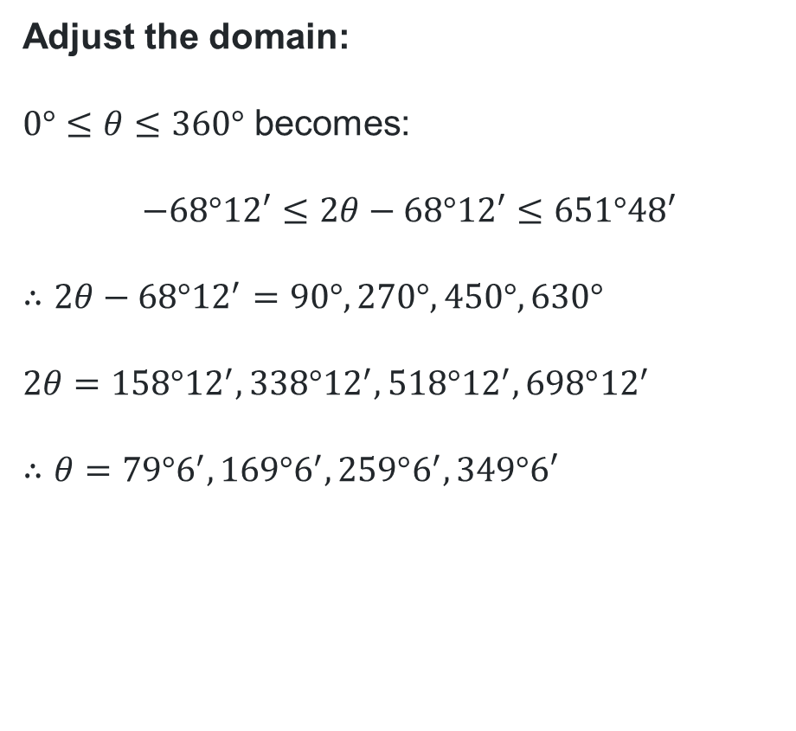

Solution using $R\cos{(2θ−α)}$ (2)
$$\sqrt{29}\cos{(2θ}+68°12′)=0$$
$$\cos{(2θ+68°{12}^{′})}=0$$
Using the unit circle or the graph $y=\cos{x}$
Related $∠=90°, 270°, 450°, 630°$
Adjust the domain:
$0°≤θ≤360°$ becomes:
$$−68°12′≤2θ−68°12′≤651°48′$$
$$∴2θ−68°{12}^{′}=90°, 270°, 450°, 630°$$
$$2θ=158°{12}^{′},338°{12}^{′}, 518°{12}^{′}, 698°{12}^{′}$$
$$∴θ=79°6^{′}, 169°6^{′}, 259°6^{′}, 349°6′$$

Slide 11
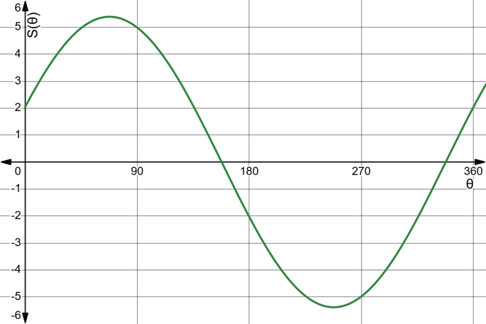
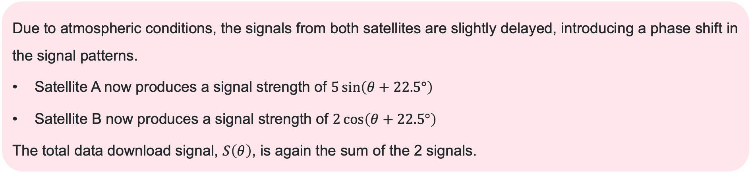
Scenario (3)
Due to atmospheric conditions, the signals from both satellites are slightly delayed, introducing a phase shift in the signal patterns.
Satellite A now produces a signal strength of $5\sin\left(θ+22.5°\right)$
Satellite B now produces a signal strength of $2\cos\left(θ+22.5°\right)$
The total data download signal, $S\left(θ\right)$, is again the sum of the 2 signals.

Slide 12
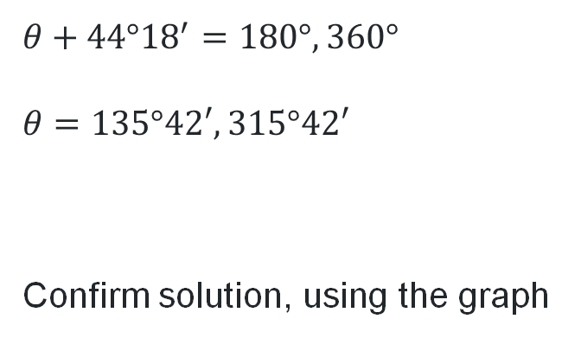
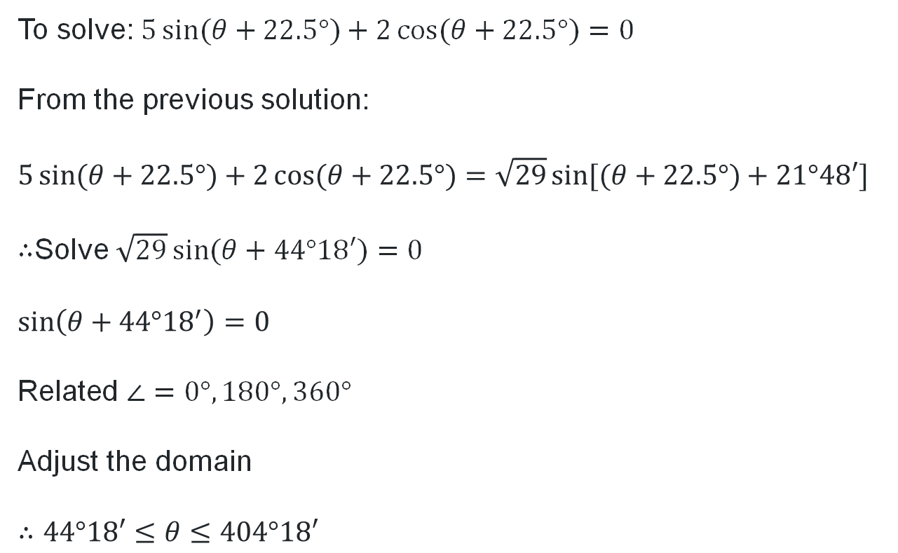
Scenario (3) solution
$θ$ is a bearing, so assume $0°≤θ≤360°$
$$θ+44°{18}^{′}=180°, 360°$$
$$θ=135°42′, 315°42′$$
Confirm solution, using the graph
To solve: $5\sin{(θ+22.5°)}+2\cos{(θ+22.5°)}=0$
From the previous solution:
$$5\sin{(θ+22.5°)}+2\cos{(θ+22.5°)}=\sqrt{29}\sin{[(θ+22.5°)}+21°48′]$$
$∴$Solve $\sqrt{29}\sin{(θ+44°18′)}=0$
$$\sin\left(θ+44°{18}^{′}\right)=0$$
Related $∠=0°, 180°, 360°$
Adjust the domain
$$∴44°18′≤θ≤404°18′$$

Slide 13
Independent practice

Slide 14

Approaching questions scaffold

Slide 15
References
This presentation contains NSW Curriculum and syllabus content. The NSW Curriculum is developed by the NSW Education Standards Authority. This content is prepared by NESA for and on behalf of the Crown in the right of the State of New South Wales. The material is protected by Crown copyright.
Please refer to the NESA Copyright Disclaimer for more information https://educationstandards.nsw.edu.au/wps/portal/nesa/mini-footer/copyright.
NESA holds the only official and up-to-date versions of the NSW Curriculum and syllabus documents. Please visit the NSW Education Standards Authority (NESA) website https://educationstandards.nsw.edu.au/wps/portal/nesa/home and the NSW Curriculum website https://curriculum.nsw.edu.au.
Mathematics Extension 1 11–12 Syllabus © NSW Education Standards Authority (NESA) for and on behalf of the Crown in right of the State of New South Wales, 2024.

Slide 16
Copyright
© State of New South Wales (Department of Education), 2026
The copyright material published in this resource is subject to the Copyright Act 1968 (Cth) and is owned by the NSW Department of Education or, where indicated, by a party other than the NSW Department of Education (third-party material).
Copyright material available in this resource and owned by the NSW Department of Education is licensed under a Creative Commons Attribution 4.0 International (CC BY 4.0) license.
This license allows you to share and adapt the material for any purpose, even commercially.
Attribution should be given to © State of New South Wales (Department of Education), 2026.
Material in this resource not available under a Creative Commons license:
the NSW Department of Education logo, other logos and trademark-protected material
Material owned by a third party that has been reproduced with permission. You will need to obtain permission from the third party to reuse its material.
Links to third-party material and websites
Please note that the provided (reading/viewing material/list/links/texts) are a suggestion only and implies no endorsement, by the New South Wales Department of Education, of any author, publisher, or book title. School principals and teachers are best placed to assess the suitability of resources that would complement the curriculum and reflect the needs and interests of their students.
If you use the links provided in this document to access a third-party’s website, you acknowledge that the terms of use, including licence terms set out on the third-party’s website apply to the use which may be made of the materials on that third-party website or where permitted by the Copyright Act 1968 (Cth). The department accepts no responsibility for content on third-party websites.

