Slide 1
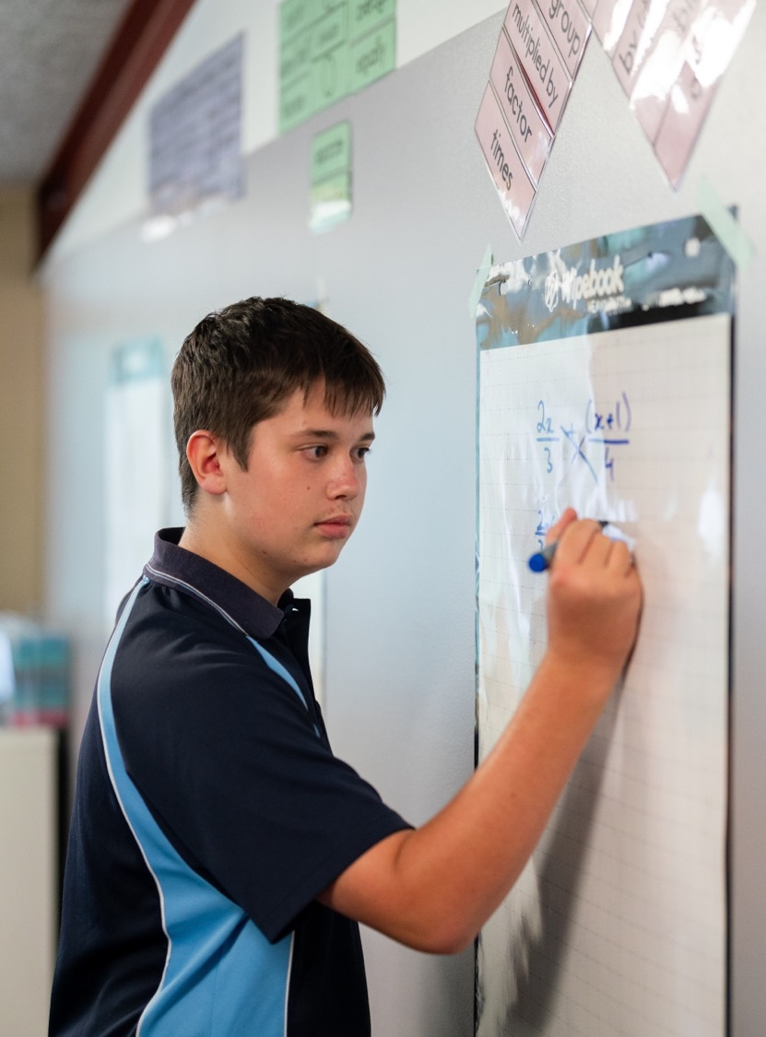

Using $Rsin(x±α)$or $Rcos(x±α)$to solve equations
Mathematics Extension 1 – Stage 6 (Year 11)
Further trigonometry

Slide 2
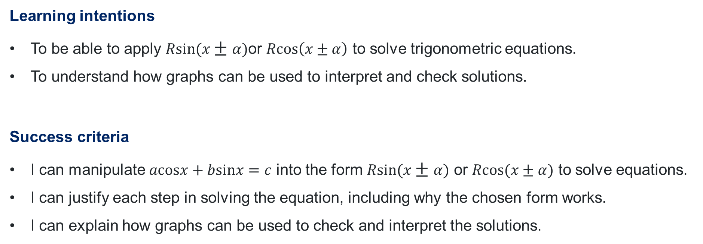
Learning intentions and success criteria
Learning intentions
To be able to apply $Rsin(x±α)$or $Rcos\left(x±α\right)$ to solve trigonometric equations.
To understand how graphs can be used to interpret and check solutions.
Success criteria
I can manipulate $acosx+bsinx=c$ into the form $Rsin(x±α)$ or $Rcos(x±α)$ to solve equations.
I can justify each step in solving the equation, including why the chosen form works.
I can explain how graphs can be used to check and interpret the solutions.

Slide 3
Activating prior knowledge

Slide 4
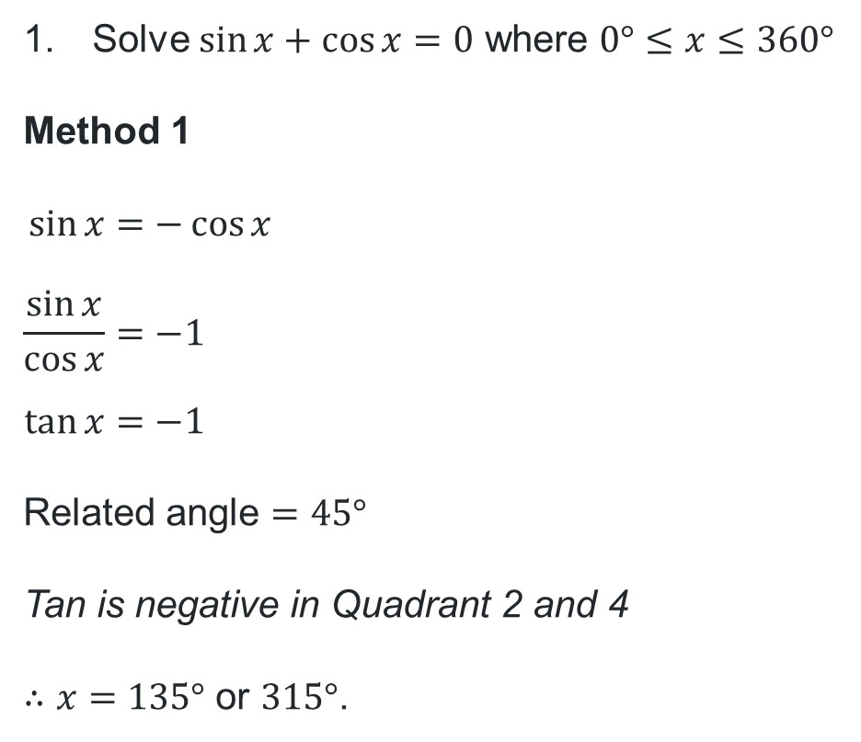
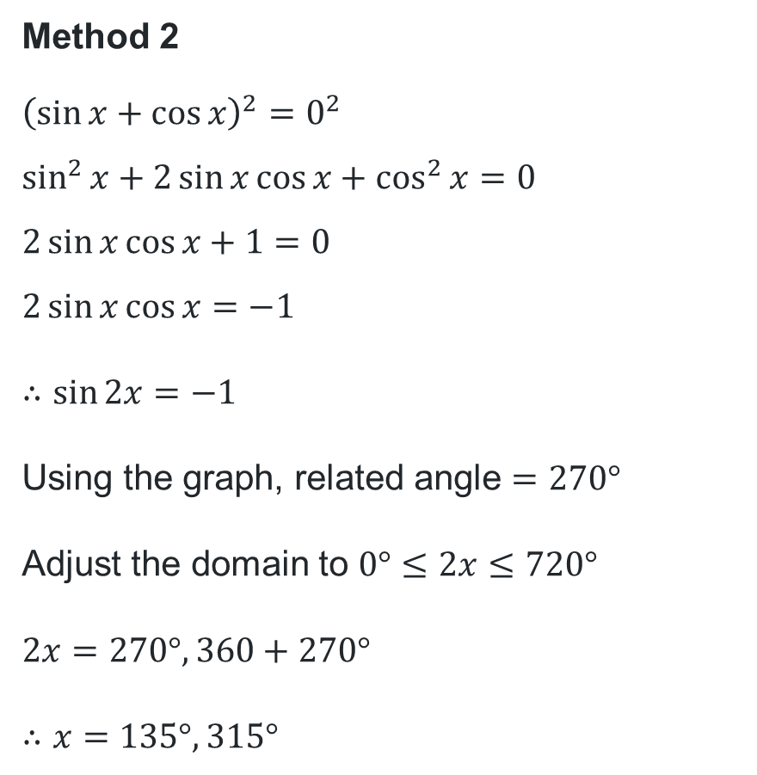
Solving trigonometric equations (1)
Solve $\sin{x}+\cos{x}=0$ where $0°≤x≤360°$
Method 1
$$\sin{x}=−\cos{x} \\ \frac{\sin{x}}{\cos{x}}=−1 \\ \tan{x}=−1$$
Related angle $=45°$
Tan is negative in Quadrant 2 and 4
$∴x=135°$ or $315°$.
Method 2
$${\left(\sin{x}+\cos{x}\right)}^{2}=0^{2} \\ \sin^{2}{x}+2\sin{x}\cos{x}+\cos^{2}{x}=0$$
$$2\sin{x}\cos{x}+1=0$$
$$2\sin{x}\cos{x}=−1$$
$∴\sin{2x=−1}$
Using the graph, related angle $=270°$
Adjust the domain to $0°≤2x≤720°$
$$2x=270°, 360+270°$$
$$∴x=135°, 315°$$

Slide 5
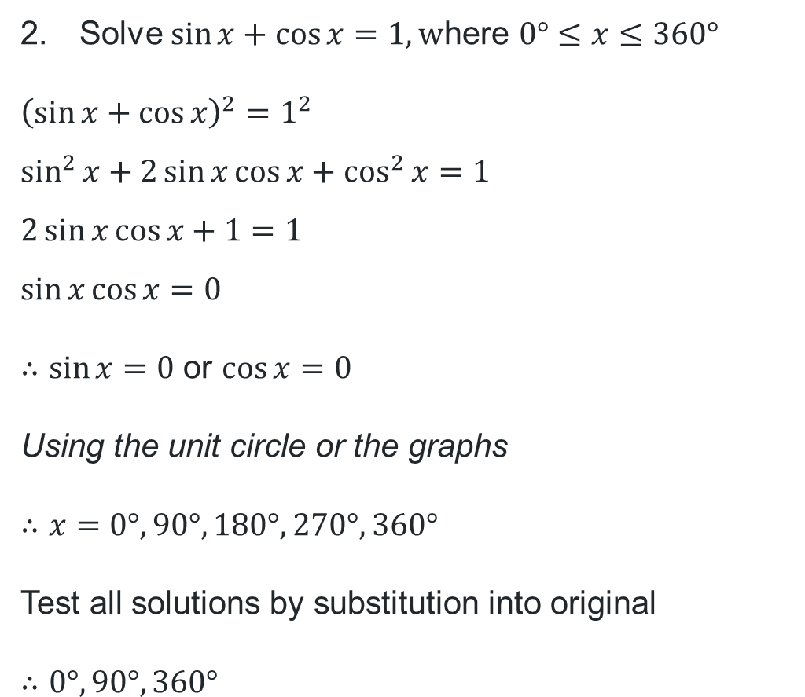
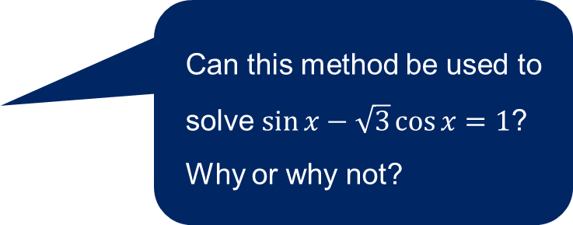
Solving trigonometric equations (2)
Solve $\sin{x}+\cos{x}=1,\text{w}\text{here} 0°≤x≤360°$
$${\left(\sin{x}+\cos{x}\right)}^{2}=1^{2} \\ \sin^{2}{x}+2\sin{x}\cos{x}+\cos^{2}{x}=1$$
$$2\sin{x}\cos{x}+1=1$$
$$\sin{x}\cos{x}=0$$
$∴\sin{x=0}$ or $\cos{x}=0$
Using the unit circle or the graphs
$$∴x=0°, 90°, 180°, 270°,360°$$
Test all solutions by substitution into original
$$∴0°, 90°, 360°$$
How did the change from 0 to 1 in the equation restrict the methods of solving?
Can this method be used to solve $\sin{x}−\sqrt{3}\cos{x}=1$? Why or why not?

Slide 6
Connecting learning

Slide 7




Comparing forms of $R\cos{(x±α)}$ and $R\sin{(x±α)}$
$\sin{x}−\sqrt{3}\cos{x}$
$$R\sin{(x+α)}$$
𝑅 sin⁡〖(𝑥+𝛼)〗
$$R\sin{(x−α)}$$
𝑅 sin⁡〖(𝑥−𝛼)〗
$$R\cos{(x+α)}$$
𝑅 cos⁡〖(𝑥+𝛼)〗
$$R\cos{(x−α)}$$
𝑅 cos⁡〖(𝑥−𝛼)〗
$$R\sin{x}\cos{α}+R\cos{x}\sin{α}=\sin{x}−\sqrt{3}\cos{x}$$
$$R\sin{x}\cos{α}−R\cos{x}\sin{α}=\sin{x}−\sqrt{3}\cos{x}$$
$$R\cos{x}\cos{α}−R\sin{x}\sin{α}=\sin{x}−\sqrt{3}\cos{x}$$
$$R\cos{x}\cos{α}+R\sin{x}\sin{α}=\sin{x}−\sqrt{3}\cos{x}$$

Slide 8
Releasing responsibility

Slide 9
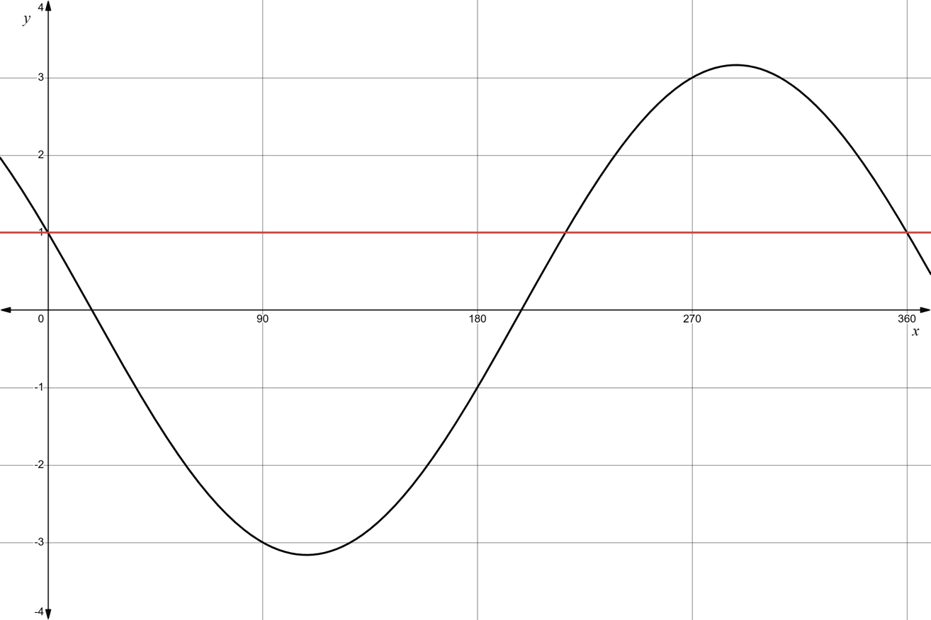


Solving equations using the graph
For the domain $0°≤x≤360°$
$$y=1$$
$$y=\cos{x}−3\sin{x}$$

Slide 10

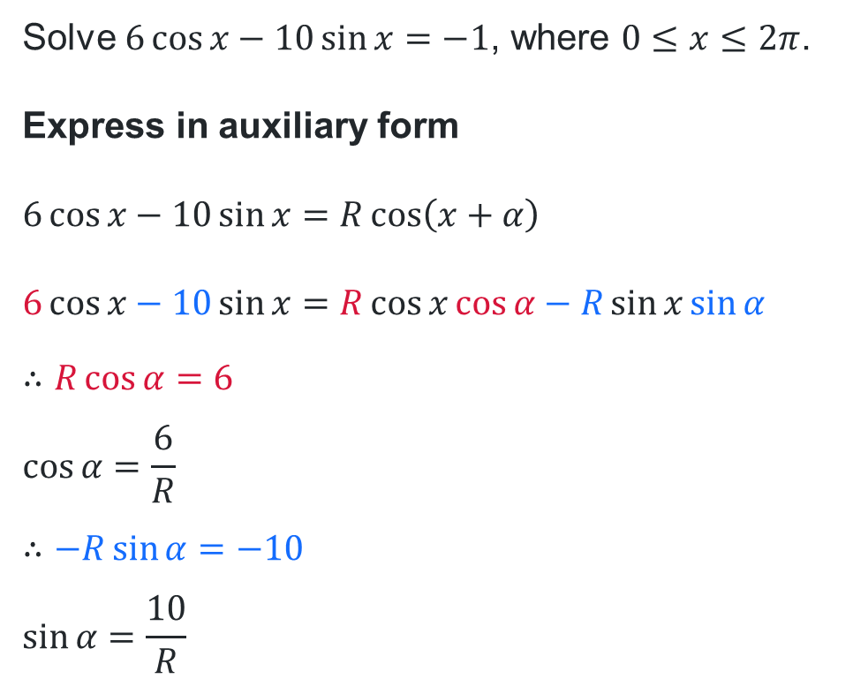

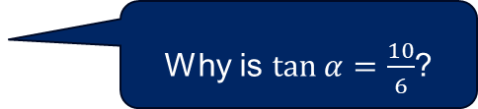
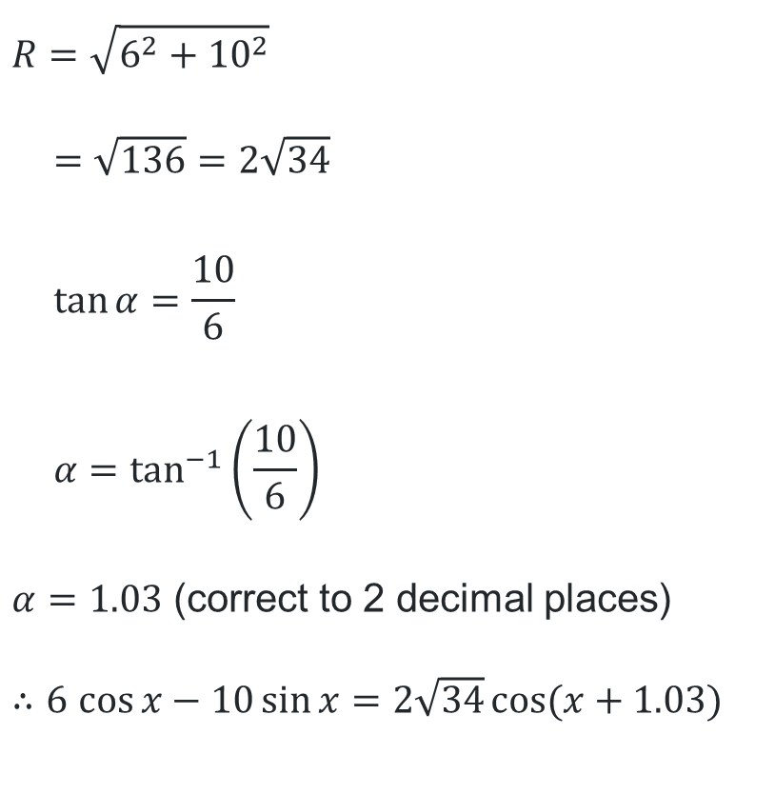


Using auxiliary angles to solve equations (1)
Worked example 1 – Part 1
$$R=\sqrt{6^{2}+{10}^{2}}$$
$$=\sqrt{136}=2\sqrt{34}$$
$$\tan{α}=\frac{10}{6}$$
$$α=\tan^{−1}\left(\frac{10}{6}\right)$$
$α=1.03$ (correct to 2 decimal places)
$∴6$ $\cos{x}−10\sin{x}=2\sqrt{34}\cos{(x+1.03)}$
Solve $6\cos{x}−10\sin{x}=−1$, where $0≤x≤2π$.
Express in auxiliary form
$$6\cos{x}−10\sin{x}=R\cos\left(x+α\right)$$
$$6\cos{x}−10\sin{x}=R\cos{x}\cos{α}−R\sin{x}\sin{α}$$
$$∴R\cos{α}=6$$
$$\cos{α=\frac{6}{R}}$$
$$∴−R\sin{α}=−10$$
$$\sin{α=\frac{10}{R}}$$
Why was this form chosen over the other forms?
Why is $\tan{α}=\frac{10}{6}$?
$$10$$
$$R$$
$$α$$
$$6$$

Slide 11
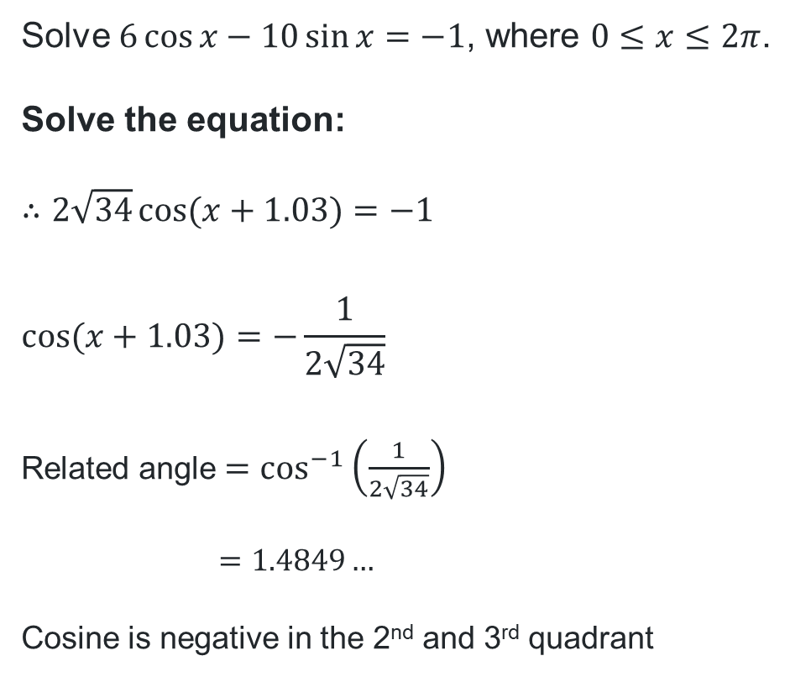

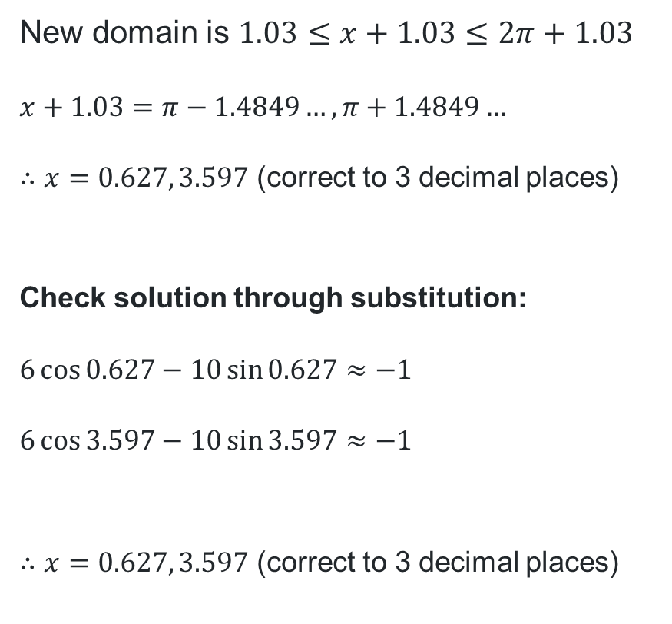
Using auxiliary angles to solve equations (2)
Why was the domain adjusted?
Worked example 1 – Part 2
Solve $6\cos{x}−10\sin{x}=−1$, where $0≤x≤2π$.
Solve the equation:
$$∴2\sqrt{34}\cos{(x+1.03)}=−1$$
$$\cos{(x+1.03)}=−\frac{1}{2\sqrt{34}}$$
Related angle $=\cos^{−1}\left(\frac{1}{2\sqrt{34}}\right)$
$$=1.4849…$$
Cosine is negative in the 2nd and 3rd quadrant
New domain is $1.03≤x+1.03≤2π+1.03$
$$x+1.03=π−1.4849…, π+1.4849…$$
$∴x=0.627, 3.597$ (correct to 3 decimal places)
Check solution through substitution:
$$6\cos{0.627}−10\sin{0.627}≈−1$$
$$6\cos{3.597}−10\sin{3.597}≈−1$$
$∴x=0.627, 3.597$ (correct to 3 decimal places)
These expression aren’t exactly equal to $−1$. Why might this be?

Slide 12
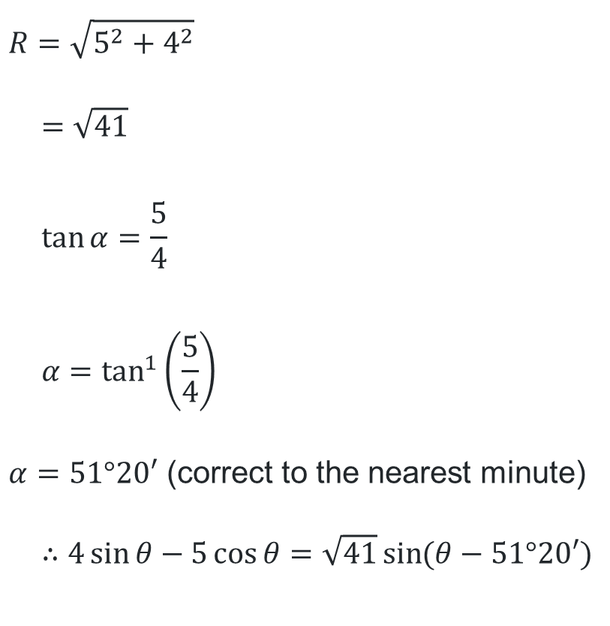
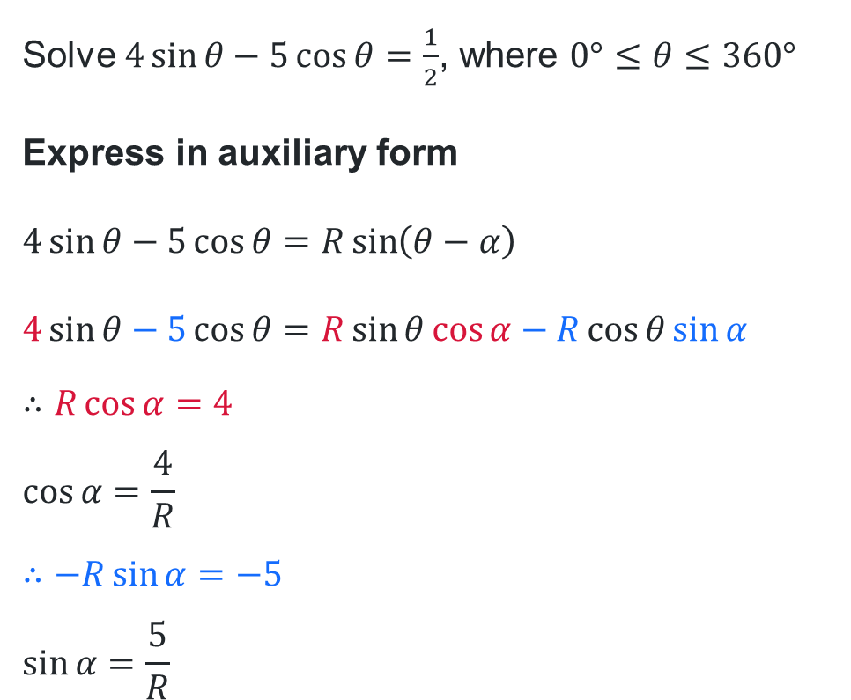


Using auxiliary angles to solve equations (4)
Your turn – Question 1 Part 1
$$R=\sqrt{5^{2}+4^{2}}$$
$$=\sqrt{41}$$
$$\tan{α}=\frac{5}{4}$$
$$α=\tan^{1}\left(\frac{5}{4}\right)$$
$α=51°20′$ (correct to the nearest minute)
$$∴4\sin{θ}−5\cos{θ}=\sqrt{41}\sin{(θ−51°20′)}$$
Solve $4\sin{θ}−5\cos{θ}=\frac{1}{2}$, where $0°≤θ≤360°$
Express in auxiliary form
$$4\sin{θ}−5\cos{θ}=R\sin\left(θ−α\right)$$
$$4\sin{θ}−5\cos{θ}=R\sin{θ}\cos{α}−R\cos{θ}\sin{α}$$
$$∴R\cos{α}=4$$
$$\cos{α=\frac{4}{R}}$$
$$∴−R\sin{α}=−5$$
$$\sin{α=\frac{5}{R}}$$
$$5$$
$$R$$
$$α$$
$$4$$

Slide 13
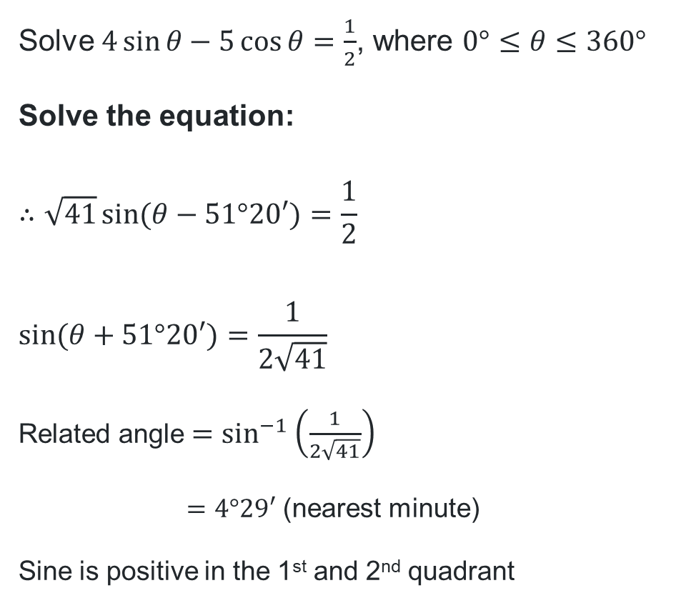
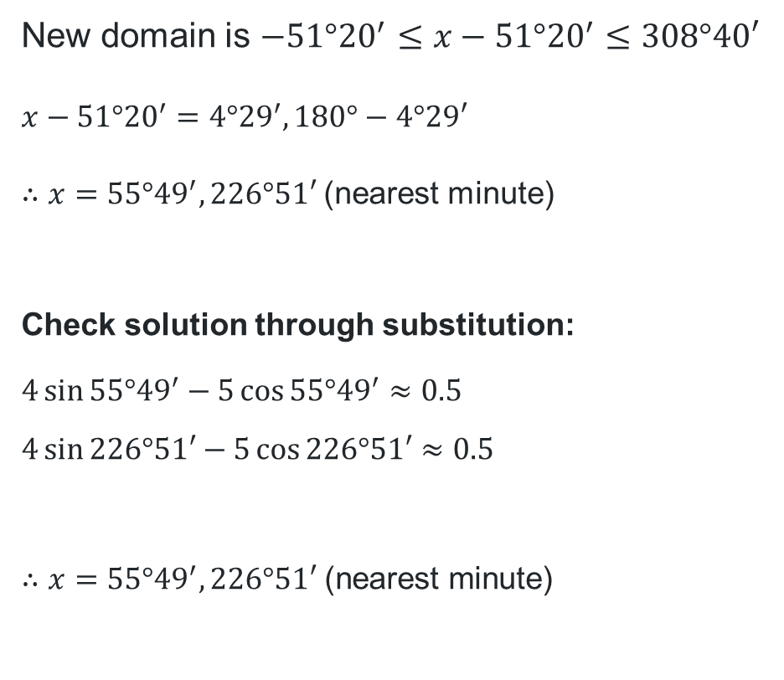
Using auxiliary angles to solve equations (5)
You turn – Question 1 Part 2
Solve $4\sin{θ}−5\cos{θ}=\frac{1}{2}$, where $0°≤θ≤360°$
Solve the equation:
$$∴\sqrt{41}\sin{(θ−51°20′)}=\frac{1}{2}$$
$$\sin{(θ+51°20′)}=\frac{1}{2\sqrt{41}}$$
Related angle $=\sin^{−1}\left(\frac{1}{2\sqrt{41}}\right)$
$=4°29′$ (nearest minute)
Sine is positive in the 1st and 2nd quadrant
New domain is $−51°{20}^{′}≤x−51°{20}^{′}≤308°40′$
$$x−51°{20}^{′}=4°{29}^{′}, 180°−4°29′$$
$∴x=55°{49}^{′}, 226°51′$(nearest minute)
Check solution through substitution:
$$4\sin{55°{49}^{′}}−5\cos{55°{49}^{′}}≈0.5$$
$$4\sin{226°51′}−5\cos{226°51′}≈0.5$$
$$∴x=55°{49}^{′}, 226°51′ \text{(}\text{nearest} \text{minute}\text{)}$$

Slide 14
References
This presentation contains NSW Curriculum and syllabus content. The NSW Curriculum is developed by the NSW Education Standards Authority. This content is prepared by NESA for and on behalf of the Crown in the right of the State of New South Wales. The material is protected by Crown copyright.
Please refer to the NESA Copyright Disclaimer for more information https://educationstandards.nsw.edu.au/wps/portal/nesa/mini-footer/copyright.
NESA holds the only official and up-to-date versions of the NSW Curriculum and syllabus documents. Please visit the NSW Education Standards Authority (NESA) website https://educationstandards.nsw.edu.au/wps/portal/nesa/home and the NSW Curriculum website https://curriculum.nsw.edu.au.
Mathematics Extension 1 Stage 6 Syllabus © NSW Education Standards Authority (NESA) for and on behalf of the Crown in right of the State of New South Wales, 2024.

Slide 15
Copyright
© State of New South Wales (Department of Education), 2026
The copyright material published in this resource is subject to the Copyright Act 1968 (Cth) and is owned by the NSW Department of Education or, where indicated, by a party other than the NSW Department of Education (third-party material).
Copyright material available in this resource and owned by the NSW Department of Education is licensed under a Creative Commons Attribution 4.0 International (CC BY 4.0) license.
This license allows you to share and adapt the material for any purpose, even commercially.
Attribution should be given to © State of New South Wales (Department of Education), 2026.
Material in this resource not available under a Creative Commons license:
the NSW Department of Education logo, other logos and trademark-protected material
Material owned by a third party that has been reproduced with permission. You will need to obtain permission from the third party to reuse its material.
Links to third-party material and websites
Please note that the provided (reading/viewing material/list/links/texts) are a suggestion only and implies no endorsement, by the New South Wales Department of Education, of any author, publisher, or book title. School principals and teachers are best placed to assess the suitability of resources that would complement the curriculum and reflect the needs and interests of their students.
If you use the links provided in this document to access a third-party’s website, you acknowledge that the terms of use, including licence terms set out on the third-party’s website apply to the use which may be made of the materials on that third-party website or where permitted by the Copyright Act 1968 (Cth). The department accepts no responsibility for content on third-party websites.

