Slide 1
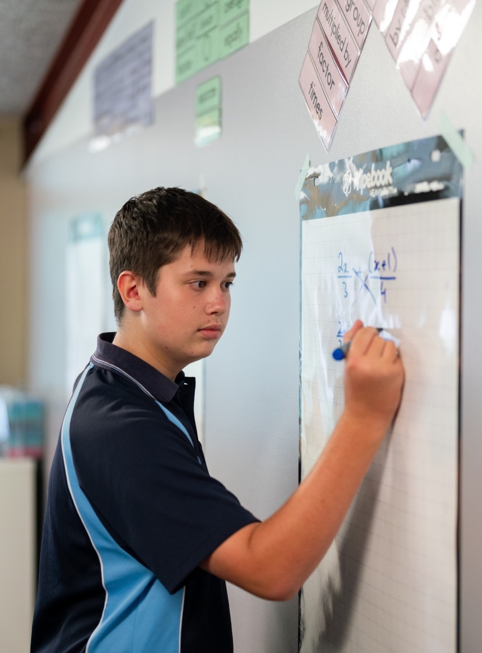
Solving trigonometric equations
Mathematics Extension 1 – Stage 6 (Year 11)
Further trigonometry

Slide 2
Learning intention and success criteria
Learning intention
To be able to solve trigonometric equations accurately over restricted domains.
Success criteria
I can manipulate trigonometric equations using factorisation and substitution of identities to create solvable equations.
I can explain how restricted domains affect the number and validity of solutions of a trigonometric equation.
I can justify my solutions of trigonometric equations by showing that all possible values within the domain have been found and checked.

Slide 3
Connecting learning

Slide 4
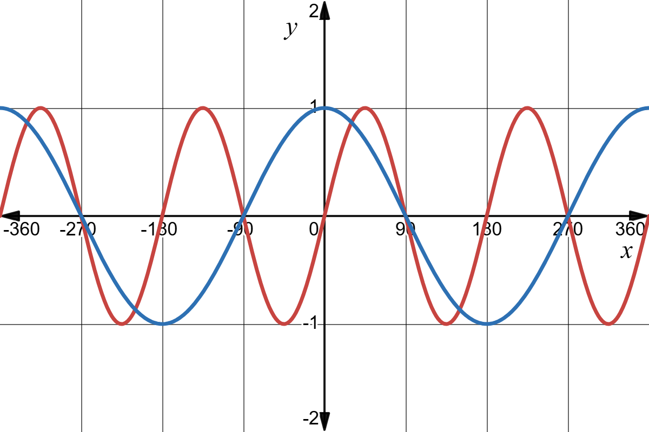


Solving trigonometric equations – graphically
Solve $\sin{2x}=\cos{x}$ for $0°≤x≤360°$.
$$y=\cos{x}$$
$$y=\sin{2x}$$

Slide 5
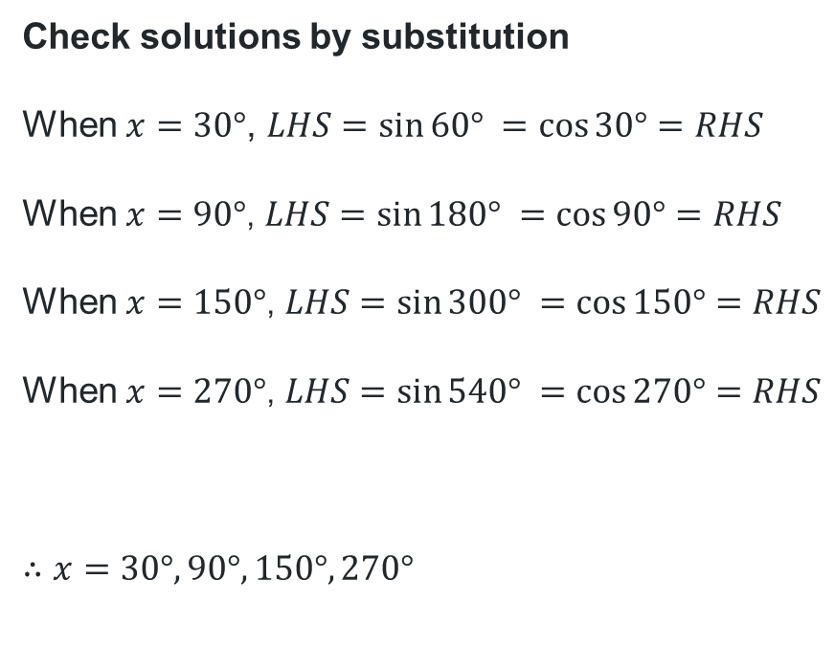
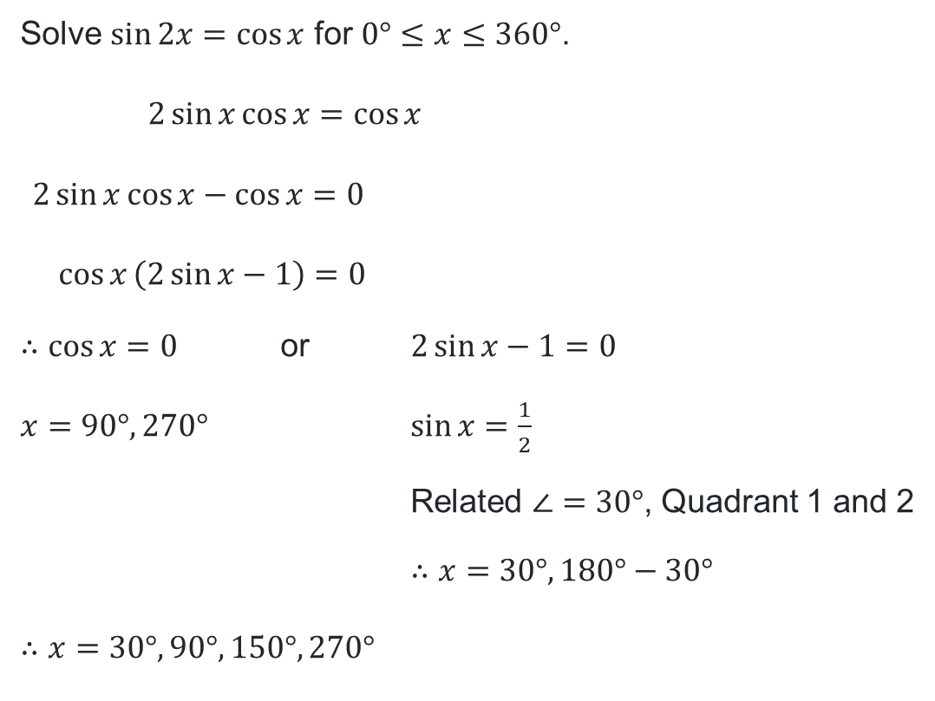
Solving trigonometric equations – algebraically
Solve $\sin{2x}=\cos{x}$ for $0°≤x≤360°$.
$$2\sin{x}\cos{x}=\cos{x}$$
$$2\sin{x}\cos{x}−\cos{x}=0$$
$$\cos{x}\left(2\sin{x}−1\right)=0$$
$∴\cos{x}=0$ or $2\sin{x}−1=0$
$x=90°,270°$ $\sin{x}=\frac{1}{2}$
Related $∠=30°$, Quadrant 1 and 2
$∴x=30°, 180°−30°$
$$∴x=30°, 90°, 150°, 270°$$
Check solutions by substitution
When $x=30°$, $LHS=\sin{60°} =\cos{30°}=RHS$
When $x=90°$, $LHS=\sin{180°} =\cos{90°}=RHS$
When $x=150°$, $LHS=\sin{300°} =\cos{150°}=RHS$
When $x=270°$, $LHS=\sin{540°} =\cos{270°}=RHS$
$$∴x=30°, 90°, 150°, 270°$$

Slide 6
Using graphs
$$y=\cos{x}$$
$$y=\sin{2x}$$

Slide 7
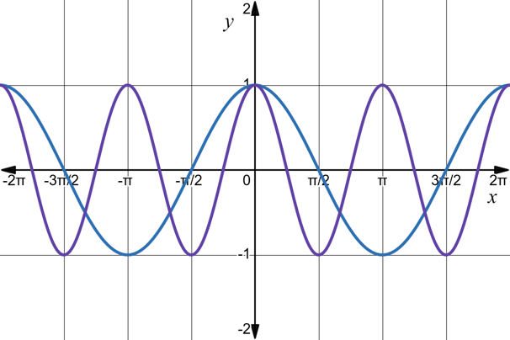
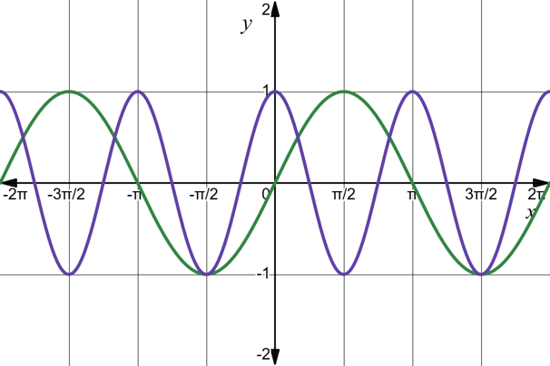


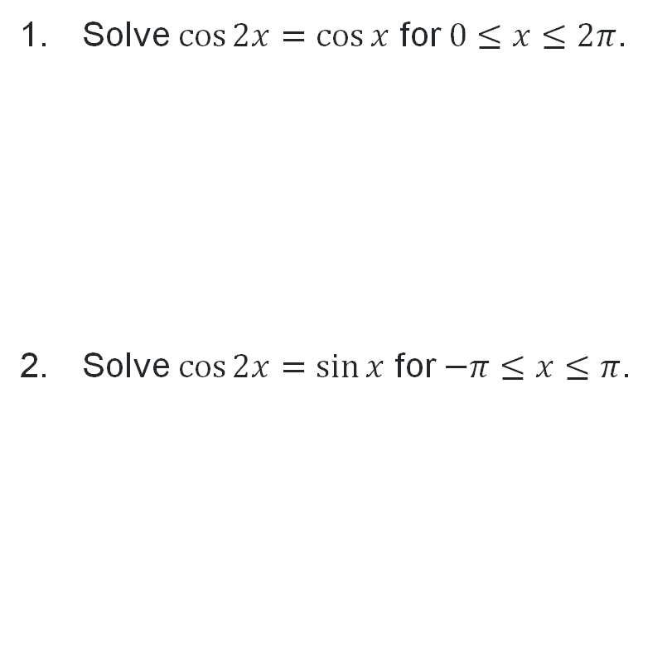


Solving trigonometric equations (2)
Solve $\cos{2x}=\cos{x}$ for $0≤x≤2π$.
Solve $\cos{2x}=\sin{x}$ for $−π≤x≤π$.
$$y=\cos{x}$$
$$y=\cos{2x}$$
$$y=\cos{2x}$$
$$y=\sin{x}$$

Slide 8
Independent practice

Slide 9

Solving trigonometric equations across contexts
Questions
Show that $\cos{3x}=4\cos^{3}{x}−3\cos{x}$
By substituting $x=2\cos{θ},$ show that the equation $x^{3}−3x−\sqrt{2}=0$ can be written in the form $\cos{3θ}=\frac{\sqrt{2}}{2}$
Hence show that the roots are $x=2\cos{15°}, 2\cos{105°}, 2\cos{135°}$

Slide 10
References
This presentation contains NSW Curriculum and syllabus content. The NSW Curriculum is developed by the NSW Education Standards Authority. This content is prepared by NESA for and on behalf of the Crown in the right of the State of New South Wales. The material is protected by Crown copyright.
Please refer to the NESA Copyright Disclaimer for more information https://educationstandards.nsw.edu.au/wps/portal/nesa/mini-footer/copyright.
NESA holds the only official and up-to-date versions of the NSW Curriculum and syllabus documents. Please visit the NSW Education Standards Authority (NESA) website https://educationstandards.nsw.edu.au/wps/portal/nesa/home and the NSW Curriculum website https://curriculum.nsw.edu.au.
Mathematics Extension 1 11–12 Syllabus © NSW Education Standards Authority (NESA) for and on behalf of the Crown in right of the State of New South Wales, 2024.

Slide 11
Copyright
© State of New South Wales (Department of Education), 2026
The copyright material published in this resource is subject to the Copyright Act 1968 (Cth) and is owned by the NSW Department of Education or, where indicated, by a party other than the NSW Department of Education (third-party material).
Copyright material available in this resource and owned by the NSW Department of Education is licensed under a Creative Commons Attribution 4.0 International (CC BY 4.0) license.
This license allows you to share and adapt the material for any purpose, even commercially.
Attribution should be given to © State of New South Wales (Department of Education), 2026.
Material in this resource not available under a Creative Commons license:
the NSW Department of Education logo, other logos and trademark-protected material
Material owned by a third party that has been reproduced with permission. You will need to obtain permission from the third party to reuse its material.
Links to third-party material and websites
Please note that the provided (reading/viewing material/list/links/texts) are a suggestion only and implies no endorsement, by the New South Wales Department of Education, of any author, publisher, or book title. School principals and teachers are best placed to assess the suitability of resources that would complement the curriculum and reflect the needs and interests of their students.
If you use the links provided in this document to access a third-party’s website, you acknowledge that the terms of use, including licence terms set out on the third-party’s website apply to the use which may be made of the materials on that third-party website or where permitted by the Copyright Act 1968 (Cth). The department accepts no responsibility for content on third-party websites.

