Slide 1

Proving results
Mathematics Extension 1 – Stage 6 (Year 11)
Further trigonometry

Slide 2
Learning intention and success criteria
Learning intention
To be able to apply trigonometric formulas and identities to prove trigonometric results.
Success criteria
I can identify and select appropriate sum, difference or double angle formulas to solve trigonometric problems.
I can apply trigonometric identities or formulas accurately in the context of a proof or solution.
I can explain and justify my reasoning when working through trigonometric proofs.

Slide 3
Connecting learning

Slide 4

Year 11 Advanced review
Proving further trigonometric identities
Prove that $\sec^{2}{x}+\sec{x}\tan{x}=\frac{1+\sin{x}}{\cos^{2}{x}}$.
$$LHS=\sec^{2}{x}+\sec{x}\tan{x}$$
$$=\frac{1}{\cos^{2}{x}}+\left(\frac{1}{\cos{x}}\right)×\left(\frac{\sin{x}}{\cos{x}}\right)$$
$$=\frac{1}{\cos^{2}{x}}+\frac{\sin{x}}{\cos^{2}{x}}$$
$$=\frac{1+\sin{x}}{\cos^{2}{x}}$$
$$=RHS$$

Slide 5

Proving results (1)
Worked example 1
Why did it seem more efficient to begin with the LHS of the proof?
Prove that $\sin{(A+B)}\sin{(A−B)}=\sin^{2}{A}−\sin^{2}{B}.$
$$LHS=\sin\left(A+B\right)\sin{(A−B)}$$
$$=\left(\sin{A}\cos{B}+\cos{A}\sin{B}\right)\left(\sin{A}\cos{B}−\cos{A}\sin{B}\right)$$
$$={\left(\sin{A}\cos{B}\right)}^{2}−{\left(\cos{A}\sin{B}\right)}^{2}$$
$$=\sin^{2}{A}\cos^{2}{B}−\cos^{2}{A}\sin^{2}{B}$$
$$=\sin^{2}{A}\left(1−\sin^{2}{B}\right)−(1−\sin^{2}{A})\sin^{2}{B}$$
$$=\sin^{2}{A}−\sin^{2}{A}\sin^{2}{B}−\sin^{2}{B}+\sin^{2}{A}\sin^{2}{B}$$
$$=\sin^{2}{A}−\sin^{2}{B}$$
$$=RHS$$
Are both formulas on the HSC reference sheet?
Why might cosine have been replaced and not sine?

Slide 6

Proving results (2)
Your turn – question 1
Prove that $\cos{(x+y)}+\cos{(x−y)}=2\cos{x}\cos{y}$.
$$LHS=\cos\left(x+y\right)+\cos{(x−y)}$$
$$=\left(\cos{x}\cos{y}−\sin{x}\sin{y}\right)+\left(\cos{x}\cos{y}+\sin{x}\sin{y}\right)$$
$$=\cos{x}\cos{y}+\cos{x}\cos{y}−\sin{x}\sin{y}+\sin{x}\sin{y}$$
$$=2\cos{x}\cos{y}$$
$$=RHS$$

Slide 7

Proving results activity
Show that $\sin{(A+B)}+\cos\left(A−B\right)=(\sin{A}+\cos{A})(\sin{B}+\cos{B)}$
Prove that $\frac{\cos{2x}−1}{\sin{x}}=−2\sin{x}$
Prove that $\sin^{2}{x}=\frac{1−\cos{2x}}{2}$
Prove that $\frac{1−\cos{2x}}{\sin{2x}}=\tan{x}$

Slide 8
Independent practice

Slide 9
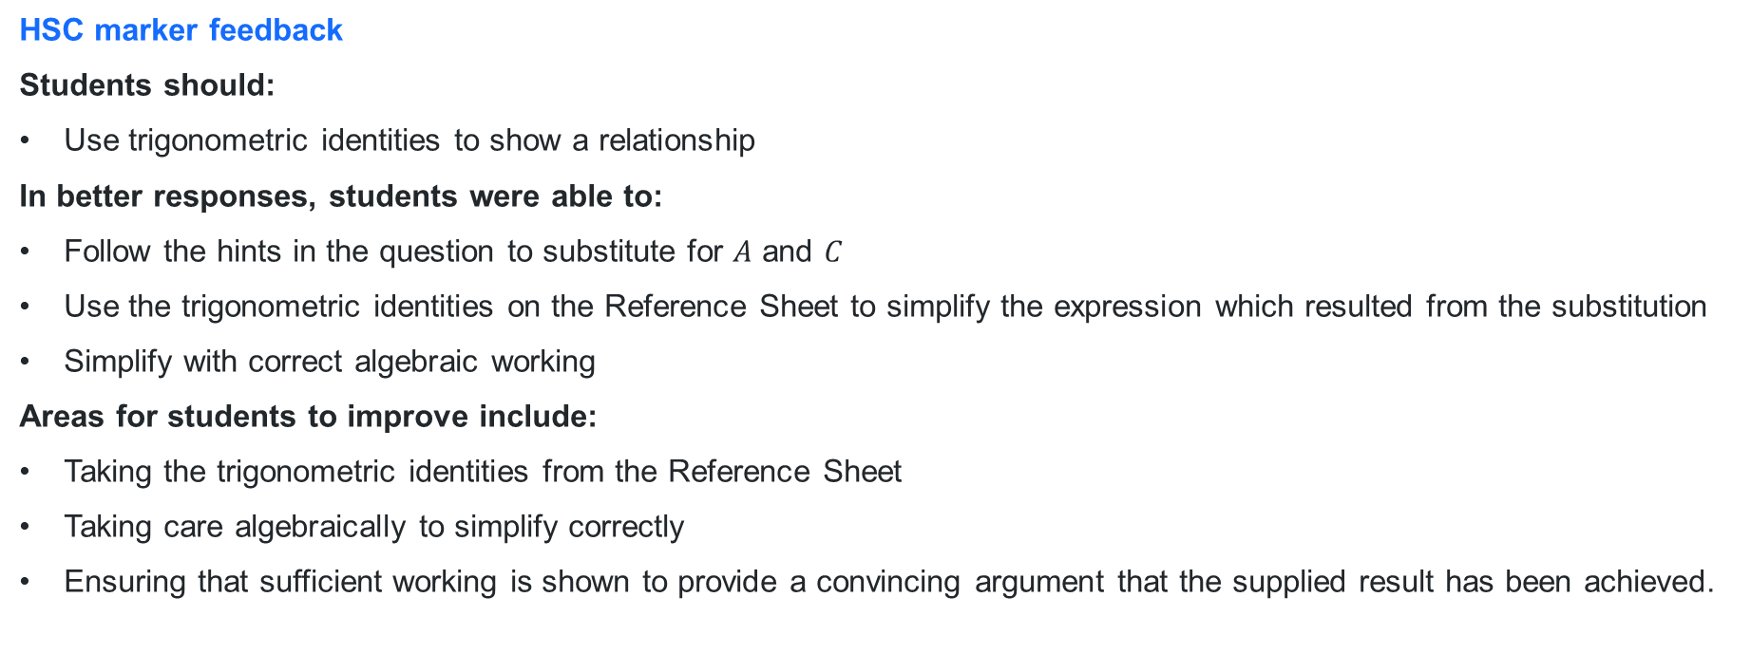
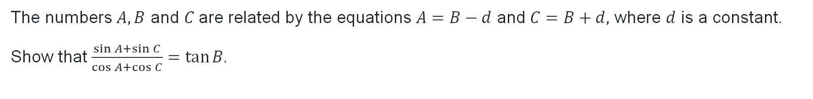
Mathematics Extension 1 2021 HSC exam (1)
Question 13 (d) (i)
The numbers $A, B$ and $C$are related by the equations $A=B−d$ and $C=B+d,$ where $d$ is a constant.
Show that $\frac{\sin{A}+\sin{C}}{\cos{A}+\cos{C}}=\tan{B}$.
HSC marker feedback
Students should:
Use trigonometric identities to show a relationship
In better responses, students were able to:
Follow the hints in the question to substitute for $A$ and $C$
Use the trigonometric identities on the Reference Sheet to simplify the expression which resulted from the substitution
Simplify with correct algebraic working
Areas for students to improve include:
Taking the trigonometric identities from the Reference Sheet
Taking care algebraically to simplify correctly
Ensuring that sufficient working is shown to provide a convincing argument that the supplied result has been achieved.

Slide 10
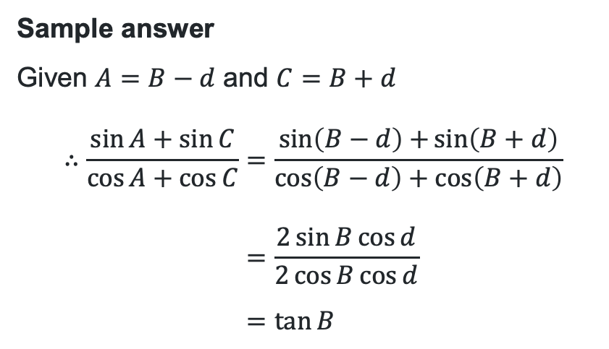
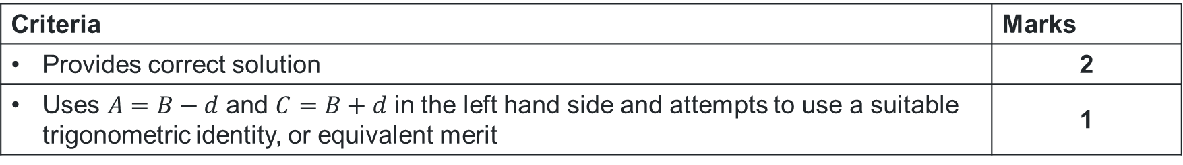
Mathematics Extension 1 2021 HSC exam (2)
Question 13 (d) (i)
The numbers $A, B$ and $C$are related by the equations $A=B−d$ and $C=B+d,$ where $d$ is a constant.
Show that $\frac{\sin{A}+\sin{C}}{\cos{A}+\cos{C}}=\tan{B}$.
Criteria | Marks
Provides correct solution | 2
Uses $A=B−d$ and $C=B+d$ in the left hand side and attempts to use a suitable trigonometric identity, or equivalent merit | 1
Sample answer
Given $A=B−d$ and $C=B+d$
$$∴\frac{\sin{A}+\sin{C}}{\cos{A}+\cos{C}}=\frac{\sin\left(B−d\right)+\sin\left(B+d\right)}{\cos\left(B−d\right)+\cos\left(B+d\right)} \\ =\frac{2\sin{B}\cos{d}}{2\cos{B}\cos{d}} \\ =\tan{B}$$

Slide 11

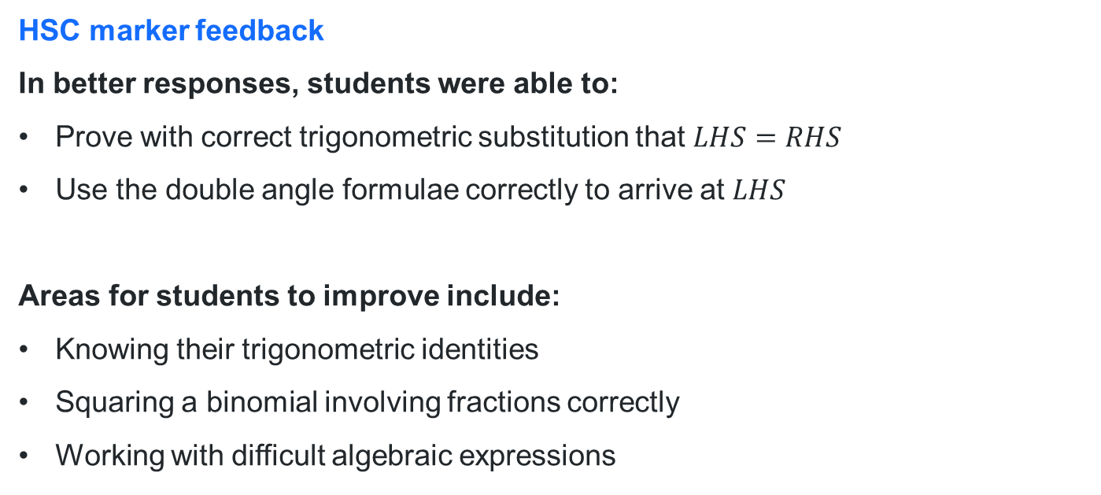
Mathematics Extension 1 2024 HSC exam (1)
Question 13 (b) (i)
Show that $\cos^{4}{x+\sin^{4}{x= \frac{1+\cos^{2}{2x }}{2}}}$
HSC marker feedback
In better responses, students were able to:
Prove with correct trigonometric substitution that $LHS=RHS$
Use the double angle formulae correctly to arrive at $LHS$
Areas for students to improve include:
Knowing their trigonometric identities
Squaring a binomial involving fractions correctly
Working with difficult algebraic expressions

Slide 12
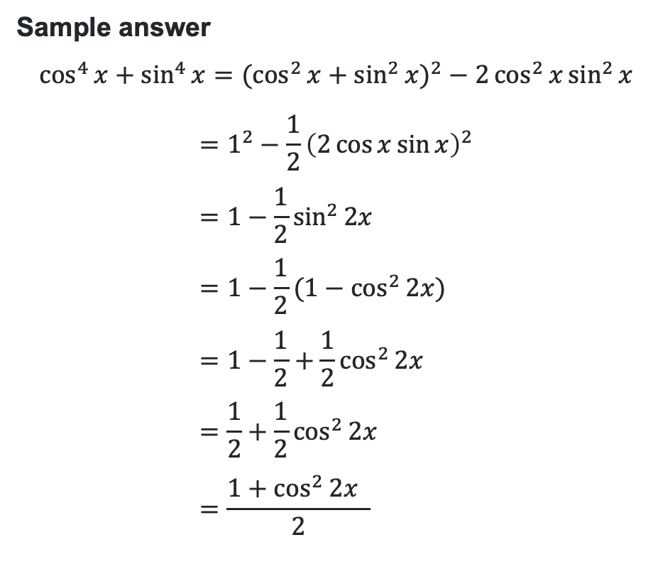
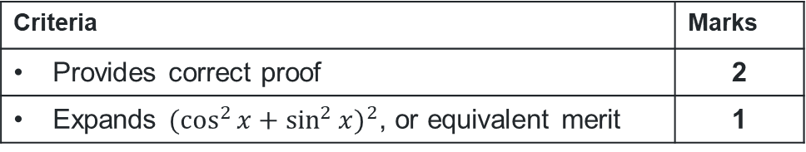
Mathematics Extension 1 2024 HSC exam (2)
Question 13 (b) (i)
Show that $\cos^{4}{x+\sin^{4}{x= \frac{1+\cos^{2}{2x }}{2}}}$
Criteria | Marks
Provides correct proof | 2
Expands $(\cos^{2}{x+{\sin^{2}{x)}}^{2}}$, or equivalent merit | 1
Sample answer
$$\cos^{4}{x}+\sin^{4}{x}=(\cos^{2}{x}+{\sin^{2}{x})}^{2}−2\cos^{2}{x}\sin^{2}{x}$$
$$=1^{2}−\frac{1}{2}{\left(2\cos{x}\sin{x}\right)}^{2} \\ =1−\frac{1}{2}\sin^{2}{2x} \\ =1−\frac{1}{2}(1−\cos^{2}{2x)} \\ =1−\frac{1}{2}+\frac{1}{2}\cos^{2}{2x} \\ =\frac{1}{2}+\frac{1}{2}\cos^{2}{2x} \\ =\frac{1+\cos^{2}{2x }}{2}$$

Slide 13
References
This presentation contains NSW Curriculum and syllabus content. The NSW Curriculum is developed by the NSW Education Standards Authority. This content is prepared by NESA for and on behalf of the Crown in the right of the State of New South Wales. The material is protected by Crown copyright.
Please refer to the NESA Copyright Disclaimer for more information https://educationstandards.nsw.edu.au/wps/portal/nesa/mini-footer/copyright.
NESA holds the only official and up-to-date versions of the NSW Curriculum and syllabus documents. Please visit the NSW Education Standards Authority (NESA) website https://educationstandards.nsw.edu.au/wps/portal/nesa/home and the NSW Curriculum website https://curriculum.nsw.edu.au.
Mathematics Extension 1 11-12 Syllabus © NSW Education Standards Authority (NESA) for and on behalf of the Crown in right of the State of New South Wales, 2024.

Slide 14
Copyright
© State of New South Wales (Department of Education), 2026
The copyright material published in this resource is subject to the Copyright Act 1968 (Cth) and is owned by the NSW Department of Education or, where indicated, by a party other than the NSW Department of Education (third-party material).
Copyright material available in this resource and owned by the NSW Department of Education is licensed under a Creative Commons Attribution 4.0 International (CC BY 4.0) license.
This license allows you to share and adapt the material for any purpose, even commercially.
Attribution should be given to © State of New South Wales (Department of Education), 2026.
Material in this resource not available under a Creative Commons license:
the NSW Department of Education logo, other logos and trademark-protected material
Material owned by a third party that has been reproduced with permission. You will need to obtain permission from the third party to reuse its material.
Links to third-party material and websites
Please note that the provided (reading/viewing material/list/links/texts) are a suggestion only and implies no endorsement, by the New South Wales Department of Education, of any author, publisher, or book title. School principals and teachers are best placed to assess the suitability of resources that would complement the curriculum and reflect the needs and interests of their students.
If you use the links provided in this document to access a third-party’s website, you acknowledge that the terms of use, including licence terms set out on the third-party’s website apply to the use which may be made of the materials on that third-party website or where permitted by the Copyright Act 1968 (Cth). The department accepts no responsibility for content on third-party websites.

