Slide 1

Sum and difference expansion formulas
Mathematics Extension 1 – Stage 6 (Year 11)
Further trigonometry

Slide 2
Learning intentions and success criteria
Learning intentions
To be able to derive the sum and difference expansion formulas for sine, cosine and tangent.
To understand how to use the sum and difference expansion formulas to solve problems.
Success criteria
I can derive the sum and difference expansions formula for cosine.
I can use the sum and difference expansion formulas for cosine to derive the formulas for sine and tangent.
I can use the sum and difference expansion formulas to solve problems.

Slide 3
Activating prior knowledge

Slide 4
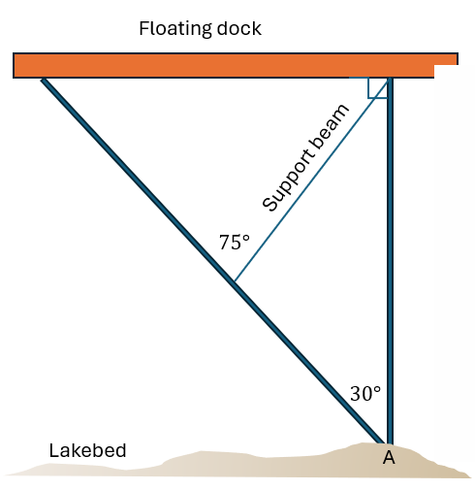
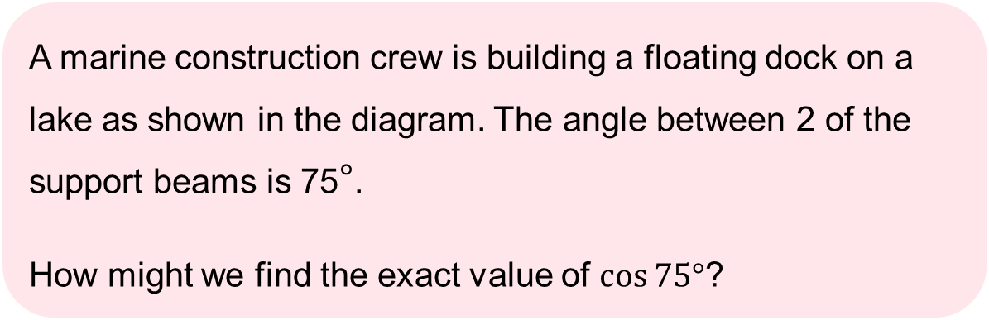

A floating dock on a lake
A marine construction crew is building a floating dock on a lake as shown in the diagram. The angle between 2 of the support beams is 75°.
How might we find the exact value of $\cos{75°}$?
$$45°$$
Image is not to scale

Slide 5

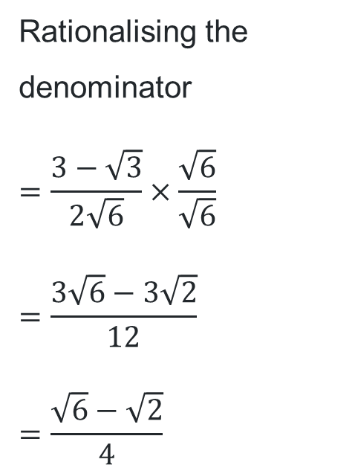

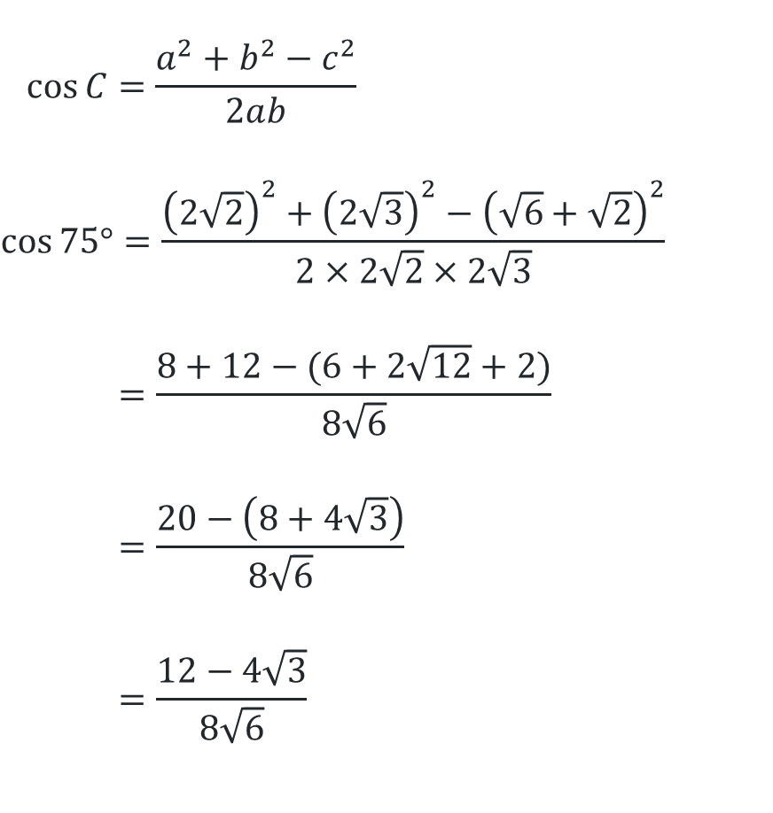






Finding the exact value of $\cos{75°}$
Rationalising the denominator
$$=\frac{3−\sqrt{3}}{2\sqrt{6}}×\frac{\sqrt{6}}{\sqrt{6}}$$
$$=\frac{3\sqrt{6}−3\sqrt{2}}{12}$$
$$=\frac{\sqrt{6}−\sqrt{2}}{4}$$
The cosine rule
$$\cos{C}=\frac{a^{2}+b^{2}−c^{2}}{2ab}$$
$$\cos{75°}=\frac{{\left(2\sqrt{2}\right)}^{2}+{\left(2\sqrt{3}\right)}^{2}−{\left(\sqrt{6}+\sqrt{2}\right)}^{2}}{2×2\sqrt{2}×2\sqrt{3}}$$
$$=\frac{8+12−(6+2\sqrt{12}+2)}{8\sqrt{6}}$$
$$=\frac{20−\left(8+4\sqrt{3}\right)}{8\sqrt{6}}$$
$$=\frac{12−4\sqrt{3}}{8\sqrt{6}}$$
$$45°$$
$$c$$
$$\sqrt{6}+\sqrt{2}$$
$$2\sqrt{3}$$
$$60°$$
$$75°$$
$$2\sqrt{2}$$
$$C$$

Slide 6
Connecting learning

Slide 7
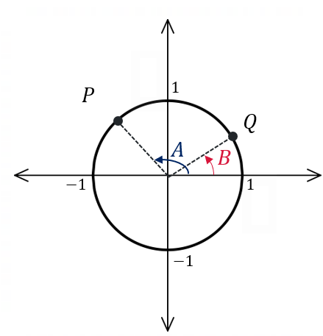



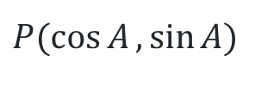


Deriving the sum and difference expansion formulas (1)
The distance formula
$y$
$$d^{2}=(x_{2}−x_{1})^{2}+(y_{2}−y_{1})^{2}$$
$$PQ^{2}={\left(\cos{B}−\cos{A}\right)}^{2}+{\left(\sin{B}−\sin{A}\right)}^{2}$$
$$=\cos^{2}{B}−2\cos{A}\cos{B}+\cos^{2}{A}+\sin^{2}{B}−2\sin{A}\sin{B}+\sin^{2}{A}$$
$\sin^{2}{B+\cos^{2}{B=1}}$ $\sin^{2}{A}+\cos^{2}{A}=1$
$$=2−2\cos{A}\cos{B}−2\sin{A}\sin{B}$$
$P(\cos{A},\sin{A})$
$$Q\left(\cos{B,\sin{B}}\right)$$
$x$
$$0$$

Slide 8

Deriving the sum and difference expansion formulas (2)
The cosine formula
$y$
$$c^{2}=a^{2}+b^{2}−2ab\cos{C}$$
$$a=1,b=1, ∠C=A−B$$
$PQ^{2}=1^{2}+1^{2}−2×1×1×\cos{(A−B)}$
$$=2−2\cos{(A−B)}$$
$P(\cos{A},\sin{A) }$
$$Q\left(\cos{B,\sin{B}}\right)$$
$x$

Slide 9
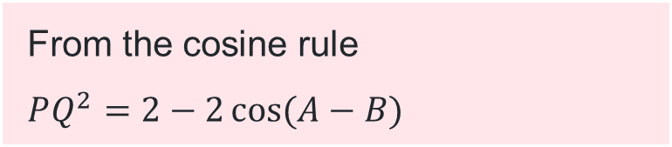
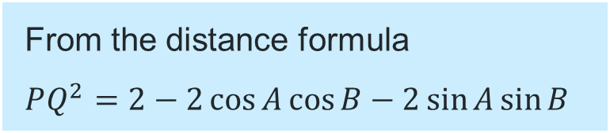
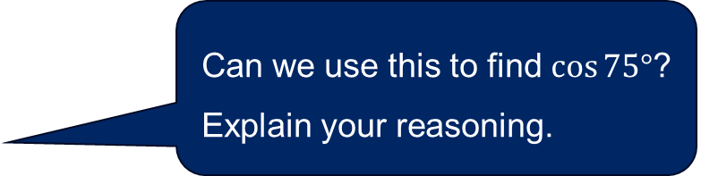
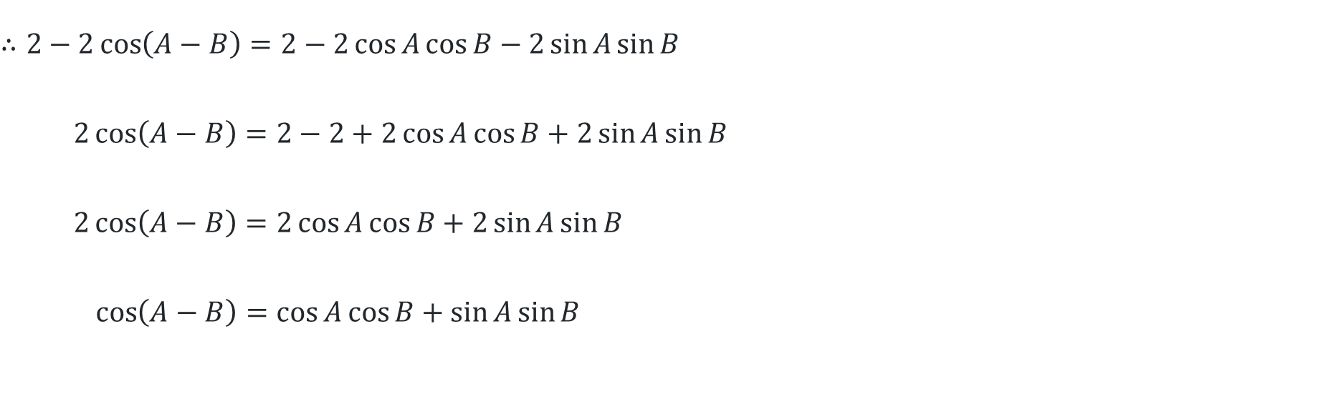
Deriving the sum and difference expansion formulas (3)
Equating the 2 expressions
From the cosine rule
$$PQ^{2}=2−2\cos{(A−B)}$$
From the distance formula
$$PQ^{2}=2−2\cos{A}\cos{B}−2\sin{A}\sin{B}$$
$$∴2−2\cos\left(A−B\right)=2−2\cos{A}\cos{B}−2\sin{A}\sin{B}$$
$$2\cos\left(A−B\right)=2−2+2\cos{A}\cos{B}+2\sin{A}\sin{B}$$
$$2\cos\left(A−B\right)=2\cos{A}\cos{B}+2\sin{A}\sin{B}$$
$$\cos\left(A−B\right)=\cos{A}\cos{B}+\sin{A}\sin{B}$$
Can we use this to find $\cos{75°}$? Explain your reasoning.

Slide 10
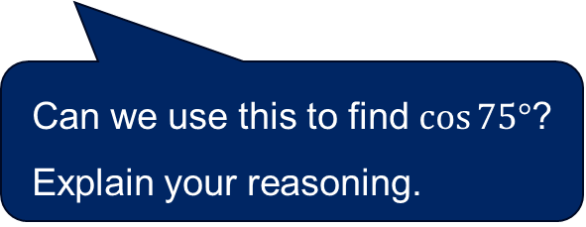
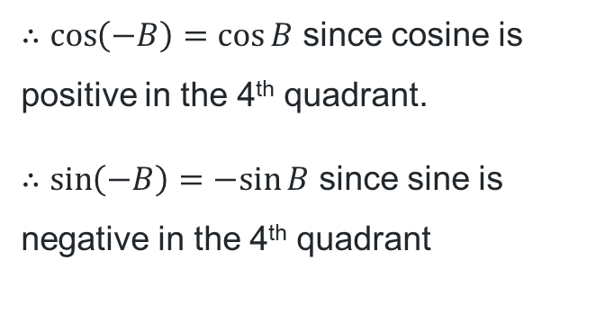


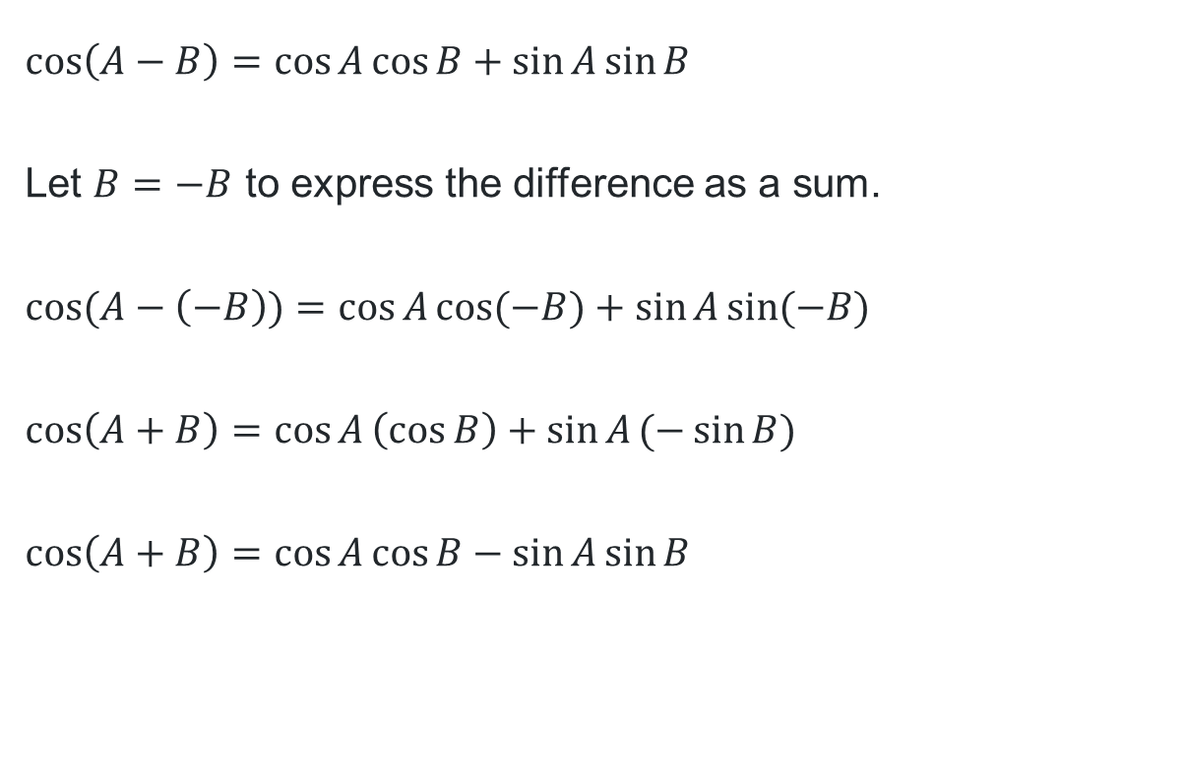
Deriving the sum and difference expansion formula (4)
Replacing $B$ with $−B$
$$\cos\left(A−B\right)=\cos{A}\cos{B}+\sin{A}\sin{B}$$
Let $B=−B$ to express the difference as a sum.
$$\cos{(A−\left(−B\right))}=\cos{A}\cos{(−B)}+\sin{A}\sin{(−B)}$$
$$\cos\left(A+B\right)=\cos{A}\left(\cos{B}\right)+\sin{A}(−\sin{B})$$
$$\cos\left(A+B\right)=\cos{A}\cos{B}−\sin{A}\sin{B}$$
$B$
$−B$
$∴\cos\left(−B\right)=\cos{B}$ since cosine is positive in the 4th quadrant.
$∴\sin\left(−B\right)=−sin{B}$ since sine is negative in the 4th quadrant
Can we use this to find $\cos{75°}$? Explain your reasoning.

Slide 11
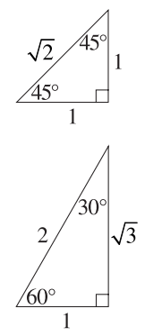


Revisiting $\cos{75°}$
Sum and difference expansion formula
$$\cos{75°=}\frac{\sqrt{3}}{2}×\frac{1}{\sqrt{2}}−\frac{1}{2}×\frac{1}{\sqrt{2}}$$
$$=\frac{\sqrt{3}}{2\sqrt{2}}−\frac{1}{2\sqrt{2}}$$
$$=\frac{\sqrt{3}−1}{2\sqrt{2}}$$
$$=\frac{\sqrt{3}−1}{2\sqrt{2}}×\frac{\sqrt{2}}{\sqrt{2}}$$
$$=\frac{\sqrt{6}−\sqrt{2}}{4}$$
$$\cos\left(A+B\right)=\cos{A}\cos{B}−\sin{A}\sin{B}$$
Let $A=30°$ and $B=45°$
$$\cos{(30°+45°})=\cos{30°}\cos{45°}−\sin{30°}\sin{45°}$$

Slide 12
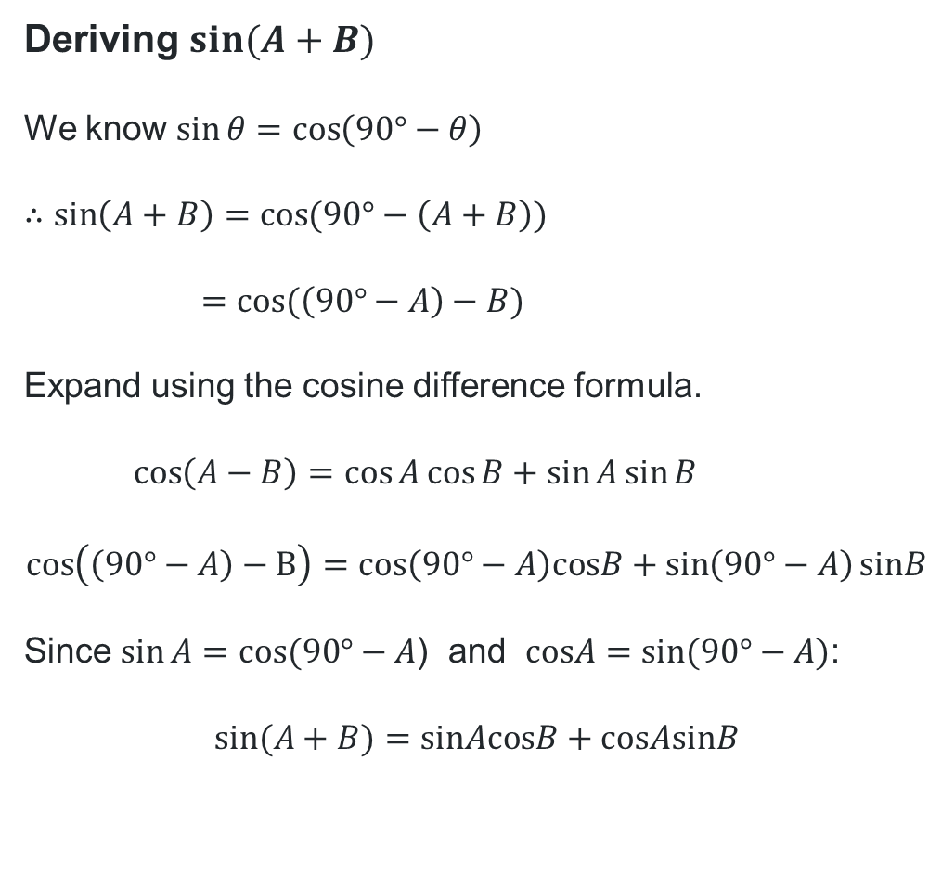
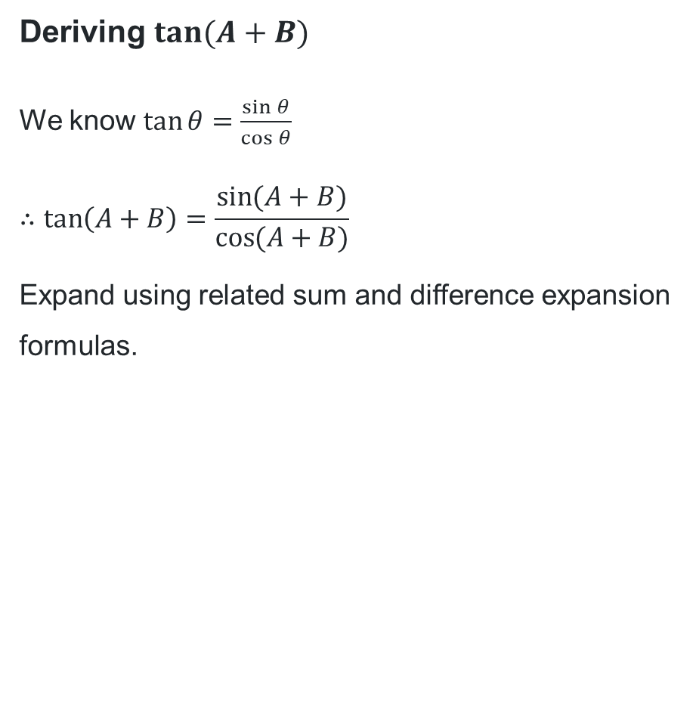
Deriving more sum and difference expansion formulas (1)
Deriving $\sin{(A+B)}$
We know $\sin{θ}=\cos\left(90°−θ\right)$
$$∴\sin\left(A+B\right)=\cos{(90°−\left(A+B\right))}$$
$$=\cos{(\left(90°−A\right)−B)}$$
Expand using the cosine difference formula.
$$\cos\left(A−B\right)=\cos{A}\cos{B}+\sin{A}\sin{B}$$
$$\cos\left(\left(90°−A\right)−B\right)=cos\left(90°−A\right)cosB+\sin\left(90°−A\right)sinB$$
Since $\sin{A}=cos⁡(90°−A$) and $cosA=sin⁡(90°−A)$:
$$sin⁡(A+B)=sinAcosB+cosAsinB$$
Deriving $\tan{(A+B)}$
We know $\tan{θ}=\frac{\sin{θ}}{\cos{θ}}$
$$∴\tan\left(A+B\right)=\frac{\sin{(A+B)}}{\cos{(A+B)}}$$
Expand using related sum and difference expansion formulas.

Slide 13
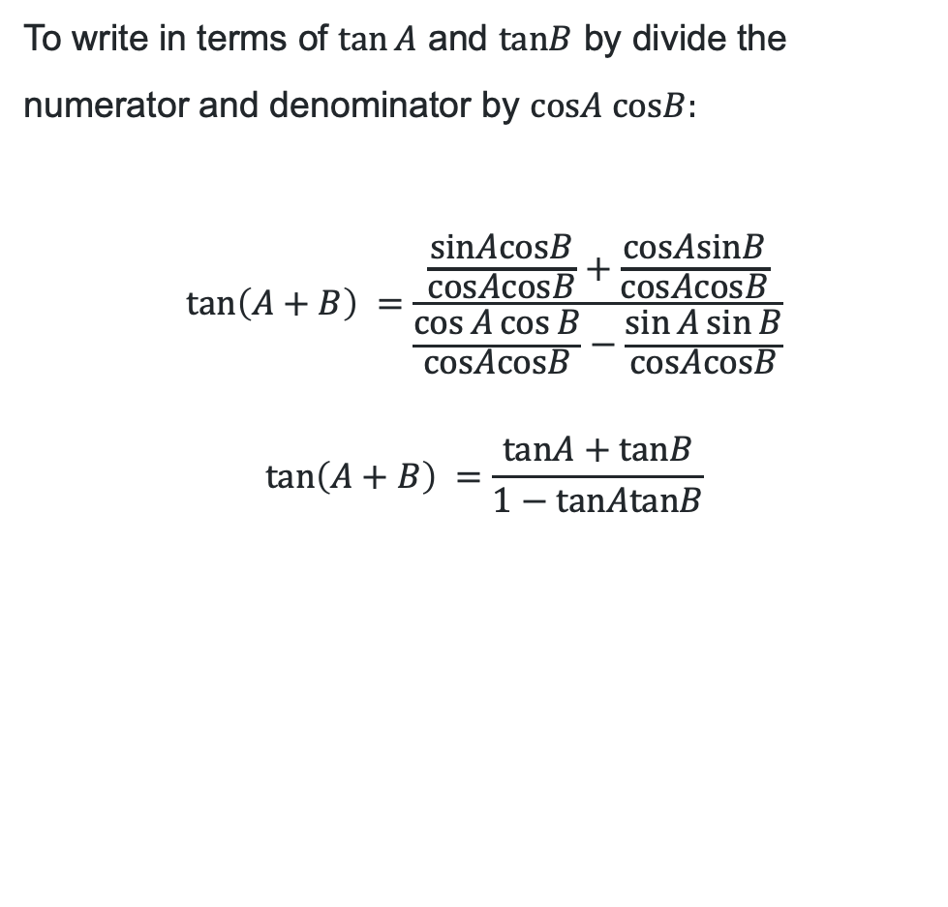
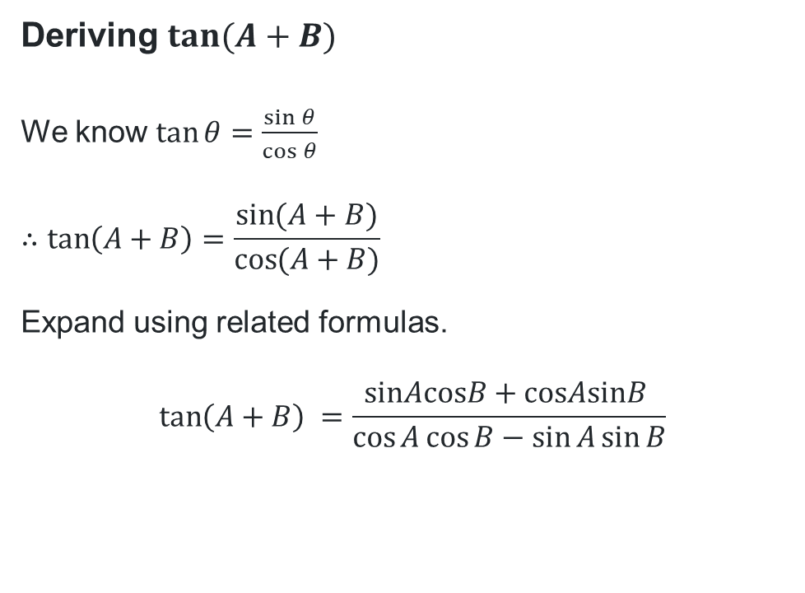
Deriving more sum and difference expansion formulas (2)
Deriving $\tan{(A+B)}$
We know $\tan{θ}=\frac{\sin{θ}}{\cos{θ}}$
$$∴\tan\left(A+B\right)=\frac{\sin{(A+B)}}{\cos{(A+B)}}$$
Expand using related formulas.
$$\tan\left(A+B\right) =\frac{sinAcosB+cosAsinB }{\cos{A}\cos{B}−\sin{A}\sin{B}}$$
To write in terms of $\tan{A}$ and $tanB$ by divide the numerator and denominator by $cosA cosB:$
$$\tan\left(A+B\right) =\frac{\frac{sinAcosB}{cosAcosB}+\frac{cosAsinB}{cosAcosB}}{\frac{\cos{A}\cos{B}}{cosAcosB}−\frac{\sin{A}\sin{B}}{cosAcosB}}$$
$$\tan\left(A+B\right) =\frac{tanA+tanB}{1−tanAtanB}$$

Slide 14
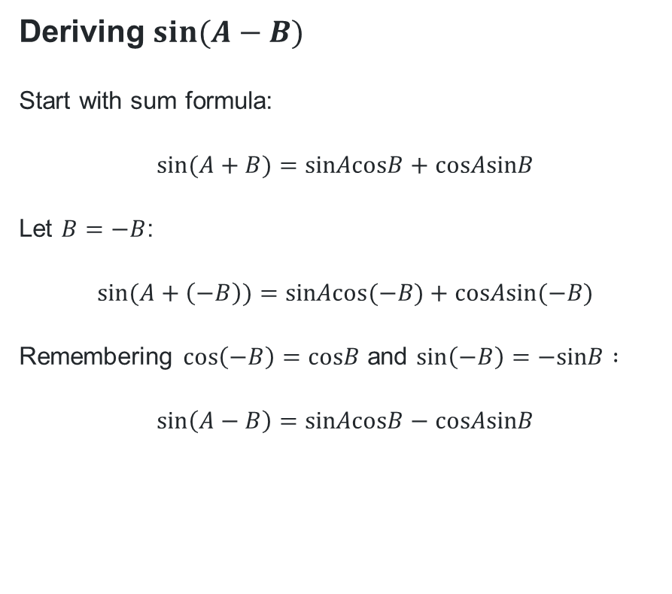
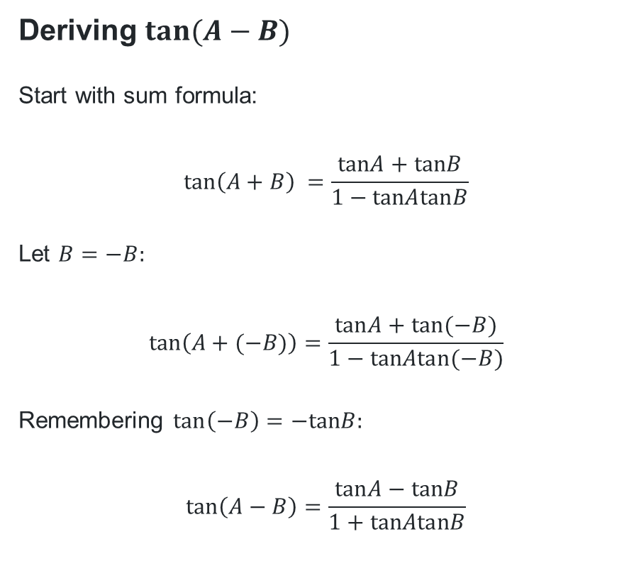
Deriving more sum and difference expansion formulas (3)
Deriving $\sin{(A−B)}$
Start with sum formula:
$$sin⁡(A+B)=sinAcosB+cosAsinB$$
Let $B=−B$:
$$sin⁡(A+\left(−B\right))=sinAcos(−B)+cosAsin(−B)$$
Remembering $\cos\left(−B\right)=cosB$ and $\sin\left(−B\right)=−sinB :$
$$\sin\left(A−B\right)=sinAcosB−cosAsinB$$
Deriving $\tan{(A−B)}$
Start with sum formula:
$$\tan\left(A+B\right) =\frac{tanA+tanB}{1−tanAtanB}$$
Let $B=−B:$
$$\tan\left(A+(−B)\right)=\frac{tanA+tan(−B)}{1−tanAtan(−B)}$$
Remembering $\tan\left(−B\right)=−tanB:$
$$\tan\left(A−B\right)=\frac{tanA−tanB}{1+tanAtanB}$$

Slide 15
Releasing responsibility

Slide 16
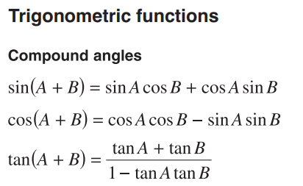
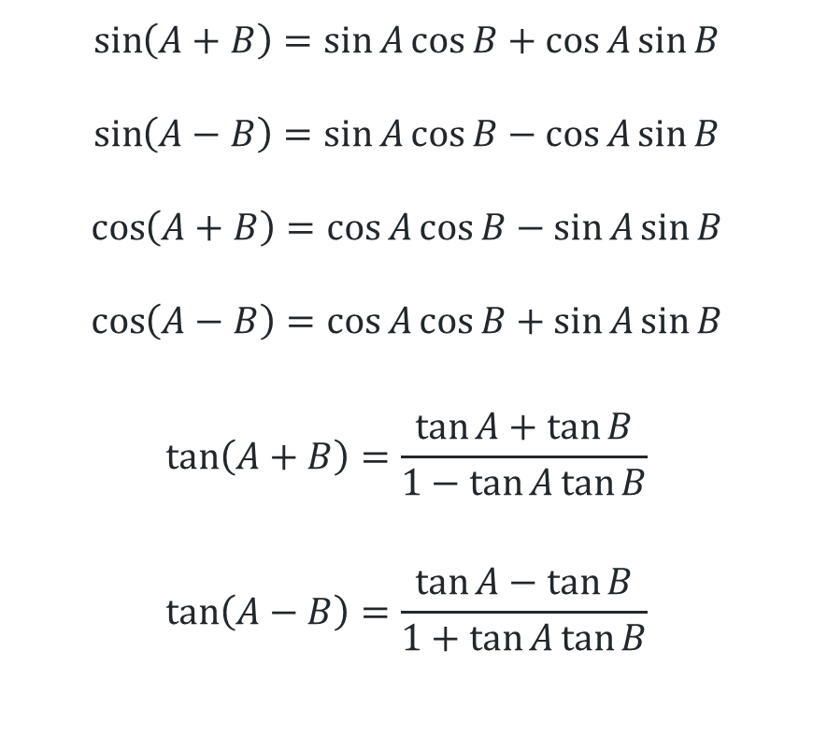
Sum and difference expansion formulas summary
$$\sin\left(A+B\right)=\sin{A}\cos{B}+\cos{A}\sin{B}$$
$$\sin\left(A−B\right)=\sin{A}\cos{B}−\cos{A}\sin{B}$$
$$\cos\left(A+B\right)=\cos{A}\cos{B}−\sin{A}\sin{B}$$
$$\cos\left(A−B\right)=\cos{A}\cos{B}+\sin{A}\sin{B}$$
$$\tan\left(A+B\right)=\frac{\tan{A}+\tan{B}}{1−\tan{A}\tan{B}}$$
$$\tan\left(A−B\right)=\frac{\tan{A}−\tan{B}}{1+\tan{A}\tan{B}}$$
Mathematics Extension 1
HSC reference sheet

Slide 17
Independent practice

Slide 18

Approaching questions scaffold

Slide 19
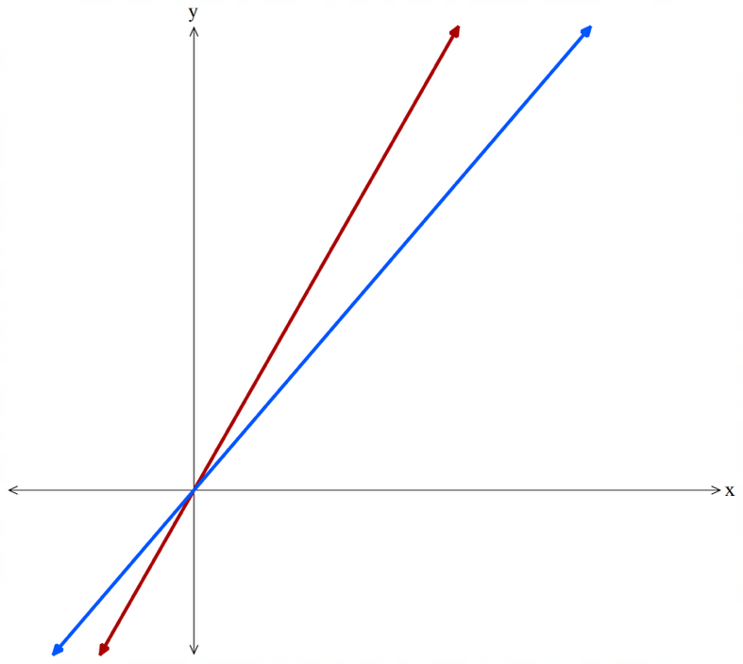

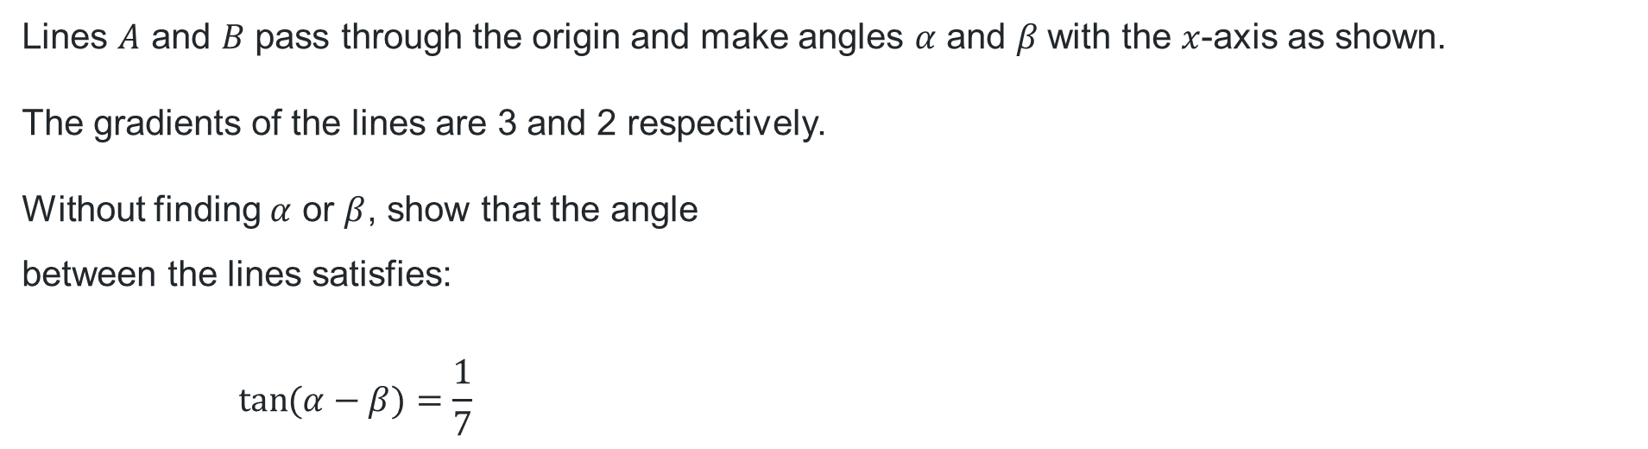



Problem 1
Applying the sum and differences expansion formula
Lines $A$ and $B$ pass through the origin and make angles $α$ and $β$with the $x$-axis as shown.
The gradients of the lines are 3 and 2 respectively.
Without finding $α$ or $β$, show that the angle
between the lines satisfies:
$$\tan{(α−β)}=\frac{1}{7}$$
Line $A$
Line $B$
$$α$$
$$β$$

Slide 20
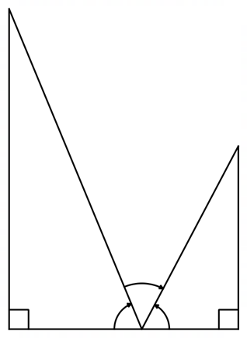


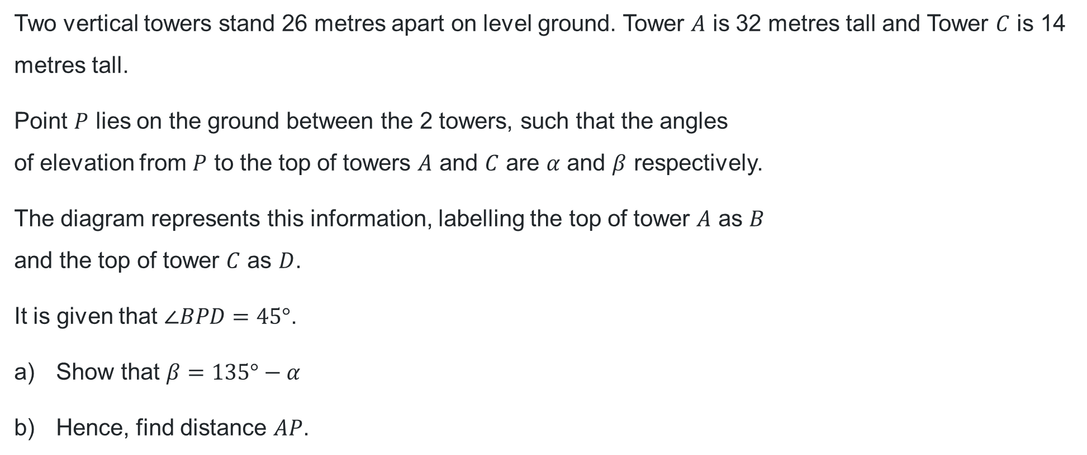









Problem 2
Applying the sum and difference formulas
Two vertical towers stand 26 metres apart on level ground. Tower $A$ is 32 metres tall and Tower $C$ is 14 metres tall.
Point $P$ lies on the ground between the 2 towers, such that the angles
of elevation from $P$ to the top of towers $A$ and $C$ are $α$ and $β$ respectively.
The diagram represents this information, labelling the top of tower $A$ as $B$
and the top of tower $C$ as $D$.
It is given that $∠BPD=45°$.
Show that $β=135°−α$
Hence, find distance $AP$.
$$B$$
$$D$$
$32$ m
$$45°$$
$14$ m
$$α$$
$$β$$
$$A$$
$$P$$
$$C$$
$26$ m

Slide 21
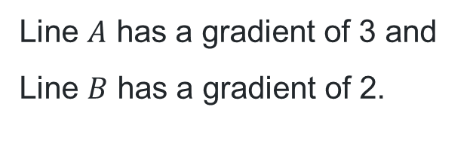




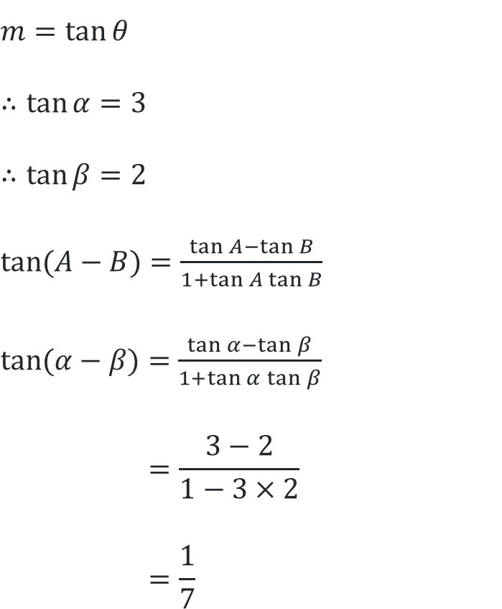
Solution 1
Applying the sum and differences expansion formula
Line $A$
Line $B$
$$m=tan{θ}$$
$$∴\tan{α}=3$$
$$∴\tan{β}=2$$
$\tan{(A−B)}=$ $\frac{\tan{A}−\tan{B}}{1+\tan{A}\tan{B}}$
$\tan{(α−β)}=$ $\frac{\tan{α}−\tan{β}}{1+\tan{α}\tan{β}}$
$$=\frac{3−2}{1−3×2}$$
$$=\frac{1}{7}$$
$$α$$
$$β$$
Line $A$ has a gradient of 3 and
Line $B$ has a gradient of 2.

Slide 22



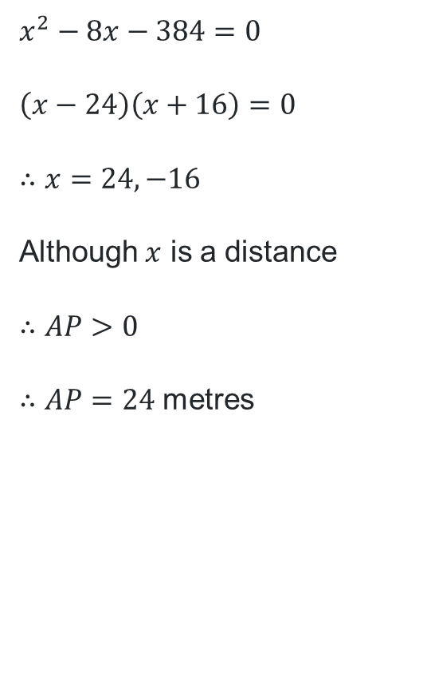
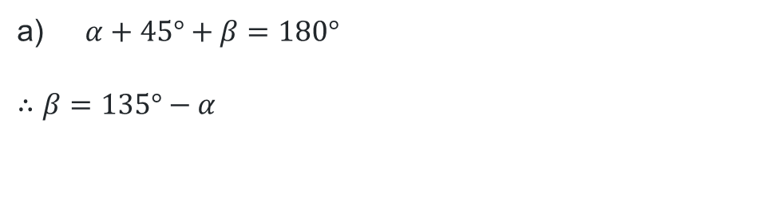


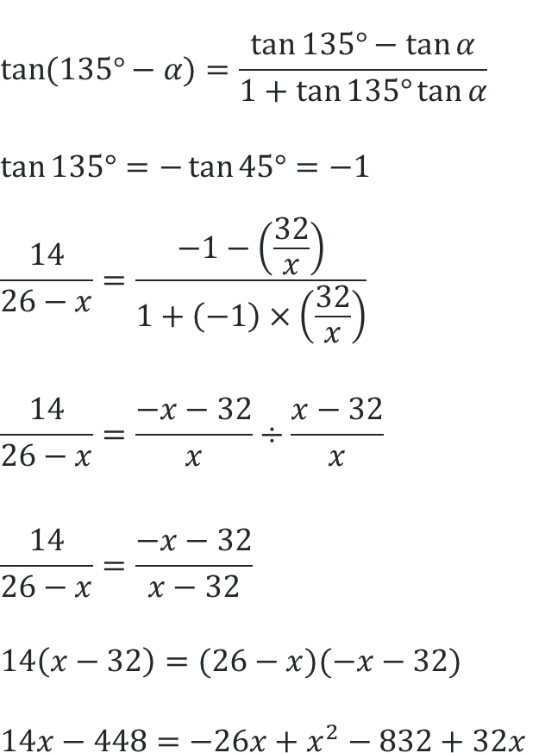
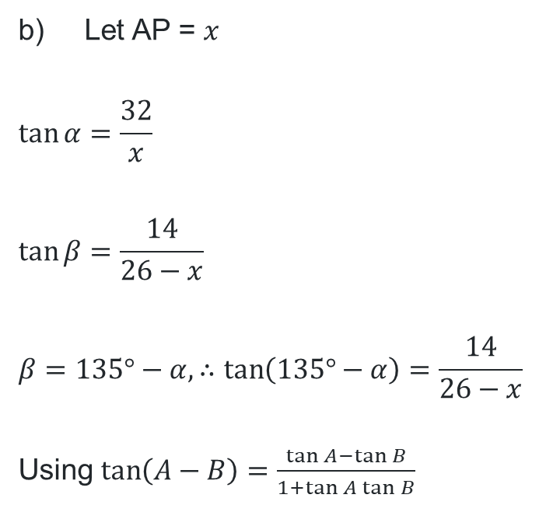







Solution 2
$$\tan{(135°−α)}=\frac{\tan{135°}−\tan{α}}{1+\tan{135°}\tan{α}}$$
$$\tan{135°}=−\tan{45°}=−1$$
$$\frac{14}{26−x}=\frac{−1−\left(\frac{32}{x}\right)}{1+\left(−1\right)×\left(\frac{32}{x}\right)}$$
$$\frac{14}{26−x}=\frac{−x−32}{x}÷\frac{x−32}{x}$$
$$\frac{14}{26−x}=\frac{−x−32}{x−32}$$
$$14\left(x−32\right)=(26−x)(−x−32)$$
$$14x−448=−26x+x^{2}−832+32x$$
$$x^{2}−8x−384=0$$
$$\left(x−24\right)\left(x+16\right)=0$$
$$∴x=24, −16$$
Although $x$ is a distance
$$∴AP>0$$
$∴AP=24$ metres
$α+45°+β=180°$
$$∴β=135°−α$$
$$B$$
Let AP = $x$
$$\tan{α}=\frac{32}{x}$$
$$\tan{β}=\frac{14}{26−x}$$
$$β=135°−α, ∴\tan\left(135°−α\right)=\frac{14}{26−x}$$
Using $\tan\left(A−B\right)=\frac{\tan{A}−\tan{B}}{1+\tan{A}\tan{B}}$
$$D$$
$32$ m
$$45°$$
$14$ m
$$α$$
$$β$$
$$A$$
$$P$$
$$C$$
$26$ m

Slide 23
References
This presentation contains NSW Curriculum and syllabus content. The NSW Curriculum is developed by the NSW Education Standards Authority. This content is prepared by NESA for and on behalf of the Crown in the right of the State of New South Wales. The material is protected by Crown copyright.
Please refer to the NESA Copyright Disclaimer for more information https://educationstandards.nsw.edu.au/wps/portal/nesa/mini-footer/copyright.
NESA holds the only official and up-to-date versions of the NSW Curriculum and syllabus documents. Please visit the NSW Education Standards Authority (NESA) website https://educationstandards.nsw.edu.au/wps/portal/nesa/home and the NSW Curriculum website https://curriculum.nsw.edu.au.
Mathematics Extension 1 11-12 Syllabus © NSW Education Standards Authority (NESA) for and on behalf of the Crown in right of the State of New South Wales, 2024.

Slide 24
Copyright
© State of New South Wales (Department of Education), 2026
The copyright material published in this resource is subject to the Copyright Act 1968 (Cth) and is owned by the NSW Department of Education or, where indicated, by a party other than the NSW Department of Education (third-party material).
Copyright material available in this resource and owned by the NSW Department of Education is licensed under a Creative Commons Attribution 4.0 International (CC BY 4.0) license.
This license allows you to share and adapt the material for any purpose, even commercially.
Attribution should be given to © State of New South Wales (Department of Education), 2026.
Material in this resource not available under a Creative Commons license:
the NSW Department of Education logo, other logos and trademark-protected material
Material owned by a third party that has been reproduced with permission. You will need to obtain permission from the third party to reuse its material.
Links to third-party material and websites
Please note that the provided (reading/viewing material/list/links/texts) are a suggestion only and implies no endorsement, by the New South Wales Department of Education, of any author, publisher, or book title. School principals and teachers are best placed to assess the suitability of resources that would complement the curriculum and reflect the needs and interests of their students.
If you use the links provided in this document to access a third-party’s website, you acknowledge that the terms of use, including licence terms set out on the third-party’s website apply to the use which may be made of the materials on that third-party website or where permitted by the Copyright Act 1968 (Cth). The department accepts no responsibility for content on third-party websites.

