Slide 1
Absolute value inequalities
Mathematics Extension 1 – Stage 6 (Year 11)
Inequalities

Slide 2
Learning intentions and success criteria
Learning intentions
To be able to solve absolute value inequalities.
Success criteria
I can graph an absolute value graph and use it to identify critical points.
I can solve absolute value inequalities by finding the distance from the critical point.
I can solve absolute value inequalities by graphing 2 separate equations.
I can solve absolute value inequalities algebraically.
Notes:
Notes for teachers:
Learning intentions and success criteria are best co-constructed with students. Adapt the learning intention as required and add matching success criteria.
For more information See ⁠AITSL or the NSW Department of Education explicit teaching strategies, ⁠Sharing learning intentions and ⁠Sharing success criteria
LISC is not necessarily presented at the beginning of the lesson. Teacher needs to consider most effectual time to introduce
LISC should be revisited during the lesson to support students' evaluation of their learning

Slide 3
Activating prior knowledge

Slide 4
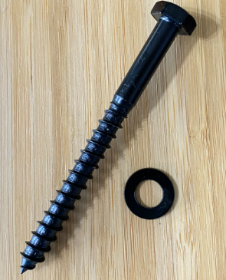
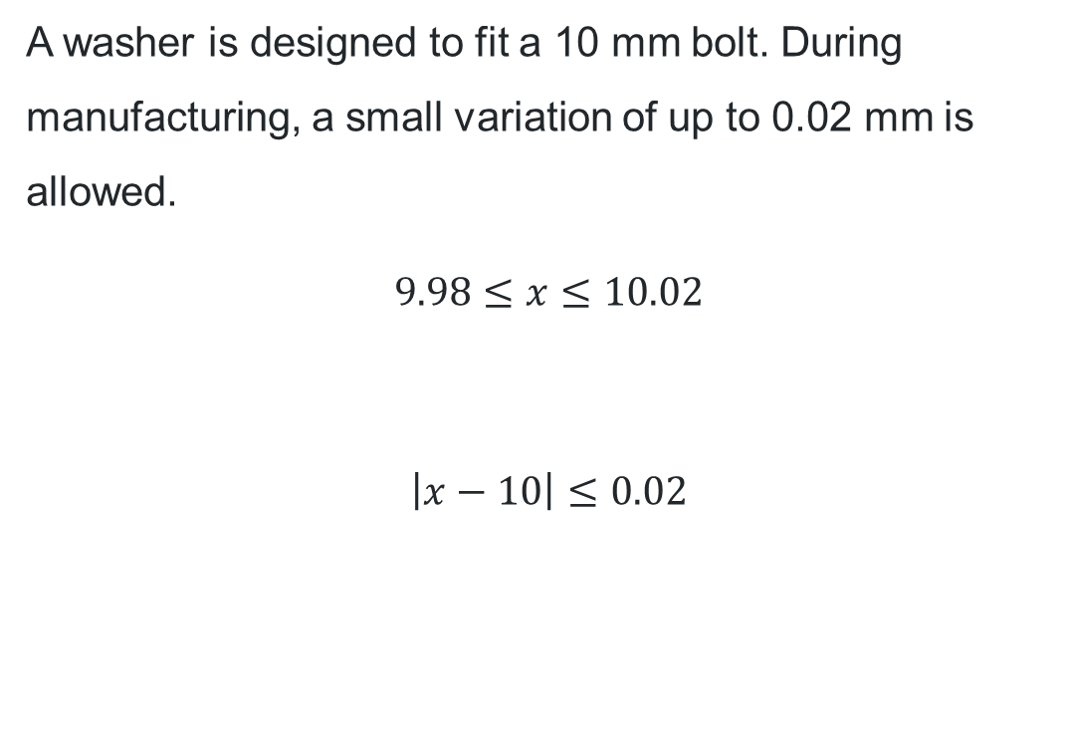
Engineering tolerances
A washer is designed to fit a 10 mm bolt. During manufacturing, a small variation of up to 0.02 mm is allowed.
$$9.98≤x≤10.02$$
$$\left|x−10\right|≤0.02$$

Slide 5
Connecting learning

Slide 6
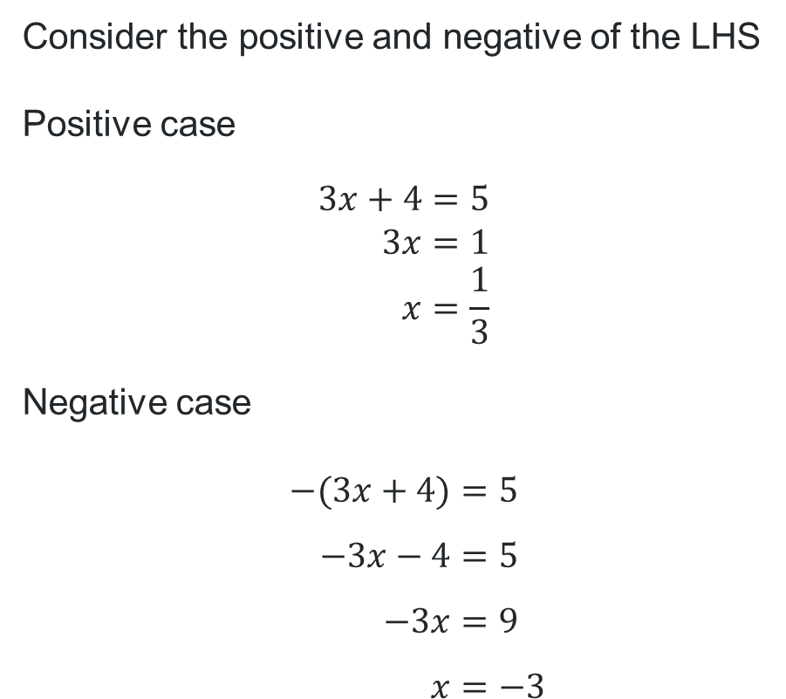
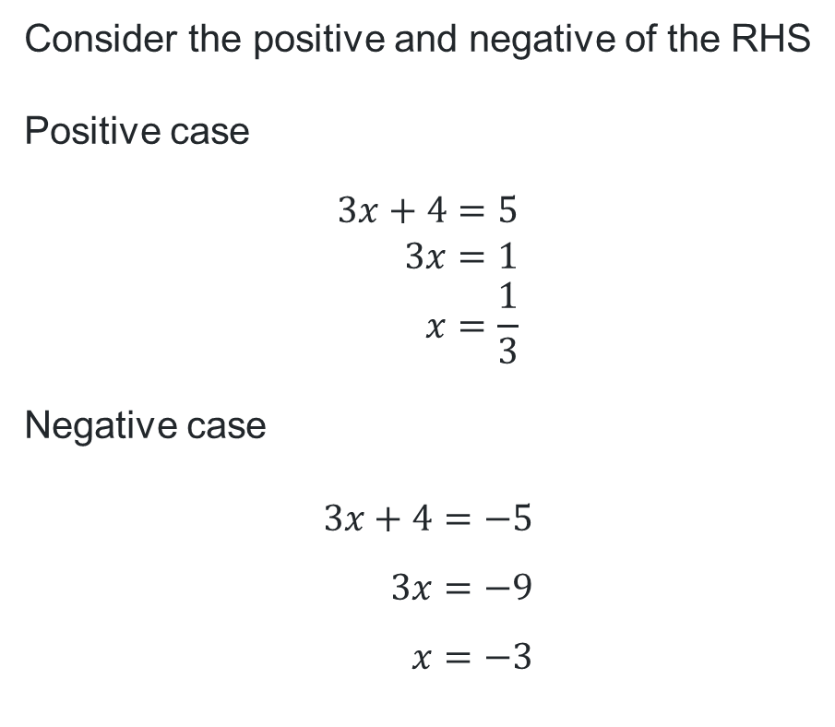
Solve $\left|3x+4\right|=5$
2 methods
Consider the positive and negative of the LHS
Positive case
$$3x+4=5 \\ 3x=1 \\ x=\frac{1}{3}$$
Negative case
$$−(3x+4)=5 \\ −3x−4=5 \\ −3x=9 \\ x=−3$$
Consider the positive and negative of the RHS
Positive case
$$3x+4=5 \\ 3x=1 \\ x=\frac{1}{3}$$
Negative case
$$3x+4=−5 \\ 3x=−9 \\ x=−3$$

Slide 7


Find the values that satisfy $\left|3x+4\right|>5$
2 methods
Consider the positive and negative of the LHS
Positive case
$$3x+4>5 \\ 3x>1 \\ x>\frac{1}{3}$$
Negative case
$$−\left(3x+4\right)>5 \\ −3x−4>5 \\ −3x>9 \\ x<−3$$
Consider the positive and negative of the RHS
Positive case
$$3x+4>5 \\ 3x>1 \\ x>\frac{1}{3}$$
Negative case
$$3x+4>−5 \\ 3x> −9 \\ x>−3$$

Slide 8
Releasing responsibility

Slide 9

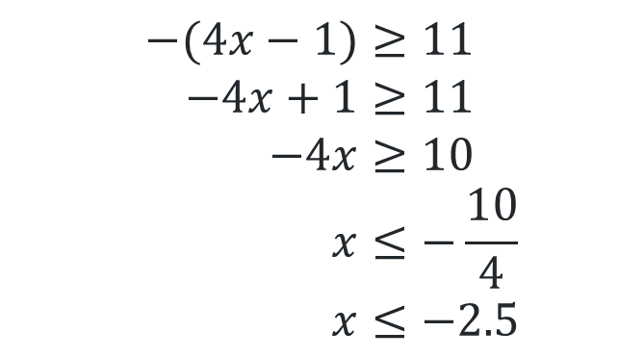
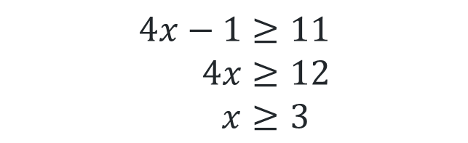
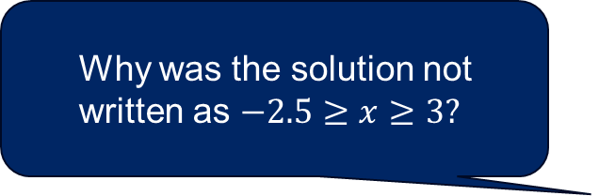
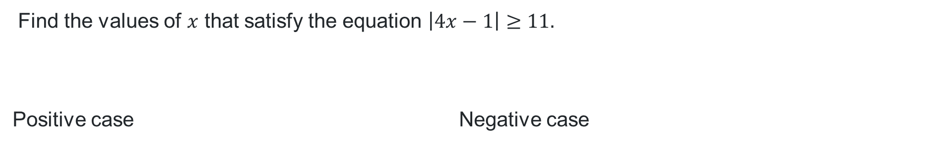
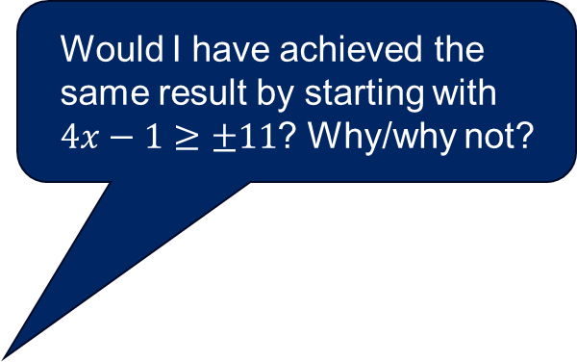
Solving algebraically (1)
Example 1
Would I have achieved the same result by starting with $4x−1≥±11$? Why/why not?
Find the values of $x$ that satisfy the equation $\left|4x−1\right|≥11.$
Positive case Negative case
$$4x−1≥11 \\ 4x≥12 \\ x≥3$$
$$−(4x−1)≥11 \\ −4x+1≥11 \\ −4x≥10 \\ x≤−\frac{10}{4} \\ x≤−2.5$$
Why was the solution not written as $−2.5≥x≥3?$
How can you check your answer is correct?
$x≥3$and $x≤−2.5$

Slide 10



Solving algebraically (2)
Question 1
Find the values of $x$ that satisfy the equation $\left|5x+2\right|≤12.$
Positive case
Negative case
$$5x+2≤12 \\ 5x≤10 \\ x≤2$$
$$−\left(5x+2\right)≤12 \\ −5x−2≤12 \\ −5x≤14 \\ x≥−\frac{14}{5} \\ x≥−2.8$$
$$−2.8≤x≤2$$

Slide 11
Independent practice

Slide 12

Problem
Find all values of $x$ which satisfy the equation
$$\left|x−1\right|≤|4−2x|$$

Slide 13
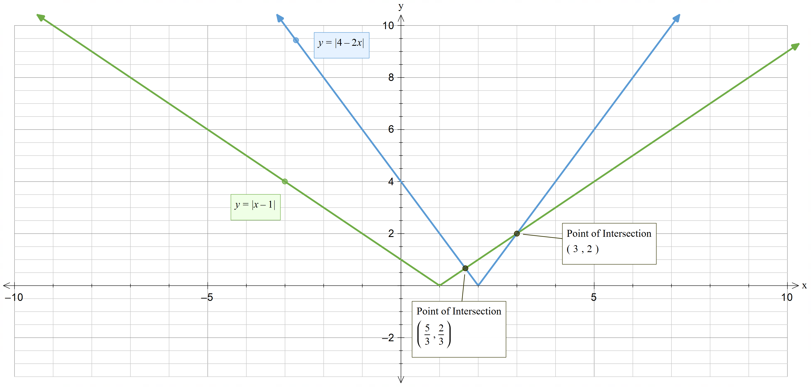

Solution (graphically)
$$\left|x−1\right|≤\left|4−2x\right| \\ x≤\frac{5}{3} and x≥3$$
Find all values of $x$ which satisfy the equation

Slide 14


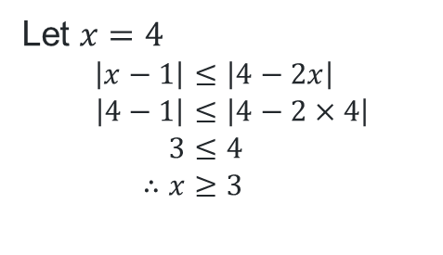

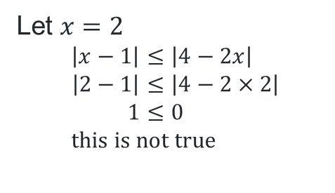
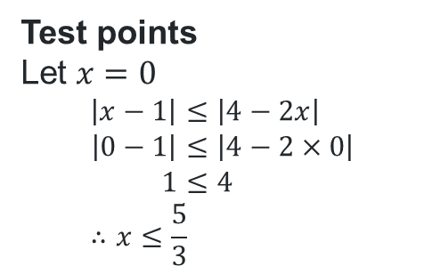


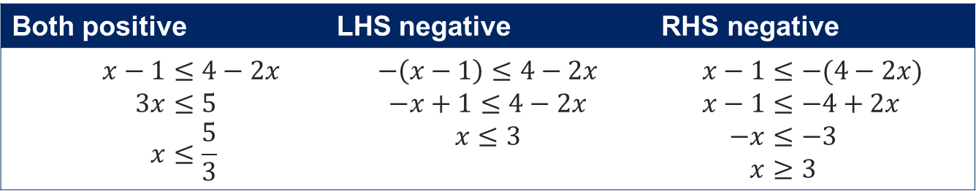

Solution (algebraically)
$$\left|x−1\right|≤|4−2x|$$
Both positive | LHS negative | RHS negative
$$x−1≤4−2x \\ 3x≤5 \\ x≤\frac{5}{3}$$ | $$−\left(x−1\right)≤4−2x \\ −x+1≤4−2x \\ x≤3$$ | $$x−1≤−(4−2x) \\ x−1≤−4+2x \\ −x≤−3 \\ x≥3$$
Test points
Let $x=0$
$$\left|x−1\right|≤\left|4−2x\right| \\ \left|0−1\right|≤\left|4−2×0\right| \\ 1≤4 \\ ∴x≤\frac{5}{3}$$
Let $x=2$
$$\left|x−1\right|≤\left|4−2x\right| \\ \left|2−1\right|≤\left|4−2×2\right| \\ 1≤0 \\ this is not true$$
Let $x=4$
$$\left|x−1\right|≤\left|4−2x\right| \\ \left|4−1\right|≤\left|4−2×4\right| \\ 3≤4 \\ ∴x≥3$$
$$\frac{5}{3}$$
$$3$$
$$x≤\frac{5}{3}and x≥3$$

Slide 15
References
This presentation contains NSW Curriculum and syllabus content. The NSW Curriculum is developed by the NSW Education Standards Authority. This content is prepared by NESA for and on behalf of the Crown in the right of the State of New South Wales. The material is protected by Crown copyright.
Please refer to the NESA Copyright Disclaimer for more information https://educationstandards.nsw.edu.au/wps/portal/nesa/mini-footer/copyright.
NESA holds the only official and up-to-date versions of the NSW Curriculum and syllabus documents. Please visit the NSW Education Standards Authority (NESA) website https://educationstandards.nsw.edu.au/wps/portal/nesa/home and the NSW Curriculum website https://curriculum.nsw.edu.au.
Mathematics Extension 1 11–12 Syllabus © NSW Education Standards Authority (NESA) for and on behalf of the Crown in right of the State of New South Wales, 2024.

Slide 16
Copyright
© State of New South Wales (Department of Education), 2025
The copyright material published in this resource is subject to the Copyright Act 1968 (Cth) and is owned by the NSW Department of Education or, where indicated, by a party other than the NSW Department of Education (third-party material).
Copyright material available in this resource and owned by the NSW Department of Education is licensed under a Creative Commons Attribution 4.0 International (CC BY 4.0) license.
This license allows you to share and adapt the material for any purpose, even commercially.
Attribution should be given to © State of New South Wales (Department of Education), 2025.
Material in this resource not available under a Creative Commons license:
the NSW Department of Education logo, other logos and trademark-protected material
Material owned by a third party that has been reproduced with permission. You will need to obtain permission from the third party to reuse its material.
Links to third-party material and websites
Please note that the provided (reading/viewing material/list/links/texts) are a suggestion only and implies no endorsement, by the New South Wales Department of Education, of any author, publisher, or book title. School principals and teachers are best placed to assess the suitability of resources that would complement the curriculum and reflect the needs and interests of their students.
If you use the links provided in this document to access a third-party’s website, you acknowledge that the terms of use, including licence terms set out on the third-party’s website apply to the use which may be made of the materials on that third-party website or where permitted by the Copyright Act 1968 (Cth). The department accepts no responsibility for content on third-party websites.

