Slide 1

Remainder and factor theorems
Mathematics Extension 1 – Stage 6 (Year 11)
Polynomials

Slide 2
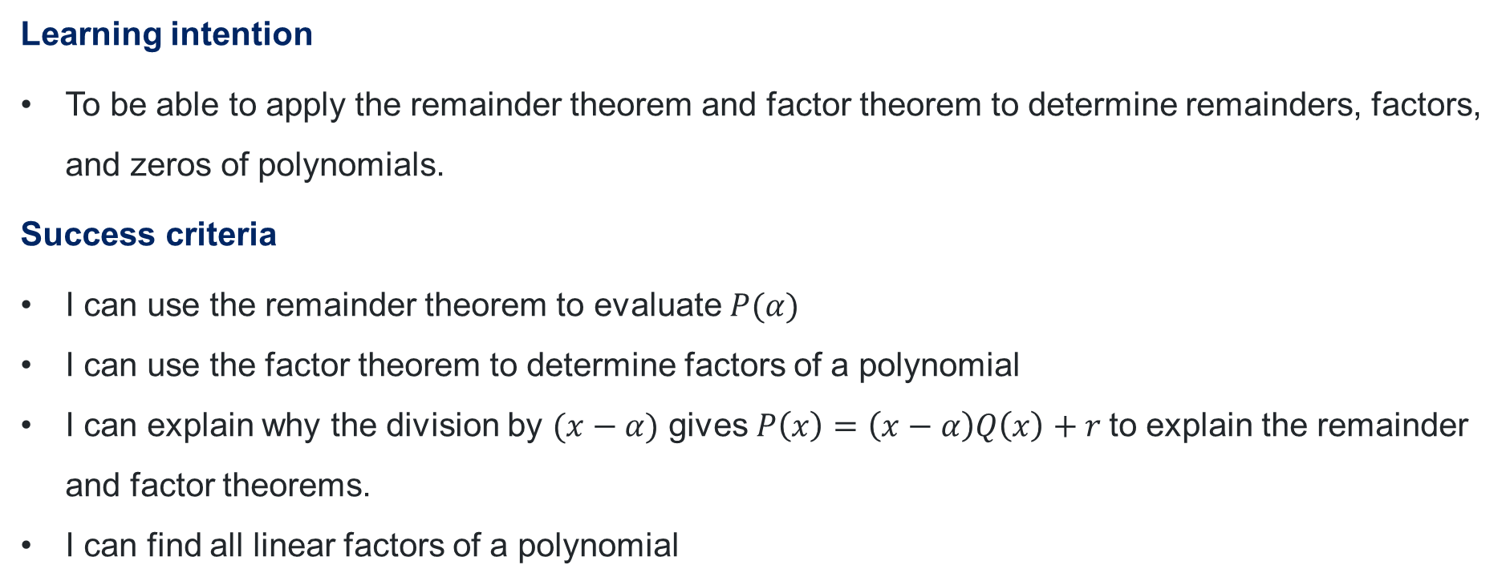
Learning intention and success criteria
Learning intention
To be able to apply the remainder theorem and factor theorem to determine remainders, factors, and zeros of polynomials.
Success criteria
I can use the remainder theorem to evaluate $P(α)$
I can use the factor theorem to determine factors of a polynomial
I can explain why the division by $(x−α)$ gives $P\left(x\right)=\left(x−α\right)Q\left(x\right)+r$to explain the remainder and factor theorems.
I can find all linear factors of a polynomial

Slide 3
Connecting learning

Slide 4
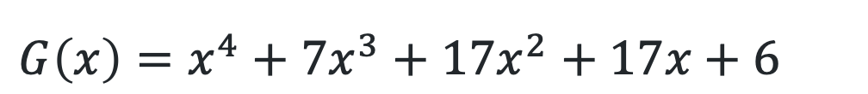
Testing values using your calculator
Polynomials
$P\left(x\right)=x^{3}−6x^{2}+11x−6$
$G\left(x\right)=x^{4}+7x^{3}+17x^{2}+17x+6$
$$G\left(x\right)={\left(x+1\right)}^{2}(x+2)(x+3)$$

Slide 5
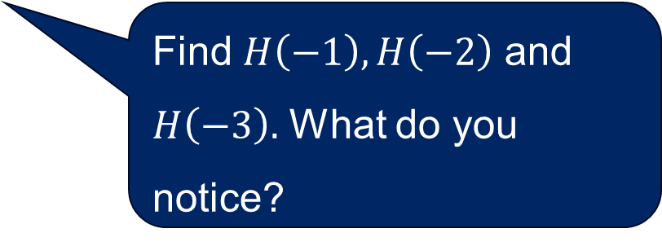

Find the remainder
$H\left(x\right)={\left(x+1\right)}^{2}\left(x+2\right)\left(x+3\right)+5$
Find $H\left(−1\right), H\left(−2\right)$ and $H\left(−3\right).$ What do you notice?
$$H\left(−1\right)={\left(−1+1\right)}^{2}\left(−1+2\right)\left(−1+3\right)+5 \\ =0×1×2+5 \\ =5$$
$$H\left(−2\right)={\left(−2+1\right)}^{2}\left(−2+2\right)\left(−2+3\right)+5 \\ ={(−1)}^{2}×0×1+5 \\ =5$$
$$H\left(−3\right)={\left(−3+1\right)}^{2}\left(−3+2\right)\left(−3+3\right)+5 \\ ={\left(−2\right)}^{2}×−1×0+5 \\ =5$$

Slide 6
Releasing responsibility

Slide 7
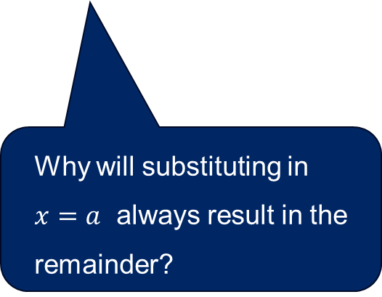

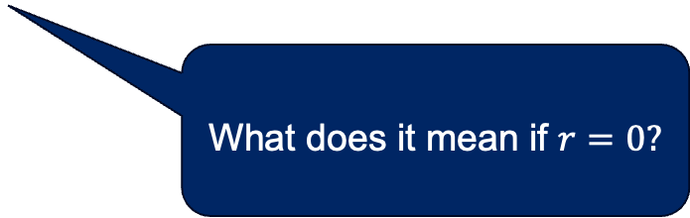
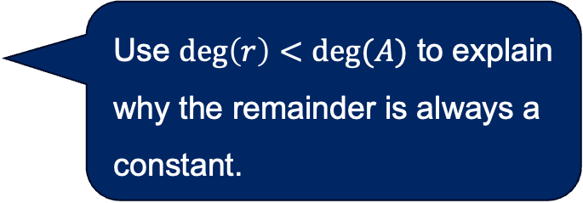
The remainder theorem
…and the factor theorem
Use $\deg\left(r\right)<deg⁡(A)$ to explain why the remainder is always a constant.
$$f\left(x\right)=A\left(x\right)×Q\left(x\right)+r$$
Let $A\left(x\right)=x−a$
$∴f\left(x\right)=\left(x−a\right)×Q\left(x\right)+r$
Let $x=a$
$$f\left(a\right)=\left(a−a\right)×Q\left(x\right)+r \\ =0+r \\ =r$$
Why will substituting in
$x=a$ always result in the remainder?
What does it mean if $r=0?$

Slide 8
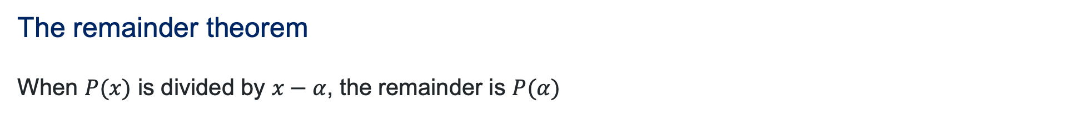
Formalising the theorems
NESA glossary
The remainder theorem
When $P(x)$ is divided by $x−α$, the remainder is $P(α)$
The factor theorem
$P\left(α\right)=0$ if and only if $x−α$ is a factor of $P\left(x\right)$

Slide 9
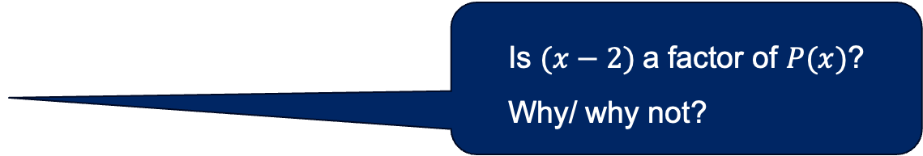
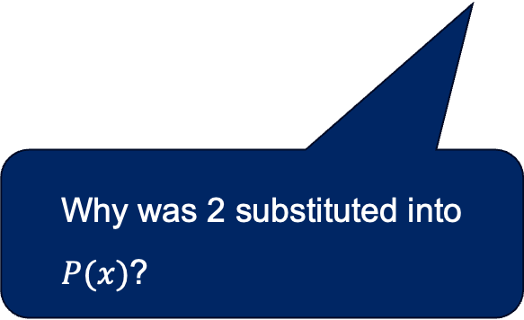
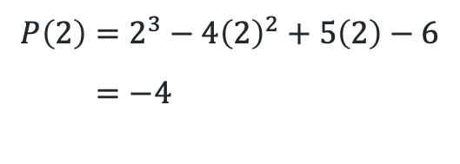
Finding the remainder (1)
Worked example 1
Find the remainder of $P\left(x\right)=x^{3}−4x^{2}+5x−6$ when divided by $(x−2)$
$$P\left(2\right)=2^{3}−4{\left(2\right)}^{2}+5\left(2\right)−6 \\ =−4$$
Is $(x−2)$a factor of $P(x)$? Why/ why not?
Why was 2 substituted into $P(x)$?

Slide 10
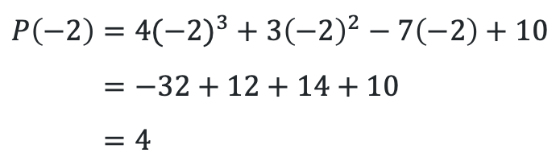
Finding the remainder (2)
Your turn – Question 1
Find the remainder of $P\left(x\right)={4x}^{3}+3x^{2}−7x+10$ when divided by $(x+2)$
$$P\left(−2\right)={4(−2)}^{3}+3{\left(−2\right)}^{2}−7\left(−2\right)+10 \\ =−32+12+14+10 \\ =4$$

Slide 11
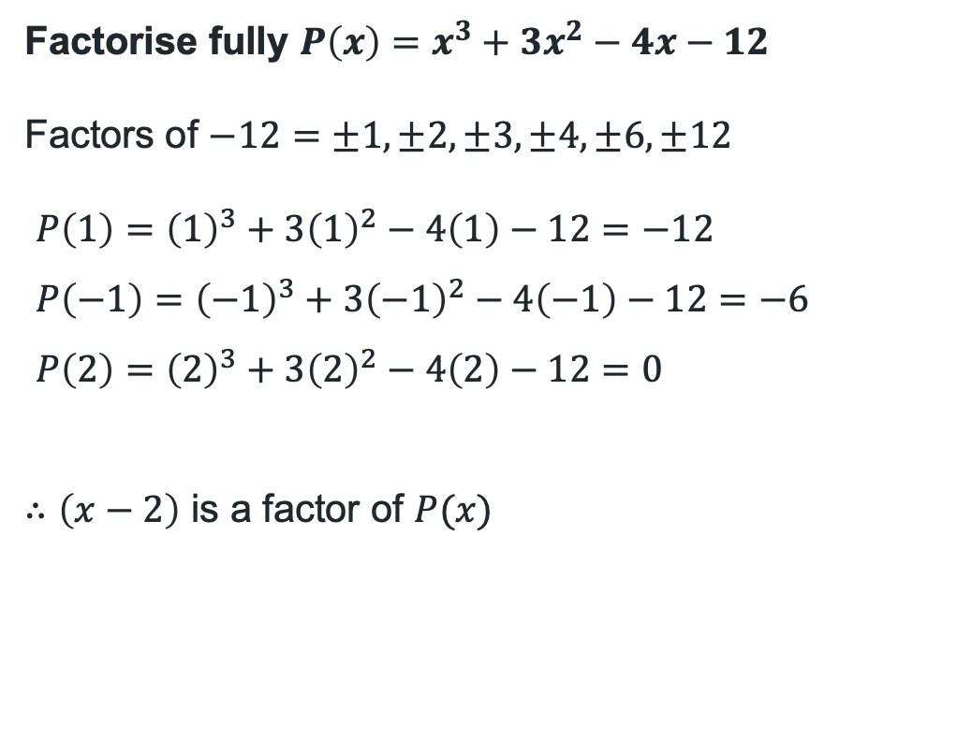
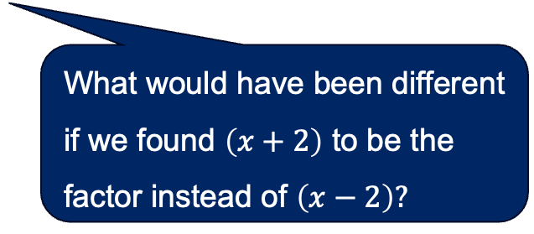
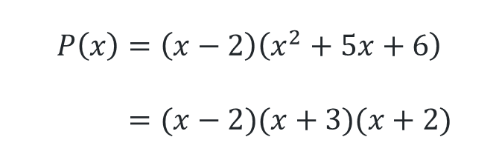
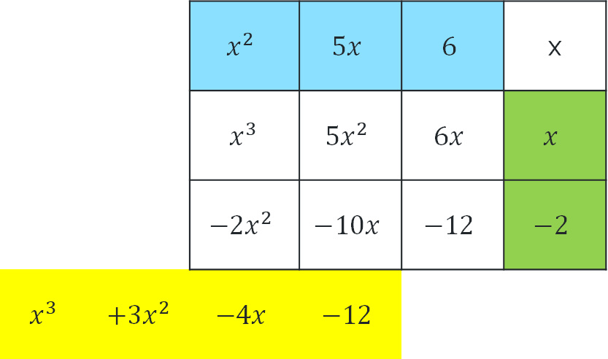
Finding factors (1)
Why did we perform division rather than finding all the factors through substitution?
Worked example 2
 |  | $$x^{2}$$ | $$5x$$ | $$6$$ | x
 |  | $$x^{3}$$ | $$5x^{2}$$ | $$6x$$ | $$x$$
 |  | $$−2x^{2}$$ | $$−10x$$ | $$−12$$ | $$−2$$
$$x^{3}$$ | $${+3x}^{2}$$ | $$−4x$$ | $$−12$$
Factorise fully $P\left(x\right)=x^{3}+3x^{2}−4x−12$
Factors of $−12=±1, ±2, ±3, ±4, ±6, ±12$
$P\left(1\right)={\left(1\right)}^{3}+3{\left(1\right)}^{2}−4\left(1\right)−12=−12$
$P\left(−1\right)={\left(−1\right)}^{3}+3{\left(−1\right)}^{2}−4\left(−1\right)−12=−6$
$P\left(2\right)={\left(2\right)}^{3}+3{\left(2\right)}^{2}−4\left(2\right)−12=0$
$∴\left(x−2\right)$ is a factor of $P(x)$
How does completely factorising help to graph the polynomial?
$$P\left(x\right)=\left(x−2\right)\left(x^{2}+5x+6\right) \\ =(x−2)(x+3)(x+2)$$
What would have been different if we found $\left(x+2\right)$ to be the factor instead of $\left(x−2\right)?$

Slide 12
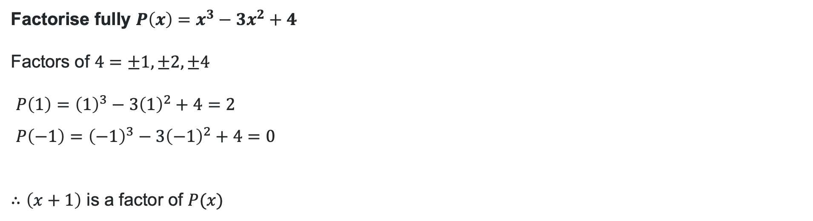
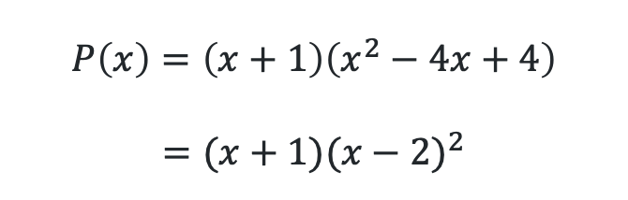
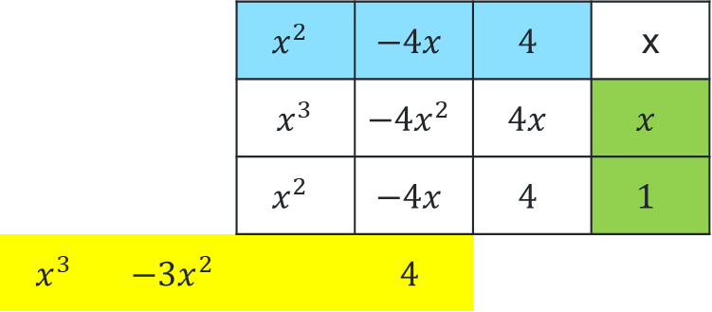
Finding factors (2)
Your turn – Question 2
Factorise fully $P\left(x\right)=x^{3}−3x^{2}+4$
Factors of $4=±1, ±2, ±4$
$P\left(1\right)={\left(1\right)}^{3}−3{\left(1\right)}^{2}+4=2$
$P\left(−1\right)={\left(−1\right)}^{3}−3{\left(−1\right)}^{2}+4=0$
$∴\left(x+1\right)$ is a factor of $P(x)$
 |  | $$x^{2}$$ | $$−4x$$ | $$4$$ | x
 |  | $$x^{3}$$ | $$−4x^{2}$$ | $$4x$$ | $$x$$
 |  | $$x^{2}$$ | $$−4x$$ | $$4$$ | $$1$$
$$x^{3}$$ | $$−3x^{2}$$ |  | $$4$$
$$P\left(x\right)=\left(x+1\right)\left(x^{2}−4x+4\right)$$
$$=(x+1){(x−2)}^{2}$$

Slide 13
References
This presentation contains NSW Curriculum and syllabus content. The NSW Curriculum is developed by the NSW Education Standards Authority. This content is prepared by NESA for and on behalf of the Crown in the right of the State of New South Wales. The material is protected by Crown copyright.
Please refer to the NESA Copyright Disclaimer for more information https://educationstandards.nsw.edu.au/wps/portal/nesa/mini-footer/copyright.
NESA holds the only official and up-to-date versions of the NSW Curriculum and syllabus documents. Please visit the NSW Education Standards Authority (NESA) website https://educationstandards.nsw.edu.au/wps/portal/nesa/home and the NSW Curriculum website https://curriculum.nsw.edu.au.
Mathematics Extension 1 11-12 Syllabus © NSW Education Standards Authority (NESA) for and on behalf of the Crown in right of the State of New South Wales, 2024.

Slide 14
Copyright
© State of New South Wales (Department of Education), 2026
The copyright material published in this resource is subject to the Copyright Act 1968 (Cth) and is owned by the NSW Department of Education or, where indicated, by a party other than the NSW Department of Education (third-party material).
Copyright material available in this resource and owned by the NSW Department of Education is licensed under a Creative Commons Attribution 4.0 International (CC BY 4.0) license.
This license allows you to share and adapt the material for any purpose, even commercially.
Attribution should be given to © State of New South Wales (Department of Education), 2026.
Material in this resource not available under a Creative Commons license:
the NSW Department of Education logo, other logos and trademark-protected material
Material owned by a third party that has been reproduced with permission. You will need to obtain permission from the third party to reuse its material.
Links to third-party material and websites
Please note that the provided (reading/viewing material/list/links/texts) are a suggestion only and implies no endorsement, by the New South Wales Department of Education, of any author, publisher, or book title. School principals and teachers are best placed to assess the suitability of resources that would complement the curriculum and reflect the needs and interests of their students.
If you use the links provided in this document to access a third-party’s website, you acknowledge that the terms of use, including licence terms set out on the third-party’s website apply to the use which may be made of the materials on that third-party website or where permitted by the Copyright Act 1968 (Cth). The department accepts no responsibility for content on third-party websites.

