Slide 1
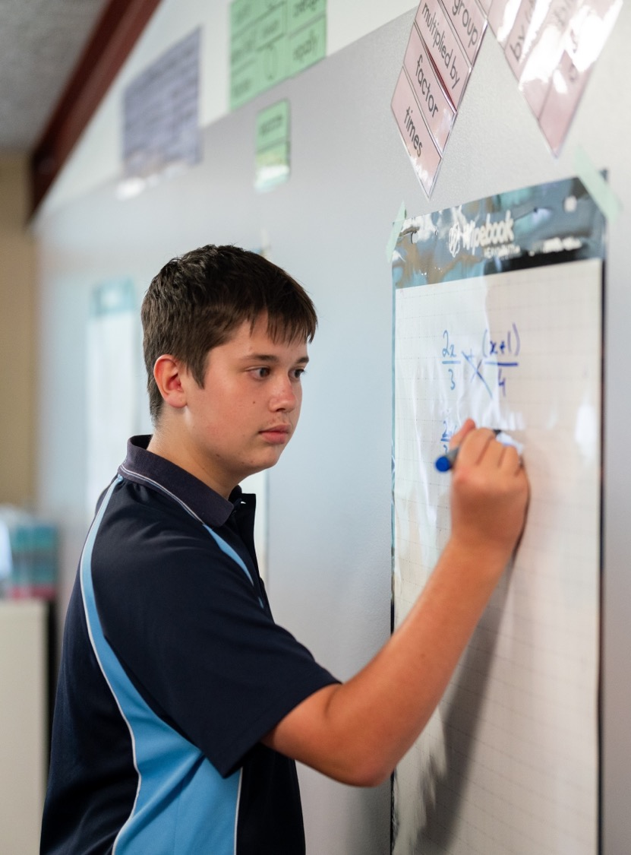
Dividing polynomials
Mathematics Extension 1 – Stage 6 (Year 11)
Polynomials

Slide 2
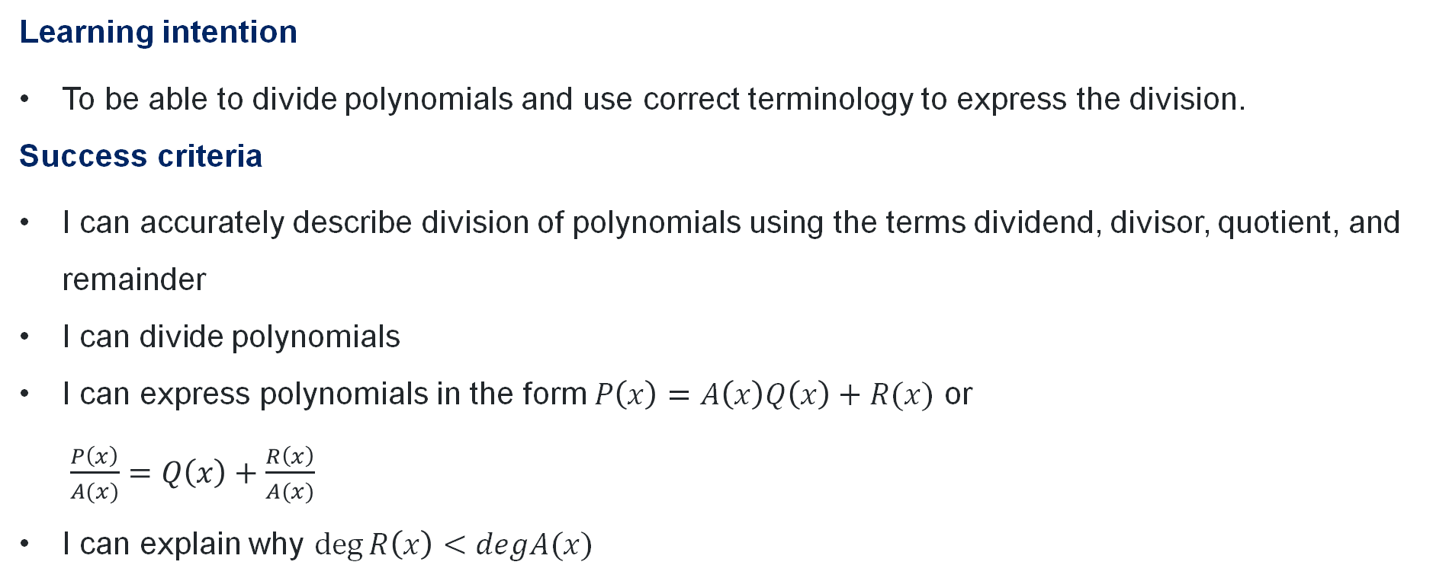
Learning intention and success criteria
Learning intention
To be able to divide polynomials and use correct terminology to express the division.
Success criteria
I can accurately describe division of polynomials using the terms dividend, divisor, quotient, and remainder
I can divide polynomials
I can express polynomials in the form $P\left(x\right)=A\left(x\right)Q\left(x\right)+R(x)$ or
$\frac{P\left(x\right)}{A(x)}=Q\left(x\right)+\frac{R\left(x\right)}{A(x)}$
I can explain why $\deg{R\left(x\right)<degA(x)}$
Notes:
Notes for teachers:
Learning intentions and success criteria are best co-constructed with students. Adapt the learning intention as required and add matching success criteria.
For more information See ⁠AITSL or the NSW Department of Education explicit teaching strategies, ⁠Sharing learning intentions and ⁠Sharing success criteria
LISC is not necessarily presented at the beginning of the lesson. Teacher needs to consider most effectual time to introduce
LISC should be revisited during the lesson to support students' evaluation of their learning

Slide 3
Retrieval practice

Slide 4
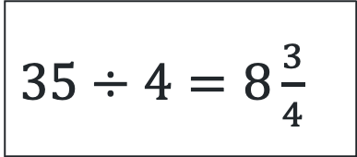
The language of division
quotient
remainder
$35÷4=8\frac{3}{4}$
dividend
divisor

Slide 5
Connecting learning

Slide 6
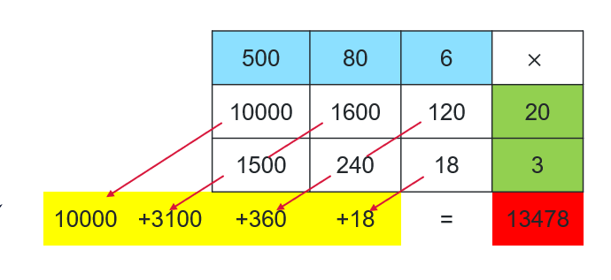
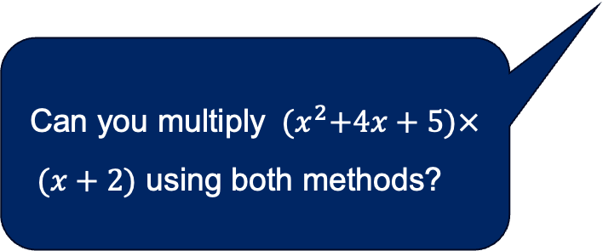
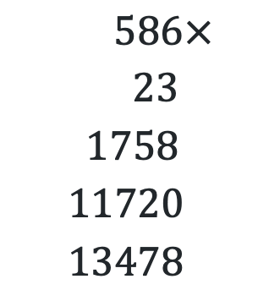
Compare the pair (1)
$$586×23$$
Multiplication algorithm
Area model
$$586× \\ 23 \\ 1758 \\ 11720 \\ 13478$$
Can you multiply ${(x}^{2}+4x+5)×$
$(x+2)$ using both methods?

Slide 7
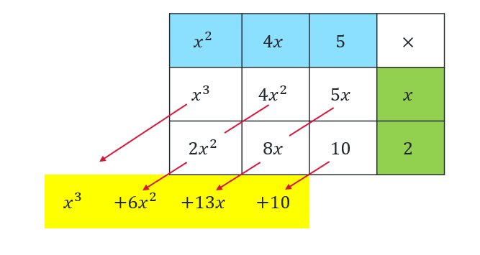
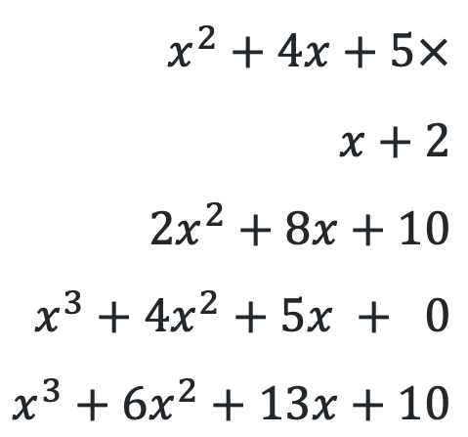
Compare the pair (2)
$${(x}^{2}+4x+5)×(x+2)$$
Multiplication algorithm
Area model
$$x^{2}+4x+5× \\ x+2 \\ 2x^{2}+8x+10 \\ x^{3}+4x^{2}+5x + 0 \\ x^{3}+6x^{2}+13x+10$$

Slide 8
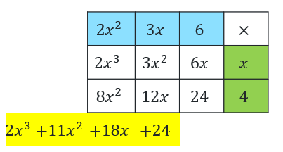
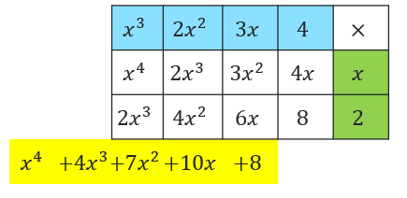
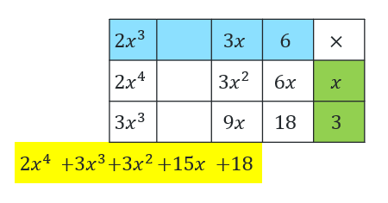
Multiplication
Using the area model
$$(2x^{2}+3x+6)(x+4)$$ | $$(x^{3}+2x^{2}+3x+4)(x+2)$$ | $$(2x^{3}+3x+6)(x+3)$$

Slide 9
Releasing responsibility

Slide 10
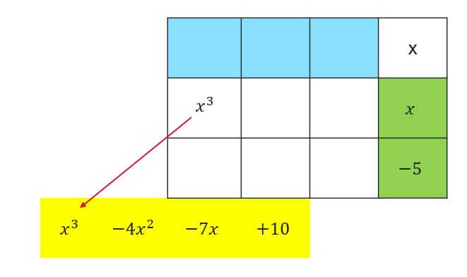
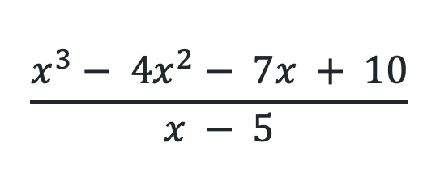
Dividing polynomials (1)
Where can I use it?
Slow reveal
$$\frac{x^{3}− 4x^{2}− 7x + 10}{x − 5}$$
What do I know?

Slide 11


Dividing polynomials (2)
Slow reveal
Where can I use it?
$$\frac{x^{3}− 4x^{2}− 7x + 10}{x − 5}$$
What do I know?
$$x^{2}$$
$${−5x}^{2}$$

Slide 12
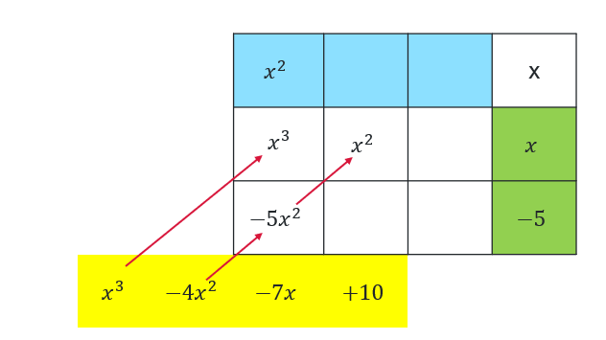


Dividing polynomials (3)
Slow reveal
$$\frac{x^{3}− 4x^{2}− 7x + 10}{x − 5}$$
Where can I use it?
What do I know?
$$x$$
$$−5x$$

Slide 13
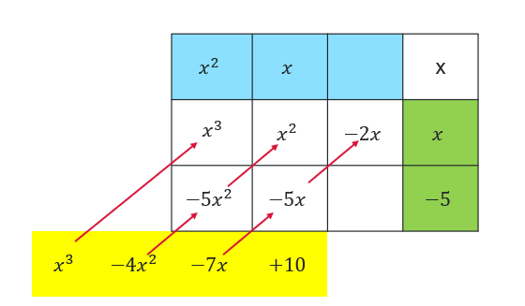


Dividing polynomials (4)
Slow reveal
$$\frac{x^{3}− 4x^{2}− 7x + 10}{x − 5}$$
Where can I use it?
What do I know?
$$−2$$
$$10$$

Slide 14
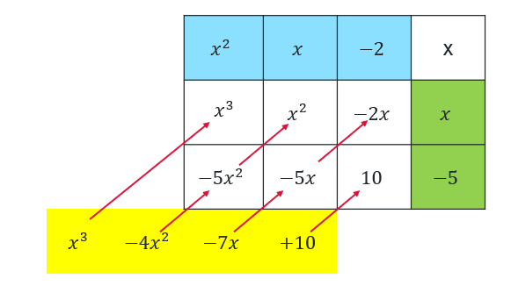
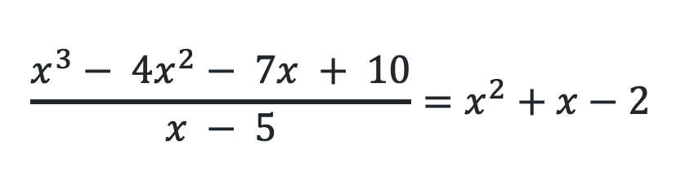
Dividing polynomials (5)
Slow reveal
$$\frac{x^{3}− 4x^{2}− 7x + 10}{x − 5}=x^{2}+x−2$$

Slide 15
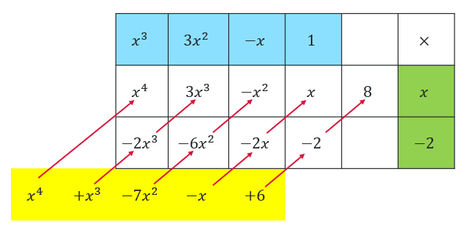
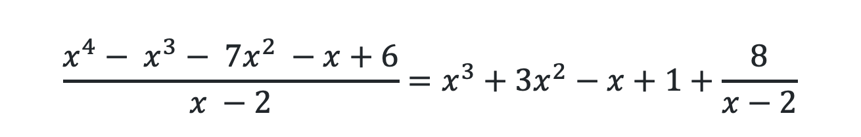
Dividing polynomials (6)
Why is the remainder written as a fraction?
Worked example 1
$$\frac{x^{4}− x^{3}− 7x^{2} −x+6}{x −2}=x^{3}+3x^{2}−x+1+\frac{8}{x−2}$$
Why is 8 added?
What would change if the constant was 3?

Slide 16
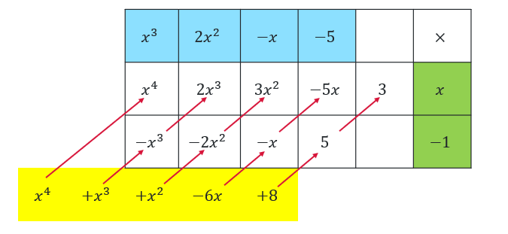
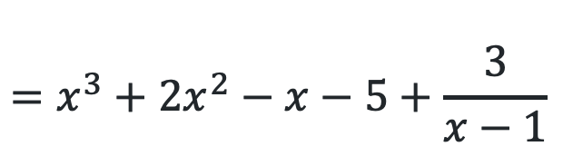
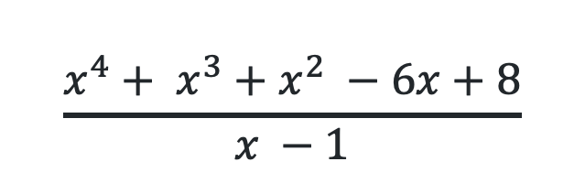
Dividing polynomials (7)
Your turn – Question 1
$$\frac{x^{4}+ x^{3}+x^{2} −6x+8}{x −1}$$
$$=x^{3}+2x^{2}−x−5+\frac{3}{x−1}$$

Slide 17

Dividing polynomials (8)
Different ways of writing
quotient
remainder
$P\left(x\right)=A\left(x\right)Q\left(x\right)+R(x)$
dividend
divisor
$$\frac{P\left(x\right)}{A\left(x\right)}=Q\left(x\right)+\frac{R\left(x\right)}{A\left(x\right)}$$
17

Slide 18
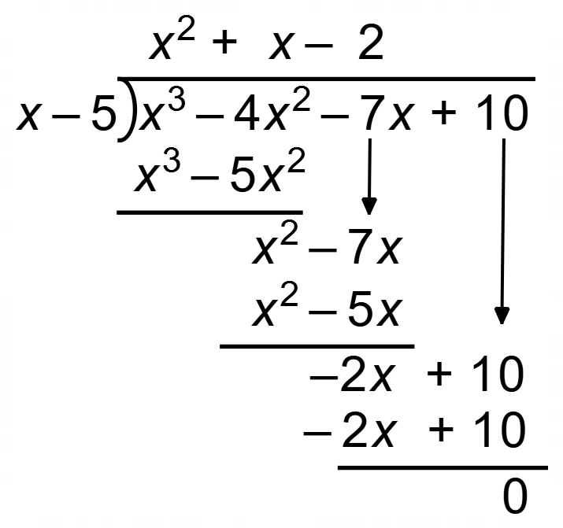
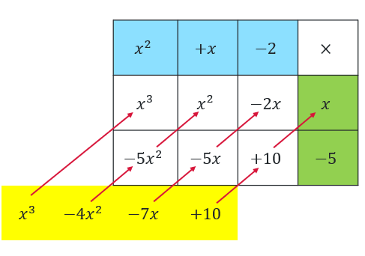
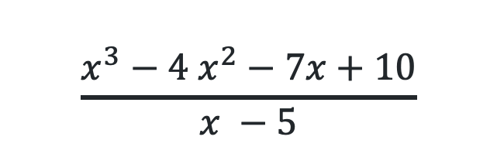
Compare the pair (3)
$$\frac{x^{3}−4 x^{2}−7x+10}{x −5}$$
Simone’s solution
Colleen’s solution

Slide 19
Independent practice

Slide 20
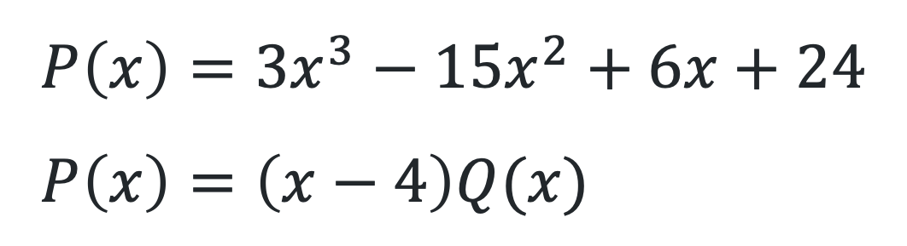
Graphing polynomials
$$P\left(x\right)=3x^{3}−15x^{2}+6x+24 \\ P\left(x\right)=\left(x−4\right)Q(x)$$
20

Slide 21
References
This presentation contains NSW Curriculum and syllabus content. The NSW Curriculum is developed by the NSW Education Standards Authority. This content is prepared by NESA for and on behalf of the Crown in the right of the State of New South Wales. The material is protected by Crown copyright.
Please refer to the NESA Copyright Disclaimer for more information https://educationstandards.nsw.edu.au/wps/portal/nesa/mini-footer/copyright.
NESA holds the only official and up-to-date versions of the NSW Curriculum and syllabus documents. Please visit the NSW Education Standards Authority (NESA) website https://educationstandards.nsw.edu.au/wps/portal/nesa/home and the NSW Curriculum website https://curriculum.nsw.edu.au.
Mathematics Extension 1 11-12 Syllabus © NSW Education Standards Authority (NESA) for and on behalf of the Crown in right of the State of New South Wales, 2024.

Slide 22
Copyright
© State of New South Wales (Department of Education), 2026
The copyright material published in this resource is subject to the Copyright Act 1968 (Cth) and is owned by the NSW Department of Education or, where indicated, by a party other than the NSW Department of Education (third-party material).
Copyright material available in this resource and owned by the NSW Department of Education is licensed under a Creative Commons Attribution 4.0 International (CC BY 4.0) license.
This license allows you to share and adapt the material for any purpose, even commercially.
Attribution should be given to © State of New South Wales (Department of Education), 2026.
Material in this resource not available under a Creative Commons license:
the NSW Department of Education logo, other logos and trademark-protected material
Material owned by a third party that has been reproduced with permission. You will need to obtain permission from the third party to reuse its material.
Links to third-party material and websites
Please note that the provided (reading/viewing material/list/links/texts) are a suggestion only and implies no endorsement, by the New South Wales Department of Education, of any author, publisher, or book title. School principals and teachers are best placed to assess the suitability of resources that would complement the curriculum and reflect the needs and interests of their students.
If you use the links provided in this document to access a third-party’s website, you acknowledge that the terms of use, including licence terms set out on the third-party’s website apply to the use which may be made of the materials on that third-party website or where permitted by the Copyright Act 1968 (Cth). The department accepts no responsibility for content on third-party websites.

