Slide 1
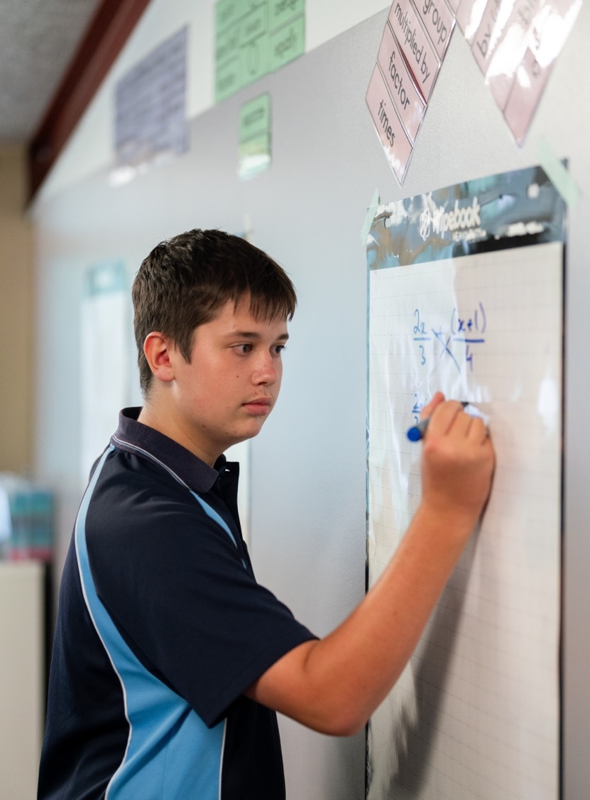
Connecting the zeroes
Mathematics Extension 1 – Stage 6 (Year 11)
Polynomials

Slide 2
Learning intentions and success criteria
Learning intention
To understand how the coefficients of a polynomial determine the relationships between its zeroes, and to use these relationships to solve problems involving quadratic, cubic and quartic polynomials.
Success criteria
I can interpret a condition about the zeroes of a polynomial and express it using sums, products, or symmetric relationships
I can use the relationships between coefficients and zeroes to determine unknown zeroes or unknown coefficients in quadratic, cubic and quartic polynomials.
I can justify my reasoning by forming and manipulating identities that link zeroes to coefficients.

Slide 3
Activating prior knowledge

Slide 4
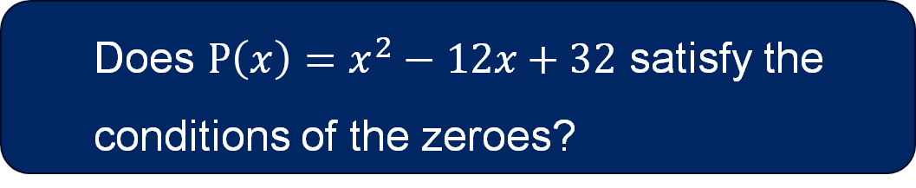


The business model
An economist is modelling a simple business. They know that revenue is double spending. If spending is one zero of the model and profit is the other, what could the 2 zeroes look like?
Spending $=α$
Revenue $=2α$
$$P\left(x\right)=\left(x−α\right)\left(x−2α\right) \\ P\left(x\right)=x^{2}−3αx+2α^{2}$$
Does $P\left(x\right)=x^{2}−12x+32$ satisfy the conditions of the zeroes?

Slide 5
Connecting learning

Slide 6
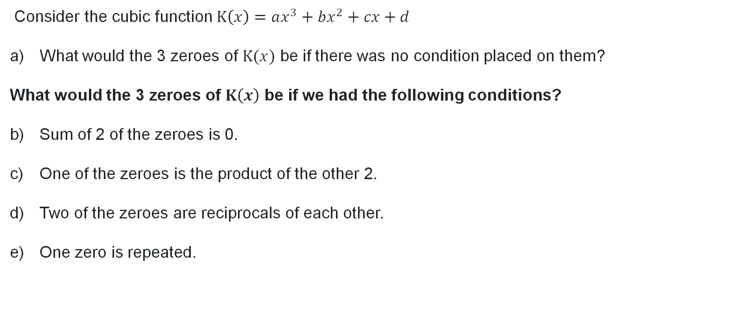
Forming identities with coefficients
Consider the cubic function $K\left(x\right)=ax^{3}+bx^{2}+cx+d$
What would the 3 zeroes of $K(x)$ be if there was no condition placed on them?
What would the 3 zeroes of $K\left(x\right)$ be if we had the following conditions?
Sum of 2 of the zeroes is 0.
One of the zeroes is the product of the other 2.
Two of the zeroes are reciprocals of each other.
One zero is repeated.

Slide 7
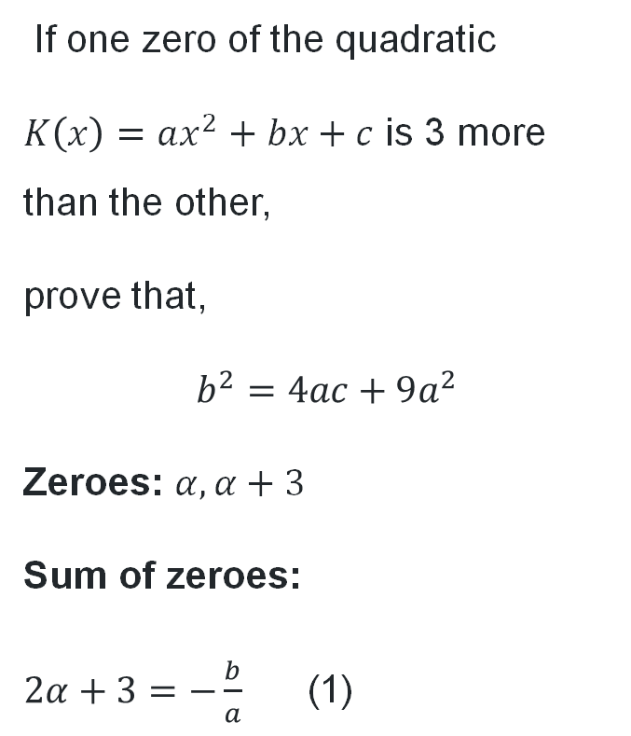
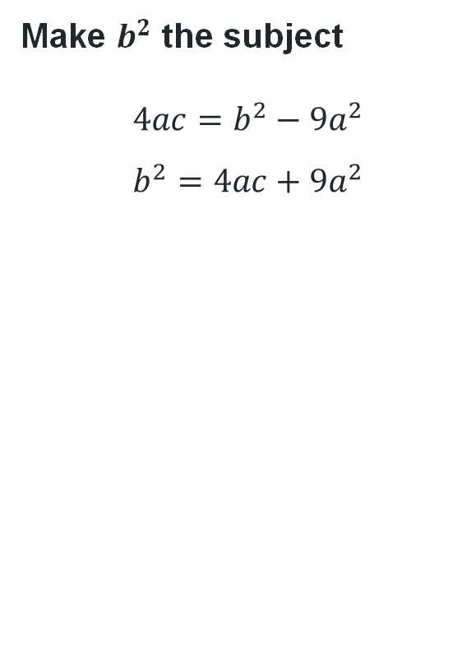
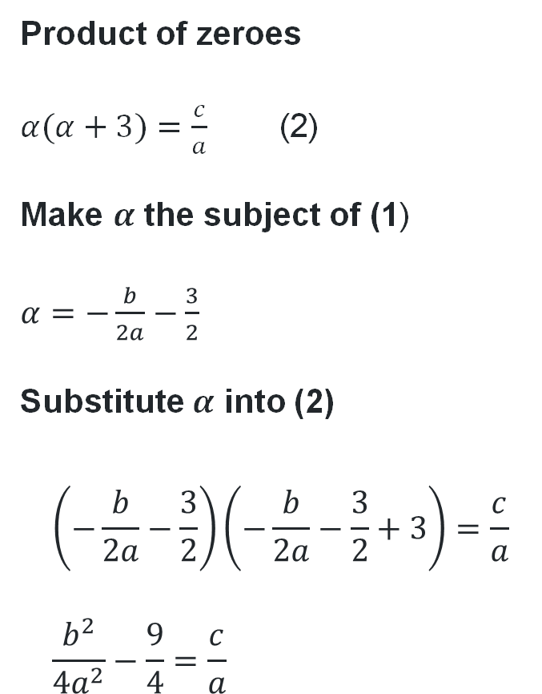
Forming identities with coefficients (1)
If one zero of the quadratic
$K\left(x\right)=ax^{2}+bx+c$ is 3 more than the other,
prove that,
$$b^{2}=4ac+9a^{2}$$
Zeroes: $α, α+3$
Sum of zeroes:
$2α+3=−\frac{b}{a}$ (1)
Product of zeroes
$α(α+3)=\frac{c}{a}$ (2)
Make $α$ the subject of (1)
$α=−\frac{b}{2a}−\frac{3}{2}$
Substitute $α$ into (2)
$$\left(−\frac{b}{2a}−\frac{3}{2}\right)\left(−\frac{b}{2a}−\frac{3}{2}+3\right)=\frac{c}{a} \\ \frac{b^{2}}{4a^{2}}−\frac{9}{4}=\frac{c}{a}$$
Make $b^{2}$ the subject
$$4ac=b^{2}−9a^{2} \\ b^{2}=4ac+9a^{2}$$

Slide 8
Releasing responsibility

Slide 9
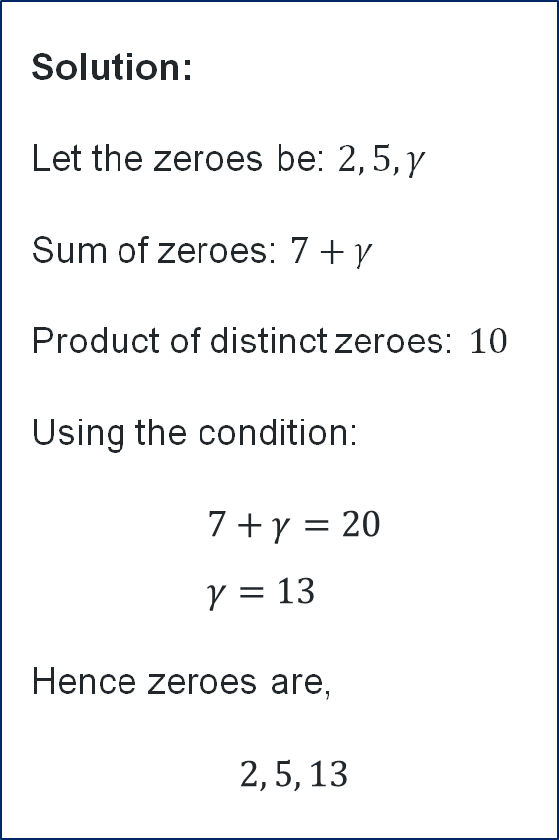
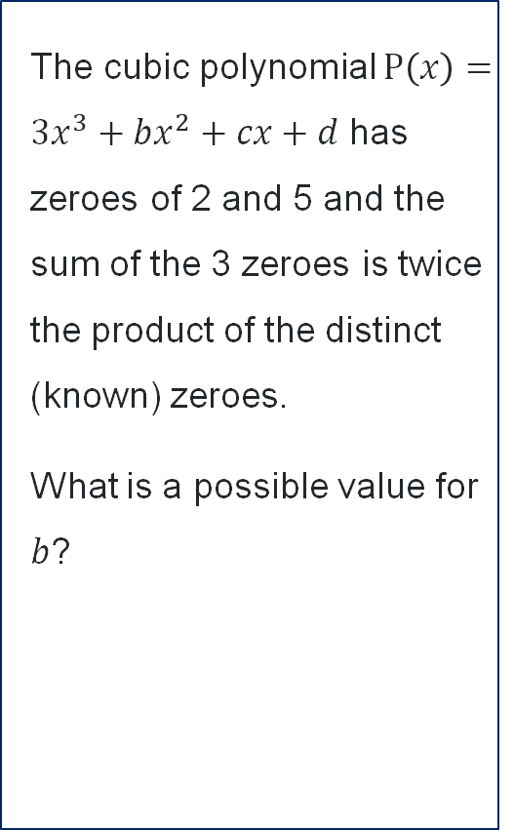

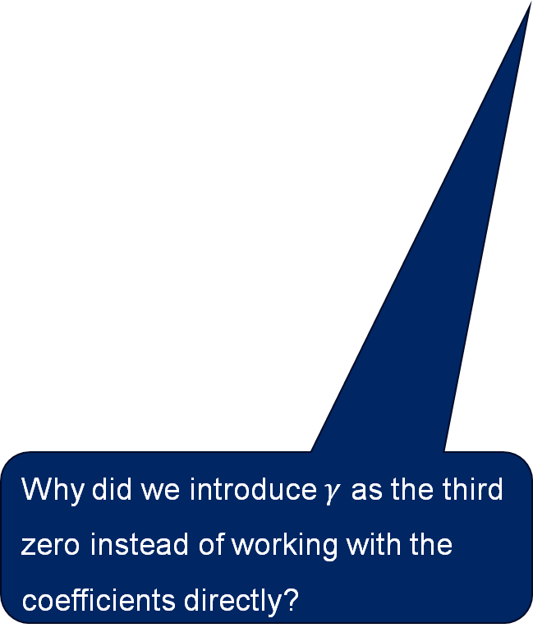
Worked example
The cubic polynomial $P\left(x\right)=3x^{3}+bx^{2}+cx+d$ has zeroes of 2 and 5 and the sum of the 3 zeroes is twice the product of the distinct (known) zeroes.
What is a possible value for $b$?
Solution:
Let the zeroes be: $2, 5, γ$
Sum of zeroes: $7+γ$
Product of distinct zeroes: $10$
Using the condition:
$$7+γ=20 \\ γ=13$$
Hence zeroes are,
$$2, 5, 13$$
Find $b$ via sum of zeroes
$$2+5+13=−\frac{b}{a} \\ 20=−\frac{b}{3} \\ b=−60$$
What if the condition said, ‘the sum of the zeroes is 3 times the product of the distinct zeroes?’
Why did we introduce $γ$ as the third zero instead of working with the coefficients directly?

Slide 10
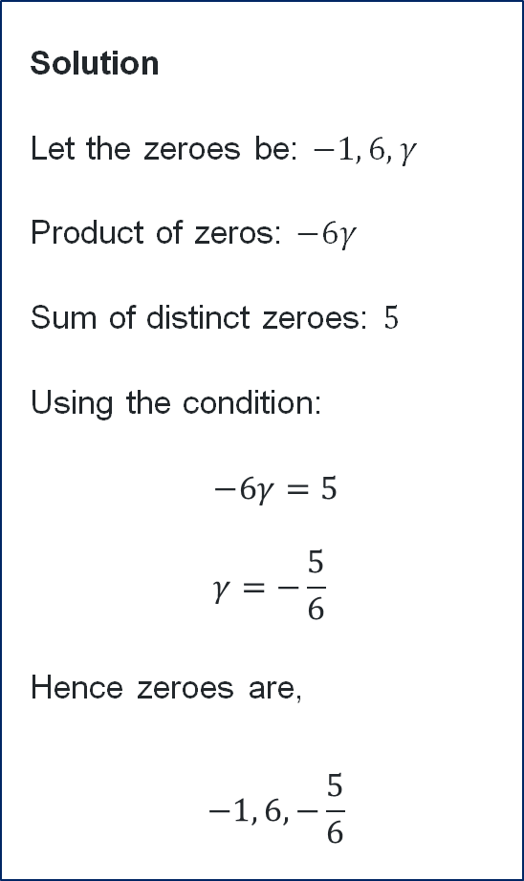
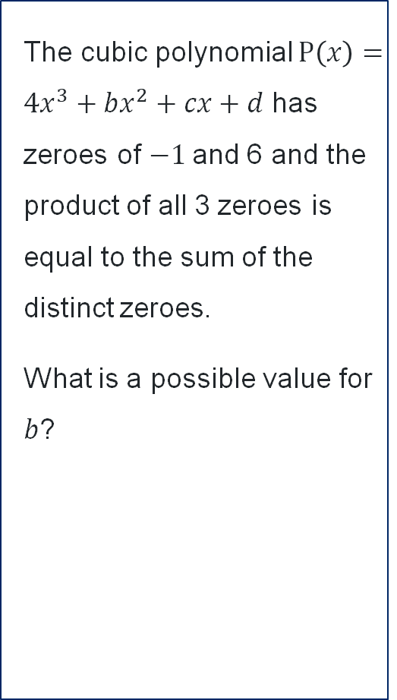

Your turn
The cubic polynomial $P\left(x\right)=4x^{3}+bx^{2}+cx+d$ has zeroes of $−1$and 6 and the product of all 3 zeroes is equal to the sum of the distinct zeroes.
What is a possible value for $b$?
Solution
Let the zeroes be: $−1, 6, γ$
Product of zeros: $−6γ$
Sum of distinct zeroes: $5$
Using the condition:
$$−6γ=5 \\ γ=−\frac{5}{6}$$
Hence zeroes are,
$$−1, 6, −\frac{5}{6}$$
Find $b$ via sum of roots
$$−1+6−\frac{5}{6}=−\frac{b}{4} \\ b=−\frac{50}{3}$$

Slide 11
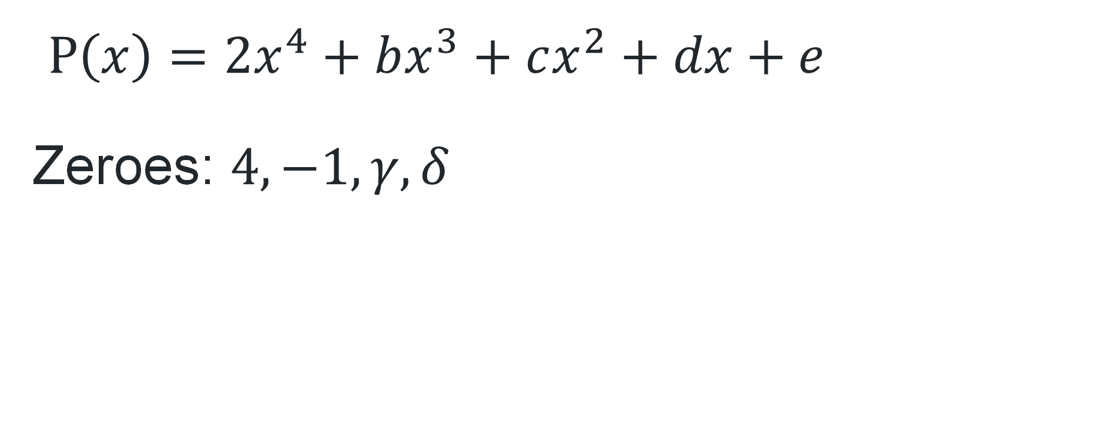
Banner task
$P\left(x\right)=2x^{4}+bx^{3}+cx^{2}+dx+e$
Zeroes: $4, −1, γ, δ$

Slide 12
Independent practice

Slide 13

Approaching questions scaffold

Slide 14
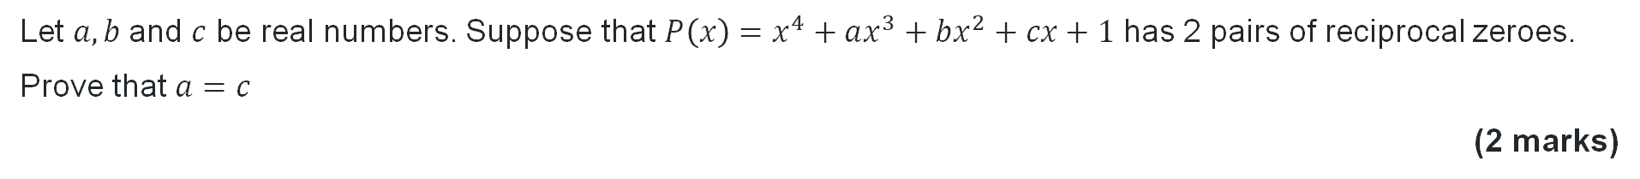
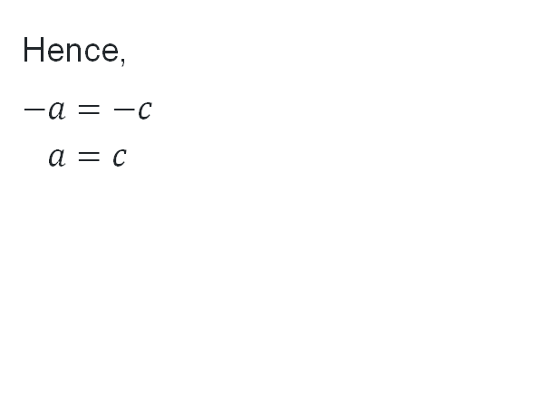
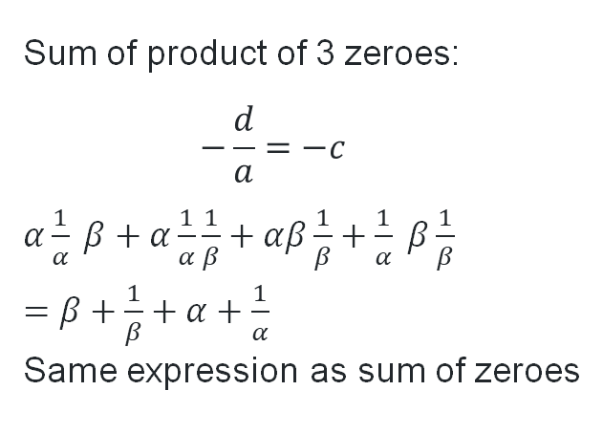
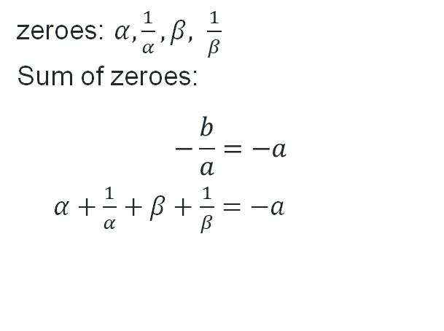
HSC-style question
Let $a, b$and $c$ be real numbers. Suppose that $P\left(x\right)=x^{4}+ax^{3}+bx^{2}+cx+1$ has 2 pairs of reciprocal zeroes.
Prove that $a=c$
(2 marks)
Criteria | Marks
Provides correct proof | 2
Attempts to use sum of the three-wise products of roots, or equivalent merit | 1
zeroes: $α,\frac{1}{α}, β, \frac{1}{β}$
Sum of zeroes:
$$−\frac{b}{a}=−a$$
$α+\frac{1}{α}+β+\frac{1}{β}=−a$
Sum of product of 3 zeroes:
$$−\frac{d}{a}=−c$$
$α\frac{1}{α} β+α\frac{1}{α}\frac{1}{β}+αβ\frac{1}{β}+\frac{1}{α} β\frac{1}{β}$
$=$ $β+\frac{1}{β}+α+\frac{1}{α}$
Same expression as sum of zeroes
Hence,
$$−a=−c \\ a=c$$

Slide 15
References
This presentation contains NSW Curriculum and syllabus content. The NSW Curriculum is developed by the NSW Education Standards Authority. This content is prepared by NESA for and on behalf of the Crown in the right of the State of New South Wales. The material is protected by Crown copyright.
Please refer to the NESA Copyright Disclaimer for more information https://educationstandards.nsw.edu.au/wps/portal/nesa/mini-footer/copyright.
NESA holds the only official and up-to-date versions of the NSW Curriculum and syllabus documents. Please visit the NSW Education Standards Authority (NESA) website https://educationstandards.nsw.edu.au/wps/portal/nesa/home and the NSW Curriculum website https://curriculum.nsw.edu.au.
Mathematics Extension 1 11-12 Syllabus © NSW Education Standards Authority (NESA) for and on behalf of the Crown in right of the State of New South Wales, 2024.

Slide 16
Copyright
© State of New South Wales (Department of Education), 2026
The copyright material published in this resource is subject to the Copyright Act 1968 (Cth) and is owned by the NSW Department of Education or, where indicated, by a party other than the NSW Department of Education (third-party material).
Copyright material available in this resource and owned by the NSW Department of Education is licensed under a Creative Commons Attribution 4.0 International (CC BY 4.0) license.
This license allows you to share and adapt the material for any purpose, even commercially.
Attribution should be given to © State of New South Wales (Department of Education), 2026.
Material in this resource not available under a Creative Commons license:
the NSW Department of Education logo, other logos and trademark-protected material
Material owned by a third party that has been reproduced with permission. You will need to obtain permission from the third party to reuse its material.
Links to third-party material and websites
Please note that the provided (reading/viewing material/list/links/texts) are a suggestion only and implies no endorsement, by the New South Wales Department of Education, of any author, publisher, or book title. School principals and teachers are best placed to assess the suitability of resources that would complement the curriculum and reflect the needs and interests of their students.
If you use the links provided in this document to access a third-party’s website, you acknowledge that the terms of use, including licence terms set out on the third-party’s website apply to the use which may be made of the materials on that third-party website or where permitted by the Copyright Act 1968 (Cth). The department accepts no responsibility for content on third-party websites.

