Slide 1

Relationship between zeroes
Mathematics Extension 1 – Stage 6 (Year 11)
Polynomials

Slide 2
Learning intention and success criteria
Learning intention
To be able to use the relationships between coefficients and zeroes to analyse and solve problems involving the roots of quadratic, cubic and quartic polynomials.
Success criteria
I can use the relationships between coefficients and zeroes to determine unknown roots of quadratic, cubic and quartic polynomials.
I can manipulate expressions involving zeroes using symmetric sums and algebraic identities.
I can apply sums and products of zeroes to solve non-routine problems, including those involving conditions on zeroes or geometric contexts.

Slide 3
Retrieval practice

Slide 4

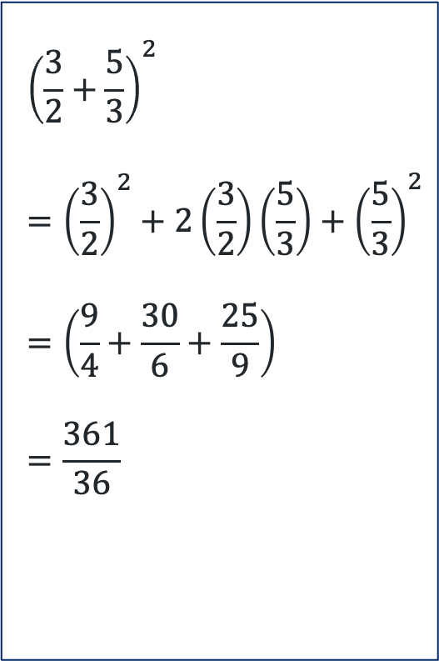

Expand and simplify the following (1)
Without using a calculator
${\left(x+3\right)}^{2}$
$=x^{2}+6x+9$
${\left(p+q\right)}^{2}−2pq$
$=p^{2}+2pq+q^{2}−2pq$
$=p^{2}+q^{2}$
$${\left(\frac{3}{2}+\frac{5}{3}\right)}^{2} \\ ={\left(\frac{3}{2}\right)}^{2}+2\left(\frac{3}{2}\right)\left(\frac{5}{3}\right)+{\left(\frac{5}{3}\right)}^{2} \\ =\left(\frac{9}{4}+\frac{30}{6}+\frac{25}{9}\right) \\ =\frac{361}{36}$$

Slide 5
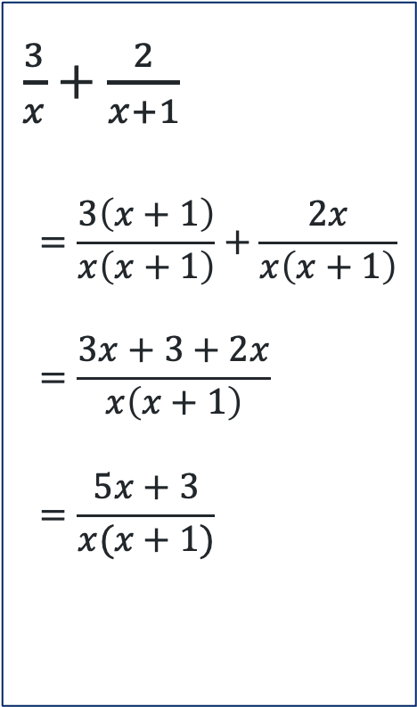
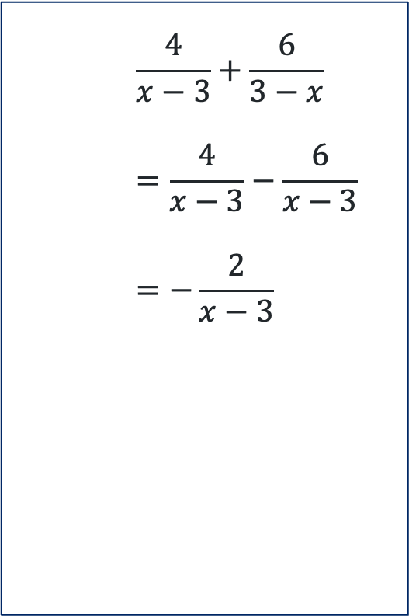
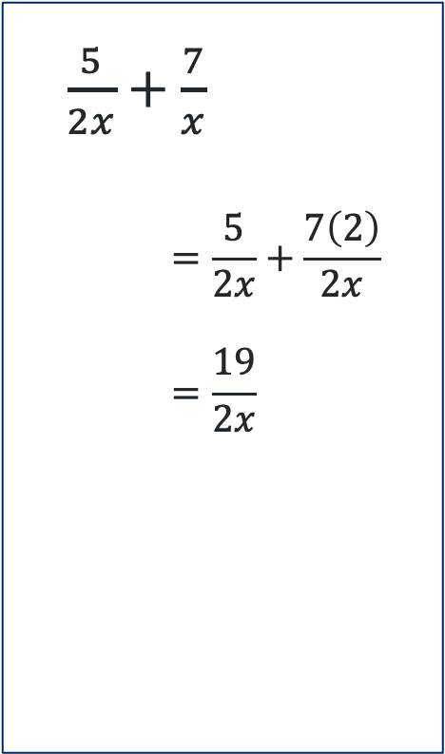
Expand and simplify the following (2)
Without using a calculator
$\frac{3}{x}+\frac{2}{x+1}$
$$=\frac{3\left(x+1\right)}{x\left(x+1\right)}+\frac{2x}{x\left(x+1\right)} \\ =\frac{3x+3+2x}{x\left(x+1\right)} \\ =\frac{5x+3}{x(x+1)}$$
$\frac{5}{2x}+\frac{7}{x}$
$$=\frac{5}{2x}+\frac{7\left(2\right)}{2x} \\ =\frac{19}{2x}$$
$$\frac{4}{x−3}+\frac{6}{3−x} \\ =\frac{4}{x−3}−\frac{6}{x−3} \\ =−\frac{2}{x−3}$$

Slide 6
Connecting learning

Slide 7



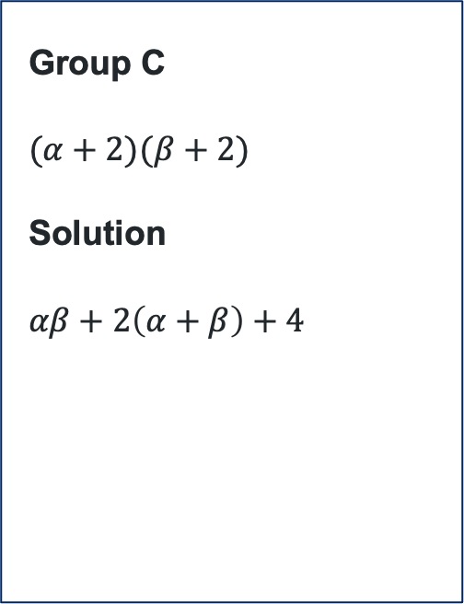
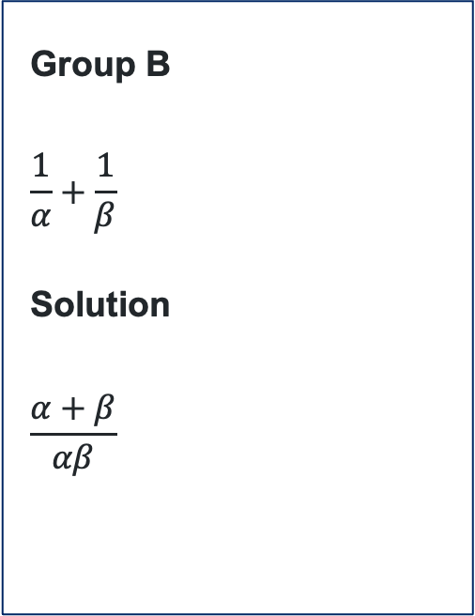
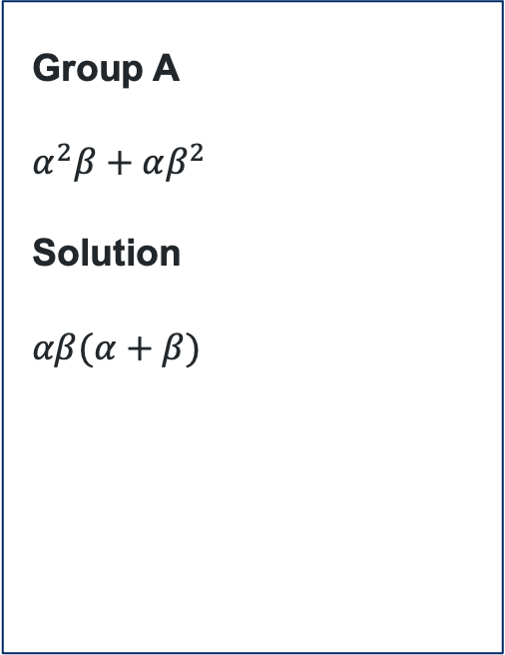
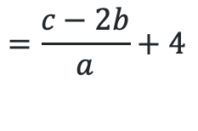
Using sums and products (1)
Quadratic zeroes
Express the following in terms of $α+β$ and $αβ$.
Now, express you solution in terms of $a, b$ and $c$.
Group A
$$α^{2}β+αβ^{2}$$
Solution
$$αβ(α+β)$$
Group B
$$\frac{1}{α}+\frac{1}{β}$$
Solution
$$\frac{α+β}{αβ}$$
Group C
$$(α+2)(β+2)$$
Solution
$$αβ+2\left(α+β\right)+4$$
$$=−\frac{cb}{a^{2}}$$
$$=\frac{c−2b}{a}+4$$
$$=−\frac{b}{c}$$

Slide 8
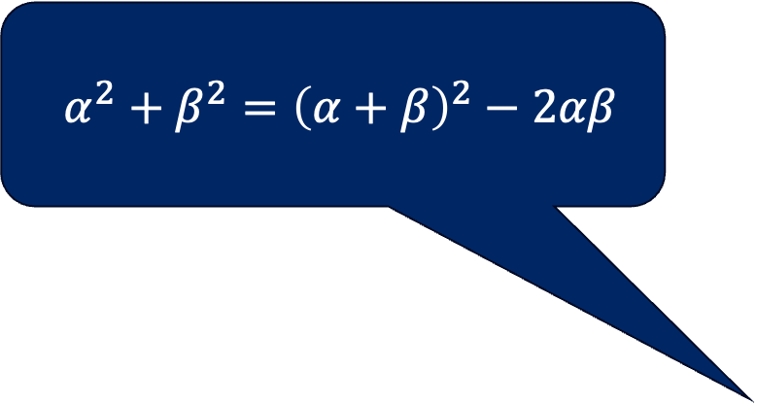
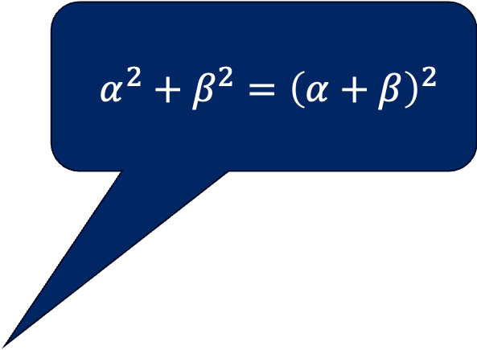
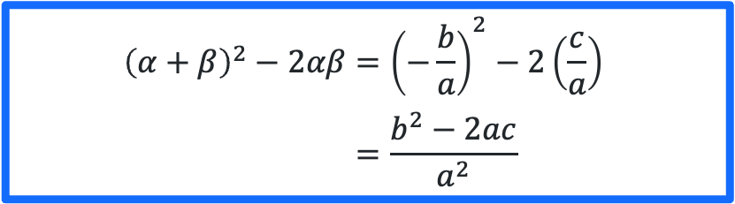
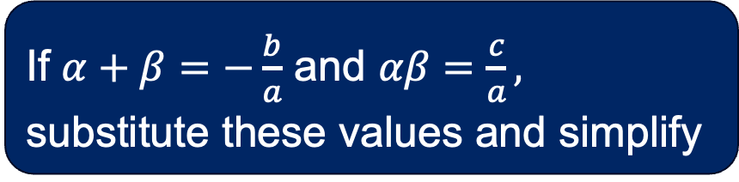
Manipulating the roots
Quadratic zeroes
Determine which statement is correct
$$α^{2}+β^{2}={\left(α+β\right)}^{2}$$
$$α^{2}+β^{2}={\left(α+β\right)}^{2}−2αβ$$
If $α+β=−\frac{b}{a}$ and $αβ=\frac{c}{a},$ substitute these values and simplify
$${\left(α+β\right)}^{2}−2αβ={\left(−\frac{b}{a}\right)}^{2}−2\left(\frac{c}{a}\right) \\ =\frac{b^{2}−2ac}{a^{2}}$$

Slide 9
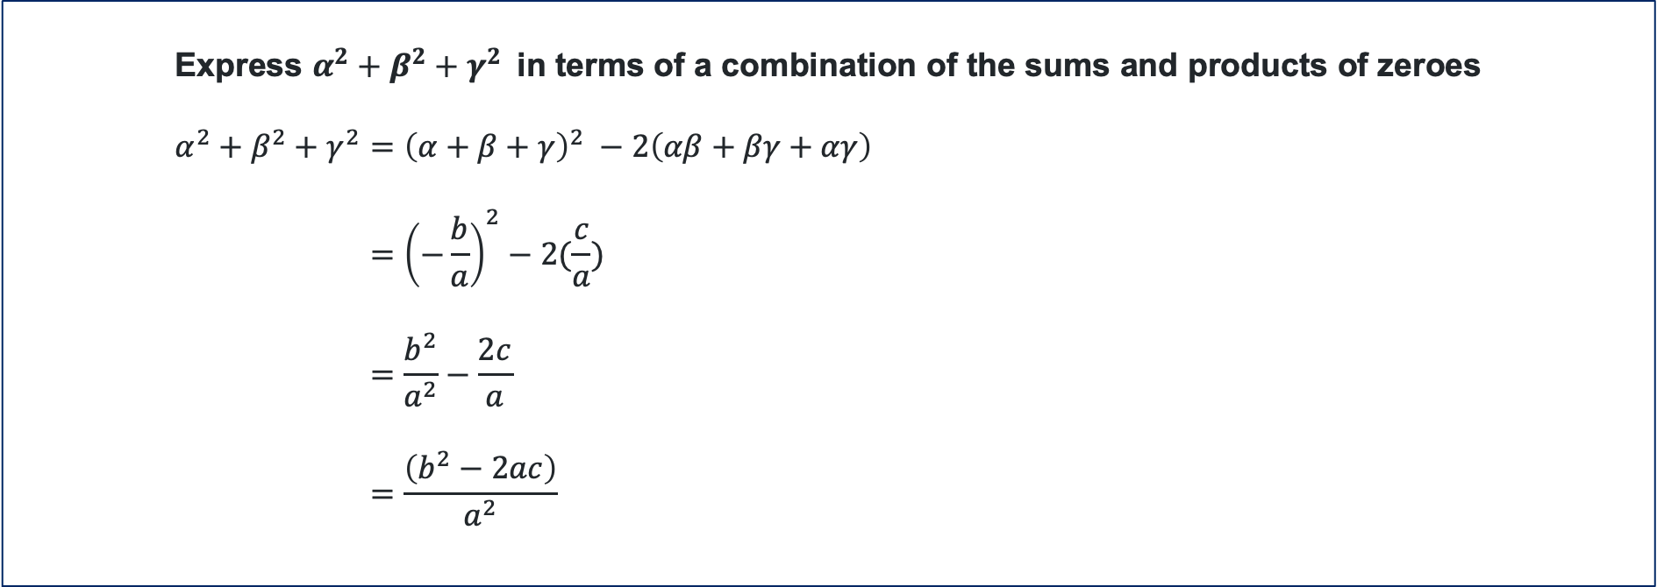
Using sums and products (2)
Cubic zeroes
Consider the manipulation of $α^{2}+β^{2}$and $α^{2}+β^{2}+γ^{2}$
Express $α^{2}+β^{2}+γ^{2}$in terms of a combination of the sums and products of zeroes
$$α^{2}+β^{2}+γ^{2}={\left(α+β+γ\right)}^{2} −2\left(αβ+βγ+αγ\right) \\ ={\left(−\frac{b}{a}\right)}^{2}−2(\frac{c}{a}) \\ =\frac{b^{2}}{a^{2}}−\frac{2c}{a} \\ =\frac{\left(b^{2}−2ac\right)}{a^{2}}$$

Slide 10


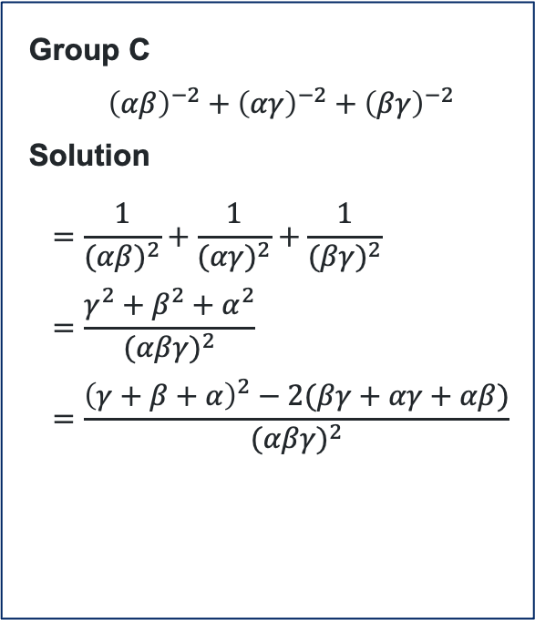
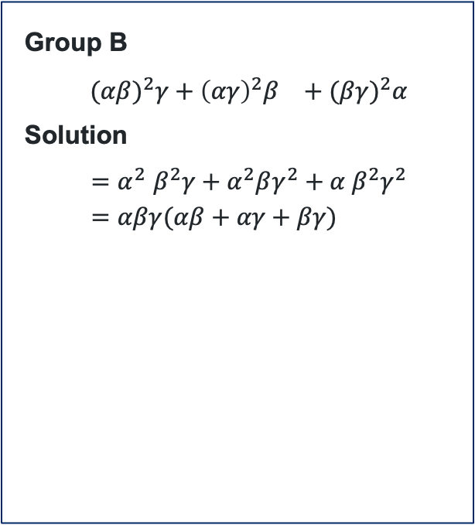
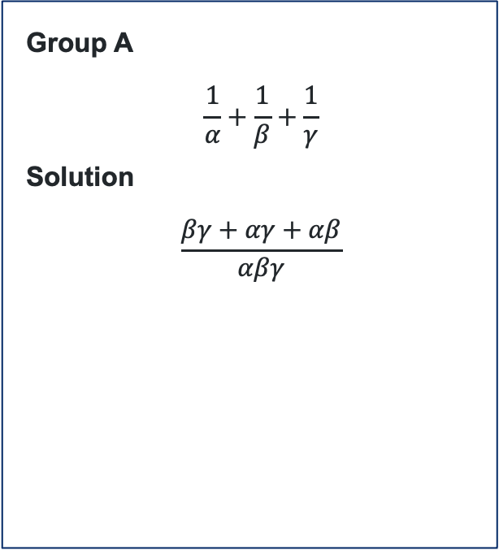

Using sums and products (3)
Cubic zeroes
Express the following in terms of a combination of the sums and products of zeroes and in terms of$a, b, c$ and $d$.
Group A
$$\frac{1}{α}+\frac{1}{β}+\frac{1}{γ}$$
Solution
$$\frac{βγ+αγ+αβ}{αβγ}$$
Group B
$${(αβ)}^{2}γ+{{\left(αγ\right)}^{2}β}^{}+{(βγ)}^{2}α$$
Solution
$${=α}^{2}β^{2}γ+α^{2}βγ^{2}+α β^{2}γ^{2} \\ =αβγ(αβ+αγ+βγ)$$
Group C
$${\left(αβ\right)}^{−2}+{\left(αγ\right)}^{−2}+{\left(βγ\right)}^{−2}$$
Solution
$$=\frac{1}{{(αβ)}^{2}}+\frac{1}{{(αγ)}^{2}}+\frac{1}{{(βγ)}^{2}} \\ =\frac{γ^{2}+β^{2}+α^{2}}{{(αβγ)}^{2}} \\ =\frac{{\left(γ+β+α\right)}^{2}−2(βγ+αγ+αβ)}{{(αβγ)}^{2}}$$
$$=−\frac{cd}{a^{2}}$$
$$=−\frac{c}{d}$$
$$=−\frac{b^{2}−2ac}{d^{2}}$$

Slide 11

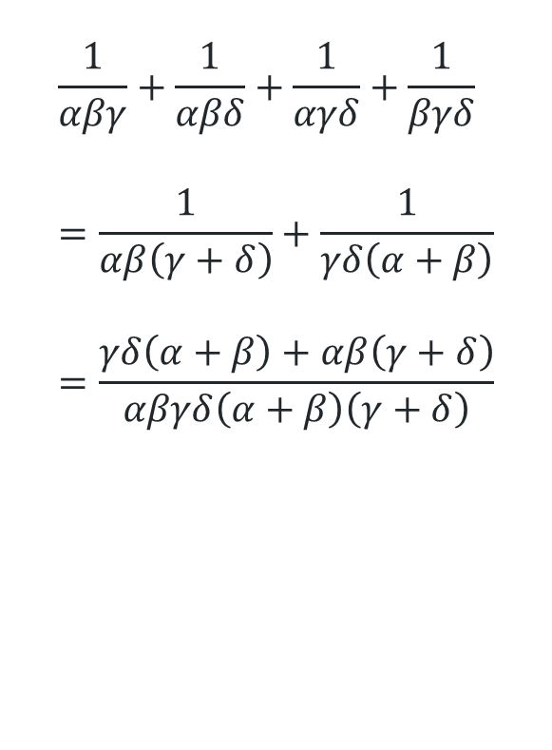
Using sum and products (4)
Quartic zeroes – Find the error
$$\frac{1}{αβγ}+\frac{1}{αβδ}+\frac{1}{αγδ}+\frac{1}{βγδ} \\ =\frac{1}{αβ\left(γ+δ\right)}+\frac{1}{γδ\left(α+β\right)} \\ =\frac{γδ\left(α+β\right)+αβ\left(γ+δ\right)}{αβγδ\left(α+β\right)\left(γ+δ\right)}$$
$$\frac{1}{αβγ}+\frac{1}{αβδ}+\frac{1}{αγδ}+\frac{1}{βγδ} \\ =\frac{δ}{αβγδ}+\frac{γ}{αβγδ}+\frac{β}{αβγδ}+\frac{α}{αβγδ} \\ =\frac{α+β+γ+δ}{αβγδ}$$
The denominators were changed by adding factors instead of keeping them multiplied, so the fractions were not added correctly.

Slide 12
Releasing responsibility

Slide 13
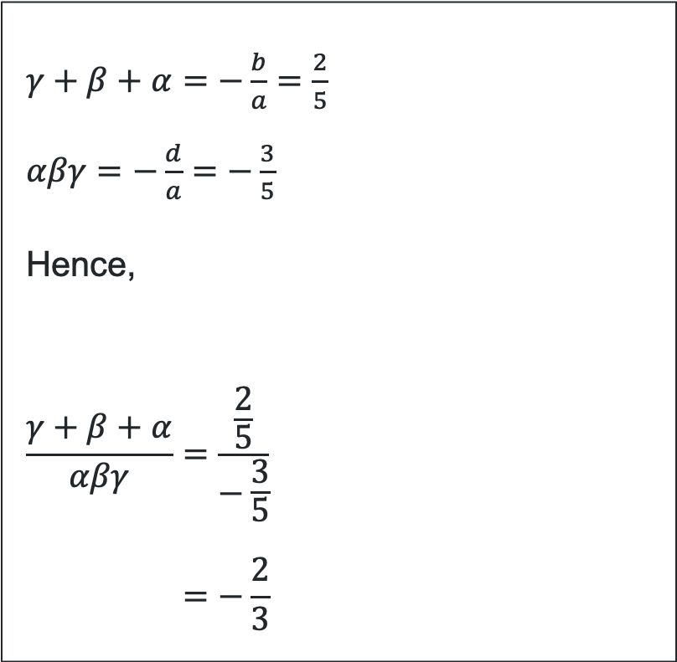
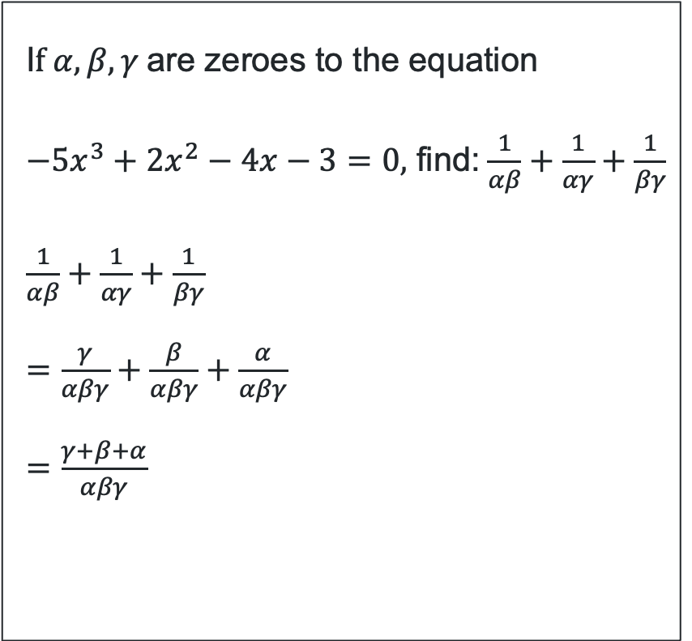
Worked example
I$f α, β, γ$are zeroes to the equation
$−5x^{3}+2x^{2}−4x−3=0,$ find:$\frac{1}{αβ}+\frac{1}{αγ}+\frac{1}{βγ}$
$\frac{1}{αβ}+\frac{1}{αγ}+\frac{1}{βγ}$
$=\frac{γ}{αβγ}+\frac{β}{αβγ}+\frac{α}{αβγ}$
$=\frac{γ+β+α}{αβγ}$
$γ+β+α=−\frac{b}{a}=\frac{2}{5}$
$αβγ=−\frac{d}{a}=−\frac{3}{5}$
Hence,
$$\frac{γ+β+α}{αβγ}=\frac{\frac{2}{5}}{−\frac{3}{5}} \\ =−\frac{2}{3}$$
How did we get these values?
How did we get this expression?

Slide 14
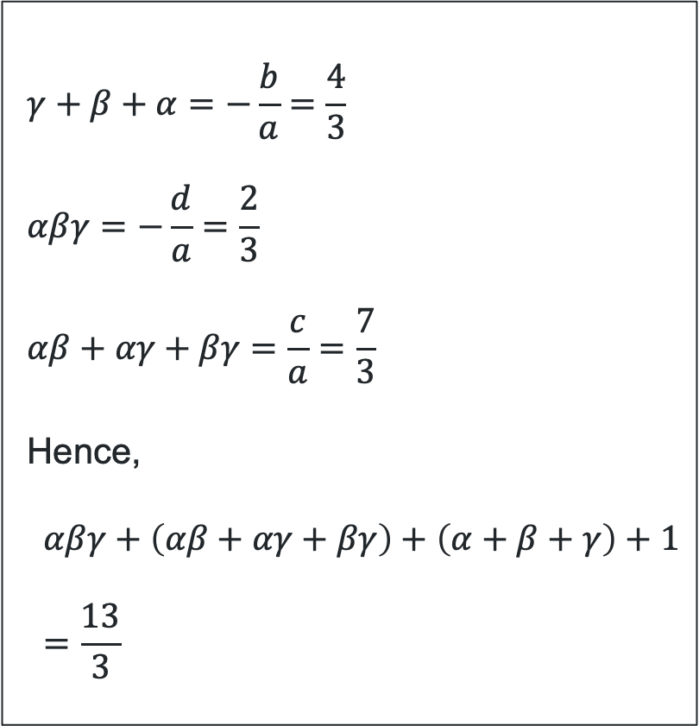
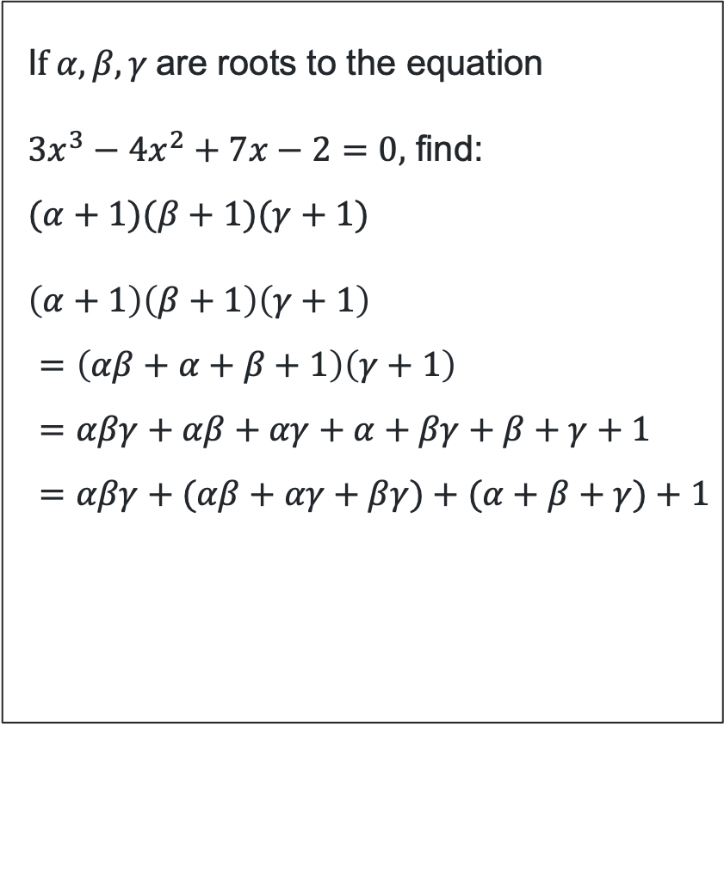
Your turn
I$f α, β, γ$are roots to the equation
$3x^{3}−4x^{2}+7x−2=0,$ find:
$$(α+1)(β+1)(γ+1)$$
$\left(α+1\right)\left(β+1\right)\left(γ+1\right)$
$$=\left(αβ+α+β+1\right)\left(γ+1\right) \\ =αβγ+αβ+αγ+α+βγ+β+γ+1 \\ =αβγ+(αβ+αγ+βγ)+(α+β+γ)+1$$
$$γ+β+α=−\frac{b}{a}=\frac{4}{3} \\ αβγ=−\frac{d}{a}=\frac{2}{3} \\ αβ+αγ+βγ=\frac{c}{a}=\frac{7}{3}$$
Hence,
$$αβγ+\left(αβ+αγ+βγ\right)+\left(α+β+γ\right)+1 \\ =\frac{13}{3}$$

Slide 15
Independent practice

Slide 16

Approaching questions scaffold
…..

Slide 17


HSC-style question (1)
A polynomial equation has zeroes $α, β, γ$where,
$$α+β+γ=−2 , αβ+αγ+βγ=3, αβγ=1$$
Which polynomial equation has zeroes $α, β$ and $γ$?
$x^{3}+2x^{2}+3x+1=0$
$x^{3}+2x^{2}+3x−1=0$
$x^{3}−2x^{2}+3x+1=0$
$x^{3}−2x^{2}+3x−1=0$
Solution
Consider (A) → $αβγ=−\frac{d}{a}=−1≠$given $αβγ$
Consider (B) → $αβγ=1,αβ+αγ+βγ=\frac{c}{a}=3,α+β+γ=−\frac{b}{a}=−2$
Consider (C) → $α+β+γ=2 ≠$ given $α+β+γ$, $αβγ=−1≠$ given $αβγ$
Consider (D) → $α+β+γ=2≠$ given $α+β+γ$

Slide 18
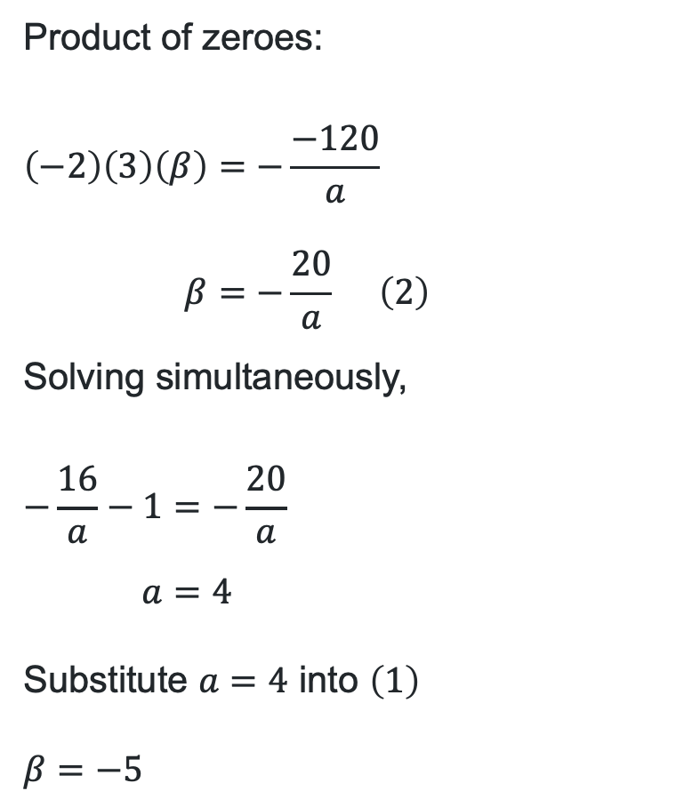
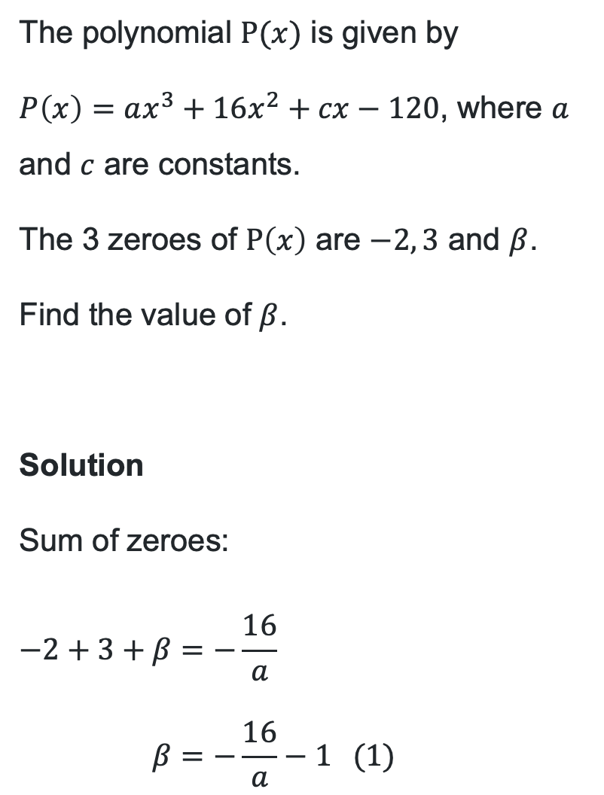
HSC-style question (2)
The polynomial $P(x)$ is given by
$P\left(x\right)=ax^{3}+16x^{2}+cx−120$, where $a$ and $c$ are constants.
The 3 zeroes of $P\left(x\right)$ are $−2, 3$ and $β$.
Find the value of $β$.
Solution
Sum of zeroes:
$$−2+3+β=−\frac{16}{a} \\ β=−\frac{16}{a}−1 (1)$$
Product of zeroes:
$$\left(−2\right)\left(3\right)\left(β\right)=−\frac{−120}{a} \\ β=−\frac{20}{a} \left(2\right)$$
Solving simultaneously,
$$−\frac{16}{a}−1=−\frac{20}{a} \\ a=4$$
Substitute $a=4$ into $\left(1\right)$
$$β=−5$$

Slide 19
References
This presentation contains NSW Curriculum and syllabus content. The NSW Curriculum is developed by the NSW Education Standards Authority. This content is prepared by NESA for and on behalf of the Crown in the right of the State of New South Wales. The material is protected by Crown copyright.
Please refer to the NESA Copyright Disclaimer for more information https://educationstandards.nsw.edu.au/wps/portal/nesa/mini-footer/copyright.
NESA holds the only official and up-to-date versions of the NSW Curriculum and syllabus documents. Please visit the NSW Education Standards Authority (NESA) website https://educationstandards.nsw.edu.au/wps/portal/nesa/home and the NSW Curriculum website https://curriculum.nsw.edu.au.
Mathematics Extension 1 11-12 Syllabus © NSW Education Standards Authority (NESA) for and on behalf of the Crown in right of the State of New South Wales, 2024.

Slide 20
Copyright
© State of New South Wales (Department of Education), 2026
The copyright material published in this resource is subject to the Copyright Act 1968 (Cth) and is owned by the NSW Department of Education or, where indicated, by a party other than the NSW Department of Education (third-party material).
Copyright material available in this resource and owned by the NSW Department of Education is licensed under a Creative Commons Attribution 4.0 International (CC BY 4.0) license.
This license allows you to share and adapt the material for any purpose, even commercially.
Attribution should be given to © State of New South Wales (Department of Education), 2026.
Material in this resource not available under a Creative Commons license:
the NSW Department of Education logo, other logos and trademark-protected material
Material owned by a third party that has been reproduced with permission. You will need to obtain permission from the third party to reuse its material.
Links to third-party material and websites
Please note that the provided (reading/viewing material/list/links/texts) are a suggestion only and implies no endorsement, by the New South Wales Department of Education, of any author, publisher, or book title. School principals and teachers are best placed to assess the suitability of resources that would complement the curriculum and reflect the needs and interests of their students.
If you use the links provided in this document to access a third-party’s website, you acknowledge that the terms of use, including licence terms set out on the third-party’s website apply to the use which may be made of the materials on that third-party website or where permitted by the Copyright Act 1968 (Cth). The department accepts no responsibility for content on third-party websites.

