Slide 1
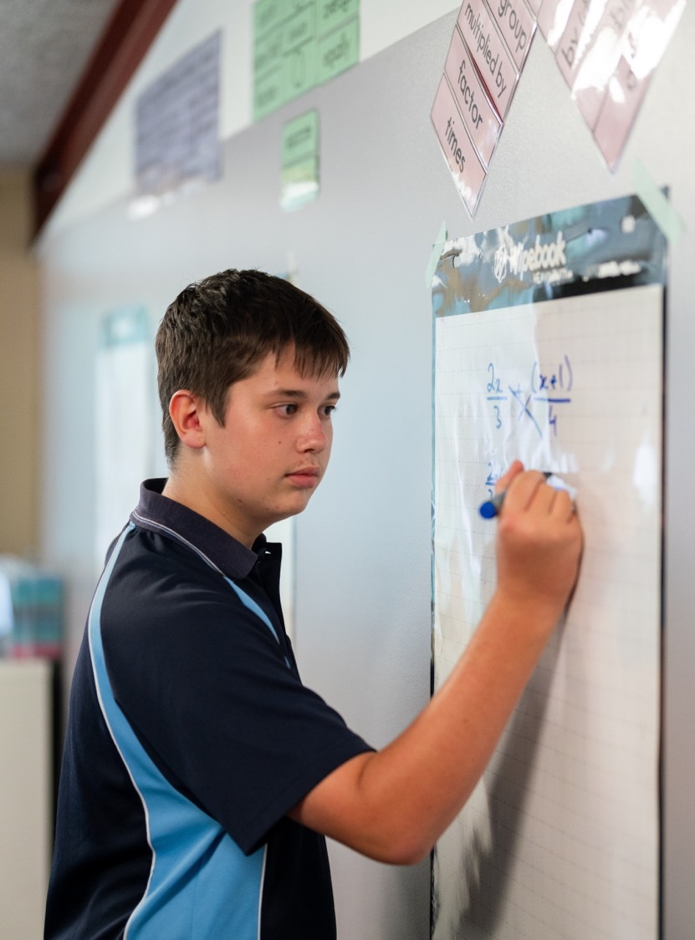
Sum and product of zeroes
Mathematics Extension 1 – Stage 6 (Year 11)
Polynomials

Slide 2
Learning intention and success criteria
Learning intention
To understand the connection between the zeroes of a polynomial and its equation in expanded form.
Success criteria
I can derive the formula for the sum and product of the zeroes of a quadratic polynomial.
I can prove the relationships between the coefficients and zeroes of a cubic polynomial using algebraic manipulation.
I can prove the relationships between the coefficients and zeroes of a quartic polynomial using algebraic manipulation.
I can use the sum and product of the zeroes of quadratic, cubic and quartic polynomials.

Slide 3
Retrieval practice

Slide 4
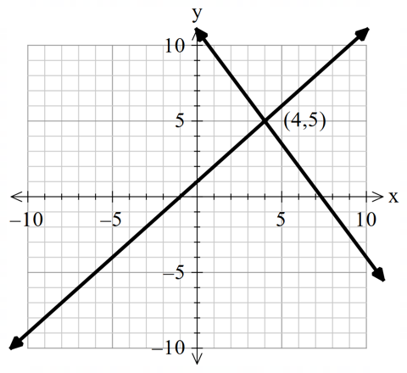
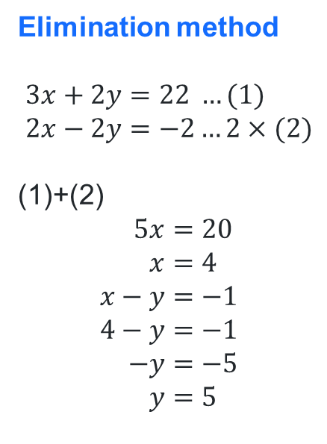
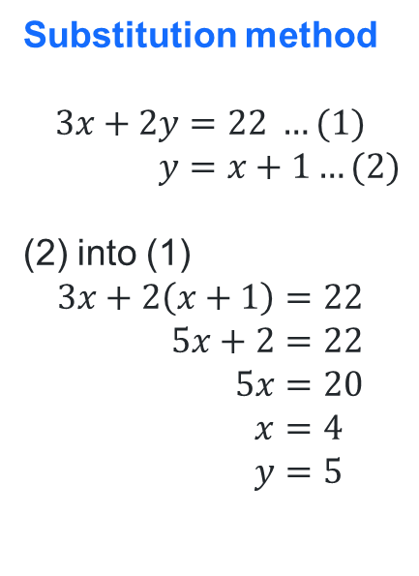
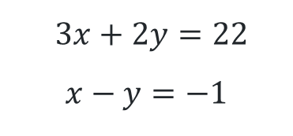
Solve these equations
$3x+2y=22$
$$x−y=−1$$
Substitution method
$$3x+2y=22 …(1) \\ y=x+1…(2)$$
(2) into (1)
$$3x+2\left(x+1\right)=22 \\ 5x+2=22 \\ 5x=20 \\ x=4 \\ y=5$$
Elimination method
$$3x+2y=22 …(1) \\ 2x−2y=−2…2×(2)$$
(1)+(2)
$$5x=20 \\ x=4 \\ x−y=−1 \\ 4−y=−1 \\ −y=−5 \\ y=5$$
Graphical method

Slide 5
Connecting learning

Slide 6
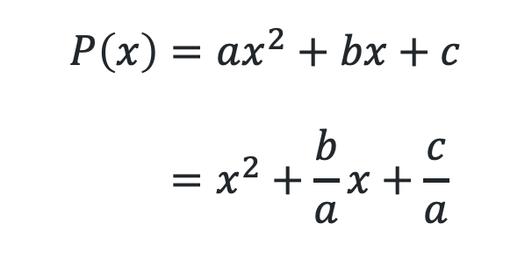
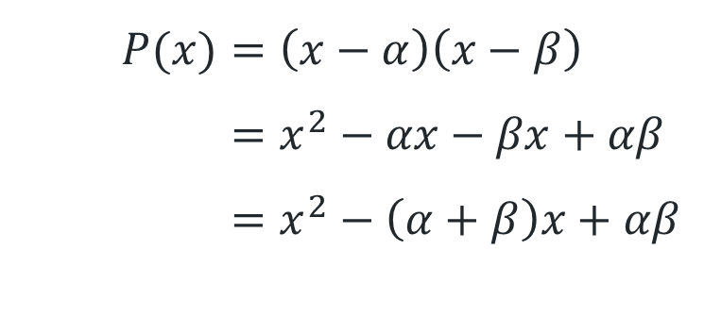
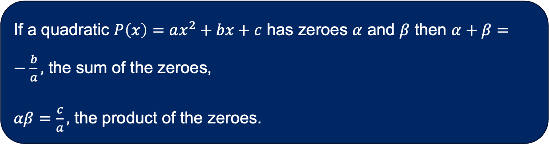
Quadratics (1)
Equating coefficients
$$P(x)=\left(x−α\right)\left(x−β\right) \\ =x^{2}−αx−βx+αβ \\ =x^{2}−\left(α+β\right)x+αβ$$
$$P\left(x\right)=ax^{2}+bx+c \\ =x^{2}+\frac{b}{a}x+\frac{c}{a}$$
If a quadratic $P\left(x\right)=ax^{2}+bx+c$ has zeroes $α$ and $β$ then $α+β=−\frac{b}{a},$ the sum of the zeroes,
$αβ=\frac{c}{a},$ the product of the zeroes.

Slide 7
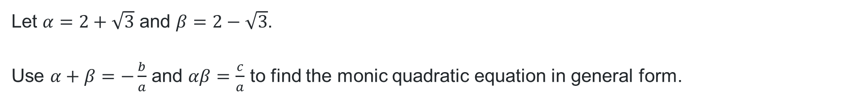
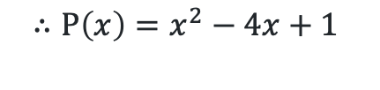
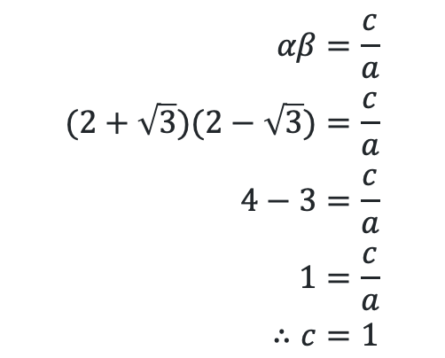
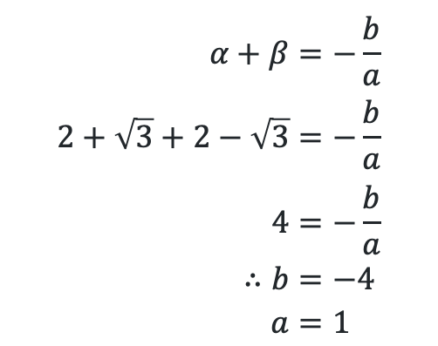
Quadratics (2)
Using the sum and product of zeroes
Let $α=2+\sqrt{3}$ and $β=2−\sqrt{3}$.
Use $α+β=−\frac{b}{a}$ and $αβ=\frac{c}{a}$ to find the monic quadratic equation in general form.
$$α+β=−\frac{b}{a} \\ 2+\sqrt{3}+2−\sqrt{3}=−\frac{b}{a} \\ 4=−\frac{b}{a} \\ ∴b=−4 \\ a=1$$
$$αβ=\frac{c}{a} \\ (2+\sqrt{3})(2−\sqrt{3})=\frac{c}{a} \\ 4−3=\frac{c}{a} \\ 1=\frac{c}{a} \\ ∴c=1$$
$$∴P\left(x\right)=x^{2}−4x+1$$

Slide 8
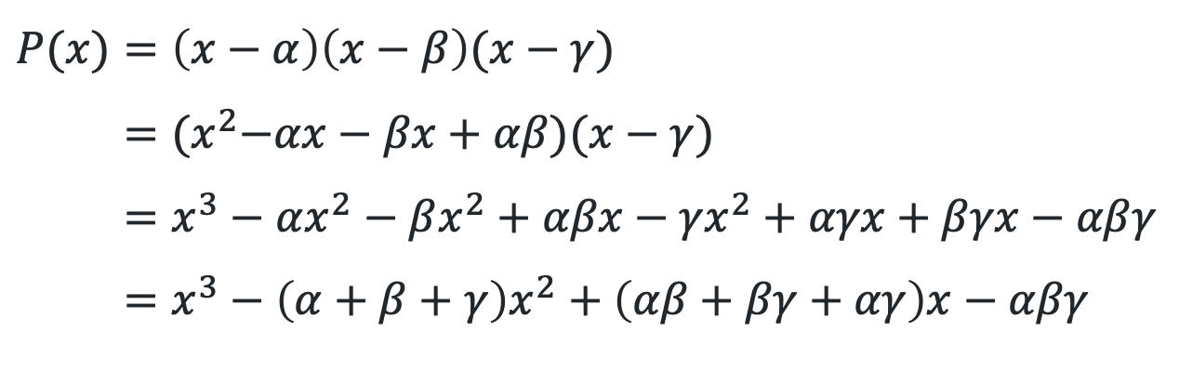
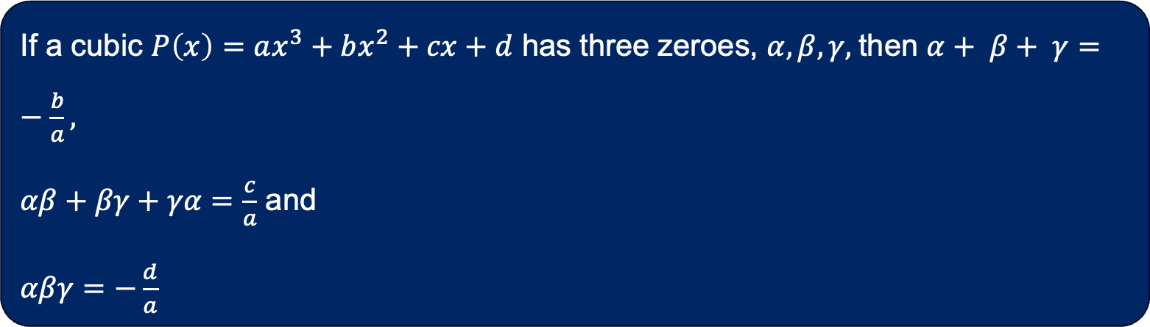
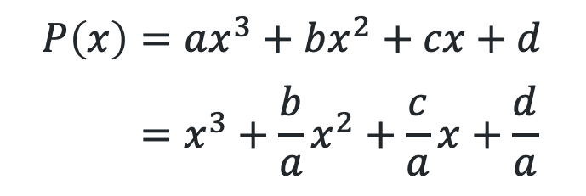
Cubic polynomials
Equating coefficients
$$P(x)=\left(x−α\right)\left(x−β\right)(x−γ) \\ ={(x}^{2}−αx−βx+αβ)(x−γ) \\ =x^{3}−αx^{2}−βx^{2}+αβx−{γx}^{2}+αγx+βγx−αβγ \\ =x^{3}−\left(α+β+γ\right)x^{2}+\left(αβ+βγ+αγ\right)x−αβγ$$
$$P\left(x\right)=ax^{3}+bx^{2}+cx+d \\ =x^{3}+\frac{b}{a}x^{2}+\frac{c}{a}x+\frac{d}{a}$$
If a cubic $P\left(x\right)=ax^{3}+bx^{2}+cx+d$ has three zeroes, $α, β, γ,$then $α+ β+ γ=−\frac{b}{a},$
$αβ+βγ+γα=\frac{c}{a}$ and
$αβγ=−\frac{d}{a}$

Slide 9
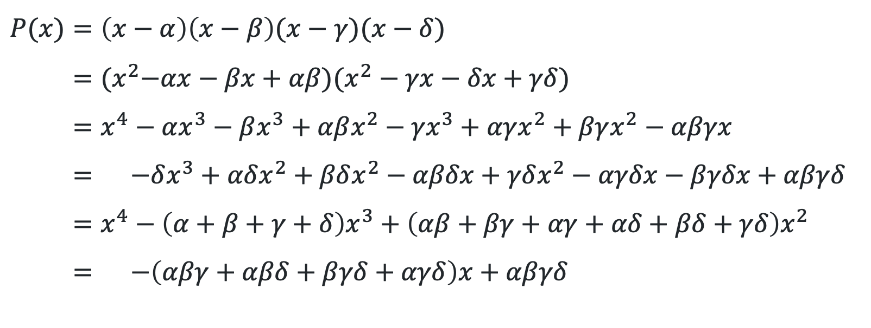
Quartic polynomials (1)
Equating coefficients
$$P(x)=\left(x−α\right)\left(x−β\right)(x−γ)(x−δ) \\ ={(x}^{2}−αx−βx+αβ)(x^{2}−γx−δx+γδ) \\ =x^{4}−αx^{3}−βx^{3}+αβx^{2}−{γx}^{3}+αγx^{2}+βγx^{2}−αβγx \\ = −δx^{3}+αδx^{2}+βδx^{2}−αβδx+γδx^{2}−αγδx−βγδx+αβγδ \\ =x^{4}−\left(α+β+γ+δ\right)x^{3}+\left(αβ+βγ+αγ+αδ+βδ+γδ\right)x^{2} \\ = −\left(αβγ+αβδ+βγδ+αγδ\right)x+αβγδ$$

Slide 10
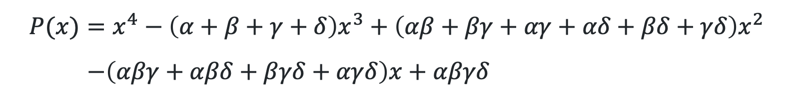
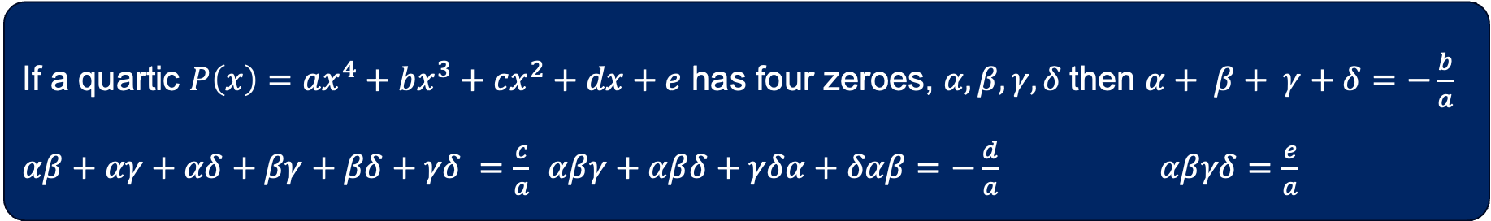
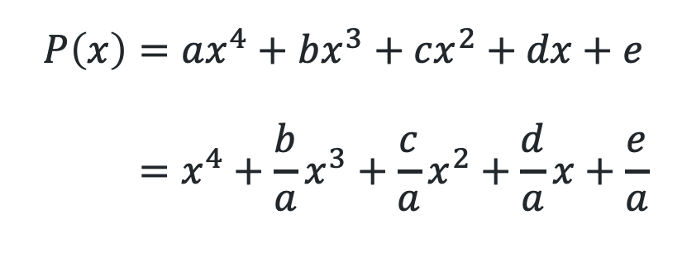
Quartic polynomials (2)
Equating coefficients
$$P(x)=x^{4}−\left(α+β+γ+δ\right)x^{3}+\left(αβ+βγ+αγ+αδ+βδ+γδ\right)x^{2} \\ −\left(αβγ+αβδ+βγδ+αγδ\right)x+αβγδ$$
$$P\left(x\right)=ax^{4}+bx^{3}+cx^{2}+dx+e \\ =x^{4}+\frac{b}{a}x^{3}+\frac{c}{a}x^{2}+\frac{d}{a}x+\frac{e}{a}$$
If a quartic $P\left(x\right)=ax^{4}+bx^{3}+cx^{2}+dx+e$ has four zeroes, $α, β, γ,δ$then $α+ β+ γ+δ=−\frac{b}{a}$ $αβ+αγ+αδ+βγ+βδ+γδ =\frac{c}{a}$ $αβγ+αβδ+γδα+δαβ=−\frac{d}{a}$ $αβγδ=\frac{e}{a}$

Slide 11
Releasing responsibility

Slide 12

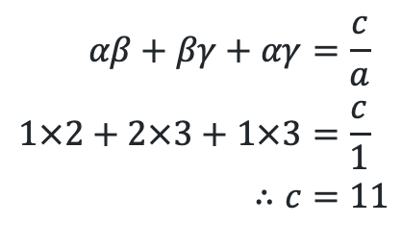


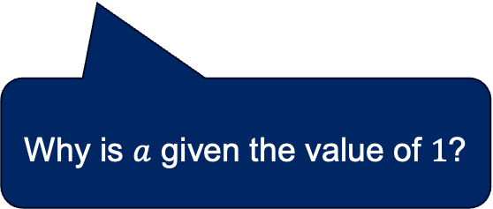

Finding a cubic equation (1)
Worked example 1
What would be different if there were 4 zeroes or just 2?
Find the monic cubic polynomial with zeroes $1, 2$and $3$.
Let $α,β$ and $γ$ be the zeroes of $P\left(x\right)={ax}^{3}+bx^{2}+cx+d$.
$$α+β+γ=−\frac{b}{a} \\ 1+2+3=−\frac{b}{a} \\ ∴b=−6 \\ a=1$$
$$αβ+βγ+αγ=\frac{c}{a} \\ 1×2+2×3+1×3=\frac{c}{1} \\ ∴c=11$$
$$αβγ=−\frac{d}{a} \\ 1×2×3=−\frac{d}{1} \\ ∴d=−6$$
Why is $a$ given the value of $1$?
$$∴P\left(x\right)=x^{3}−6x^{2}+11x−6$$
How can you check if you are correct?

Slide 13


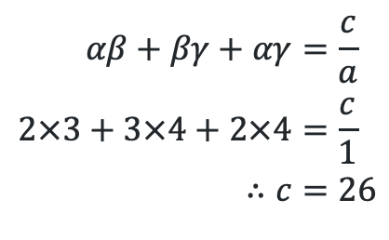


Finding a cubic equation (2)
Your turn – question 1
Find the monic cubic polynomial with zeroes 2,3 and 4.
Let $α,β$ and $γ$ be the zeroes of $P\left(x\right)={ax}^{3}+bx^{2}+cx+d$.
$$α+β+γ=−\frac{b}{a} \\ 2+3+4=−\frac{b}{a} \\ ∴b=−9 \\ a=1$$
$$αβ+βγ+αγ=\frac{c}{a} \\ 2×3+3×4+2×4=\frac{c}{1} \\ ∴c=26$$
$$αβγ=−\frac{d}{a} \\ 2×3×4=−\frac{d}{1} \\ ∴d=−24$$
$$∴P\left(x\right)=x^{3}−9x^{2}+26x−24$$

Slide 14
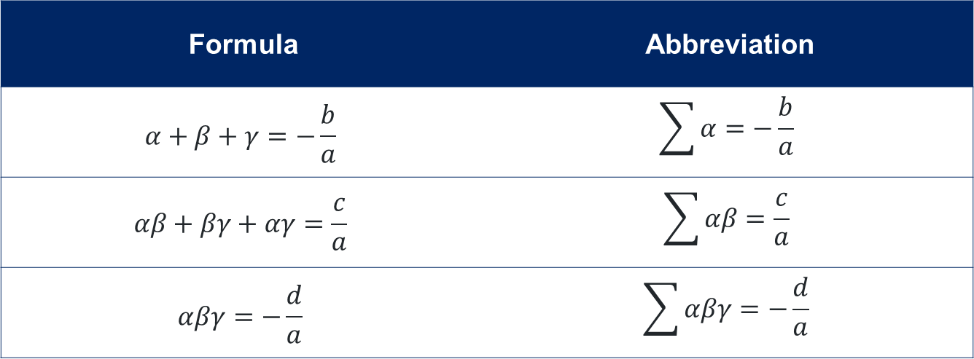
Using summation notation (1)
Cubic abbreviations
Formula | Abbreviation
$$α+β+γ=−\frac{b}{a}$$ | $$\sum{α=−\frac{b}{a}}$$
$$αβ+βγ+αγ=\frac{c}{a}$$ | $$\sum{αβ=\frac{c}{a}}$$
$$αβγ=−\frac{d}{a}$$ | $$\sum{αβγ}=−\frac{d}{a}$$

Slide 15
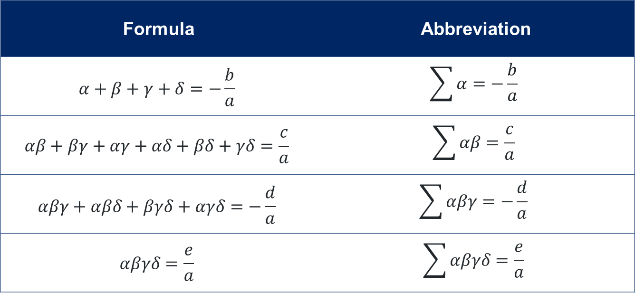
Using summation notation (2)
Quartic abbreviations
Formula | Abbreviation
$$α+β+γ+δ=−\frac{b}{a}$$ | $$\sum{α=−\frac{b}{a}}$$
$$αβ+βγ+αγ+αδ+βδ+γδ=\frac{c}{a}$$ | $$\sum{αβ=\frac{c}{a}}$$
$$αβγ+αβδ+βγδ+αγδ=−\frac{d}{a}$$ | $$\sum{αβγ}=−\frac{d}{a}$$
$$αβγδ=\frac{e}{a}$$ | $$\sum{αβγδ}=\frac{e}{a}$$

Slide 16
References
This presentation contains NSW Curriculum and syllabus content. The NSW Curriculum is developed by the NSW Education Standards Authority. This content is prepared by NESA for and on behalf of the Crown in the right of the State of New South Wales. The material is protected by Crown copyright.
Please refer to the NESA Copyright Disclaimer for more information https://educationstandards.nsw.edu.au/wps/portal/nesa/mini-footer/copyright.
NESA holds the only official and up-to-date versions of the NSW Curriculum and syllabus documents. Please visit the NSW Education Standards Authority (NESA) website https://educationstandards.nsw.edu.au/wps/portal/nesa/home and the NSW Curriculum website https://curriculum.nsw.edu.au.
Mathematics Extension 1 11–12 Syllabus © NSW Education Standards Authority (NESA) for and on behalf of the Crown in right of the State of New South Wales, 2024.

Slide 17
Copyright
© State of New South Wales (Department of Education), 2025
The copyright material published in this resource is subject to the Copyright Act 1968 (Cth) and is owned by the NSW Department of Education or, where indicated, by a party other than the NSW Department of Education (third-party material).
Copyright material available in this resource and owned by the NSW Department of Education is licensed under a Creative Commons Attribution 4.0 International (CC BY 4.0) license.
This license allows you to share and adapt the material for any purpose, even commercially.
Attribution should be given to © State of New South Wales (Department of Education), 2025.
Material in this resource not available under a Creative Commons license:
the NSW Department of Education logo, other logos and trademark-protected material
Material owned by a third party that has been reproduced with permission. You will need to obtain permission from the third party to reuse its material.
Links to third-party material and websites
Please note that the provided (reading/viewing material/list/links/texts) are a suggestion only and implies no endorsement, by the New South Wales Department of Education, of any author, publisher, or book title. School principals and teachers are best placed to assess the suitability of resources that would complement the curriculum and reflect the needs and interests of their students.
If you use the links provided in this document to access a third-party’s website, you acknowledge that the terms of use, including licence terms set out on the third-party’s website apply to the use which may be made of the materials on that third-party website or where permitted by the Copyright Act 1968 (Cth). The department accepts no responsibility for content on third-party websites.

