Slide 1

Finding zeroes
Mathematics Extension 1 – Stage 6 (Year 11)
Polynomials

Slide 2
Learning intentions and success criteria
Learning intention
To learn how zeroes, roots and multiplicity link the equation and graph of a polynomial function, enabling movement between the 2.
Success criteria
I can find the zeroes of a polynomial and state the multiplicity of each one from its factored form.
I can explain how multiplicity affects the graph and apply this when sketching.
I can sketch the overall shape of a polynomial by using zeroes, multiplicity and end behaviour.

Slide 3
Activating prior knowledge

Slide 4
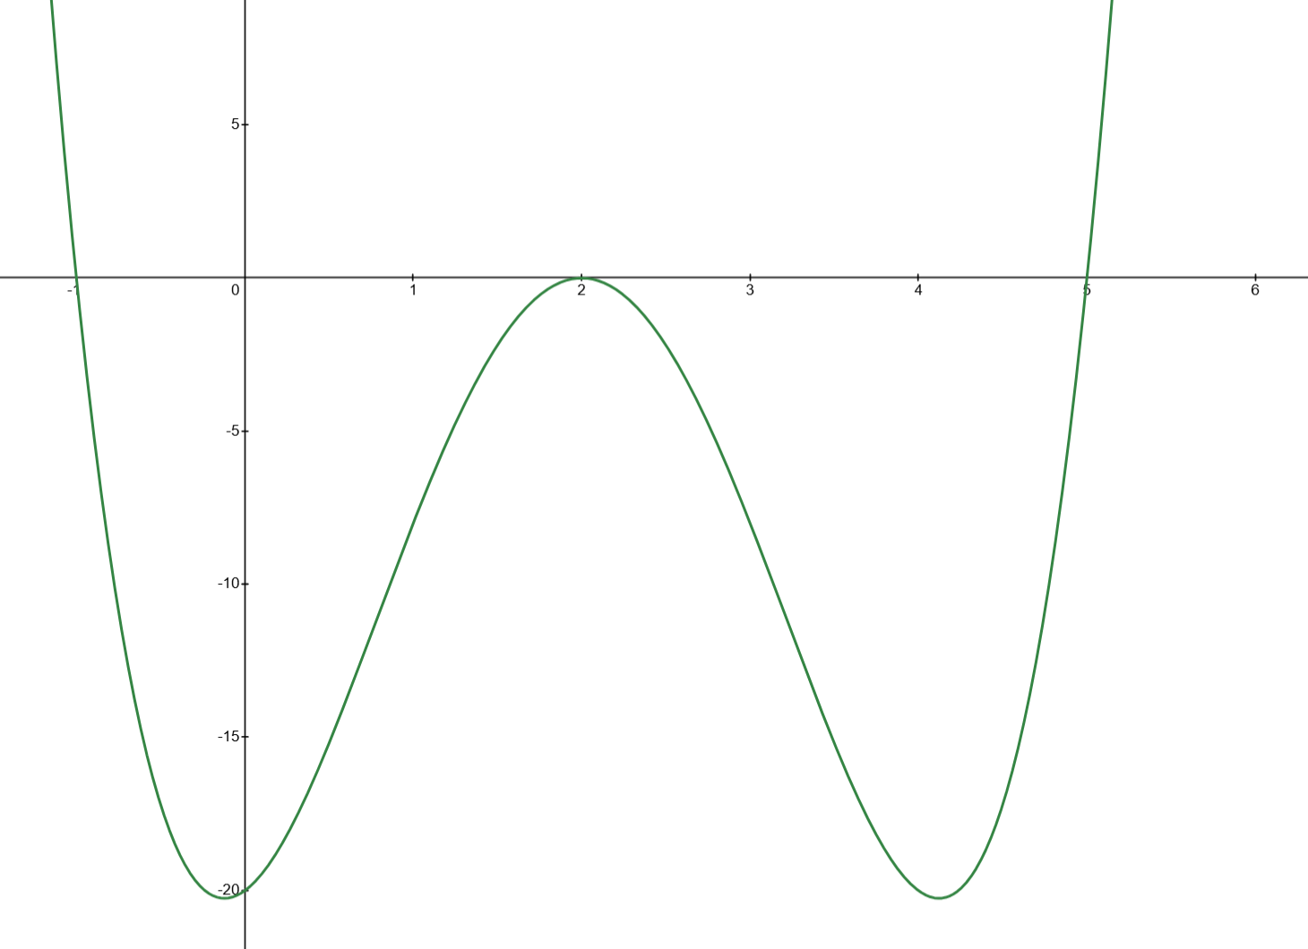
What could the equation of this graph be?

Slide 5
Connecting learning

Slide 6
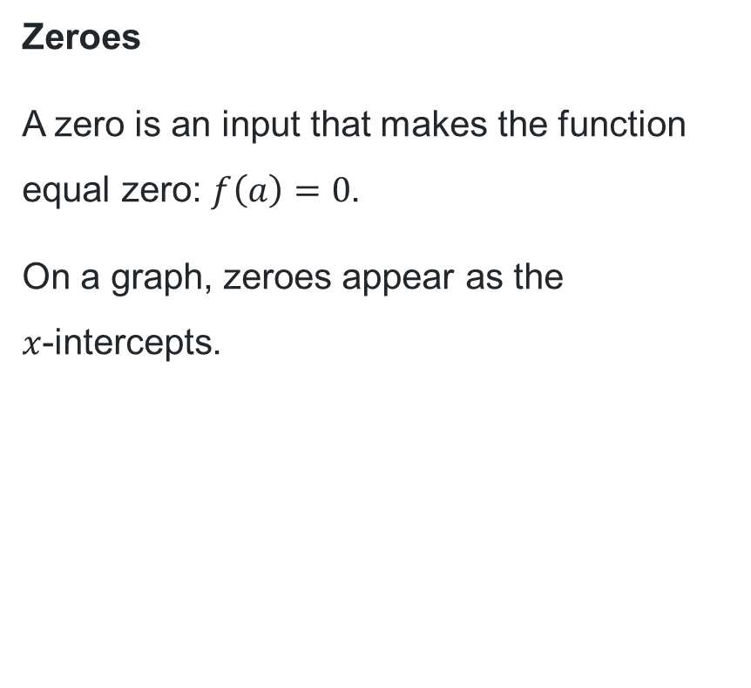

Roots or zeroes?
Roots
A root is a value of $x$ that solves an equation of the form $f\left(x\right)=0.$
It is the algebraic solution to the equation.
Zeroes
A zero is an input that makes the function equal zero: $f\left(a\right)=0$.
On a graph, zeroes appear as the
$x$-intercepts.
What is similar and different between these 2 definitions?

Slide 7
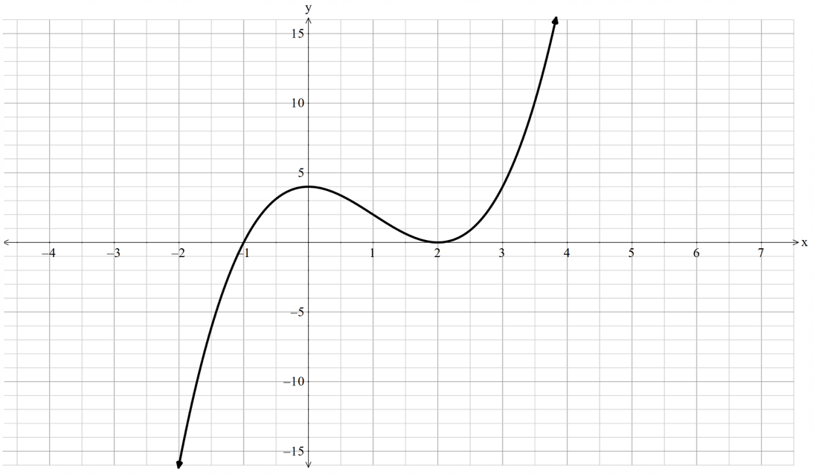
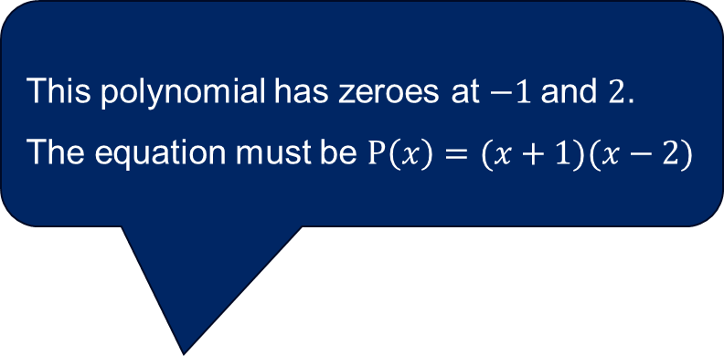
Equation of a polynomial
This polynomial has zeroes at $−1$and $2$. The equation must be $P\left(x\right)=(x+1)(x−2)$
Is this statement correct? Why / why not?

Slide 8
Releasing responsibility

Slide 9
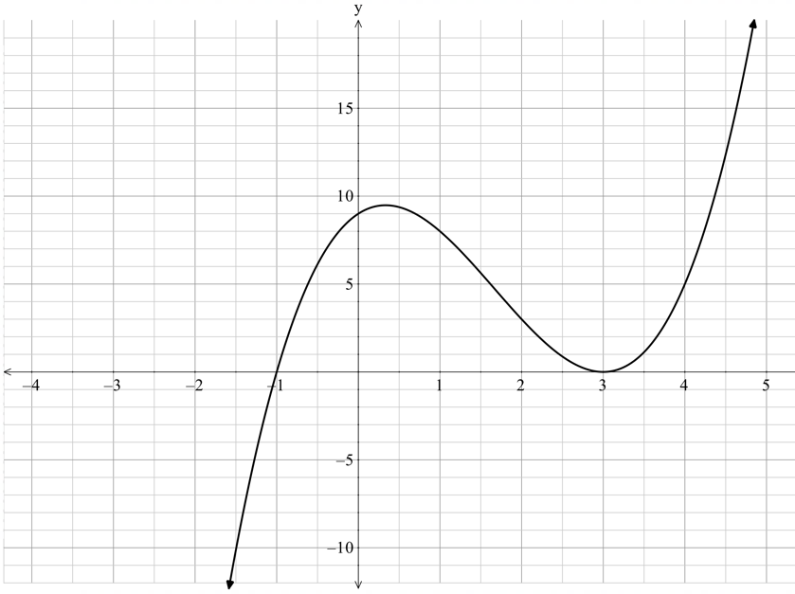
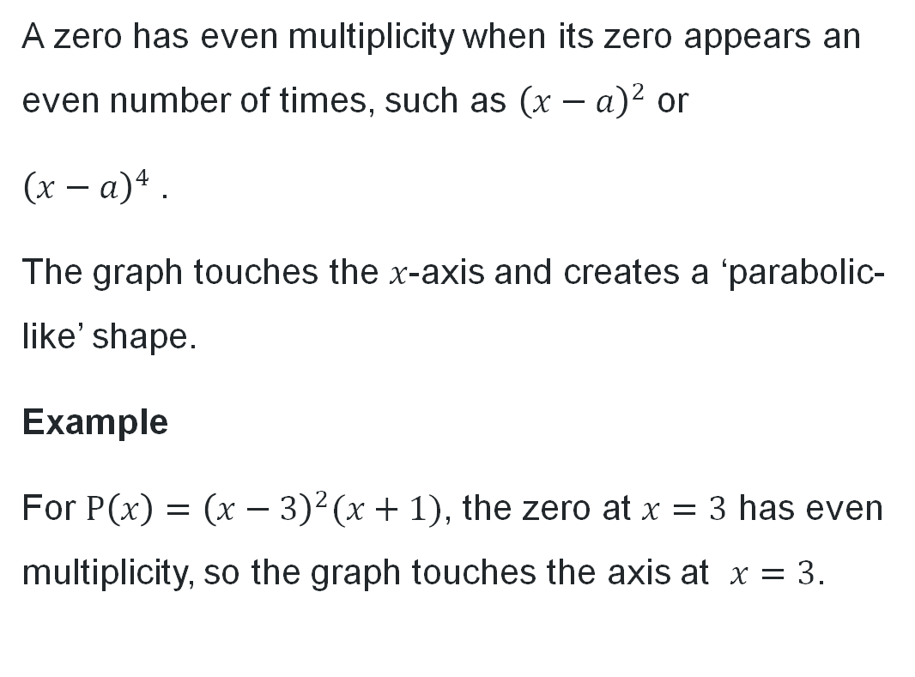
Multiplicity of roots (1)
Even multiplicity
A zero has even multiplicity when its zero appears an even number of times, such as ${\left(x−a\right)}^{2}$ or
${\left(x−a\right)}^{4}$.
The graph touches the $x$-axis and creates a ‘parabolic-like’ shape.
Example
For $P\left(x\right)={\left(x−3\right)}^{2}(x+1)$, the zero at $x=3$ has even multiplicity, so the graph touches the axis at $x=3$.

Slide 10
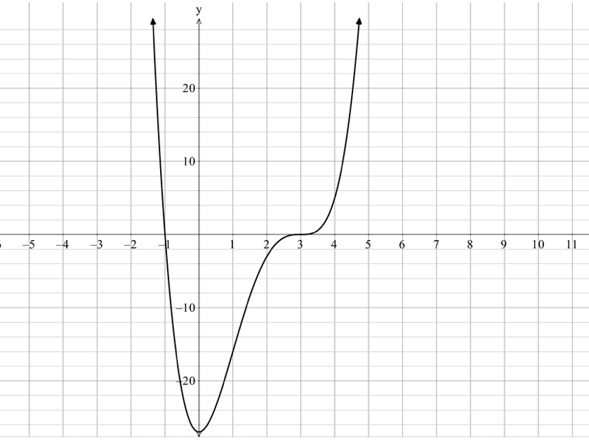
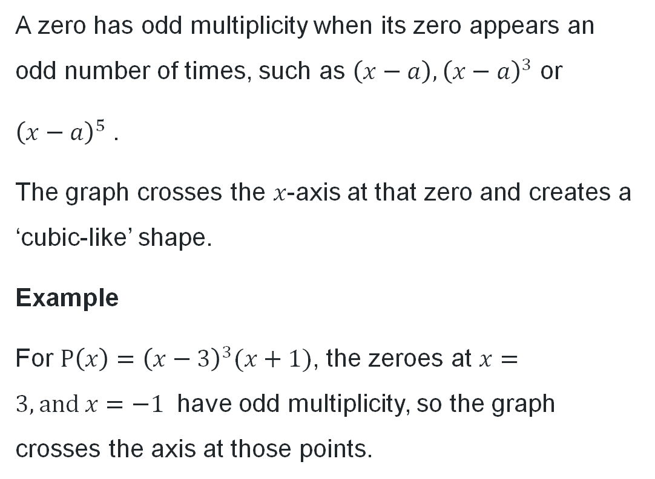
Multiplicity of roots (2)
Odd multiplicity
A zero has odd multiplicity when its zero appears an odd number of times, such as $\left(x−a\right), {\left(x−a\right)}^{3}$ or
${\left(x−a\right)}^{5}$.
The graph crosses the $x$-axis at that zero and creates a ‘cubic-like’ shape.
Example
For $P\left(x\right)={\left(x−3\right)}^{3}(x+1)$, the zeroes at $x=3, \text{and} x=−1$ have odd multiplicity, so the graph crosses the axis at those points.

Slide 11
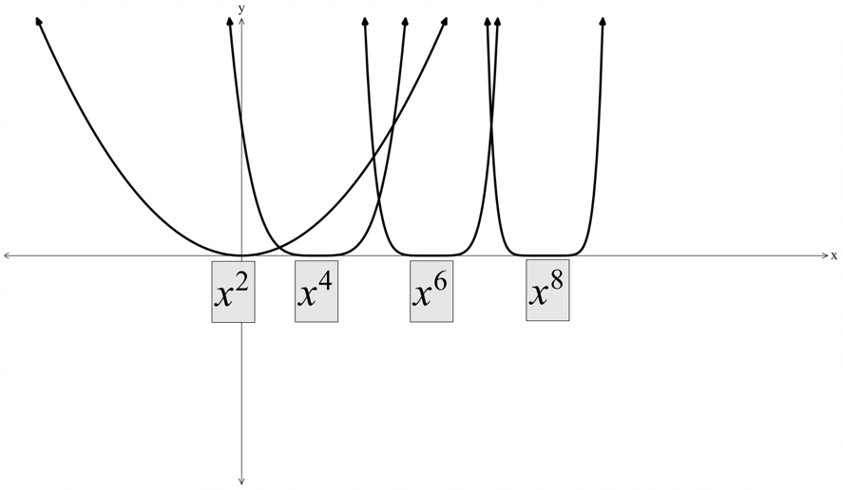
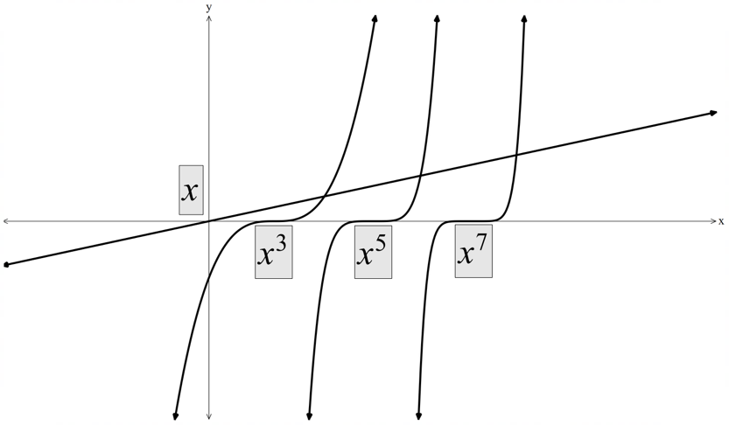
Multiplicity of roots (3)
Summary
Even multiplicity
Odd multiplicity
How does the graph’s behaviour at a zero evolve as the multiplicity increases?

Slide 12
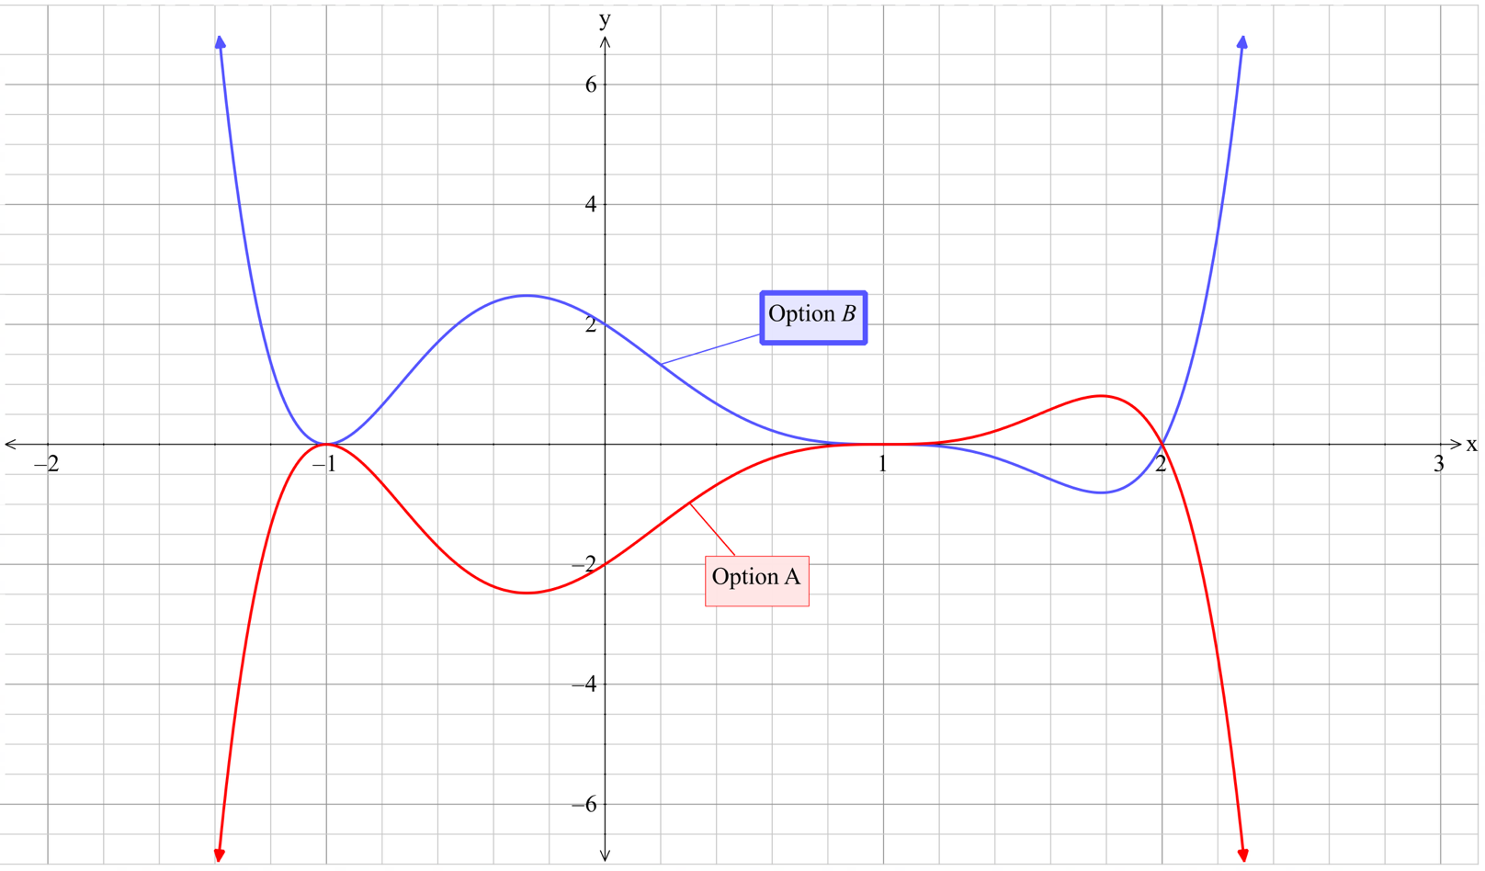
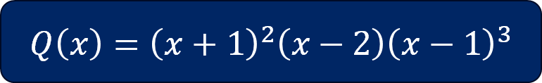
Which polynomial graph is correct?
$$Q\left(x\right)={\left(x+1\right)}^{2}\left(x−2\right){\left(x−1\right)}^{3}$$

Slide 13
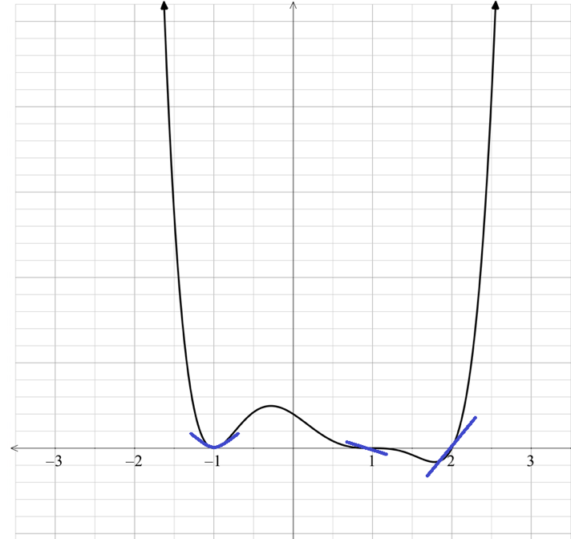
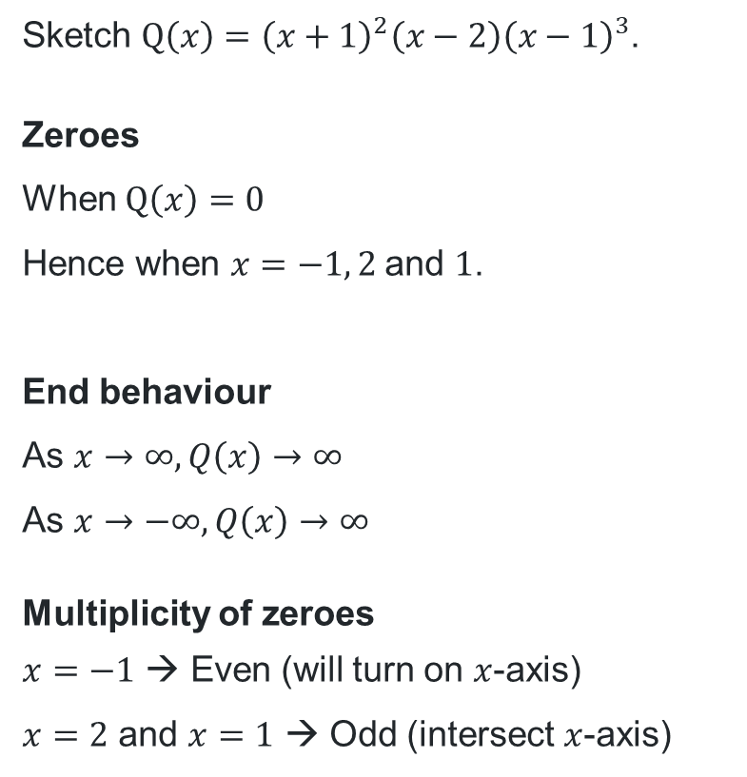
Sketching a polynomial (1)
Worked example 1
What is the degree of the polynomial and what does this tell us about its graph?
Sketch $Q\left(x\right)={\left(x+1\right)}^{2}\left(x−2\right){\left(x−1\right)}^{3}$.
Zeroes
When $Q\left(x\right)=0$
Hence when $x=−1, 2$and $1$.
End behaviour
As $x→∞, Q\left(x\right)→∞$
As $x→−∞, Q\left(x\right)→∞$
Multiplicity of zeroes
$x=−1$ → Even (will turn on $x$-axis)
$x=2$ and $x=1$ → Odd (intersect $x$-axis)
How has this been determined?
What is the difference between a ‘sketch’ and a ‘graph?

Slide 14
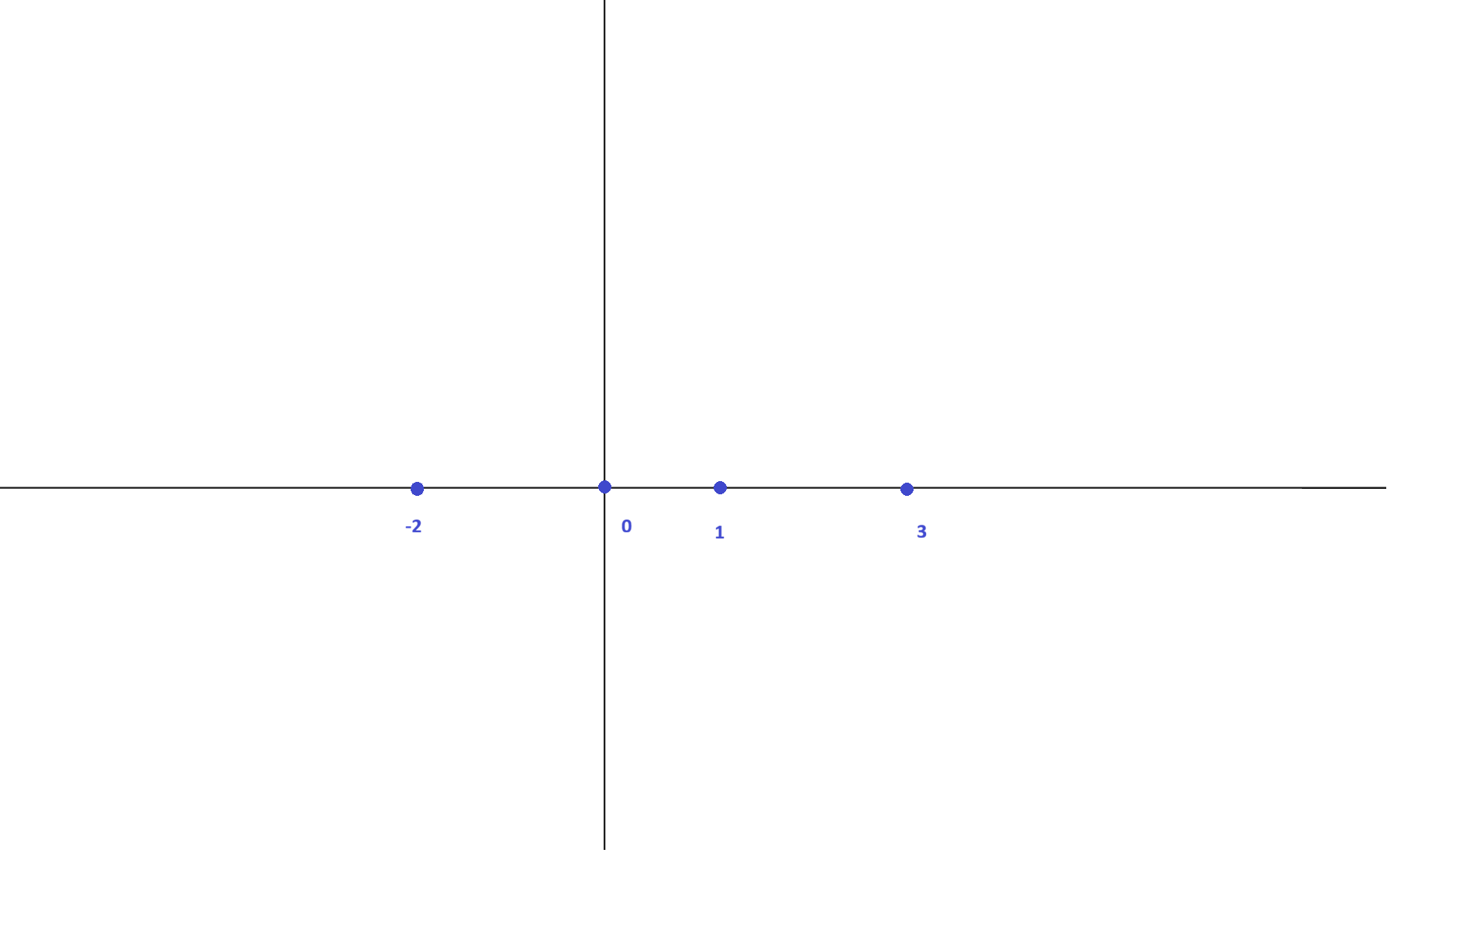

Sketching a polynomial (2)
Your turn
Sketch $W\left(x\right)={\left(x+2\right)}^{4}{\left(x−1\right)}^{3}\left(x−3\right)x$.
Zeroes
When $W\left(x\right)=0$.
Hence when $x=−2, 1, 3$and $0$.

Slide 15
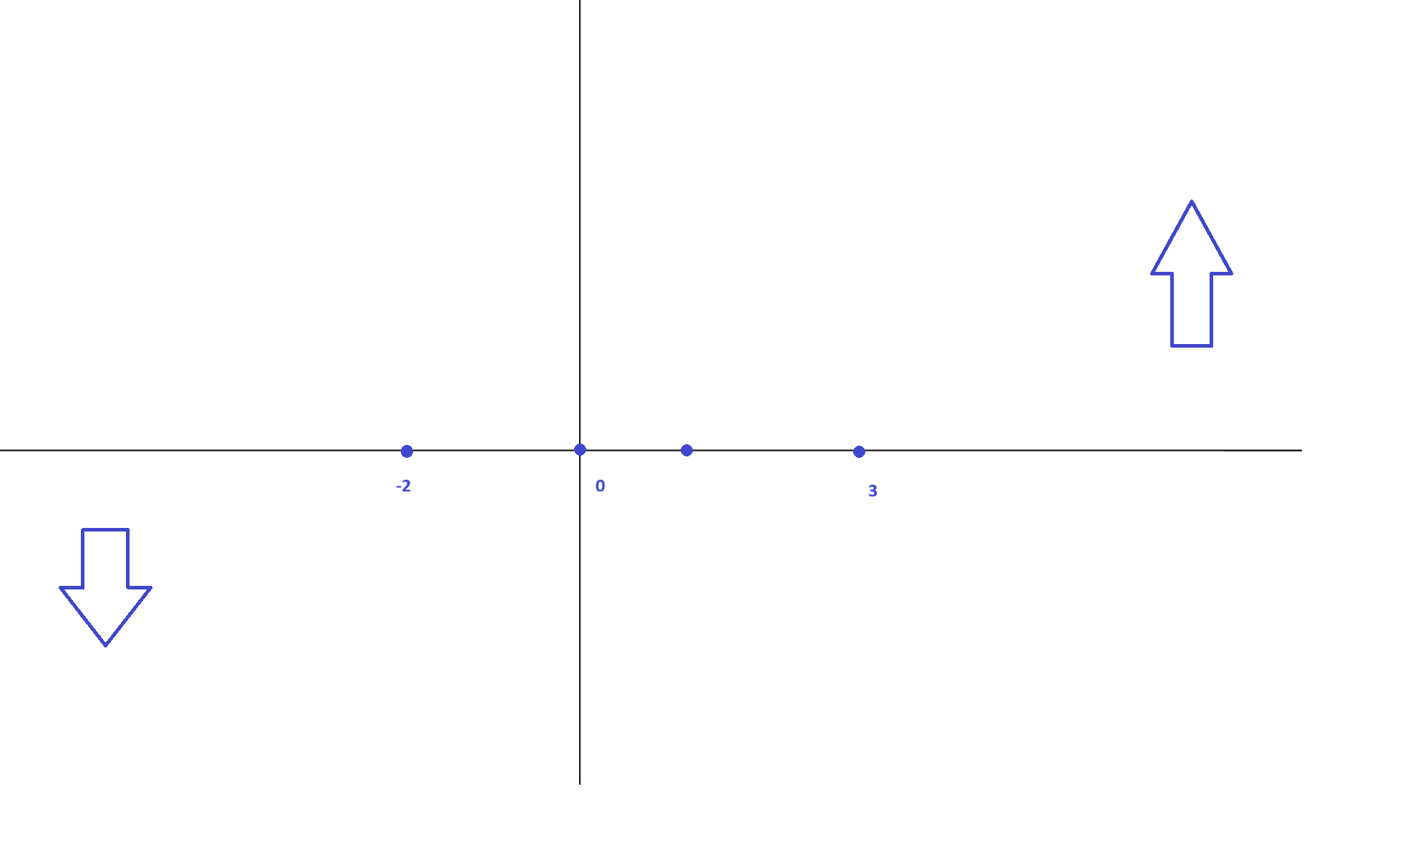
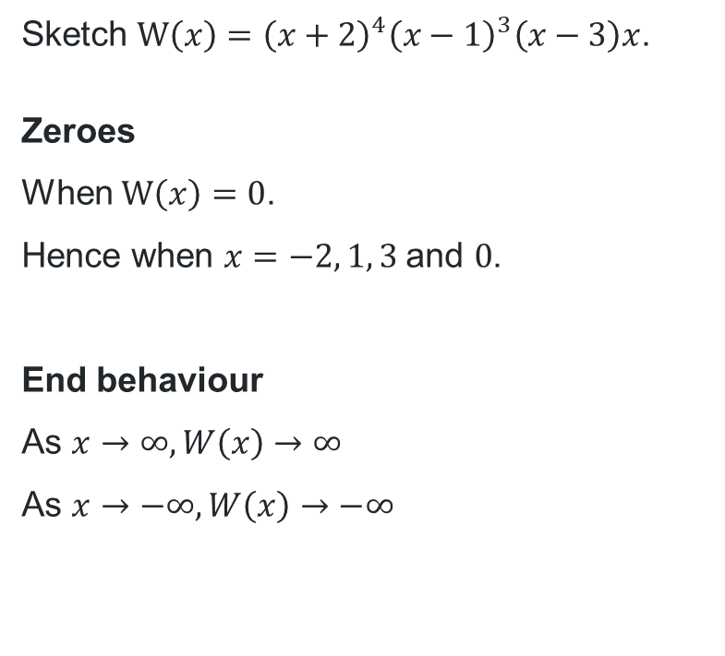
Sketching a polynomial (3)
Your turn
Sketch $W\left(x\right)={\left(x+2\right)}^{4}{\left(x−1\right)}^{3}\left(x−3\right)x$.
Zeroes
When $W\left(x\right)=0$.
Hence when $x=−2, 1, 3 \text{and} 0$.
End behaviour
As $x→∞, W\left(x\right)→∞$
As $x→−∞, W\left(x\right)→−∞$

Slide 16
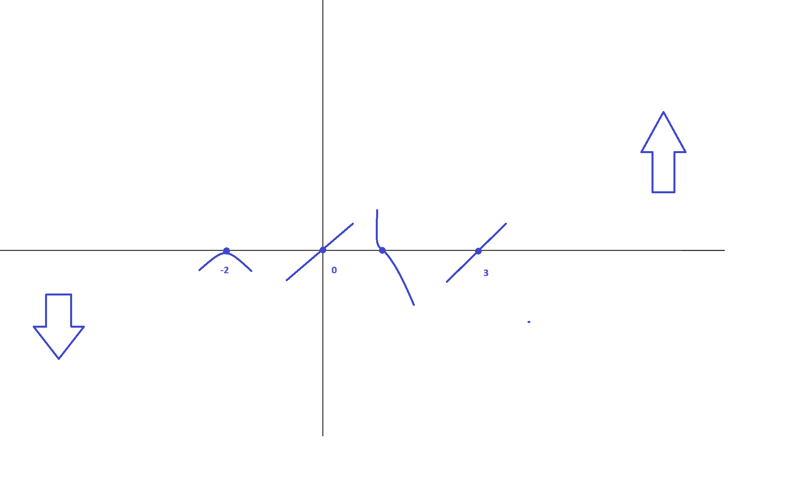
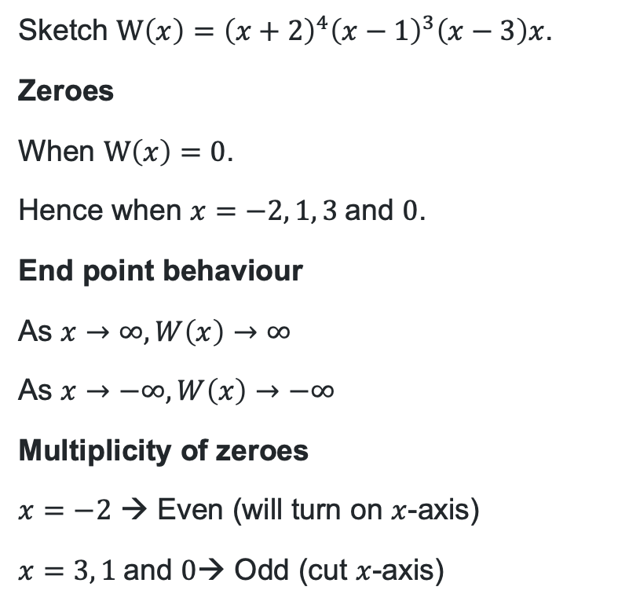
Sketching a polynomial (4)
Your turn
Sketch $W\left(x\right)={\left(x+2\right)}^{4}{\left(x−1\right)}^{3}\left(x−3\right)x$.
Zeroes
When $W\left(x\right)=0$.
Hence when $x=−2, 1, 3 \text{and} 0$.
End point behaviour
As $x→∞, W\left(x\right)→∞$
As $x→−∞, W\left(x\right)→−∞$
Multiplicity of zeroes
$x=−2$ → Even (will turn on $x$-axis)
$x=3, 1 \text{and} 0$→ Odd (cut $x$-axis)

Slide 17
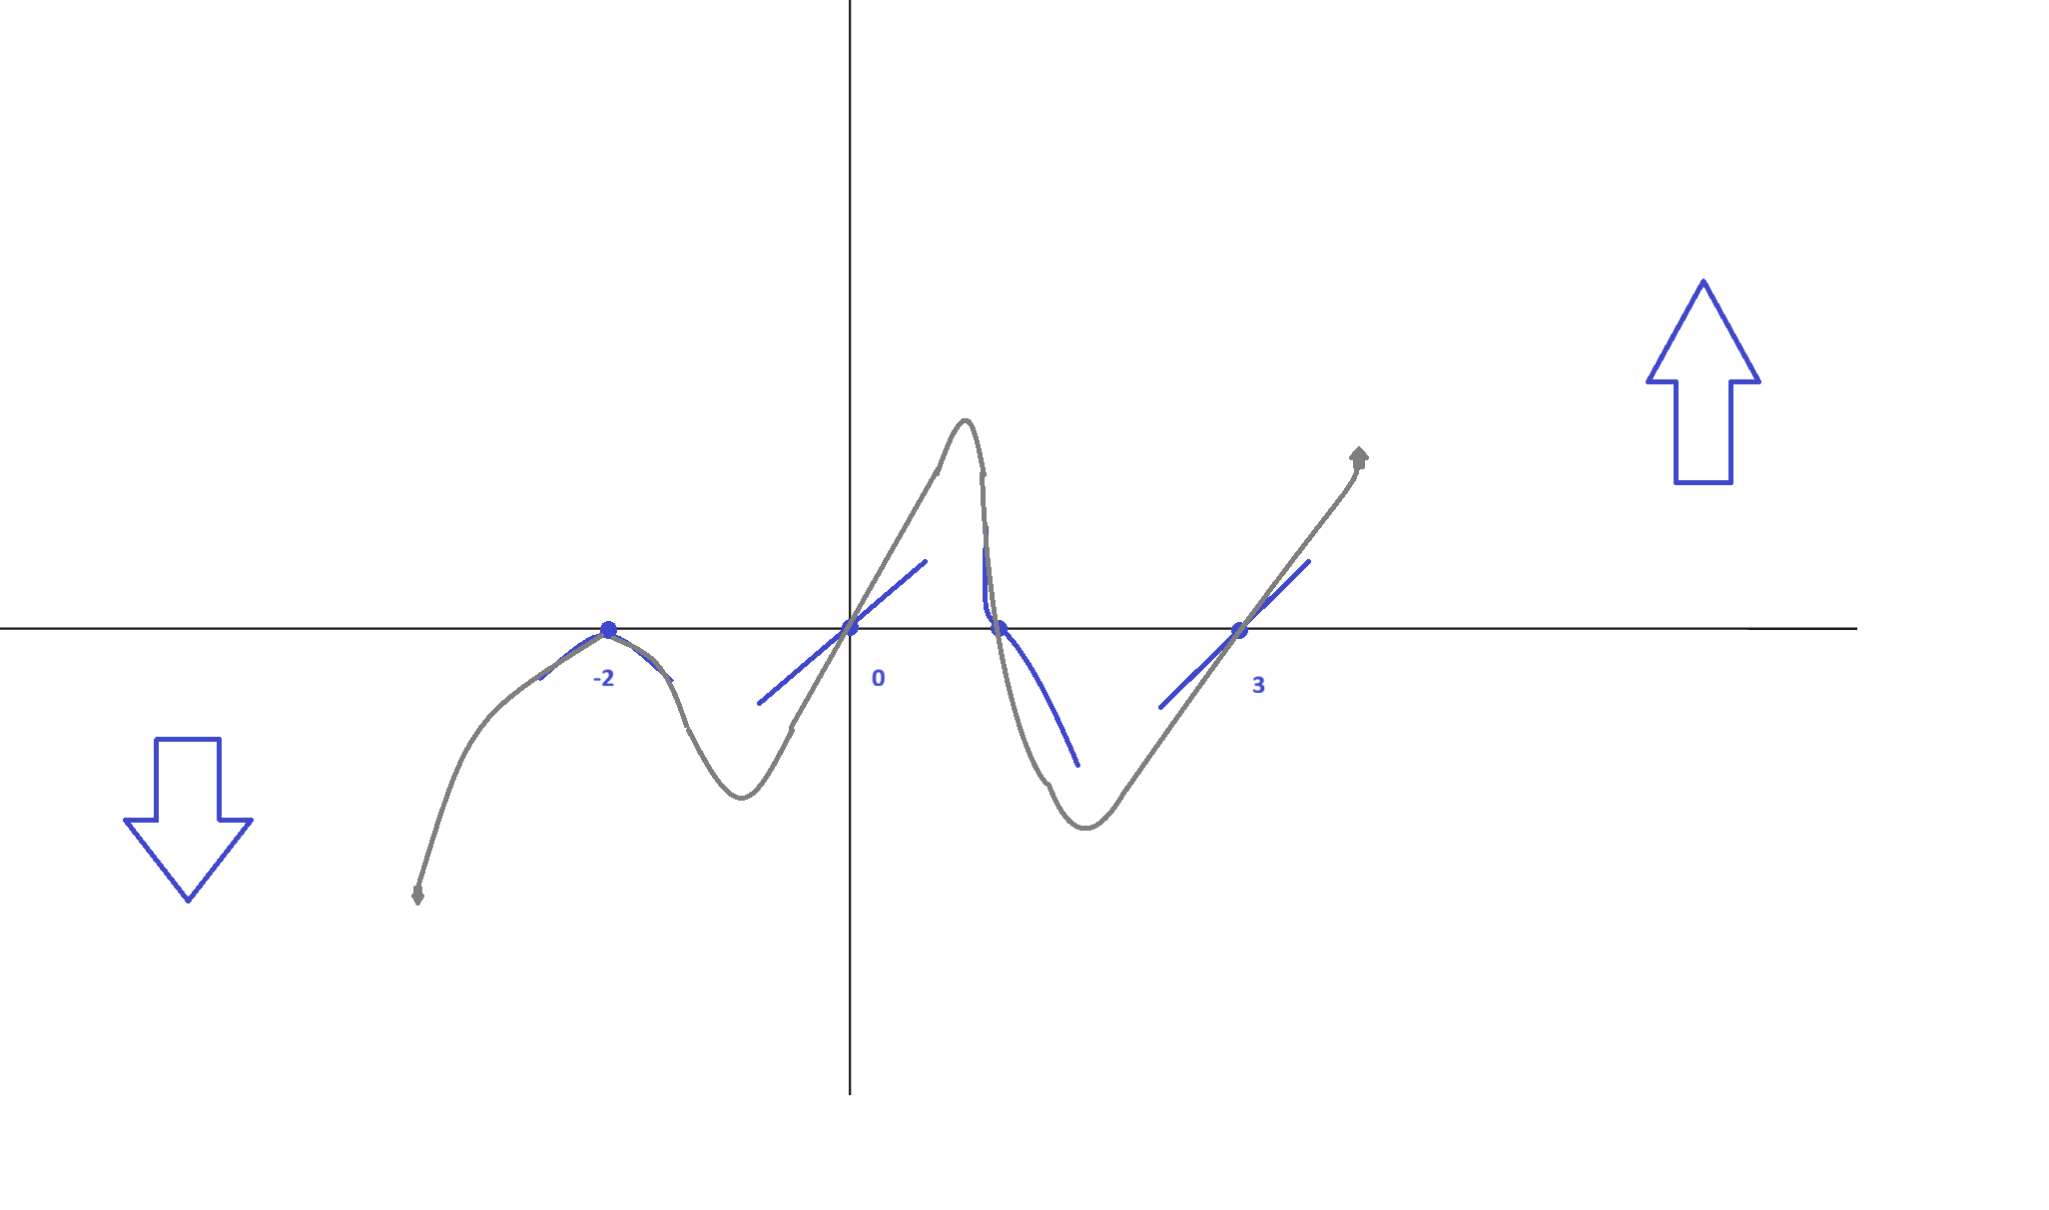
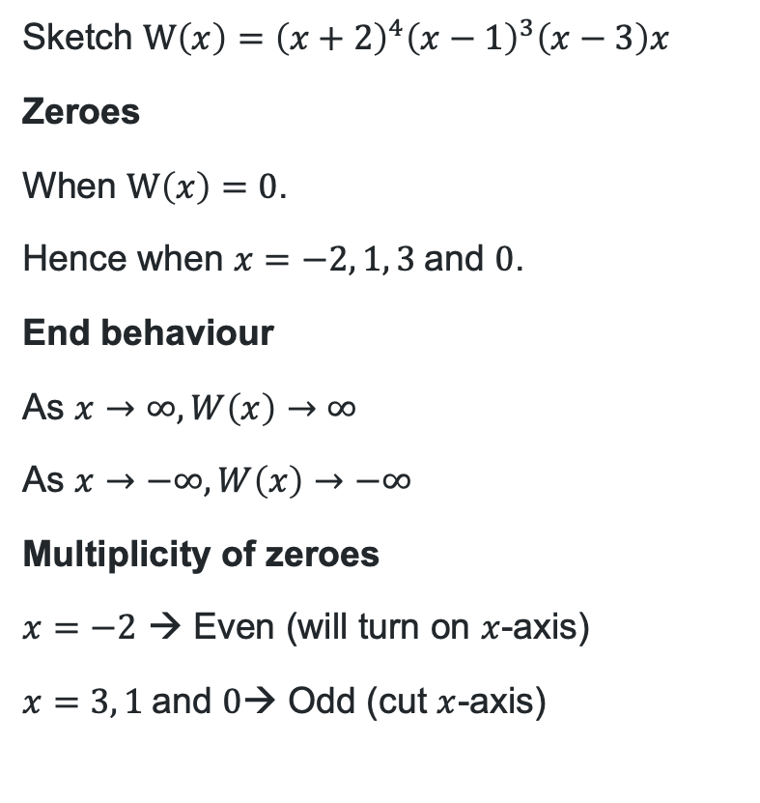
Sketching a polynomial (5)
Your turn
Sketch $W\left(x\right)={\left(x+2\right)}^{4}{\left(x−1\right)}^{3}\left(x−3\right)x$
Zeroes
When $W\left(x\right)=0$.
Hence when $x=−2, 1, 3 \text{and} 0$.
End behaviour
As $x→∞, W\left(x\right)→∞$
As $x→−∞, W\left(x\right)→−∞$
Multiplicity of zeroes
$x=−2$ → Even (will turn on $x$-axis)
$x=3, 1 \text{and} 0$→ Odd (cut $x$-axis)

Slide 18
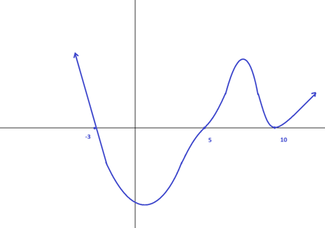
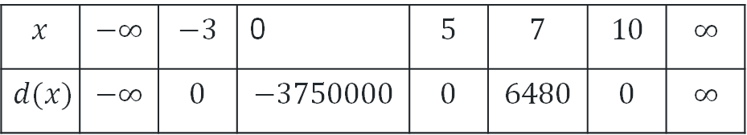

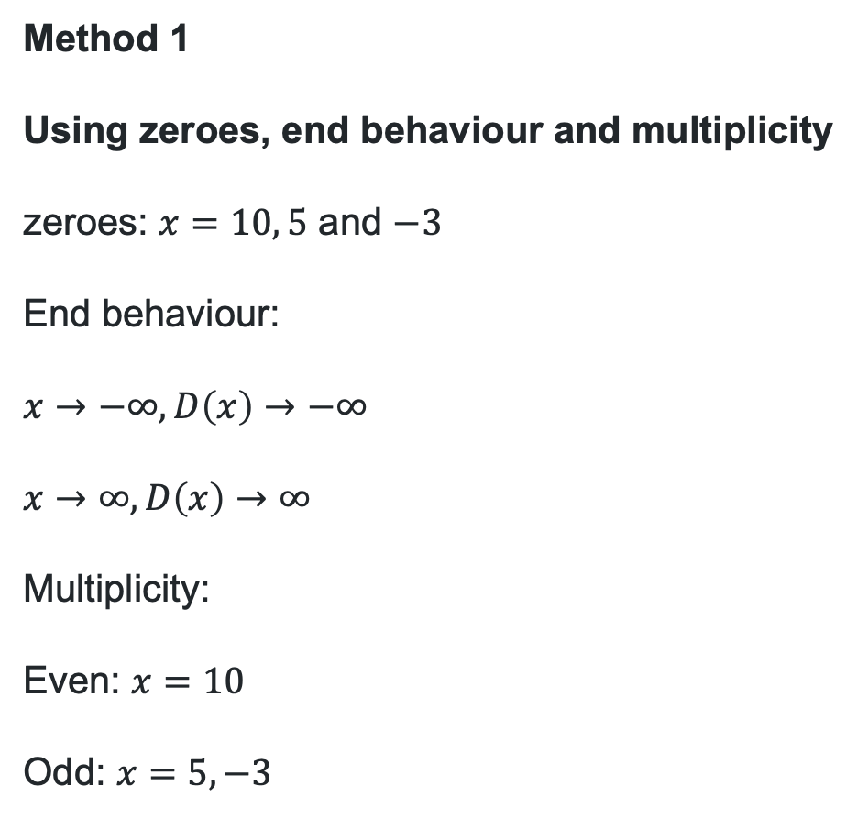
Comparative example
Method 1
Using zeroes, end behaviour and multiplicity
zeroes: $x=10, 5$ and $−3$
End behaviour:
$x→−∞, D\left(x\right)→−∞$
$x→∞, D\left(x\right)→∞$
Multiplicity:
Even: $x=10$
Odd: $x=5, −3$
Method 2
Testing points between zeroes and end behaviour
zeroes: $x=10, 5$ and $−3$
Sketch $D\left(x\right)={\left(x−10\right)}^{4}{\left(x−5\right)}^{3}(x+3)$
$$x$$ | $$−∞$$ | $$−3$$ | 0 | $$5$$ | $$7$$ | $$10$$ | $$∞$$
$$d(x)$$ | $$−∞$$ | $$0$$ | $$−3750000$$ | $$0$$ | $$6480$$ | $$0$$ | $$∞$$

Slide 19
Independent practice

Slide 20
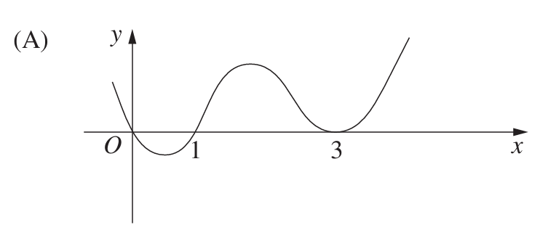
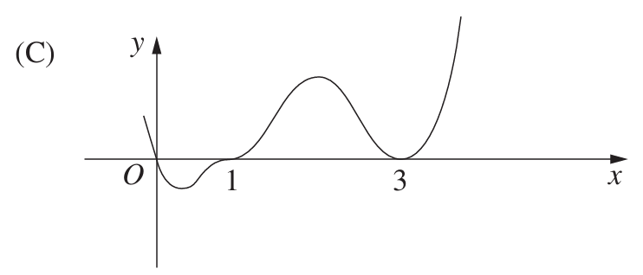
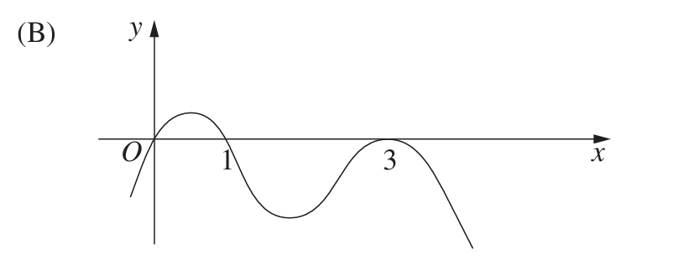
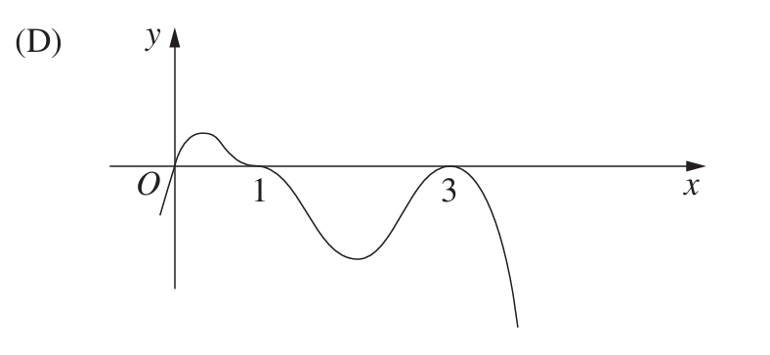

Past HSC questions (1)
2013 HSC Mathematics Extension 1
Which diagram best represents the graph $y=x{\left(1−x\right)}^{3}{\left(3−x\right)}^{2}$?

Slide 21
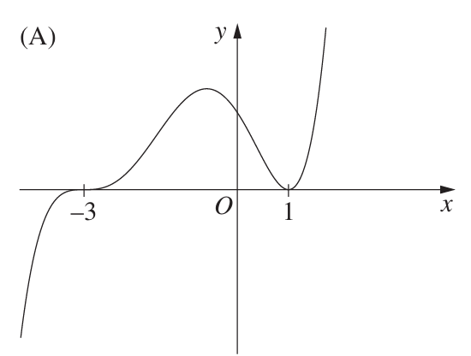
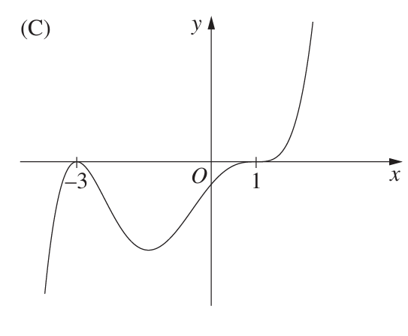
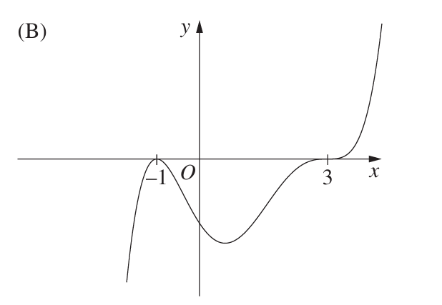
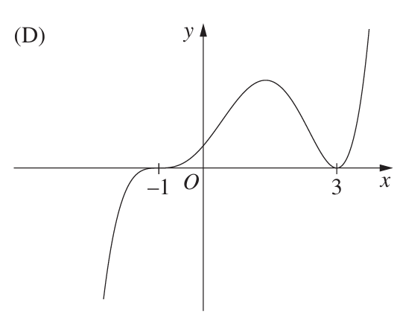

Past HSC questions (2)
2015 HSC Mathematics Extension 2
Which graph best represents the curve $y={\left(x−1\right)}^{2}{\left(x+3\right)}^{5}$?

Slide 22
References
This presentation contains NSW Curriculum and syllabus content. The NSW Curriculum is developed by the NSW Education Standards Authority. This content is prepared by NESA for and on behalf of the Crown in the right of the State of New South Wales. The material is protected by Crown copyright.
Please refer to the NESA Copyright Disclaimer for more information https://educationstandards.nsw.edu.au/wps/portal/nesa/mini-footer/copyright.
NESA holds the only official and up-to-date versions of the NSW Curriculum and syllabus documents. Please visit the NSW Education Standards Authority (NESA) website https://educationstandards.nsw.edu.au/wps/portal/nesa/home and the NSW Curriculum website https://curriculum.nsw.edu.au.
Mathematics Extension 1 11-12 Syllabus © NSW Education Standards Authority (NESA) for and on behalf of the Crown in right of the State of New South Wales, 2024.

Slide 23
Copyright
© State of New South Wales (Department of Education), 2026
The copyright material published in this resource is subject to the Copyright Act 1968 (Cth) and is owned by the NSW Department of Education or, where indicated, by a party other than the NSW Department of Education (third-party material).
Copyright material available in this resource and owned by the NSW Department of Education is licensed under a Creative Commons Attribution 4.0 International (CC BY 4.0) license.
This license allows you to share and adapt the material for any purpose, even commercially.
Attribution should be given to © State of New South Wales (Department of Education), 2026.
Material in this resource not available under a Creative Commons license:
the NSW Department of Education logo, other logos and trademark-protected material
Material owned by a third party that has been reproduced with permission. You will need to obtain permission from the third party to reuse its material.
Links to third-party material and websites
Please note that the provided (reading/viewing material/list/links/texts) are a suggestion only and implies no endorsement, by the New South Wales Department of Education, of any author, publisher, or book title. School principals and teachers are best placed to assess the suitability of resources that would complement the curriculum and reflect the needs and interests of their students.
If you use the links provided in this document to access a third-party’s website, you acknowledge that the terms of use, including licence terms set out on the third-party’s website apply to the use which may be made of the materials on that third-party website or where permitted by the Copyright Act 1968 (Cth). The department accepts no responsibility for content on third-party websites.

