Slide 1
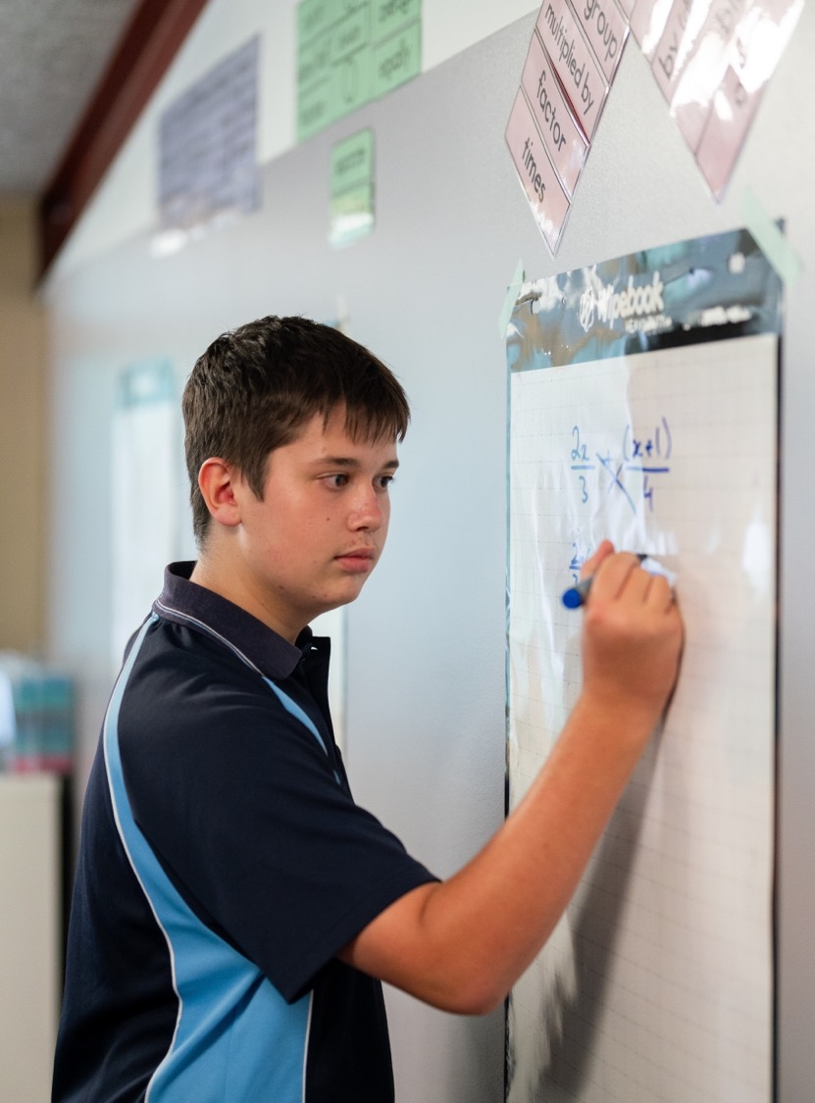
Introducing polynomials
Mathematics Extension 1 – Stage 6 (Year 11)
Polynomials

Slide 2
Learning intentions and success criteria
Learning intention
To be able to understand and use terminology and the key features of a polynomial function to determine classification and end behaviour.
Success criteria
I can correctly identify the degree, leading term, leading coefficient, and constant terms of a given polynomial.
I can classify polynomials as monic, non-monic, or zero and justify my reasoning.
I can explain and predict the end behaviour of a polynomial using its degree and leading coefficient.

Slide 3
Activating prior knowledge

Slide 4
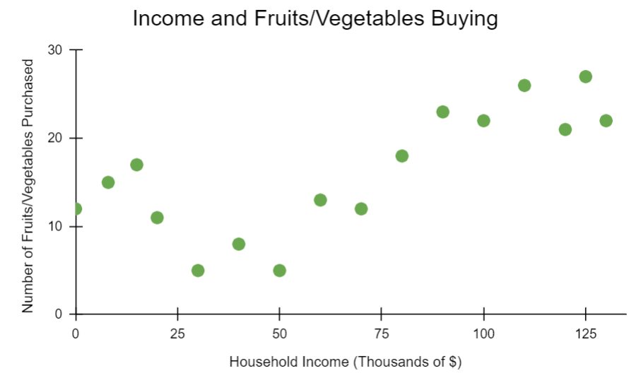
Grocery data

Slide 5
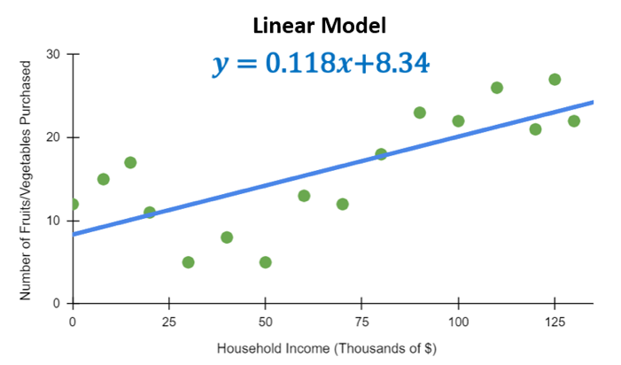
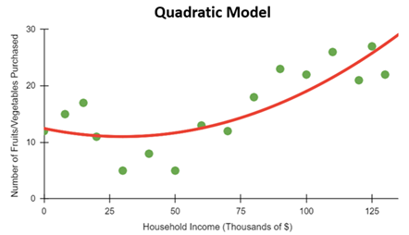

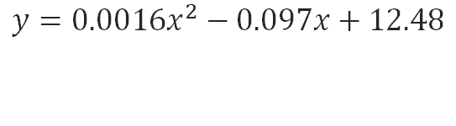
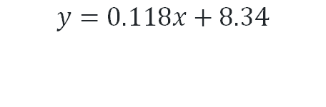
Modelling the data
$$y=0.0016x^{2}−0.097x+12.48$$
$$y=0.118x+8.34$$
$$y=0.0016x^{2}−0.097x+12.48$$
Using each model, predict the number of fruit and vegetables purchased for a household earning $50 000

Slide 6
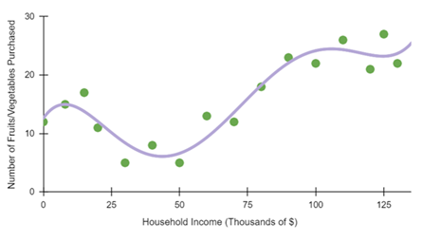
Modelling the data (1)
$$y=0.00000000029x^{5}−0.00001x^{4}+0.0012x^{3}−0.055x^{2}+0.66x+12.63$$

Slide 7
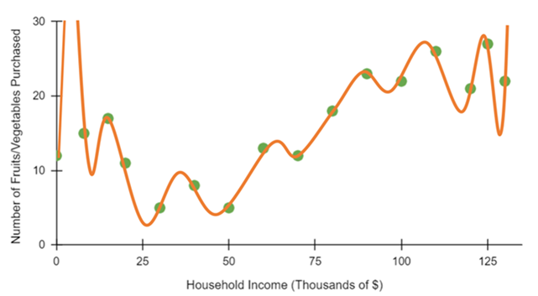
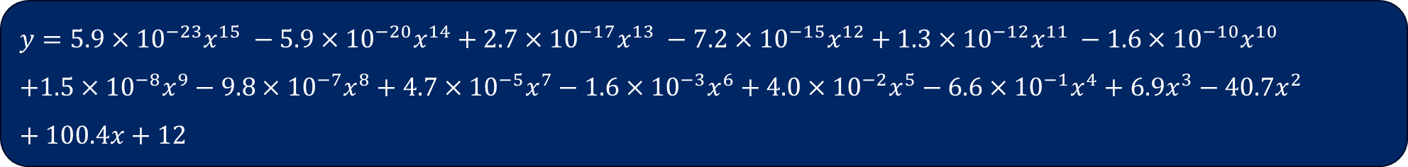
Modelling the data (2)
$$y=5.9×{10}^{−23}x^{15} −5.9×{10}^{−20}x^{14}+2.7×{10}^{−17}x^{13} −7.2×{10}^{−15}x^{12}+1.3×{10}^{−12}x^{11} −1.6×{10}^{−10}x^{10} \\ +1.5×{10}^{−8}x^{9}−9.8×{10}^{−7}x^{8}+4.7×{10}^{−5}x^{7}−1.6×{10}^{−3}x^{6}+4.0×{10}^{−2}x^{5}−6.6×{10}^{−1}x^{4}+6.9x^{3}−40.7x^{2}+100.4x+12$$

Slide 8
Connecting learning

Slide 9
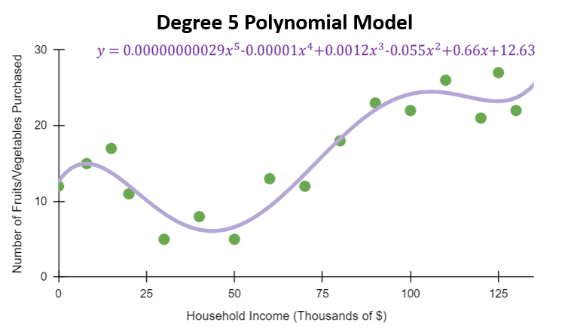
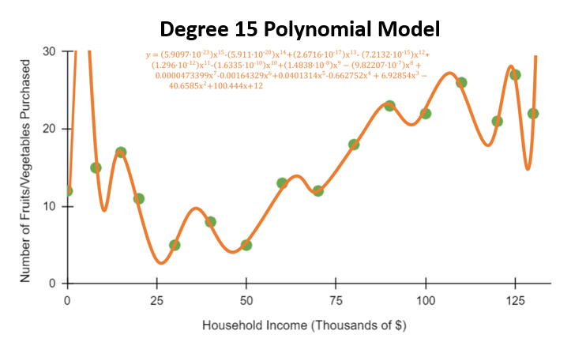
What is a polynomial? (1)
These two models are known as polynomials. The name is derived from the Greek word poly (meaning ‘many’) and the Latin word nomen (meaning ‘name’ or ‘term’)

Slide 10



The degree of a polynomial
Examine the equations of these polynomial models labelled as degree 2, 5 and 15. What do you think the term ‘degree’ means?
Degree 2 quadratic polynomial
$$P\left(x\right)=4x^{2}+3x+1$$
Degree 5 quintic model
$$Q\left(x\right)=7x^{5}−3x^{4}+10x^{2}−4$$
Degree 15 polynomial model
$$R\left(x\right)=−9x^{15}+6x^{14}+10x^{12}−4x^{6}+2x^{5}$$
What do you think the phrase ‘degree of a polynomial’ means?

Slide 11




The leading term of a polynomial
Examine the equations of these polynomial models with a leading coefficient of $4, 7$and $−9$. What do you think the phrase ‘leading term’ means?
Leading term is $4x^{2}$
$$P\left(x\right)=4x^{2}+3x+1$$
Leading term is $7x^{5}$
$$Q\left(x\right)=7x^{5}−3x^{4}+10x^{2}−4$$
Leading term is $−9x^{15}$
$$R\left(x\right)=−9x^{15}+6x^{14}+10x^{12}−4x^{6}+2x^{5}$$
What do you think the phrase ‘leading term’ means?

Slide 12




The leading coefficient of a polynomial
Examine the equations of these polynomial models with a leading coefficient of $4, 7$and $−9$. What do you think the phrase ‘leading coefficient’ means?
Leading coefficient is $4$
$$P\left(x\right)=4x^{2}+3x+1$$
Leading coefficient is $7$
$$Q\left(x\right)=7x^{5}−3x^{4}+10x^{2}−4$$
Leading coefficient is $−9$
$$R\left(x\right)=−9x^{15}+6x^{14}+10x^{12}−4x^{6}+2x^{5}$$
What do you think the phrase ‘leading coefficient’ means?

Slide 13


The constant term of a polynomial
Examine the equations of these polynomial models with a constant term of $1, −4$ and $0$. What do you think the phrase ‘constant term’ means?
Constant term is 1
$$P\left(x\right)=4x^{2}+3x+1$$
Constant term is $−4$
$$Q\left(x\right)=7x^{5}−3x^{4}+10x^{2}−4$$
Constant term is 0
$$R\left(x\right)=−9x^{15}+6x^{14}+10x^{12}−4x^{6}+2x^{5}$$
What do you think the phrase ‘constant term’ means?

Slide 14
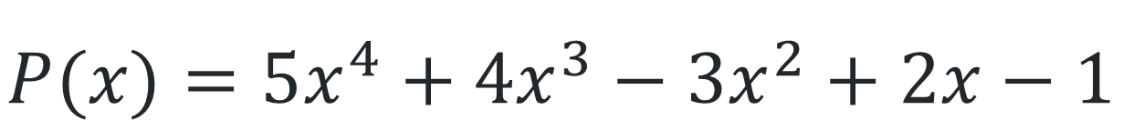

Language of a polynomial
Degree
$$degP(x)$$
Leading term
$$P(x)=5x^{4}+4x^{3}−3x^{2}+2x−1$$
Constant term
Leading coefficient

Slide 15
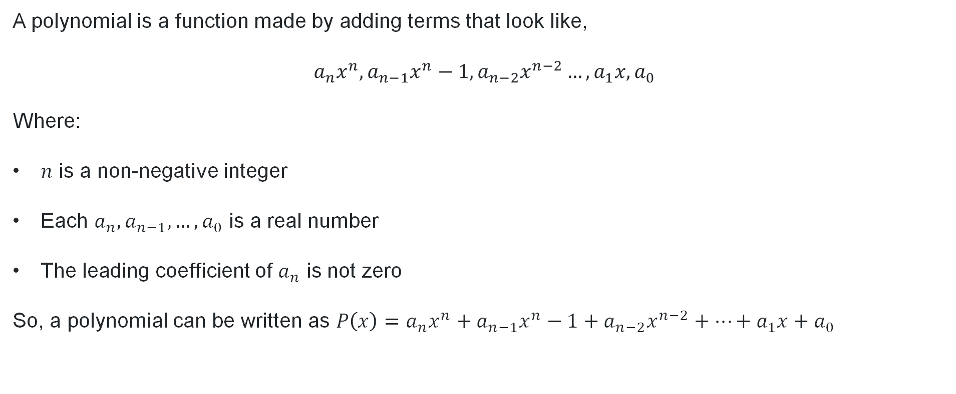
What is a polynomial (2)
Definition
A polynomial is a function made by adding terms that look like,
$$a_{n}x^{n},a_{n−1}x^{n}−1,a_{n−2}x^{n−2}…,a_{1}x,a_{0}$$
Where:
$n$ is a non-negative integer
Each $a_{n}, a_{n−1}, …, a_{0}$ is a real number
The leading coefficient of $a_{n}$ is not zero
So, a polynomial can be written as $P\left(x\right)=a_{n}x^{n}+a_{n−1}x^{n}−1+a_{n−2}x^{n−2}+…+a_{1}x+a_{0}$

Slide 16
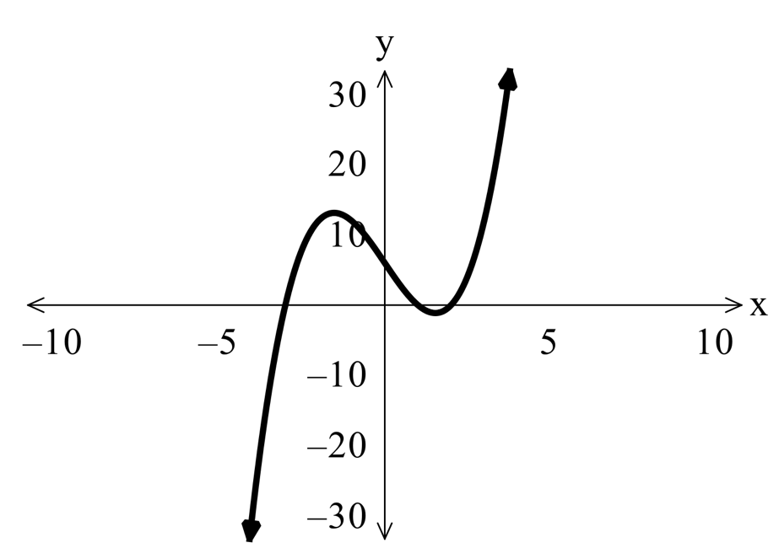
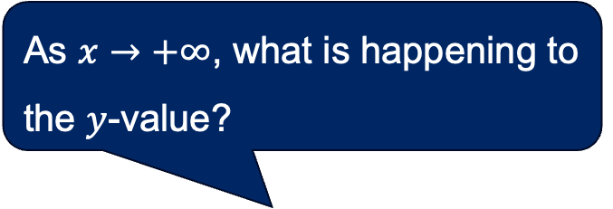
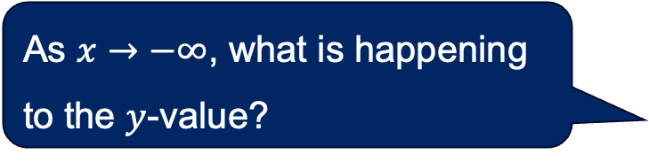
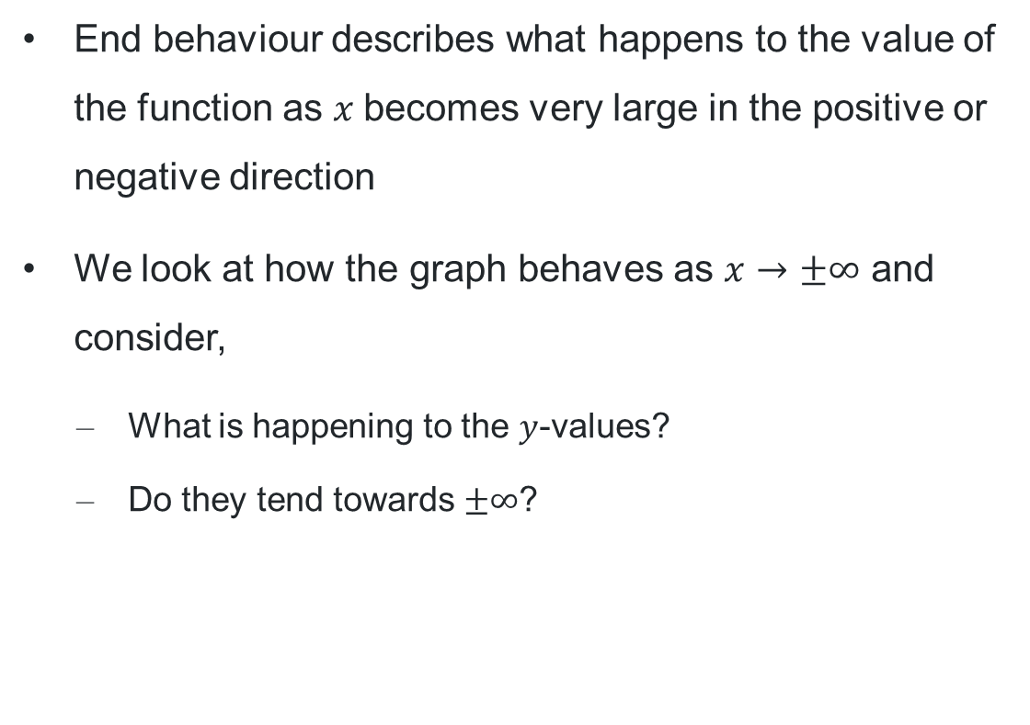
What is end behaviour?
As $x→+∞$, what is happening to the $y$-value?
End behaviour describes what happens to the value of the function as $x$becomes very large in the positive or negative direction
We look at how the graph behaves as $x→±∞$ and consider,
        What is happening to the $y$-values?
        Do they tend towards $±∞$?
As $x→−∞$, what is happening to the $y$-value?

Slide 17
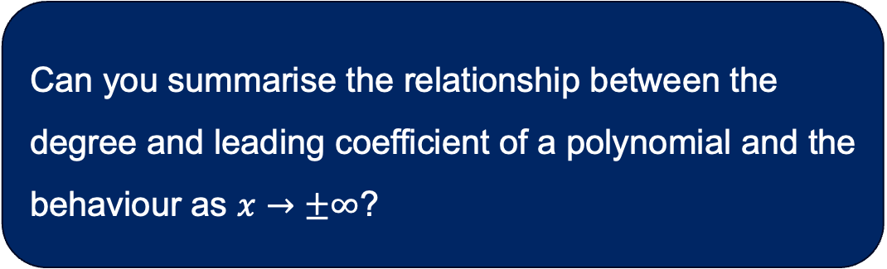
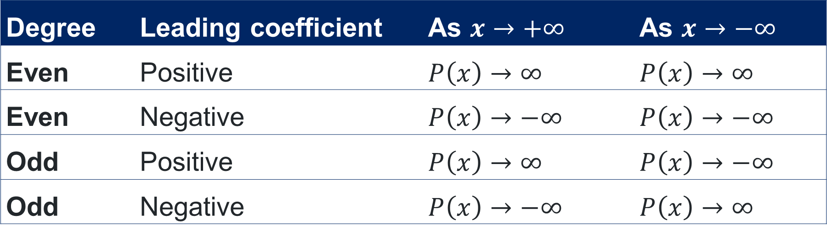
Graphing a polynomial
Explain why this relationship occurs.
Relationship between degree
Can you summarise the relationship between the degree and leading coefficient of a polynomial and the behaviour as $x→±∞$?
Degree | Leading coefficient | As $x→+∞$ | As $x→−∞$
Even | Positive | $P\left(x\right)→∞$ | $P\left(x\right)→∞$
Even | Negative | $P\left(x\right)→−∞$ | $P\left(x\right)→−∞$
Odd | Positive | $P\left(x\right)→∞$ | $P\left(x\right)→−∞$
Odd | Negative | $P\left(x\right)→−∞$ | $P\left(x\right)→∞$

Slide 18
Releasing responsibility

Slide 19
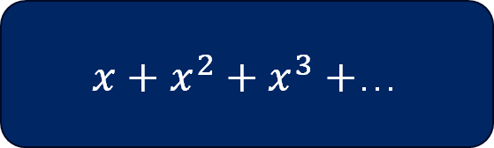

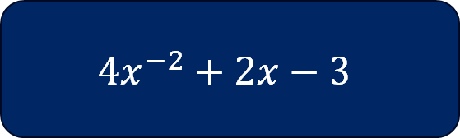
Is it a polynomial?
$x+x^{2}+x^{3}+$…
Infinite number of terms
$$x^{4}−\frac{1}{8}x$$
$$4x^{−2}+2x−3$$
Negative index

Slide 20


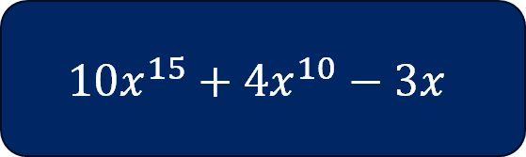
Is it a polynomial?
$$5x+1$$
$$10x^{15}+4x^{10}−3x$$
$$9\sqrt{x}+2x$$
Fractional index

Slide 21
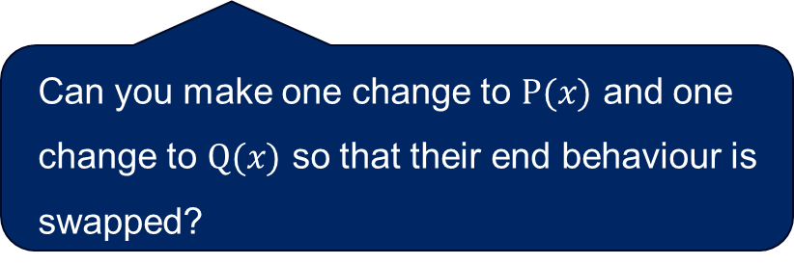
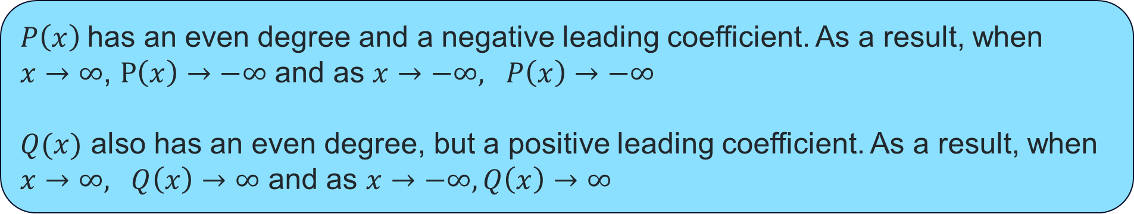

End behaviour of a polynomial (1)
Worked example 1
Consider the polynomials $P\left(x\right)=−3x^{4}+2x−1$and $Q\left(x\right)=7x^{2}+5$.
Describe the end behaviour of each polynomial as $x→±∞$
$P\left(x\right)$has an even degree and a negative leading coefficient. As a result, when
$x→∞$, $P\left(x\right)→−∞$ and as $x→−∞, P\left(x\right)→−∞$
$Q(x)$ also has an even degree, but a positive leading coefficient. As a result, when
$x→∞, Q\left(x\right)→∞$ and as $x→−∞, Q\left(x\right)→∞$
Can you make one change to $P(x)$ and one change to $Q(x)$ so that their end behaviour is swapped?

Slide 22

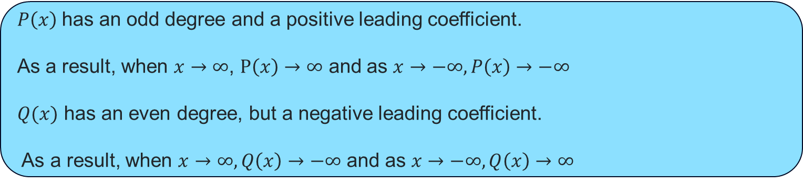
End behaviour of a polynomial (2)
Your turn
Consider the polynomials $P\left(x\right)=2x^{3}−x+4$and $Q\left(x\right)=−5x^{4}+3x^{2}−1$.
Describe the end behaviour of each polynomial as $x→±∞$
$P\left(x\right)$has an odd degree and a positive leading coefficient.
As a result, when $x→∞$, $P\left(x\right)→∞$ and as $x→−∞, P\left(x\right)→−∞$
$Q(x)$ has an even degree, but a negative leading coefficient.
As a result, when $x→∞, Q\left(x\right)→−∞$ and as $x→−∞, Q\left(x\right)→∞$

Slide 23
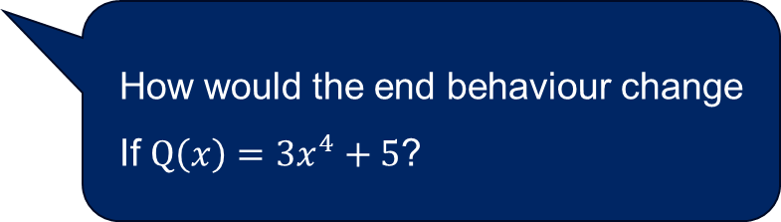
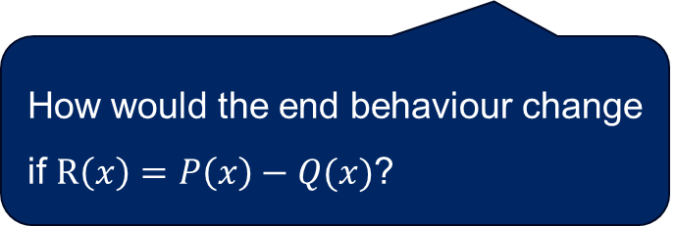
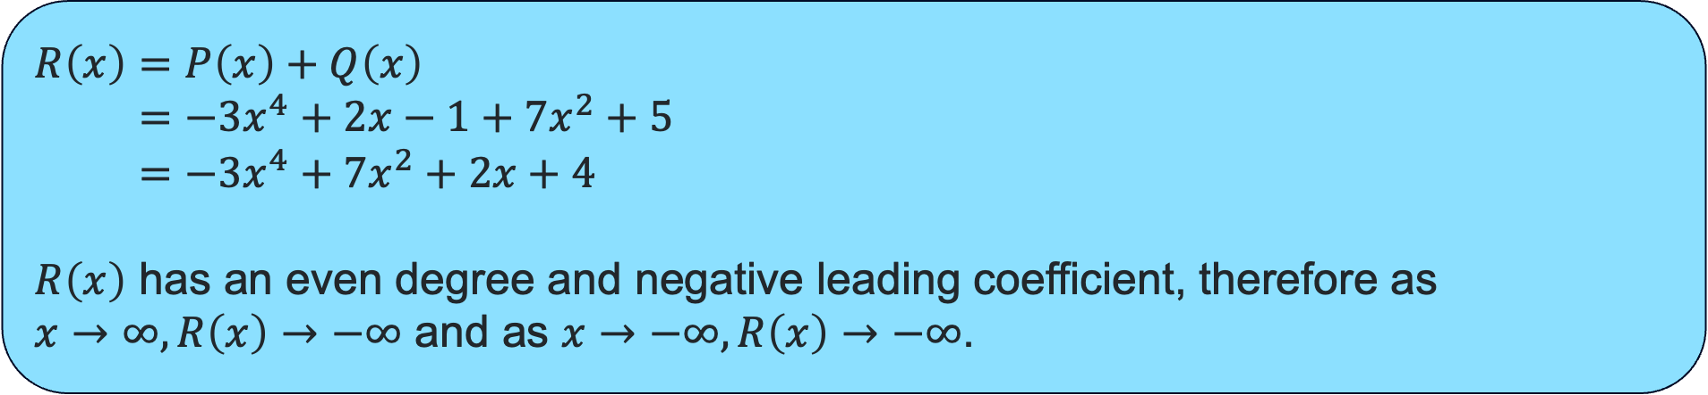

End behaviour of a polynomial (3)
Worked example 1
Consider the polynomials $P\left(x\right)=−3x^{4}+2x−1$and $Q\left(x\right)=7x^{2}+5$.
Write an expression for $R\left(x\right)$ if $R\left(x\right)=P\left(x\right)+Q\left(x\right)$ and describe the end behaviour.
$$R\left(x\right)=P\left(x\right)+Q\left(x\right) \\ =−3x^{4}+2x−1+7x^{2}+5 \\ =−3x^{4}+7x^{2}+2x+4$$
$R\left(x\right)$ has an even degree and negative leading coefficient, therefore as
$x→∞, R\left(x\right)→−∞$ and as $x→−∞, R\left(x\right)→−∞$.
How would the end behaviour change If $Q\left(x\right)=3x^{4}+5$?
How would the end behaviour change if $R\left(x\right)=P\left(x\right)−Q(x)$?

Slide 24
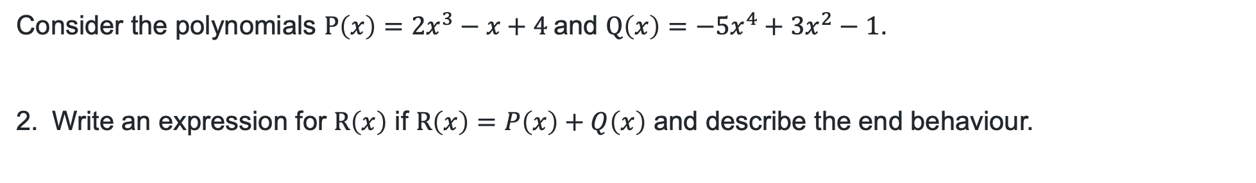
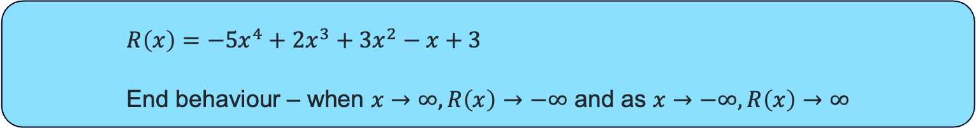
End behaviour of a polynomial (4)
Your turn
Consider the polynomials $P\left(x\right)=2x^{3}−x+4$and $Q\left(x\right)=−5x^{4}+3x^{2}−1$.
Write an expression for $R\left(x\right)$ if $R\left(x\right)=P\left(x\right)+Q\left(x\right)$ and describe the end behaviour.
$$R\left(x\right)=−5x^{4}+2x^{3}+3x^{2}−x+3$$
End behaviour – when $x→∞, R\left(x\right)→−∞$ and as $x→−∞, R\left(x\right)→∞$

Slide 25

Summary…
‘When you add 2 polynomials, you can just look at the highest degree from either polynomial to work out the degree and end behaviour of the sum.’
Does the summary still work for this $P(x)$ and $Q(x)$?
$P\left(x\right)=4x^{5}−3x+2$
$Q\left(x\right)=−4x^{5}+x^{2}−7$
Can you make an improvement on the statement above?

Slide 26
Independent practice

Slide 27
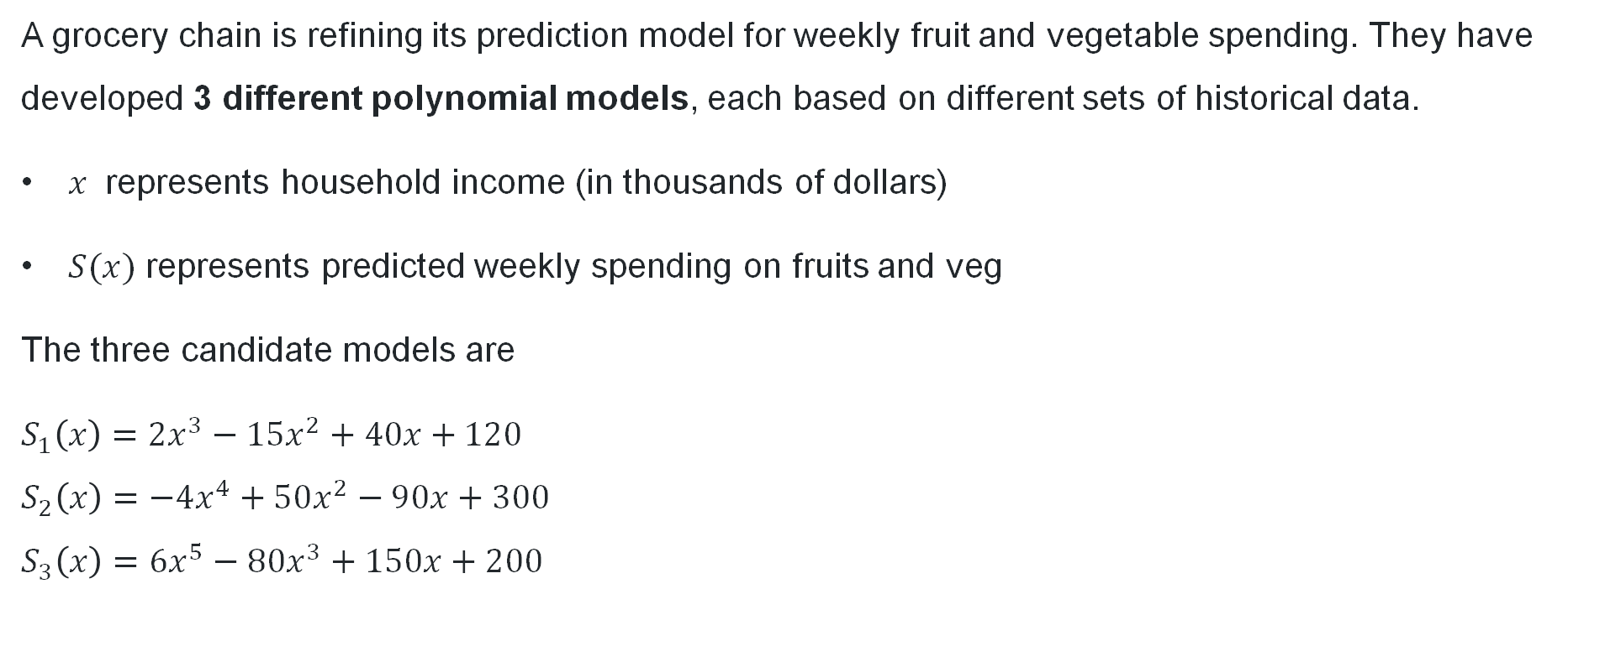
Choosing the most appropriate model
A grocery chain is refining its prediction model for weekly fruit and vegetable spending. They have developed 3 different polynomial models, each based on different sets of historical data.
$x$ represents household income (in thousands of dollars)
$S(x)$ represents predicted weekly spending on fruits and veg
The three candidate models are
$S_{1}\left(x\right)=2x^{3}−15x^{2}+40x+120$
$S_{2}\left(x\right)=−4x^{4}+50x^{2}−90x+300$
$S_{3}\left(x\right)=6x^{5}−80x^{3}+150x+200$
Which model is most appropriate for accurate predictions?
Which model is the least appropriate and why?
If you were to recommend one model to the grocery chain, which one would you recommend and why?

Slide 28
References
This presentation contains NSW Curriculum and syllabus content. The NSW Curriculum is developed by the NSW Education Standards Authority. This content is prepared by NESA for and on behalf of the Crown in the right of the State of New South Wales. The material is protected by Crown copyright.
Please refer to the NESA Copyright Disclaimer for more information https://educationstandards.nsw.edu.au/wps/portal/nesa/mini-footer/copyright.
NESA holds the only official and up-to-date versions of the NSW Curriculum and syllabus documents. Please visit the NSW Education Standards Authority (NESA) website https://educationstandards.nsw.edu.au/wps/portal/nesa/home and the NSW Curriculum website https://curriculum.nsw.edu.au.
Mathematics Extension 1 11-12 Syllabus © NSW Education Standards Authority (NESA) for and on behalf of the Crown in right of the State of New South Wales, 2024.

Slide 29
Copyright
© State of New South Wales (Department of Education), 2026
The copyright material published in this resource is subject to the Copyright Act 1968 (Cth) and is owned by the NSW Department of Education or, where indicated, by a party other than the NSW Department of Education (third-party material).
Copyright material available in this resource and owned by the NSW Department of Education is licensed under a Creative Commons Attribution 4.0 International (CC BY 4.0) license.
This license allows you to share and adapt the material for any purpose, even commercially.
Attribution should be given to © State of New South Wales (Department of Education), 2026.
Material in this resource not available under a Creative Commons license:
the NSW Department of Education logo, other logos and trademark-protected material
Material owned by a third party that has been reproduced with permission. You will need to obtain permission from the third party to reuse its material.
Links to third-party material and websites
Please note that the provided (reading/viewing material/list/links/texts) are a suggestion only and implies no endorsement, by the New South Wales Department of Education, of any author, publisher, or book title. School principals and teachers are best placed to assess the suitability of resources that would complement the curriculum and reflect the needs and interests of their students.
If you use the links provided in this document to access a third-party’s website, you acknowledge that the terms of use, including licence terms set out on the third-party’s website apply to the use which may be made of the materials on that third-party website or where permitted by the Copyright Act 1968 (Cth). The department accepts no responsibility for content on third-party websites.

