Slide 1
Further proofs
Mathematics Extension 1 – Stage 6 (Year 11)
The binomial theorem

Slide 2
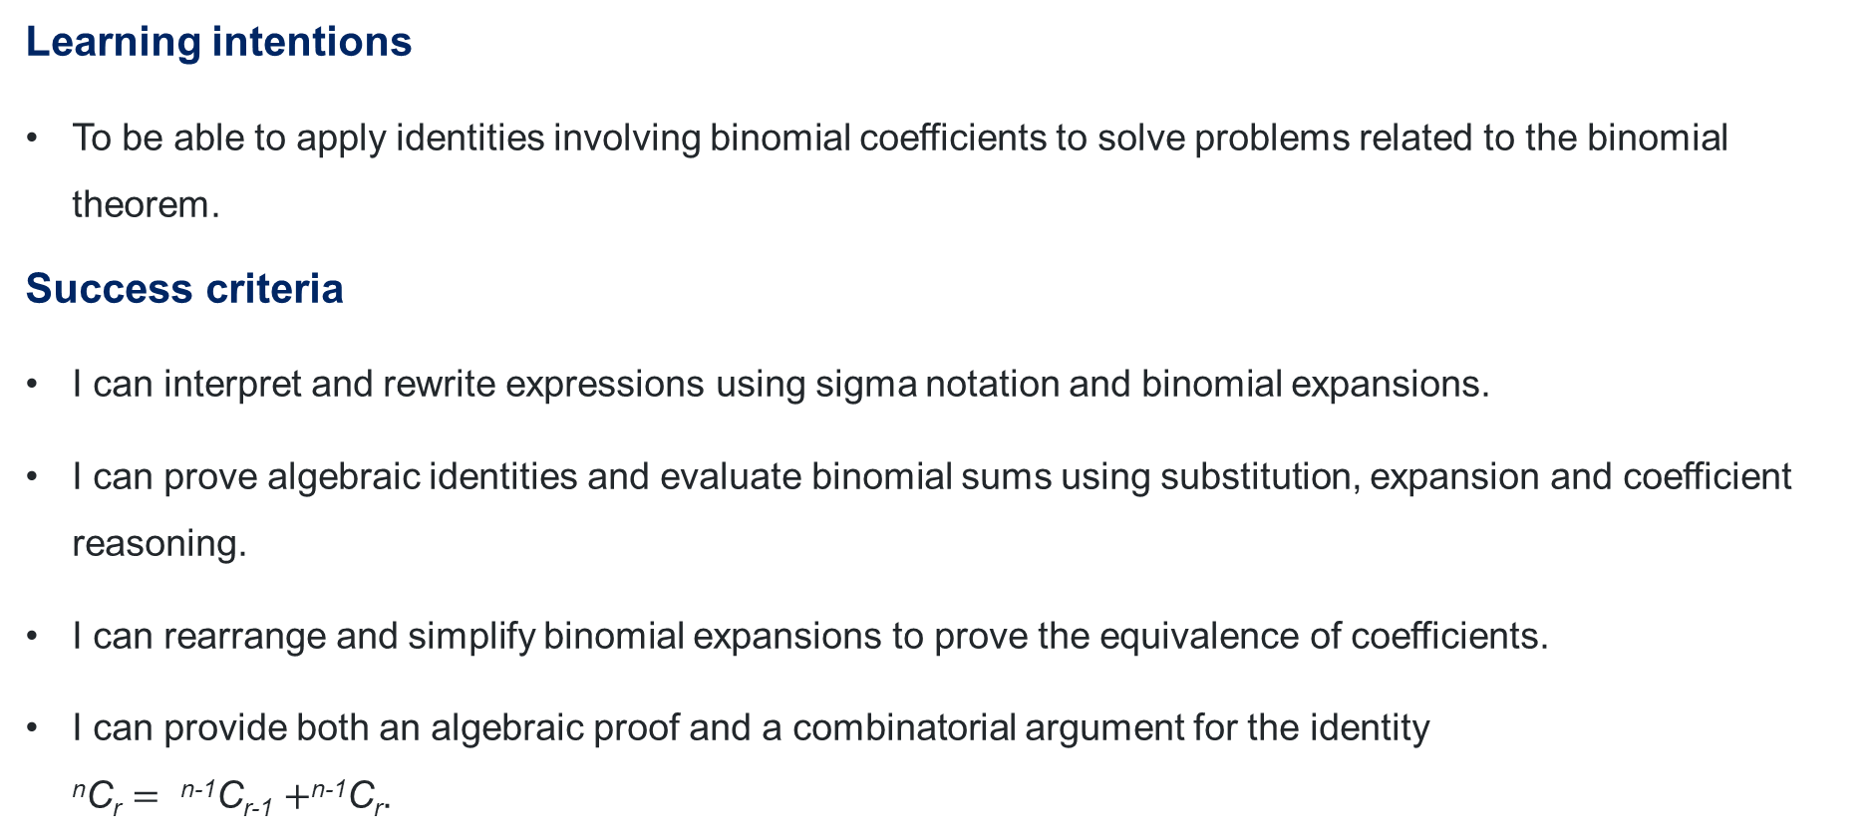
Learning intentions and success criteria
Learning intentions
To be able to apply identities involving binomial coefficients to solve problems related to the binomial theorem.
Success criteria
I can interpret and rewrite expressions using sigma notation and binomial expansions.
I can prove algebraic identities and evaluate binomial sums using substitution, expansion and coefficient reasoning.
I can rearrange and simplify binomial expansions to prove the equivalence of coefficients.
I can provide both an algebraic proof and a combinatorial argument for the identity
^{n}C_{r} $=$ ^{n-1}C_{r-1} $+$^{n-1}C_{r}.
Notes:
Notes for teachers:
Learning intentions and success criteria are best co-constructed with students. Adapt the learning intention as required and add matching success criteria.
For more information See ⁠AITSL or the NSW Department of Education explicit teaching strategies, ⁠Sharing learning intentions and ⁠Sharing success criteria
LISC is not necessarily presented at the beginning of the lesson. Teacher needs to consider most effectual time to introduce
LISC should be revisited during the lesson to support students' evaluation of their learning

Slide 3
Retrieval practice

Slide 4
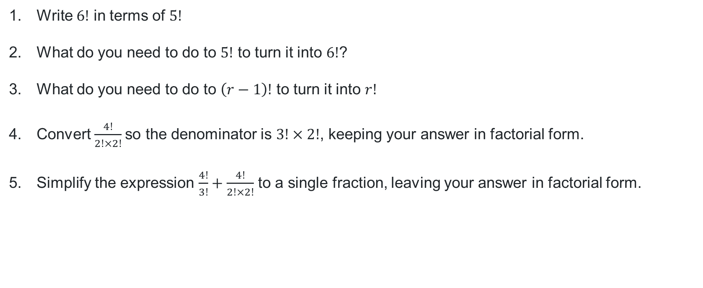
Factorials
$$n!=n×\left(n−1\right)×\left(n−2\right)×…×1$$
Questions
Write $6!$ in terms of $5!$
What do you need to do to $5!$ to turn it into $6!$?
What do you need to do to $\left(r−1\right)!$ to turn it into $r!$
Convert $\frac{4!}{2!×2!}$so the denominator is $3!×2!$, keeping your answer in factorial form.
Simplify the expression $\frac{4!}{3!}+\frac{4!}{2!×2!}$ to a single fraction, leaving your answer in factorial form.

Slide 5
Activating prior learning

Slide 6
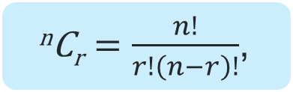


Identities
^{n}C_{r} $=$ $\frac{n!}{r!\left(n−r\right)!}$,
$$n!=n×\left(n−1\right)×\left(n−2\right)×…×1$$
Questions
Use the formula ^{n}C_{r} $=$ $\frac{n!}{r!\left(n−r\right)!}$ to show that:
^{n}C₀ $=1$
^{n}C_{n} $=1$
^{n}C_{r} $=\text{n}\text{C}\text{n}\text{−}\text{r}$
^{n}C₀ $=\frac{n!}{0!\left(n−0\right)!}=\frac{n!}{1×n!}=1$
^{n}C_{n} $= \frac{n!}{n!\left(n−n\right)!}=\frac{n!}{n!0!}=\frac{n!}{n!×1}=1$
^{n}C_{n-r} $=$ $\frac{n!}{(n−r)!\left(n−n−r\right)!}=\frac{n!}{\left(n−r\right)!n!}=$ ^{n}C_{r}

Slide 7
Connecting learning

Slide 8
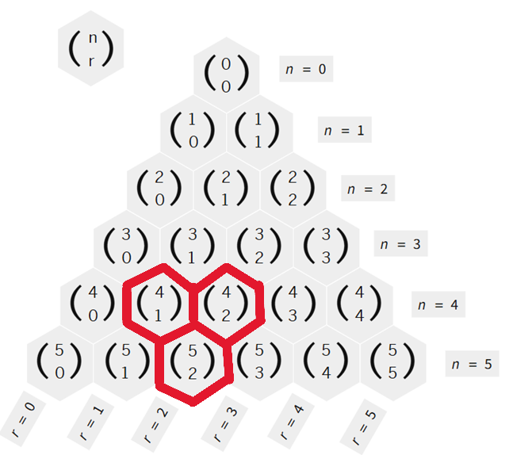
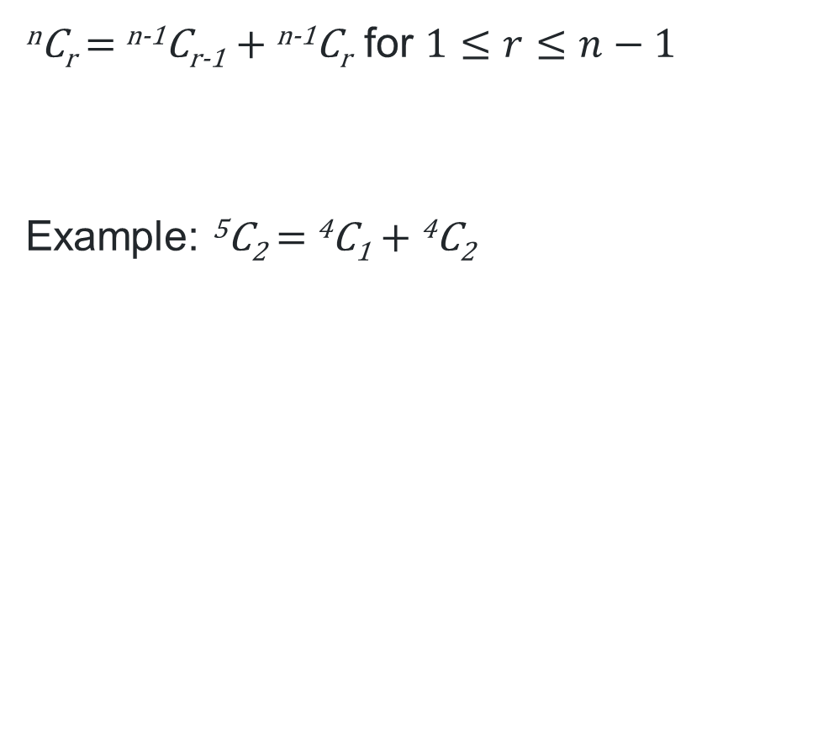
Patterns in Pascal’s triangle
Pascal’s identity
^{n}C_{r} $=$ ^{n-1}C_{r-1} $+$ ^{n-1}C_{r} for $1≤r≤n−1$
Example: ⁵C₂ $=$ ⁴C₁ $+$ ⁴C₂

Slide 9


Pascal’s identity (1)
^{n}C_{r} $=\frac{n!}{r!\left(n−r\right)!}$
^{n-1}C_{r-1} $=\frac{(n−1)!}{(r−1)!\left(n−r\right)!}$
^{n-1}C_{r} $=\frac{(n−1)!}{r!\left(n−1−r\right)!}$
Since ^{n}C_{r} $=$ ^{n-1}C_{r-1} $+$ ^{n-1}C_{r} for $1≤r≤n−1$
$$∴\frac{n!}{r!\left(n−r\right)!}=\frac{(n−1)!}{(r−1)!\left(n−r\right)!}+\frac{(n−1)!}{r!\left(n−1−r\right)!}$$
How has this denominator been derived?
Why is the identity limited to these boundaries?
Use this to prove ⁵C₂ $=$ ⁴C₁ $+$ ⁴C₂.

Slide 10
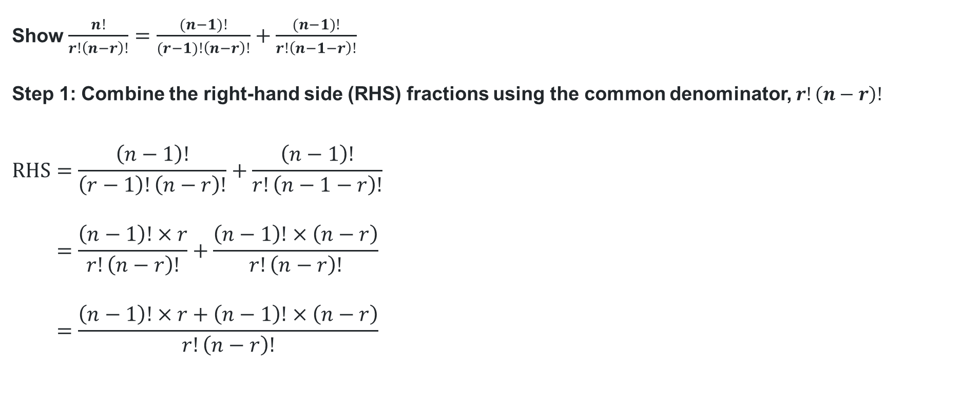
Pascal’s identity (2)
^{n}C_{r} $=$ ^{n-1}C_{r-1} $+$ ^{n-1}C_{r}
Show $\frac{n!}{r!\left(n−r\right)!}=\frac{(n−1)!}{(r−1)!\left(n−r\right)!}+\frac{(n−1)!}{r!\left(n−1−r\right)!}$
Step 1: Combine the right-hand side (RHS) fractions using the common denominator, $r!\left(n−r\right)!$
$$RHS=\frac{\left(n−1\right)!}{\left(r−1\right)!\left(n−r\right)!}+\frac{\left(n−1\right)!}{r!\left(n−1−r\right)!} \\ =\frac{\left(n−1\right)!×r}{r!\left(n−r\right)!}+\frac{\left(n−1\right)!×\left(n−r\right)}{r!\left(n−r\right)!} \\ =\frac{\left(n−1\right)!×r+\left(n−1\right)!×\left(n−r\right)}{r!\left(n−r\right)!}$$
Why is this the common denominator?

Slide 11

Pascal’s identity (3)
Show $\frac{n!}{r!\left(n−r\right)!}=\frac{(n−1)!}{(r−1)!\left(n−r\right)!}+\frac{(n−1)!}{r!\left(n−1−r\right)!}$
Step 2: Factorise the RHS
From Step 1,
$$RHS=\frac{\left(n−1\right)!×r+\left(n−1\right)!×\left(n−r\right)}{r!\left(n−r\right)!} \\ =\frac{\left(n−1\right)!×\left(r+n−r\right)}{r!\left(n−r\right)!} \\ =\frac{\left(n−1\right)!×n}{r!\left(n−r\right)!}$$
What steps are involved in this factorisation?

Slide 12


Pascal’s identity (4)
Show $\frac{n!}{r!\left(n−r\right)!}=\frac{(n−1)!}{(r−1)!\left(n−r\right)!}+\frac{(n−1)!}{r!\left(n−1−r\right)!}$
Step 3: Simplify the RHS to equal the LHS
From Step 2,
$$RHS=\frac{\left(n−1\right)!×n}{r!\left(n−r\right)!} \\ = \frac{n!}{r!\left(n−r\right)!} \\ =LHS$$
Explain why $\left(n−1\right)!×n$ is simplified to $n!$ in the numerator.

Slide 13

Applying identities (1)
Questions
If ${\left(1+x\right)}^{n}=\sum_{r=0}^{n}{\left(\begin{matrix}n \\ r\end{matrix}\right)x^{r}}$ show that $\sum_{r=0}^{n}{3^{r}\left(\begin{matrix}n \\ r\end{matrix}\right)=4^{n}}$
Given that ${\left(1+x\right)}^{n}=\left(\begin{matrix}n \\ 0\end{matrix}\right)+\left(\begin{matrix}n \\ 1\end{matrix}\right)x+\left(\begin{matrix}n \\ 2\end{matrix}\right)x^{2}+…+\left(\begin{matrix}n \\ n\end{matrix}\right)x^{n}$,
prove that $\left(\begin{matrix}n \\ 0\end{matrix}\right)+2\left(\begin{matrix}n \\ 1\end{matrix}\right)+2^{2}\left(\begin{matrix}n \\ 2\end{matrix}\right)+…+2^{n}\left(\begin{matrix}n \\ n\end{matrix}\right)=3^{n}$

Slide 14
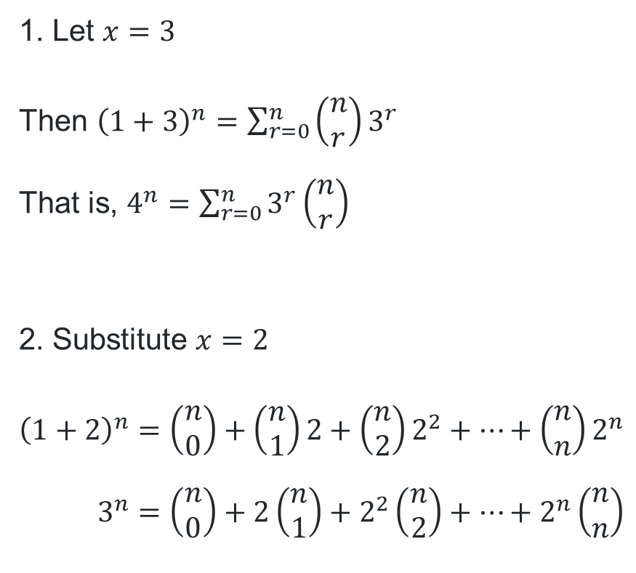
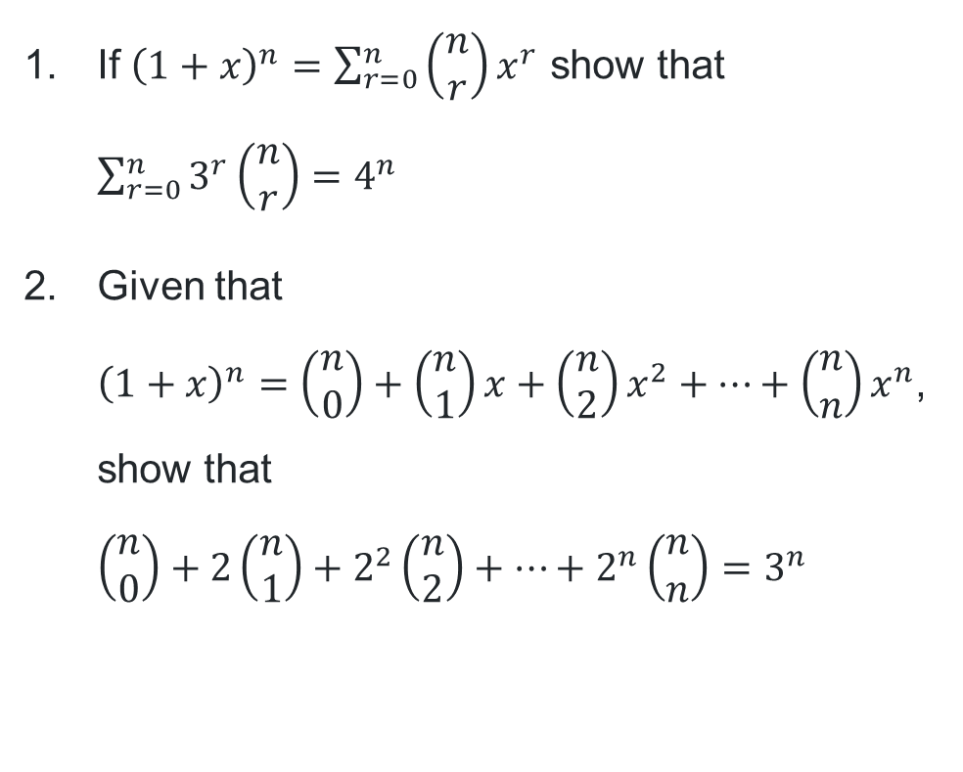
Applying identities (2)
Questions and solutions
If ${\left(1+x\right)}^{n}=\sum_{r=0}^{n}{\left(\begin{matrix}n \\ r\end{matrix}\right)x^{r}}$ show that $\sum_{r=0}^{n}{3^{r}\left(\begin{matrix}n \\ r\end{matrix}\right)=4^{n}}$
Given that
${\left(1+x\right)}^{n}=\left(\begin{matrix}n \\ 0\end{matrix}\right)+\left(\begin{matrix}n \\ 1\end{matrix}\right)x+\left(\begin{matrix}n \\ 2\end{matrix}\right)x^{2}+…+\left(\begin{matrix}n \\ n\end{matrix}\right)x^{n}$,
show that
$\left(\begin{matrix}n \\ 0\end{matrix}\right)+2\left(\begin{matrix}n \\ 1\end{matrix}\right)+2^{2}\left(\begin{matrix}n \\ 2\end{matrix}\right)+…+2^{n}\left(\begin{matrix}n \\ n\end{matrix}\right)=3^{n}$
1. Let $x=3$
Then ${\left(1+3\right)}^{n}=\sum_{r=0}^{n}{\left(\begin{matrix}n \\ r\end{matrix}\right)3^{r}}$
That is, $4^{n}=\sum_{r=0}^{n}{3^{r}\left(\begin{matrix}n \\ r\end{matrix}\right)}$
2. Substitute $x=2$
$${\left(1+2\right)}^{n}=\left(\begin{matrix}n \\ 0\end{matrix}\right)+\left(\begin{matrix}n \\ 1\end{matrix}\right)2+\left(\begin{matrix}n \\ 2\end{matrix}\right)2^{2}+…+\left(\begin{matrix}n \\ n\end{matrix}\right)2^{n} \\ 3^{n}=\left(\begin{matrix}n \\ 0\end{matrix}\right)+2\left(\begin{matrix}n \\ 1\end{matrix}\right)+2^{2}\left(\begin{matrix}n \\ 2\end{matrix}\right)+…+2^{n}\left(\begin{matrix}n \\ n\end{matrix}\right)$$

Slide 15
Releasing responsibility

Slide 16
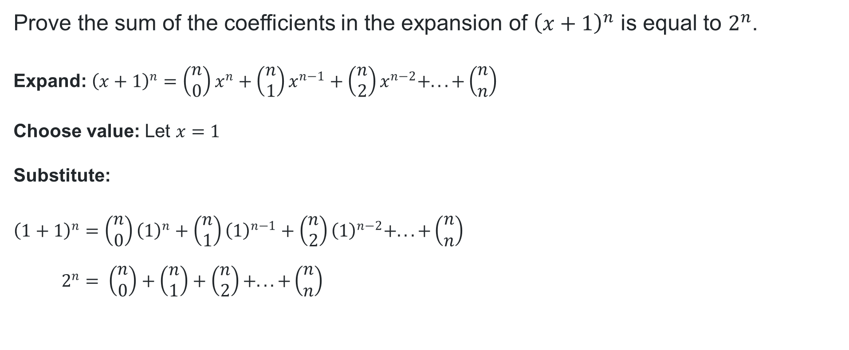

Proving further identities (1)
What identity is this from Pascal’s triangle?
Prove the sum of the coefficients in the expansion of ${\left(x+1\right)}^{n}$ is equal to $2^{n}$.
Expand: ${\left(x+1\right)}^{n}=\left(\begin{matrix}n \\ 0\end{matrix}\right)x^{n}+\left(\begin{matrix}n \\ 1\end{matrix}\right)x^{n−1}+\left(\begin{matrix}n \\ 2\end{matrix}\right)x^{n−2}+. . . +\left(\begin{matrix}n \\ n\end{matrix}\right)$
Choose value: Let $x=1$
Substitute:
$${\left(1+1\right)}^{n}=\left(\begin{matrix}n \\ 0\end{matrix}\right){\left(1\right)}^{n}+\left(\begin{matrix}n \\ 1\end{matrix}\right){\left(1\right)}^{n−1}+\left(\begin{matrix}n \\ 2\end{matrix}\right){\left(1\right)}^{n−2}+. . . +\left(\begin{matrix}n \\ n\end{matrix}\right) \\ 2^{n}= \left(\begin{matrix}n \\ 0\end{matrix}\right)+\left(\begin{matrix}n \\ 1\end{matrix}\right)+\left(\begin{matrix}n \\ 2\end{matrix}\right)+. . . +\left(\begin{matrix}n \\ n\end{matrix}\right)$$
Why does the solution require the substitution of $x=1$?

Slide 17

Proving further identities (2)
How is this question similar to the previous question?
If ${\left(x+1\right)}^{n}=\sum_{r=0}^{n}{\left(\begin{matrix}n \\ r\end{matrix}\right)x^{r}}$ show that $\sum_{r=0}^{n}{\left(\begin{matrix}n \\ r\end{matrix}\right)=2^{n}}$
Choose value: Let $x=1$
Substitute:
$${\left(1+1\right)}^{n}=\sum_{r=0}^{n}{\left(\begin{matrix}n \\ r\end{matrix}\right)}(1^{r}) \\ 2^{n}=\sum_{r=0}^{n}{\left(\begin{matrix}n \\ r\end{matrix}\right)}$$
Could you show this by first expanding?

Slide 18


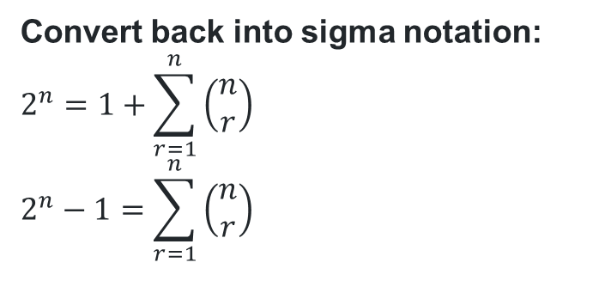
Proving further identities (3)
If ${\left(x+1\right)}^{n}=\sum_{r=0}^{n}{\left(\begin{matrix}n \\ r\end{matrix}\right)x^{r}}$ show that $\sum_{r=1}^{n}{\left(\begin{matrix}n \\ r\end{matrix}\right)=2^{n}−1}$
Expand: ${\left(x+1\right)}^{n}=\left(\begin{matrix}n \\ 0\end{matrix}\right)x^{n}+\left(\begin{matrix}n \\ 1\end{matrix}\right)x^{n−1}+\left(\begin{matrix}n \\ 2\end{matrix}\right)x^{n−2}+. . . +\left(\begin{matrix}n \\ n\end{matrix}\right)$
Choose value: Let $x=1$
Substitute:
$${\left(1+1\right)}^{n}=\left(\begin{matrix}n \\ 0\end{matrix}\right){\left(1\right)}^{n}+\left(\begin{matrix}n \\ 1\end{matrix}\right){\left(1\right)}^{n−1}+\left(\begin{matrix}n \\ 2\end{matrix}\right){\left(1\right)}^{n−2}+. . . +\left(\begin{matrix}n \\ n\end{matrix}\right) \\ 2^{n}= \left(\begin{matrix}n \\ 0\end{matrix}\right)+\left(\begin{matrix}n \\ 1\end{matrix}\right)+\left(\begin{matrix}n \\ 2\end{matrix}\right)+. . . +\left(\begin{matrix}n \\ n\end{matrix}\right) \\ 2^{n}=1+\left(\begin{matrix}n \\ 1\end{matrix}\right)+\left(\begin{matrix}n \\ 2\end{matrix}\right)+. . . +\left(\begin{matrix}n \\ n\end{matrix}\right)$$
What is the significance of $r=1$ in the sum?
Why is the solution converted back into sigma notation?
Convert back into sigma notation:
$$2^{n}=1+\sum_{r=1}^{n}{\left(\begin{matrix}n \\ r\end{matrix}\right)} \\ 2^{n}−1=\sum_{r=1}^{n}{\left(\begin{matrix}n \\ r\end{matrix}\right)}$$

Slide 19
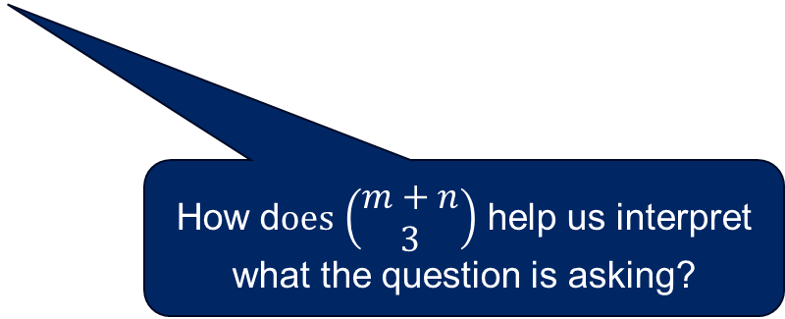

Proving further identities (4)
By expanding both sides of the identity ${\left(1+x\right)}^{m+n}={\left(1+x\right)}^{m}{\left(1+x\right)}^{n}$,
prove that $\left(\begin{matrix}m+n \\ 3\end{matrix}\right)=\left(\begin{matrix}m \\ 3\end{matrix}\right)+\left(\begin{matrix}m \\ 2\end{matrix}\right)\left(\begin{matrix}n \\ 1\end{matrix}\right)+\left(\begin{matrix}m \\ 1\end{matrix}\right)\left(\begin{matrix}n \\ 2\end{matrix}\right)+\left(\begin{matrix}n \\ 3\end{matrix}\right)$
How d$oes$ $\left(\begin{matrix}m+n \\ 3\end{matrix}\right)$ help us interpret what the question is asking?

Slide 20
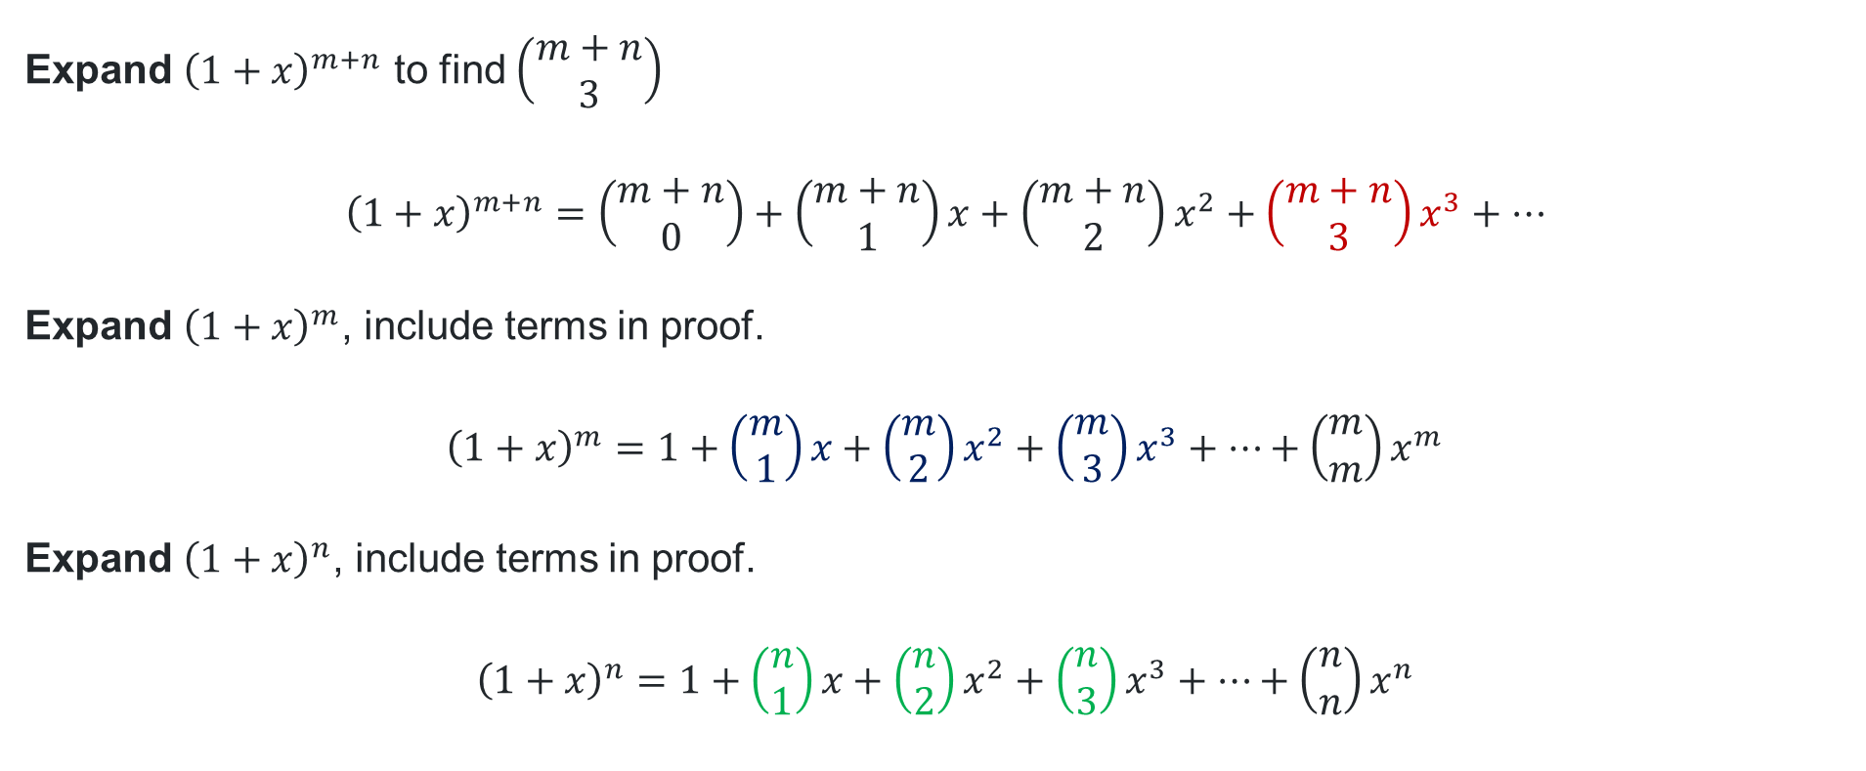
Proving further identities (5)
Prove that $\left(\begin{matrix}m+n \\ 3\end{matrix}\right)=\left(\begin{matrix}m \\ 3\end{matrix}\right)+\left(\begin{matrix}m \\ 2\end{matrix}\right)\left(\begin{matrix}n \\ 1\end{matrix}\right)+\left(\begin{matrix}m \\ 1\end{matrix}\right)\left(\begin{matrix}n \\ 2\end{matrix}\right)+\left(\begin{matrix}n \\ 3\end{matrix}\right)$
Expand ${\left(1+x\right)}^{m+n}$ to find $\left(\begin{matrix}m+n \\ 3\end{matrix}\right)$
$${\left(1+x\right)}^{m+n}=\left(\begin{matrix}m+n \\ 0\end{matrix}\right)+\left(\begin{matrix}m+n \\ 1\end{matrix}\right)x+\left(\begin{matrix}m+n \\ 2\end{matrix}\right)x^{2}+\left(\begin{matrix}m+n \\ 3\end{matrix}\right)x^{3}+…$$
Expand ${\left(1+x\right)}^{m}$, include terms in proof.
$${\left(1+x\right)}^{m}=1+\left(\begin{matrix}m \\ 1\end{matrix}\right)x+\left(\begin{matrix}m \\ 2\end{matrix}\right)x^{2}+\left(\begin{matrix}m \\ 3\end{matrix}\right)x^{3}+…+\left(\begin{matrix}m \\ m\end{matrix}\right)x^{m}$$
Expand ${\left(1+x\right)}^{n}$, include terms in proof.
$${\left(1+x\right)}^{n}=1+\left(\begin{matrix}n \\ 1\end{matrix}\right)x+\left(\begin{matrix}n \\ 2\end{matrix}\right)x^{2}+\left(\begin{matrix}n \\ 3\end{matrix}\right)x^{3}+…+\left(\begin{matrix}n \\ n\end{matrix}\right)x^{n}$$
What is represented by “…”?
How do we know which terms to show in the expansions?

Slide 21

Proving further identities (6)
Prove that $\left(\begin{matrix}m+n \\ 3\end{matrix}\right)=\left(\begin{matrix}m \\ 3\end{matrix}\right)+\left(\begin{matrix}m \\ 2\end{matrix}\right)\left(\begin{matrix}n \\ 1\end{matrix}\right)+\left(\begin{matrix}m \\ 1\end{matrix}\right)\left(\begin{matrix}n \\ 2\end{matrix}\right)+\left(\begin{matrix}n \\ 3\end{matrix}\right)$
Multiply terms to form $x^{3}$
$$\left(\begin{matrix}m \\ 3\end{matrix}\right)x^{3}×1 \\ \left(\begin{matrix}m \\ 2\end{matrix}\right)x^{2}\left(\begin{matrix}n \\ 1\end{matrix}\right)x \\ \left(\begin{matrix}m \\ 1\end{matrix}\right)x\left(\begin{matrix}n \\ 2\end{matrix}\right)x^{2} \\ 1×\left(\begin{matrix}n \\ 3\end{matrix}\right)x^{3}$$
Equate coefficients of $x^{3}$ on both sides
$$\left(\begin{matrix}m+n \\ 3\end{matrix}\right)=\left(\begin{matrix}m \\ 3\end{matrix}\right)+\left(\begin{matrix}m \\ 2\end{matrix}\right)\left(\begin{matrix}n \\ 1\end{matrix}\right)+\left(\begin{matrix}m \\ 1\end{matrix}\right)\left(\begin{matrix}n \\ 2\end{matrix}\right)+\left(\begin{matrix}n \\ 3\end{matrix}\right)$$

Slide 22
References
This presentation contains NSW Curriculum and syllabus content. The NSW Curriculum is developed by the NSW Education Standards Authority. This content is prepared by NESA for and on behalf of the Crown in the right of the State of New South Wales. The material is protected by Crown copyright.
Please refer to the NESA Copyright Disclaimer for more information https://educationstandards.nsw.edu.au/wps/portal/nesa/mini-footer/copyright.
NESA holds the only official and up-to-date versions of the NSW Curriculum and syllabus documents. Please visit the NSW Education Standards Authority (NESA) website https://educationstandards.nsw.edu.au/wps/portal/nesa/home and the NSW Curriculum website https://curriculum.nsw.edu.au.
Mathematics Extension 1 11–12 Syllabus © NSW Education Standards Authority (NESA) for and on behalf of the Crown in right of the State of New South Wales, 2024.

Slide 23
Copyright
© State of New South Wales (Department of Education), 2025
The copyright material published in this resource is subject to the Copyright Act 1968 (Cth) and is owned by the NSW Department of Education or, where indicated, by a party other than the NSW Department of Education (third-party material).
Copyright material available in this resource and owned by the NSW Department of Education is licensed under a Creative Commons Attribution 4.0 International (CC BY 4.0) license.
This license allows you to share and adapt the material for any purpose, even commercially.
Attribution should be given to © State of New South Wales (Department of Education), 2025.
Material in this resource not available under a Creative Commons license:
the NSW Department of Education logo, other logos and trademark-protected material
Material owned by a third party that has been reproduced with permission. You will need to obtain permission from the third party to reuse its material.
Links to third-party material and websites
Please note that the provided (reading/viewing material/list/links/texts) are a suggestion only and implies no endorsement, by the New South Wales Department of Education, of any author, publisher, or book title. School principals and teachers are best placed to assess the suitability of resources that would complement the curriculum and reflect the needs and interests of their students.
If you use the links provided in this document to access a third-party’s website, you acknowledge that the terms of use, including licence terms set out on the third-party’s website apply to the use which may be made of the materials on that third-party website or where permitted by the Copyright Act 1968 (Cth). The department accepts no responsibility for content on third-party websites.

