Slide 1
Comparing coefficients
Mathematics Extension 1 – Stage 6 (Year 11)
The binomial theorem

Slide 2
Learning intentions and success criteria
Learning intentions
To understand how to prove identities involving binomial coefficients by comparing coefficients in binomial expansions.
Success criteria
I can multiply terms from different binomial expansions.
I can match and add terms from 2 expansions to get a specific coefficient.
I can explain the relationship between the terms of binomial expansions and combinations.
Notes:
Notes for teachers:
Learning intentions and success criteria are best co-constructed with students. Adapt the learning intention as required and add matching success criteria.
For more information See ⁠AITSL or the NSW Department of Education explicit teaching strategies, ⁠Sharing learning intentions and ⁠Sharing success criteria
LISC is not necessarily presented at the beginning of the lesson. Teacher needs to consider most effectual time to introduce
LISC should be revisited during the lesson to support students' evaluation of their learning

Slide 3
Connecting learning

Slide 4
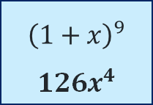
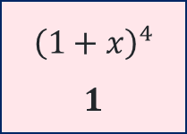
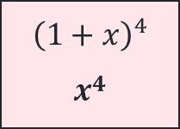
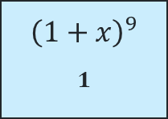
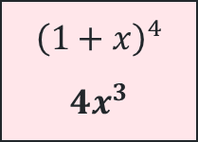
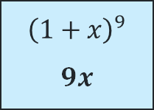
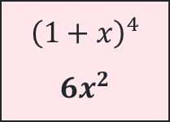
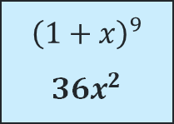
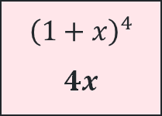
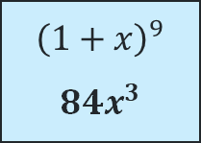
Matching cards (1)
Can you find the coefficient of $x^{4}?$
$${\left(1+x\right)}^{4}$$
$$1$$
$${\left(1+x\right)}^{4}$$
$$4x$$
$${\left(1+x\right)}^{4}$$
$$6x^{2}$$
$${\left(1+x\right)}^{4}$$
$$4x^{3}$$
$${\left(1+x\right)}^{4}$$
$$x^{4}$$
$${\left(1+x\right)}^{9}$$
$$126x^{4}$$
$${\left(1+x\right)}^{9}$$
$$84x^{3}$$
$${\left(1+x\right)}^{9}$$
$$36x^{2}$$
$${\left(1+x\right)}^{9}$$
$$9x$$
$${\left(1+x\right)}^{9}$$
$$1$$
$$(1×126)x^{4}$$ | $$(4×84)x^{4}$$ | $$(6×36)x^{4}$$ | $$(4×9)x^{4}$$ | $$(1×1)x^{4}$$
$$(1×126)+(4×84)+(6×36)+(4×9)+(1×1)=715$$

Slide 5
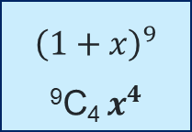
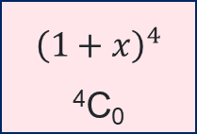
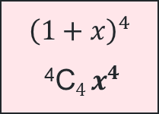
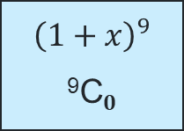
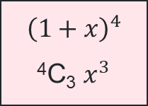
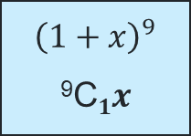
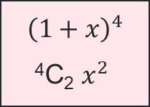
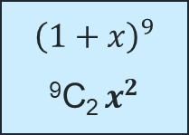
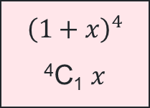
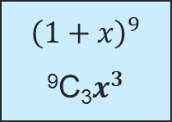
Matching cards (2)
Can you find the coefficient of $x^{4}?$
$${\left(1+x\right)}^{4}$$
$\text{4}\text{C}\text{0}$
$${\left(1+x\right)}^{4}$$
$\text{4}\text{C}\text{1}$ $x$
$${\left(1+x\right)}^{4}$$
$\text{4}\text{C}\text{2}$ $x^{2}$
$${\left(1+x\right)}^{4}$$
$\text{4}\text{C}\text{3}$ $x^{3}$
$${\left(1+x\right)}^{4}$$
$\text{4}\text{C}4 x^{4}$
$${\left(1+x\right)}^{9}$$
$$\text{9}\text{C}\text{4 }x^{4}$$
$${\left(1+x\right)}^{9}$$
$$\text{9}\text{C}\text{3}x^{3}$$
$${\left(1+x\right)}^{9}$$
$$\text{9}\text{C}\text{2} x^{2}$$
$${\left(1+x\right)}^{9}$$
$$\text{9}\text{C}1x$$
$${\left(1+x\right)}^{9}$$
$$\text{9}\text{C}0$$
$$(\text{4}\text{C}\text{0} ×\text{9}\text{C}\text{4}){ x}^{4}$$ | $$(\text{4}\text{C}\text{1}×\text{9}\text{C}3)x^{4}$$ | $$(\text{4}\text{C}\text{2}×\text{9}\text{C}\text{2})x^{4}$$ | $$(\text{4}\text{C}\text{3}×\text{9}\text{C}\text{1})x^{4}$$ | $$(\text{4}\text{C}4×\text{9}\text{C}0)x^{4}$$
$$(1×126)+(4×84)+(6×36)+(4×9)+(1×1)=715$$

Slide 6
Proof question (1)
Question 1
Use the identify ${\left(1+x\right)}^{4}{\left(1+x\right)}^{9}={\left(1+x\right)}^{13}$ to prove ⁴C₀⁹C₄ + ⁴C₁⁹C₃ + ⁴C₂⁹C₂ + ⁴C₃⁹C₁ + ⁴C₄⁹C₀ = ¹³C₄
What is the question asking?
What is the significance of the 4 in ¹³C₄ ?

Slide 7
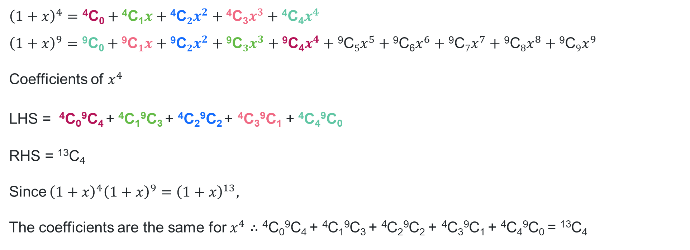
Proof question (2)
Question 1 (solution)
Use the identify ${\left(1+x\right)}^{4}{\left(1+x\right)}^{9}={\left(1+x\right)}^{13}$ to prove ⁴C₀⁹C₄ + ⁴C₁⁹C₃ + ⁴C₂⁹C₂ + ⁴C₃⁹C₁ + ⁴C₄⁹C₀ = ¹³C₄
$${\left(1+x\right)}^{4}=\text{4}\text{C}\text{0}+\text{4}\text{C}\text{1}x+\text{4}\text{C}2x^{2}+\text{4}\text{C}\text{3}x^{3}+{\text{4}\text{C}\text{4}x}^{4} \\ {\left(1+x\right)}^{9}=\text{9}\text{C}\text{0}+\text{9}\text{C}1x+\text{9}\text{C}2x^{2}+\text{9}\text{C}3x^{3}+\text{9}\text{C}\text{4}x^{4}+\text{9}\text{C}5x^{5}+\text{9}\text{C}\text{6}x^{6}+\text{9}\text{C}7x^{7}+\text{9}\text{C}8x^{8}+{\text{9}\text{C}9x}^{9}$$
Coefficients of $x^{4}$
LHS = ⁴C₀⁹C₄ + ⁴C₁⁹C₃ + ⁴C₂⁹C₂ + ⁴C₃⁹C₁ + ⁴C₄⁹C₀
RHS = $\text{13}\text{C}\text{4}$
Since ${\left(1+x\right)}^{4}{\left(1+x\right)}^{9}={\left(1+x\right)}^{13},$
The coefficients are the same for $x^{4}∴$ $\text{4}\text{C}\text{0}\text{9}\text{C}\text{4 }\text{+ }\text{4}\text{C}\text{1}\text{9}\text{C}\text{3 }\text{+ }\text{4}\text{C}\text{2}\text{9}\text{C}\text{2 }\text{+} \text{4}\text{C}\text{3}\text{9}\text{C}\text{1 }\text{+ }\text{4}\text{C}\text{4}\text{9}\text{C}\text{0 }\text{= }\text{13}\text{C}\text{4}$

Slide 8
Releasing responsibility

Slide 9
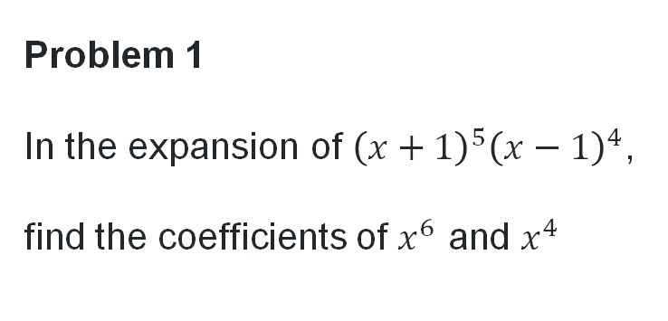
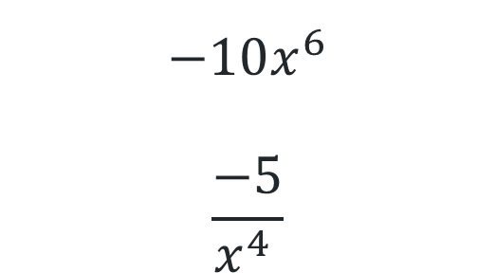

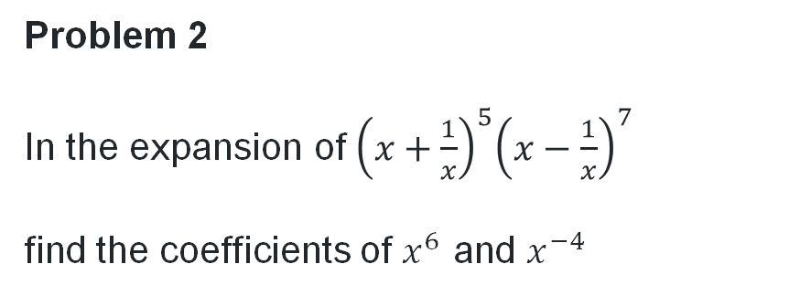
Match your cards
To find the coefficient
Problem 1
In the expansion of ${\left(x+1\right)}^{5}{\left(x−1\right)}^{4}$, find the coefficients of $x^{6}$ and $x^{4}$
Problem 2
In the expansion of${ \left(x+\frac{1}{x}\right)}^{5}{\left(x−\frac{1}{x}\right)}^{7}$
find the coefficients of $x^{6}$ and $x^{−4}$
$$−4x^{6}$$
$$6x^{4}$$
$$−10x^{6}$$
$$\frac{−5}{x^{4 }}$$

Slide 10


Find the coefficient of $x^{3}$ in ${\left(x+1\right)}^{5}{\left(x−1\right)}^{3}$
Worked example 1
$${\left(x+1\right)}^{5}=x^{5}+5x^{4}+10x^{3}+10x^{2}+5x+1$$
$${\left(x−1\right)}^{3}=x^{3}−{3x}^{2}+3x−1$$
Match terms which multiply to give $x^{3}$
$$x^{3}×1=x^{3}$$
$$−3x^{2}×5x=−15x^{3}$$
$$3x×10x^{2}=30x^{3}$$
$$−1×10x^{3}=−10x^{3}$$
Coefficient of $x^{3}=1−15+30−10=6$
Why are colours paired from the 2 equations and not within the one equation?
Which pairs would you match if you were finding the coefficient of $x^{4}$?

Slide 11

Find the coefficient of $x^{4}$ in ${\left(x+1\right)}^{4}{\left(x−1\right)}^{3}$
Your turn – question 1
$${\left(x+1\right)}^{4}=x^{4}+4x^{3}+6x^{2}+4x+1$$
$${\left(x−1\right)}^{3}=x^{3}−{3x}^{2}+3x−1$$
Match terms which multiply to give $x^{4}$
$$x^{4}×−1={−x}^{4}$$
$$4x^{3}×3x=12x^{4}$$
$$6x^{2}×−3x^{2}=−18x^{4}$$
$$4x×x^{3}=4x^{3}$$
Coefficient of $x^{4}=−1+12−18+4=−3$

Slide 12
Independent practice

Slide 13
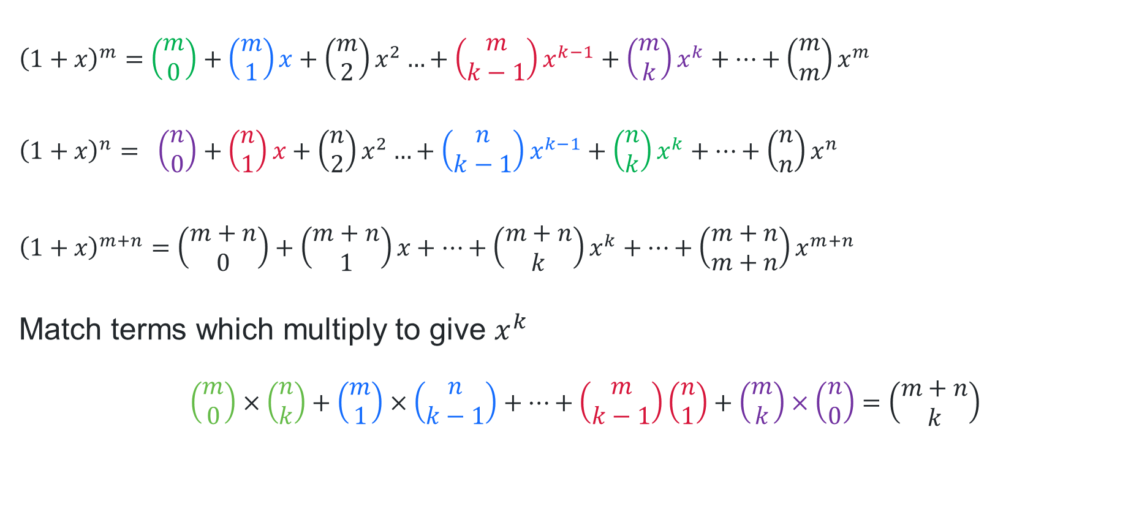
The coefficient of $x^{k}$ in${\left(1+x\right)}^{m}{\left(1+x\right)}^{n}={\left(1+x\right)}^{m+n}$
${\left(1+x\right)}^{m}=$ $\left(\begin{matrix}m \\ 0\end{matrix}\right)+\left(\begin{matrix}m \\ 1\end{matrix}\right)x+\left(\begin{matrix}m \\ 2\end{matrix}\right)x^{2}…+\left(\begin{matrix}m \\ k−1\end{matrix}\right)x^{k−1}+\left(\begin{matrix}m \\ k\end{matrix}\right)x^{k}+…+\left(\begin{matrix}m \\ m\end{matrix}\right)x^{m}$
$${\left(1+x\right)}^{n}= \left(\begin{matrix}n \\ 0\end{matrix}\right)+\left(\begin{matrix}n \\ 1\end{matrix}\right)x+\left(\begin{matrix}n \\ 2\end{matrix}\right)x^{2}…+\left(\begin{matrix}n \\ k−1\end{matrix}\right)x^{k−1}+\left(\begin{matrix}n \\ k\end{matrix}\right)x^{k}+…+\left(\begin{matrix}n \\ n\end{matrix}\right)x^{n}$$
${\left(1+x\right)}^{m+n}=$ $\left(\begin{matrix}m+n \\ 0\end{matrix}\right)+\left(\begin{matrix}m+n \\ 1\end{matrix}\right)x+…+\left(\begin{matrix}m+n \\ k\end{matrix}\right)x^{k}+…+\left(\begin{matrix}m+n \\ m+n\end{matrix}\right)x^{m+n}$
Match terms which multiply to give $x^{k}$
$$\left(\begin{matrix}m \\ 0\end{matrix}\right)×\left(\begin{matrix}n \\ k\end{matrix}\right)+\left(\begin{matrix}m \\ 1\end{matrix}\right)×\left(\begin{matrix}n \\ k−1\end{matrix}\right)+…+\left(\begin{matrix}m \\ k−1\end{matrix}\right)\left(\begin{matrix}n \\ 1\end{matrix}\right)+\left(\begin{matrix}m \\ k\end{matrix}\right)×\left(\begin{matrix}n \\ 0\end{matrix}\right)=\left(\begin{matrix}m+n \\ k\end{matrix}\right)$$

Slide 14
References
This presentation contains NSW Curriculum and syllabus content. The NSW Curriculum is developed by the NSW Education Standards Authority. This content is prepared by NESA for and on behalf of the Crown in the right of the State of New South Wales. The material is protected by Crown copyright.
Please refer to the NESA Copyright Disclaimer for more information https://educationstandards.nsw.edu.au/wps/portal/nesa/mini-footer/copyright.
NESA holds the only official and up-to-date versions of the NSW Curriculum and syllabus documents. Please visit the NSW Education Standards Authority (NESA) website https://educationstandards.nsw.edu.au/wps/portal/nesa/home and the NSW Curriculum website https://curriculum.nsw.edu.au.
Mathematics Extension 1 11–12 Syllabus © NSW Education Standards Authority (NESA) for and on behalf of the Crown in right of the State of New South Wales, 2024.
NSW Education Standards Authority (NESA) (2008) ‘Mathematics Extension 1 HSC exam paper 2008’, HSC Exam Papers

Slide 15
Copyright
© State of New South Wales (Department of Education), 2025
The copyright material published in this resource is subject to the Copyright Act 1968 (Cth) and is owned by the NSW Department of Education or, where indicated, by a party other than the NSW Department of Education (third-party material).
Copyright material available in this resource and owned by the NSW Department of Education is licensed under a Creative Commons Attribution 4.0 International (CC BY 4.0) license.
This license allows you to share and adapt the material for any purpose, even commercially.
Attribution should be given to © State of New South Wales (Department of Education), 2025.
Material in this resource not available under a Creative Commons license:
the NSW Department of Education logo, other logos and trademark-protected material
Material owned by a third party that has been reproduced with permission. You will need to obtain permission from the third party to reuse its material.
Links to third-party material and websites
Please note that the provided (reading/viewing material/list/links/texts) are a suggestion only and implies no endorsement, by the New South Wales Department of Education, of any author, publisher, or book title. School principals and teachers are best placed to assess the suitability of resources that would complement the curriculum and reflect the needs and interests of their students.
If you use the links provided in this document to access a third-party’s website, you acknowledge that the terms of use, including licence terms set out on the third-party’s website apply to the use which may be made of the materials on that third-party website or where permitted by the Copyright Act 1968 (Cth). The department accepts no responsibility for content on third-party websites.

